Slide 1
Programming Logic and Design
Ninth Edition
Chapter 8
Advanced Data Handling Concepts

Slide 2
Objectives
In this chapter, you will learn about:
The need for sorting data
The bubble sort algorithm
Sorting multifield records
The insertion sort algorithm
Multidimensional arrays
Indexed files and linked lists

Slide 3
Understanding the Need for Sorting Data
Sequential order
  Placed in order based on the value of some field
    Alphabetical or numerical
  Ascending order (arranging records from A to Z or lowest to highest)
  Descending order (arranging records from Z to A or highest to lowest)
  The median value in a list is the value of the middle item when the values are listed in order
    not the same as the arithmetic average, or mean

Slide 4
Understanding the Need for Sorting Data (continued -1)
When computers sort data
  Always use numeric values when making comparisons between values
  Letters are translated into numbers using coding schemes such as ASCII, Unicode, or EBCDIC
    “B” is numerically one greater than “A”
    “y” is numerically one less than “z”
  Whether “A” is represented by a number that is greater or smaller than the number representing “a” depends on your system

Slide 5
Understanding the Need for Sorting Data (continued -2)
Professional programmers might never have to write a program that sorts data
  Organizations can purchase prewritten sorting programs
  Many popular language compilers come with built-in methods that can sort data for you
Beneficial to understand the sorting process

Slide 6
Using the Bubble Sort Algorithm
An algorithm is a list of instructions that accomplish a task, such as a sort
Bubble sort
  Items in a list are compared with each other in pairs
  Items are then swapped based on which is larger or smaller
  Sometimes called a sinking sort
    Ascending sorts put the smaller item on top so the largest item sinks to the bottom
    Descending sorts put the larger item on top so the smallest item sinks to the bottom

Slide 7
Understanding Swapping Values
To swap values stored in two variables:
  Exchange their values
  Set the first variable equal to the value of the second
  Set the second variable equal to the value of the first
There is a trick to swapping any two values

Slide 8
Understanding Swapping Values (continued -1)
Example
  num score1 = 90
  num score2 = 85
This is what could go wrong
  If you first assign score1 to score2 using a statement such as score2 = score1
  Both score1 and score2 hold 90, and the value 85 is lost
Must create a temporary variable to hold one of the scores
  temp = score2 (temp and score2 both contain 85)
  score2 = score1 (score2 contains 90)
  score1 = temp (score1 contains 85)

Slide 9
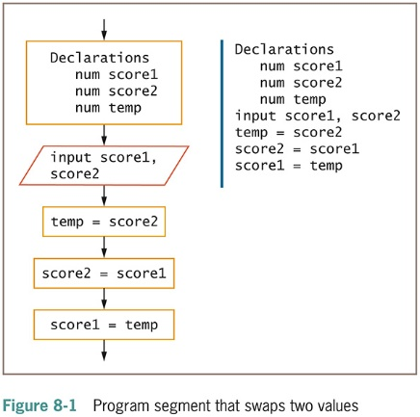
Understanding Swapping Values (continued -2)

Slide 10
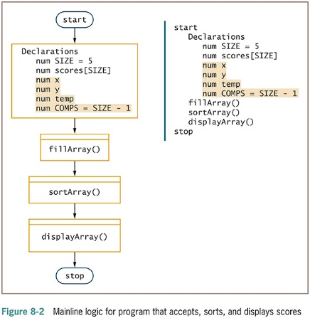
Understanding the Bubble Sort

Slide 11
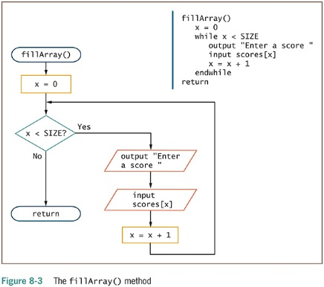
Understanding the Bubble Sort (continued -1)

Slide 12
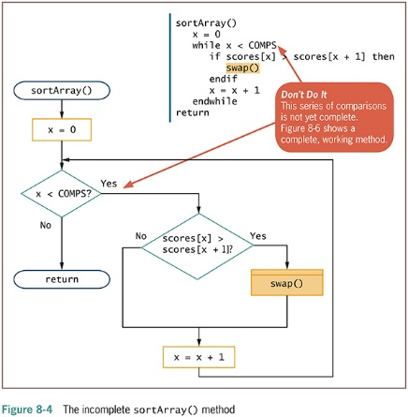
Understanding the Bubble Sort (continued -2)

Slide 13
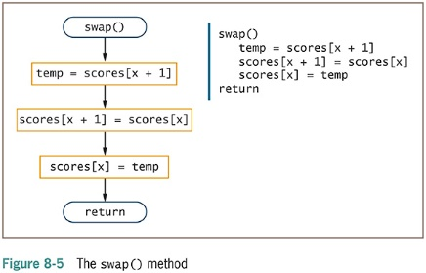
Understanding the Bubble Sort (continued -3)

Slide 14
Understanding the Bubble Sort (continued -4)
Initial list
  score[0] = 90
  score[1] = 85
  score[2] = 65
  score[3] = 95
  score[4] = 75
85 and 90 are switched
  score[0] = 85
  score[1] = 90
  score[2] = 65
  score[3] = 95
  score[4] = 75
90 and 65 are switched
  score[0] = 85
  score[1] = 65
  score[2] = 90
  score[3] = 95
  score[4] = 75
No change: 90 and 95 in order
  score[0] = 85
  score[1] = 65
  score[2] = 90
  score[3] = 95
  score[4] = 75

Slide 15
Understanding the Bubble Sort (continued -5)
75 and 95 are switched
  score[0] = 85
  score[1] = 65
  score[2] = 90
  score[3] = 75
  score[4] = 95
Back to top: 65 and 85 switch
  score[0] = 65
  score[1] = 85
  score[2] = 90
  score[3] = 75
  score[4] = 95
No change: 90 and 75 in order
  score[0] = 65
  score[1] = 85
  score[2] = 75
  score[3] = 90
  score[4] = 95
75 and 85 switch: sorted!
  score[0] = 65
  score[1] = 75
  score[2] = 85
  score[3] = 90
  score[4] = 95

Slide 16
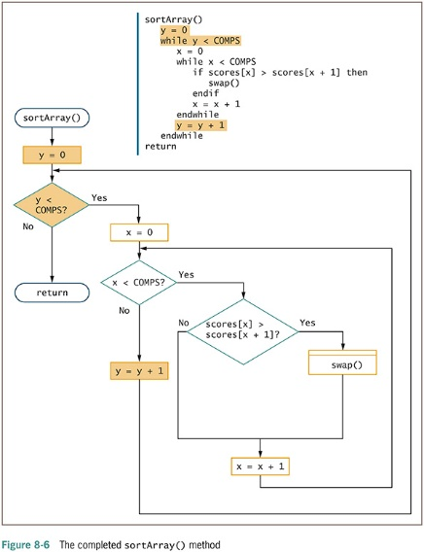
Understanding the Bubble Sort (continued -6)

Slide 17
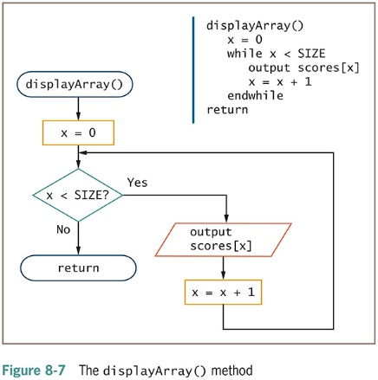
Understanding the Bubble Sort (continued -7)

Slide 18
Understanding the Bubble Sort (continued -8)
Nested loops
  Inner loop swaps out-of-order pairs
  Outer loop goes through the list multiple times
General rules
  Greatest number of pair comparisons is one less than the number of elements in the array
  Number of times you need to process the list of values is one less than the number of elements in the array

Slide 19
Sorting a List of Variable Size
Might not know how many array elements will hold valid values
Keep track of the number of elements stored in an array
  Store number of elements
  Compute comparisons as number of elements - 1

Slide 20
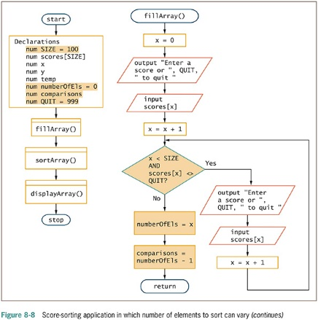
Sorting a List of Variable Size (continued -1)

Slide 21
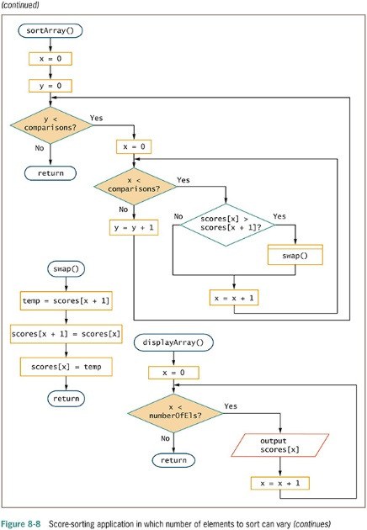
Sorting a List of Variable Size (continued -2)

Slide 22
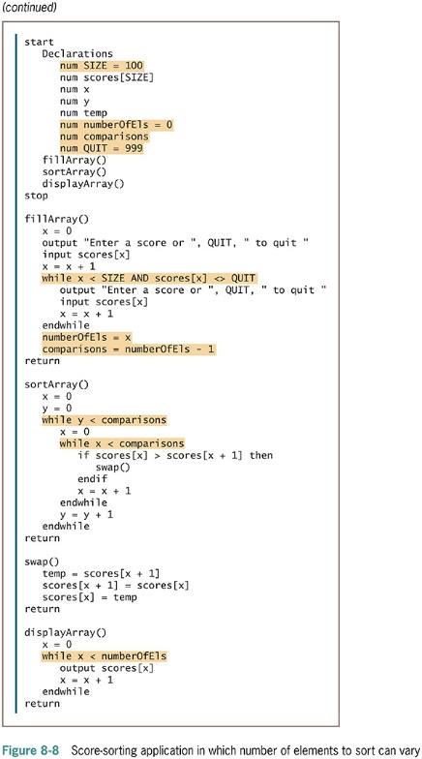
Sorting a List of Variable Size (continued -3)

Slide 23
Refining the Bubble Sort to Reduce Unnecessary Comparisons
If you are performing an ascending sort
  After you have made one pass through the list, the largest value is guaranteed to be in its correct final position
Compare every element pair in the list on every pass through the list
  Comparing elements that are already guaranteed to be in their final correct position
On each pass through the array
  Stop your pair comparisons one element sooner

Slide 24
Refining the Bubble Sort to Reduce Unnecessary Comparisons (continued -1)
Create a new variable pairsToCompare
  Set it equal to the value of numberOfEls – 1
  On each subsequent pass through the list, reduce pairsToCompare by 1

Slide 25
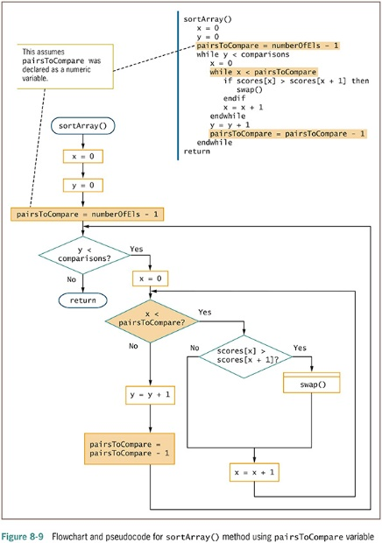
Refining the Bubble Sort to Reduce Unnecessary Comparisons (continued -2)

Slide 26
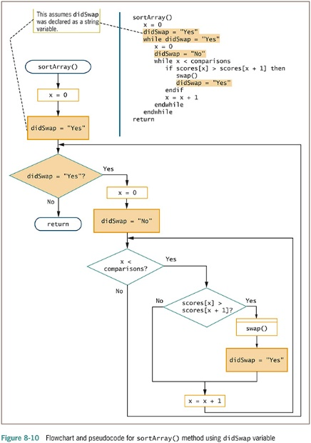
Refining the Bubble Sort to Reduce Unnecessary Passes
Create a new variable didSwap
  Set it equal to the value of “No”
  Each time the swap() module executes, change the value to ”Yes”

Slide 27
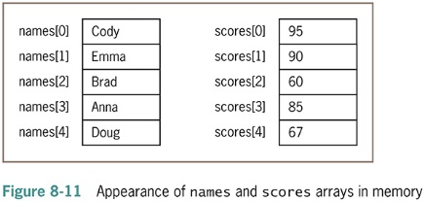
Sorting Multifield Records
Sorting data stored in parallel arrays
  Each array must stay in sync

Slide 28
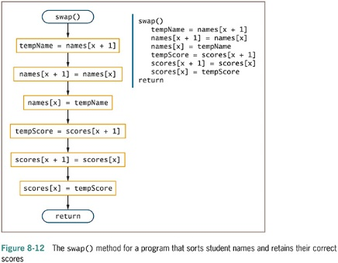
Sorting Multifield Records (continued -1)

Slide 29
Sorting Multifield Records (continued -2)
Sorting records as a whole
  Create groups called record structures or classes
    Will be covered in detail in Chapters 10 and 11
    class StudentRecord
    string name
    num score
    endClass
  Defining a class allows you to sort by either name or score

Slide 30
Other Sorting Algorithms
Insertion sort
  Look at each element one at a time
  If element is out of order relative to any of the items earlier in the list, move each earlier item down one
  Each earlier item is moved down one slot
  Similar to the technique you would most likely use to sort a group of objects manually

Slide 31
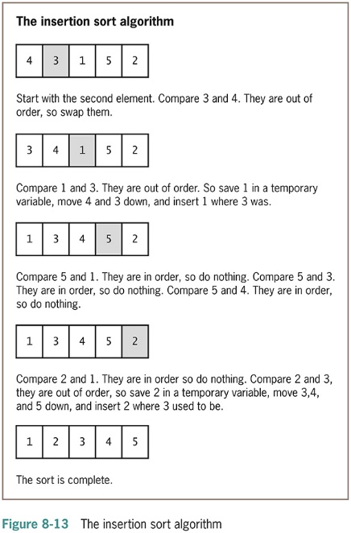
Other Sorting Algorithms (continued -1)

Slide 32
Other Sorting Algorithms (continued -2)
Selection sort
  Uses two sublists containing
    Values already sorted
    Values not yet sorted
  Repeatedly look for the smallest value in the unsorted sublist
  Swap it with the item at the beginning
  Then add that element to the end of the sorted sublist

Slide 33
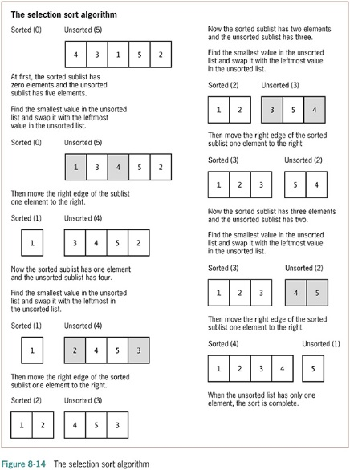
Other Sorting Algorithms (continued -3)

Slide 34
Using Multidimensional Arrays
One-dimensional array
  Single-dimensional array
  Elements accessed using a single subscript
Data can be stored in a table that has just one dimension
  HNint
If you know the vertical position of a one-dimensional array’s element, you can find its value
Multidimensional array
  requires more than one subscript to access an element

Slide 35
Using Multidimensional Arrays (continued -1)
Two-dimensional array
  Contains two dimensions: hNint and width
  Location of any element depends on two factors
Example
  Apartment building with five floors
  Each floor has studio apartments and one- and two-bedroom apartments
  To determine a tenant’s rent, you need to know two pieces of information:
    The floor
    The number of bedrooms in the apartment

Slide 36
Using Multidimensional Arrays (continued -2)
Each element in a two-dimensional array requires two subscripts to reference it
  Row and column
Declare a two-dimensional array
  Type two sets of brackets after the array type and name
  First square bracket holds the number of rows
  Second square bracket holds the number of columns

Slide 37
Using Multidimensional Arrays (continued -3)
Access a two-dimensional array value
  First subscript represents the row
  Second subscript represents the column
  RENT_BY_FLOOR_AND_BDRMS[0][0] is 350
Mathematicians often call a two-dimensional array a matrix or a table

Slide 38
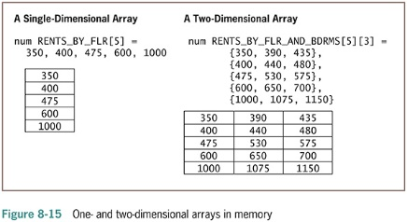
Using Multidimensional Arrays (continued -4)

Slide 39
Using Multidimensional Arrays (continued -5)
Three-dimensional arrays
  Supported by many programming languages
  Apartment building
    Number of floors
    Different numbers of bedrooms available in apartments on each floor
    Building number
Examples
  RENT_BY_3_FACTORS[floor][bedrooms]
  [building]
  RENT_BY_3_FACTORS[0][1][2]

Slide 40
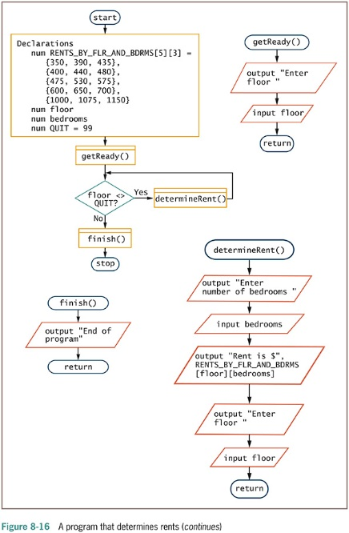
Using Multidimensional Arrays (continued -6)

Slide 41
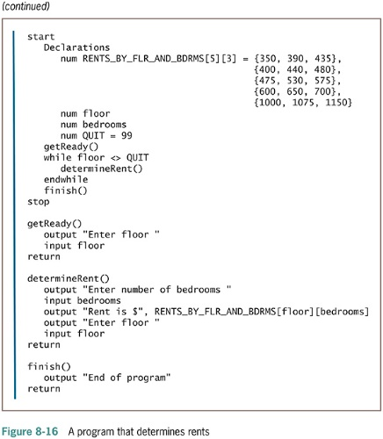
Using Multidimensional Arrays (continued -7)

Slide 42
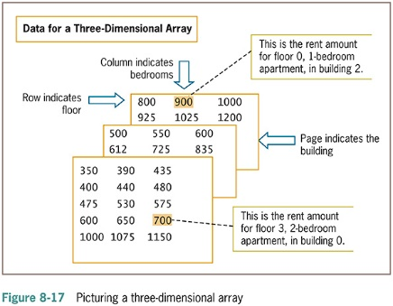
Using Multidimensional Arrays (continued -8)

Slide 43
Using Indexed Files and Linked Lists
Sorting large numbers of data records requires considerable time and computer memory
  Usually more efficient to store and access records based on their logical order than to sort and access them in their physical order
Physical order
  Refers to a “real” order for storage
Logical order
  Virtual order based on any criterion you choose

Slide 44
Using Indexed Files and Linked Lists (continued -1)
Common method of accessing records in logical order
  Use an index
  Identify a key field for each record
Key field
  A field whose contents make the record unique among all records in a file
  Example: a unique employee identification number

Slide 45
Using Indexed Files and Linked Lists (continued -2)
Memory and storage locations have addresses
  Every data record on a disk has a numeric address where it is stored
Index records
  To store a list of key fields paired with the storage address for the corresponding data record
Use the index to find the records in order based on their addresses

Slide 46
Using Indexed Files and Linked Lists (continued -3)
Store records on a random-access storage device
  Records can be accessed in any order
Each record can be placed in any physical location on the disk
  Use the index as you would use the index in the back of a book
  Picture an index based on ID numbers
When a record is removed from an indexed file
  It does not have to be physically removed
  The reference can simply be deleted from the index

Slide 47
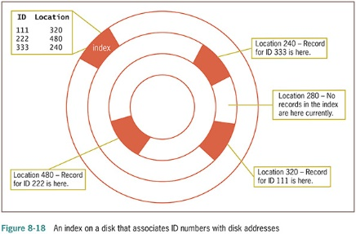
Using Indexed Files and Linked Lists (continued -4)

Slide 48
Using Linked Lists
Linked list
  Another way to access records in a desired order, even though they might not be physically stored in that order
  Create one extra field in every record of stored data
  Holds the physical address of the next logical record
    Address idNum name phoneNum nextCustAddress
    0000 111 Baker 234-5676 7200
    7200 222 Vincent 456-2345 4400
Add a new record to a linked list
  Search through the list for the correct logical location of the new record

Slide 49
Using Linked Lists (continued)
Remove records from a linked list
  Records do not need to be physically deleted from the medium on which they are stored
  Remove link field
More sophisticated linked lists store two additional fields with each record
  Address of the next record
  Address of the previous record
  List can be accessed either forward or backward

Slide 50
Summary
Sort data
  Ascending order
  Descending order
Bubble sort
  Items in a list are compared with each other in pairs
  When an item is out of order, it swaps values with the item based on which is larger or smaller
Two possible approaches
  Place related items in parallel arrays
  Sort records as a whole

Slide 51
Summary (continued -1)
Insertion sort looks at each element one at a time
  Insert tested record in place and move other records down
Selection sort uses two sublists—values already sorted and values not yet sorted
  Repeatedly look for the smallest value in the unsorted sublist
  swap it with the item at the beginning
  then add that element to the end of the sorted sublist

Slide 52
Summary (continued -2)
Two-dimensional arrays
  Use two subscripts when you access an element in a two-dimensional array
Access data records in a logical order that differs from their physical order
  Using an index involves identifying a physical address and key field for each record
  Creating a linked list involves creating an extra field within every record to hold the physical address of the next logical record

