Slide 1
Programming Logic and Design
Ninth Edition
Chapter 10
Object-Oriented Programming

Slide 2
Objectives
In this chapter, you will learn about:
The principles of object-oriented programming
Classes
Public and private access
Ways to organize classes
Instance methods
Static methods
Using objects

Slide 3
Principles of Object-Oriented
Programming
Object-oriented programming (OOP)
  A programming model that focuses on an application’s components and data and the methods to manipulate them
Uses all of the familiar concepts from modular procedural programming
  Variables, methods, passing arguments
  Sequence, selection, and looping structures
  But involves a different way of thinking

Slide 4
Principles of Object-Oriented
Programming (continued)
Important features of object-oriented languages
  Classes
  Objects
  Polymorphism
  Inheritance
  Encapsulation

Slide 5
Classes and Objects
Class
  Describes a group or collection of objects with common attributes
Object - One instance of a class
  Sometimes called one instantiation of a class
  When a program creates an object, it instantiates the object
Example
  Class name: dog
  Attributes: name, age, hasShots
  Methods: changeName, updateShots

Slide 6
Classes and Objects (continued -1)
Attributes
  Characteristics that define an object as part of a class
  Example
    Automobile’s attributes: make, model, year, and purchase price
Methods
  Actions that alter, use, or retrieve the attributes
  Example
    Methods for changing an automobile’s running status, gear, speed, and cleanliness

Slide 7
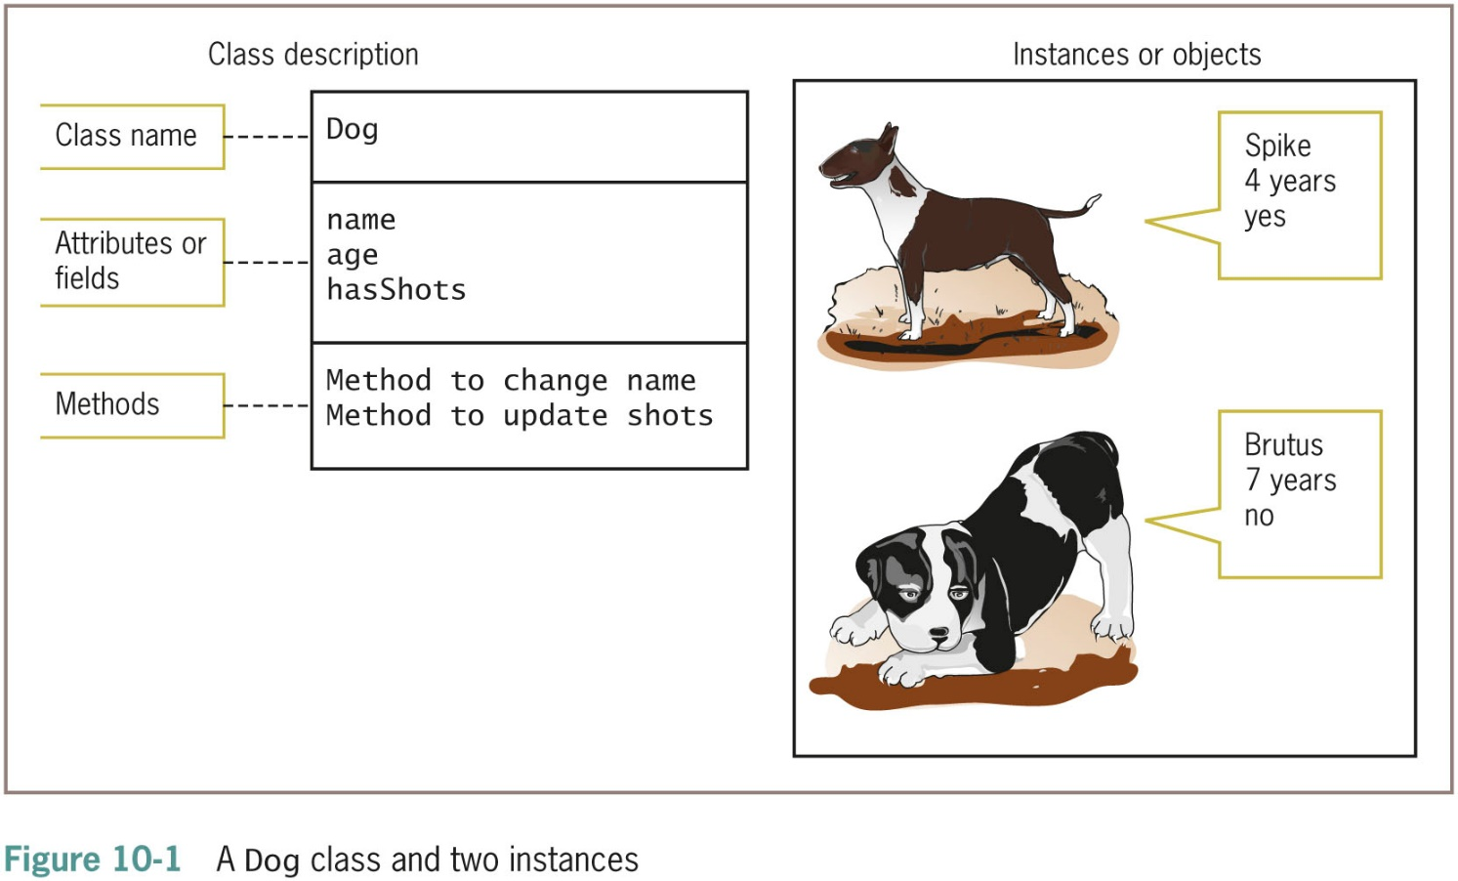
Classes and Objects (continued -2)

Slide 8
Classes and Objects (continued -3)
Think in an object-oriented manner
  Everything is an object
  Every object is a member of a class
Is-a relationship
  “My oak desk with the scratch on top is a Desk”
Class reusability
Class’s instance variables
  Data components of a class that belong to every instantiated object
  Often called fields

Slide 9
Classes and Objects (continued -4)
State
  A set of all the values or contents of a class object’s instance variables
Every object that is an instance of a class possesses the same methods
Create classes from which objects will be instantiated
Class client or class user
  A program or class that instantiates objects of another prewritten class

Slide 10
Polymorphism
The world is full of objects
  A door is an object that needs to be open or closed
  But an “open” procedure works differently on different objects
    Open a door
    Open a drawer
    Open a bank account
    Open a file
    Open your eyes
  One “open” procedure can open anything if it gets the correct arguments

Slide 11
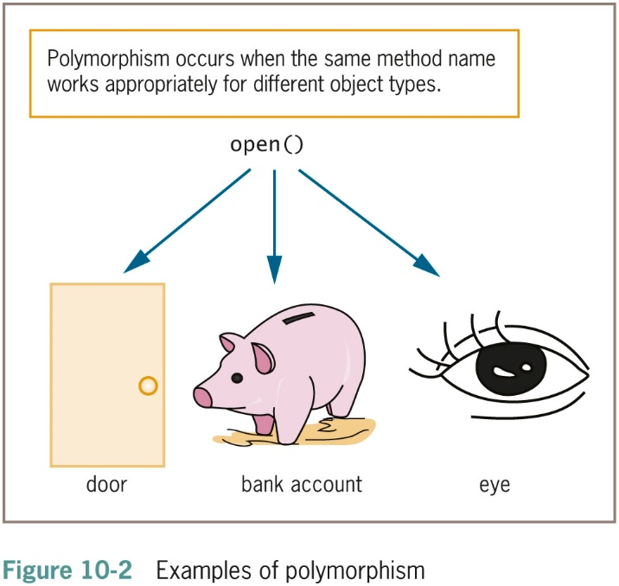
Polymorphism (continued)

Slide 12
Inheritance
Inheritance
  The process of acquiring the traits of one’s predecessors
Example
  A door with a stained glass window inherits all the attributes (doorknob, hinges) and methods (open and close) of a door
Once you create an object
  Develop new objects that possess all the traits of the original object
  Plus new traits

Slide 13
Encapsulation
Encapsulation
  The process of combining all of an object’s attributes and methods into a single package
Information hiding (also called data hiding)
  Other classes should not alter an object’s attributes
Outside classes should only be allowed to make a request that an attribute be altered
  It is up to the class’s methods to determine whether the request is appropriate

Slide 14
Defining Classes and Creating
Class Diagrams
Class definition
  A set of program statements
  Characteristics of the class’s objects and the methods that can be applied to its objects
Three parts:
  Every class has a name
  Most classes contain data (not required)
  Most classes contain methods (not required)

Slide 15
Defining Classes and Creating
Class Diagrams (continued -1)
Declaring a class
  Does not create any actual objects
After an object is instantiated
  Methods can be accessed using an identifier, a dot, and a method call
  myAssistant.setHourlyWage(16.75)
Employee myAssistant
  Declare the myAssistant object
  Contains all the data fields
  Access to all methods contained within the class

Slide 16
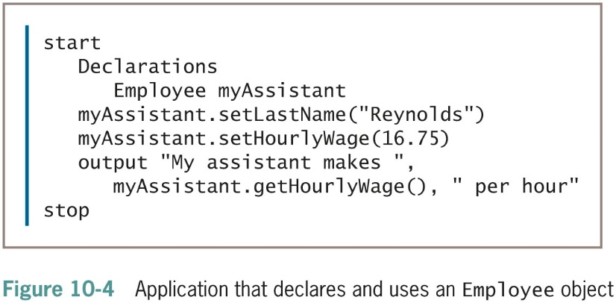
Defining Classes and Creating
Class Diagrams (continued -2)

Slide 17
Defining Classes and Creating
Class Diagrams (continued -3)
Programmers call the classes they write user-defined types
  More accurately called programmer-defined types
  OOP programmers call them abstract data types (ADTs)
  Simple numbers and characters are called primitive data types
“Black box”
  The ability to use methods without knowing the details of their contents
  A feature of encapsulation

Slide 18
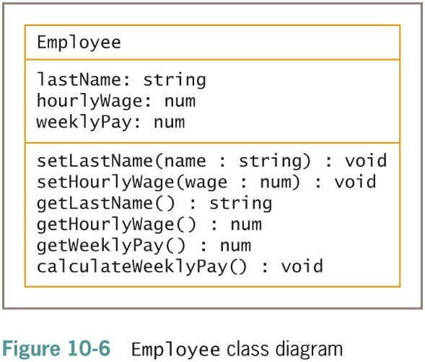
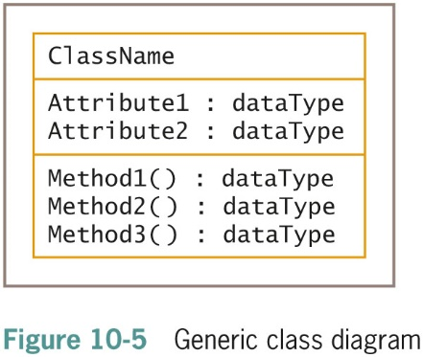
Creating Class Diagrams
Class diagram
  Three sections
    Top: contains the name of the class
    Middle: contains the names and data types of the attributes
    Bottom: contains the methods

Slide 19
Creating Class Diagrams (continued -1)
Purpose of Employee class methods
  Two of the methods accept values from the outside world
  Three of the methods send data to the outside world
  One method performs work within the class

Slide 20
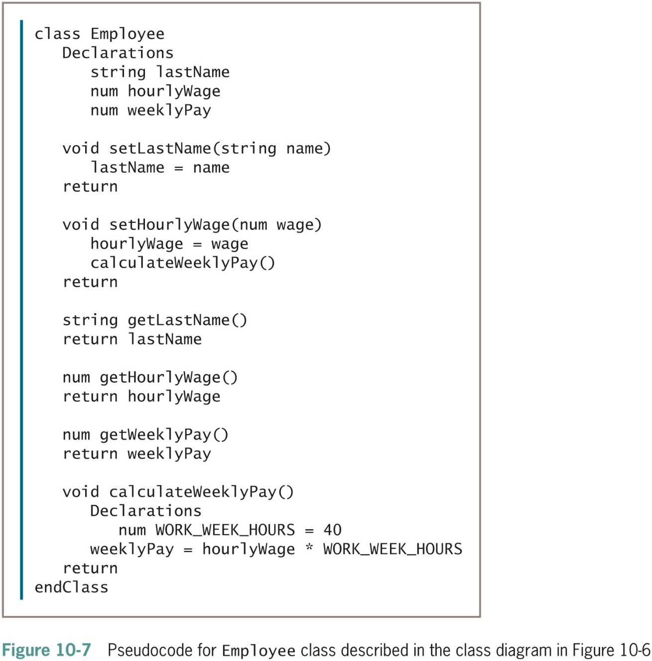
Creating Class Diagrams
(continued -2)

Slide 21
The Set Methods
Set method (also called mutator method)
  Sets the values of data fields within the class
  void setLastName(string name)
  lastName = name
  return
  mySecretary.setLastName("Johnson")
  No requirement that such methods start with the set prefix
  Some languages allow you to create a property to set field values instead of creating a set method

Slide 22
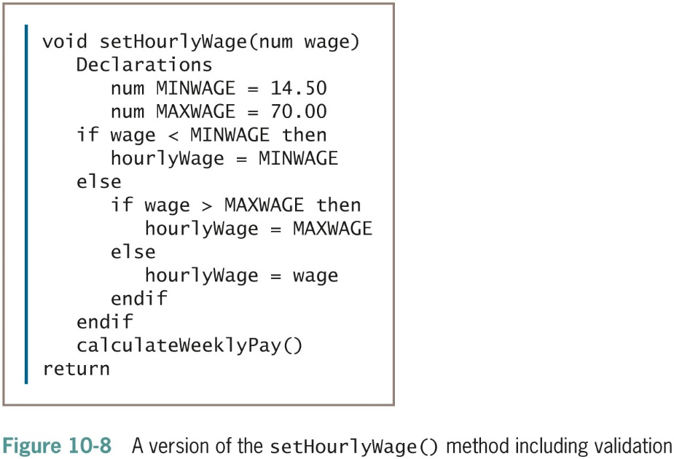
The Set Methods (continued)

Slide 23
The Get Methods
Get method (also called accessor method)
Purpose is to return a value to the world outside the class
  string getLastName()
  return lastName
Value returned from a get method can be used as any other variable of its type would be used

Slide 24
Work Methods
Work method (also called help method, or faciltator)
  performs tasks within a class
void calculateWeeklyPay()
Declarations
num WORK_WEEK_HOURS = 40
weeklyPay = hourlyWage * WORK_WEEK_HOURS
return

Slide 25
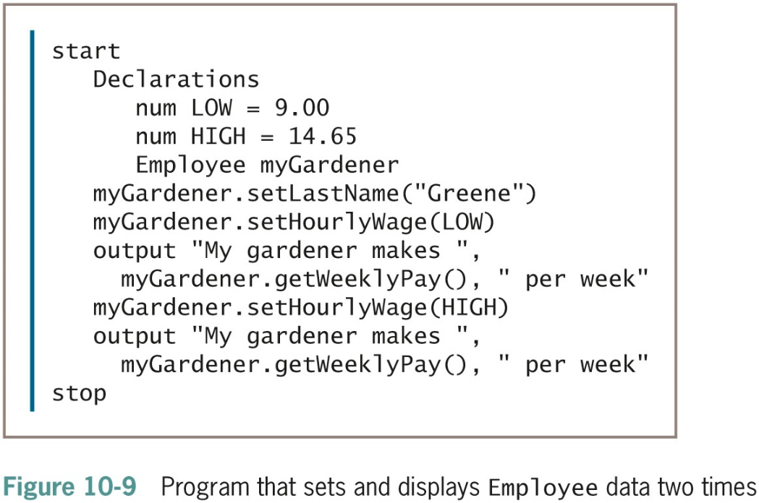
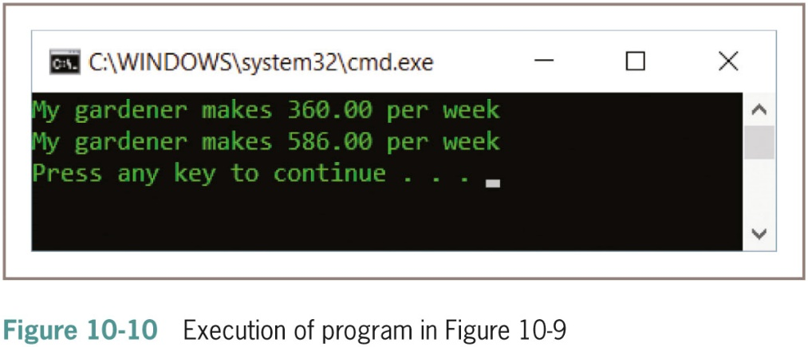
Work Methods (continued)

Slide 26
Understanding Public and Private Access
You do not want any outside programs or methods to alter your class’s data fields unless you have control over the process
Prevent outsiders from changing your data
  Force other programs and methods to use a method that is part of the class
Specify that data fields have private access
  Data cannot be accessed by any method that is not part of the class

Slide 27
Understanding Public and Private Access (continued -1)
Public access
  Other programs and methods may use the methods that control access to the private data
Access specifier
  Also called an access modifier
  An adjective defining the type of access that outside classes will have to the attribute or method
    public or private

Slide 28
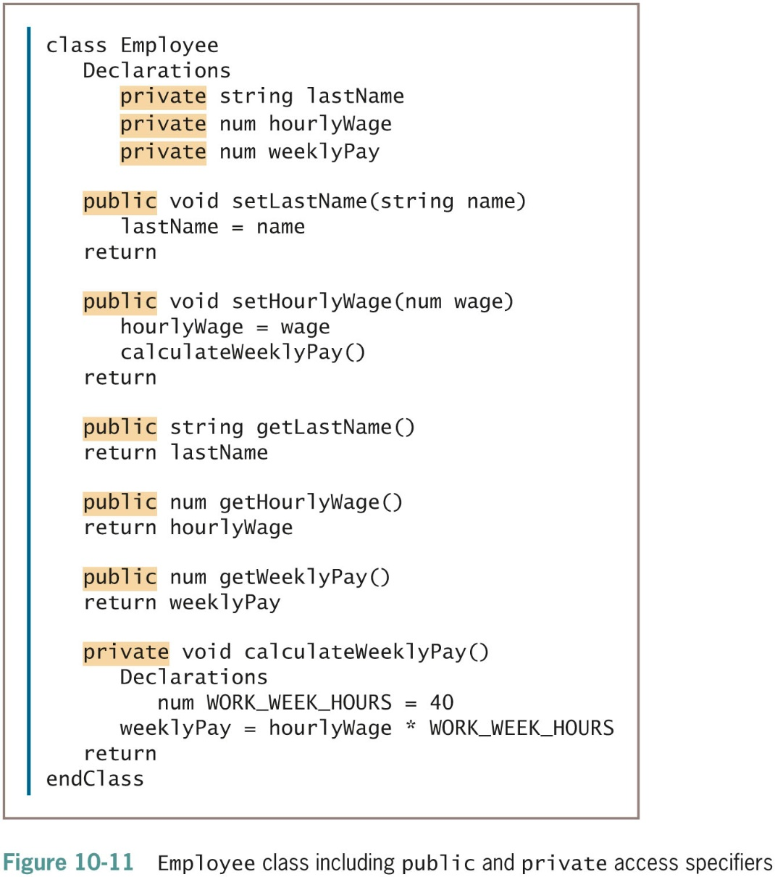
Understanding Public and Private Access (continued -2)

Slide 29
Understanding Public and Private Access (continued -3)
Don’t do it:
  myAssistant.hourlyWage = 15.00
Instead:
  myAssistant.setHourlyWage(15.00)
Methods may be private; don’t do it:
  myAssistant.calculateWeeklyPay()

Slide 30
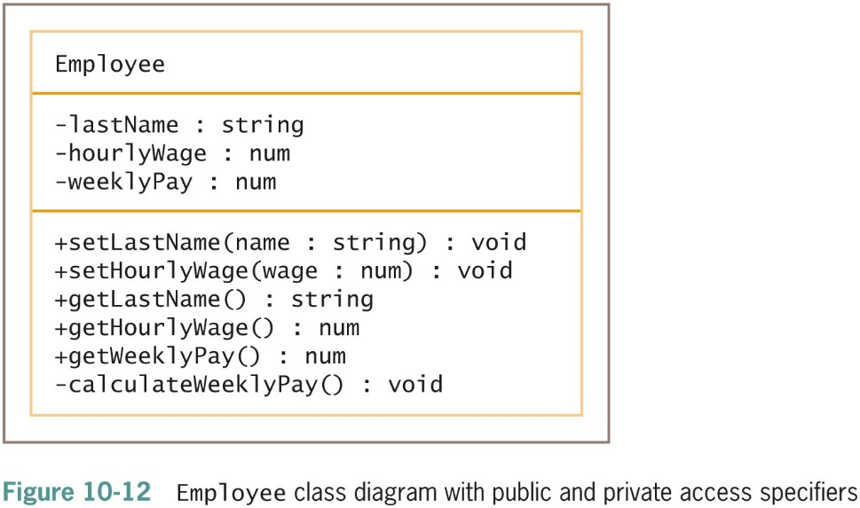
Understanding Public and Private Access (continued -4)

Slide 31
Organizing Classes
Most programmers place data fields in logical order at the beginning of a class
  An ID number is most likely used as a unique identifier
    Primary key
  Flexibility in how you position data fields
In some languages, you can organize a class’s data fields and methods in any order

Slide 32
Organizing Classes (continued)
Class method ordering
  Alphabetical
  Pairs of get and set methods
  Same order as the data fields are defined
  All accessor (get) methods together and all mutator (set) methods together

Slide 33
Understanding Instance Methods
Every object that is an instance of a class is assumed to possess the same data and have access to the same methods

Slide 34
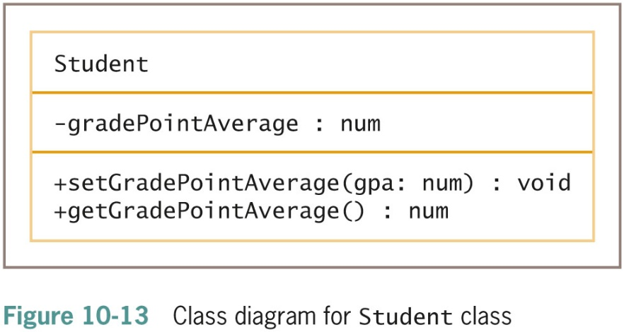
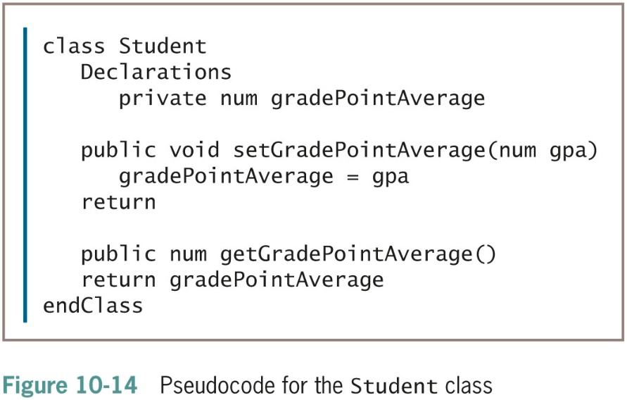
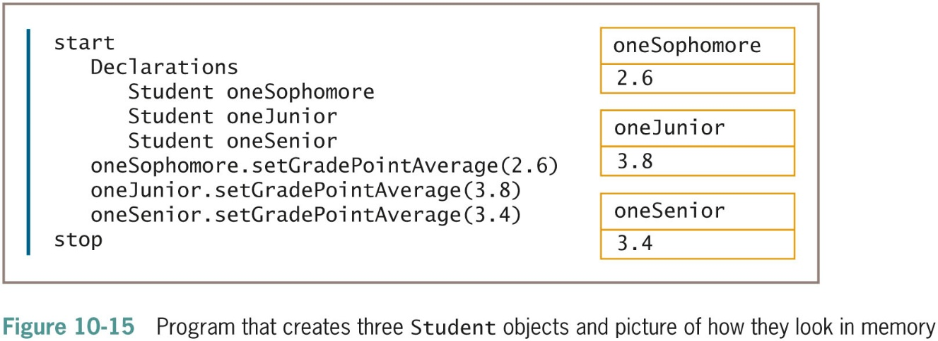
Understanding Instance Methods (continued -1)

Slide 35
Understanding Instance Methods (continued -2)
Instance method
  Method that works appropriately with different objects
  If you create 100 Students and assign grade point averages to each of them, you would need 100 storage locations in computer memory
Only one copy of each instance method is stored in memory
  The computer needs a way to determine whose gradePointAverage is being set or retrieved

Slide 36
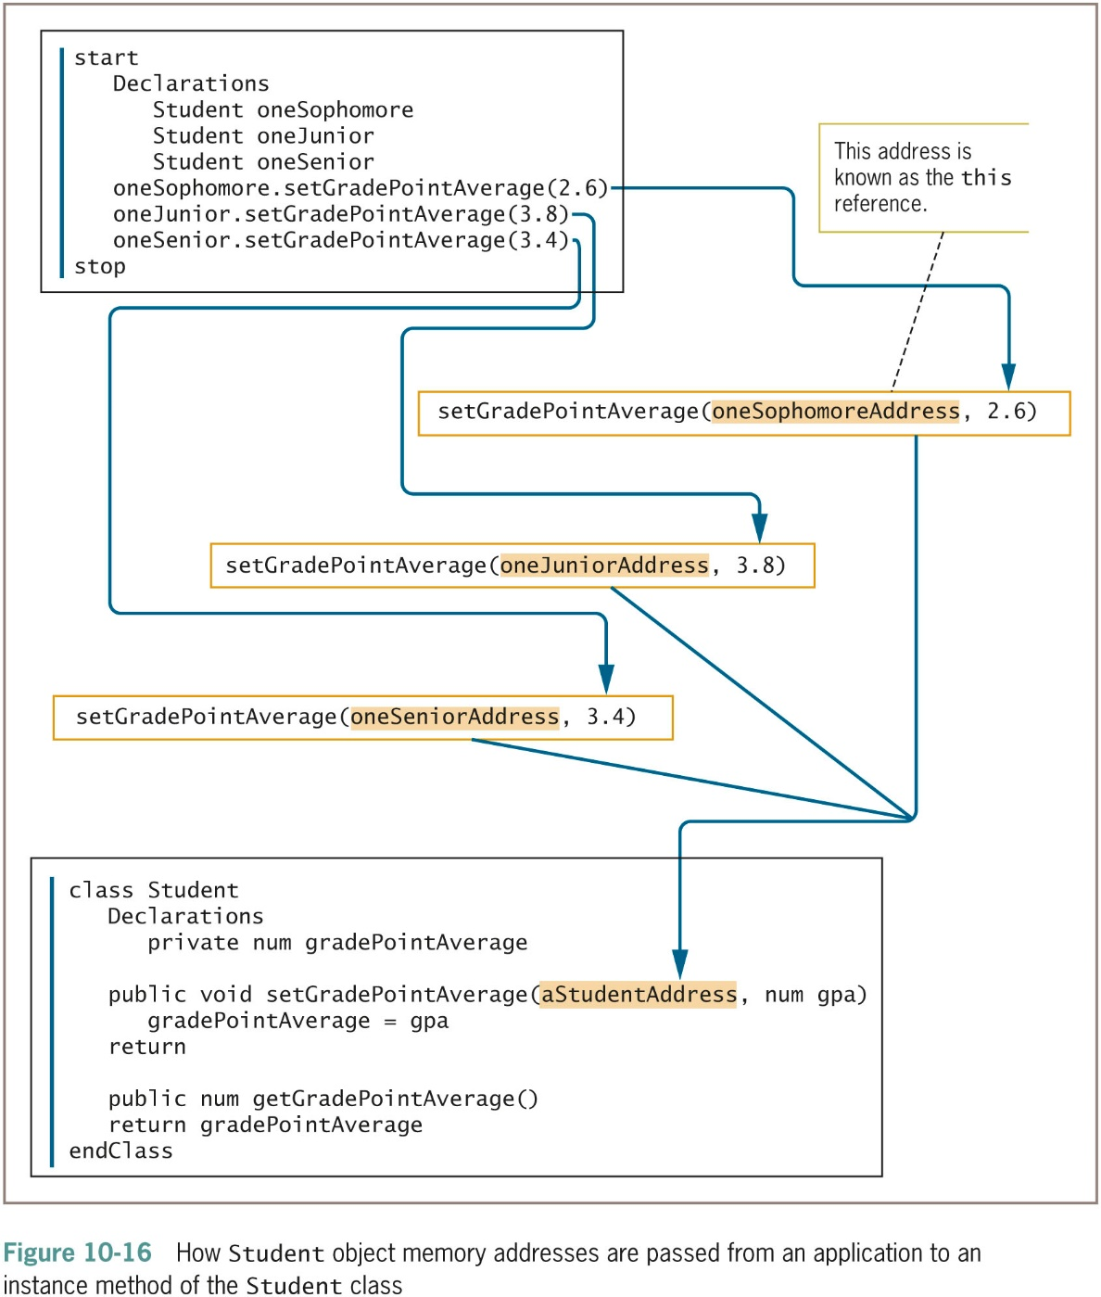
Understanding Instance Methods (continued -3)

Slide 37
Understanding Instance Methods (continued -4)
this reference
  An automatically created variable
  Holds the address of an object
  Passes it to an instance method whenever the method is called
  Refers to “this particular object” using the method
  Implicitly passed as a parameter to each instance method

Slide 38
Understanding Instance Methods (continued -5)
Identifiers within the method always mean exactly the same thing
  Any field name defined in the class
  this, followed by a dot, followed by the same field name
Example of an occasion when you might use the this reference explicitly

Slide 39
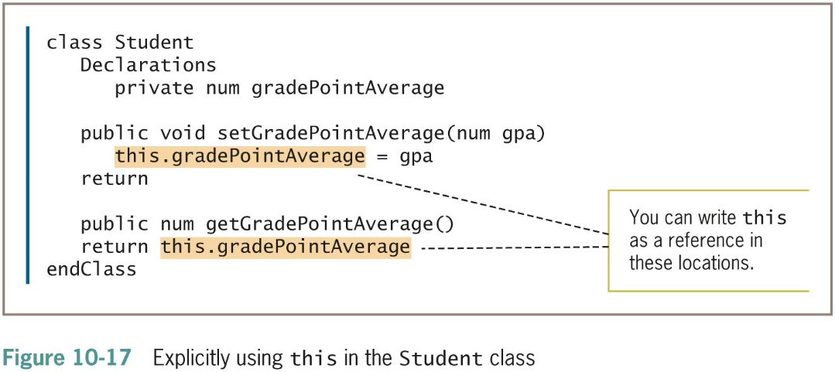
Understanding Instance Methods (continued -6)

Slide 40
Understanding Static Methods
Some methods do not require a this reference
displayStudentMotto()
  A class method instead of an instance method
Two types of methods
  Static methods (also called class methods)
    Methods for which no object needs to exist
  Nonstatic methods
    Methods that exist to be used with an object
Student.displayStudentMotto()

Slide 41
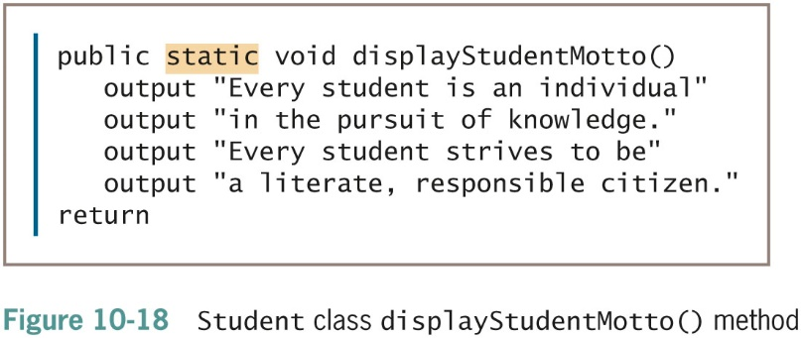
Understanding Static Methods (continued)

Slide 42
Using Objects
You can use objects like you would use any other simpler data type
InventoryItem class
  Pass to an object to a method
  Return an object from a method
  Use an array of objects

Slide 43
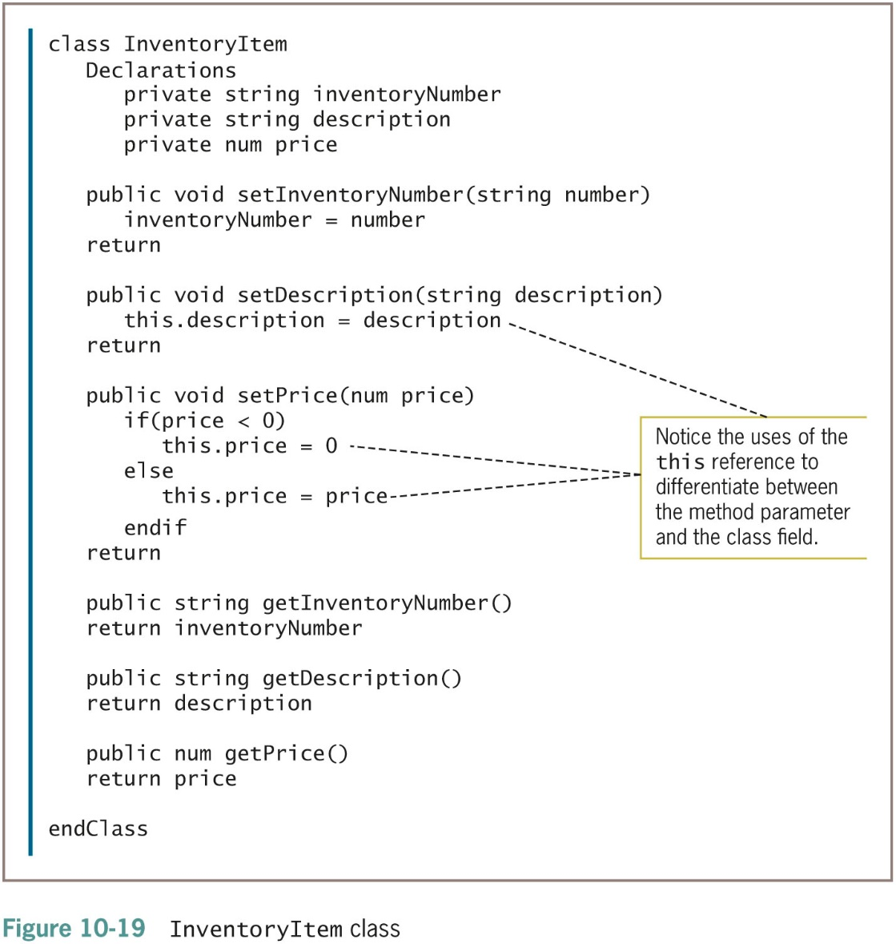
Using Objects (continued)

Slide 44
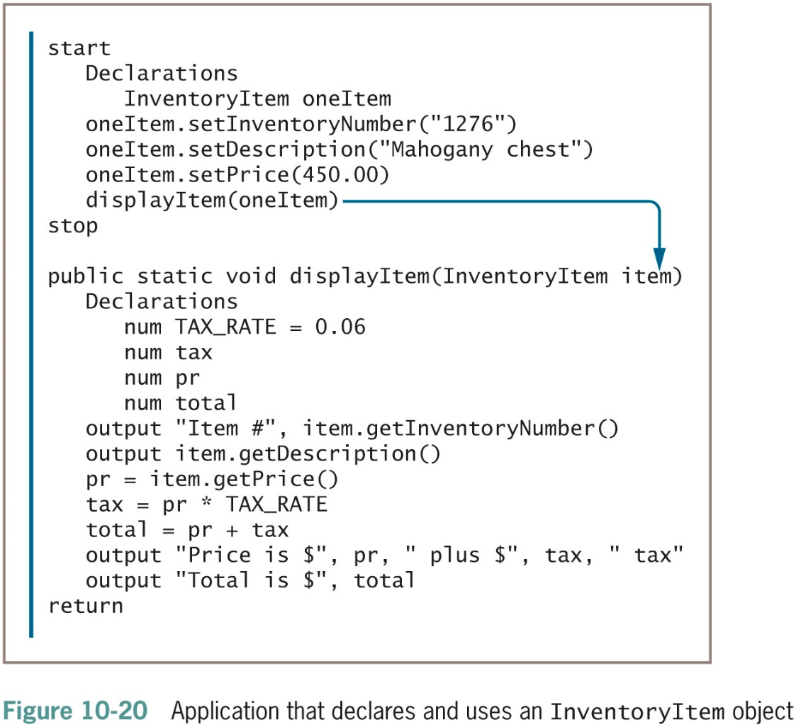
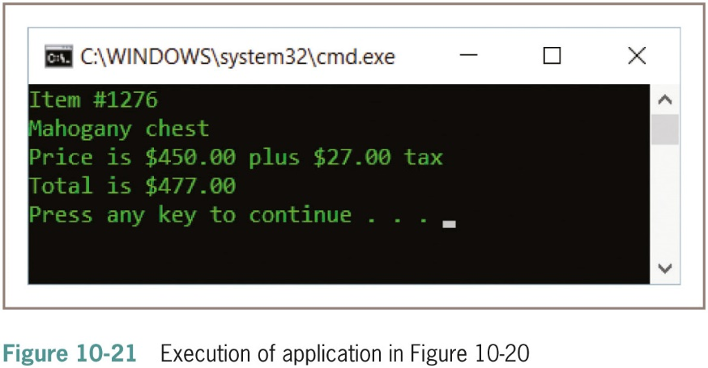
Passing an Object to a Method

Slide 45
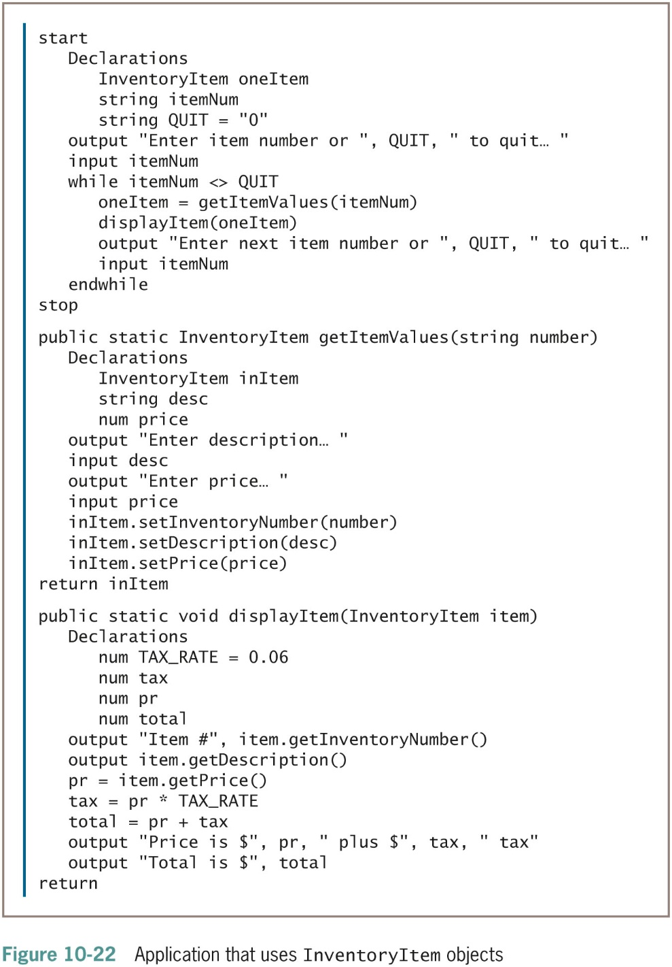
Returning an Object from a Method

Slide 46
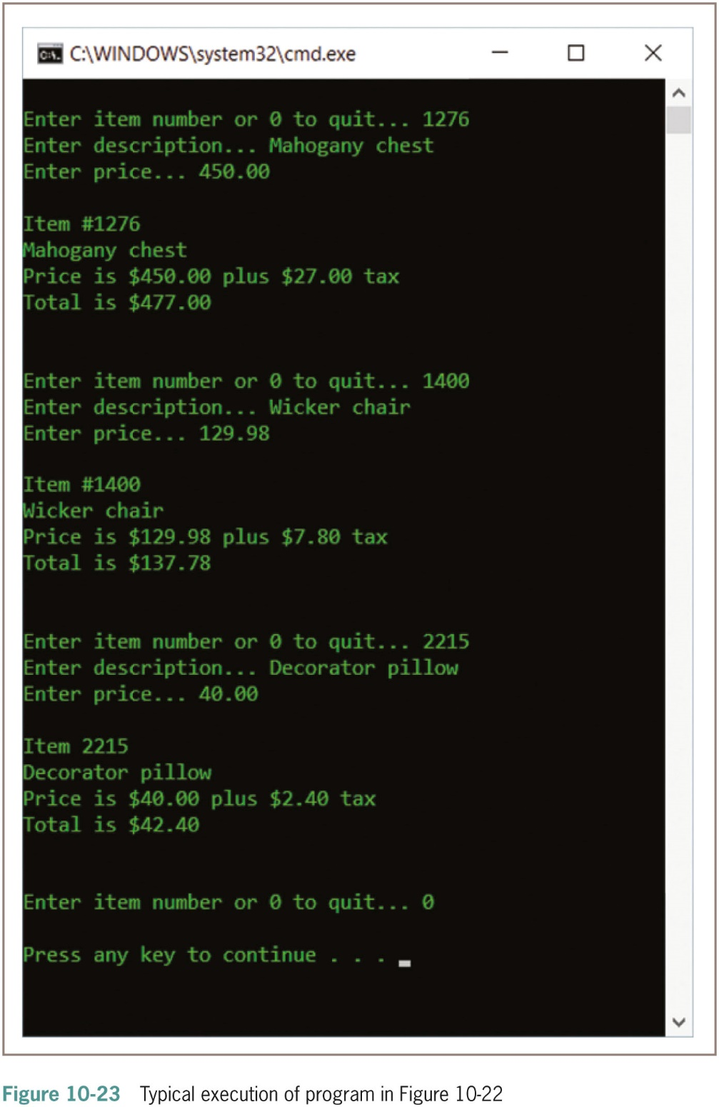
Returning an Object from a Method
(continued)

Slide 47
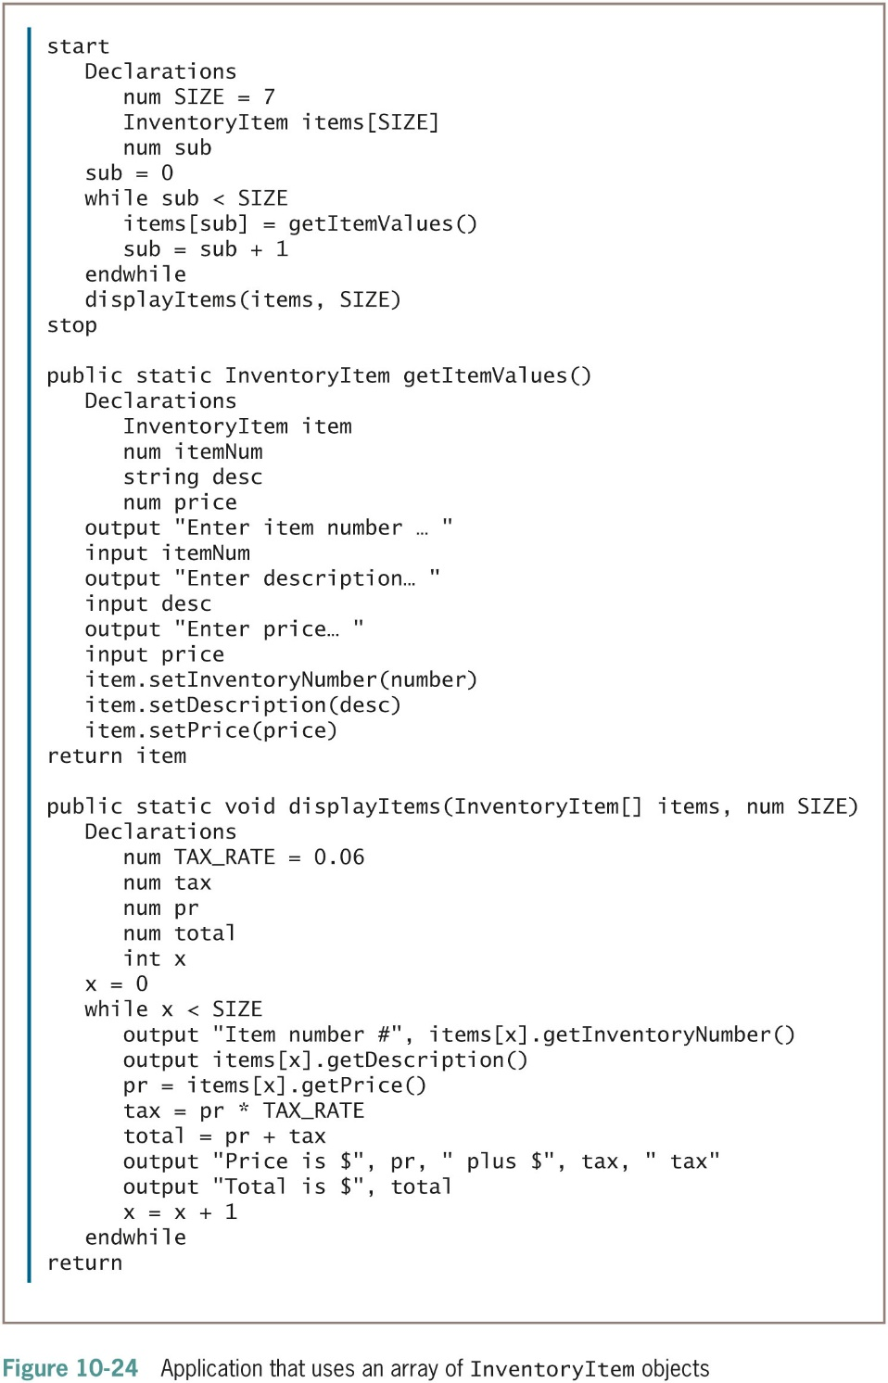
Using Arrays of Objects

Slide 48
Summary
Classes
  Basic building blocks of object-oriented programming
Class definition
  A set of program statements that tell you the characteristics of the class’s objects and the methods that can be applied to its objects
Object-oriented programmers
  Specify that their data fields will have private access
As classes get more complex, organizing becomes more important

Slide 49
Summary (continued -1)
Instance method operates correctly yet differently for every object instantiated from a class
A class can contain two types of methods:
  Static methods, which are also known as class methods and do not receive a this reference as an implicit parameter
  Nonstatic methods, which are instance methods and do receive a this reference implicitly

Slide 50
Summary (continued -2)
Objects can be used in many of the same ways you use items of simpler data types, such as passing them to and from methods and storing them in arrays

