Slide 1
Programming Logic and Design
Ninth Edition
Chapter 11
More Object-Oriented Programming Concepts

Slide 2
Objectives
In this chapter, you will learn about:
Constructors
Destructors
Composition
Inheritance
GUI objects
Exception handling
The advantages of object-oriented programming

Slide 3
Understanding Constructors
Constructor
  A method that has the same name as the class
  Establishes an object
Constructors fall into two categories:
  Default constructor
    Requires no arguments
  Non-default or parameterized constructor
    Requires arguments

Slide 4
Understanding Constructors (continued)
A class can have three types of constructors:
  Default constructor –
    automatically-created default constructor exists in a class in which the programmer has not explicitly written any constructors
    Programmer-written default constructor can reside in any class and replaces the automatically-created one
  Non-default or parameterized constructor
    Written by programmer with one of more parameters

Slide 5
Default Constructors
Default constructor for the Employee class
  Establishes one Employee object with the identifier provided
Declare constructors to be public so that other classes can instantiate objects that belong to the class
Write any statement you want in a constructor
Place the constructor anywhere inside the class
  Often, programmers list the constructor first

Slide 6
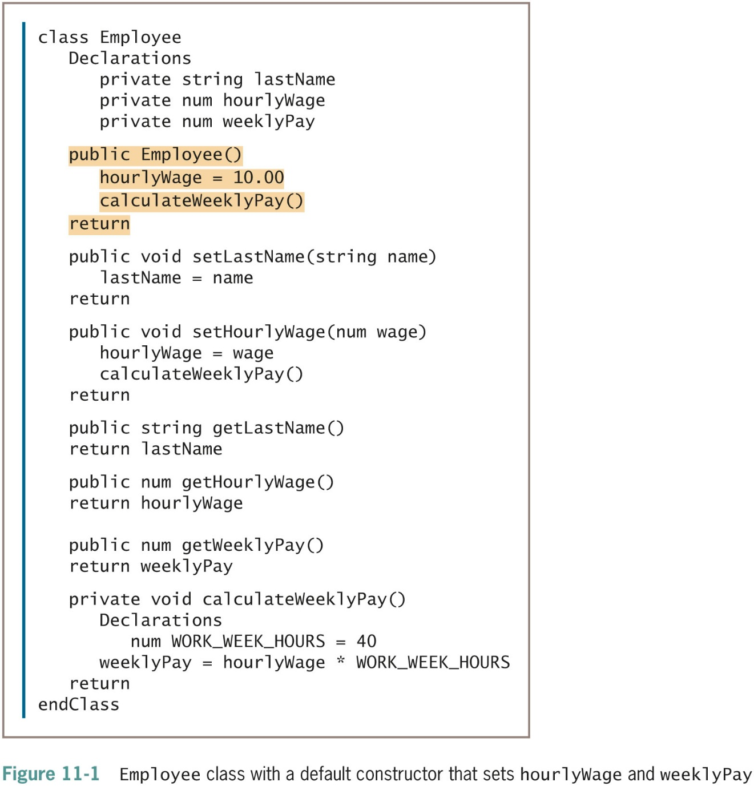
Default Constructors (continued -1)

Slide 7
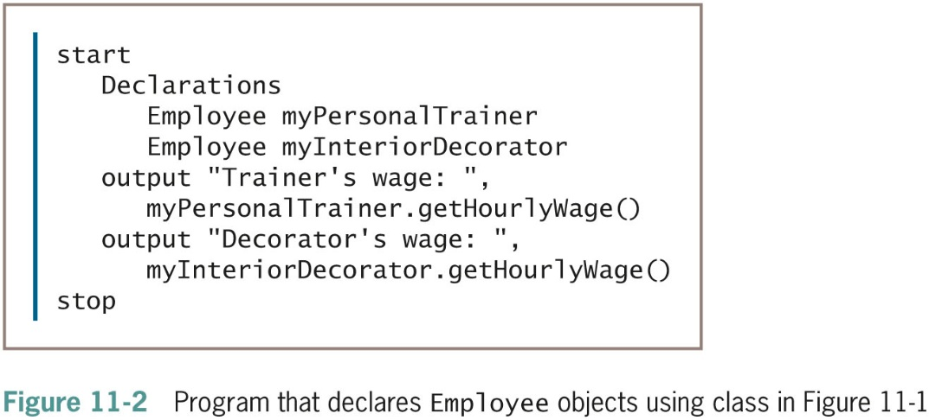
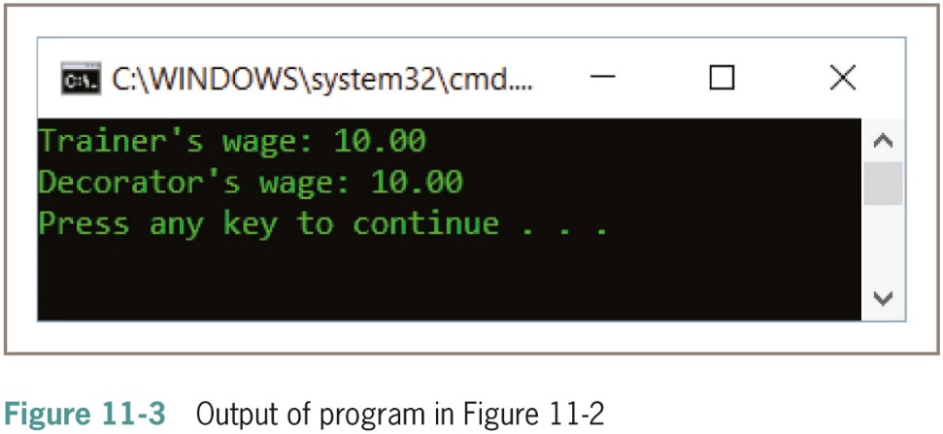
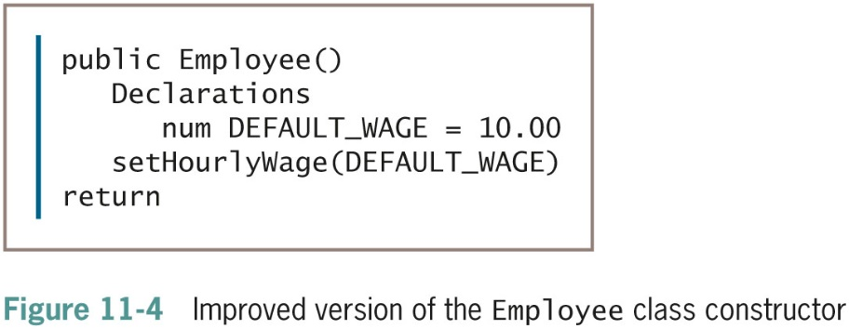
Default Constructors (continued -2)

Slide 8
Nondefault Constructors
Choose to create Employee objects with values that differ for each employee
  Initialize each Employee with a unique hourlyWage
Write constructors that receive arguments
  Employee partTimeWorker(8.81)
  Employee partTimeWorker(valueEnteredByUser)
When the constructor executes
  Numeric value within the constructor call is passed to Employee()

Slide 9
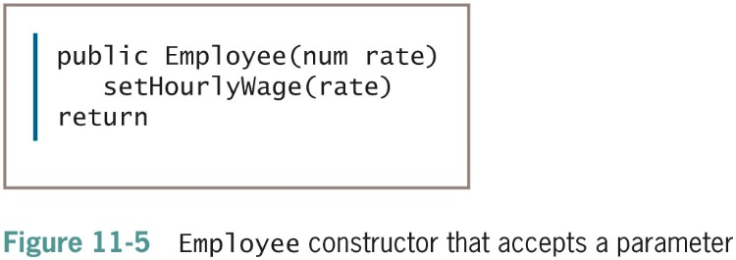
Nondefault Constructors (continued)
Once you write a constructor for a class, you no longer receive the automatically written default constructor
If a class’s only constructor requires an argument, you must provide an argument for every object of that class you create

Slide 10
Overloading Instance Methods and Constructors
Overload methods
  Write multiple versions of a method with the same name but different argument lists
Any method or constructor in a class can be overloaded
Can provide as many versions as you want

Slide 11
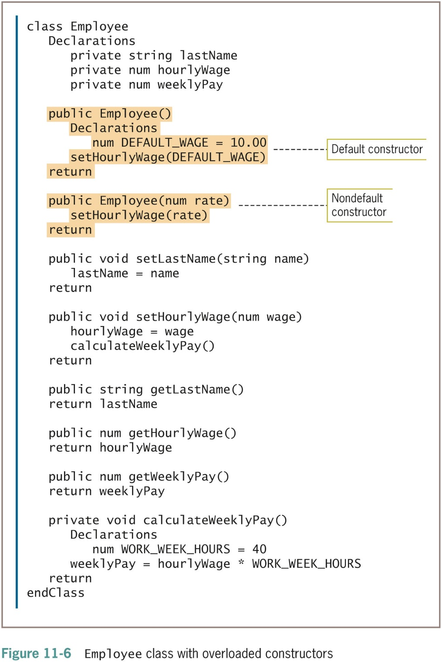
Overloading Instance Methods and Constructors (continued -1)

Slide 12
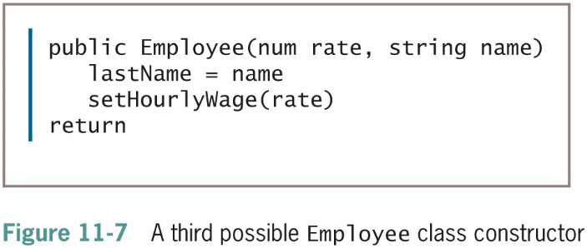
Overloading Instance Methods and Constructors (continued -2)

Slide 13
Understanding Destructors
Destructor
  A method that contains the actions you require when an instance of a class is destroyed
Instance destroyed
  When the object goes out of scope
If you do not explicitly create a destructor for a class, one is provided automatically
Declare a destructor
  Identifier consists of a tilde (˜) followed by the class name

Slide 14
Understanding Destructors (continued -1)
Cannot provide any parameters to a destructor
  Empty parameter list
Destructors cannot be overloaded
  Only one destructor per class
A destructor has no return type
Programs never explicitly call a destructor
  Invoked automatically
The last object created is the first object destroyed

Slide 15
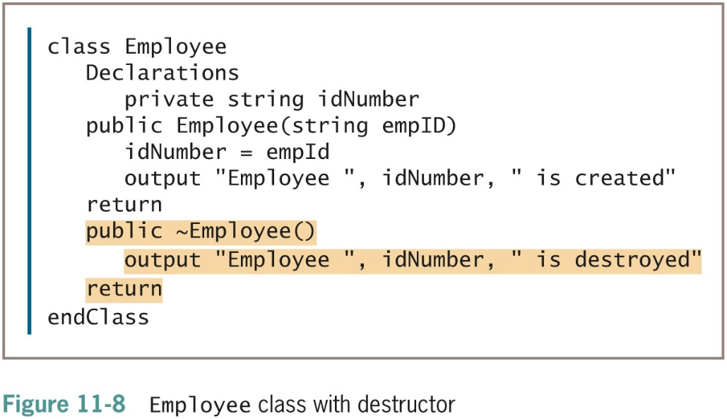
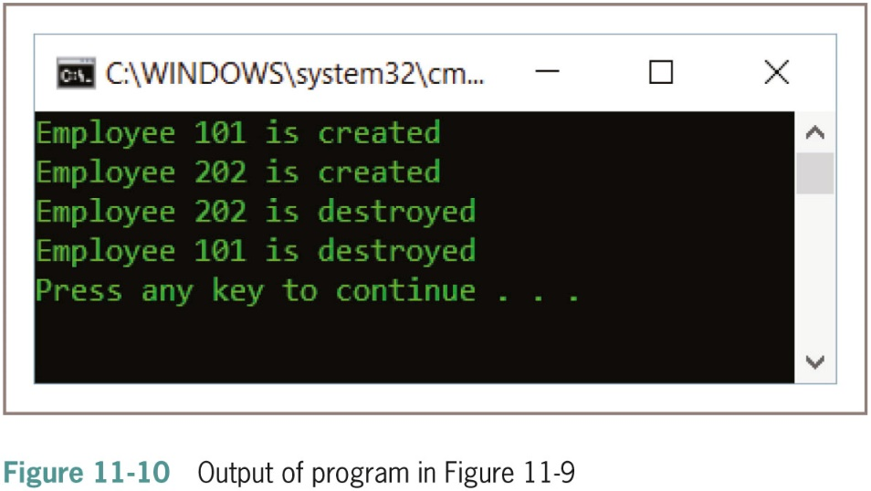
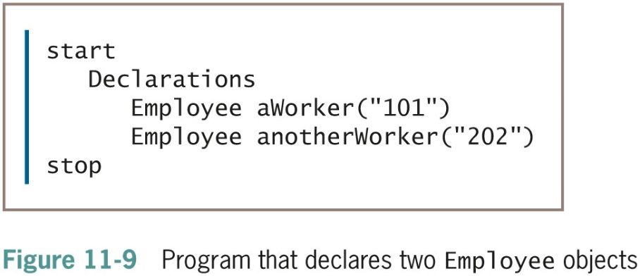
Understanding Destructors (continued -2)

Slide 16
Understanding Composition
When a class contains objects of another class as data fields, the relationship is called a whole-part relationship or composition
Example
  Date that contains a month, day, and year
  Employee class has two Date fields to hold Employee’s birth date and hire date
Composition
  Placing a class object within another class object
  Called has-a relationship because one class “has an” instance of another

Slide 17
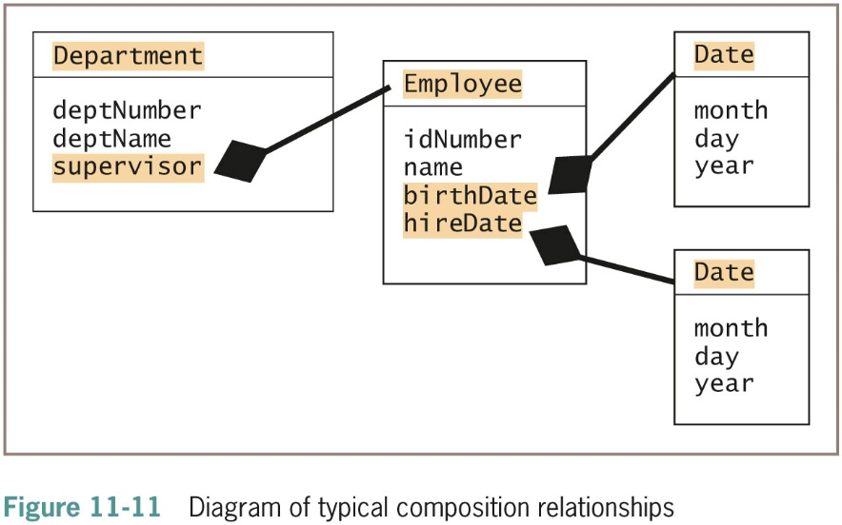
Understanding Composition (continued)

Slide 18
Understanding Inheritance
Understanding classes helps you organize objects in real life
Inheritance
  A principle that enables you to apply your knowledge of a general category to more specific objects
Reuse the knowledge you gain about general categories and apply it to more specific categories

Slide 19
Understanding Inheritance (continued -1)
Create a class by making it inherit from another class
  Provided with data fields and methods automatically
  Reuse fields and methods that are already written and tested
Employee class
  CommissionEmployee inherits all the attributes and methods of Employee

Slide 20
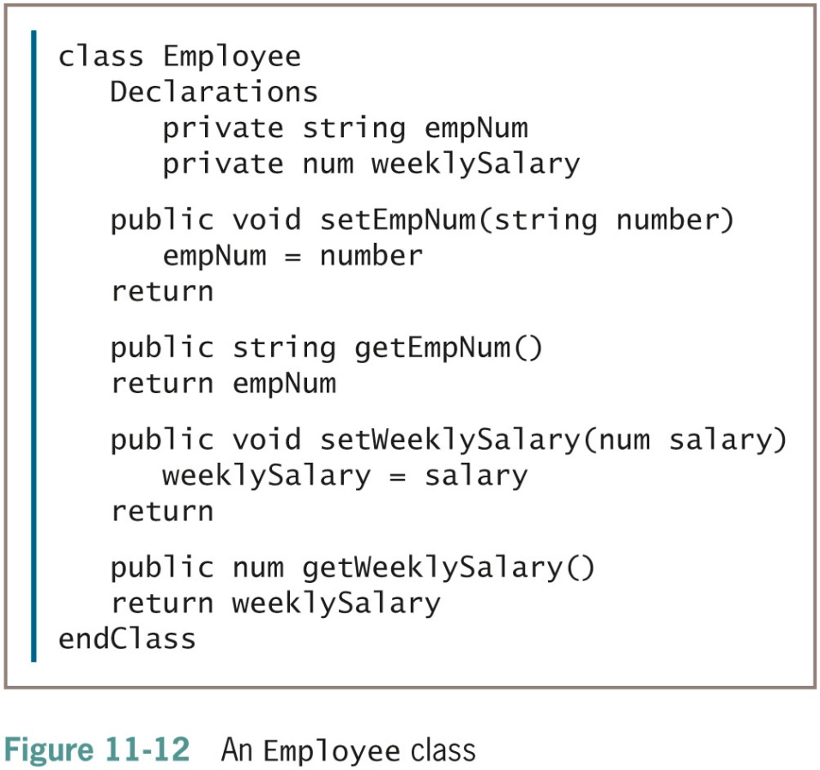
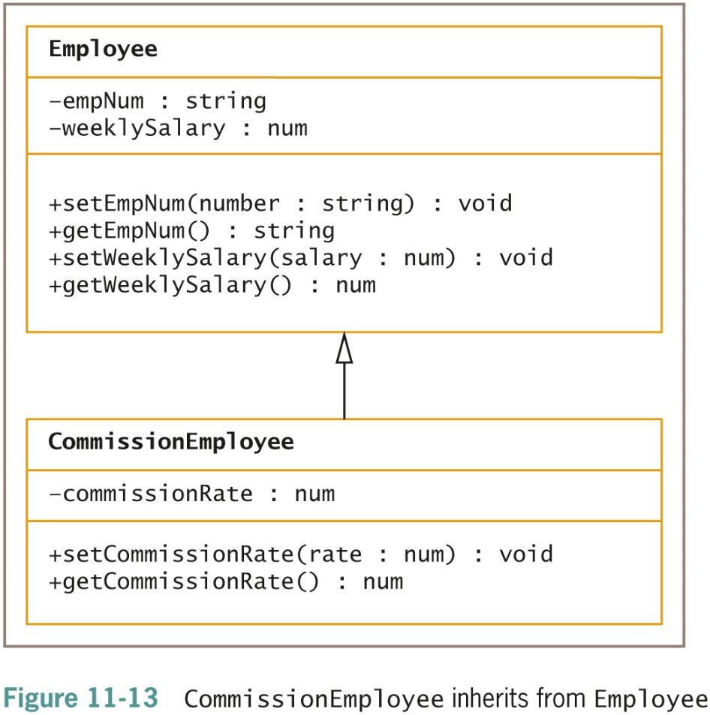
Understanding Inheritance (continued -2)

Slide 21
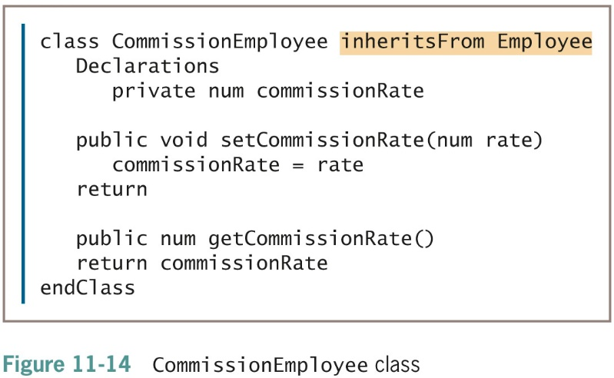
Understanding Inheritance (continued -3)

Slide 22
Understanding Inheritance (continued -4)
Benefits of using inheritance to create the CommissionEmployee class:
  Save time
  Reduce chance of errors
  Make it easier to understand
  Reduce errors and inconsistencies in shared fields

Slide 23
Understanding Inheritance Terminology
Base class
  A class that is used as a basis for inheritance
  Also called: superclass, parent class
Derived class or extended class
  A class that inherits from a base class
  Also called: subclass, child class

Slide 24
Understanding Inheritance Terminology (continued -1)
Tell which class is the base class and which is the derived class
  The base class is also called the superclass
  The derived class is also called the subclass
  Use the two classes in a sentence with the phrase “is a”
  Try saying the two class names together
  Compare the class sizes
The derived class can be further extended

Slide 25
Understanding Inheritance Terminology (continued -2)
Ancestors
  The entire list of parent classes from which a child class is derived
  A child inherits all the members of all its ancestors
  A parent class does not gain any child class members

Slide 26
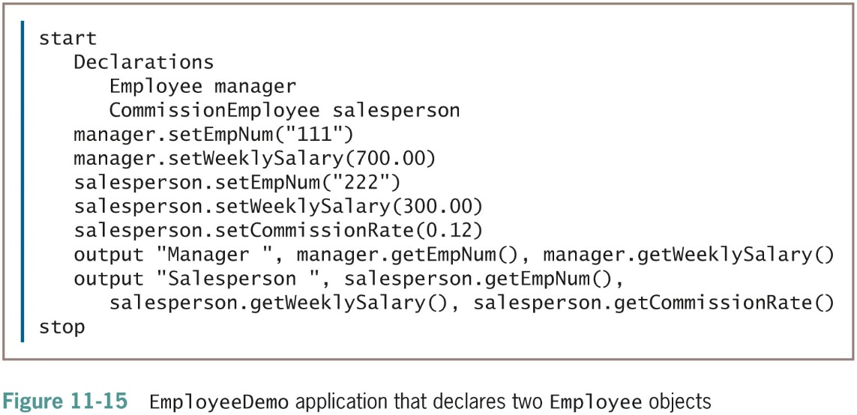
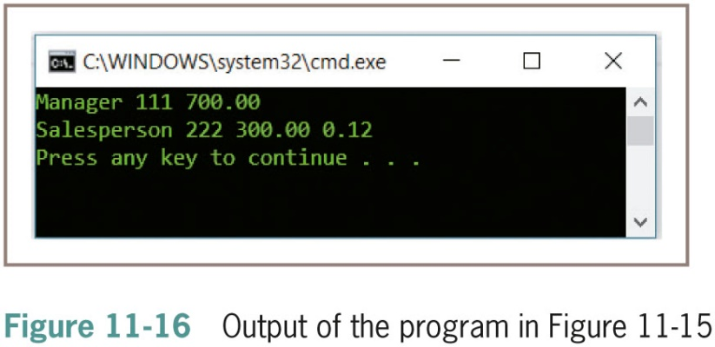
Understanding Inheritance Terminology (continued -3)

Slide 27
Accessing Private Fields and Methods of a Parent Class
It is common for methods to be public but for data to be private
When a data field within a class is private:
  No outside class can use it
  Including a child class
    Can be inconvenient
  Inaccessible

Slide 28
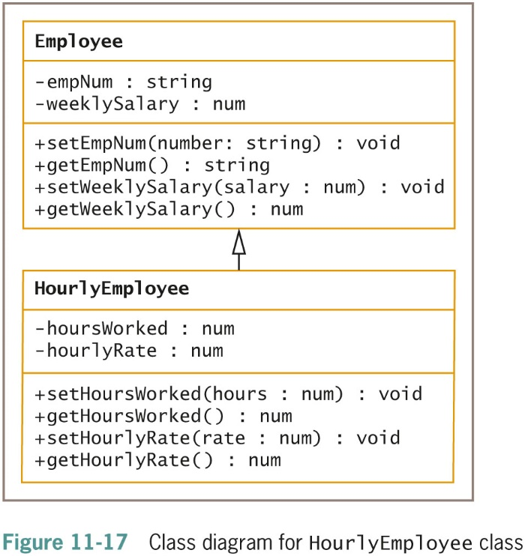
Accessing Private Fields and
Methods of a Parent Class (continued -1)

Slide 29
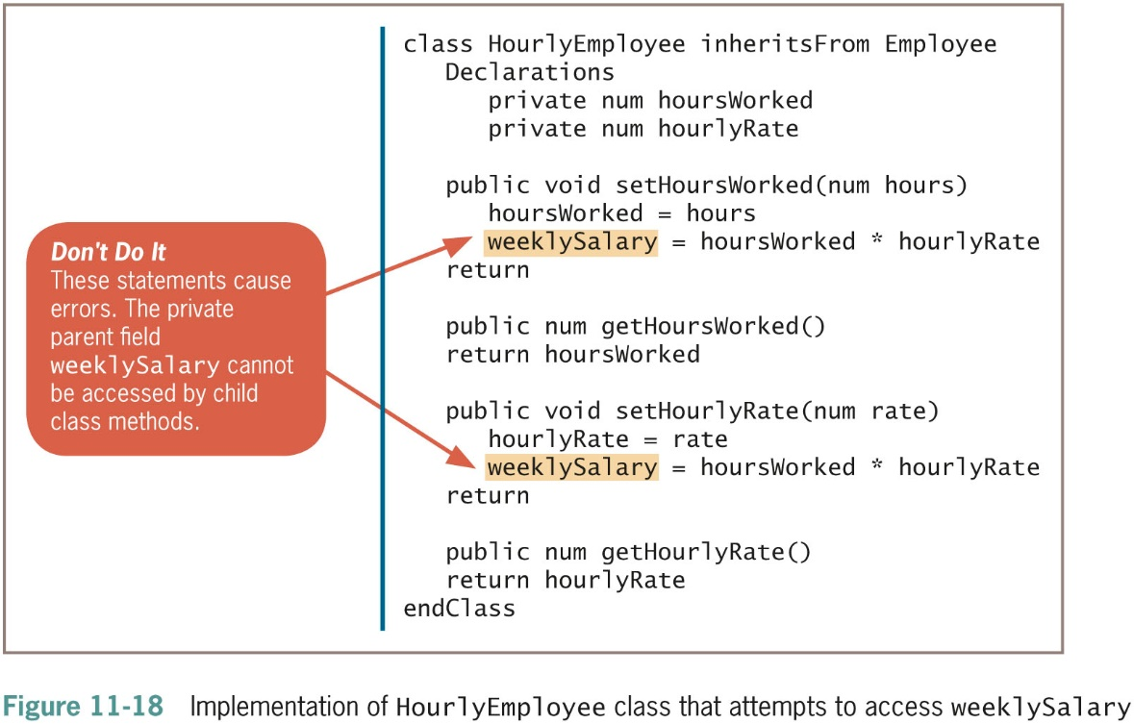
Accessing Private Fields and
Methods of a Parent Class (continued -2)

Slide 30
Accessing Private Fields and
Methods of a Parent Class (continued -3)
protected access specifier
  Used when you want no outside classes to be able to use a data field except classes that are children of the original class
If the Employee class’s creator did not foresee that a field would need to be accessible, then weeklySalary will remain private
  Possible to correctly set an HourlyEmployee’s weekly pay using the setWeeklySalary() method

Slide 31
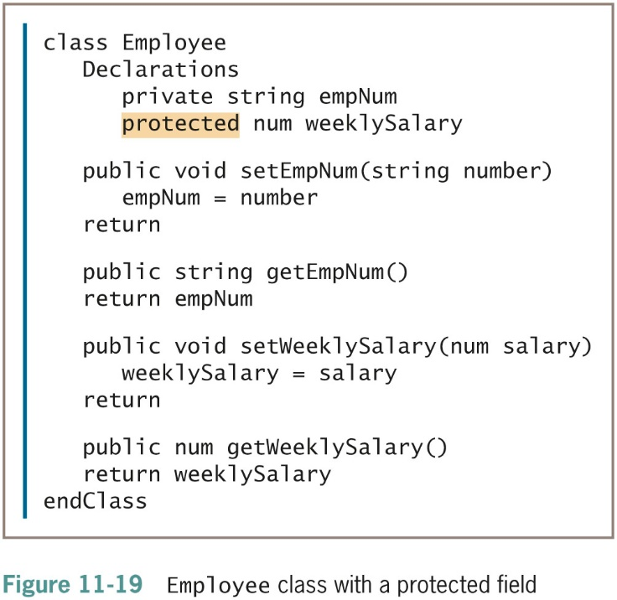
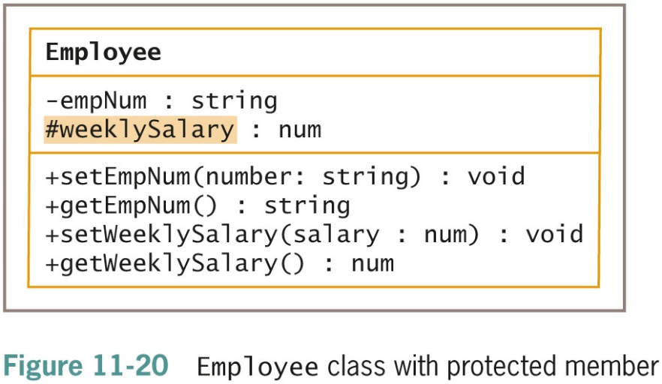
Accessing Private Fields and
Methods of a Parent Class (continued -4)

Slide 32
Accessing Private Fields and
Methods of a Parent Class (continued -5)
When a child class accesses a private field of its parent’s class:
  Modify the parent class to make the field protected
  The child class can use a public method within the parent class that modifies the field
Protected access improves performance
  Use protected data members sparingly
Classes that depend on field names from parent classes are called fragile because they are prone to errors

Slide 33
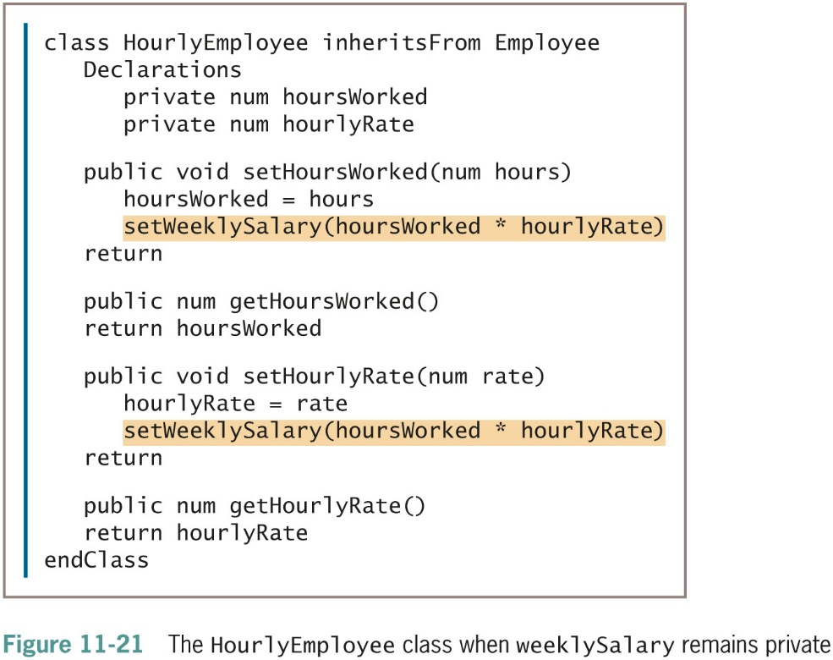
Accessing Private Fields and
Methods of a Parent Class (continued -6)

Slide 34
Accessing Private Fields and
Methods of a Parent Class (continued -7)
Multiple inheritance
  The capability to inherit from more than one class
Abstract class
  A class from which you cannot create any concrete objects, but from which you can inherit

Slide 35
Overriding Parent Class Methods in a Child Class
Overriding
  The mechanism by which a child class method is used by default when a parent class contains a method with the same signature

Slide 36
Using Inheritance to Achieve
Good Software Design
You can create powerful computer programs more easily if many of their components are used either “as is” or with slight modifications
Advantages of creating a useful, extendable superclass:
  Subclass creators save development and testing time
  Superclass code has been tested and is reliable
  Programmers who create or use new subclasses already understand how the superclass works
  Neither the superclass source code nor the translated superclass code is changed

Slide 37
An Example of Using Predefined
Classes: Creating GUI Objects
Libraries or packages
  Collections of classes that serve related purposes
Graphical user interface (GUI) objects
  Created in a visual development environment known as an IDE (integrated development environment)
  Frames, buttons, labels, and text boxes
  Place within interactive programs so that users can manipulate them using input devices

Slide 38
An Example of Using Predefined
Classes: Creating GUI Objects (continued)
Disadvantages of creating your own GUI object classes:
  Lots of work
  Repetitious
  Components would look different in various applications
Visual development environment
  Known as an IDE (Integrated Development Environment)
  Create programs by dragging components such as buttons and labels onto a screen and arranging them visually

Slide 39
Understanding Exception Handling
A lot of effort goes into checking data items to make sure they are valid and reasonable
Procedural programs handled errors in various ways that were effective
  Techniques had some drawbacks
Object-oriented programming
  New model called exception handling

Slide 40
Drawbacks to Traditional Error-Handling Techniques
The most often used error-handling outcome in traditional programming was to terminate the program
  Unforgiving
  Unstructured
Forcing the user to reenter data or limiting the number of chances the user gets to enter correct data
  May allow no second chance at all

Slide 41
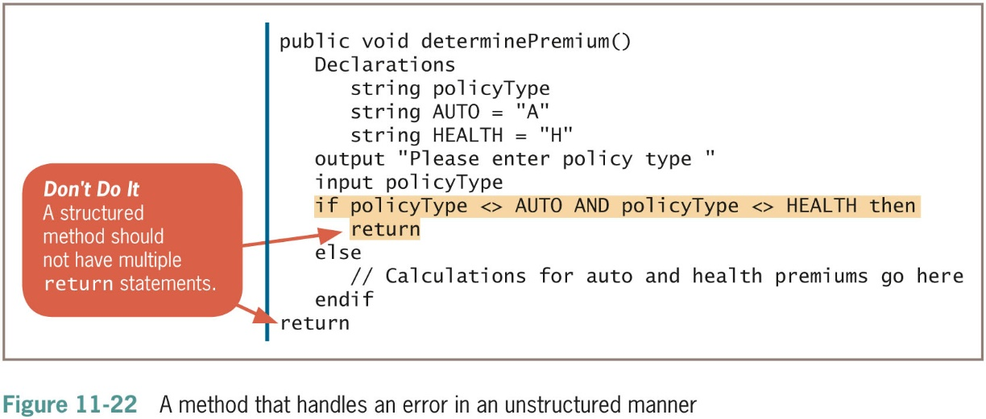
Drawbacks to Traditional Error-Handling Techniques (continued -1)

Slide 42
Drawbacks to Traditional Error-Handling Techniques (continued -2)
More elegant solution
  Looping until the data item becomes valid
Shortcomings
  Method is not very reusable
  Method is not very flexible
  Only works with interactive programs

Slide 43
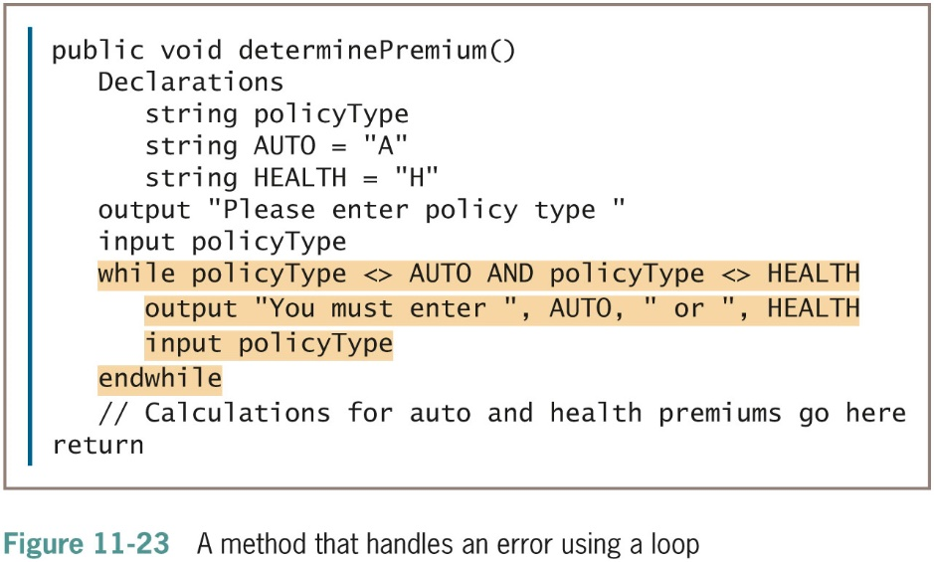
Drawbacks to Traditional Error-Handling Techniques (continued -3)

Slide 44
The Object-Oriented Exception-Handling Model
Exception handling
  A specific group of techniques for handling errors in object-oriented programs
Exceptions
  The generic name used for errors in object-oriented languages
Try some code that might throw an exception
If an exception is thrown, it is passed to a block of code that can catch the exception

Slide 45
The Object-Oriented Exception-Handling Model (continued -1)
throw statement
  Sends an Exception object out of the current code block or method so it can be handled elsewhere
try block
  A block of code you attempt to execute while acknowledging that an exception might occur
  The keyword try, followed by any number of statements
  If a statement in the block causes an exception, the remaining statements in the try block do not execute and the try block is abandoned

Slide 46
The Object-Oriented Exception-Handling Model (continued -2)
catch block
  A segment of code that can handle an exception
  The keyword catch, followed by parentheses that contain an Exception type and an identifier
  Statements that take the action to handle the error condition
  The endcatch keyword indicates the end of the catch block in the pseudocode

Slide 47
The Object-Oriented Exception-Handling Model (continued -3)
General principle of exception handling:
  The method that uses the data should be able to detect errors, but not be required to handle them
  Handling should be left to the application that uses the object
Sunny day case
  When there are no exceptions and nothing goes wrong with a program

Slide 48
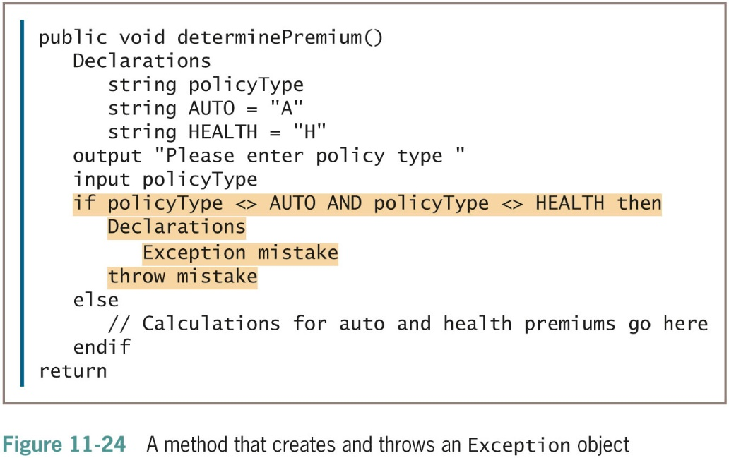
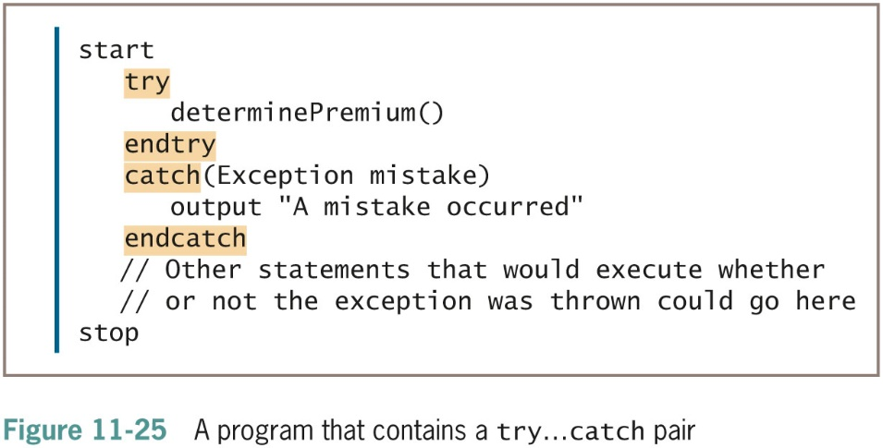
The Object-Oriented Exception-Handling Model (continued -4)

Slide 49
Using Built-in Exceptions and Creating
Your Own Exceptions
Many OO languages provide many built-in Exception types
  Built-in Exceptions in a programming language cannot cover every condition
Create your own throwable Exception
  Extend a built-in Exception class

Slide 50
Reviewing the Advantages of Object-Oriented Programming
Save development time
  Each object automatically includes appropriate, reliable methods and attributes
Develop new classes more quickly
  By extending classes that already exist and work
Use existing objects
  Concentrate only on the interface to those objects
Polymorphism
  Use reasonable, easy-to-remember names for methods

Slide 51
Summary
A constructor establishes objects and a destructor destroys them
Composition or aggregation (has-a relationship)is where a class can contain objects of another class as data members
Creating a class by using inheritance provides you with prewritten and tested data fields and methods automatically. Using inheritance helps save time, reduces the chance of errors and inconsistencies, and makes it easier to understand your classes.

Slide 52
Summary (continued)
Libraries contain the some of the most useful classes to create graphical user interface (GUI) objects
Exception-handling techniques are used to handle errors in object-oriented programs
Object-oriented programming saves development time
Efficiency is achieved through both inheritance and polymorphism

