Slide 1
Programming Logic and Design
Ninth Edition
Chapter 12
Event-Driven GUI Programming,
Multithreading, and Animation

Slide 2
Objectives
In this chapter, you will learn about:
The principles of event-driven programming
User-initiated actions and GUI components
Designing graphical user interfaces
Developing an event-driven application
Threads and multithreading
Creating animation

Slide 3
Understanding Event-Driven
Programming
Operating system
  The software used to run a computer and manage its resources
Early days of computing
  Command line entry: the DOS prompt
  Interacting with a computer operating system was difficult
  The user had to know the exact syntax to use when typing commands

Slide 4
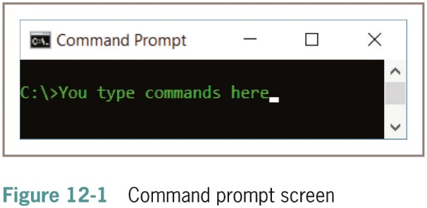
Understanding Event-Driven
Programming (continued -1)

Slide 5
Understanding Event-Driven
Programming (continued -2)
Modern operating system software
  Allows use of mouse, fingers or other pointing device to select icons
  GUI
Computer users can expect to see a standard interface
Event
  Generates a message sent to an object

Slide 6
Understanding Event-Driven
Programming (continued -3)
Event-driven or event-based program
  Actions occur in response to user-initiated events such as clicking a mouse button or tapping a screen
  Emphasis is on the objects that the user can manipulate
  Programmer writes instructions within modules that execute each type of event

Slide 7
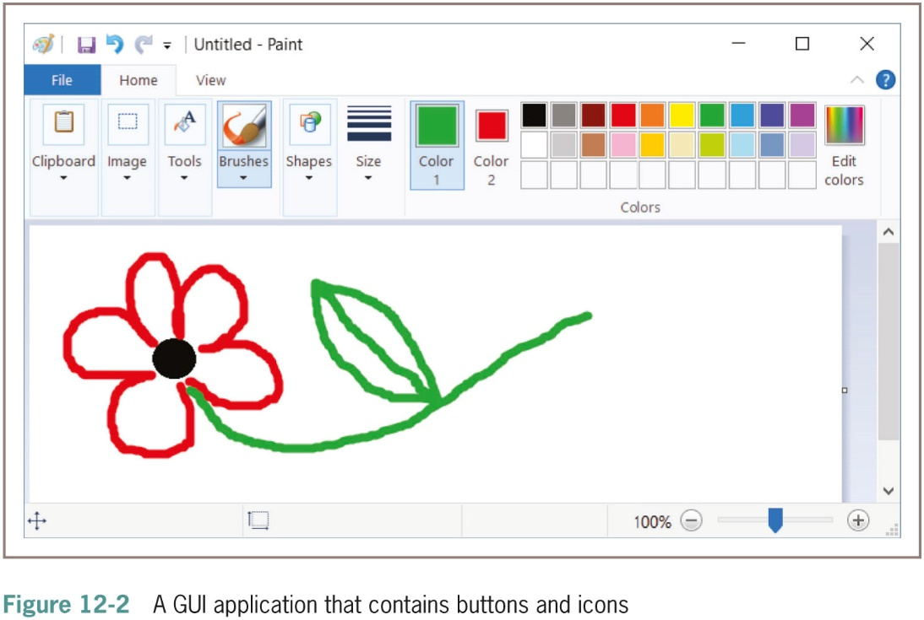
Understanding Event-Driven
Programming (continued -4)

Slide 8
Understanding Event-Driven
Programming (continued -5)
Procedural application
  Programmer controls order of program statements
Event-driven programs
  User might initiate any number of events in any order
  More flexible than procedural counterparts
Source of the event
  The component from which an event is generated
Listener
  An object that is “interested in” an event to which you want it to respond to

Slide 9
Understanding Event-Driven
Programming (continued -6)
Not all objects can receive all events
Event-driven programming
  Newer than procedural programming
  But uses many similar techniques to procedural
In object-oriented languages, the procedural modules that depend on user-initiated events are called scripts

Slide 10
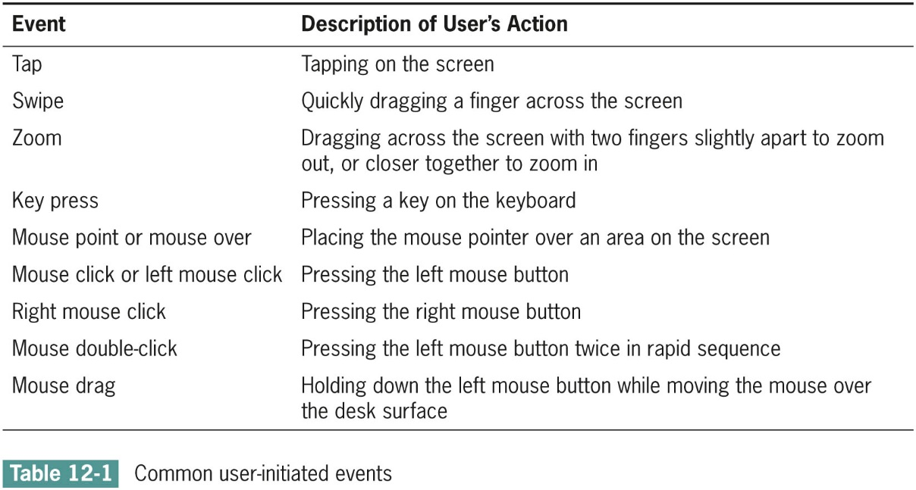
User-Initiated Actions and GUI
Components

Slide 11
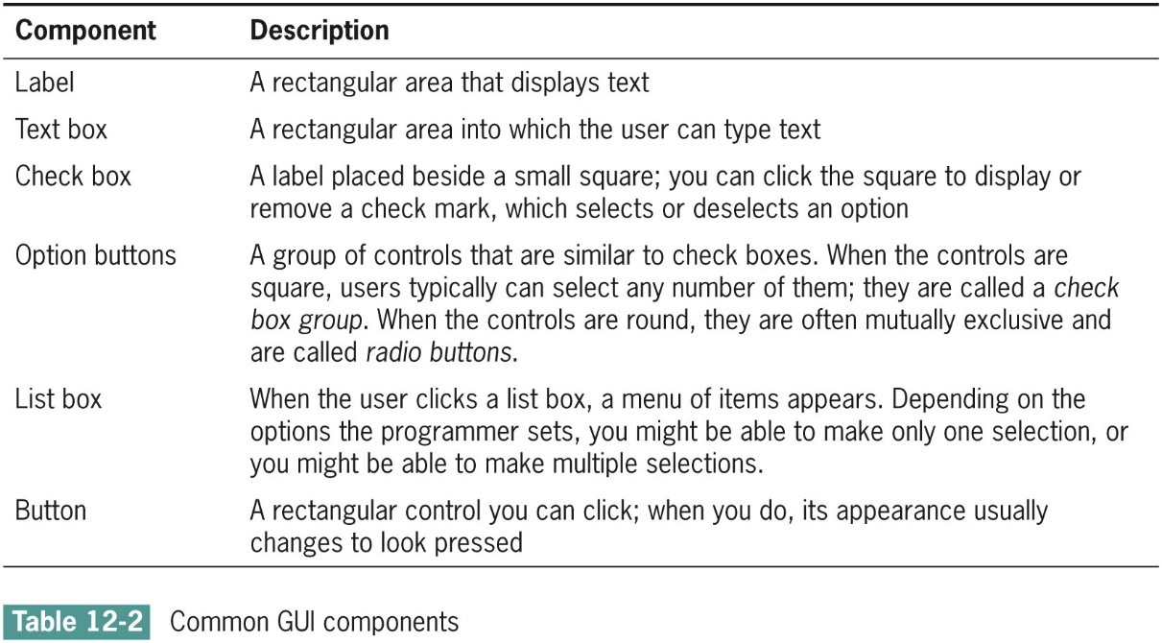
User-Initiated Actions and GUI
Components (continued -1)

Slide 12
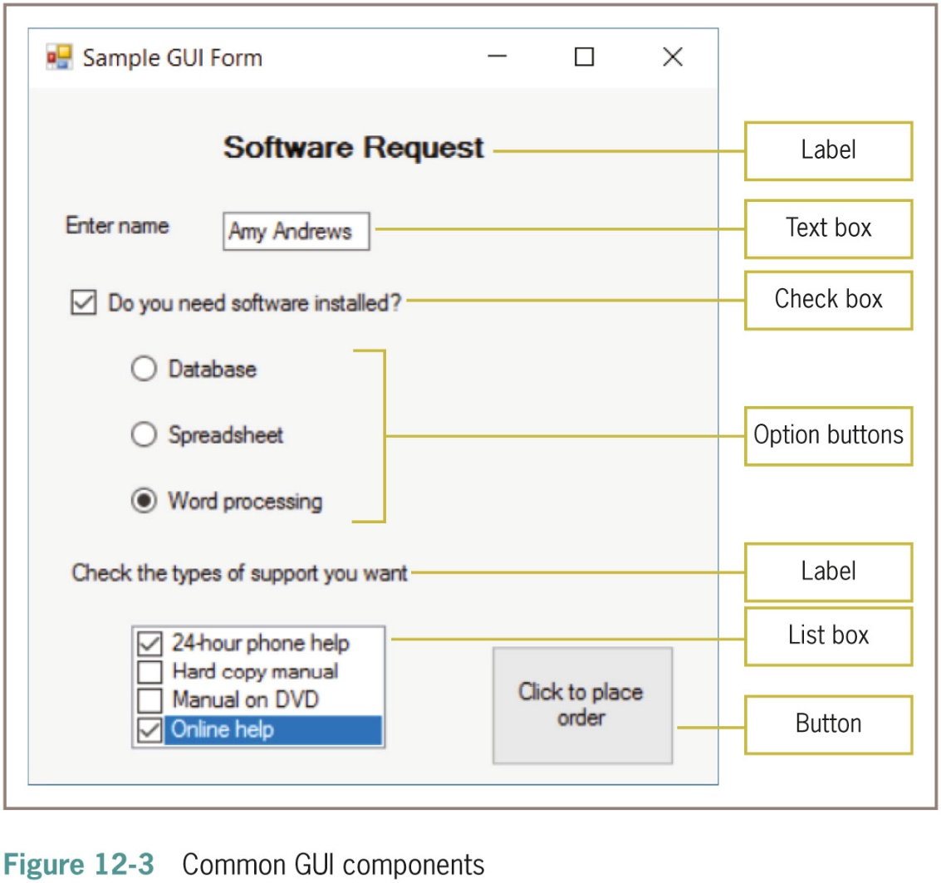
User-Initiated Actions and GUI
Components (continued -2)

Slide 13
User-Initiated Actions and GUI
Components (continued -3)
Do not create the GUI components you need from scratch
  Call prewritten methods that draw the GUI components on the screen for you
Components themselves are constructed using existing classes complete with names, attributes, and methods
Text or graphical environment

Slide 14
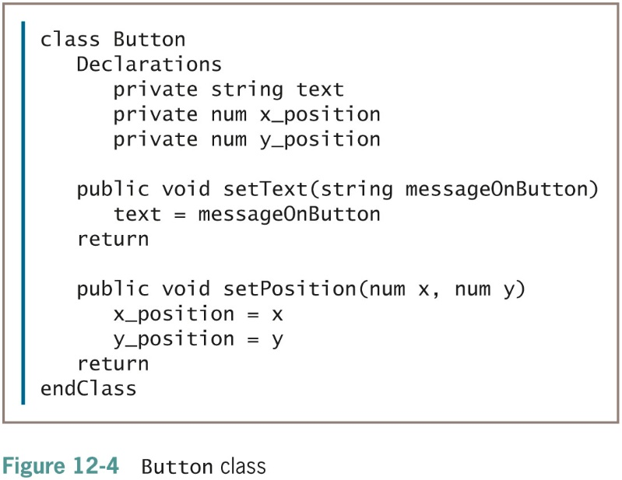
User-Initiated Actions and GUI
Components (continued -4)

Slide 15
User-Initiated Actions and GUI
Components (continued -5)
The x_position and y_position of the Button object refer to horizontal and vertical coordinates where the Button appears on the screen
A pixel is one of the tiny dots of light that form a grid on your screen
Together, the x and y coordinates locate any specific pixel location on the screen

Slide 16
User-Initiated Actions and GUI
Components (continued -6)
Create a Button object
  Button myProgramButton
Use Button’s methods
  myProgramButton.setText("Click here")
  myProgramButton.setPosition(10, 30)
Different GUI classes support different attributes and methods

Slide 17
Designing Graphical User Interfaces
The interface should be natural and predictable
The interface should be attractive, easy to read, and nondistracting
To some extent, it’s helpful if the user can customize your applications
The program should be forgiving
The GUI is only a means to an end

Slide 18
The Interface Should Be Natural and Predictable
Represent objects like their real-world counterparts
Actions should be predictable
  Similar to other programs
Be predictable in layout
  Put related items together in proper order
  Example: locate menu at top

Slide 19
The Interface Should Be Attractive,
Easy to Read, and Nondistracting
Attractive
  People are more likely to use it
Easy to read
  Less likely to make mistakes
Screen designs should not be distracting
  Fancy fonts and weird color combinations are the signs of amateur designers

Slide 20
To Some Extent, It’s Helpful If the User Can Customize Your Applications
It’s helpful if users can position components in the order that’s easiest for them
Users appreciate being able to change features like color schemes
Accessibility
  Screen design issues that make programs easier to use for people with physical limitations
Possibly allow for choice of language and currency

Slide 21
The Program Should Be Forgiving
Always provide an escape route
  Accommodate users who make bad choices or change their minds
  Back button or functional Escape key
  Option to revert to the default settings
  Allow users to perform tasks in a variety of ways:
    Mouse click
    Touch
    Keyboard shortcut
    Menu item
    Disability options

Slide 22
The GUI Is Only a Means to an End
The GUI is only an interface
The point of a graphical interface is to help people be more productive
The real work of any GUI program is done after the user clicks a button or makes a list box selection

Slide 23
Developing an Event-Driven Application
Steps to developing a procedural computer program
  1. Understanding the problem
  2. Planning the logic
    2a. Creating storyboards
    2b. Defining the objects
    2c. Defining the connections between the screens the user will see
  3. Coding the program
  4. Translating the program into machine language
  5. Testing the program
  6. Putting the program into production
  7. Maintaining the program

Slide 24
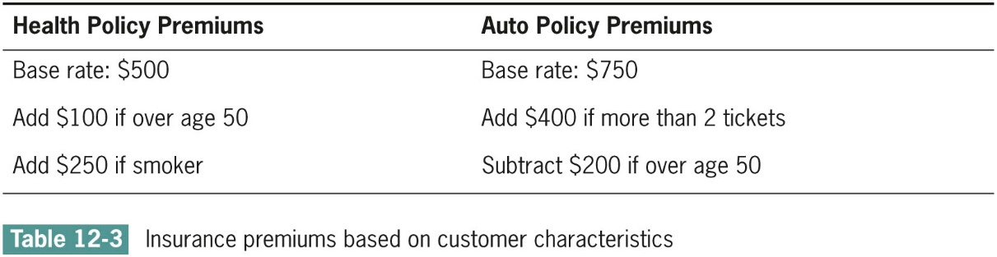
Developing an
Event-Driven Application (continued)

Slide 25
Creating Wireframes
Wireframe
  A picture or sketch of a screen the user will see when running a program
  Also called a page schematic or screen blueprint
  Can be pencil sketches or produced by software applications

Slide 26
Creating Storyboards
Storyboard
  Contains a series of wireframes that represent a user’s experience with the proposed software
GUI storyboards
  Represent “snapshot” views of the screens the user will encounter during the run of a program

Slide 27
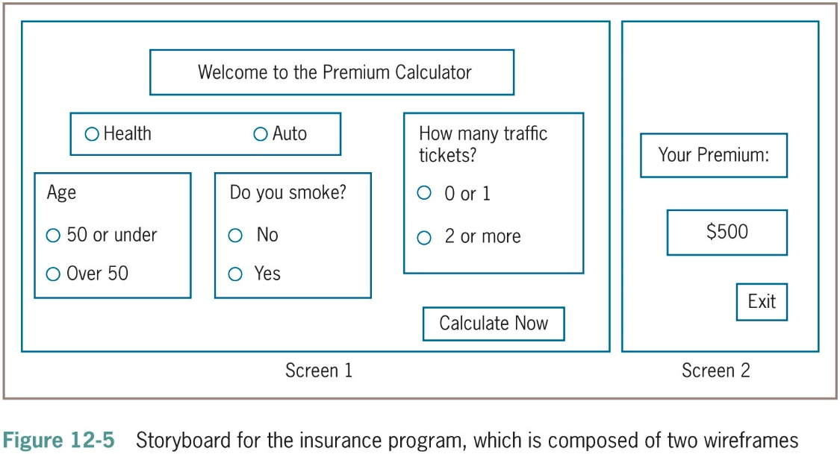
Creating Storyboards (continued)

Slide 28
Defining the Storyboard Objects in an Object Dictionary
An event-driven program may contain dozens or even hundreds of objects
Object dictionary
  A list of the objects used in a program
  Includes which screens they are used on and whether any code, or script, is associated with them

Slide 29
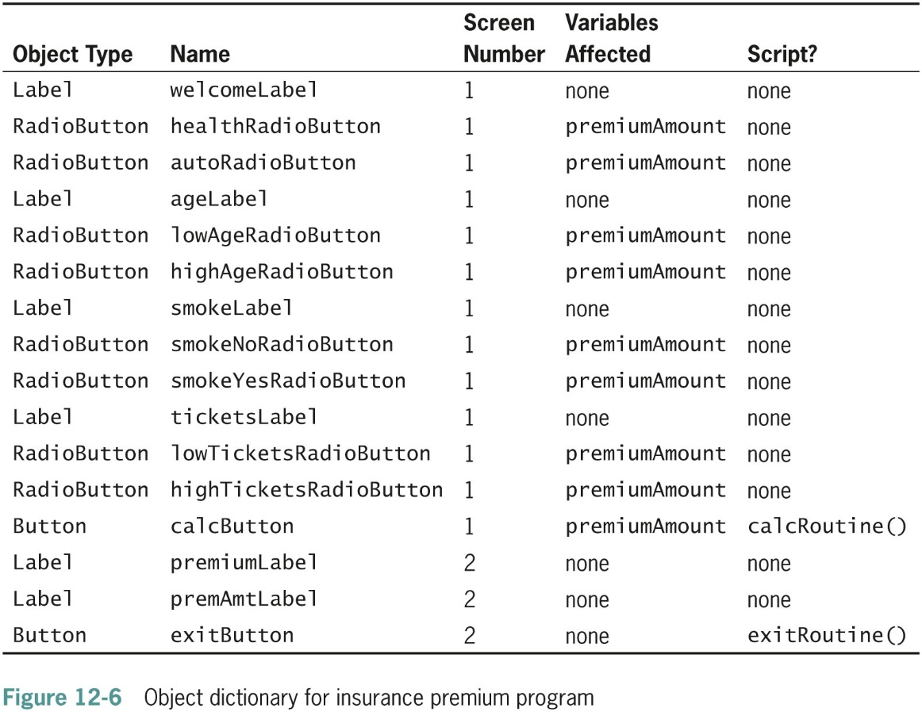
Defining the Storyboard Objects in an Object Dictionary (continued)

Slide 30
Defining Connections Between the User Screens
Draw the connections between the screens to show how they interact
Interactivity diagram
  Shows the relationship between screens in an interactive GUI program
One screen may lead to different screens depending on the options the user selects at any one screen

Slide 31
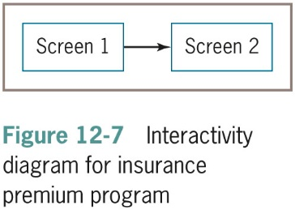
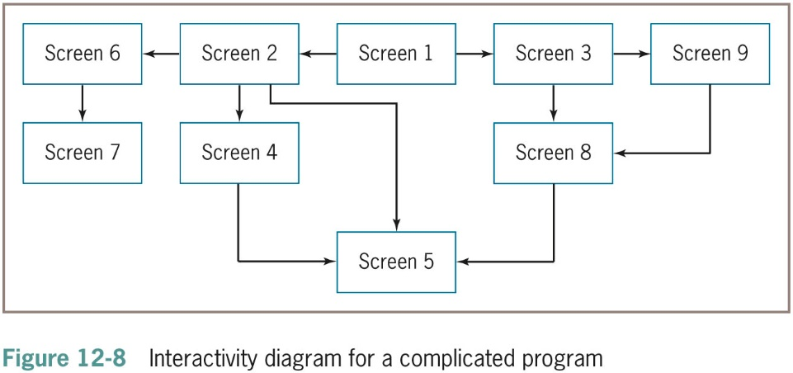
Defining Connections Between the User Screens (continued)

Slide 32
Planning the Logic
Design the screens
Define the objects
Define how the screens will connect
Then start to plan the client program
Create the component onto which all the GUI elements are placed
  Might use a class with a name such as Screen, Form, or Window

Slide 33
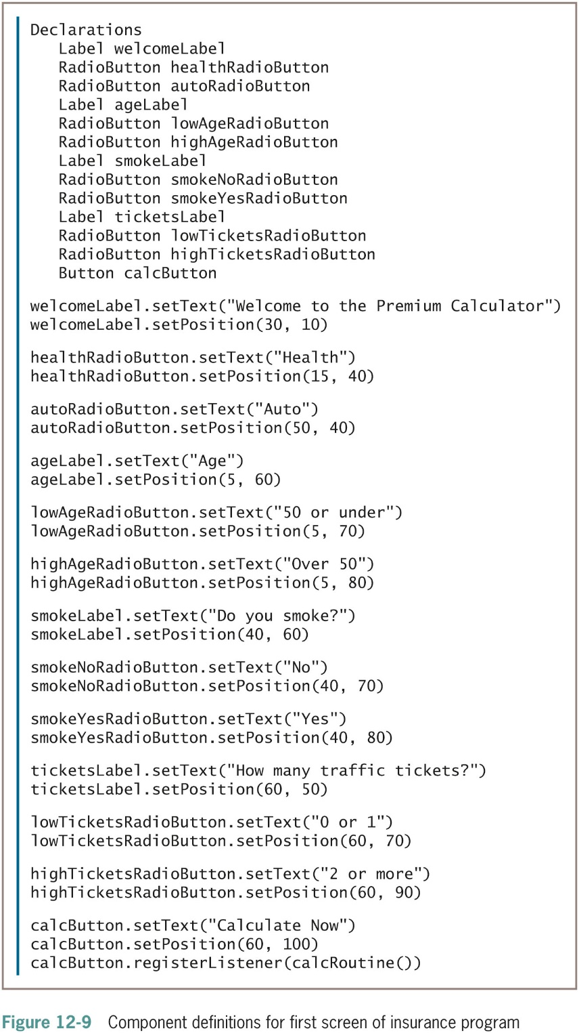
Planning the Logic (continued -1)

Slide 34
Planning the Logic (continued -2)
Register components
  Sign them up so that they can react to events initiated by other components
Container
  A class of objects whose main purpose is to hold other elements
  Contains methods that allow you to set physical properties such as height and width
  Contains methods that allow you to add the appropriate components to a container

Slide 35
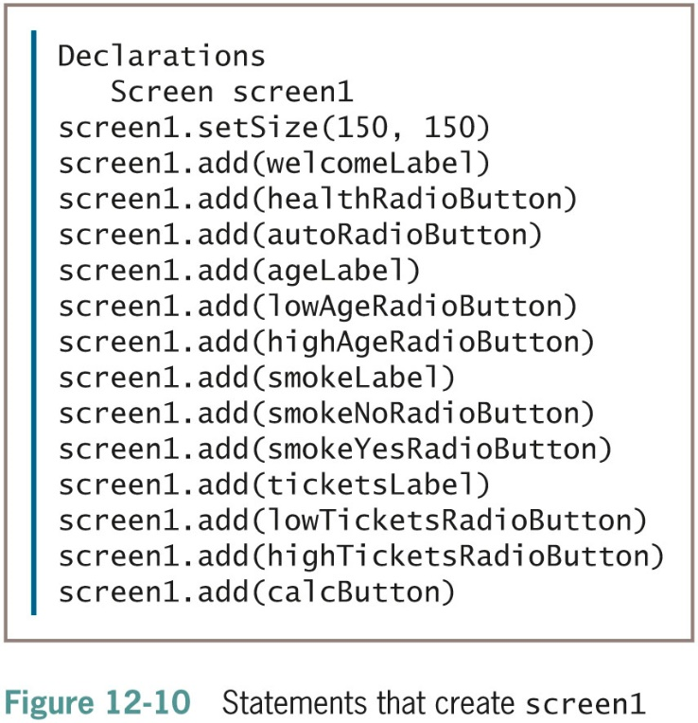
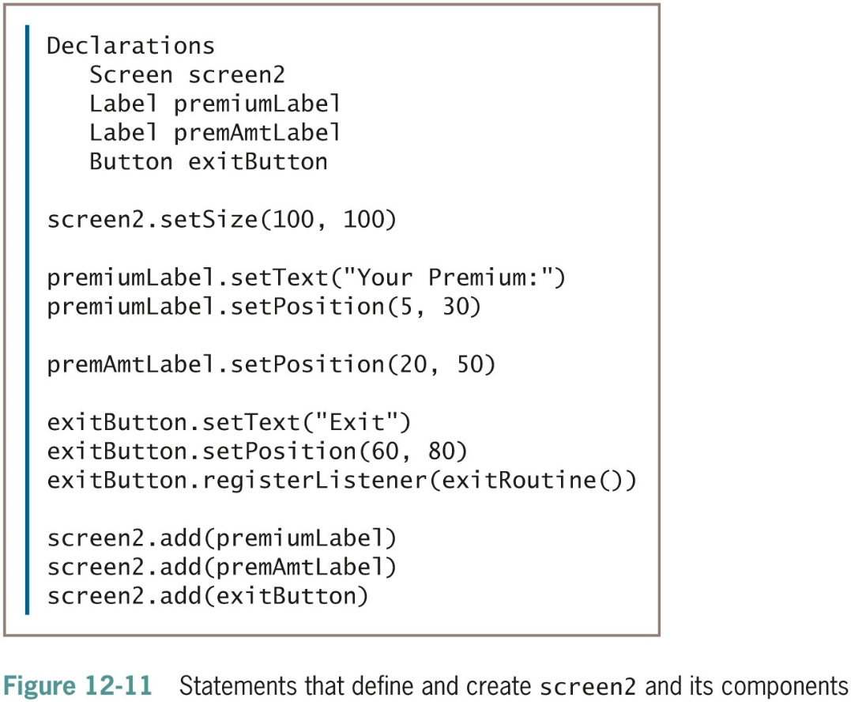
Planning the Logic (continued -3)

Slide 36
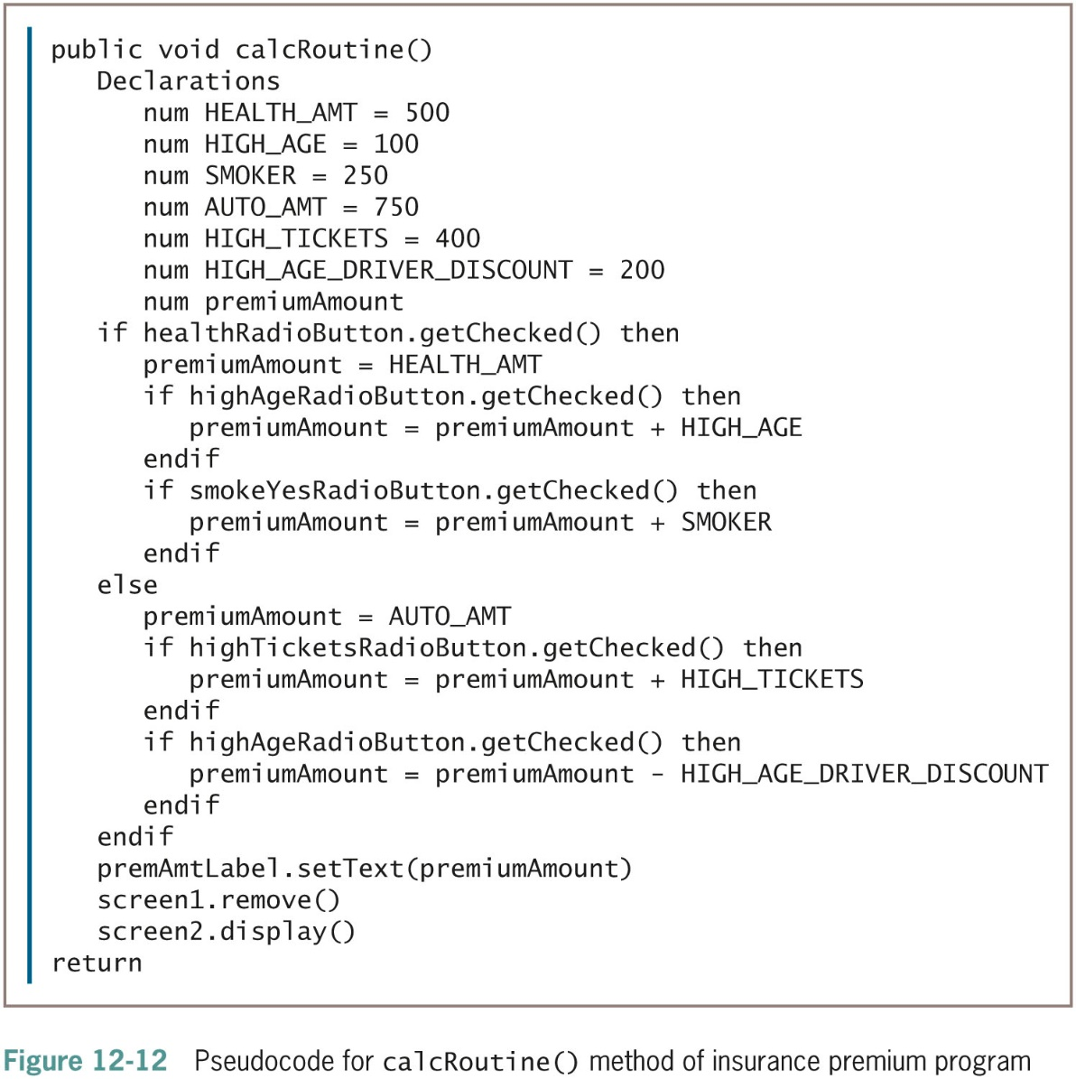
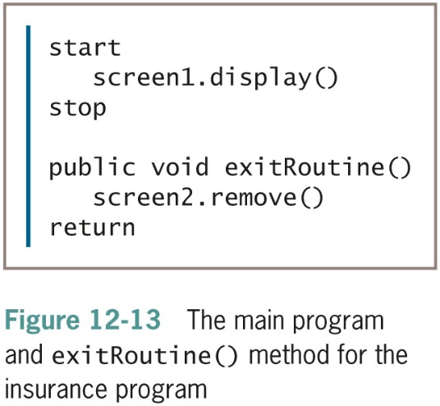
Planning the Logic (continued -4)

Slide 37
Understanding Threads and Multithreading
Thread
  The flow of execution of one set of program statements
Many applications follow a single thread
A computer’s central processing unit (CPU) can execute only one statement at a time regardless of its processor speed
A computer with multiple CPUs can execute multiple instructions simultaneously

Slide 38
Understanding Threads and Multithreading (continued -1)
Multithreading
  Using multiple threads of execution
  Multiple threads share the CPU’s time for a single processor
Use multithreading to improve the performance of your programs
  More user friendly
Object-oriented languages often contain a built-in Thread class
  Contains methods to help handle multiple threads

Slide 39
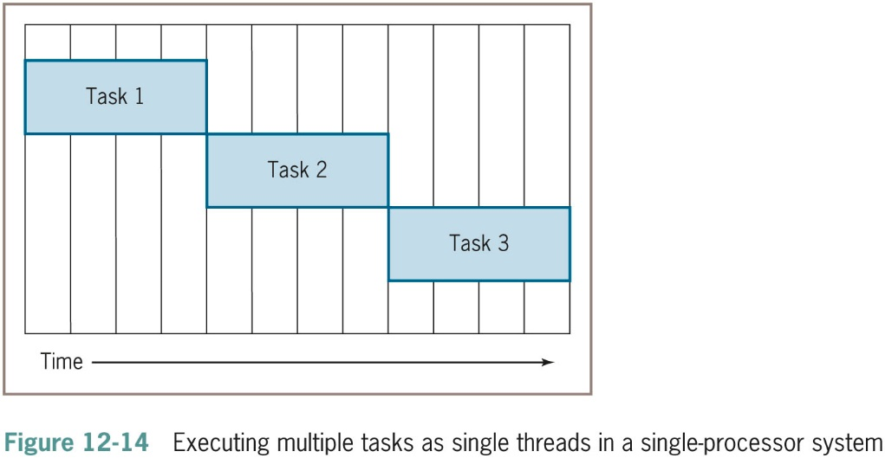
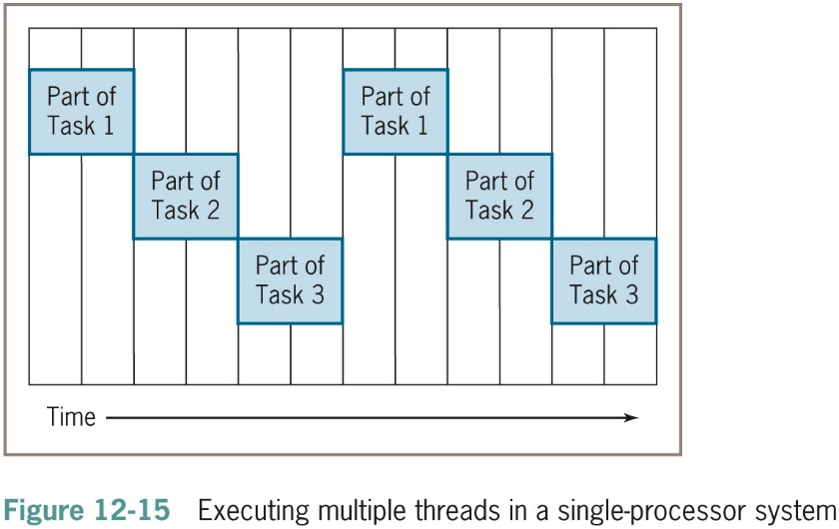
Understanding Threads and Multithreading (continued -2)

Slide 40
Understanding Threads and Multithreading (continued -3)
Code carefully to avoid deadlock and starvation
  Deadlock occurs when two or more threads wait for each other
  Starvation occurs when a thread is abandoned because other threads occupy all computer resources
Techniques like thread synchronization avoid problems such as:
  Two clerks accessing the same record, and the first one updating it while the other is still viewing it
  The second user still thinks the data is accurate

Slide 41
Creating Animation
Animation
  A rapid sequence of still images
  Each is slightly different from the previous one
  Produces the illusion of movement
Object-oriented languages offer built-in classes used to draw geometric figures on the screen
Position
  Horizontal: x-axis, x-coordinate
  Vertical: y-axis, y-coordinate

Slide 42
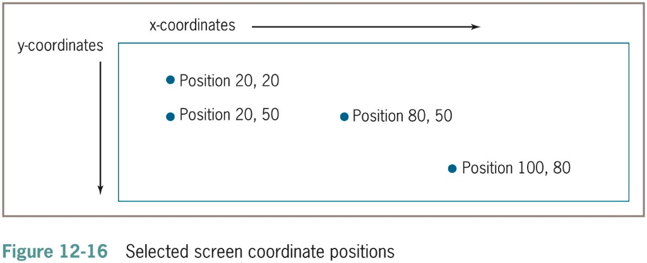
Creating Animation (continued -1)

Slide 43
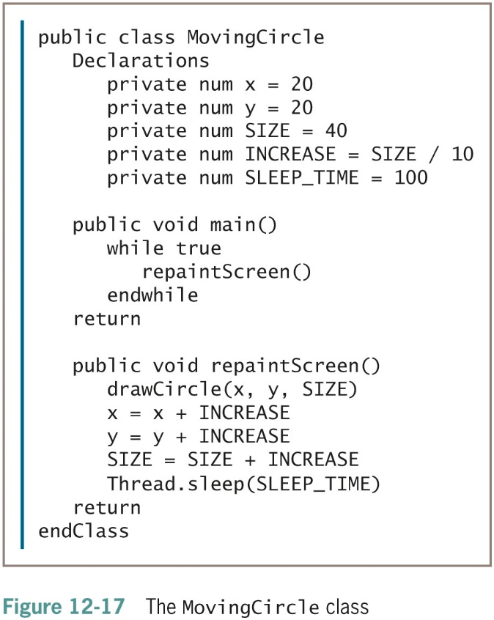
Creating Animation (continued -2)
MovingCircle class
  Moves a circle across the screen
  Constants SIZE and INCREASE
  drawCircle() method
  sleep() method

Slide 44
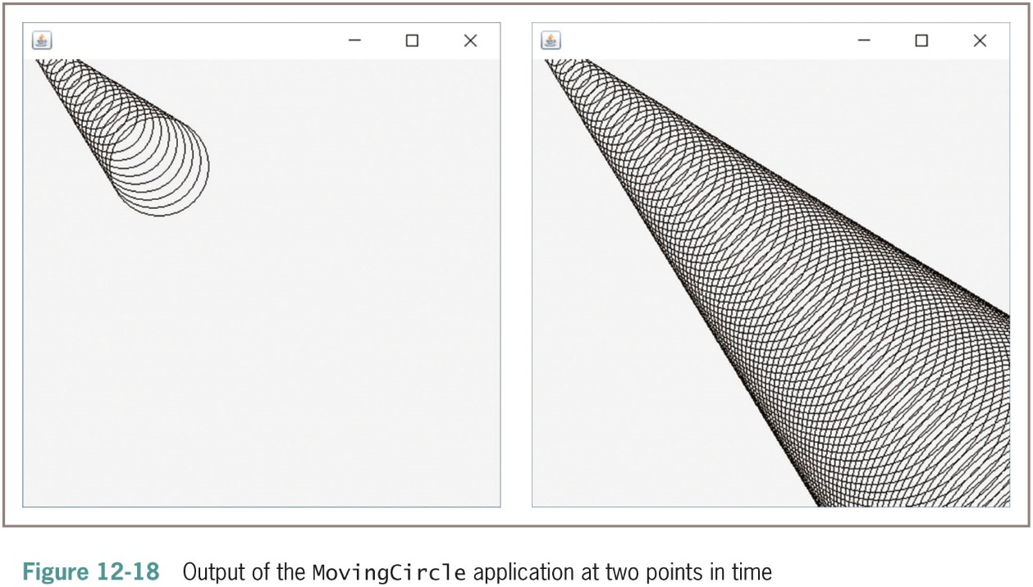
Creating Animation (continued -3)

Slide 45
Summary
Graphical user interface (GUI)
  Users manipulate objects such as buttons and menus
  Listeners are “interested in” an event
  Common user events involve tapping a screen or clicking a mouse
Common GUI components include labels, text boxes, buttons, check boxes, check box groups, option buttons, and list boxes
Interface should be natural, predictable, attractive, easy to read, and nondistracting

Slide 46
Summary (continued)
Event-driven applications require creating wireframes and storyboards, defining objects and dictionaries for them, and defining connections between screens the user will see
Thread
  The flow of execution of one set of program statements
Animation
  A rapid sequence of still images that produces the illusion of movement

