Slide 1
BlipIt!
http://code.google.com/p/blipit/

Slide 2


A person is in danger...

Slide 3






Slide 4



HELP !!!
What does the victim do...
      Reach out to 911, 108, or other voice based services
      Others may help the victim
Humanitarian relief operations
    Red Cross
    WHO
    NGOs
    Government agencies
    HAM Radios

Slide 5


What should I do ?
Whom should I call ?
I stay on the outskirts !!!
Oops... no network :-(
I can't speak Pandora...
... and a lot can go wrong

Slide 6

  Bridge the gap between the victim & service provider(s)
  Communicate the plight of the victim to as many relevant authorities as possible.
  Help locate the victim as precisely as possible
  Make the solution affordable & easily accessible

Slide 7
BlipIt! to the rescue...
    A system for exchanging blips between publishers & subscribers
    Blip consists of...
  Channel, an identifier for a victim's situation
  Geo location information of the victim
  Victim's identification information
  Mapping tools like Google Maps render Blips
Easy to use & report panic

Slide 8


Slide 9

"I will like to congratulate the brains behind BlipIt for such a great initiative...of course such a system will be very helpful. Infact, it has come at a very critical point when governments, law enforcement agencies, etc are looking for ways to increase efficiency in the performance of their duties and provide maximum security."
-- Nii A. Sowah, IT Officer, 1ViLLAGE, "Connecting the Unconnected in rural Africa", Ghana. West Africa
"Congratulations! It sounds great! Can you tell me when the users will might download the Android app? "
-- Jorge Luis Alonso G, Teléfonos inteligentes como TIC para el desarrollo, Argentina
"We might be able to try it out for pregnant women who need emergency transport. I'll let you know once we think about that a bit more... Cool. Well the nice thing is that we're operating in Nairobi which is well mapped by Google so I suspect we'll be able to resolve a lot of the locations. "
-- Aliya Walji, CTO, Jacaranda Clinics, Nairobi

Slide 10

  Internationalization
  Send additional information with every PanicBlip
  BlipIt Web client for viewing blips
  BlipIt Installation & Deployment
  And lot more... check out our road map at:
http://code.google.com/p/blipit/wiki/BlipItRoadMap

Slide 11
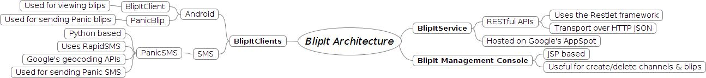
BlipIt Architecture

Slide 12

Developers: Diptanu G & Kiran G
QA: Chethan V
All hands: Kalyan C. Akella

Slide 13


