Slide 1

Natural Language Processing CS6030
SMS SPAM DETECTION
Arunraj M - 2018103011
Muni Raj Kalyan - 2018103044

Slide 2


INTRODUCTION
In recent times messages, reviews and opinions have become a significant source of information.
In this era, Short message service or SMS is considered one of the most powerful means of communication. As the dependence on mobile devices has drastically increased over the period of time it has led to an increased number of attacks in the form of SMS Spam.
In order to deal with such problems, Natural language processing, is used to give valuable insights.
we are now able to extract meaningful information from such data using various NLP techniques.
Natural Language processing is that toolkit which gives machines the ability to read, understand and interpret human language.

Slide 3

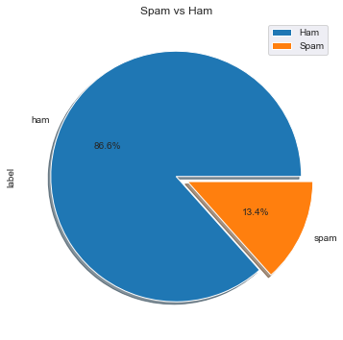

Objectives
The main aim of this project is to build an SMS spam Detection Model. We will build a binary classification model to detect whether a text message is a Spam or not.
Dataset
Collection of more than 5 thousand SMS phone messages.

Slide 4
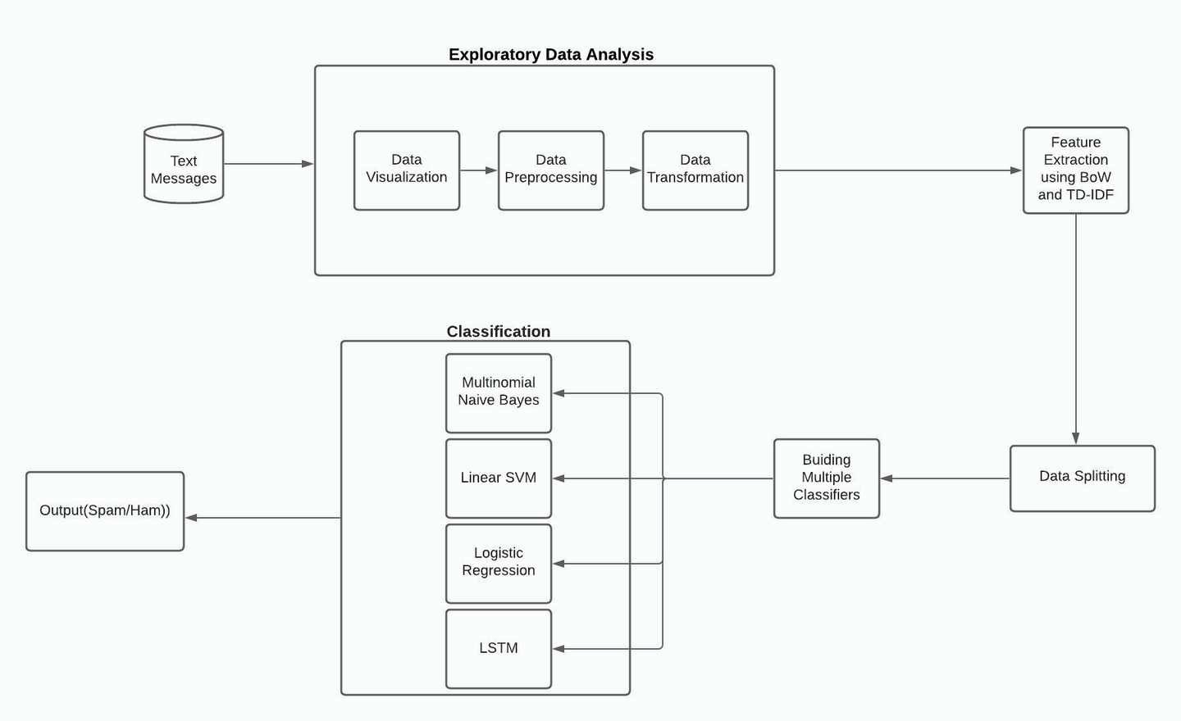
Methodology Diagram

Slide 5
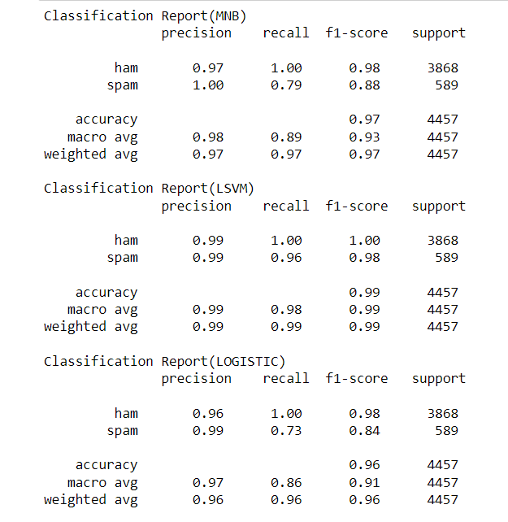
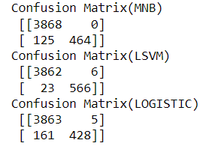
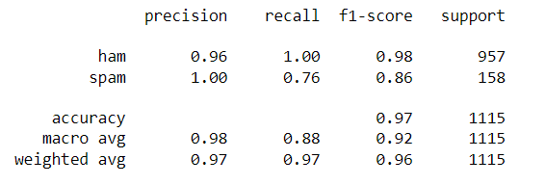



Performance
Training Dataset
Testing Dataset

Slide 6


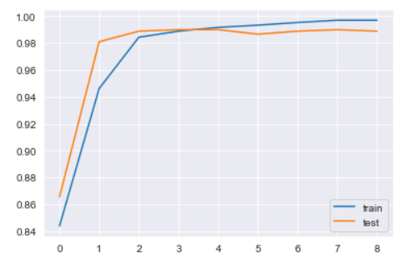
Performance
Training Dataset
Testing Dataset

