Slide 1
Quick start guide to Kaggle – Titanic
By Kunaal NAIK (Lifeaholic)

Slide 2
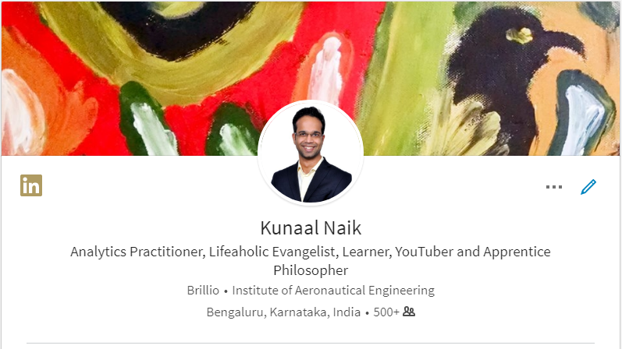


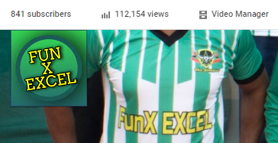
fxexcel@gmail.com
This is me!
Notes:
YouTube channel link
Lifeaholic
Blog link
Add me on LinkedIn
Follow me on Twitter – Give both
Medium Link

Slide 3
My attempt will be to make you fall in love with Analytics.
Kunaal Naik
Guiding Principles:
Does not cover statistics in details. Rather focuses on the problem solving approach and submission to Kaggle.
Primary tool – R and Excel. SAS and Python codes also on GitHub.
Work along session. If you miss out just start from the next topic.

Slide 4
Passion (Why?)
Career Square
Personal Branding
Family and Friends
Learning
LinkedIn
Writing
Raise your standards
Social Media
Finance
YouTube, Lynda – Calendarized
Reading and implementing
Musical Instrument
Travel
Experiments
Jigsaw
Fun X Excel
Work Life Balance
Others
Current job
Relationships
Wife/Girlfriend
Office colleges
Jigsaw Community
Health and Spirituality
Lifeaholic

Slide 5
Kaggle and how to use it smartly
Unless you get exposed to a variety of datasets for Analytics, you will not become confident during your interviews.
What to do on Kaggle?

Slide 6
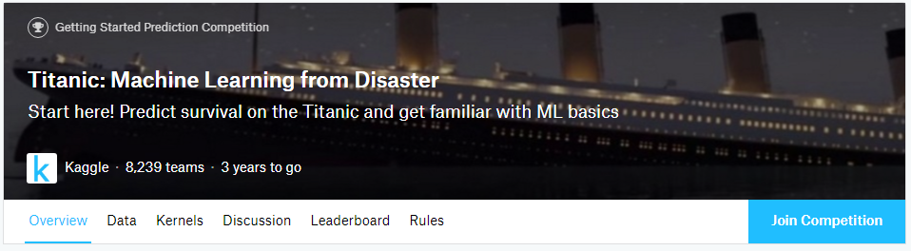
Select a competition – E.g.. Titanic | Read the overview
Join completion
Choose your tool
Download data and get started
You have an option to run the codes on Kaggle itself
Take help from Kernel which are written by participants for others to learn and use
Try and be at least on top 25 in the leaderboard

Slide 7
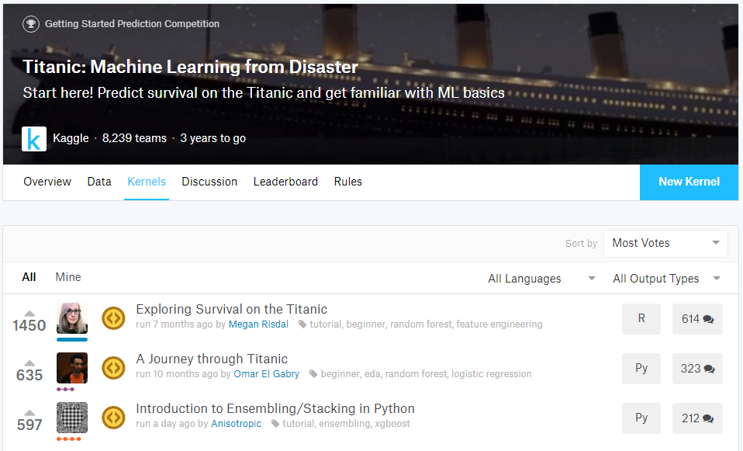
How to start on Kaggle
Go to Kernels
Select the Most Votes(in Sort by)
Choose your preferred Tool (R, Python)
Select the kernel

Slide 8
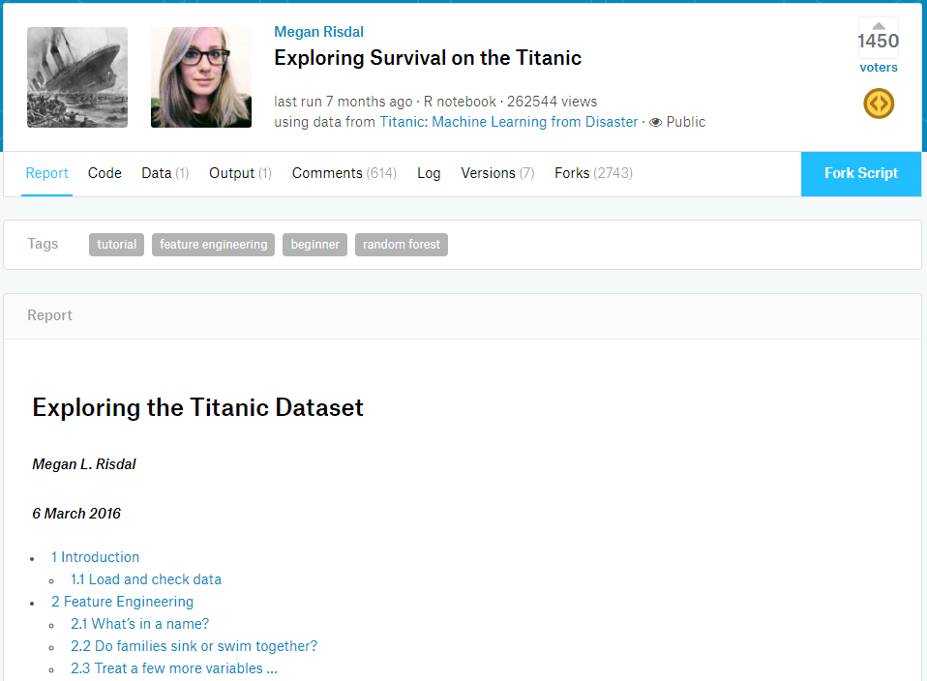
How to start on Kaggle
You find a variety of sections
Each section will have components of the analysis that is required
When you are working in a real environment, the practice given here will give you good clarity
Fork Script – Gives you an option to copy the script and use it for your submissions
Call to action: Create a fork, run as in and make a submission

Slide 9
Process for solving Kaggle problems and making submissions
Everything works like a charm if you have a process!

Slide 11
Yes ! I love to play with data and Analytics Industry is where I belong.
You
If this is your answer lets start the journey on how to brand yourself to be a part of this awesome industry.

Slide 12
How to update your LinkedIn Profile?
LinkedIn – a great platform to create your Personal Brand

Slide 13
Your LinkedIn profile needs multiple iterations
Before it becomes Analytics ready
What you are currently working as will have a strong essence of it on your LinkedIn profile.

Slide 14
Some Interesting Facts on LinkedIn

Slide 15
I saw 1,000 videos on Excel to be good at it!
Thecoolgeek
Learning to play the keyboard [Daily Practice Videos]
Daily Lynda.com – I have done over 30 courses from Lynda and other places

Slide 16
References
Logistic Regression : https://www.kaggle.com/iliasemenov/logistic-regression
Caret Package : http://topepo.github.io/caret/available-models.html
Feature Selection : https://machinelearningmastery.com/feature-selection-with-the-caret-r-package/
Performance Plots : https://machinelearningmastery.com/compare-models-and-select-the-best-using-the-caret-r-package/
Score 0.81 : https://ahmedbesbes.com/how-to-score-08134-in-titanic-kaggle-challenge.html
Score 0.82 : https://www.kaggle.com/pliptor/divide-and-conquer-0-82296/code

Slide 17
It’s all about solving business problems – What tool you use won’t matter!
Kunaal Naik
You personal brand won’t guarantee you a job but it will definitely boost your confidence to get one quick.

Slide 18
Hope you solve many more Kaggle problems!
Kunaal Naik
Remember:
Choose a tool(R/Python) – They are going to be here for next 10 years.
Use Kernels. Find the those that have a high score and understand the methods that worked.
Use Train/Cross Validation before you submit to Kaggle. In real life you wont have a scoring engine like Kaggle to track your score.

Slide 19
fxexcel@gmail.com
Stay in touch!
Notes:
YouTube channel link
Lifeaholic
Blog link
Add me on LinkedIn
Follow me on Twitter – Give both
Medium Link

