Slide 1
Introduction to Algorithms

Slide 2
Algorithms
What is an Algorithm ?

Slide 3
Algorithms
What is an Algorithm ?
Method of solving a problem by a finite sequence of instructions.

Slide 4
Algorithms
Is there a problem for which there can not be an Algorithm ?

Slide 5
Performance of Algorithms
What metric should be used to judge algorithms?
  How many steps does a it take ? (Running time)
  Memory required
Running time is the dominant standard.
  Quantifiable and easy to compare
  Often the critical bottleneck

Slide 6
How long this program takes ?
#include <stdio.h>
void main(){
int i,j,k,n,s;
n=10000;s=2;
for (i=0;i<n;++i)
for (j=0;j<n;++j)
for (k=0;k<n;++k)
s=2*s+1;
printf("%d",s);
}

Slide 7
What is the output ?
#include <stdio.h>
void main(){
int i,j,k,n,a[10000000];
n=1000;
for (i=0;i<n;++i)
for (j=0;j<n;++j)
for (k=0;k<n;++k)
a[i*n*n+j*n+k]=2*i*j*k+1;
}
#include <stdio.h>
void main(){
int i,j,k,n,a[10000000];
n=1000;
for (i=0;i<n;++i)
for (j=0;j<n;++j)
for (k=0;k<n;++k)
a[i*n*n+j*n+k]=2*i*j*k+1;
}

Slide 8
Why Efficient Algorithms Matter ?
Suppose N = 10^8
A PC can process 10N records in 1 sec.
But if some algorithm does N*N computation, then it takes 10M seconds = 110 days!!!
100 City Traveling Salesman Problem.
  A supercomputer checking 100 billion tours/sec still requires 10¹⁰ years!

Slide 9
Asymptotic Notations
Big-O, “bounded above by”: T(n) = O(f(n))
  For some c and N, T(n) ≤ c·f(n) whenever n > N.

Slide 10
Asymptotic Notations
Big-O, “bounded above by”: T(n) = O(f(n))
  For some c and N, T(n) ≤ c·f(n) whenever n > N.
Big-Omega, “bounded below by”: T(n) = Ω(f(n))
  For some c>0 and N, T(n) ≥ c·f(n) whenever n > N.

Slide 11
Asymptotic Notations
Big-O, “bounded above by”: T(n) = O(f(n))
  For some c and N, T(n) ≤ c·f(n) whenever n > N.
Big-Omega, “bounded below by”: T(n) = Ω(f(n))
  For some c>0 and N, T(n) ≥ c·f(n) whenever n > N.
Big-Theta, “bounded above and below”: T(n) = Θ(f(n))
  T(n) = O(f(n)) and also T(n) = Ω(f(n))

Slide 12
There exist positive constants c
such that there is a positive constant n₀
such that …
There exist positive constants c₁ and c₂
such that there is a positive constant n₀
such that …
cg(n)
c₂g(n)
f(n)
f(n)
c₁g(n)
n
n
n₀
n₀
f(n) = Θ( g(n))
f(n) = O( g(n))
There exist positive constants c
such that there is a positive constant n₀
such that …
f(n)
cg(n)
n
n₀
f(n) = Ω( g(n))

Slide 13

Practical Complexity

Slide 14
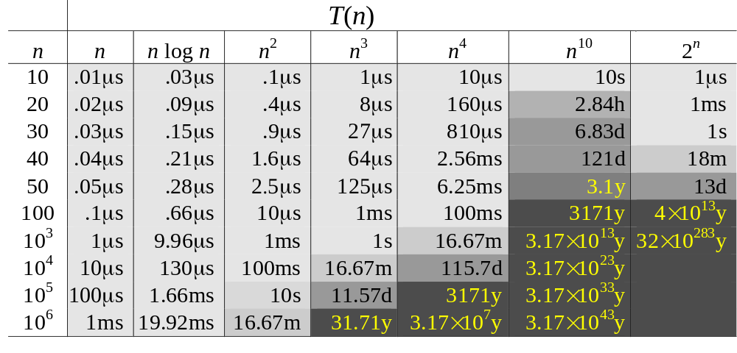
Complexity and Tractability
Assume the computer does 1 billion ops per sec.

Slide 15
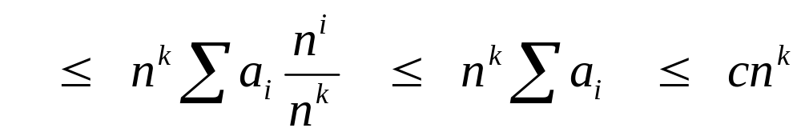
Big O Fact
A polynomial of degree k is O(n^{k})
Proof:
  Suppose f(n) = b_{k}n^{k} + b_{k-1}n^{k-1} + … + b₁n + b₀
    Let a_{i} = | b_{i} |
  f(n) ≤ a_{k}n^{k} + a_{k-1}n^{k-1} + … + a₁n + a₀

Slide 16
Simplifications
Keep just one term!
  the fastest growing term (dominates the runtime)
Asymtotic behavior (as n gets large) is determined entirely by the leading term.
  Example. T(n) = 10 n³ + n² + 40n + 800
    If n = 1,000, then T(n) = 10,001,040,800
    error is 0.01% if we drop all but the n³ term

Slide 17
Runtime Analysis
Two important rules
  Rule of sums
    if you do a number of operations in sequence, the runtime is dominated by the most expensive operation
  Rule of products
    if you repeat an operation a number of times, the total runtime is the runtime of the operation multiplied by the iteration count

