Slide 1

Retail Banking Transaction Analysis
MySQL Business Analytics Project

Slide 2
About Me
• My name is Boga Kalyan
• B.Sc. Physical Science (MPCs) Graduate
• Currently learning Data Science with GenAI
• Interested in solving real-world business problems using data
• Understand how data can support better decision-making
• Build a strong career in data science and analytics
• Team Size: 3 Members
LINKEDIN
https://www.linkedin.com/in/kalyanb
GITHUB
https://github.com/Kalyanboga21
02

Slide 3
Meet Team
B. Kalyan
Background: BSc
Experience: Fresher
LinkedIn:
https://www.linkedin.com/in/kalyanb
GitHub:
https://github.com/Kalyanboga21
K. Mani Kumar
Background: B.Tech
Experience: Fresher
LinkedIn:
https://www.linkedin.com/in/manikum
GitHub:
https://github.com/manikumards
R. Shanoor Basha
Background: BCA
Experience: Fresher
LinkedIn:
https://www.linkedin.com/in/shanoor
GitHub:
https://github.com/Shannu25

Slide 4
Table of Contents
Project Overview
Business Scenario
Business Objectives
Dataset & Database Overview
ER Diagram & Database Structure
Analysis of the Objectives
Overall Key Findings
Business Recommendations
Conclusion
03

Slide 5
Project Overview
PROJECT
ROLE
DATABASE
DATA
Retail Banking Transaction Analysis
Data Analyst
retail_banking
9,140 records
Business-focused SQL analysis
Relational MySQL database
7 related tables
MySQL Business Analytics Project
Project workflow
Business Requirement
Data Understanding
Database Creation
SQL Analysis
Insights & Recommendations
04

Slide 6
Business Scenario
• A retail bank manages customer accounts, transactions, loans, loan payments, and cards across multiple branches.
• The bank generates large volumes of customer and financial data through these banking activities.
• Management needs to understand customer profiles, account usage, transaction behaviour, loan repayment performance, and card engagement.
• SQL is used to analyze this data and identify meaningful patterns and business insights.
• These insights can help the bank improve customer engagement, monitor financial performance, and support better decision-making.
05

Slide 7
Business Objectives
01
Customer Profile & Segmentation
02
Account Usage & Branch Activity
Understand the customer base and differences between customer groups.
Understand account usage across account types and branches.
03
Transaction Patterns
04
Loan Performance & Repayment Behaviour
Analyse how customers use accounts and how money moves through the bank.
Evaluate loan performance and repayment behaviour.
05
Card Usage & Product Engagement
Understand card usage and its relationship with broader banking products.
06

Slide 8
Dataset & Database Overview
Table | Rows | Columns
Customers | 500 | 13
Accounts | 700 | 10
Branches | 40 | 7
Loans | 300 | 13
Loan_Payments | 2,000 | 11
Cards | 600 | 10
Transactions | 5,000 | 10
Total | 9,140 | 74
Database setup
• Database: retail_banking
• Relational database implemented in MySQL
• Primary keys used to uniquely identify records
• Foreign keys used to connect related tables
• CSV data imported and verified before analysis
7 tables • 9,140 records • 74 columns
07

Slide 9
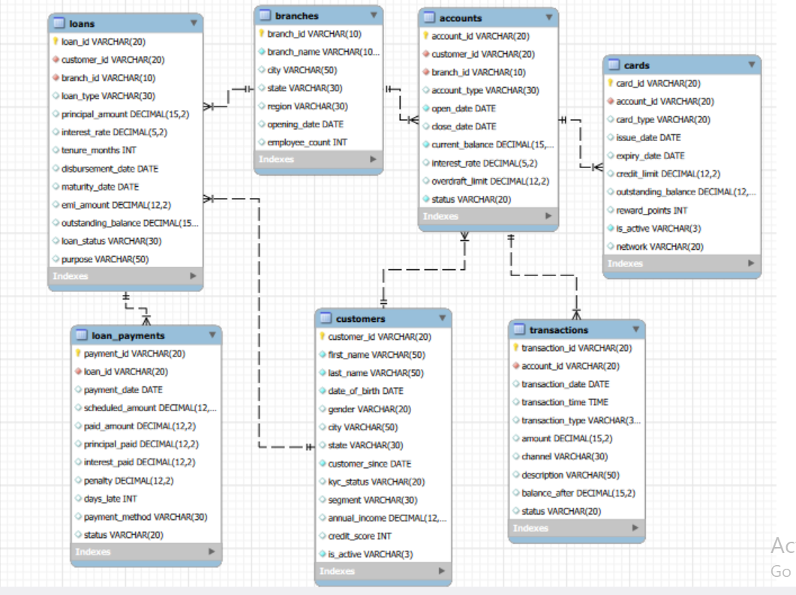
ER Diagram & Database Structure
Key relationships
• Customers → Accounts
• Customers → Loans
• Branches → Accounts
• Branches → Loans
• Accounts → Transactions
• Accounts → Cards
• Loans → Loan_Payments
The database structure supports analysis across customers, products, branches and financial activity.
08

Slide 10

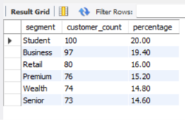

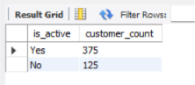
Customer Profile & Segmentation
Who are the bank's customers, and how do segments differ?
1. Customer base: 500 customers are in the dataset, including 375 active and 125 inactive customers.
2. Segment mix: Student is the largest segment with 100 customers (20%), followed by Business with 97.
3. Income profile: Average annual income ranges from $140,525.70 in Retail to $158,667.68 in Premium.
4. Credit profile: Average credit scores are closely grouped, ranging from 679.15 for Student to 687.08 for Retail.
09

Slide 11

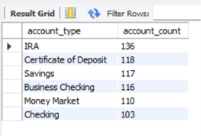

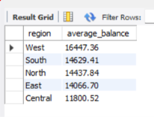
Account Usage & Branch Activity
How are accounts used, and how does activity vary by account type and branch?
1. Account mix: IRA is the most common account type with 136 accounts, while Checking has 103.
2. Balance concentration: IRA has the highest total balance at $2.89M, followed by Certificates of Deposit at $2.60M.
3. Account status: 497 accounts are Active and 203 are Closed, so about 71% of accounts remain active.
4. Regional value: West has the highest average account balance at $16,447.36, while South has the largest account count.
10

Slide 12
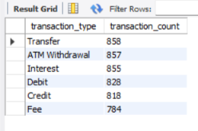

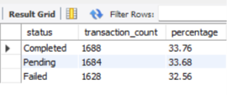
Transaction Patterns
How is money moving through the bank, and how consistently?
1. Transaction volume: The dataset contains 5,000 transactions; Transfer is the most frequent type with 858 transactions.
2. Channel usage: Online is the busiest channel with 1,470 transactions, followed by Branch with 1,144.
3. Transaction status: 1,688 transactions are Completed, while 1,684 are Pending and 1,628 are Failed.
4. Completed value: Completed transactions account for $10.98M in recorded transaction value.
11

Slide 13

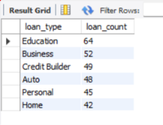






Loan Performance & Repayment Behaviour
Are loan customers repaying as expected?
1. Loan mix: Education loans are the largest category with 64 loans, followed by Business loans with 52.
2. Portfolio exposure: Total outstanding loan balance is $53.44M; Education loans contribute the largest share at $10.94M.
3. Repayment risk: 169 of 300 loans are Defaulted or In Arrears, indicating a significant repayment-risk concentration.
4. Payment behaviour: 500 payments were late, with an average delay of 5.63 days and total penalties of $93,961.47.
12

Slide 14






Card Usage & Product Engagement
How do customers use cards, and how does that connect to their broader relationship with the bank?
1. Card mix: Debit cards are more common than Credit cards, with 358 Debit and 242 Credit cards.
2. Active usage: Only 37 of 600 cards are currently active, while 563 are inactive.
3. Credit utilization: Average utilization across credit cards is approximately 39.70%.
4. Reward engagement: Average reward points are 24,790 for Credit cards and 24,490 for Debit cards.
13

Slide 15
Overall Key Findings
Customers
Accounts
Student is the largest segment (100); Premium has the highest average income ($158.7K).
IRA is the most common account type (136) and holds the highest total balance ($2.89M).
Transactions
Loans
Online is the leading channel (1,470); 1,688 transactions are completed.
Education has the most loans (64) and highest outstanding balance ($10.94M).
Repayments
Cards
500 payments were late; average delay is 5.63 days and penalties total $93,961.47.
Debit cards are more common (358), while average credit-card utilization is 39.70%.
Overall: the analysis reveals clear differences in customer segments, product usage, transaction channels and repayment behaviour that can support targeted banking decisions.
14

Slide 16
Business Recommendations
01
Customer Management
Use segment, income and credit-score patterns to support more targeted product offerings.
02
Branch Management
Review branch-level account activity and workload indicators to support resource allocation.
03
Transaction Management
Monitor dominant channels and transaction statuses; investigate failed or unusual activity.
04
Loan Management
Strengthen early-warning monitoring for repayment delays and focus on loan types with higher late-payment counts.
05
Card Engagement
Use utilization and activity patterns to improve card engagement and identify cross-selling opportunities.
15

Slide 17
Conclusion
The Retail Banking Transaction Analysis project provides a structured view of customers, accounts, branches, transactions, loans, loan repayments and cards.
MySQL was used to build the relational database and perform objective-based analysis across five business areas.
The analysis helps identify customer patterns, account and branch activity, transaction behaviour, loan repayment trends and card engagement.
16

Slide 18
THANK YOU
B. Kalyan | Retail Banking Transaction Analysis

