Slide 1

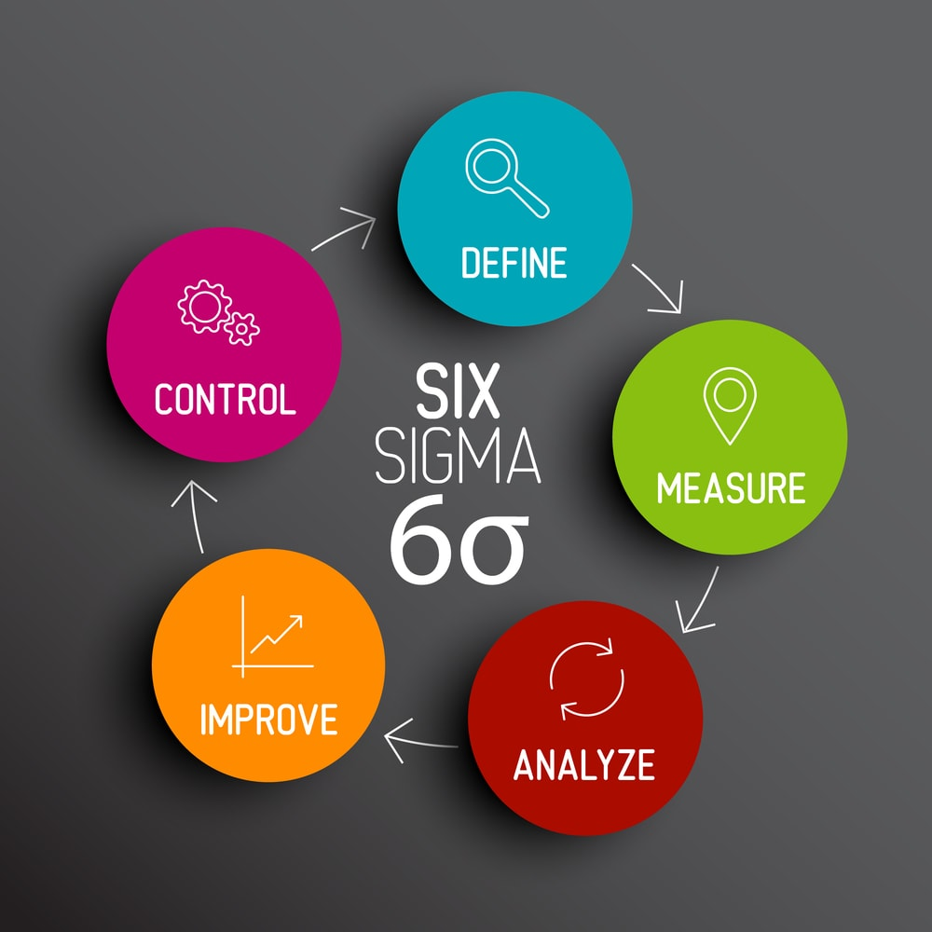

LSS Green Belt Certification Proposal:
Inventory Management Reengineering
Presented by
Yushan Su
Kalyan Chilakamarri
Raj Vyas
Henna Shah
Li Wei Cheng

Slide 2



Executive Summary
The objective of this project was to enhance inventory planning process by utilizing advanced techniques, standardizing sales cycles, and providing recommendations to improve brand image
The project utilized the ARIMA (AutoRegressive Integrated Moving Average) model to forecast future demand and optimize inventory levels
Built a dashboard to visualize the forecasted demand and inventory levels, making it easier for stakeholders to make data-driven decisions
Resulted in 85% reduction in process time, a quarterly cost savings of $2,000, and effective reduction of wastage and holding costs

Slide 3
About Bev International Food Corporation
Established first Boba tea shop in 2013, which became the most popular beverage store in Arizona
Utilized experiences and relevant data from Tea Swirl to operate BEV International Food Crop. smoothly and successfully
2
3
1
3
4
5
Largest Taiwanese Boba tea and food ingredient supplier in Arizona
Successfully catered to both Asian and Caucasian customers by redeveloping flavors
Has a strong ability to capture tasting trends in the Boba tea market and steadily increasing customer base.

Slide 4
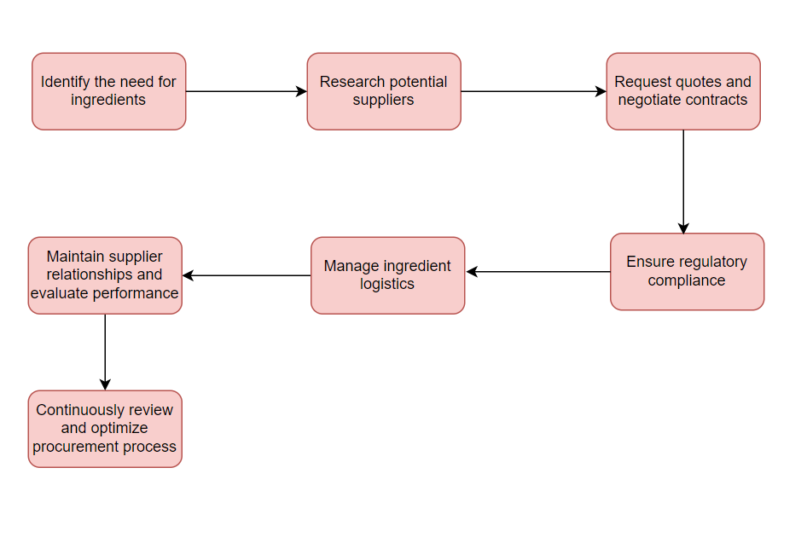
Company Operation Flow

Slide 5
DEFINE

Slide 6
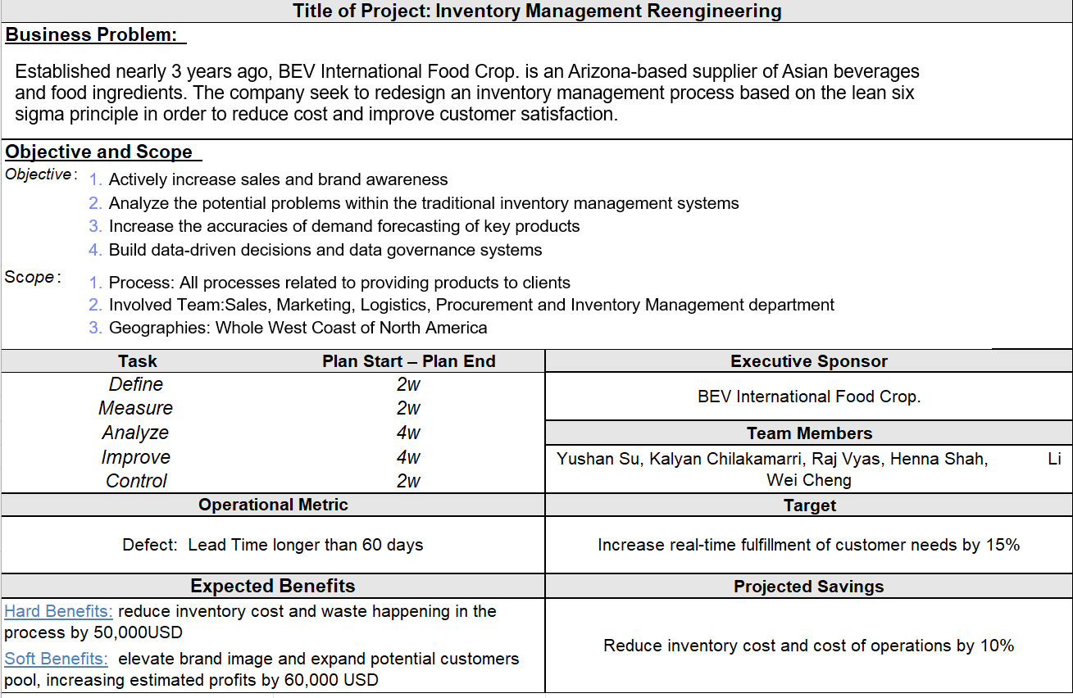
Project Charter

Slide 7
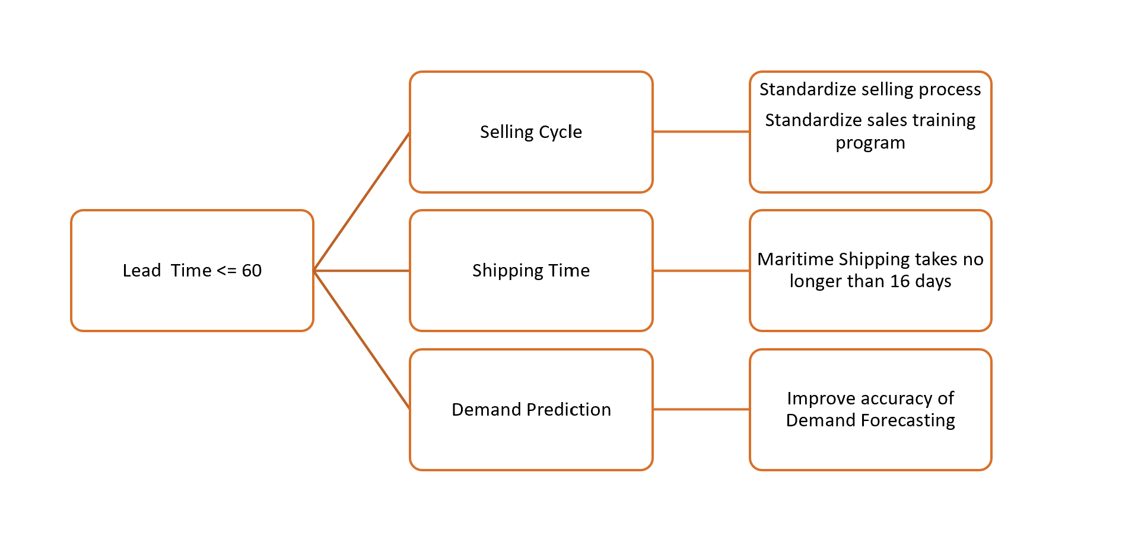
CTQ Tree

Slide 8
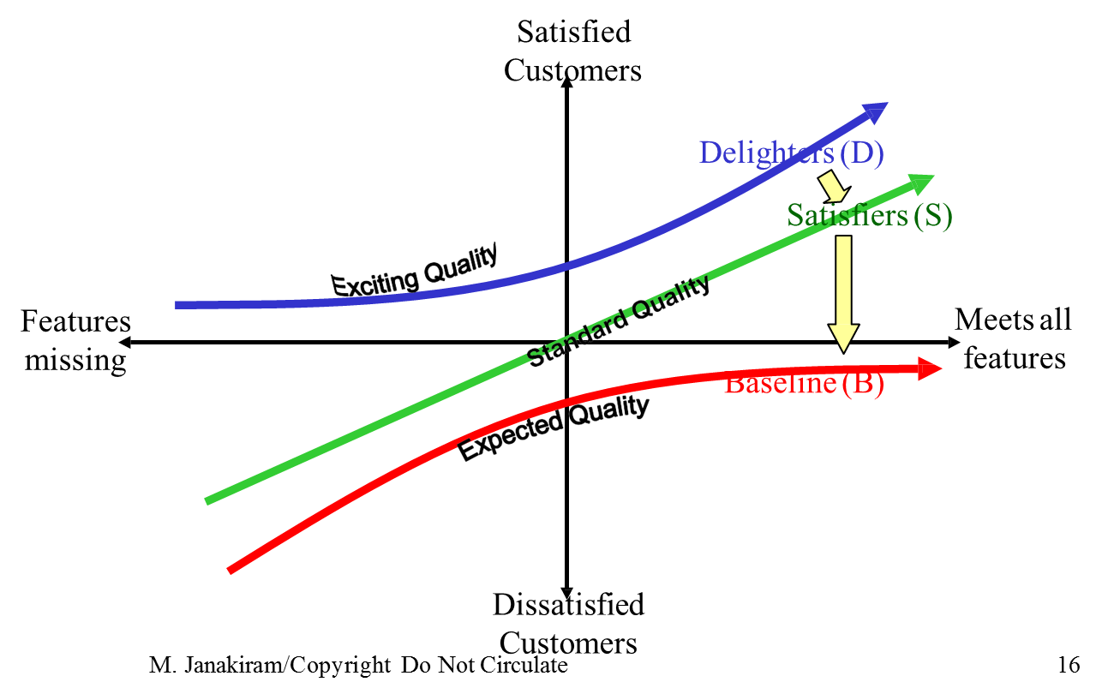
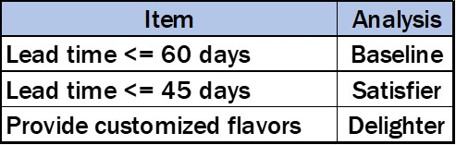
Quick Win Opportunities
Use current dataset to contact potential customers and retain customers.
Improve customer service to relieve customers’ unsatisfactory.

Slide 9
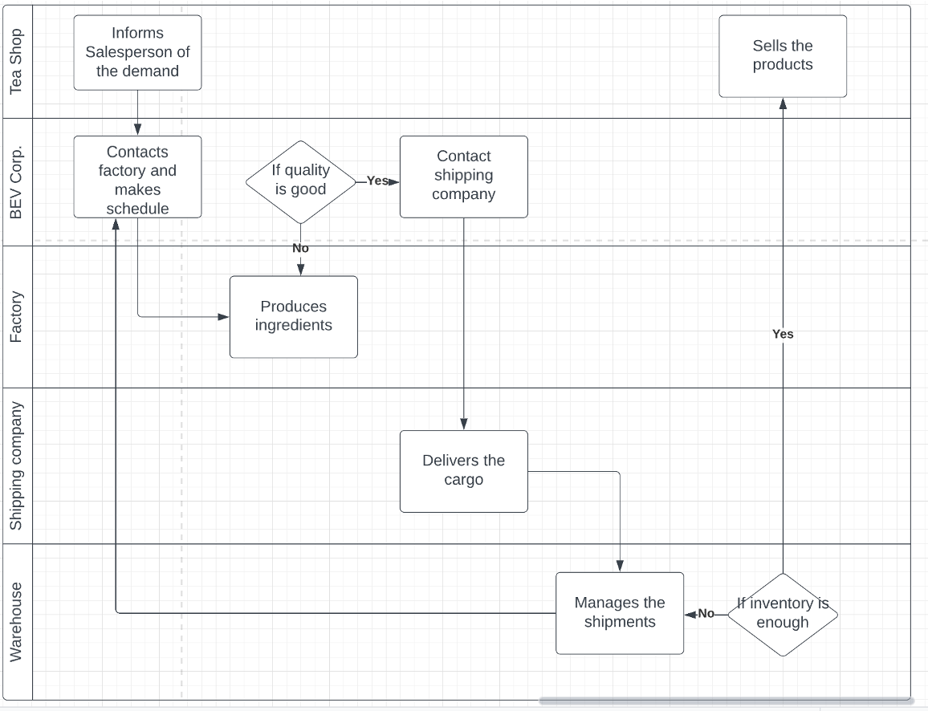
SwimLane

Slide 10
MEASURE

Slide 11
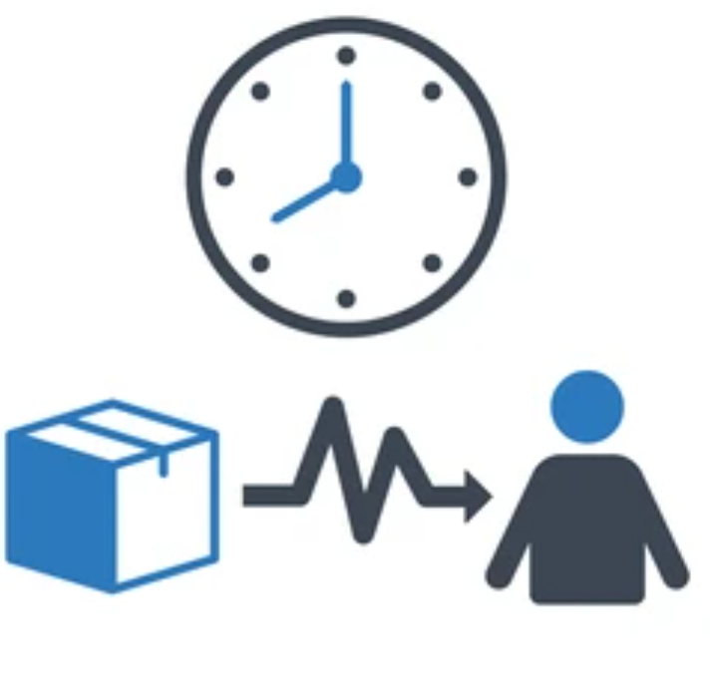

Basic Metric and KPI
Lead Time
Inventory Process Time

Slide 12

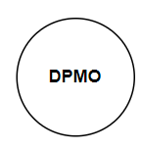


DPMO
Bev International Food Corporation approximately receives 1000 sales orders across 20 products in each quarter
On average, 20 orders are not delivered within the lead time
Average Defects = 20
Average Order = 1000
20000
Currently functioning at 3-4

Slide 13
ANALYZE

Slide 14
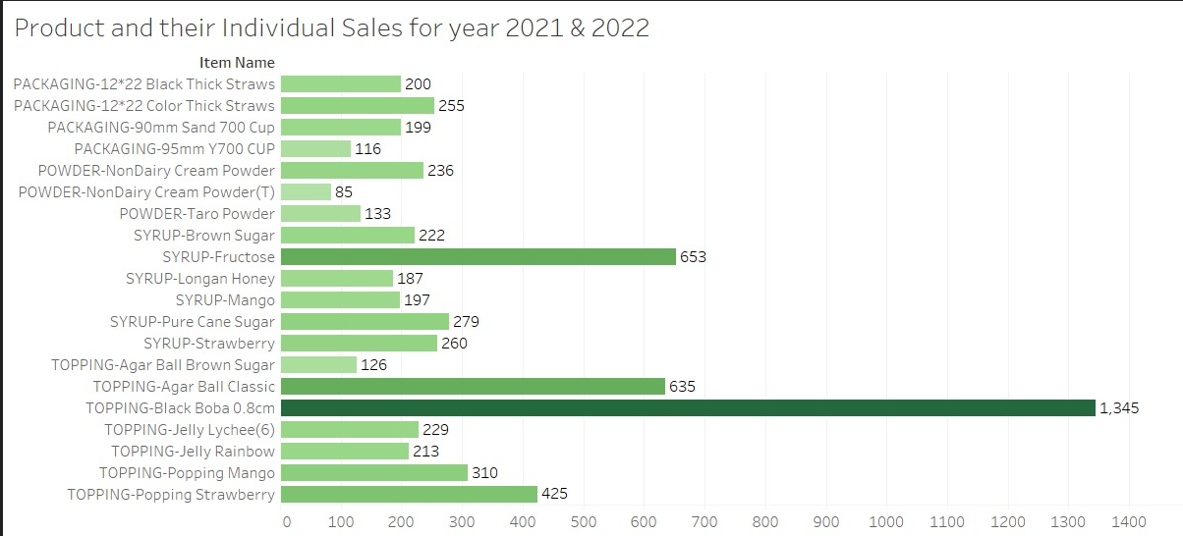
Product Analysis
Overall Product Sales

Slide 15
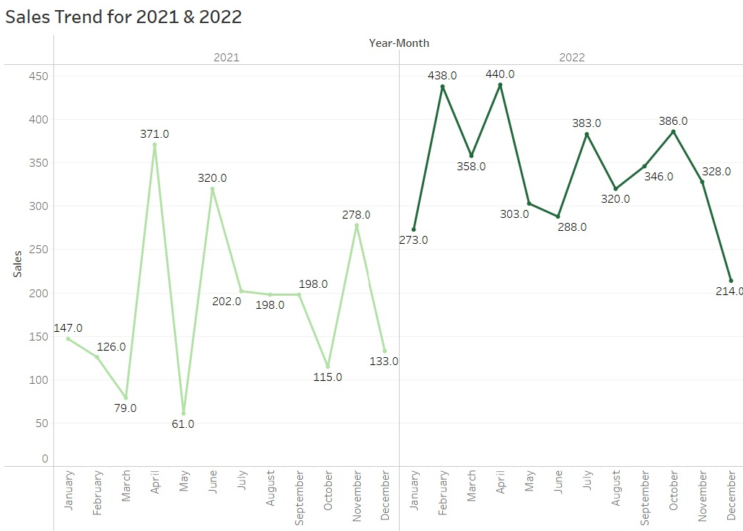
Product Analysis

Slide 16
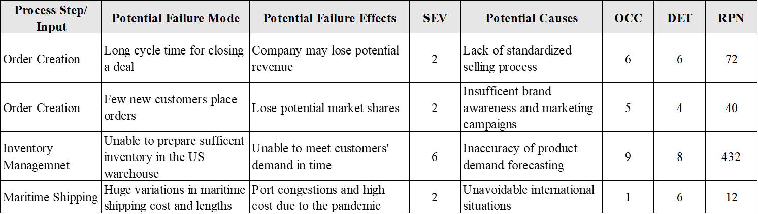
Failure Mode & Effects Analysis (FMEA)

Slide 17
IMPROVE

Slide 18
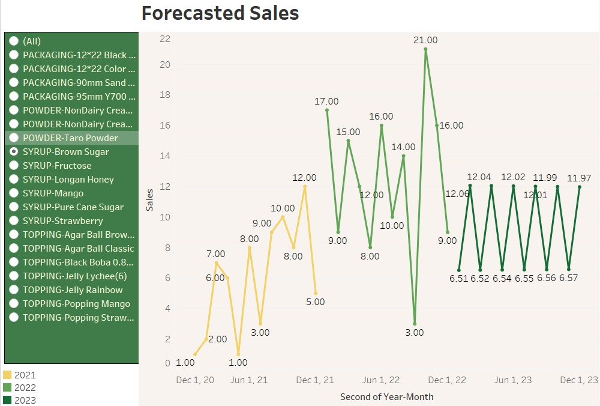
Recommendations
Ensure that a company's supply of products meets the customers' demand on time
ARIMA MODEL
ARIMA (Autoregressive Integrated Moving Average) model is a popular time series forecasting method used to model and predict future values based on historical data.
It is a statistical model that combines autoregression, integration, and moving average processes.

Slide 19
Recommendations
Use SCFI index (Shanghai Containerized Freight Index) and relevant information to predict future shipping costs
Place the shipment booking during the off-season as peak seasons usually fall in the 2nd half of the year
Choose the most economical route and check if the shipping schedule can fit the estimated delivery date
Prices between forwarders might be charged very differently. Carefully selecting an authentic partner can save up a big amount

Slide 20
Recommendations
Establish Standardized Selling Process
1. Provide sales training program to new salesperson.
2. Establish Standardized Sales Process, compiling into brochures
3. New salesperson will be assigned a mentor in the first 3 months
4. Require salesperson to develop at least 2 customers each quarter and revisit at least 5 existing or
former customers every month
5. Salesperson should attend relevant exhibitions to explore potential customers.
6. After receiving new potential customers inquiry from official website or phone call, salesperson
must reply with 24 hours.
7. Salesperson should meet the new potential customer in person within 2 weeks after receiving
potential customers’ inquiry
8. Internal sales meeting should be held every 2 weeks to update the new product info and sales talk

Slide 21
Recommendations
Actively increase sales and brand awareness
1
2
3
4
5
6
Partner with businesses
Attend trade shows
Run Social Media Campaigns
Offer Customization
Focus on packaging
Build Green Supply Chain

Slide 22
CONTROL

Slide 23
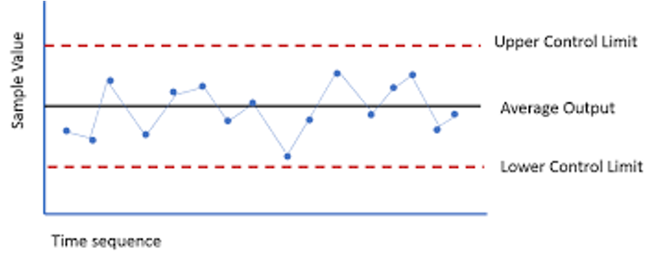
Control Chart
Process Average : In general, 15 days of shipping time can be expected from Asia to Los Angeles port.
Sample size : Assume Bev International Food Corporation plans to ship their ingredients once a month. Given it’s a 2-years span data, hence sample size = 24
Std Error : Assume StdDev is 7 days, Std Error = 7/√ 24 = 1.429 days
Upper Limit : 15 + 3 (1.429) = 19.29 days
Lower Limit : 15 - 3 (1.429) = 10.71 days
Control limits | Value
UCL | 19.29
CL | 15
LCL | 10.71

Slide 24
Control Plan
1
2
3
4
Process
Monitoring
Identify key process inputs, outputs, and variables
Response Plan
Identify potential process failures or deviations
Establish a clear escalation and notification system
Training Plan
Identify Knowledge gaps
Develop training materials
Standardization Plan
Identify best practices and standard operating procedures
Develop a system for documenting and communicating standards

Slide 25
Thank you!

