Slide 1
Commerce Shipping Analysis
Submitted By :-
KALYANI ARCHIT PATEL

Slide 2
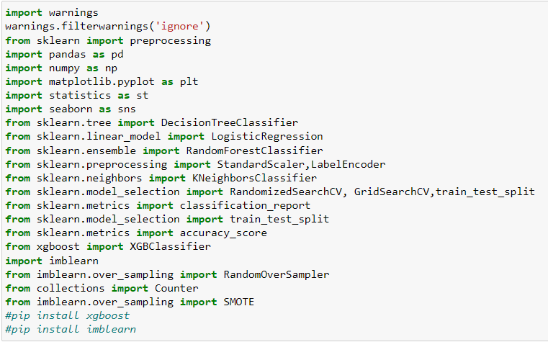
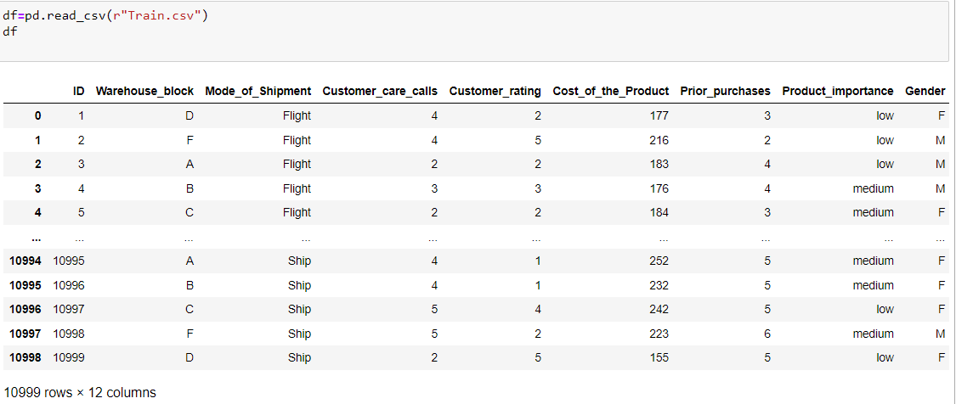
Import all Libraries
Display the Dataset

Slide 3

Exploratory Data Analysis (EDA).

Slide 4
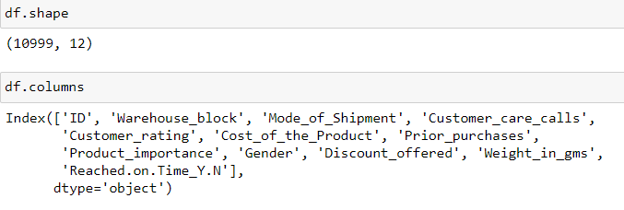
No. of rows and columns and list of columns in the dataset

Slide 5
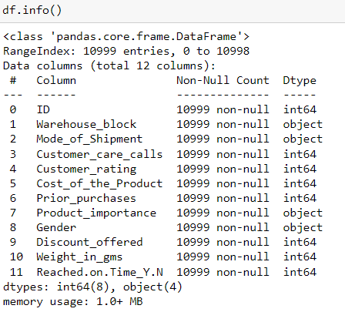
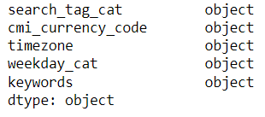
Data Types of all columns before EDA

Slide 6
Description of columns
1. ID: ID Number of Customers.
2. Warehouse block: The Company have big Warehouse which is divided in to block such as A,B,C,D,E.
3. Mode of shipment:The Company Ships the products in multiple way such as Ship, Flight and Road.
4. Customer care calls: The number of calls made from enquiry for enquiry of the shipment.
5. Customer rating: The company has rated from every customer. 1 is the lowest (Worst), 5 is the highest (Best).
6. Cost of the product: Cost of the Product in US Dollars.
7. Prior purchases: The Number of Prior Purchase.
8. Product importance: The company has categorized the product in the various parameter such as low, medium, high.
9. Gender: Male and Female.
10. Discount offered: Discount offered on that specific product.
11. Weight in gms: It is the weight in grams.
12. Reached on time: It is the target variable, where 1 Indicate that the product has NOT reached on time and 0 indicates it has reached on time.

Slide 7
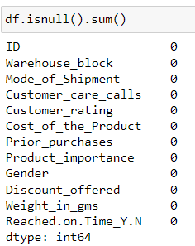
Finding Missing values
Here we Find that there are no missing values

Slide 8
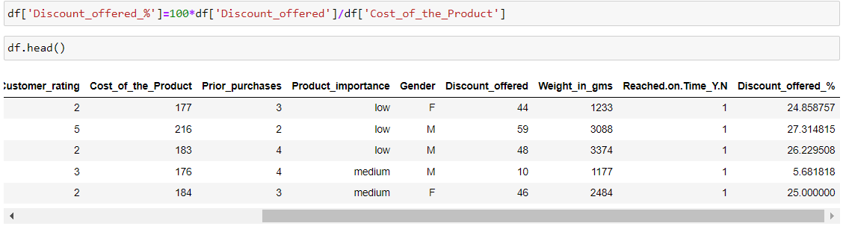
Adding new column as discount offer in percentage
Here this Discount offered% column is calculated by
“Discount offered%” = (“Discount-offered” / “Cost of the product”) x 100

Slide 9
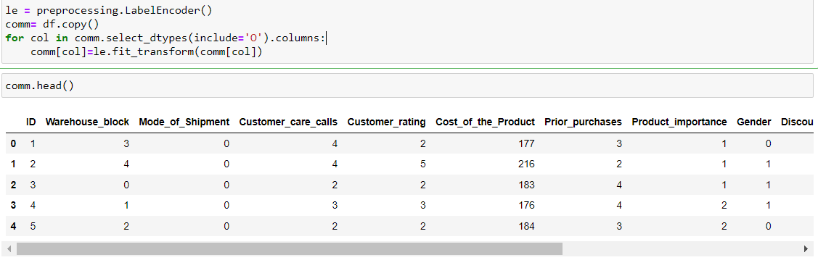
Label Encoding
Here We use Label encoding is a technique used in machine learning to convert categorical data into numerical format.
Warehouse block , Mode of Shipment ,Product importance , Gender this columns are converted to numerical format.

Slide 10
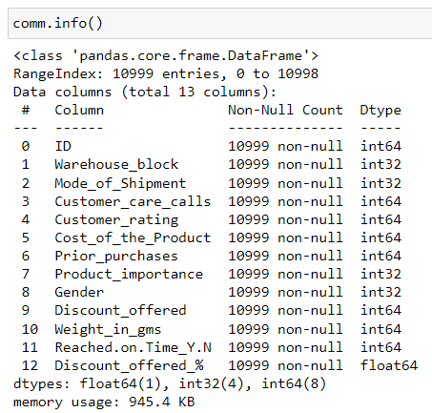
Compare changes Before and After EDA
Before EDA
After EDA

Slide 11


Slide 12

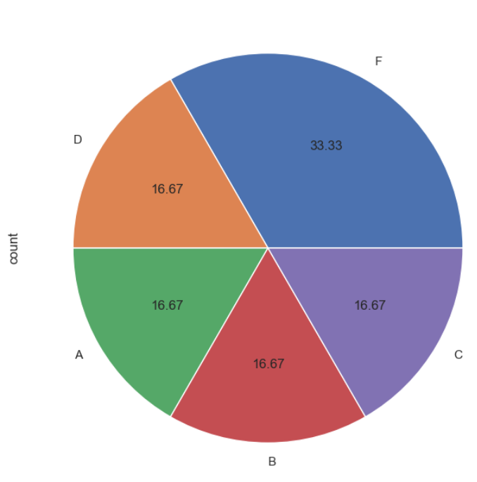
Warehouse_block Feature
It can be seen that warehouse block F dominates our data

Slide 13
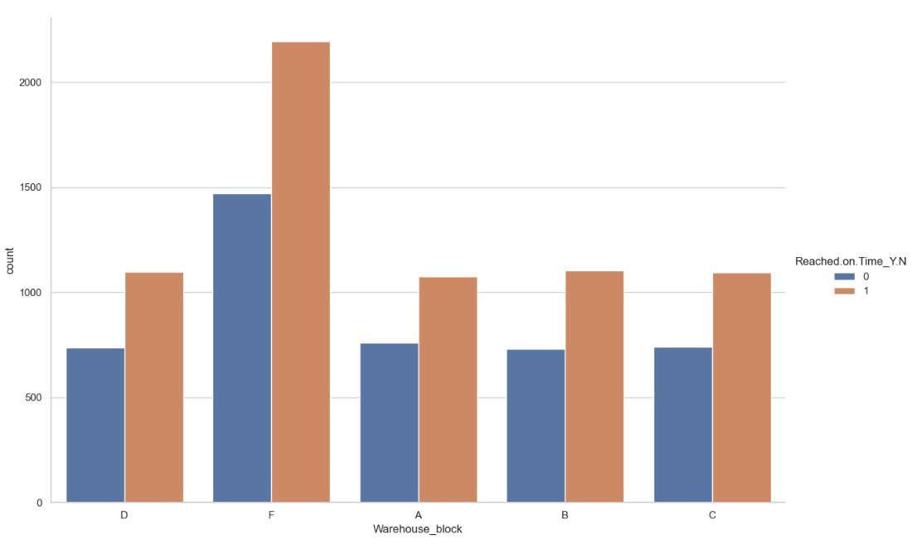
We can see from above that products that have been delivered to warehouse block F are not reached on time the most.

Slide 14

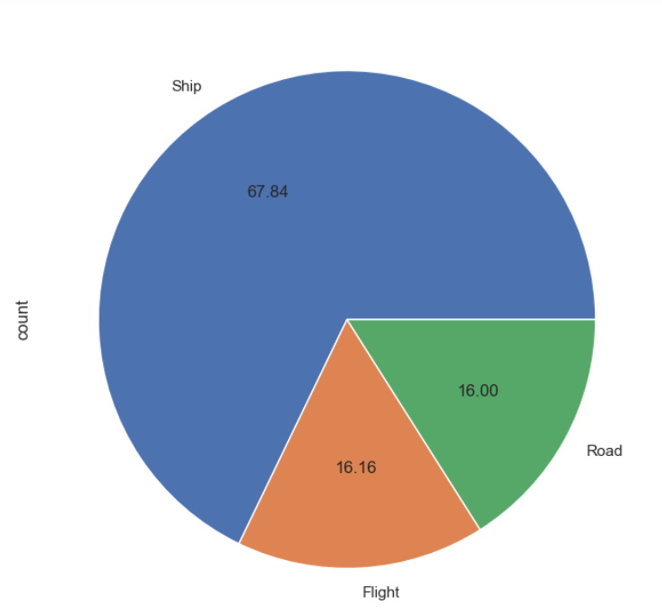
Mode_of_Shipment Feature
We can see the number of products sent by ship is more than the products sent by other modes of transportation

Slide 15
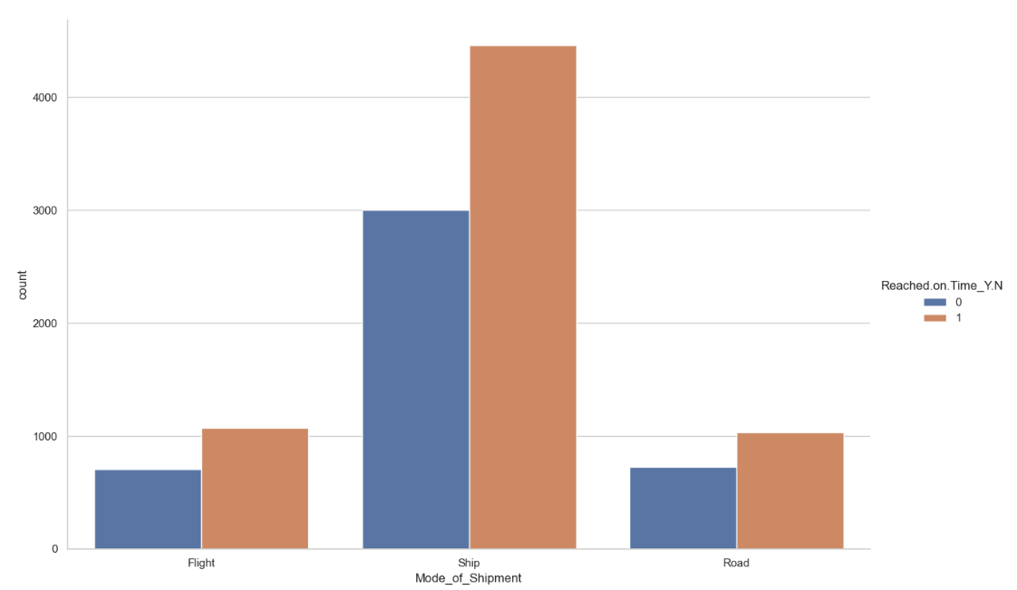
And of course, the delivery of products using ships are later to arrive to customers.

Slide 16
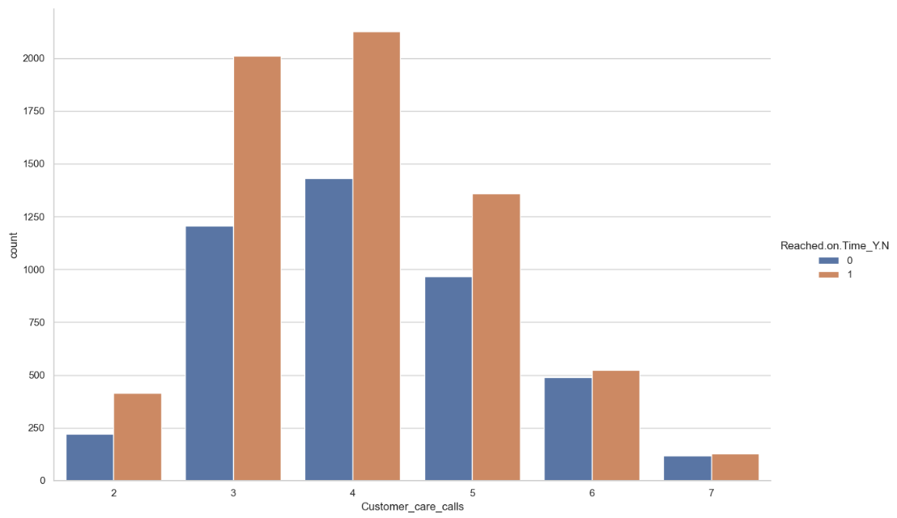
Customer_care_calls Feature
We can see the number of customer care calls is dominated by 4 calls and from those 4 calls, the products related dominated the number of products which didn't arrive on time

Slide 17
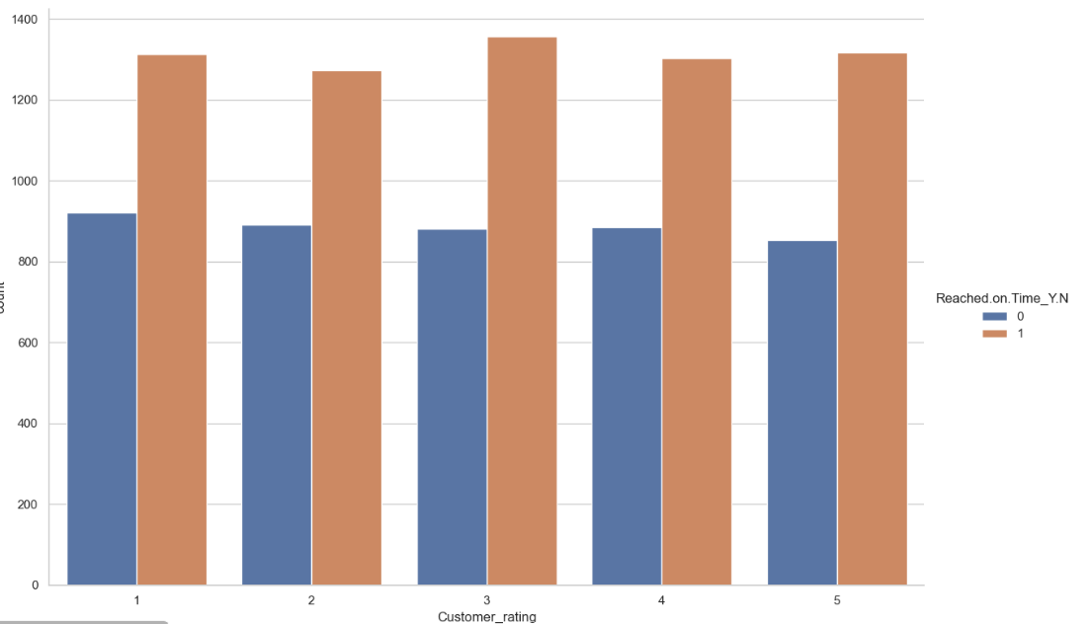
Customer_rating Feature
Almost all ratings are equal in number.

Slide 18

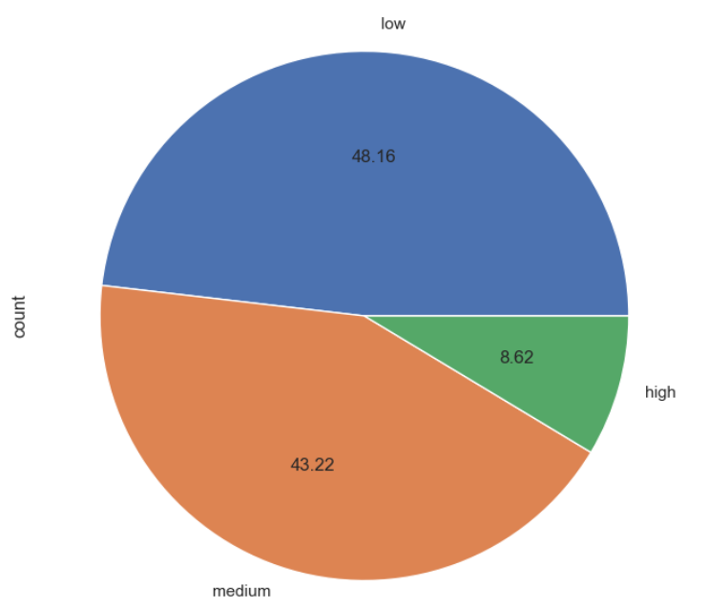
Product_importance Feature
As usual, our data is dominated by products with low importance levels. Data of products with high importance level is the least.

Slide 19
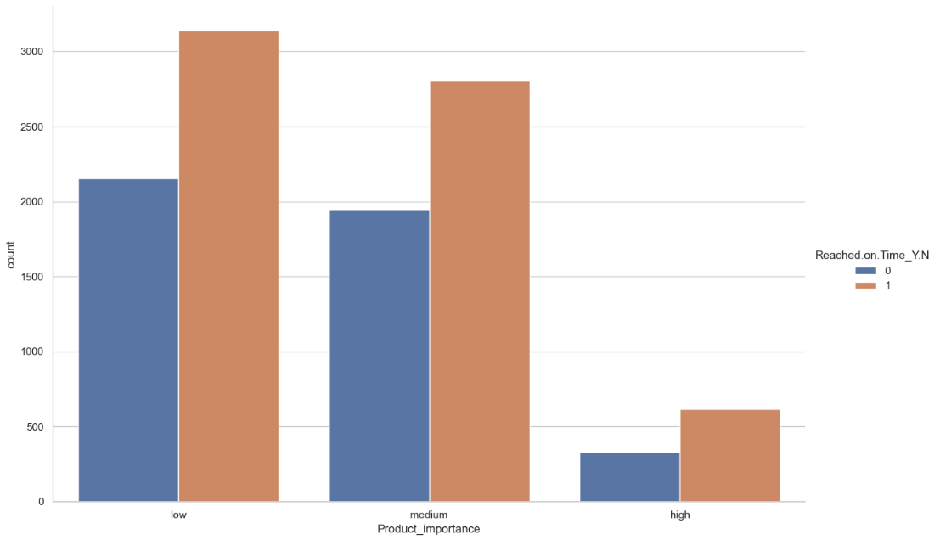
And of course, products with a low level of importance tend to arrive late to customers.

Slide 20

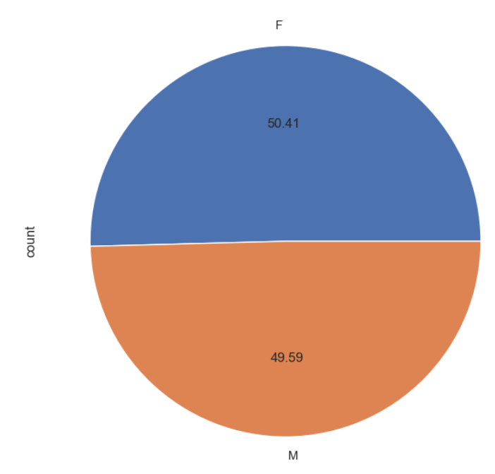
Gender Feature
Our data is almost equal in gender context. Males and females are equal in our data.

Slide 21


Slide 22
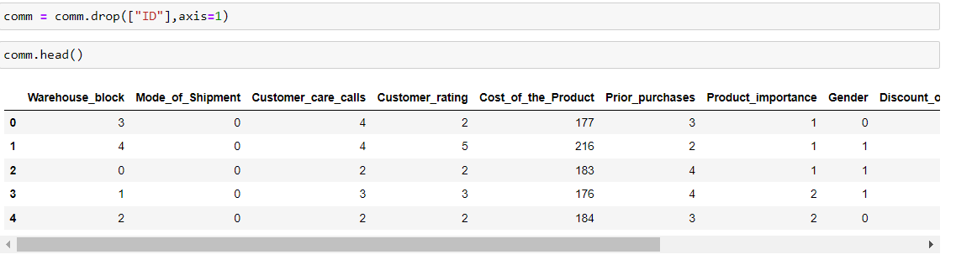
Data Preprocessing
1. Removing Unnecessary Feature

Slide 23
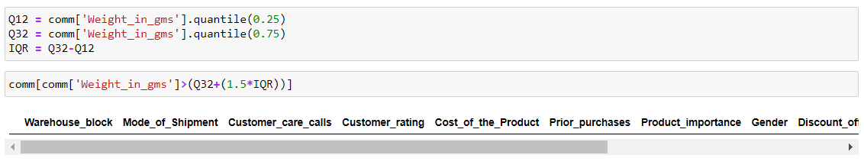
Data Preprocessing
2. Checking For Outlier
It seems that no outliers are detected in the Weight_in_gms data feature

Slide 24
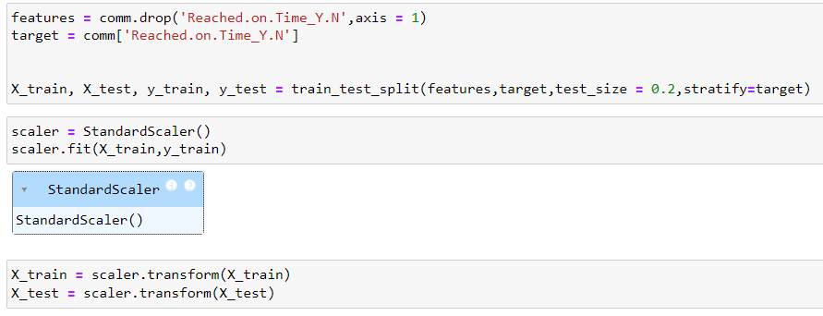
Split the data into features , target variable, test and train dataset and applying Feature Scaling
We Split the data into 2 parts as Features & Target
Then this 2 variables are again divided into 2 parts namely Train which contain 80% data and Test which contain 20% data
Apply Standard Scaling as well

Slide 25

Machine Learning Models

Slide 26
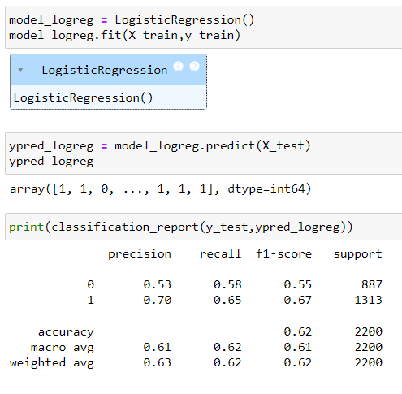
Logistic regression Model

Slide 27
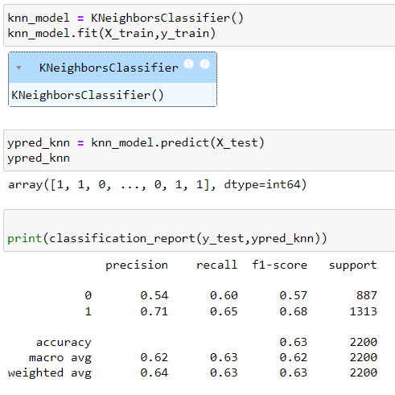
k Near Neighbors Model

Slide 28
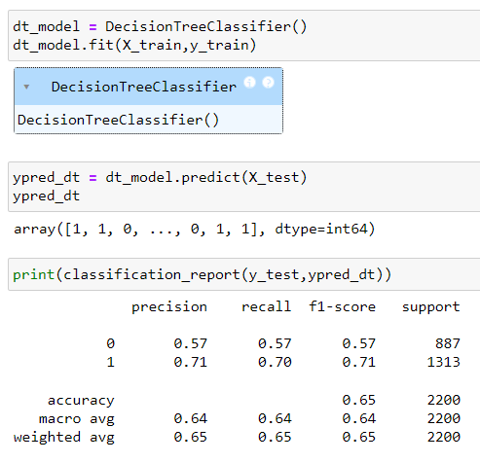
Decision Tree Model

Slide 29
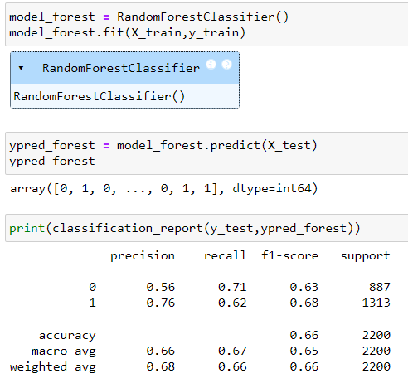
Random Forest Model

Slide 30
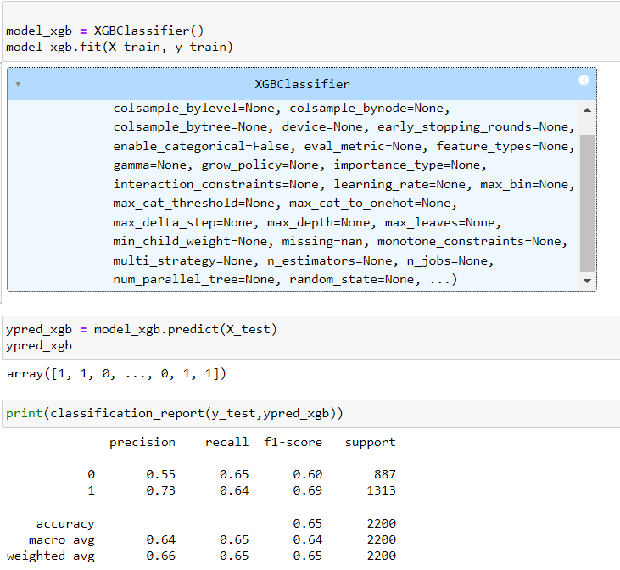
Extreme Gradient Boosting Model

Slide 31
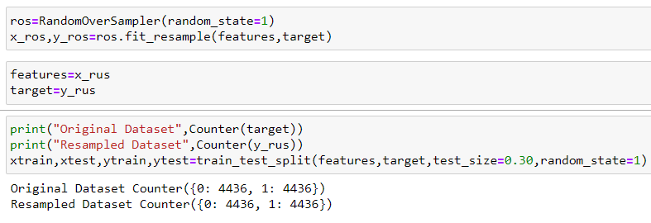
Accuracy of Model is low so we oversample the data

Slide 32
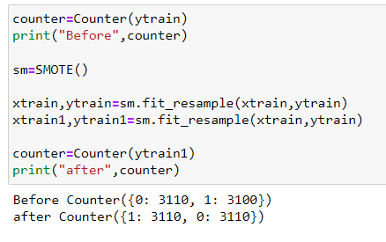
Smote Algorithm

Slide 33
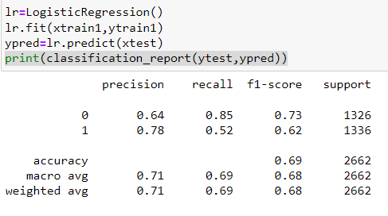
Logistic Regression Model (Oversampled data)

Slide 34
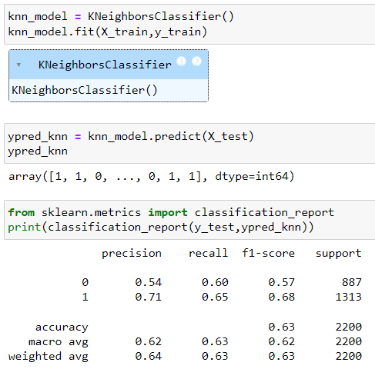
k Near Neighbors Model (Oversampled data)

Slide 35
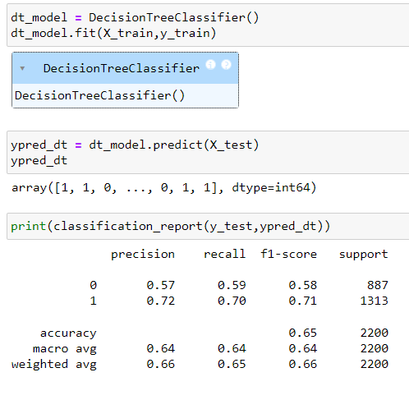
Decision Tree Model (Oversampled data)

Slide 36
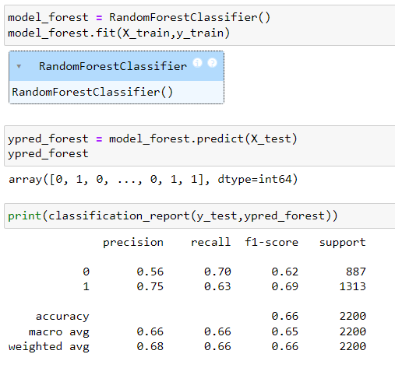
Random Forest Model (Oversampled data)

Slide 37
Conclusion
Our journey through machine learning techniques has led us to a significant discovery: the logistic regression model has proven to be the most accurate in our analysis. The logistic regression model has given me the best accuracy.

Slide 38


