Slide 1
Introduction to Software Engineering
Ms. Sujata P. Kangune

Slide 2
Contents
Overview of Software Engineering
1.1. Overview of Software Engineering
1.2. SDLC models
1.3. Requirement Engineering
1.3.1. Types of Requirements: -Functional and Non-functional
1.3.2. Four Phases of Requirement Engineering
1.4. Software requirement Specification (SRS)
1.4.1. Structure and contents of SRS
1.4.2. IEEE SRS Format
Case studies : based on SRS

Slide 3
Software
Software is a program or set of programs containing instructions that provide the desired functionality. Engineering is the process of designing and building something that serves a particular purpose and finds a cost-effective solution to problems.

Slide 4
Software Engineering is the process of designing, developing, testing, and maintaining software.

Slide 5
Software engineering includes requirements analysis, design, testing, and maintenance.
It focuses mainly on large software systems, not just single programs.
The field is rapidly evolving with new tools and technologies.
The main goal is to develop high-quality, reliable, and maintainable software.
It ensures software is delivered on time, within budget, and meets requirements.
Software engineering improves quality, budget management, and time efficiency.

Slide 6
Key Principles of Software Engineering
Modularity: Breaking the software into smaller, reusable components that can be developed and tested independently.
Abstraction: Hiding the implementation details of a component and exposing only the necessary functionality to other parts of the software.
Encapsulation: Wrapping up the data and functions of an object into a single unit, and protecting the internal state of an object from external modifications.
Reusability: Creating components that can be used in multiple projects, which can save time and resources.

Slide 7
Maintenance: Regularly updating and improving the software to fix bugs, add new features, and address security vulnerabilities.
Testing: Verifying that the software meets its requirements and is free of bugs.
Design Patterns: Solving recurring problems in software design by providing templates for solving them.
Agile methodologies: Using iterative and incremental development processes that focus on customer satisfaction, rapid delivery, and flexibility.
Continuous Integration & Deployment: Continuously integrating the code changes and deploying them into the production environment.

Slide 8
Main Attributes of Software Engineering
Efficiency: It provides a measure of the resource requirement of a software product efficiently.
Reliability: It assures that the product will deliver the same results when used in similar working environment.
Reusability: This attribute makes sure that the module can be used in multiple applications.
Maintainability: It is the ability of the software to be modified, repaired, or enhanced easily with changing requirements.

Slide 9
Dual Role of Software
1. As a Product
It delivers computing potential across networks of Hardware.
It enables the Hardware to deliver the expected functionality.
It acts as an information transformer because it produces, manages, acquires, modifies, displays, or transmits information.

Slide 10
2. As a Vehicle for Delivering a Product
It provides system functionality (e.g., payroll system).
It controls other software (e.g., an operating system).
It helps build other software (e.g., software tools).

Slide 11
Objectives of Software Engineering
Maintainability: It should be feasible for the software to evolve to meet changing requirements.
Efficiency: The software should not make wasteful use of computing devices such as memory, processor cycles, etc.
Correctness: A software product is correct if the different requirements specified in the SRS Document have been correctly implemented.
Reusability: A software product has good reusability if the different modules of the product can easily be reused to develop new products.
Testability: Here software facilitates both the establishment of test criteria and the evaluation of the software concerning those criteria.

Slide 12
Reliability: It is an attribute of software quality. The extent to which a program can be expected to perform its desired function, over an arbitrary time period.
Portability: In this case, the software can be transferred from one computer system or environment to another.
Adaptability: In this case, the software allows differing system constraints and the user needs to be satisfied by making changes to the software.
Interoperability: Capability of 2 or more functional units to process data cooperatively.

Slide 13
What Careers Are There in Software Engineering?
SWE (Software Engineer)
SDE ( Software Development Engineer)
Web Developer
Quality Assurance Engineer
Web Designer
Software Test Engineer
Cloud Engineer ·
Front-End Developer
Back-End Developer
DevOps Engineer.
Security Engineer.

Slide 14
What Tasks do Software Engineers do?
Requirement Analysis: Collaborating with stakeholders to understand and gather the requirements to design and develop software solutions.
Design and Development: Creating well-structured, maintainable code that meets the functional requirements and adheres to software design principles.
Testing and Debugging: Writing and conducting unit tests, integration tests, and debugging code to ensure software is reliable and bug-free.

Slide 15
Code Review: Participating in code reviews to improve code quality, ensure adherence to standards, and facilitate knowledge sharing among team members.
Maintenance: Updating and maintaining existing software systems, fixing bugs, and improving performance or adding new features.
Documentation: Writing clear documentation, including code comments, API documentation, and design documents to help other engineers and future developers understand the system.

Slide 16
What Skills do Software Engineers Need?
Following are some must have technical skills to become Software Engineers:
Coding and computer programming
Software testing
Object-oriented design (OOD)
Software development

Slide 17
Following are some must have soft skills to become Software Engineers:
Communication skills
Team player
Problem solving
Attention to detail

Slide 18
Program vs Software Product
Parameters | Program | Software Product
Definition | A program is a set of instructions that are given to a computer in order to achieve a specific task. | Software is when a program is made available for commercial business and is properly documented along with its licensing. Software Product = Program + Documentation + Licensing.
Stages Involved | Program is one of the stages involved in the development of the software. | Software Development usually follows a life cycle, which involves the feasibility study of the project, requirement gathering, development of a prototype, system design, coding, and testing.

Slide 19
Software Development Life Cycle (SDLC)

Slide 20
Introduction
Software Development Life Cycle (SDLC) is a structured process that is used to design, develop, and test high-quality software.
SDLC, or software development life cycle, is a methodology that defines the entire procedure of software development step-by-step.
The goal of the SDLC life cycle model is to deliver high-quality, maintainable software that meets the user's requirements.

Slide 21
What is the Software Development Life Cycle (SDLC)?
SDLC is a process followed for software building within a software organization.
SDLC consists of a precise plan that describes how to develop, maintain, replace, and enhance specific software.
The life cycle defines a method for improving the quality of software and the all-around development process.

Slide 22
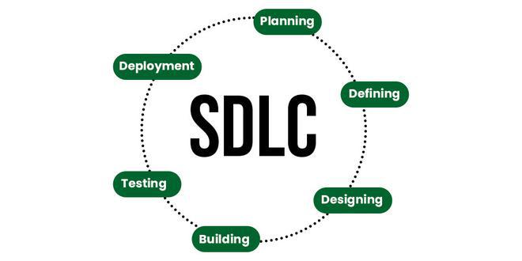

Slide 23
Stages of the Software Development Life Cycle
SDLC specifies the tasks to be performed at various stages by a software engineer or developer.
It ensures that the end product is able to meet the customer's expectations and fits within the overall budget.
Hence, it's vital for a software developer to have prior knowledge of this software development process.
SDLC is a collection of these six stages, and the stages of SDLC are as follows:

Slide 24
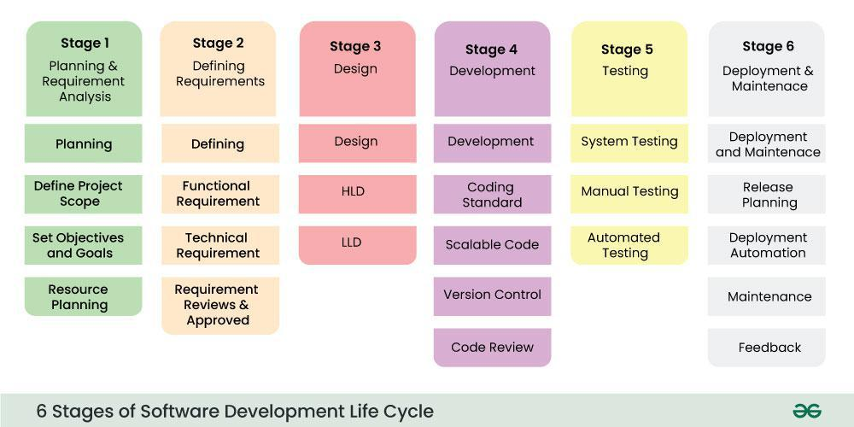

Slide 25
Stage 1: Planning and Requirement Analysis
Planning is a crucial step in everything, just as in software development.
In this same stage, requirement analysis is also performed by the developers of the organization.
This is attained from customer inputs, and sales department/market surveys.
The information from this analysis forms the building blocks of a basic project.
The quality of the project is a result of planning. Thus, in this stage, the basic project is designed with all the available information.

Slide 26
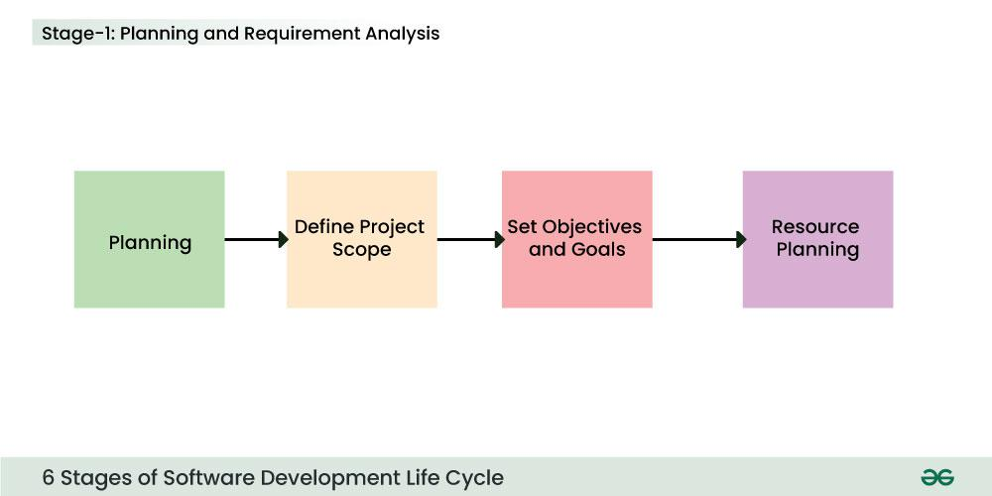

Slide 27
Stage 2: Defining Requirements
In this stage, all the requirements for the target software are specified.
These requirements get approval from customers, market analysts, and stakeholders.
This is fulfilled by utilizing SRS (Software Requirement Specification).
This is a sort of document that specifies all those things that need to be defined and created during the entire project cycle.

Slide 28
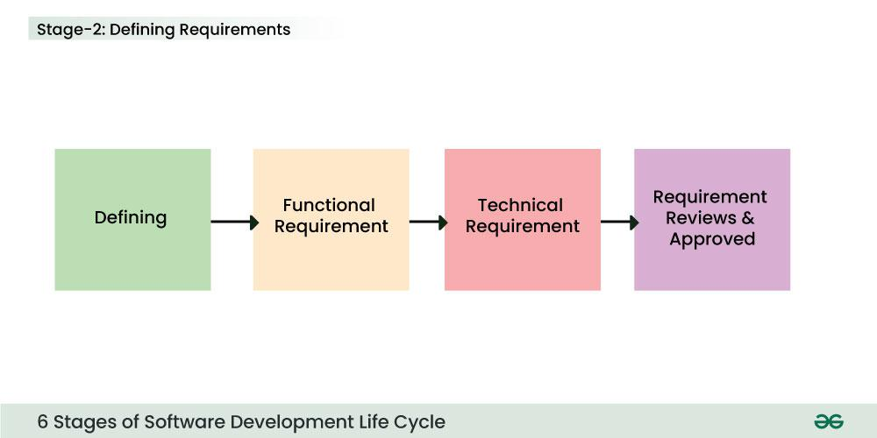

Slide 29
Stage 3: Designing Architecture
SRS is a reference for software designers to come up with the best architecture for the software.
Hence, with the requirements defined in SRS, multiple designs for the product architecture are present in the Design Document Specification (DDS).
This DDS is assessed by market analysts and stakeholders. After evaluating all the possible factors, the most practical and logical design is chosen for development.

Slide 30
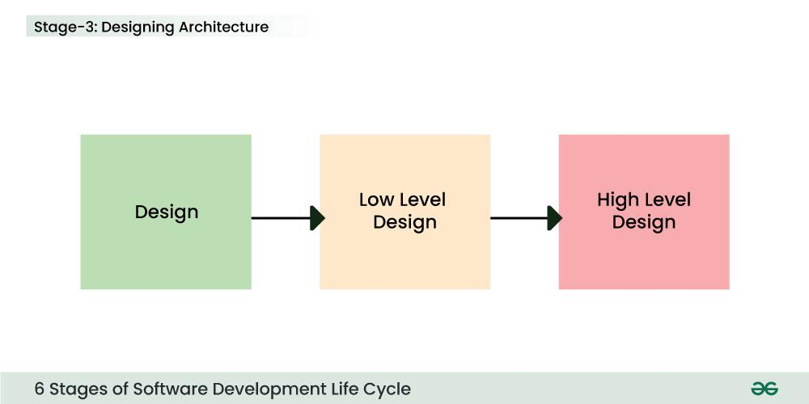

Slide 31
Stage 4: Developing Product
At this stage, the fundamental development of the product starts.
For this, developers use a specific programming code as per the design in the DDS. Hence, it is important for the coders to follow the protocols set by the association.
Conventional programming tools like compilers, interpreters, debuggers, etc. are also put into use at this stage. Some popular languages like C/C++, Python, Java, etc. are put into use as per the software regulations.

Slide 32
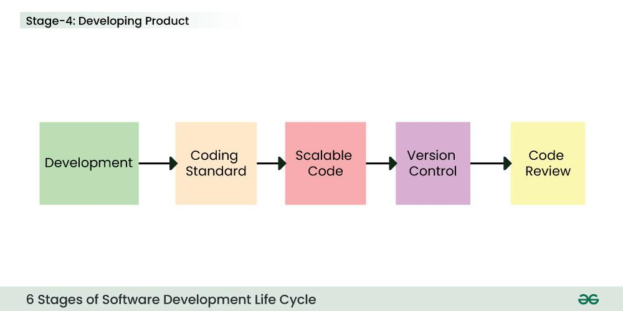

Slide 33
Stage 5: Product Testing and Integration
After the development of the product, testing of the software is necessary to ensure its smooth execution. Although, minimal testing is conducted at every stage of SDLC.
Therefore, at this stage, all the probable flaws are tracked, fixed, and retested. This ensures that the product confronts the quality requirements of SRS.

Slide 34
Documentation, Training, and Support:
Software documentation is an essential part of the software development life cycle.
A well-written document acts as a tool and means to information repository necessary to know about software processes, functions, and maintenance.
Documentation also provides information about how to use the product.
Training in an attempt to improve the current or future employee performance by increasing an employee's ability to work through learning, usually by changing his attitude and developing his skills and understanding.

Slide 35
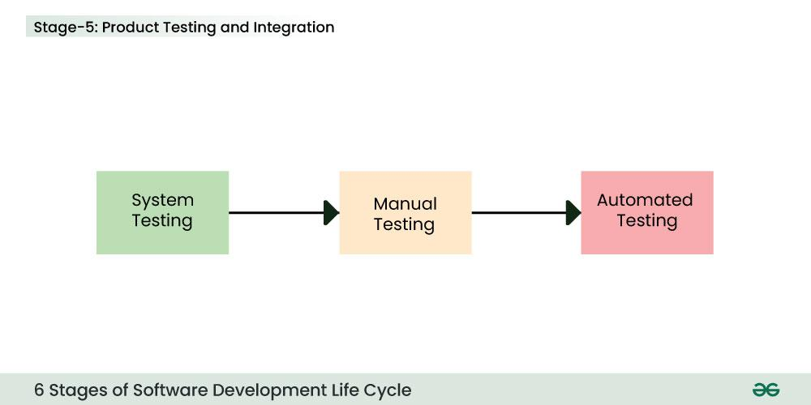

Slide 36
Stage 6: Deployment and Maintenance of Products
After detailed testing, the conclusive product is released in phases as per the organization’s strategy.
Then it is tested in a real industrial environment. It is important to ensure its smooth performance.
If it performs well, the organization sends out the product as a whole. After retrieving beneficial feedback, the company releases it as it is or with auxiliary improvements to make it further helpful for the customers.
However, this alone is not enough. Therefore, along with the deployment, the product's supervision.

Slide 37
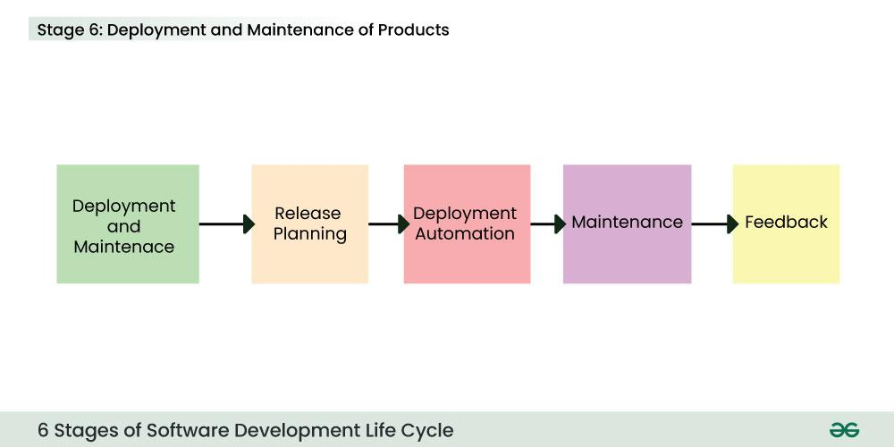

Slide 38
SDLC Models
Waterfall Model
Agile Model
V-Model
Spiral Model
Incremental Model
RAD Model

Slide 39
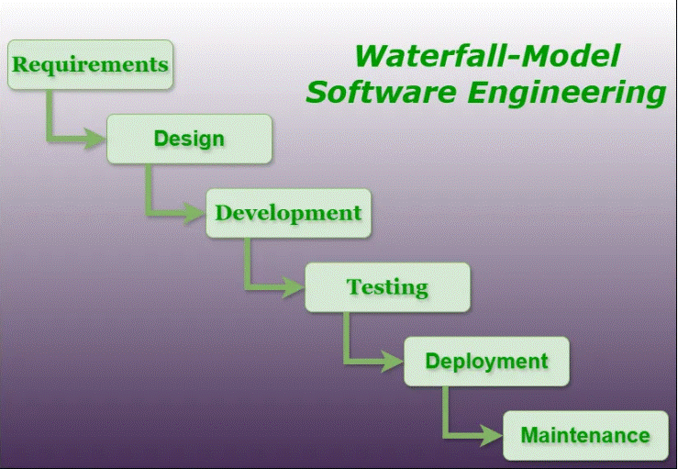
Waterfall Model

Slide 40
Waterfall Model - Software Engineering
The Waterfall Model is the oldest SDLC model, introduced in 1970 by Winston Royce.
It is a linear-sequential life cycle model, where the output of one phase becomes the input of the next.
Each phase must be completed fully before moving to the next — like water flowing down a waterfall.

Slide 41
Phases of Waterfall Model
Requirement Gathering & Analysis – Collect and document all requirements clearly.
System Design – High-level design and detailed design created.
Implementation (Coding) – Actual coding based on the design.
Integration & Testing – Modules are integrated and tested.
Deployment – System is installed at the customer site.
Maintenance – Fixing bugs, upgrades, and improvements.

Slide 42
Features of Waterfall Model
Linear and sequential approach.
Documentation-heavy.
Simple and easy to understand.
Each phase has specific deliverables and reviews.

Slide 43
Importance of Waterfall Model
Provides a structured approach to software development.
Suitable for small to medium projects with well-defined requirements.
Ensures clarity because every phase is properly documented.

Slide 44
Advantages of Waterfall Model
Easy to understand and manage.
Phases are clearly defined.
Works well for projects with fixed requirements.
Easy to track progress (phase by phase).

Slide 45
Disadvantages of Waterfall Model
Inflexible: hard to go back once a phase is completed.
Poor model for long, complex projects.
Not suitable for projects with changing requirements.
Late testing (issues are found very late).

Slide 46
When to Use Waterfall Model?
When requirements are well understood and unlikely to change.
For short-duration projects.
Where technology is stable.
For projects with strict government/defense standards.

Slide 47
Applications of Waterfall Model
Banking and financial software.
Payroll and billing systems.
Manufacturing and production systems.
Government projects.

Slide 48
Agile Development Model
The Agile Model was primarily designed to help a project adapt quickly to change requests.
So, the main aim of the Agile model is to facilitate quick project completion. To accomplish this task, it's important that agility is required.
Agility is achieved by fitting the process to the project and removing activities that may not be essential for a specific project.
Also, anything that is a waste of time and effort is avoided. The Agile Model refers to a group of development processes. These processes share some basic characteristics but do have certain subtle differences among themselves.

Slide 49
Steps in the Agile Model
The Agile Model is a combination of iterative and incremental process models. The phases involve in Agile (SDLC) Model are:
Requirement Gathering
Design the Requirements
Construction / Iteration
Testing / Quality Assurance
Deployment
Feedback

Slide 50
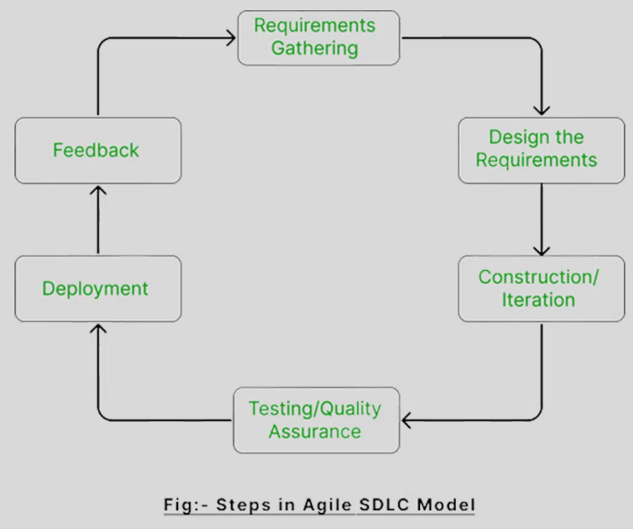

Slide 51
Agile SDLC Process
Requirement Gathering
Meet customer to capture needs & goals
Identify key requirements & feasibility (tech + cost)
Estimate time & effort

Slide 52
2. Design Requirements
Define system architecture
Create wireframes & UI design (simple blueprints that show how the software will look and how users will interact with it)
Use UML(Unified Modelling Language) diagrams for structure
Build prototypes for feedback (Rough Model)

Slide 53
3. Construction / Iteration
Develop features in short cycles (1–4 weeks)
Code & integrate new functionalities
Deliver usable product at end of each iteration(Version)
Continuous improvement with each cycle(adding new features and refining old)

Slide 54
4. Testing / Quality Assurance
Unit Testing – check individual modules
Integration Testing – test combined modules
System Testing – validate complete product

Slide 55
5. Deployment
Once an iteration is finished and fully tested, the software is ready to be released to the end users. In Agile, deployment isn't a one-time event—it's an ongoing process. Updates and improvements are rolled out regularly, making sure the software keeps evolving and getting better with each release.
Deploy the software to a test or live environment so that it can be used by customers or end-users.
Make the software accessible to users, verifying they can start using it as expected.
Verify the deployment goes smoothly and fix any issues that come up quickly

Slide 56
6. Feedback
Collect customer & stakeholder feedback
Fix bugs & improve features
Adjust plan for next iteration

Slide 57
Agile Testing Methods
TDD Test-Driven Development – write tests before code
Behaviour Driven Development BDD- – focus on user behaviour
Exploratory Testing – discover hidden issues
ATDD Acceptance Test-Driven Development – team + customer define acceptance tests
XP-Extreme Programming – customer-driven quality focus
Session-Based Testing – structured exploratory sessions
DSDM Dynamic Software Development Method – framework for iterative delivery
Crystal – people-focused, team-size based

Slide 58
Principles of Agile (12)
Early & continuous delivery of value
Welcome change, even late
Deliver working software frequently
Business & developers collaborate daily
Build around motivated individuals
Face-to-face communication best
Working software = progress measure
Sustainable development pace
Focus on technical excellence & design
Simplicity is key
Self-organizing teams create best results
Reflect & improve regularly

Slide 59
Characteristics of Agile
Adaptable to change
Incremental delivery with short cycles
Customer feedback drives progress
Iterative evaluation of increments

Slide 60
When to Use Agile
Frequent changes expected
Rapid feature implementation needed
Minimal upfront planning possible
Customer needs are evolving

Slide 61
Advantages
Pair programming = fewer errors
Faster development cycles
Strong collaboration & communication
Customer feedback after each iteration
Customer-centric development

Slide 62
Disadvantages
Lack of formal documentation → confusion
Not ideal for complex dependencies
Relies heavily on customer involvement
Hard to predict timelines & costs
Needs skilled, adaptable team
Maintenance issues after team changes

Slide 63
Conclusion
Agile = flexibility, teamwork, quick adaptation
Best for fast-changing projects with skilled teams
Customer-focused, iterative improvement

Slide 64
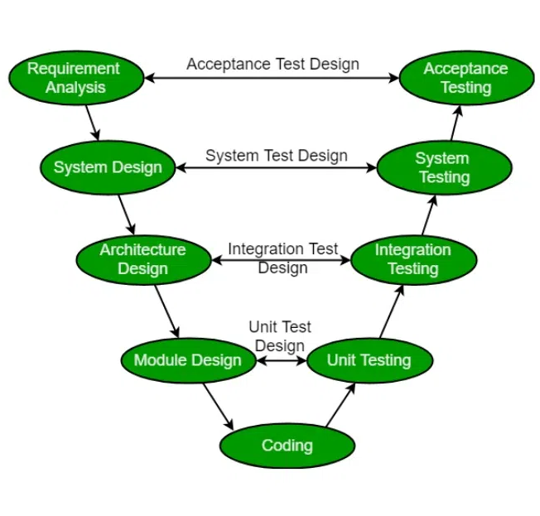
SDLC V-Model

Slide 65
V-Model (Verification & Validation Model)
The V-Model is an extension of the Waterfall Model, where testing is planned in parallel with development.
Each development phase (on the left side of "V") has a corresponding testing phase (on the right side).
It emphasizes verification (building the product right) and validation (building the right product).

Slide 66
Phases of V-Model
1. Verification Phases (Left side of V)
Requirement Analysis → Gather user requirements.
System Design → Define high-level design (architecture).
High-Level Design (HLD) → Break system into modules.
Low-Level Design (LLD) → Detailed design of each module.
Coding → Write actual code.
2. Validation Phases (Right side of V)
Unit Testing → Test each module/program separately.
Integration Testing → Check modules working together.
System Testing → Test the complete system as per requirements.
Acceptance Testing → Validate system with end users.

Slide 67
Features
Testing starts early, reducing chances of defects.
Each stage must be completed before moving to the next.
Very structured and sequential.
Advantages
Early detection of defects (since testing runs in parallel).
Clear deliverables at each phase.
Suitable for small to medium projects with well-defined requirements.
Disadvantages
Rigid, not flexible for changes once the process starts.
High cost if changes are needed later.
Not ideal for projects with evolving requirements.

Slide 68
Example of V-Model Let’s take the example of developing a Bank ATM System.
Verification Side (Development)
Requirement Analysis
ATM must allow cash withdrawal, balance check, and pin change.
Only authorized users should be able to access their account.
System Design
System needs card reader, user interface, cash dispenser, printer.
Software must interact with bank’s central server.
High-Level Design (HLD)
Divide into modules: Authentication, Transaction Processing, Account Management, Reporting.
Low-Level Design (LLD)
Authentication → Verify PIN logic.
Transaction Processing → Debit amount logic, update balance.
Printer → Generate receipt format.
Coding
Developers write C++/Java/Python programs for each module.

Slide 69
Validation Side (Testing)
Unit Testing
Test only Authentication module (correct PIN, wrong PIN).
Test Transaction module (withdrawal, insufficient balance).
Integration Testing
Combine Authentication + Transaction modules.
Test flow: Insert card → Enter PIN → Withdraw money → Update balance.
System Testing
Test entire ATM system with all features (withdraw, balance enquiry, pin change, receipt printing).
Acceptance Testing
Bank staff and a few real users test the ATM to check if it works as expected in real scenarios.

Slide 70
Summary
The V-Model ensures that for every development activity (requirements, design, coding), there is a matching test activity (acceptance test, system test, integration test, unit test).
In our ATM System Example,
Requirements were validated in acceptance testing,
System design was validated in system testing,
HLD was validated in integration testing,
LLD was validated in unit testing.

Slide 71
Spiral Model
The Spiral Model is a risk-driven software development model proposed by Barry Boehm in 1986.
The Spiral Model combines iterative development with risk management.
The process moves in a spiral (loop), with each loop called a phase.
Each phase focuses on planning, risk analysis, development, and evaluation.

Slide 72
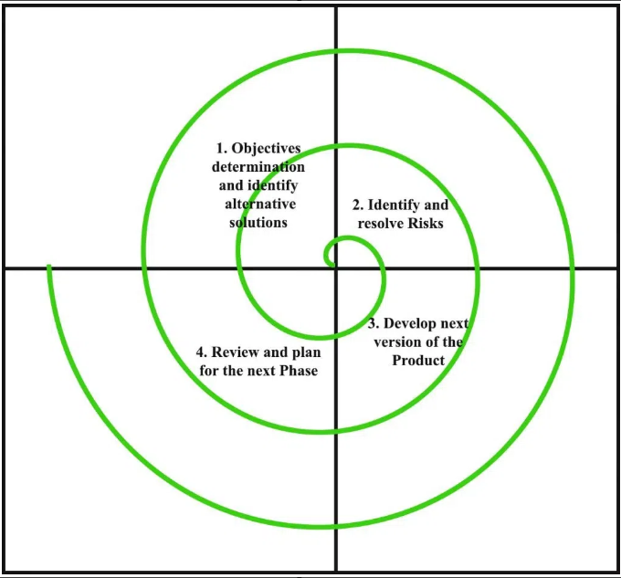
SDLC Spiral Model

Slide 73
Phases of Each Spiral Loop
Each spiral (iteration) has 4 phases:
1. Planning Phase
Identify objectives, requirements, and constraints.
Decide project goals for this iteration.
2. Risk Analysis Phase
Identify potential risks (technical, financial, schedule).
Perform prototyping or simulations to reduce risks.

Slide 74
3. Development & Engineering Phase
Build actual software (design, coding, testing) for selected features.
May involve incremental prototypes.
4. Evaluation & Review Phase
Customer/stakeholder reviews the output.
Feedback is taken.
Decide whether to continue with the next spiral or stop.

Slide 75
Features
Iterative → System is built in small parts.
Risk-oriented → Each cycle reduces risks.
Customer involvement → Frequent feedback after every cycle.
Flexibility → Requirements can evolve.
Advantages
Best for large, high-risk projects.
Risks are addressed early.
Flexible to changing requirements.
Disadvantages
Expensive due to risk analysis.
Requires highly skilled project managers.
Not suitable for small projects.

Slide 76
Example of Spiral Model Let’s take the example of developing an Online Shopping Application (E-commerce Website).
1st Spiral (Planning & Prototype)
Planning:
Identify basic requirements → User login, browsing products.
Risk Analysis:
Risk: Users may find UI confusing.
Solution: Create UI prototype (simple design).
Development:
Build a mock login page and product catalog.
Evaluation:
Customer checks prototype, gives feedback (e.g., “Add search option”).

Slide 77
2nd Spiral (Core Features)
Planning:
Add shopping cart, product search.
Risk Analysis:
Risk: Handling large product database efficiently.
Solution: Try database indexing methods.
Development:
Implement cart and search features.
Evaluation:
Client tests → Suggests faster checkout process.

Slide 78
3rd Spiral (Payment & Security)
Planning:
Add online payment and checkout process.
Risk Analysis:
Risk: Security issues in online payment.
Solution: Test encryption (SSL) and secure payment gateways.
Development:
Code payment module and checkout flow.
Evaluation:
Client checks with dummy transactions.

Slide 79
4th Spiral (Final Deployment)
Planning:
Add order tracking, reviews, notifications.
Risk Analysis:
Risk: High server load during sales.
Solution: Use cloud servers and load balancing.
Development:
Implement final modules.
Evaluation:
Customer approves → System is deployed.

Slide 80
Summary
The Spiral Model develops software in cycles (spirals) where each cycle consists of planning, risk analysis, development, and evaluation.
In our E-commerce Website Example:
First spiral gave a UI prototype,
Second spiral added cart & search,
Third spiral ensured secure payment,
Fourth spiral deployed the final system.

Slide 81
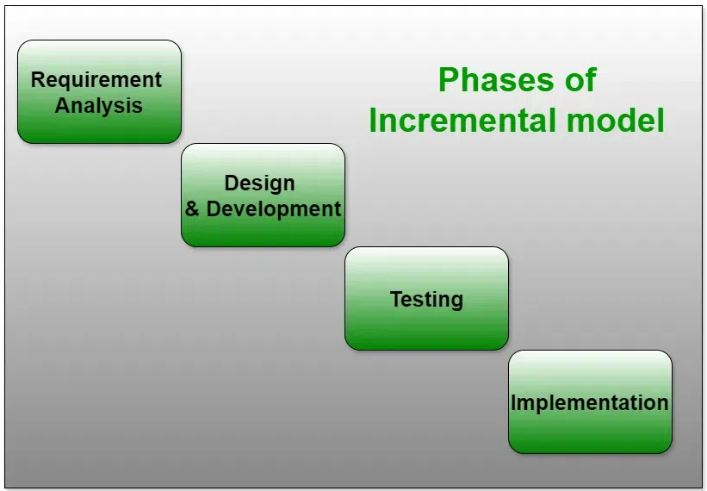
SDLC Incremental Model

Slide 82
SDLC Incremental Model
The Incremental Model is a software development approach where the system is built in parts (increments).
Each increment adds new functionality to the system.
The product grows step by step, until the final system is complete.
Every increment passes through the phases of SDLC → Requirement, Design, Coding, Testing, Implementation.

Slide 83
Phases of Incremental Model
Requirement Analysis
Break the requirements into smaller parts (modules).
Design & Development
Build the first increment (basic system).
Implementation
Deliver the increment to the customer.
Testing & Feedback
Test the increment, get user feedback.
Next Increment
Add more features in the next cycle, until the system is complete.

Slide 84
Features
System is built step by step.
Customers get partial product early and can suggest changes.
Planning and development run in parallel.
Advantages
Early delivery of useful software.
Easier to test and debug smaller modules.
Flexible to changes based on feedback.
Disadvantages
Needs good planning for splitting requirements.
Integration of many increments can be complex.
Not suitable for small projects with very limited scope.

Slide 85
Example of Incremental Model Let’s take the example of building an Online Food Delivery App (like Zomato/Swiggy).
Increment 1: Basic Features
Requirements: User login, browse restaurants.
Development: Create login system + restaurant listing.
Testing: User tests if they can log in and see restaurants.
Delivery: Basic working app is given to customer.

Slide 86
Increment 2: Ordering System
Requirements: Add “Place Order” feature.
Development: Implement cart + order placement.
Testing: Test if orders go to the restaurant correctly.
Delivery: Now customers can log in + browse + order.

Slide 87
Increment 3: Payment Integration
Requirements: Add online payment system.
Development: Integrate UPI, debit/credit card, wallet.
Testing: Verify secure and successful payments.
Delivery: Now app supports login + browse + order + pay.

Slide 88
Increment 4: Advanced Features
Requirements: Add order tracking, reviews, push notifications.
Development: Implement live order status, rating system.
Testing: Test order updates and review storage.
Delivery: Final complete food delivery app.

Slide 89
Summary
The Incremental Model builds a project in small steps, each step adds more features.
In our Food Delivery App Example:
Increment 1 → Login + restaurant list
Increment 2 → Ordering system
Increment 3 → Online payment
Increment 4 → Tracking & reviews

Slide 90
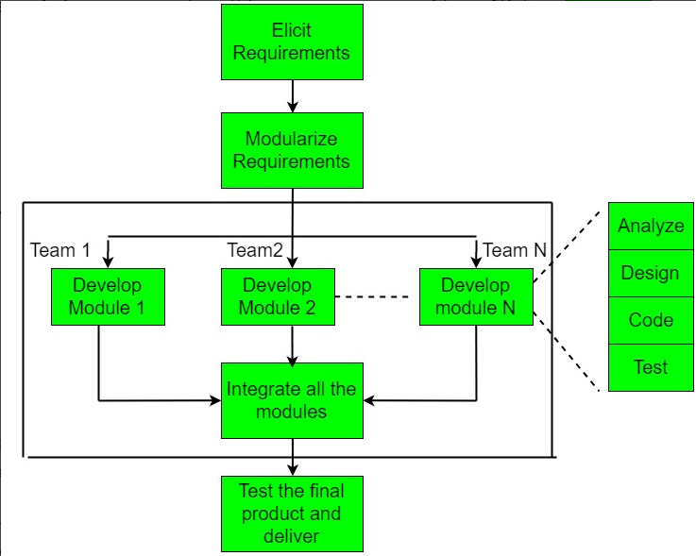
SDLC Rapid Application Development Model (RAD)

Slide 91
RAD Model (Rapid Application Development)
RAD is a software development model that focuses on fast development and quick delivery of working software.
It uses prototyping and iterative development instead of long planning and design phases.
The goal is to develop software quickly with active user involvement.

Slide 92
Phases of RAD
1. Requirement Planning Phase
Collect requirements through workshops, discussions, questionnaires.
Users and developers both participate actively.
2. User Design Phase
Build prototypes based on requirements.
Users continuously give feedback on the prototypes.
Changes are made quickly to match expectations.
3. Construction Phase
Actual system is built with reusable components and automated tools.
Focus on rapid coding and testing.
Developers use CASE (Computer-Aided Software Engineering) tools.
4. Cutover Phase
Final system is tested and deployed.
Includes user training, system conversion, and maintenance.

Slide 93
Example of RAD Model Let’s take the example of building a College Admission System.
1. Requirement Planning Phase
College management, admission staff, and developers meet.
Requirements identified:
Online application form
Document upload
Fee payment
Admission confirmation

Slide 94
2. User Design Phase
Developers quickly create a prototype of an online form.
Staff reviews it → suggests adding “course preference” option.
Prototype updated and shown again.
Iterations continue until form meets expectations.
3. Construction Phase
Developers use rapid tools (like Oracle Forms, Java Spring, or PHP frameworks).
Build modules: Application, Document Upload, Payment, Confirmation.
Unit testing done immediately.

Slide 95
4. Cutover Phase
System tested end-to-end with sample student data.
Staff trained to use the system.
System deployed before admission season begins.

Slide 96
Features
Iterative and component-based development.
Heavy focus on prototypes for validation.
Requires continuous customer interaction.
Advantages of RAD Model
Very fast development and delivery.
Users are highly involved → final system matches their needs.
Easy to incorporate changes from feedback.
Reduces overall development time.
Disadvantages
Requires skilled developers and use of advanced tools.
Not suitable for very large, complex systems.
Depends on continuous user involvement.
Difficult to manage if requirements are not clear.

Slide 97
Real Life Examples
1. Waterfall Model
Example: Banking System (e.g., Core Banking Software like Finacle)
Requirements are fixed, strict regulations.
Follows sequential phases: requirements → design → coding → testing → deployment.
Changes are minimal once development starts.
2. V-Model (Verification & Validation Model)
Example: Air Traffic Control System / Medical Device Software
Safety-critical systems where testing at every stage is essential.
High reliability needed, so verification & validation go hand-in-hand.

Slide 98
3. Incremental Model
Example: Microsoft Office Suite
Delivered in parts (e.g., Word, Excel, PowerPoint developed and released in increments).
Customers can use some features while others are still being developed.
4. Spiral Model
Example: NASA Projects / Large Defense Systems
Focuses on risk analysis at each phase.
High-cost, complex systems with frequent risk assessments and prototypes.

Slide 99
5. RAD Model (Rapid Application Development)
Example: Customer Relationship Management (CRM) Software like Zoho CRM
Quick prototyping, reusable components, and heavy customer involvement.
Ideal for business applications that evolve quickly.
6. Agile Model
Example: E-commerce Platforms (e.g., Amazon, Flipkart, Myntra)
Features (search, cart, payment, recommendations) are built in short sprints.
Constant updates and improvements based on customer feedback.
Flexibility to add/remove features as business evolves.

Slide 100
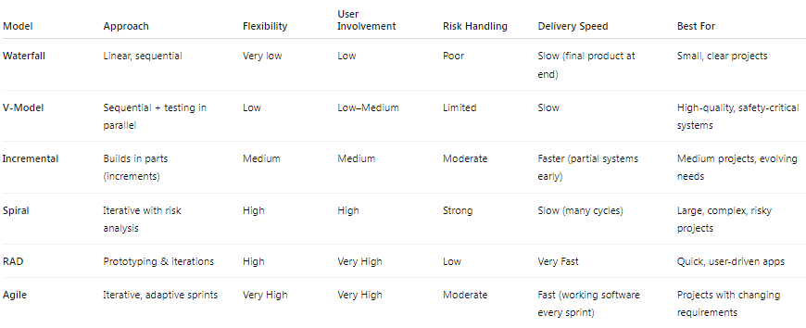

Slide 101
1.3 Requirement Engineering
The process to gather the software requirements from client, analyze and document them is known as requirement engineering.
The goal of requirement engineering is to develop and maintain sophisticated and descriptive System Requirements Specification document.

Slide 102
Requirement Engineering Process
It is a four step process, which includes
Feasibility Study
Requirement Gathering
Software Requirement Specification
Software Requirement Validation

Slide 103
Feasibility Study
Client provides a rough idea of required software functions and features.
Analysts study if the desired system is feasible to develop.
Focuses on alignment with organizational goals and objectives.
Evaluates practical aspects:
Implementation feasibility
Contribution to organization
Cost constraints
Adherence to organizational values
Analyzes technical aspects:
Usability
Maintainability
Productivity
Integration ability
Output: Feasibility Study Report with comments and recommendations on whether to undertake the project.

Slide 104
Requirement Gathering
If the feasibility report is positive towards undertaking the project, next phase starts with gathering requirements from the user.
Analysts and engineers communicate with the client and end-users to know their ideas on what the software should provide and which features they want the software to include.

Slide 105
Software Requirement Specification
Software Requirement Specification (SRS) –
Created by system analyst after gathering requirements from stakeholders.
Defines software interactions with:
Hardware and external interfaces
Performance: speed, response time, portability
Maintainability and recovery after crashes
Security, quality, and limitations

Slide 106
SRS should come up with following features:
User Requirements are expressed in natural language.
Technical requirements are expressed in structured language, which is used inside the organization.
Design description should be written in Pseudo code.
Format of Forms and GUI screen prints.
Conditional and mathematical notations for DFDs etc.

Slide 107
Software Requirement Validation
After requirement specifications are developed, the requirements mentioned in this document are validated.
User might ask for illegal, impractical solution or experts may interpret the requirements incorrectly.
Requirements can be checked against following conditions –
If they can be practically implemented
If they are valid and as per functionality and domain of software
If there are any ambiguities
If they are complete
If they can be demonstrated

Slide 108

Requirement Elicitation Process
Requirement elicitation process can be depicted using the following diagram:

Slide 109
Requirements gathering - The developers discuss with the client and end users and know their expectations from the software.
Organizing Requirements - The developers prioritize and arrange the requirements in order of importance, urgency and convenience.
Negotiation & discussion - If requirements are ambiguous or there are some conflicts in requirements of various stakeholders, if they are, it is then negotiated and discussed with stakeholders. Requirements may then be prioritized and reasonably compromised.
The requirements come from various stakeholders. To remove the ambiguity and conflicts, they are discussed for clarity and correctness. Unrealistic requirements are compromised reasonably.
Documentation - All formal & informal, functional and non-functional requirements are documented and made available for next phase processing.

Slide 110
Requirement Elicitation Techniques
Process of identifying software requirements by communicating with clients, end users, and stakeholders.
Interviews – Collect requirements through discussions:
Structured (closed) – predefined questions, fixed pattern
Unstructured (open) – flexible, exploratory
Oral or written; one-to-one or group interviews
Surveys – Query stakeholders about their expectations.
Questionnaires – Predefined objective questions; limitation: may miss unlisted issues.
Task Analysis – Study existing operations or software to determine new system requirements.
Domain Analysis – Use domain experts to identify general and specific requirements.
Brainstorming – Informal discussions among stakeholders to collect ideas.
Prototyping – Build a basic interface to gather client feedback and refine requirements.
Observation – Visit client site to study workflow and current system usage; derive requirements from real operations.

Slide 111
Software Requirements Characteristics
Complete Software Requirement Specifications must be:
Clear
Correct
Consistent
Coherent
Comprehensible
Modifiable
Verifiable
Prioritized
Unambiguous
Traceable
Credible source

Slide 112
Software Requirements
Functional Requirements
Requirements, which are related to functional aspect of software fall into this category. They define functions and functionality within and from the software system.
Examples -
Search option given to user to search from various invoices.
User should be able to mail any report to management.
Users can be divided into groups and groups can be given separate rights.
Should comply business rules and administrative functions.
Software is developed keeping downward compatibility intact.

Slide 113
Non-Functional Requirements
Requirements, which are not related to functional aspect of software, fall into this category. They are implicit or expected characteristics of software, which users make assumption of.
Non-functional requirements include -
Security
Logging
Storage
Configuration
Performance
Cost
Interoperability
Flexibility
Disaster recovery
Accessibility

Slide 114
Requirements are categorized logically as
Must Have : Software cannot be said operational without them.
Should have : Enhancing the functionality of software.
Could have : Software can still properly function with these requirements.
Wish list : These requirements do not map to any objectives of software.

Slide 115
User Interface requirements
UI is an important part of any software or hardware or hybrid system. A software is widely accepted if it is –
easy to operate
quick in response
effectively handling operational errors
providing simple yet consistent user interface

Slide 116
Content presentation
Easy Navigation
Simple interface
Responsive
Consistent UI elements
Feedback mechanism
Default settings
Purposeful layout
Strategical use of color and texture.
Provide help information
User centric approach
Group based view settings.

Slide 117
Software Requirement Specification (SRS) Format
Table of Content
Introduction
General description
Functional Requirements
Interface Requirements
Performance Requirements
Design Constraints
Non-Functional Attributes
Preliminary Schedule and Budget
Appendices
Uses of SRS document
FAQs on SRS Format
Conclusion

Slide 118
Software Requirement Specification (SRS)
Software Requirement Specification (SRS) Format as the name suggests, is a complete specification and description of requirements of the software that need to be fulfilled for the successful development of the software system.
These requirements can be functional as well as non-functional depending upon the type of requirement. The interaction between different customers and contractors is done because it is necessary to fully understand the needs of customers.

Slide 119
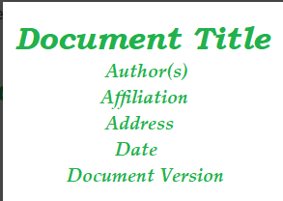

Slide 120
Introduction
Purpose of this Document - At first, main aim of why this document is necessary and what’s purpose of document is explained and described.
Scope of this document - In this, overall working and main objective of document and what value it will provide to customer is described and explained. It also includes a description of development cost and time required.
Overview - In this, description of product is explained. It’s simply summary or overall review of product.

Slide 121
General Description
General Description
Outlines the system’s purpose, user objectives, features, benefits, and target users.
Functional Requirements
Define what the system should do, including inputs, outputs, and operations.
Interface Requirements
Explain how the software communicates with users or other systems.
Performance Requirements
Specify system behaviour under conditions, like speed, memory use, and error limits.

Slide 122
Design Constraints
In this, constraints which simply means limitation or restriction are specified and explained for design team.
Examples may include use of a particular algorithm, hardware and software limitations, etc.
There are a number of factors in the client's environment that may restrict the choices of a designer leading to design constraints such factors include standards that must be followed resource limits, operating environment, reliability and security requirements and policies that may have an impact on the design of the system.
An SRS should identify and specify all such constraints.

Slide 123
Non-Functional Attributes
In this, non-functional attributes are explained that are required by software system for better performance. An example may include Security, Portability, Reliability, Reusability, Application compatibility, Data integrity, Scalability capacity, etc.
Preliminary Schedule and Budget
In this, initial version and budget of project plan are explained which include overall time duration required and overall cost required for development of project.
Appendices
In this, additional information like references from where information is gathered, definitions of some specific terms, acronyms, abbreviations, etc. are given and explained.

Slide 124
Uses of SRS document
Development team require it for developing product according to the need.
Test plans are generated by testing group based on the describe external behaviour.
Maintenance and support staff need it to understand what the software product is supposed to do.
Project manager base their plans and estimates of schedule, effort and resources on it.
customer rely on it to know that product they can expect.
As a contract between developer and customer
For documentation purpose.

Slide 125
Conclusion
Software development requires a well-structured Software Requirement Specification (SRS).
It helps stakeholders communicate, provides a roadmap for development teams, guides testers in creating effective test plans, guides maintenance and support employees, informs project management decisions, and sets customer expectations.
The SRS document helps ensure that the software meets functional and non-functional requirements, resulting in a quality product on time and within budget.

Slide 126
Thank You

