Slide 1

Multivariate Analysis on Bank-Marketing-Data-Set
Department of Artificial Intelligence and Data Science
(An Autonomous Institute affiliated to Savitribai Phule Pune University)
(NBA and NAAC accredited, ISO 9001:2015 certified)

Slide 2
Group Members
Name​ | PRN​ | Roll No.​ | Batch​
Aditya Jasoriya​ | 22210607​ | 371025​ | A1​
Aryan Dalvi​ | 22210619​ | 371014​ | A1​
Riya Shete | 22320173 | 371075 | A3
Kalyani Bonde | 22320196 | 371076 | A3
Group No. -
Div: A
TY Btech
Department of Artificial Intelligence and Data Science, VIIT, Pune-48

Slide 3
Introduction
What is Multivariate Analysis?
Definition: A statistical technique used to understand relationships between multiple variables..
Importance: Helps in uncovering hidden patterns, customer segmentation, and predicting outcomes
Department of Artificial Intelligence and Data Science, VIIT, Pune-48

Slide 4
"Introduction to Bank Marketing System"
.
Importance of customer acquisition and retention in modern banking.
Data-driven marketing strategies to predict customer behavior.
Focus of the system on term deposit subscriptions using direct marketing data

Slide 5
Objective: Predict whether a customer will subscribe to a term deposit.
Methodology: Use multivariate techniques to identify key predictors and segment customers.
Department of Artificial Intelligence and Data Science, VIIT, Pune-48

Slide 6
Project Overview:
Dataset Description:
Source: UCI Machine Learning Repository
Context: The dataset contains information on direct marketing campaigns of a Portuguese banking institution.
Key Features: Age, job, marital status, education, default, housing, loan, contact, campaign, etc.
Department of Artificial Intelligence and Data Science, VIIT, Pune-48

Slide 7
Preparing the Data
Data Cleaning:
Handling missing values
Encoding categorical variables (e.g., One-Hot Encoding)
Normalizing/Standardizing data
Exploratory Data Analysis (EDA):
Identifying correlations using heatmaps
Visualizing distributions with histograms and box plots
Department of Artificial Intelligence and Data Science, VIIT, Pune-48

Slide 8
Multiple Regression Analysis
Steps:
Define the dependent and independent variables
Interpret coefficients and p-values
Evaluate the model using R-squared, Adjusted R-squared
Department of Artificial Intelligence and Data Science, VIIT, Pune-48

Slide 9
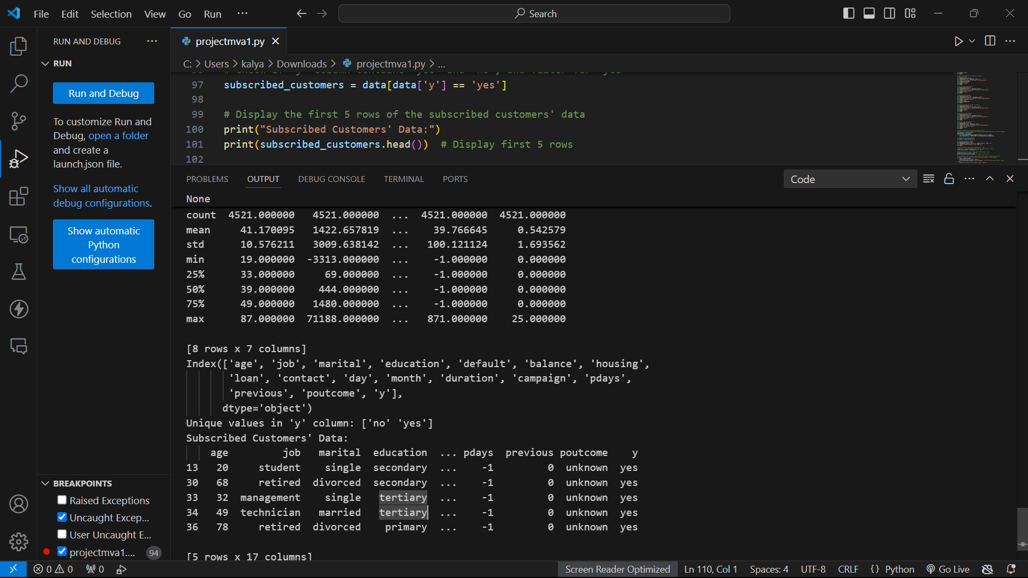
OUTPUT

Slide 10
Challenges Faced
Data imbalance: Fewer customers subscribed than unsubscribed.
Overfitting: Addressed through techniques like regularization and cross-validation.

Slide 11
Conclusion and Future Work
Summary of the system's impact on marketing strategy.
Potential for future enhancements (integration with real-time platforms, expanding dataset).

Slide 12

THANKS

