Slide 1

Data Hiding Using Steganography Industrial oriented mini project
Sri Venkateshwara Engineering College
Sponsored by the Exhibition Society, Hyderabad
Iso:9001-2015 Certified, approved by AICTE, affiliated to JNTUH
Department of Computer Science and Engineering
Domain: Cybersecurity
Sub-Domain: Data Protection / Information Hiding
Project Presented by Team 1
Meet the team behind our steganography project:
M Kalyani - 22631A0519
S Lalitha Shivapriya - 22631A0523
Azra Shaik - 22631A0506
Md Nazeema Begum - 22631A0527
T Ujwala - 22631A0556
P Yagneshwar - 22631A0562
Guide & Co-ordinator
Mr. P. Rathaiah Sr. Asst.Prof., B.Tech, M.Tech
Head of the department
Mr. P. Rathaiah Sr. Asst.Prof., B.Tech, M.Tech

Slide 2
Index
S. No. | Topic | Page No.
1 | Abstract | 4
2 | Introduction | 5
3 | Problem Statement | 6
4 | Objective | 7
5 | Literature survey | 10
6 | Existing System | 15
7 | Proposed System | 17
8 | Extension | 19
9 | System Architecture | 21
10 | UML | 22
11 | Software and Hardware Requirements | 30

Slide 3
Index
S. No. | Topic | Page No.
12 | Flow of work/ Modules | 31
13 | Types of data and image input | 33
14 | LSB Steganography Algorithm | 35
15 | Database Analysis | 42
16 | Execution | 47
17 | System Testing | 51
18 | Future Scope | 55
19 | System Security Measures | 56
20 | Conclusion | 57
21 | References | 58
22 | Vote of thanks | 59

Slide 4
Abstract
🔹 Aim:
To develop a secure and user-friendly web application using image-based
steganography to hide confidential messages within images for safe,
invisible data transmission.
🔹 Abstract:
This project uses image steganography to hide secret data inside image files without
visible changes. Unlike cryptography, which protects content, steganography conceals the
message's existence. By encrypting and embedding messages within images and protecting them with a password, the system ensures discreet and secure communication in the digital era.

Slide 5
Introduction
In today’s digital era, secure communication is vital. While cryptography protects
message content, steganography hides the existence of the message itself by embedding
it within cover media such as images. The goal is to develop a secure, user-friendly image
steganography system that achieves a balance between : Imperceptibility, Capacity,
Security.
This approach enables confidential and undetectable communication, demonstrating the
practical use of steganography in safeguarding sensitive information.

Slide 6
Problem Statement
This project presents a web-based image steganography system that securely hides
confidential messages within image files. Unlike traditional cryptography, which only
secures content, steganography conceals the very existence of the message, making it
less likely to attract attention.
Major issues that need to be solved:
Designing a robust steganographic system that resists unauthorized access and detection.
Combining steganography with resilient algorithms to further secure the embedded data.
Developing an intuitive interface for users to easily hide and retrieve information without specialized technical knowledge.
Ensuring the integrity and confidentiality of data during transfer across insecure or public networks.

Slide 7
Objectives
Title: Data Hiding Using Steganography
Objective: To create a secure web app that hides text in images using steganography and password verification.
Key Features:
Embed text in images using OpenCV (Python)
Flask web interface with password protection
Secure retrieval via image ID and password
Store metadata in MySQL
Stylish UI with HTML, CSS (glassmorphism), Bootstrap
Error handling for file type and message size
Support PNG, JPG, JPEG formats
Allow secure image download

Slide 8
Literature Survey
Project Title: Image Steganography with Password Protection
Introduction to Steganography: Steganography is the practice of hiding confidential data within digital media (like images or audio) so the message remains invisible. Unlike cryptography, it conceals the message’s existence.
An effective system must ensure:
Imperceptibility: No visible change to the image.
Robustness: Data survives modifications.
Capacity: Can embed enough data without quality loss.
Classification of Steganography Techniques
A. Spatial Domain Techniques
Least Significant Bit (LSB): Simplest method, directly replaces LSBs of pixel values. High capacity but easily detectable and fragile.

Slide 9
Literature Survey
Pixel Value Differencing (PVD): Embeds based on pixel differences, offering better imperceptibility in edge areas.
Quantization Index Modulation (QIM): Uses quantization to embed information, offering moderate robustness.
Multiple Base Notational System (MBNS): Converts data into symbols, enhancing payload capacity and PSNR.
B. Transform Domain Techniques
Discrete Cosine Transform (DCT): Embeds in frequency domain, robust to JPEG compression.
Discrete Wavelet Transform (DWT): Embeds in sub-bands of an image, good imperceptibility and multi-resolution capability.
Singular Value Decomposition (SVD): Embeds in singular values; highly robust but may cause diagonal artifacts.
Hybrid Techniques Combine methods like DWT-SVD or DCT-DWT to balance capacity, imperceptibility, and robustness.

Slide 10
Literature Survey
4. Comparative Analysis of Techniques
Technique | Robustness | Capacity | Complexity | Best Use Case
LSB | Low | High | Low | Simple message hiding
PVD | Moderate | Moderate | Moderate | Edge-focused hiding
DCT | High | Low | Moderate | JPEG image resilience
DWT | High | Moderate | High | Multi-resolution hiding
SVD | Very High | Low | High | Robust watermarking
Hybrid (DWT-SVD) | Very High | Moderate | Very High | Critical secure apps

Slide 11
Literature Survey
Conclusion & Future Work: Spatial methods are simple with high capacity but less secure. Transform methods offer better security, while hybrid techniques balance both. Future research may focus on AI-based adaptive steganography for smarter, more secure embedding.
Reference: Fkirin et al. (2016), Steganography Literature Survey, CAE, 5(10).

Slide 12
Existing system
Traditional encryption (e.g., AES, RSA) scrambles data to protect it but is easily recognizable.
Visible encrypted data can attract attention or become a target.
Steganography hides data inside regular files (images, audio, video), concealing its presence.
It is less likely to be detected or flagged by surveillance systems.
Combining encryption with steganography offers dual-layer security:
Encryption secures the content.
Steganography hides the existence of the content.

Slide 13
Existing system - limitations
Obvious encryption – encrypted files look suspicious, making them more likely to be intercepted.
Vulnerable to attacks – while encryption is strong, techniques like brute force and cryptanalysis can sometimes break it.
Lack of concealment – traditional encryption focuses on securing the message, but it doesn’t hide the fact that the message exists.
Extra storage overhead – encrypted files often require more space, making them harder to share efficiently.
The existing system lacks concealment, focusing on securing the message but not hiding its existence, and often requires extra storage overhead.

Slide 14
Proposed System
The proposed system is a web-based application that allows users to hide secret text messages inside images using a method called steganography. This means the secret message is embedded into an image in such a way that the image looks completely normal to anyone else. On top of that, the system uses password protection and a unique image ID to ensure only authorized users can retrieve the message.
Main purpose:
To provide a triple-layer security system:
Encrypt message using ceasar cipher algorithm
Hide the existence of the message.
Protect the message with a password and unique identifier.
This makes it far less likely to be detected or targeted, unlike traditional encryption methods which clearly show that data is being hidden.

Slide 15
Extension
Steganography Technique: Hides the message inside image pixels without changing the image appearance.
Password Protection: The hidden message is secured with a user-defined password.
Image ID Authentication: Each encrypted image gets a unique ID stored in a database.
Web-Based Interface: Simple to use—no technical skills required.
Database Integration: Stores image names, passwords, and image IDs securely in MySQL.

Slide 16
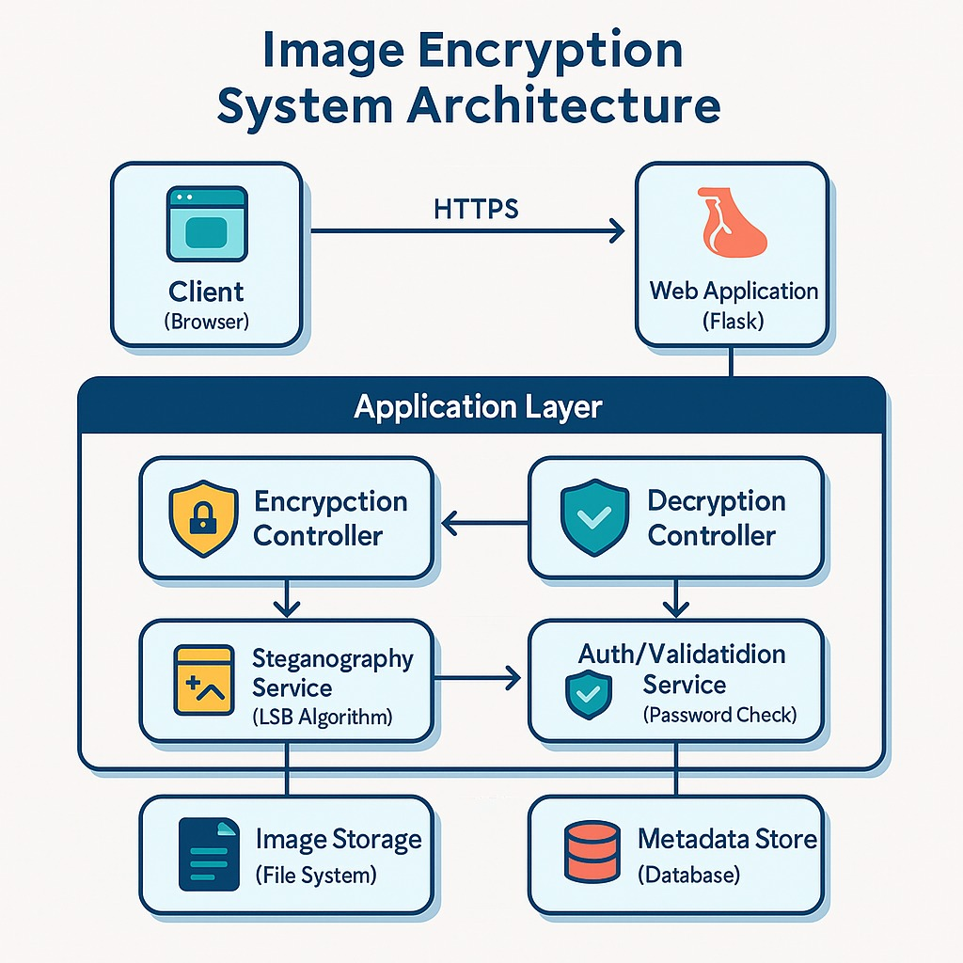
System Architecture

Slide 17
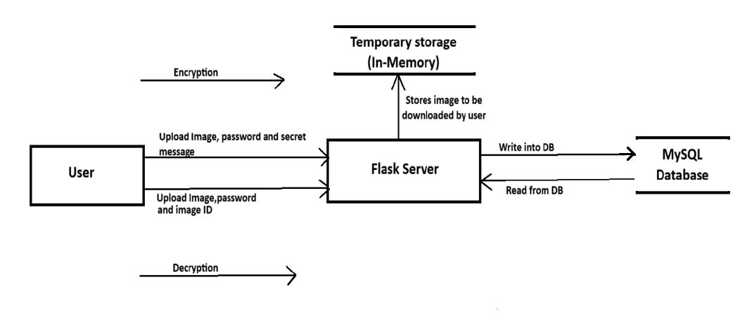
Data Flow Diagram

Slide 18
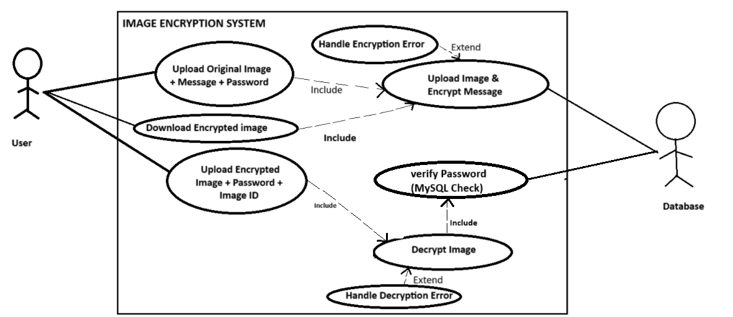
UML - Use Case Diagram

Slide 19
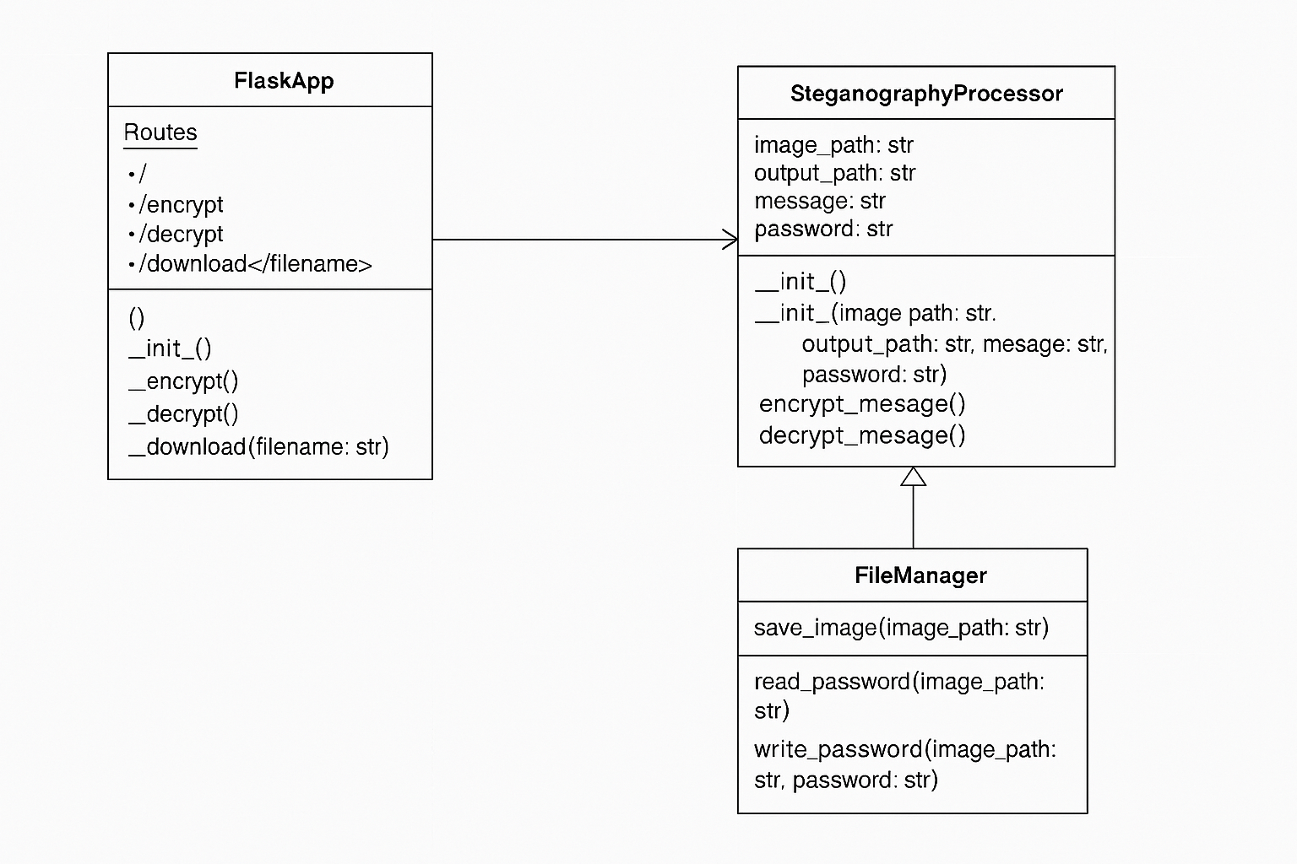
UML - Class Diagram

Slide 20
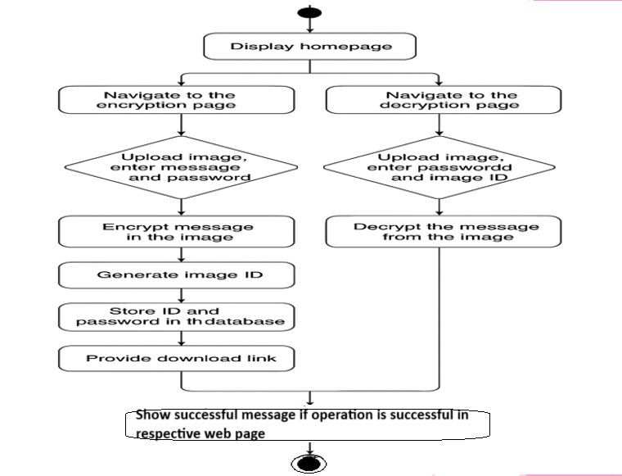
UML - Activity Diagram

Slide 21
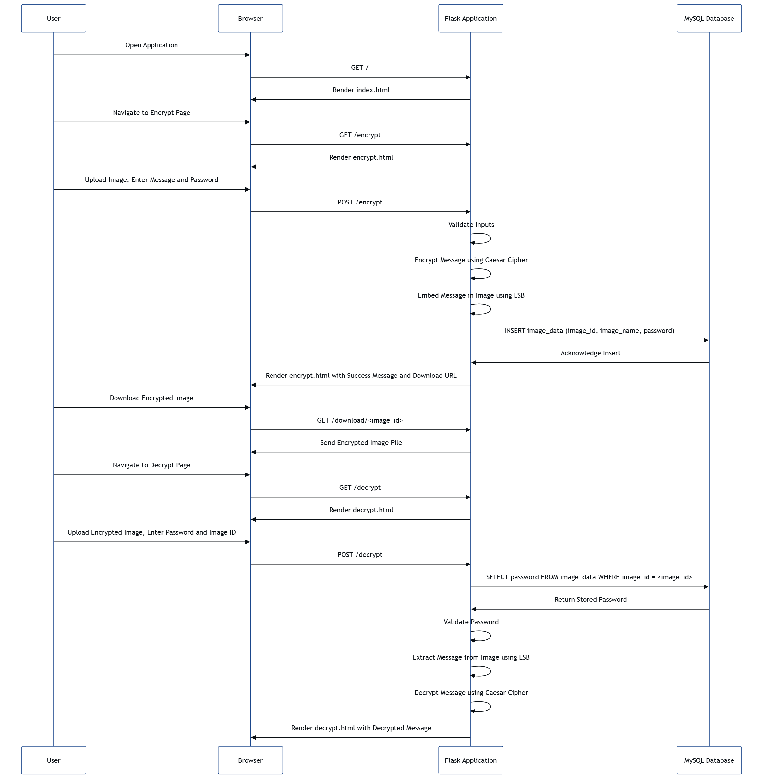
UML - Sequence Diagram

Slide 22
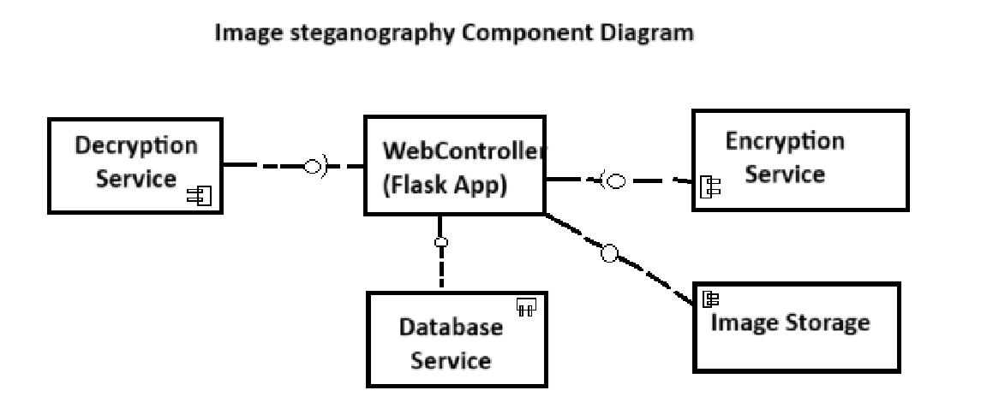
UML - Component Diagram

Slide 23
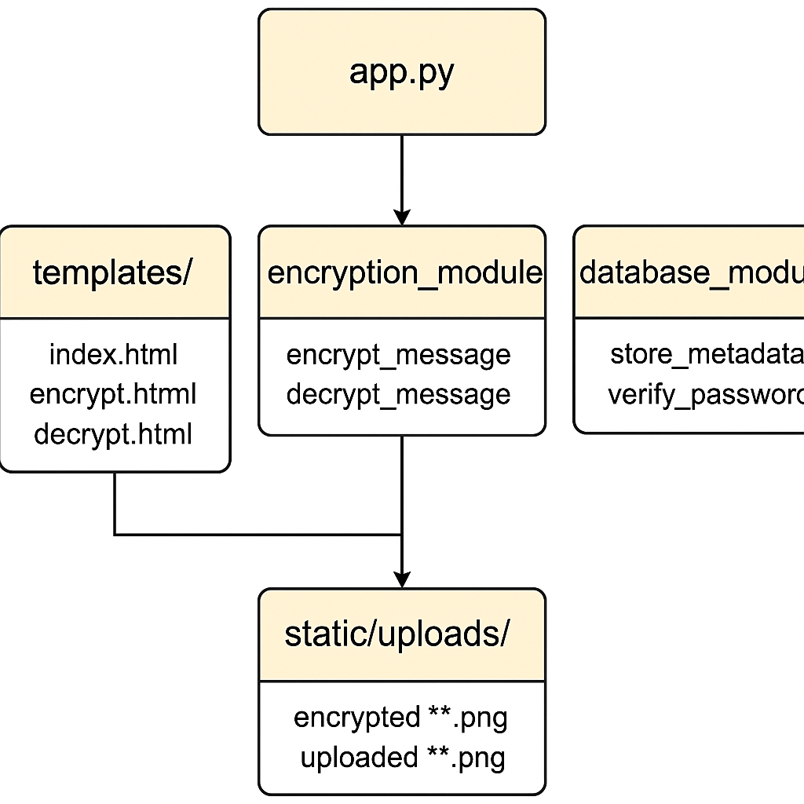
UML - Package Diagram

Slide 24
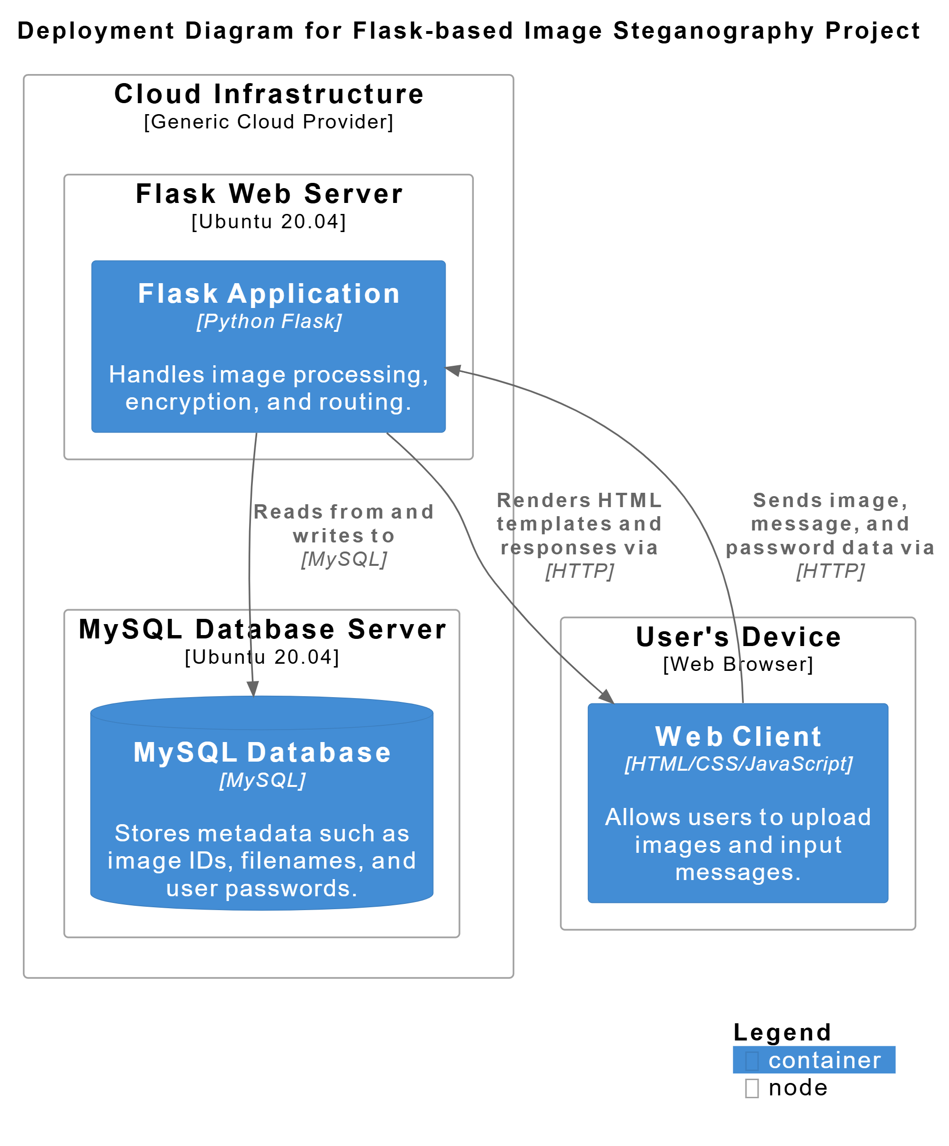
UML - Deployment Diagram

Slide 25
Software and Hardware Requirements
Hardware Requirements:
Processor: Intel core i5 (Minimum dual-core processor required)
RAM:16GB (Minimum 4GB or higher for better experience)
Storage:150GB Hard Disk Space (Minimum 60GB required)
Development Tools: Visual Studio
Software Requirements:
Operating System: Windows 10 / 11 (64-bit)
Code Editor: VS Code (VS Code) v1.89.0 or later
Front end: HTML5, CSS3
Backend: Python 3.10.x, frameworks used flask v2.2.5, OpenCV v4.7.0, MYSQL Connector for Python (mysql-connector-python) v8.0.33

Slide 26
Flow of work/ Modules
Database Module: Handles MySQL operations—stores image ID, filename, and password; verifies credentials during decryption.
Encryption/Decryption Module: Uses LSB steganography to embed/extract binary messages in images; verifies password before revealing the message.
Image Management Module: Handles in-memory image storage (BytesIO), Base64 encoding for web display, and secure image download.
Web Interface Module: Manages Flask routes and page rendering using Jinja2 templates for encryption/decryption and homepage.
Utility Module: Provides helper functions for UUIDs, binary conversion, and input validation with error feedback.
Security Features: Enforces password protection; denies unauthorized access with clear error messages.

Slide 27
Types of data and image input
1. Image Input (Cover Image)
This is the image in which the message is hidden.
Supported Image Formats:
PNG (Recommended), BMP, JPEG with enough pixels.
Other formats (e.g., TIFF, GIF) – May work depending on your image processing library, but not ideal.
2. Message Input (Secret Data)
This is the data to be hidden inside the image.
Supported Message Types:Text messages (plain strings), Special characters and punctuation are allowed.
Examples: "Hello World", passwords, notes, etc.
Not Supported: Binary files (e.g., PDFs, executables), Multimedia files (e.g., MP3, video)

Slide 28
Caesar Cipher
The Caesar Cipher is a substitution cipher where each letter in the plaintext is shifted a fixed number of positions down or up the alphabet.
For example, with a shift of 3:
A becomes D, B becomes E, …, Z becomes C
Now let’s apply it to the word “HELLO”.
Encryption
Original: H E L L O ASCII: 72 69 76 76 79 Shifted:
H → K (H is the 8th letter, K is the 11th)
E → H (5th → 8th)
L → O (12th → 15th)
O → R (15th → 18th)
➡ Encrypted Text: KHOOR
So, Caesar Cipher with shift = 3 transforms "HELLO" into "KHOOR".
🧾 Decryption (Reversing the Shift) To get back to the original message, we reverse the shift:
K → H
H → E
O → L
O → L
R → O
➡ Decrypted Text: HELLO

Slide 29
LSB Steganography Algorithm
LSB (least significant bit) steganography is a technique used to hide data within an image by modifying the least significant bits of the pixel values. Because the change in the least significant bit is visually imperceptible, it allows you to embed information without noticeably altering the original image.
Basic concept:
Every pixel in an image is usually made up of RGB (red, green, blue) color values. Each of these values is an 8-bit number (0 to 255). In LSB steganography, we can hide bits of secret data inside the LSB of these color values.

Slide 30
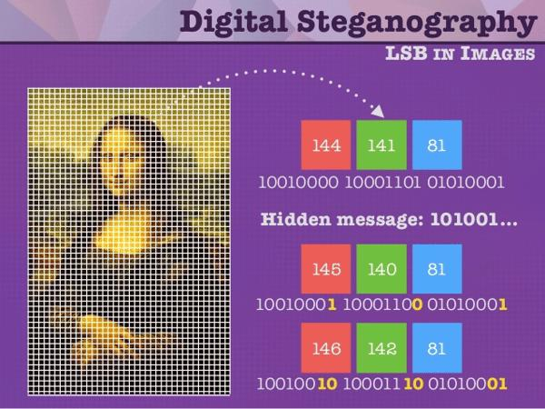
How it works and example
Input: The inputs are a cover image and a secret message (plain text), which can be text, an image, or a file.
Encoding Process: The plain text is converted into binary, creating the cipher text. Each bit of this cipher text is hidden by modifying the least significant bits (LSBs) of the cover image’s pixels, making the message invisible to the eye.
Decoding Process: The LSBs are read from the stego image in the same order. This gives the cipher text, which is then converted back to reveal the original plain text.

Slide 31
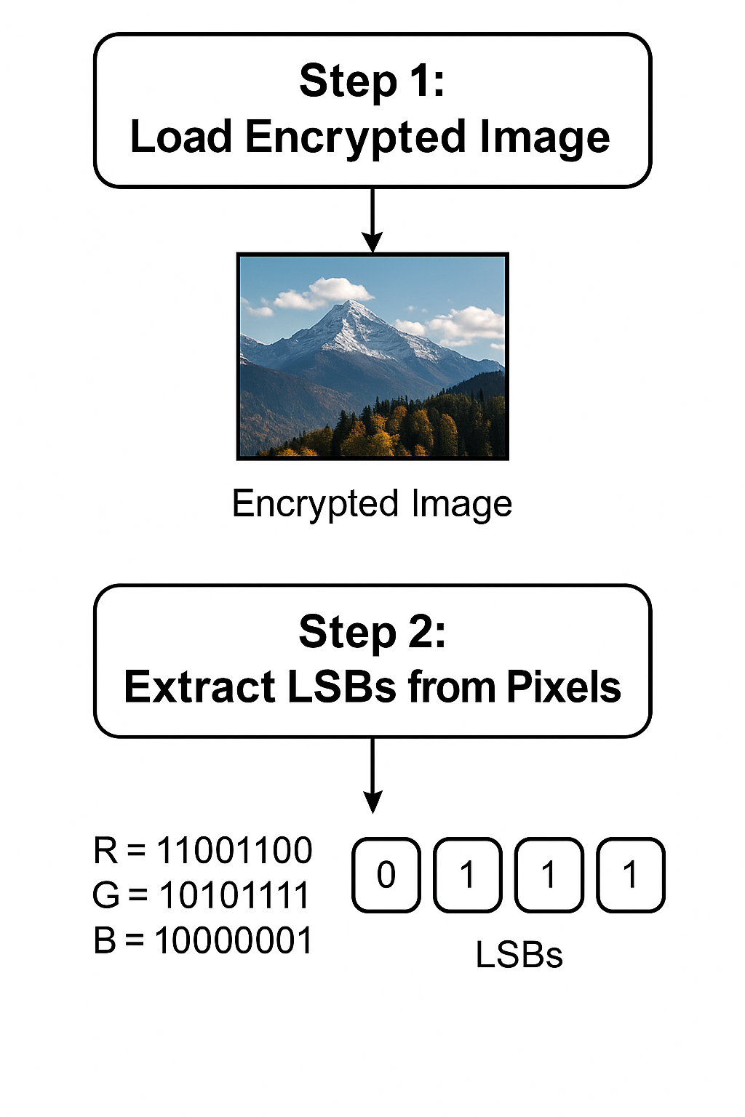
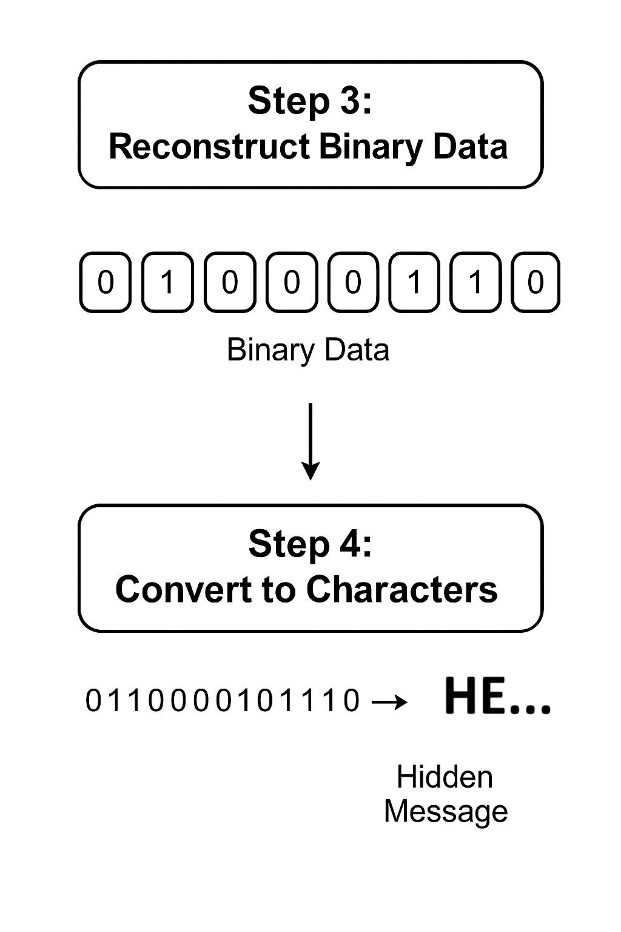
LSB Steganography Algorithm

Slide 32
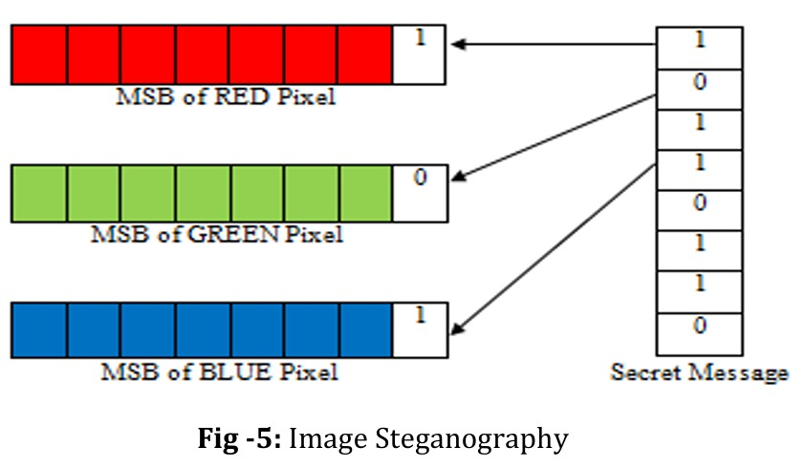
LSB Steganography Algorithm
For example: If a pixel's red value is 10110110 (binary for 182), and you want to hide a 1, you change the last bit:
Original: 10110110
Modified: 10110111
This changes the value from 182 to 183—visually negligible.

Slide 33
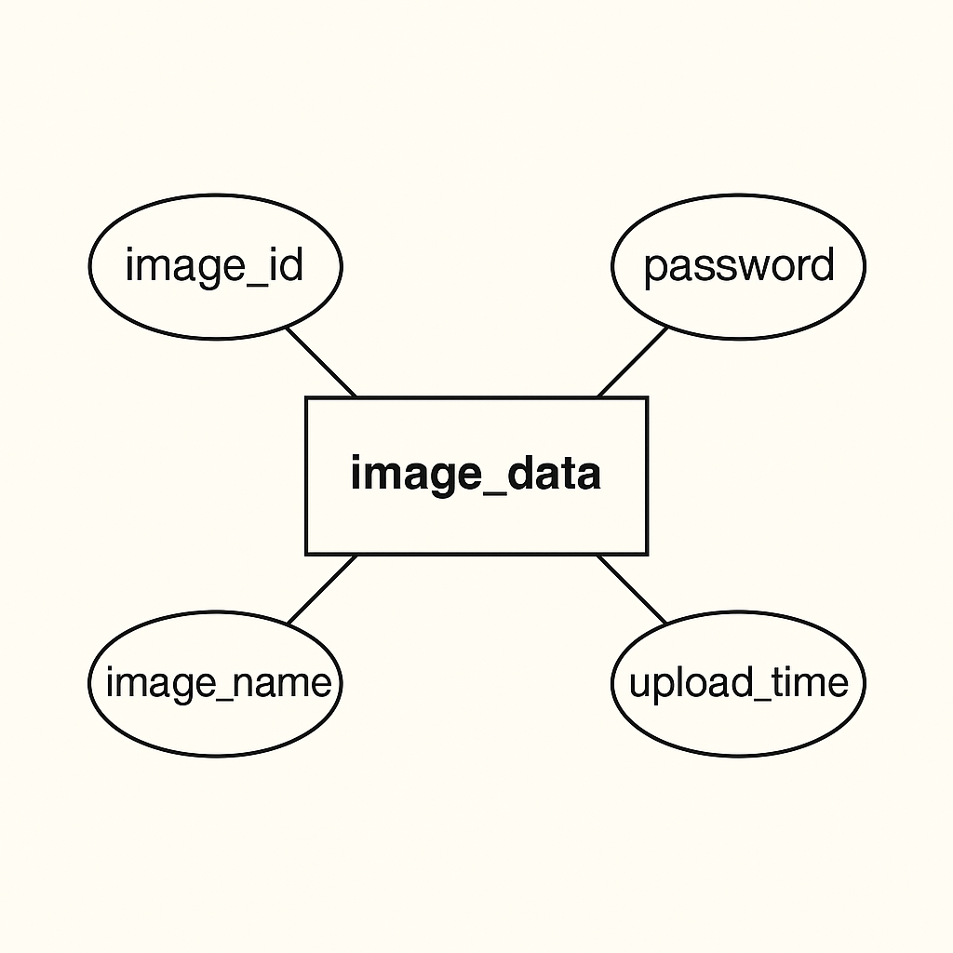
Database Analysis
The database adds a layer of security by storing image metadata and passwords,
enabling secure access control. It verifies user credentials during decryption, ensuring
only authorized users can retrieve hidden messages, while also managing multiple
encrypted images efficiently.
ER Diagram Description: The present database contains only one table that stores the image
identifier, name, upload time as well as password. Whenever the user provides an image for
decryption it verifies the id and password provided, if they match and exist in the database then
database returns the encrypted data.

Slide 34
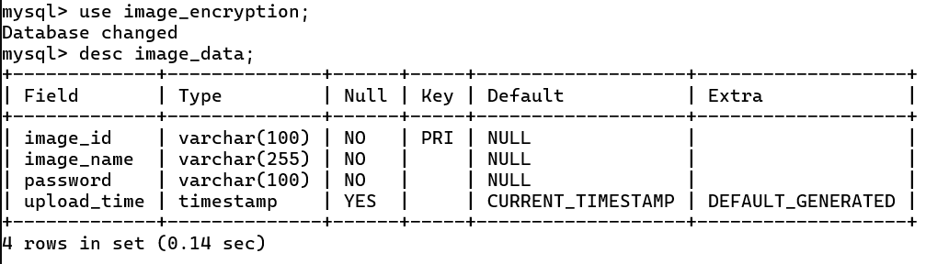
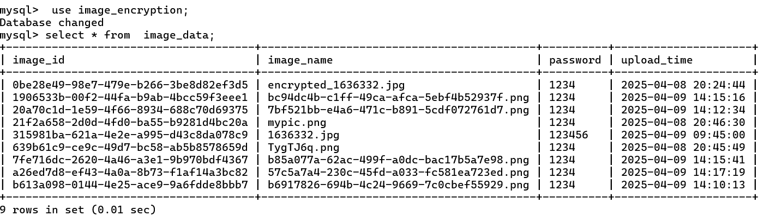
Database Analysis
The below image shows description of the table that has been created:
Here is the snapshot of the data that have been stored at a particular time of usage

Slide 35
Execution
Prerequisites: Before running the project, ensure you have:
Python installed with the following libraries:
Flask - pip install flask
OpenCV (cv2) - pip install opencv-python
Pillow (PIL) – pip install pillow
MySQL Connector (mysql-connector-python) – pip install mysql-connector-python
A MySQL server running with a database named image_encryption and a table created with:
CREATE TABLE image_data (
image_id VARCHAR(255) PRIMARY KEY,
image_name VARCHAR(255),
password VARCHAR(255)
);

Slide 36
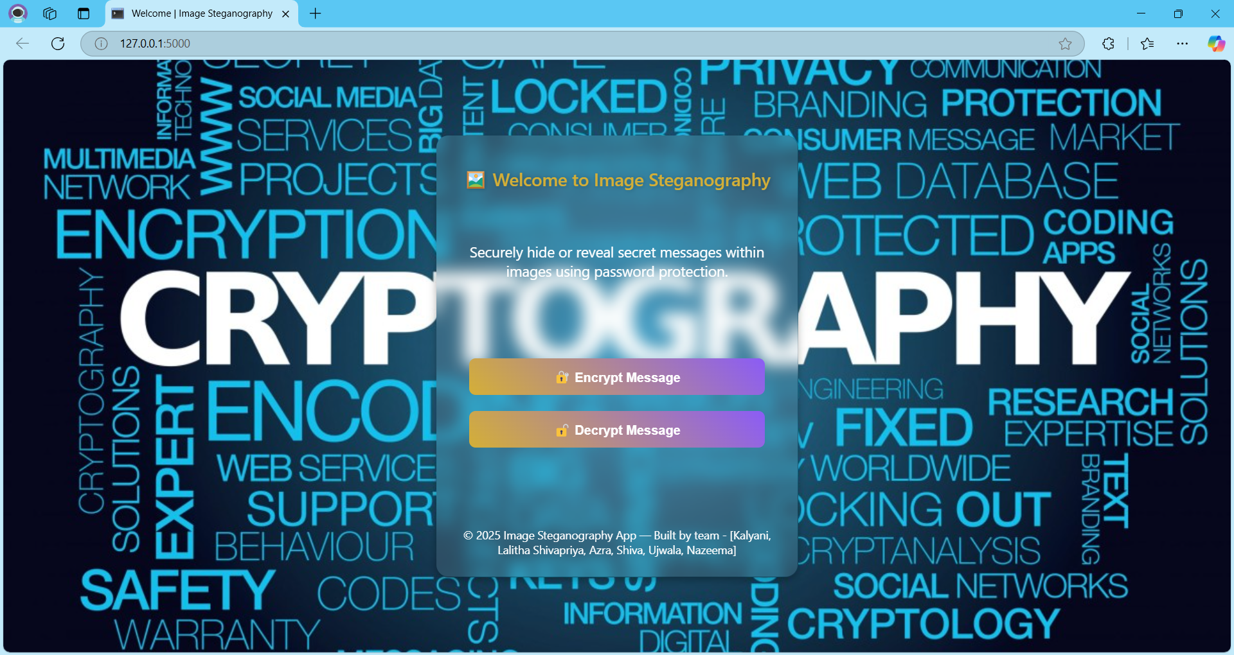
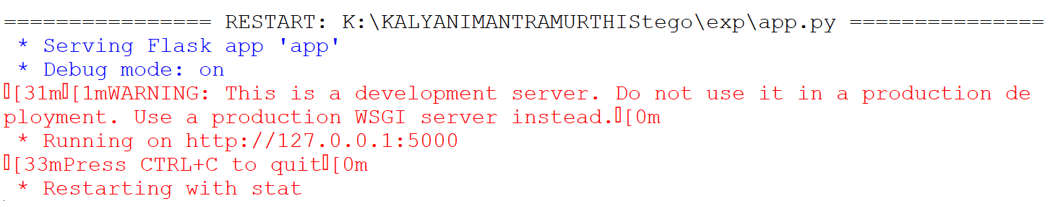
Execution
Execution Steps
Launch the Flask App
Run the Python script using command: “python app.py”. Visit http://127.0.0.1:5000/ in
your web browser.
Homepage (/): Loads the main page.

Slide 37
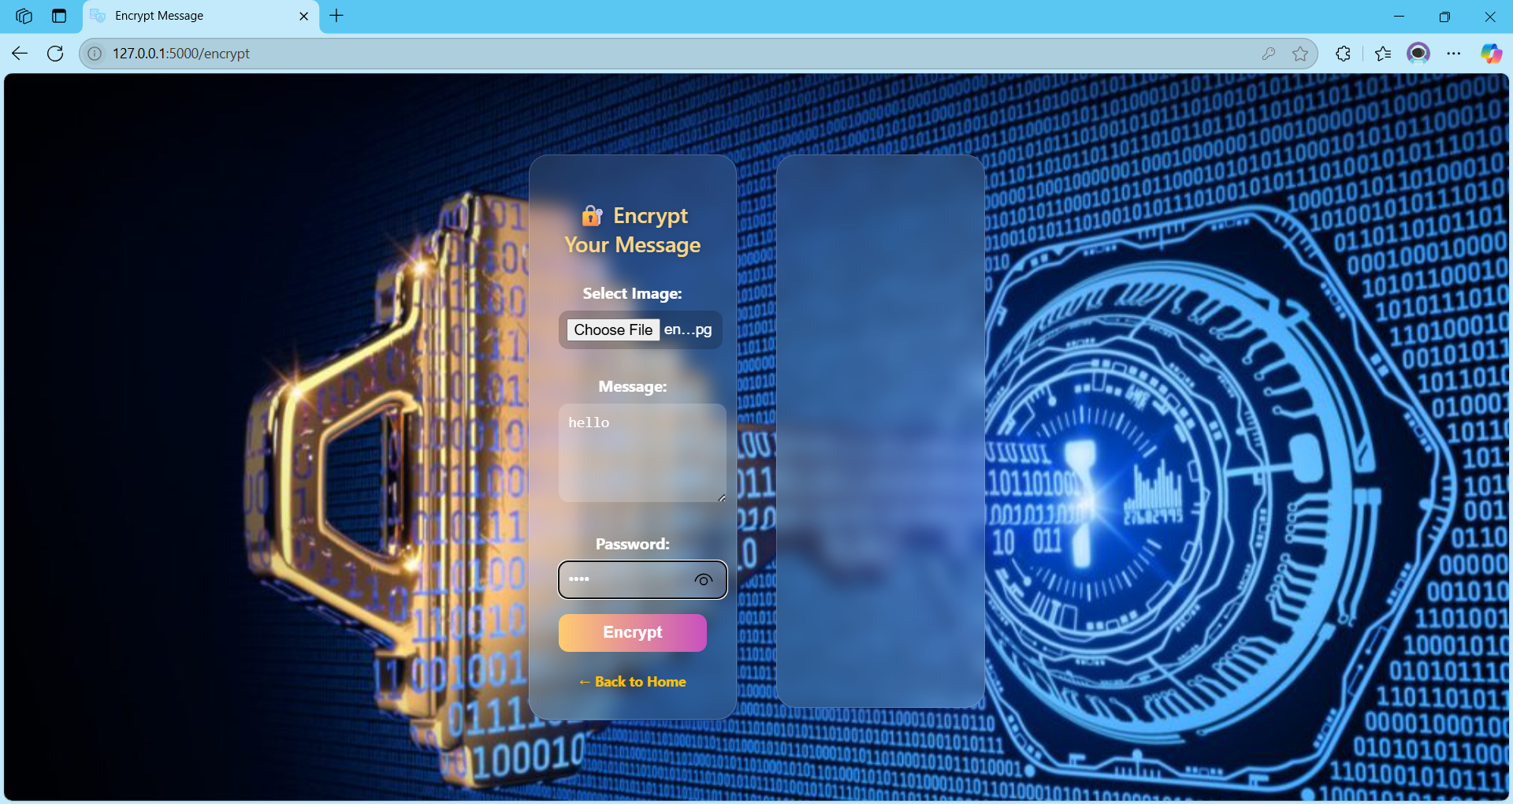
Execution
Execution Steps
Encryption Message(/):
when you click on encrypt button you will be navigated to the encryption page.

Slide 38
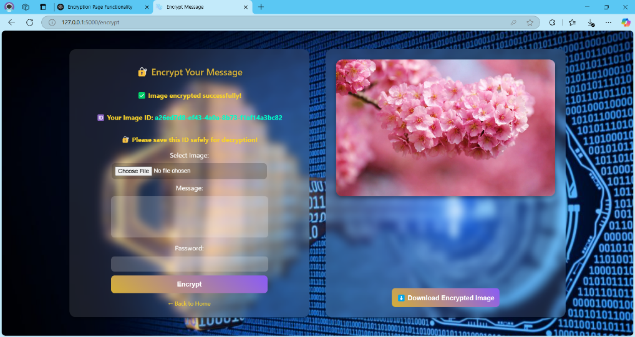
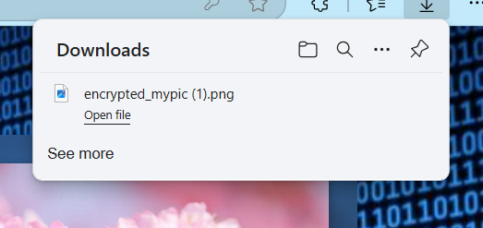
Execution
Encrypt (/encrypt):
User uploads image, message, and password. Message is Caesar-encrypted, embedded in the
image using LSB. Image is stored in memory; metadata (ID, name, password) saved in
MySQL. Returns encrypted image preview and download link. Download the encrypted
image and copy image ID

Slide 39
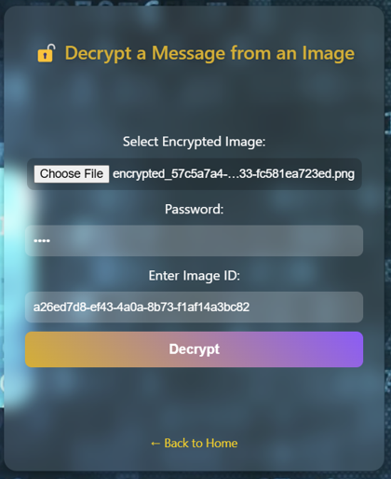
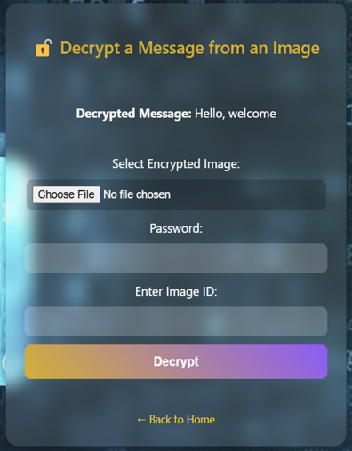
Execution
Decrypt (/decrypt):
User uploads encrypted image with image ID and password. Password is verified from
MySQL. If correct, message is extracted and Caesar-decrypted; result is shown.

Slide 40
System Testing
The aim of the system testing process was to determine all defects in our project. The program was
subjected to a set of test inputs and various observations were made and based on these observations it
will be decided whether the program behaves as expected or not. Our Project went through two levels of
testing.
1. UNIT TESTING
Overview: This Python code uses the unittest framework to test the functionality of steganography
Functions. The seies of tests that have been performed are:
test_encrypt_message_function: Verifies that the encryption function successfully encodes a message into an image without errors and produces valid Base64 image data.
setUp(self): Prepares a dummy image and sample data before each test to provide a consistent testing environment.
tearDown(self): Cleans up by deleting the dummy image after each test to avoid interference between tests.

Slide 41
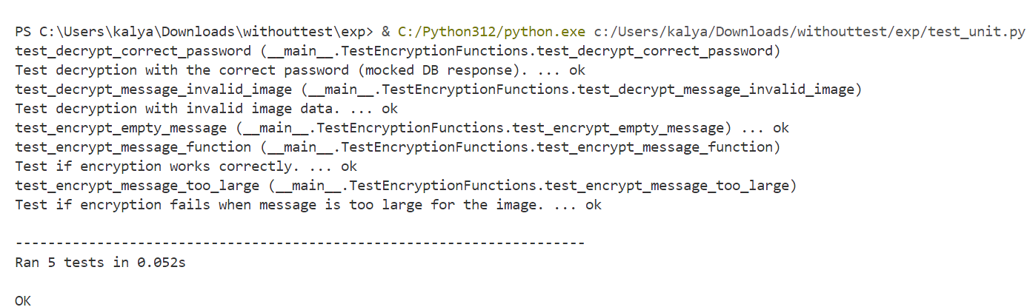
System Testing
test_decrypt_message_invalid_image: Checks that the decryption function properly detects and reports an error when given invalid image data.
test_encrypt_empty_message: Ensures the encryption function returns an appropriate error when attempting to encrypt an empty message.
test_encrypt_message_too_large: Confirms that the encryption function rejects messages that are too large to fit into the image, returning an error.
test_decrypt_correct_password: Validates that the decryption process succeeds and returns the expected result when the correct password is provided.

Slide 42
System Testing
INTEGRATION TESTING
Overview: Integration tests verify the interaction between different parts of the application, ensuring they work together as expected. In this case, the tests check if the routes of the Flask application are functioning correctly.
The tests cover various scenarios, including:
test_index_route: Tests if the home page loads and displays the word "Encrypt", confirming the main interface is available.
test_encrypt_page_get: Checks if the /encrypt page loads properly, ensuring the user can access the encryption form.
test_encrypt_post_missing_fields: Submits the encryption form with missing fields. Verifies that an error message ("All fields are required.") is shown. This checks input validation.

Slide 43
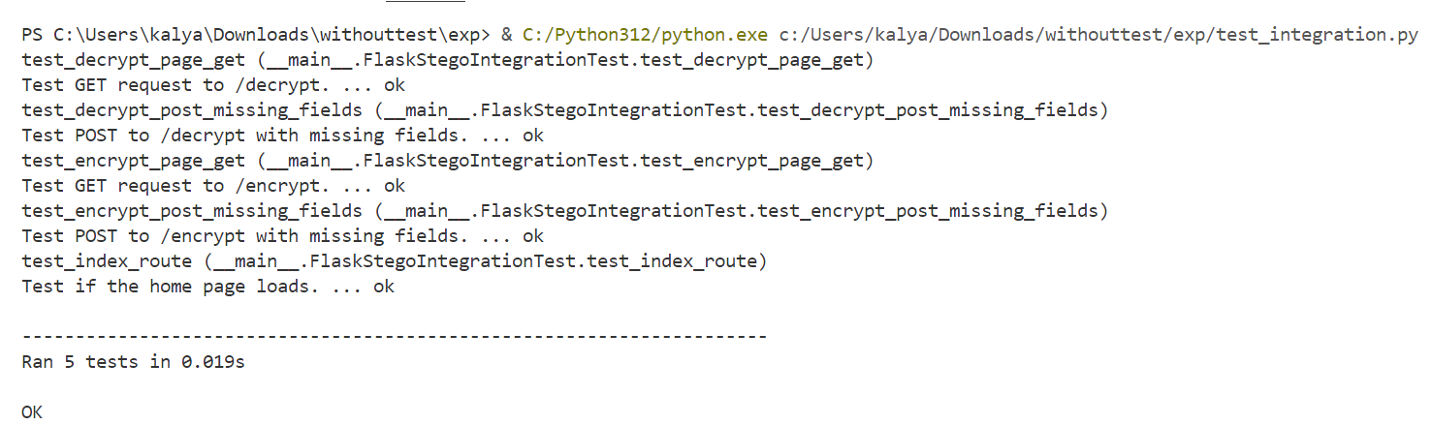
System Testing
test_decrypt_page_get: Checks if the /decrypt page loads and contains the word "Decrypt", confirming the decryption form is available.
test_decrypt_post_missing_fields: Submits the decryption form with missing data. Ensures the error message is shown, confirming validation works correctly.

Slide 44
Future Scope
Implement secure password hashing using libraries like bcrypt to protect stored passwords.
Add user authentication and registration to manage access and associate encrypted images with user accounts.
Integrate message encryption (e.g., AES) before embedding to ensure message confidentiality even if extracted.
Introduce dynamic message capacity checks based on image size and format before encryption.
Enhance logging and monitoring using Python's logging module or tools like Sentry for better debugging and error tracking
Develop a comprehensive history system to allow users to view, download, and manage previously encrypted images.
Apply brute-force protection by implementing rate limiting, captcha, and logging failed decryption attempts.

Slide 45
Conclusion
This steganography project successfully implements a secure message-hiding system within
digital images using Flask and OpenCV. The application provides an end-to-end solution for
covert communication through an intuitive web interface.
Core Achievements: The system effectively demonstrates LSB (Least Significant Bit) steganography techniques while maintaining image integrity. Password protection and MySQL database integration ensure secure data handling and access control.
Technical Validation: Comprehensive unit and integration testing confirms the reliability of both encryption/decryption workflows and system components. The project serves as a functional proof-of-concept for practical steganography applications.

Slide 46
References
BASE paper : IRJET-V7I5304.pdf
http://www.w3schools.com/html/html_intro.asp
http://www.Udemy.com/css/cssbackground.asp
http://www.w3schools.com/js/js_datatypes.asp
ChatGPT
What is Steganography? | GeeksforGeeks
Flask Tutorial | GeeksforGeeks
OpenCV Tutorial in Python | GeeksforGeeks
Connect MySQL database using MySQL-Connector Python | GeeksforGeeks
Python Pillow Tutorial

Slide 47

ANY QUESTIONS?

