Slide 1


Network Simulation using NS2
EDUCATION
EMPLOYABILITY
by K.Rasagnya
ENTREPRENEURSHIP
www.task.telangana.gov.in

Slide 2
Contents
Introduction to Network
Data communication
Components of Data communication
Direction of Data
OSI Model
TCP/IP protocol suite
Introduction to Network Simulator and its architecture
Network in NS2
Basic Linux commands
Installation of NS2
EDUCATION
EMPLOYABILITY
ENTREPRENEURSHIP
www.task.telangana.gov.in

Slide 3
Contents
EDUCATION
Steps to create a wired network scenario ﬁle
Execution of simulation and analysis of network using awk files
Procedure for simulation and analysis
Writing a TCL script to create two nodes and links between nodes
Writing a TCL script to transmit data between nodes
Wired Network Trace file format and analysis of simulation using awk script
Adding colour, shape and labelling the node and adding colour to the data traffic
EMPLOYABILITY
ENTREPRENEURSHIP
www.task.telangana.gov.in

Slide 4
Contents
EDUCATION
Writing a tcl script to label link and adding colour to the link
Writing a TCL script for UDP communication between sender & receiver
Performance evaluation of various Topologies
TCL script to simulate bottleneck network
Performance evaluation of Drop Tail and RED queue management schemes
Introduction and Installation of gnuplot and xgraph
TCL script to plot congestion for different sources and destinations
EMPLOYABILITY
ENTREPRENEURSHIP
www.task.telangana.gov.in

Slide 5
Contents
Plotting two or more files in one graph using gnuplot
Simulate to compare packet size and throughput
TCL script to simulate link state routing protocol
Steps to create a wireless network scenario ﬁle using DSDV
Performance Analysis of wireless network using awk files
Steps to create a wireless network scenario ﬁle using DSR
Tcl script to label, colour and marking the node in Wireless Networks
EDUCATION
EMPLOYABILITY
ENTREPRENEURSHIP
www.task.telangana.gov.in

Slide 6
Contents
EDUCATION
Performance evaluation of AODV Routing Protocol for Wireless Networks
Simulate to determine the performance with respect to different sources in Wireless Networks
Simulation and analysis of node movement in Wireless Networks
Tcl script to create traffic sessions for Wireless Networks using cbrgen
Tcl script to create mobility for Wireless Networks using setdest
Do’s and Don’ts in NS2
EMPLOYABILITY
ENTREPRENEURSHIP
www.task.telangana.gov.in

Slide 7
Introduction
EDUCATION
Network :
Network is a group of connected, communicating devices such as computers and printers etc.
Computer Network :
It is a collection of various computing devices.
Need of Computer Network :
A network is formed for resource sharing i.e., sharing available information to anyone on the network.
EMPLOYABILITY
ENTREPRENEURSHIP
www.task.telangana.gov.in

Slide 8
Data Communication
EDUCATION
Protocol
Protocol
Rules
Rules
EMPLOYABILITY
Sender
Message
Receiver
Medium
ENTREPRENEURSHIP
www.task.telangana.gov.in

Slide 9
Components of Data communication
Message :
It is the information(data) to be communicated.
Popular forms of information include text, numbers, pictures, audio, video.
Sender :
It is the device that sends the data message.
It can be a computer, telephone, handset, video camera etc.
Receiver :
It is the device that receives the message.
EDUCATION
EMPLOYABILITY
ENTREPRENEURSHIP
www.task.telangana.gov.in

Slide 10
Components of Data communication
EDUCATION
Transmission Medium :
It is the physical path by which a message travels from sender to receiver.
It can be wired or wireless.
Examples : twisted coaxial cable, fibre optic cable, radio waves etc.
Protocol :
It is set of rules that governs data communication.
It represents an agreement between the communicating devices.
The networking devices like computers should follow to transfer data efficiently.
EMPLOYABILITY
ENTREPRENEURSHIP
www.task.telangana.gov.in

Slide 11
Components of Data communication
EDUCATION
A Protocol defines
What is communicated
How it is communicated
When it is communicated
Key elements of Protocol are
Syntax
Semantics
Timings
EMPLOYABILITY
ENTREPRENEURSHIP
www.task.telangana.gov.in

Slide 12
Components of Data communication
EDUCATION
Syntax :
Refers to the structure or format of the data, meaning the order in which they are presented.
Example :
First 8 bits → Address of Sender
Next 8 bits → Address of Receiver
Rest of stream → Message
EMPLOYABILITY
ENTREPRENEURSHIP
www.task.telangana.gov.in

Slide 13
Components of Data communication
EDUCATION
Syntax :
The data order is also applied to the order of bits when they are stored or transmitted.
Different computers may store data in different bit orders.
When these computers communicated, this difference needs to be resolved.
EMPLOYABILITY
ENTREPRENEURSHIP
www.task.telangana.gov.in

Slide 14
Components of Data communication
EDUCATION
Semantics :
Refers to the meaning of each section of bits.
Timings :
Refers to 2 characteristics
When data should be sent
How fast it can be sent
EMPLOYABILITY
ENTREPRENEURSHIP
www.task.telangana.gov.in

Slide 15
Direction of Data
Communication between any two devices can be simplex, half-duplex, or full-duplex.
Simplex :
In simplex mode, the communication is unidirectional. Only one of the two devices on a link can transmit and the other can only receive.
EDUCATION
EMPLOYABILITY
Direction of data
keyboard
Monitor
ENTREPRENEURSHIP
www.task.telangana.gov.in

Slide 16
Direction of Data
EDUCATION
Keyboards and traditional monitors are examples of simplex devices. The keyboard can only introduce input and the monitor can only accept output.
The simplex mode can use the entire capacity of the channel to send data in one direction.
Half-duplex :
In half-duplex mode, each station can both transmit and receive, but not at the same time. When one device is sending, the other can only receive, and vice versa.
EMPLOYABILITY
ENTREPRENEURSHIP
www.task.telangana.gov.in

Slide 17
EDUCATION
Direction of data at time 1
System1
System2
Direction of data at time 2
Full-duplex :
In full-duplex mode (also called duplex), both stations can transmit and receive simultaneously.
EMPLOYABILITY
Direction of data all the time
ENTREPRENEURSHIP
System1
System2
www.task.telangana.gov.in

Slide 18
OSI Model
EDUCATION
When communication is not simple, we may divide the complex task of communication into several layers.
OSI model is used to have successful communication between computers or networks of different architectures
The OSI reference model describes how information from a software application in one computer moves through a network medium to a software application in another computer.
The model was developed by ISO and it is composed of seven layers each specifying a particular network function.
Each layer is a package of protocols.
EMPLOYABILITY
ENTREPRENEURSHIP
www.task.telangana.gov.in

Slide 19
OSI Model
Application
Presentation
Session
Transport
Network
Data Link
Physical
Enables the users to access the network
EDUCATION
To translate, encrypt and compress data
To establish, manage and terminate sessions, authentication and authorization
EMPLOYABILITY
To provide segmentation, flow control and error control
To provide logical addressing,
Routing and path determination
To organize bits into frame and to provide medium access control and error recovery
ENTREPRENEURSHIP
To transmit bits over a medium
and to provide mechanical and electrical specifications
www.task.telangana.gov.in

Slide 20
OSI Model
EDUCATION
Application Layer :
Enables the users to access the network.
This layer is used by network applications.
Network applications means computer applications that use internet like google chrome, Firefox etc.
These applications depend on application layer protocols to function.
EMPLOYABILITY
ENTREPRENEURSHIP
www.task.telangana.gov.in

Slide 21
OSI Model
EDUCATION
These Application Layer Protocols form the basis for various network services like file transfer, web surfing, sending emails etc.
File transfer is done by FTP protocol.
Web surfing is done with help of HTTP or HTTPS protocol.
For emails, SMTP is used.
So, Application layer provides services for network applications with the help of protocols to perform user activities.
EMPLOYABILITY
ENTREPRENEURSHIP
www.task.telangana.gov.in

Slide 22
EDUCATION
Presentation Layer :
It receives data from application layer.
Presentation layer performs 3 basic functions.
Translation
Compression
Encryption / Decryption
EMPLOYABILITY
ENTREPRENEURSHIP
www.task.telangana.gov.in

Slide 23
Translation :
The data which is received from application layer is in the form of characters and numbers.
Presentation layer convert these characters and numbers to machine understandable (binary) language.
Example : Conversion of ASCII to Binary
DFGJC 10010
EDUCATION
EMPLOYABILITY
ENTREPRENEURSHIP
www.task.telangana.gov.in

Slide 24
Data Compression :
Before the data is transmitted, Presentation layer reduces the number of bits that are used to represent the original data.
This bit reduction process is called “Data Compression”.
It reduces the amount of space used to store the original file.
As the size of the file is reduced, it can be received at the destination in very less time i.e., data transmission can be done faster.
EDUCATION
EMPLOYABILITY
ENTREPRENEURSHIP
www.task.telangana.gov.in

Slide 25
Encryption / Decryption :
To maintain integrity of data, before transmission, “data is encrypted”.
Encryption enhances security of sensitive data.
Secure Socket Layer ( SSL ) is used in Presentation layer for encryption and decryption.
At Sender side, data is Encrypted.
At Receiver side, data is Decrypted.
EDUCATION
EMPLOYABILITY
ENTREPRENEURSHIP
www.task.telangana.gov.in

Slide 26
Session Layer :
It helps in setting up and managing connections enabling sending and receiving of data, followed by termination of connections or sessions.
Just before a session or a connection is establishment with a server, server performs a function called “Authentication”.
After authenticating the user, “Authorization” is checked.
Thus the session layer helps in
Session management
Authentication
Authorization
EDUCATION
EMPLOYABILITY
ENTREPRENEURSHIP
www.task.telangana.gov.in

Slide 27
Transport Layer :
Transport layer controls reliability of communication through
Segmentation
Flow control
Error control
Protocols of transport layer are
Transmission Control Protocol (TCP)
User Datagram Protocol (UDP)
EDUCATION
EMPLOYABILITY
ENTREPRENEURSHIP
www.task.telangana.gov.in

Slide 28
Segmentation :
Data received from session layer is divided into small data units called segments.
Each segment contains a source and destinations Port Numbers and a Sequence Number.
EDUCATION
EMPLOYABILITY
Data
ENTREPRENEURSHIP
Data 1
Data 3
Data 2
www.task.telangana.gov.in

Slide 29
Flow control :
It controls the amount of data being transmitted.
EDUCATION
100 Mbps
Server
Mobile
EMPLOYABILITY
50 Mbps
50 Mbps
ENTREPRENEURSHIP
Server
Mobile
50 Mbps
www.task.telangana.gov.in

Slide 30
EDUCATION
Error control :
Transport layer also helps in error control.
If some data does not arrive the destination, transport layer uses “Automatic Repeat Request” to retransmit the lost or corrupted data.
A group of bits called checksum is added to each segment by the transport layer to find out the received corrupted segment.
EMPLOYABILITY
ENTREPRENEURSHIP
www.task.telangana.gov.in

Slide 31
EDUCATION
Network Layer :
Transport layer transmits segments to network layer.
Network Layer works for the transmission of received data segments from one computer to the other computer located in different network (internetworking).
Data units in the network layer are called “Packets”.
In Network Layer we have routers.
EMPLOYABILITY
ENTREPRENEURSHIP
www.task.telangana.gov.in

Slide 32
Functions of Network Layer :
Logical addressing :
IP addressing done in Network Layer is called Logical addressing.
IP address are assigned to ensure each data packet can reach the correct destination.
EDUCATION
EMPLOYABILITY
Packet
Segment | IP address (Sender) | IP address (Receiver)
ENTREPRENEURSHIP
www.task.telangana.gov.in

Slide 33
Routing :
It is the process of moving data packet from source to destination and it is based on the logical addressing.
Path determination :
A computer can be connected to internet server or to a computer in number of ways.
Choosing the best possible path for data deliver from source to destination is called Path determination.
EDUCATION
EMPLOYABILITY
ENTREPRENEURSHIP
www.task.telangana.gov.in

Slide 34
EDUCATION
Data Link Layer :
It receives data packets from Network layer.
Data Link Layer is embedded as software in NIC of a computer and provide means to transmit data from one computer to other computer via a local media ( copper wire, optical fibre, air ).
EMPLOYABILITY
ENTREPRENEURSHIP
www.task.telangana.gov.in

Slide 35
Functions of Data Link Layer :
Physical addressing :
It allows upper layer of OSI model to access the media using technique called framing.
MAC address of sender and receiver are added to data packet to form a frame.
EDUCATION
EMPLOYABILITY
ENTREPRENEURSHIP
Frame
MAC 1 | MAC 2 | Packet | Tail
www.task.telangana.gov.in

Slide 36
Medium Access Control :
The technique used to get the frame on and off the media is called Medium Access Control.
If two or more devices connected to the same media and send data at the same time, then there will be a possibility of collision of two messages.
To avoid these situations, DLL checks when the shared media is free. This is called CSMA ( Carrier Sense Multiple Access ).
Error Detection :
Tail of each frame contains bits which are used to detect errors.
EDUCATION
EMPLOYABILITY
ENTREPRENEURSHIP
www.task.telangana.gov.in

Slide 37
EDUCATION
Physical Layer :
It receives data from Data Link layer which is a sequence of binary numbers.
Physical Layer converts these binary sequence into signals and transmits over local media .
EMPLOYABILITY
ENTREPRENEURSHIP
www.task.telangana.gov.in

Slide 38
TCP/IP Protocol Suite
EDUCATION
Developed from OSI model.
It is made up of five layers.
The first four layers provide physical standards, network interface, internetworking and transport functions.
The three topmost layers in the OSI model, however are represented in TCP/IP by a single layer called the application layer.
Application
Transport
Network
Data Link
Physical
EMPLOYABILITY
ENTREPRENEURSHIP
www.task.telangana.gov.in

Slide 39
What is NS2 ?
EDUCATION
Ns2 stands for Network Simulator version 2.
It is an open source simulator designed for research in computer networks.
Network Simulator is a software that predicts the behavior of computer network.
Setting up a network to do some real experiments is the best way for studying about computer networks.
However, setting a network is not easy and costly.
For this reason, a virtual network provided by network simulator is used for experiment in only one computer.
EMPLOYABILITY
ENTREPRENEURSHIP
www.task.telangana.gov.in

Slide 40
What is NS2 ?
EDUCATION
In simulator, the computer network is modeled. The network model describes
the network (devices, links, application etc.)
the events ( data transmission, packet error etc.).
Output results include performance metrics of network like sent packets, received packets, throughput, delay, packet drop etc.
Trace files are also available which describes the every event occurred in the simulation and are used for analysis.
EMPLOYABILITY
ENTREPRENEURSHIP
www.task.telangana.gov.in

Slide 41
Reasons for Using NS-2
EDUCATION
1. It does not require costly equipment.
2. Complex scenarios can be easily tested.
3. Results can be quickly obtained.
4. More ideas can be tested in a smaller time frame.
5. Controlled experimental conditions.
EMPLOYABILITY
ENTREPRENEURSHIP
www.task.telangana.gov.in

Slide 42
Network simulation
EDUCATION
It uses programming to represent devices.
Easy and can be easily verified.
It is a event driven simulator.
It provides support for
simulation of TCP, UDP.
Routing.
Huge number of protocols ranging from wired to wireless networks.
support the addition of new entities like agents, packet, application, queue, protocol, routing etc.
Errors are being discovered and corrected.
EMPLOYABILITY
ENTREPRENEURSHIP
www.task.telangana.gov.in

Slide 43
NS2 Architecture
EDUCATION
Simulation objects
NS2 Shell Executable Command (ns)
TCL
Simulation
Script
TclCL
Simulation
Objects
Simulation
Objects
Simulation
Results
EMPLOYABILITY
C++
OTcl
ENTREPRENEURSHIP
NAM
( Animation )
Trace file

Slide 44
Network simulation
NS2 use Tcl language for creating simulation scenario ﬁle (for example, ns1.tcl).
ns1.tcl :
It is the name of a tcl script file which defines the simulation scenario.
Network topology, transmission time, using protocol etc... are deﬁned in scenario ﬁle.
If we execute this scenario ﬁle, the simulation results will be ns1.tr and ns1.nam ﬁle.
ns1.tr :
all the information about communication is written in this ﬁle.
This ﬁle is called as Trace ﬁle.
ns1.nam :
Used to visualize the simulation.
This ﬁle can be execute by Nam, an animation software.
EDUCATION
EMPLOYABILITY
ENTREPRENEURSHIP
www.task.telangana.gov.in

Slide 45
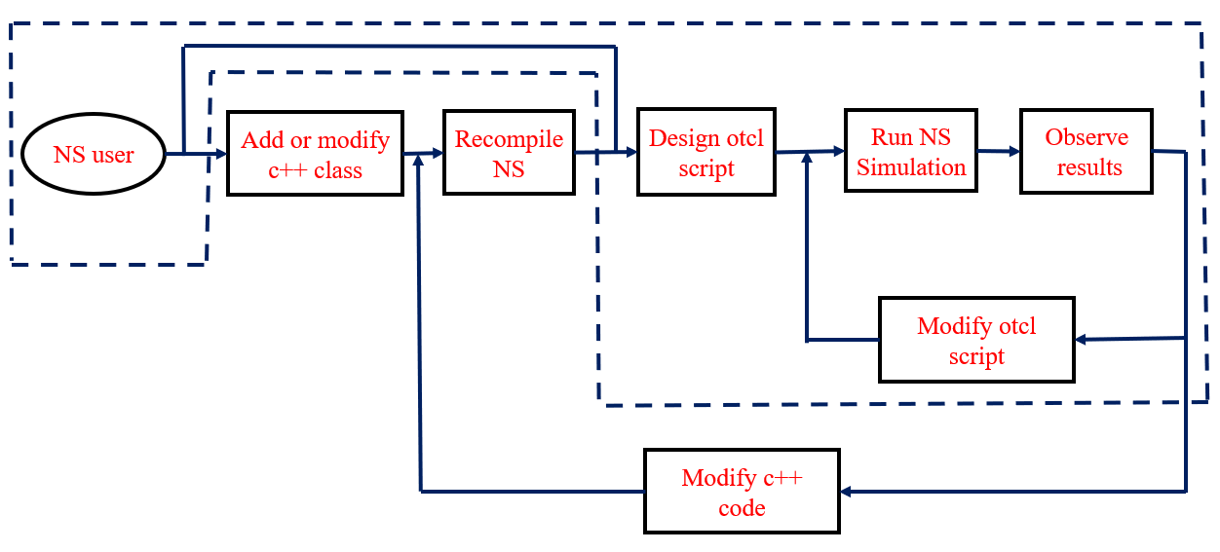
General work process of NS2
EDUCATION
EMPLOYABILITY
ENTREPRENEURSHIP
www.task.telangana.gov.in

Slide 46
Network in NS2
EDUCATION
Sender
Receiver
FTP , CBR HTTP , SMTP
TCP | UDP
IP
Ethernet
FTP , CBR HTTP , SMTP
TCP | UDP
IP
Ethernet
Application
Router
EMPLOYABILITY
Transport
Network
IP
Ethernet
Physical, Datalink
cable
cable
ENTREPRENEURSHIP
www.task.telangana.gov.in

Slide 47
Network in NS2
EDUCATION
The node (terminal, router) in real network have 4 layer using TCP/IP model.
Actually, forwarding node (router) have only 2 bottom layer.
Two bottom layers are ready automatically when a node setting up.
TCP or UDP in transport layer are shown as Agent. FTP, CBR are in application layers.
Realistic networks use cable for link between 2 nodes. In NS2, a link is use for connection. Each link has a queue which is similar to buﬀer in realistic network. Packets sent from node should be queuing in queue.
EMPLOYABILITY
ENTREPRENEURSHIP
www.task.telangana.gov.in

Slide 48
Platforms to install NS2
EDUCATION
Linux operating system
Ubuntu
Fedora
Linux mint
Windows
EMPLOYABILITY
ENTREPRENEURSHIP
www.task.telangana.gov.in

Slide 49
Requirements of NS2
EDUCATION
ns-allinone-2.35 software
NSG2.1 software
Gnuplot
Xgraph
EMPLOYABILITY
ENTREPRENEURSHIP
www.task.telangana.gov.in

Slide 50
Basic Linux Commands
cp : copy files
rm : remove or delete files
make : to compile or recompile
gedit : editors (similar to notepad)
pwd : Present Working Directory.
passwd : to change the user password.
clear : to clear the screen.
EDUCATION
EMPLOYABILITY
ENTREPRENEURSHIP
www.task.telangana.gov.in

Slide 51
Basic Linux Commands
EDUCATION
mkdir : to create a directory.
rmdir : to delete directory.
cd : to change the directory.
cd .. : previous directory
ls : to list the contents of current directory.
ls –l : long format of showing list of files.
chmod : changing the mode of the file.
EMPLOYABILITY
ENTREPRENEURSHIP
www.task.telangana.gov.in

Slide 52
Long format of file
EDUCATION
 | r | w | x | r | w | x | r | w | x
EMPLOYABILITY
Owner
Group Users
Other Users
- : File
d : Directory
r : read
w : write
x : execute
ENTREPRENEURSHIP
www.task.telangana.gov.in

Slide 53
Long format of file
Ex :
EDUCATION
- | r | w | x | r | - | x | r | - | -
EMPLOYABILITY
Indicates File
Owner
can
Read, write and execute the file
Group Users
can
Read and execute
the file
Other Users can only read file
ENTREPRENEURSHIP
www.task.telangana.gov.in

Slide 54
Steps to create a wired network scenario ﬁle
EDUCATION
Declare Simulator
Create output ﬁles (tracing and animation file )
Setting Node
Setting Link between the nodes
Setting Agent
Setting Application
Setting time schedules for Simulation
Declare ﬁnish
EMPLOYABILITY
ENTREPRENEURSHIP
www.task.telangana.gov.in

Slide 55
Steps to create a scenario ﬁle
EDUCATION
Declare Simulator :
S should be capital letter in Simulator.
Simulator is the name of the c++ class. We have to call this c++ class from the precompiled library.
new is to create the instants of this simulator.
set ns [new Simulator]
EMPLOYABILITY
ENTREPRENEURSHIP
www.task.telangana.gov.in

Slide 56
Steps to create a scenario ﬁle
EDUCATION
Create output ﬁles :
Setting Node :
set tracefile [open ns1.tr w]
$ns trace-all $tracefile
set namfile [open ns1.nam w]
$ns namtrace-all $namfile
EMPLOYABILITY
ENTREPRENEURSHIP
set n0 [$ns node]
set n1 [$ns node]
www.task.telangana.gov.in

Slide 57
Steps to create a scenario ﬁle
EDUCATION
Setting Link :
In line 1, a duplex link between n0 and n1 is declared.
The link between two nodes n0 and n1 has bandwidth 3Mbps and delay 5ms.
DropTail is a waiting queue type.
Line 2 sets positions of node and link for Nam.
$ns duplex-link $n0 $n1 3Mb 5ms DropTail
$ns duplex-link $n0 $n1 orient right-down
EMPLOYABILITY
ENTREPRENEURSHIP
www.task.telangana.gov.in

Slide 58
Steps to create a scenario ﬁle
EDUCATION
Setting Agent :
UDP Agent :
To use UDP in simulation, the sender sets the Agent as UDP Agent while the receiver sets to Null Agent.
Null Agents do nothing except receiving the packets.
In ﬁrst 4 lines, udp and null Agent are set for n0 and n1, respectively.
Line 5 declares the transmission between udp and null.
set udp [new Agent/UDP]
$ns attach-agent $n0 $udp
set null [new Agent/Null]
$ns attach-agent $n1 $null
$ns connect $udp $null
EMPLOYABILITY
ENTREPRENEURSHIP
www.task.telangana.gov.in

Slide 59
Steps to create a scenario ﬁle
EDUCATION
Setting Agent :
TCP Agent :
To use TCP in simulation, the sender sets the Agent as TCP Agent while the receiver sets to TCPSink Agent.
When receiving a packet, TCPSink Agent will reply an acknowledgment packet (ACK).
In ﬁrst 4 lines, tcp and sink Agent are set for n0 and n1, respectively.
Line 5 declares the transmission between tcp and sink.
EMPLOYABILITY
set tcp [new Agent/TCP]
$ns attach-agent $n0 $tcp
set sink [new Agent/TCPSink]
$ns attach-agent $n1 $sink
$ns connect $tcp $sink
ENTREPRENEURSHIP
www.task.telangana.gov.in

Slide 60
Steps to create a scenario ﬁle
EDUCATION
Setting Application :
UDP Agent uses CBR Application
TCP Agent uses FTP Application.
EMPLOYABILITY
set cbr [new Application/Traffic/CBR] $cbr attach-agent $udp
set ftp [new Application/FTP]
$ftp attach-agent $tcp
ENTREPRENEURSHIP
www.task.telangana.gov.in

Slide 61
Steps to create a scenario ﬁle
EDUCATION
Setting time schedule for simulation :
cbr transmits data from 1.0[sec] to 8.5[sec]
ftp transmits data from 2.5[sec] to 8.0[sec]
EMPLOYABILITY
$ns at 1.0 "$cbr start"
$ns at 2.5 "$ftp start“
$ns at 8.0 "$ftp stop"
$ns at 8.5 "$cbr stop"
ENTREPRENEURSHIP
www.task.telangana.gov.in

Slide 62
Steps to create a scenario ﬁle
Declare ﬁnish : Simulation will stop at 10 sec
EDUCATION
$ns at 10.0 "finish"
proc finish {} {
global ns tracefile namfile
$ns flush-trace
close $tracefile
close $namfile
exit 0
}
$ns run
EMPLOYABILITY
ENTREPRENEURSHIP
www.task.telangana.gov.in

Slide 63
Execution of Simulation
EDUCATION
By executing below command line, simulation will be started.
After the simulation, Nam will be started and shows the animation of simulation.
Command for opening nam file directly
ns ns1.tcl
EMPLOYABILITY
ENTREPRENEURSHIP
nam ns1.nam
www.task.telangana.gov.in

Slide 64
Analysis of Simulation
AWK is a high level programming language which is used to process the text files.
Its name is derived from the family names of its authors
A : Alfred Aho
W : Peter Weinberger
K : Brian Kernighan
AWK scripts are very good in processing the data column wise from long trace files which we get from NS2.
EDUCATION
EMPLOYABILITY
ENTREPRENEURSHIP
www.task.telangana.gov.in

Slide 65
Analysis of Simulation
EDUCATION
It contains mainly three parts
Begin
Content
End
We have to run the AWK scripts using the following command
EMPLOYABILITY
awk –f wired.awk ns1.tr
ENTREPRENEURSHIP
www.task.telangana.gov.in

Slide 66
Procedure for simulation and analysis
1. Open terminal and go to the directory where the jar file is present.
2. After going to the directory to open the jar file.
Type the command:
java –jar NSG2.1.jar
Where, NSG2.jar is the jar file name.
3. In scenario select new wired or wireless scenario. Place nodes wherever necessary and link the nodes.
4. Attach tcp or udp to source node and tcp sink or null to destination node in the Agent tab.
5. Connect to source and destination i.e., tcp and tcpsink or udp and null.
6. Attach ftp or cbr to source in the Application tab.
EDUCATION
EMPLOYABILITY
ENTREPRENEURSHIP
www.task.telangana.gov.in

Slide 67
7. In parameters give nam and trace files name in simulation tab. Select routing protocol in wireless tab.
8. Click on tcl to get tcl code. Save the file as <filename>.tcl
9. Go to the tcl file directory in terminal and execute file by command
ns <filename>.tcl
10. After executing tcl file, NAM file and trace file are generated.
11. The simulation can be seen in the network animator.
12. Analyze the files using awk files, to calculate the parameter values type the following command
awk –f <awk filename >.awk <trace filename >.tr
EDUCATION
EMPLOYABILITY
ENTREPRENEURSHIP
www.task.telangana.gov.in

Slide 68
Transport Layer Protocols
EDUCATION
A Transport Layer has several responsibilities
1. To create a process to process communication.
2. To provide error and flow control mechanisms.
A Transport Layer has two important protocols.
1. User Datagram Protocol ( UDP )
2. Transmission Control Protocol ( TCP )
EMPLOYABILITY
ENTREPRENEURSHIP
www.task.telangana.gov.in

Slide 69
User Datagram Protocol ( UDP )
It is a connectionless, unreliable transport protocol. It provides process to process communication.
There is no flow control mechanism and there is no acknowledgement for received packets.
UDP, however does provide error control to some extent. If UDP detects an error in the received packets, it silently drops it.
UDP is a very simple protocol using a minimum overhead. So if a process wants to send a small message and does not care much about reliability, it can use UDP.
EDUCATION
EMPLOYABILITY
ENTREPRENEURSHIP
www.task.telangana.gov.in

Slide 70
Transmission Control Protocol ( TCP )
1. It is a connection oriented, reliable transport protocol. It performs all tasks required by transport layer.
2. TCP is responsible for delivery of the message to the appropriate application program. TCP groups
number of bytes into a packet called a segment.
3. TCP provide flow control and error control.
4. Error detection in TCP is achieved through the use of 3 simple tools
Checksum: to check corrupted segments.
Acknowledge: uses to confirm the receipt of those segments that have reached the destination.
5. Error correction is very simple, if a segment is corrupted or lost, the segment will be retransmitted.
EDUCATION
EMPLOYABILITY
ENTREPRENEURSHIP
www.task.telangana.gov.in

Slide 71
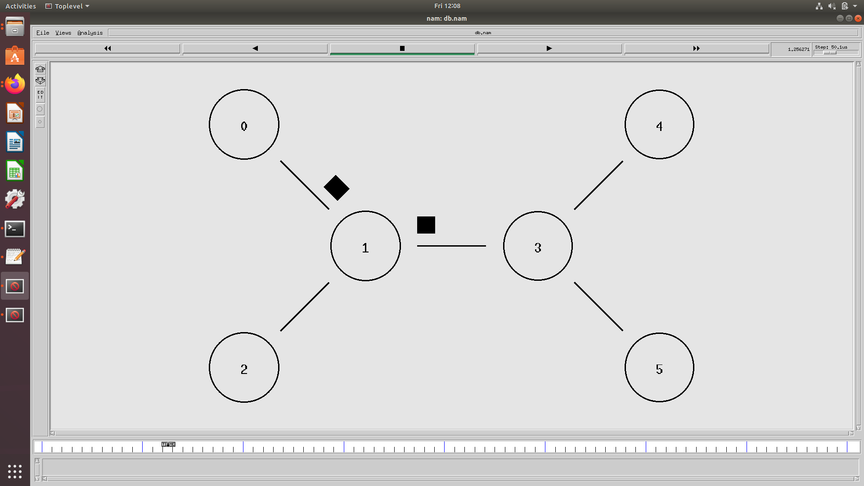
Data Transmission using TCP or UDP
EDUCATION
EMPLOYABILITY
ENTREPRENEURSHIP
www.task.telangana.gov.in

Slide 72
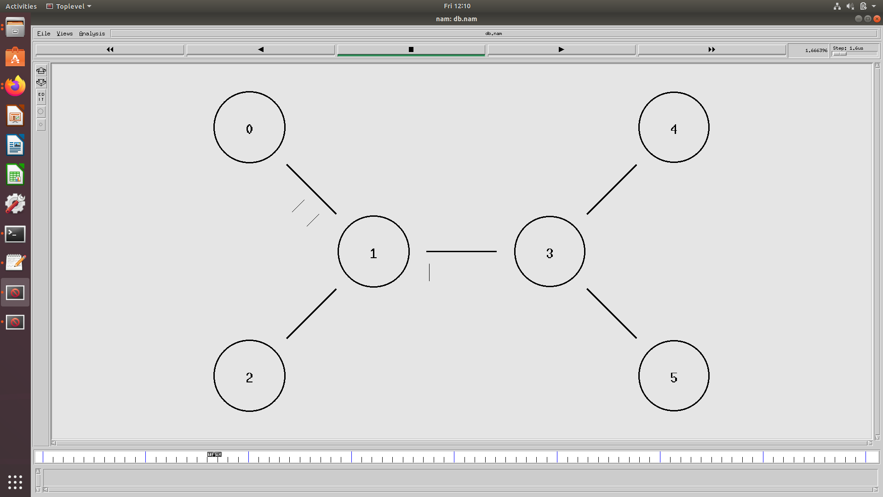
Acknowledgements in TCP
EDUCATION
EMPLOYABILITY
Acknowledgements
ENTREPRENEURSHIP
www.task.telangana.gov.in

Slide 73
Wired Network Trace file format
Event :
First character in trace file represent type of event, i.e. packet dropped, received, added to queue.
Time :
Second field in trace file represent time in second at which event occurred.
EDUCATION
Event | Time | From Node | To Node | Pkt Type | Pkt Size | Flags | Flow id | Src Addr | Dst Addr | Seq Num | Pkt Id
EMPLOYABILITY
+ | An enqueue operation occurred on the device queue
- | A dequeue operation occurred on the device queue
d | A packet was dropped, typically because the queue was full
r | A packet was received by the net device
ENTREPRENEURSHIP
www.task.telangana.gov.in

Slide 74
Wired Network Trace file format
EDUCATION
From and to Node :
Third and fourth field in trace file specify and sender and receiver of current packet.
Packet Type :
Fifth field in trace file represent type of packet. It can be tcp, ack, cbr, etc., depends on the application attached.
Packet size :
Sixth field show size of packet in bytes.
EMPLOYABILITY
Packet type | Meaning
Tcp | Tcp packet
cbr | Cbr traffic packet
Ack | Acknowledge packet
Aodv | Aodv packet
ENTREPRENEURSHIP
www.task.telangana.gov.in

Slide 75
Flow id :
This field is used to specify the data flow colour for the NAM display.
Source and Destination address :
Source and destination address is specifier in format of "addr.port". Port is also specified with node address.
Sequence number :
In ns2 agent can attach sequence number with packets. This field is used only when agent attach sequence number to packets.
Packet id :
Every packet has a unique identifier. Every time a new packet is generated, assigned a unique id to it.
EDUCATION
EMPLOYABILITY
ENTREPRENEURSHIP
www.task.telangana.gov.in

Slide 76
QOS Parameters Formula
EDUCATION
Throughput : Received Bytes *8
Simulation Time
Total Delay : Time delay of all received packets
Average Delay : Total Delay
Received Packets
EMPLOYABILITY
ENTREPRENEURSHIP
www.task.telangana.gov.in

Slide 77
QOS Parameters Formula
EDUCATION
Packet drop : Number of dropped packets
Packet Drop Ratio : Dropped Packets * 100
Sent Packets
Packet Delivery Ratio : Received Packets * 100
Sent Packets
EMPLOYABILITY
ENTREPRENEURSHIP
www.task.telangana.gov.in

Slide 78
QOS Parameters Formula
EDUCATION
Average Energy Consumed : Total Energy Consumed
Number of Nodes
Average Remaining Energy : Initial Energy – Average Energy Consumed
Control Overhead : Total Number of Routing Packets
Total Number of Data Packets
EMPLOYABILITY
ENTREPRENEURSHIP
www.task.telangana.gov.in

Slide 79
Color definition for different traffic flow
EDUCATION
1. After creating a ns Simulator, include these two lines
$ns color 1 Red ;
$ns color 2 Blue ;
2. In Agents Definition, after adding agents include below lines
$tcp0 set fid_ 1
$udp1 set fid_ 2
EMPLOYABILITY
ENTREPRENEURSHIP
www.task.telangana.gov.in

Slide 80
Color, shape and labelling nodes
EDUCATION
1. To change Color and shape of nodes
$n0 shape box
$n0 color purple
2. To label the node
$ns at 0.0 "$n0 label S1"
$ns at 0.0 "$n2 label S2“
( or )
$n4 label ”D1”
$n5 label ”D2”
EMPLOYABILITY
ENTREPRENEURSHIP
www.task.telangana.gov.in

Slide 81
Color and labelling links
EDUCATION
1. To change Color of links
$ns duplex-link-op $n0 $n1 color “green”
$ns duplex-link-op $n1 $n2 color “red”
2. To label the links
$ns duplex-link-op $n0 $n1 label “L1”
$ns duplex-link-op $n1 $n2 label “L2”
EMPLOYABILITY
ENTREPRENEURSHIP
www.task.telangana.gov.in

Slide 82
Network Topologies
EDUCATION
Topology :
Graphical Representation of the relationship of all the links and linking devices (nodes) to one another.
It is two types
Physical Topology
Logical Topology
EMPLOYABILITY
ENTREPRENEURSHIP
www.task.telangana.gov.in

Slide 83
Network Topologies
EDUCATION
Physical Topology :
It describes the way computers connect with the help of cables.
EMPLOYABILITY
cable
ENTREPRENEURSHIP
www.task.telangana.gov.in

Slide 84
Network Topologies
Logical Topology :
It describes the way data flows from one computer to another within a computer network.
EDUCATION
EMPLOYABILITY
Data
ENTREPRENEURSHIP
www.task.telangana.gov.in

Slide 85
Network Topologies
EDUCATION
Network topology refers to the way in which the devices are interconnected.
The most common computer network used to interconnect physically distributed computers is “Local Area Network”.
It is five types
1. Star 2. Mesh
3. Ring 4. Bus
5. Hybrid
EMPLOYABILITY
ENTREPRENEURSHIP
www.task.telangana.gov.in

Slide 86
Star Topology :
In this topology computers connect to a central device, a switch or a hub with point to point communication links.
point to point connection means that there is dedicated link (cable) between the two devices, other devices cannot use it.
In this topology, if one computer wants to send data frame to another, first it should be sent to the central device.
EDUCATION
EMPLOYABILITY
ENTREPRENEURSHIP
www.task.telangana.gov.in

Slide 87
EDUCATION
Star Topology :
Then the central device either broadcast or unicast the received data frame towards the destination computer based on the type of central device used.
Broadcast : It means transmission of data to all connected devices.
unicast : It means transmission of data to the target device only.
EMPLOYABILITY
ENTREPRENEURSHIP
www.task.telangana.gov.in

Slide 88
Hub :
If the central device is hub, it broadcast the received data to all the connected computers.
Hub is a multiport repeater.
The frame has a destination MAC address which is unique to every computer present in a network.
EDUCATION
EMPLOYABILITY
ENTREPRENEURSHIP
www.task.telangana.gov.in

Slide 89
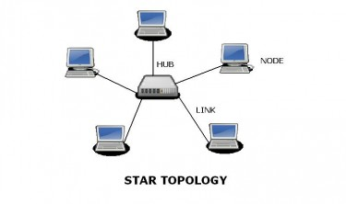
Hub :
So only target computer accepts the frame others reject it.
Since a hub broadcasts the received data, so it increases unnecessary data traffic in the network.
To overcome this limitation, a switch is used as a central device.
EDUCATION
EMPLOYABILITY
ENTREPRENEURSHIP
www.task.telangana.gov.in

Slide 90
Switch :
A switch stores the MAC address of the devices connected to its ports.
Switch knows the device with MAC address is connected to which port, so the switch forwards the received data frame to that port only.
Instead of broadcasting, switch unicast the frame.
EDUCATION
EMPLOYABILITY
ENTREPRENEURSHIP
www.task.telangana.gov.in

Slide 91
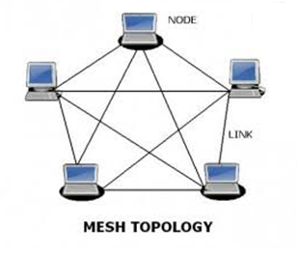
EDUCATION
Mesh Topology :
In this topology, each device is connected to all other device in the network.
Each device has a point to point connection with every other
EMPLOYABILITY
ENTREPRENEURSHIP
www.task.telangana.gov.in

Slide 92
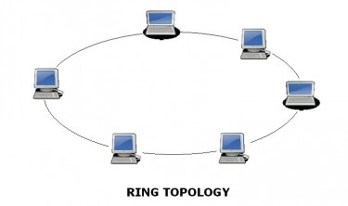
EDUCATION
Ring Topology :
It is a network configuration in which device connection create a circular direct path.
Each network device is connected to two other devices like point on a circle.
EMPLOYABILITY
ENTREPRENEURSHIP
www.task.telangana.gov.in

Slide 93
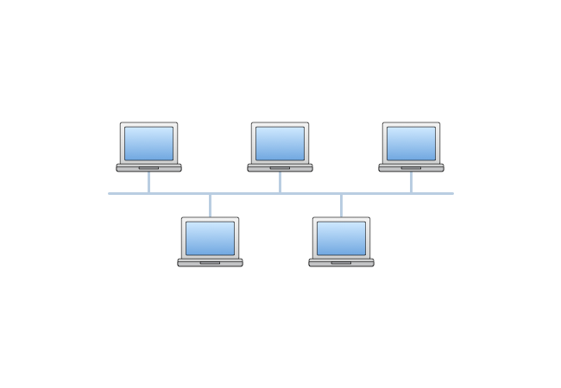
EDUCATION
Bus Topology :
In bus topology there is a main cable and all the devices are connected to this main cable through drop lines.
Since all the data is transmitted over the main cable, there is a limit of drop lines and the distance a main cable can have.
EMPLOYABILITY
ENTREPRENEURSHIP
www.task.telangana.gov.in

Slide 94
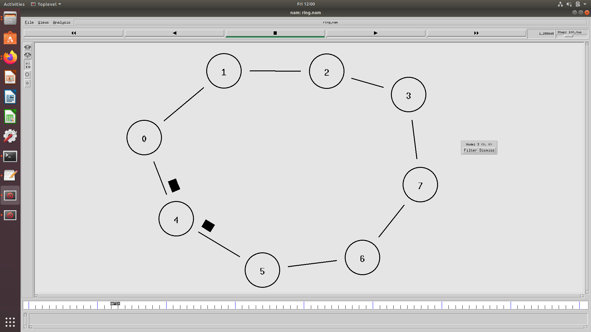
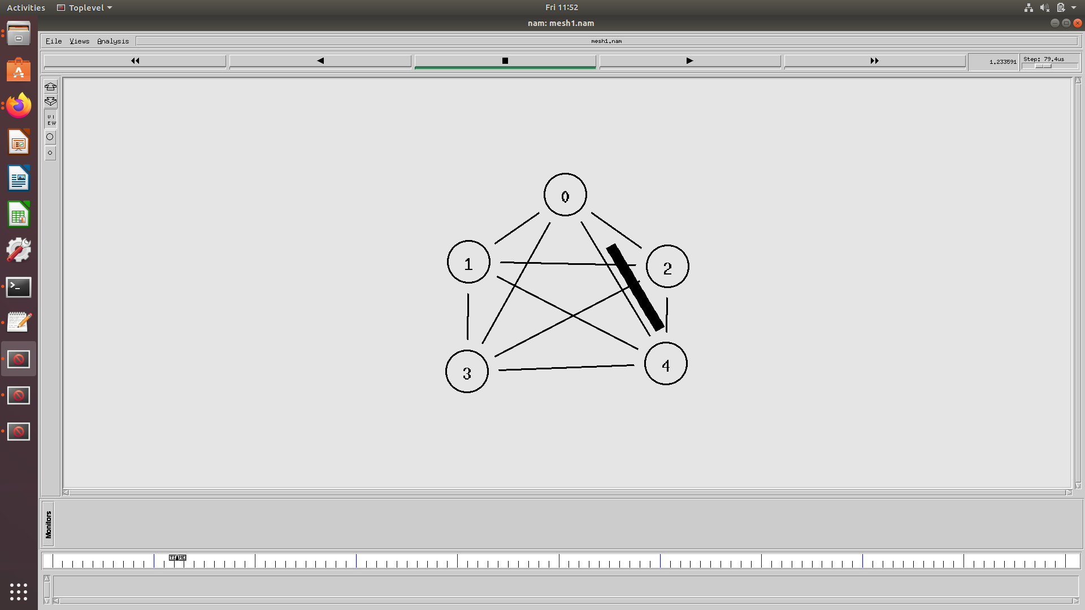
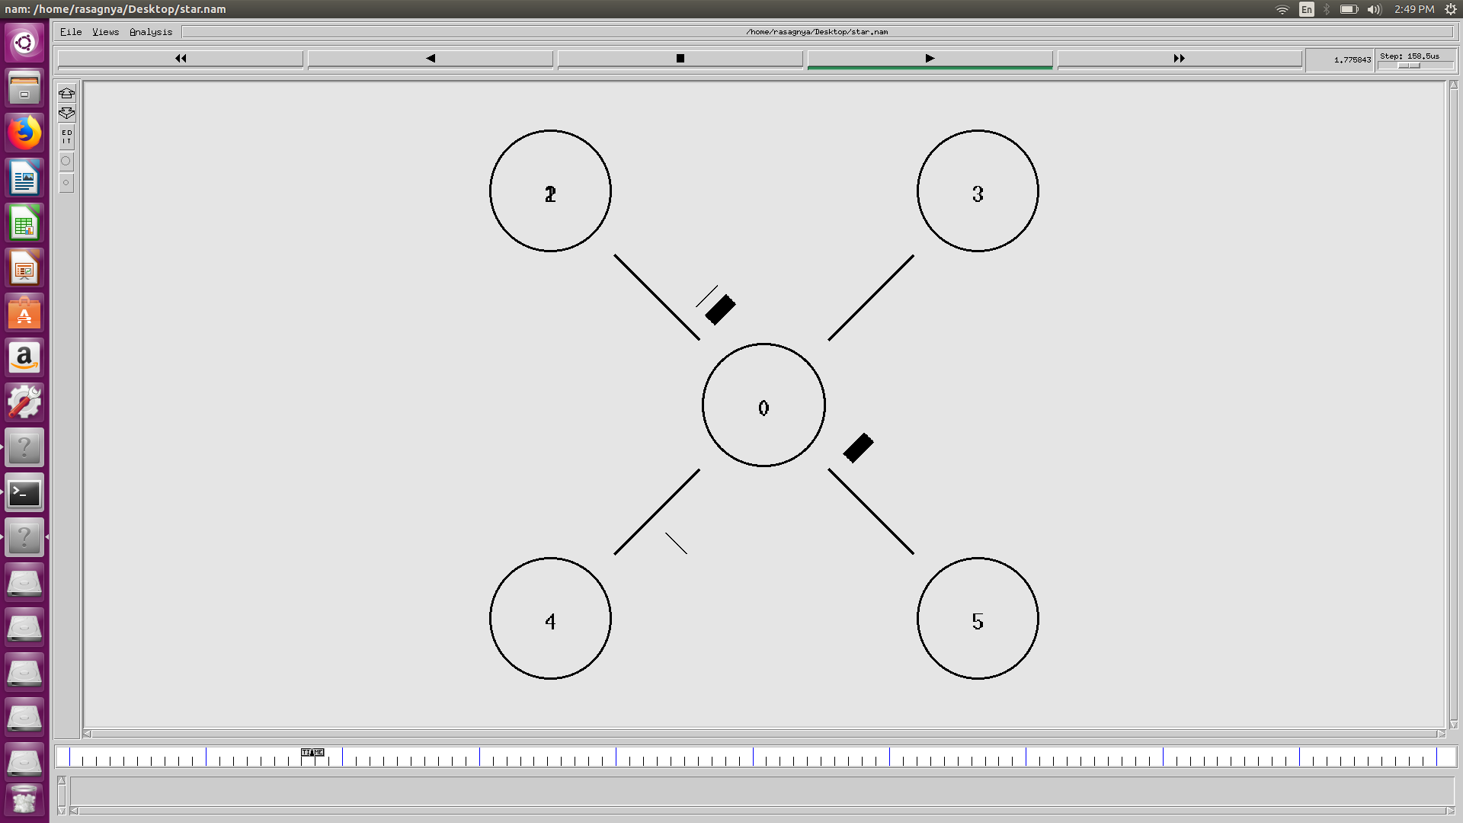
Network Topologies
EDUCATION
EMPLOYABILITY
ENTREPRENEURSHIP
www.task.telangana.gov.in

Slide 95
LAN setup in ns2
EDUCATION
To make a LAN connection between nodes n1, n2, n3, n4 the following line should be added in the tcl script
EMPLOYABILITY
set lan [$ns newLan “$n1 $n2 $n3 $n4” 0.5Mb 30ms LL Queue/DropTail MAC/802_3 channel]
ENTREPRENEURSHIP
www.task.telangana.gov.in

Slide 96
rt model
EDUCATION
It defines a model to be applied to the nodes and links in the topology.
If only one node is specified, it is assumed that the node will fail.
This is modelled by making the links incident on the node fail.
EMPLOYABILITY
$ns rtmodel-at <time> <up/down> <node>
$ns rtmodel-at 1.0 down $n(1)
$ns rtmodel-at 2.5 up $n(1)
ENTREPRENEURSHIP
www.task.telangana.gov.in

Slide 97
rt model
EDUCATION
If two nodes are specified, then it is assumed that the two nodes are adjacent to each other and the model is applied to the link incident on the two nodes.
EMPLOYABILITY
$ns rtmodel-at 1.0 up $n(1) $n(2)
$ns rtmodel-at 2.0 down $n(1) $n(2)
ENTREPRENEURSHIP
www.task.telangana.gov.in

Slide 98
Queue Management Schemes
Performance of TCP based applications critically depends on the choice of Queue Management (Q.M) in the network links.
Queue Management is defined as the algorithm that manage the length of the packet queues by dropping packets when necessary.
From the point of packet dropping, Queue management can be classified into 2 types
1. Passive Q.M : Packet drop occurs only when the buffer gets full
Ex: Drop Tail.
2. Active Q.M : Employs preventive packet drops. It provides implicit feedback mechanism to
notify senders of the onset of congestion. Arriving packets are randomly dropped.
Ex: RED
EDUCATION
EMPLOYABILITY
ENTREPRENEURSHIP
www.task.telangana.gov.in

Slide 99
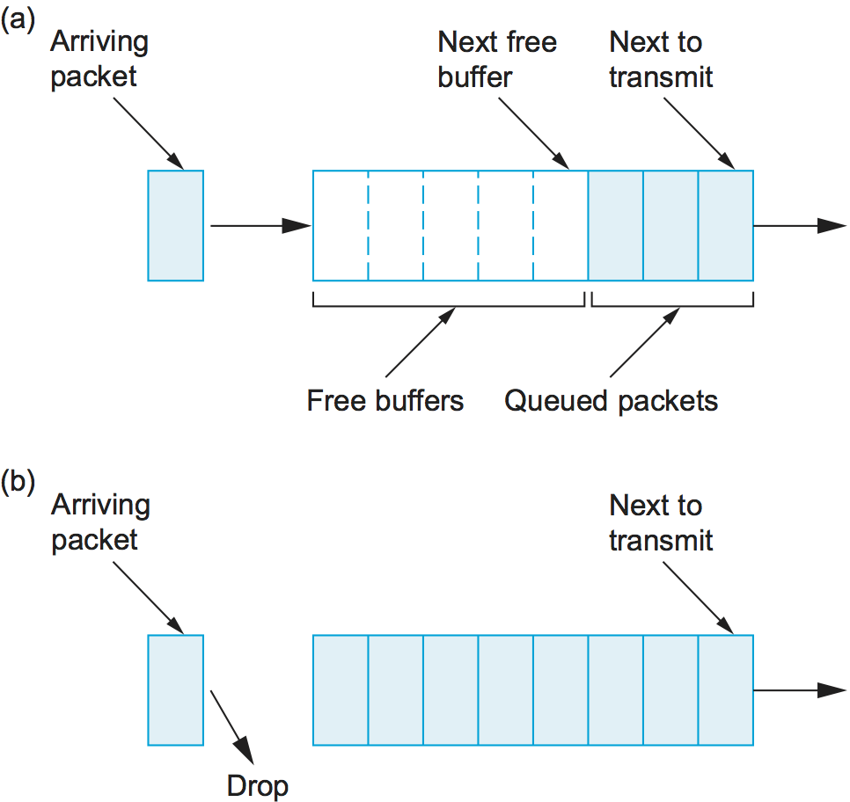
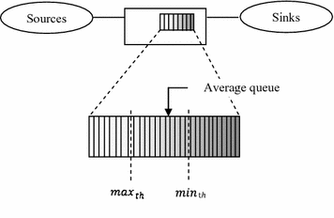
Drop Tail :
1. Drops packets from the tail of the queue.
2. Once buffer gets full, all arriving packets are discarded.
3. Packets already in the queue are not affected.
Random Early Detection :
1. RED accepts all packets until the queue reaches minth, after
which it drops a packet with a linear probability distribution
function.
2. When the queue length reaches maxth all packets are dropped
with probability of one.
EDUCATION
EMPLOYABILITY
ENTREPRENEURSHIP
www.task.telangana.gov.in

Slide 100
GNU plot
EDUCATION
It is the most widely used open source program for plotting and visualizing data.
It is used to plot highly polished graphs for presentations and publications.
Gnuplot reads data from simple text files, with the data arranged in columns.
To plot a data file takes only a single command “plot”
EMPLOYABILITY
ENTREPRENEURSHIP
www.task.telangana.gov.in

Slide 101
GNU plot
EDUCATION
The plot command requires the name of the data file in quotes
The rest of the command line specifies which columns to use for the plot and in which way to represent the data.
EMPLOYABILITY
plot “tcp1.plot”
ENTREPRENEURSHIP
plot “tcp1.plot” using 1:2 with lines title “tcpcong” lw 2
www.task.telangana.gov.in

Slide 102
GNU plot
EDUCATION
Gnuplot handles most of things by itself :
It sizes the graph and selects the most interesting plot range.
It draws the border.
It draws the tick marks and their labels.
All these details can be customized.
EMPLOYABILITY
ENTREPRENEURSHIP
www.task.telangana.gov.in

Slide 103
Steps for installation of gnuplot
1. Gnuplot is used to plot the results, to install gnuplot open terminal and type
2. Command to plot the results using gnuplot, open terminal and type
( or )
EDUCATION
cd press enter
sudo apt install gnuplot
EMPLOYABILITY
gnuplot filename
gnuplot
plot “filename”
ENTREPRENEURSHIP
www.task.telangana.gov.in

Slide 104
Steps for installation of xgraph
1. If xgraph is not working download the other xgraph from the given link
http://www.xgraph.org/linux/index.html
2. Now extract the downloaded file on to Desktop and open terminal and type
xgraph it will display the xgraph.
3. If xgraph does not open, then open terminal and type the following commands
EDUCATION
EMPLOYABILITY
ENTREPRENEURSHIP
cd Desktop/
sudo cp xgraph /usr/local/bin/
www.task.telangana.gov.in

Slide 105
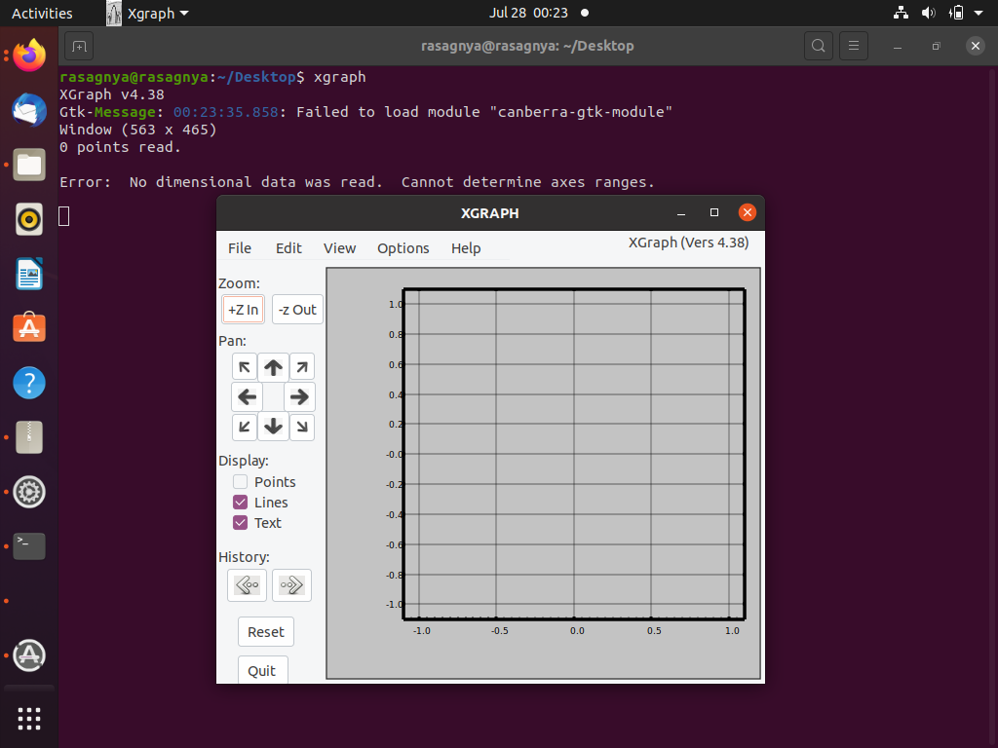
Steps for installation of xgraph
EDUCATION
EMPLOYABILITY
ENTREPRENEURSHIP
www.task.telangana.gov.in

Slide 106
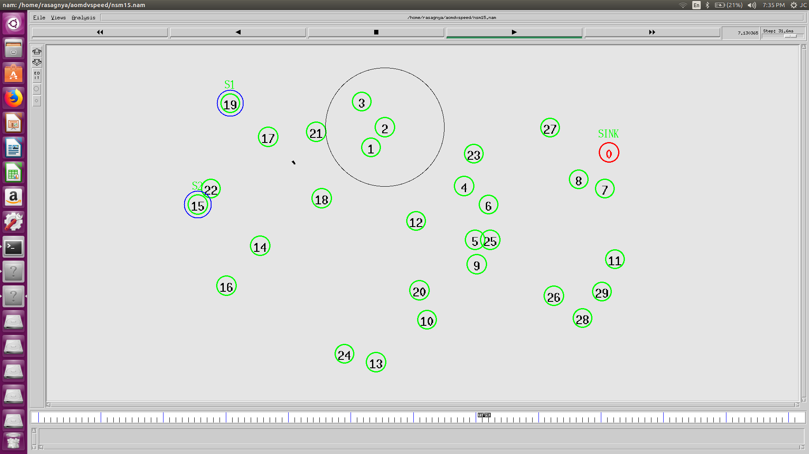
Node Movement
To generate movement setdest command is used.
Ex: $ns at 1 " $n0 setdest 616 609 50 "
EDUCATION
EMPLOYABILITY
ENTREPRENEURSHIP
www.task.telangana.gov.in

Slide 107
Routing Protocols
EDUCATION
Adhoc wireless network consists of a set of nodes(hosts) that are connected by wireless links.
Routing protocols are used to find the path between source and destination for data transmission.
Types of Routing protocols
DSR
AODV
DSDV
EMPLOYABILITY
ENTREPRENEURSHIP
www.task.telangana.gov.in

Slide 108
Dynamic Source Routing(DSR) Protocol
DSR is an on-demand protocol designed to restrict the bandwidth consumed by control packets in ad hoc wireless networks by eliminating the periodic table-update messages required in the table-driven approach.
This protocol is truly based on source routing whereby all the routing information is maintained (continually updated) at mobile nodes.
It has only two major phases.
Route Discovery
Route Maintenance.
Consider a source node that does not have a route to the destination. When it has data packets to be sent to that destination, it initiates a Route Request packet. This Route Request is flooded throughout the network.
EDUCATION
EMPLOYABILITY
ENTREPRENEURSHIP
www.task.telangana.gov.in

Slide 109
Dynamic Source Routing(DSR) Protocol
Each node, upon receiving a Route Request packet, rebroadcasts the packet to its neighbors if it has not forwarded it already, provided that the node is not the destination node and that the packet’s time to live(TTL) counter has not been exceeded.
Each Route Request carries a sequence number generated by the source node and the path it has traversed. A node, upon receiving a Route Request packet, checks the sequence number on the packet before forwarding it. The packet is forwarded only if it is not a duplicate Route Request.
The sequence number on the packet is used to prevent loop formations and to avoid multiple transmissions of the same Route Request by an intermediate node that receives it through multiple paths.
Thus, all nodes except the destination forward a Route Request packet during the route construction phase.
EDUCATION
EMPLOYABILITY
ENTREPRENEURSHIP
www.task.telangana.gov.in

Slide 110
Dynamic Source Routing(DSR) Protocol
A destination node, after receiving the first Route Request packet, replies to the source node through the reverse path the Route Request packet had traversed.
Advantages:
This protocol uses a reactive approach which eliminates the need to periodically flood the network with table update messages which are required in a table-driven approach.
In a reactive (on-demand) approach such as this, a route is established only when it is required and hence the need to find routes to all other nodes in the network as required by the table-driven approach is eliminated.
The intermediate nodes also utilize the route cache information efficiently to reduce the control overhead.
EDUCATION
EMPLOYABILITY
ENTREPRENEURSHIP
www.task.telangana.gov.in

Slide 111
Dynamic Source Routing(DSR) Protocol
EDUCATION
Disadvantages:
The disadvantage of this protocol is that the route maintenance mechanism does not locally repair a broken link.
The connection setup delay is higher than in table-driven protocols.
Even though the protocol performs well in static and low-mobility environments, the performance degrades rapidly with increasing mobility.
Also, considerable routing overhead is involved due to the source-routing mechanism employed in DSR. This routing overhead is directly proportional to the path length.
EMPLOYABILITY
ENTREPRENEURSHIP
www.task.telangana.gov.in

Slide 112
Ad hoc On-Demand Distance Vector(AODV) Routing Protocol
EDUCATION
The AODV routing protocol is an on-demand routing protocol; all routes are discovered only when needed, and are maintained only as long as they are being used.
Routes are discovered through a route discovery cycle, whereby the network nodes are queried in search of a route to the destination node.
In AODV, if source node want to transmit data to the destination node, then source node broadcast route request packets(RREQ) to the neighboring nodes, if the neighboring nodes have path to destination node, again these nodes broadcast RREQ packets to their neighboring nodes.
If a node have a route to the destination, that route is reported back to the source node.
EMPLOYABILITY
ENTREPRENEURSHIP
www.task.telangana.gov.in

Slide 113
Ad hoc On-Demand Distance Vector(AODV) Routing Protocol
EDUCATION
If any link between nodes breaks in the selected route, the intermediate nodes both informs the end nodes about the path break by sending route reply packet with hop count as infinity(∞).
Advantages : Establish on demand, Destination sequences are used to find the latest path to destination connection setup delay is less in network.
Disadvantages : Intermediate node can lead to inconsistent route, Beacon-base, Heavy control overhead and more energy consumption it there is a path break.
On demand routing protocols have three types of control messages for route maintenance Route Requests(RREQs), Route Replies(RREPs), Route Errors(RERRs) .
EMPLOYABILITY
ENTREPRENEURSHIP
www.task.telangana.gov.in

Slide 114
Ad hoc On-Demand Multipath Distance Vector(AOMDV) Routing Protocol
EDUCATION
The AOMDV routing protocol is expanded to AODV protocol where the source node keeps several different routes from source to destination.
AOMDV routing protocol maintain multiple paths between the source and the destination in a single route discovery.
So, a new route discovery is needed only when all these paths fail.
The routing protocol has two mechanisms, route discovery and route maintenance.
EMPLOYABILITY
ENTREPRENEURSHIP
www.task.telangana.gov.in

Slide 115
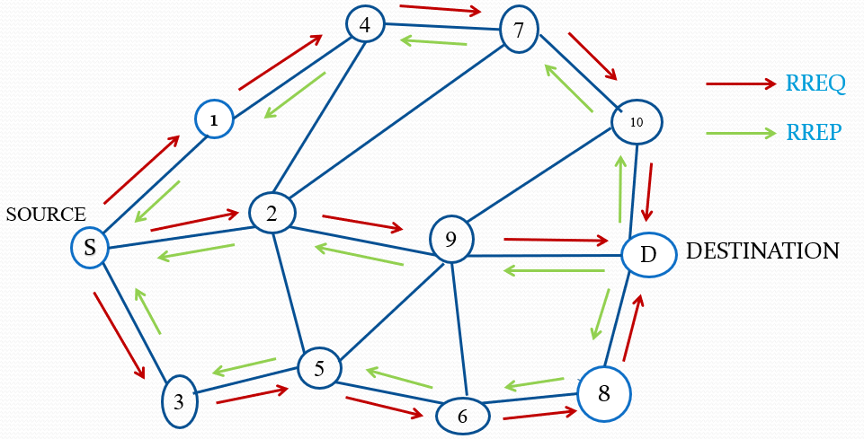
Route Discovery
The route discovery process is similar to which used in AODV. It is started by RREQ when source node have some data for sending to the specific destination node.
EDUCATION
EMPLOYABILITY
ENTREPRENEURSHIP
www.task.telangana.gov.in

Slide 116
Route Maintenance
When a link is broken due to the change of the network topology, intermediate nodes inform the route valid, by sending a RERR packet to the source node, as in the AODV protocol.
In this case, it uses alternative paths for transmitting remaining data packets.
If a corresponding RREP has not been received within the time, the entry is deleted. The routing table entry is modified for the maintenance of the multiple entries and multiple loop-free paths.
EDUCATION
EMPLOYABILITY
ENTREPRENEURSHIP
www.task.telangana.gov.in

Slide 117
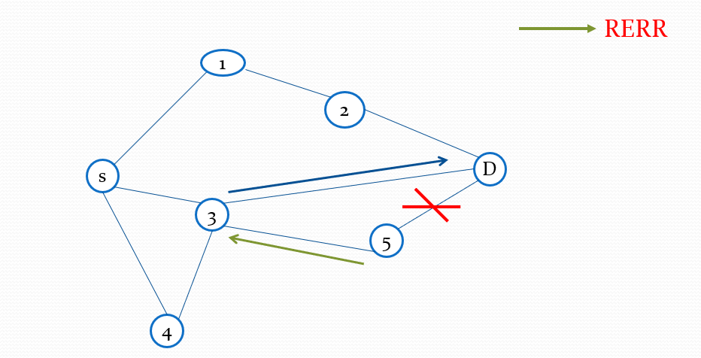
EDUCATION
EMPLOYABILITY
ENTREPRENEURSHIP
Represents Data packet transmission using alternate path from intermediate node after path break.
www.task.telangana.gov.in

Slide 118
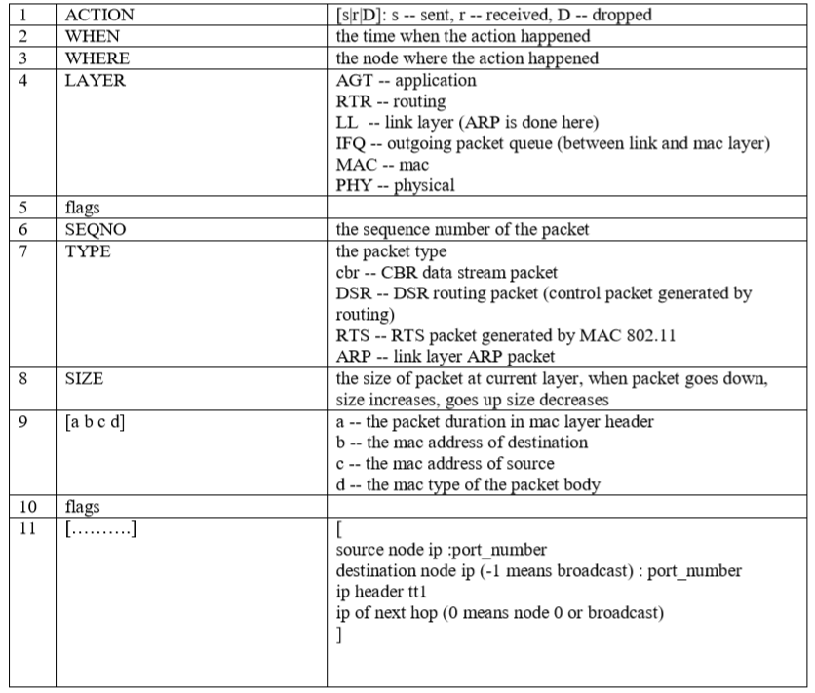
Wireless Trace File format
EDUCATION
EMPLOYABILITY
ENTREPRENEURSHIP
www.task.telangana.gov.in

Slide 119
Example: s 0.032821055 _1_ RTR --- 0 message 32 [0 0 0 0] ------- [1:255 -1:255 32 0]
It represent packet is sent at time .032821055 second by node 1.
RTR represent that this packet is routing packet.
Next three dashes are for flags.
Sequence number of packet is 0. Type of packet is message.
Size of this packet is 32 bytes.
[0 0 0 0] first zero in bracket represent packet duration in mac layer header, second 0 is for mac address for destination, third zero for mac address for source and fourth zero for mac type of the packet body.
Next dashes "-------" are flags, one of the flags is used for energy information of node.
[1:255 -1:255 32 0] source node ip and port are 1 and 255 respectively, destination ip and port are -1 and 255.
-1 is for broadcast address, next field 32 is tt1 field in ip header.
EDUCATION
EMPLOYABILITY
ENTREPRENEURSHIP
www.task.telangana.gov.in

Slide 120
Steps to create a wireless network scenario ﬁle
EDUCATION
Initialize variables
Create simulator objects
Create tracing and animation file
Create Topography
Create GOD
Create nodes
Create channel
Position of the nodes
Creation of agents and applications
Finish procedure
EMPLOYABILITY
ENTREPRENEURSHIP
www.task.telangana.gov.in

Slide 121
Do's and Don'ts
EDUCATION
Do's :
Vary only one parameter at a time.
Consider the optimal simulation time to judge the protocol.
According to our application and need, we have to consider the parameters.
While comparing between two protocols, keep all the parameters same except routing protocol.
EMPLOYABILITY
ENTREPRENEURSHIP
www.task.telangana.gov.in

Slide 122
Do's and Don'ts
EDUCATION
Don’ts :
Never compare two different layer protocols.
Don’t change multiple parameters for both the protocols.
Don’t change the mobility files of the both the protocols.
EMPLOYABILITY
ENTREPRENEURSHIP
www.task.telangana.gov.in

Slide 123
Thank you
EDUCATION
EMPLOYABILITY
ENTREPRENEURSHIP
www.task.telangana.gov.in

