Slide 1


Steps for installation
EDUCATION
1. Now install nsallinone-2.35 software, download the software from given below link
https://sourceforge.net/projects/nsnam/files/latest/download
2. Now we have to update the ubuntu with its latest components. Open terminal
and run this command
EMPLOYABILITY
sudo apt update
ENTREPRENEURSHIP
www.task.telangana.gov.in

Slide 2
Steps for installation
gcc-4.8 and g++-4.8 compilers are not present in ubuntu 20.04. So we need to install gcc-4.8 and g++-4.8 (for ubuntu 18,16,14 versions no need of these steps). Open terminal and type
Next add the below line
Save and close the file and now update system using the below command
EDUCATION
EMPLOYABILITY
sudo gedit /etc/apt/sources.list
deb http://in.archive.ubuntu.com/ubuntu bionic main universe
ENTREPRENEURSHIP
sudo apt update
www.task.telangana.gov.in

Slide 3
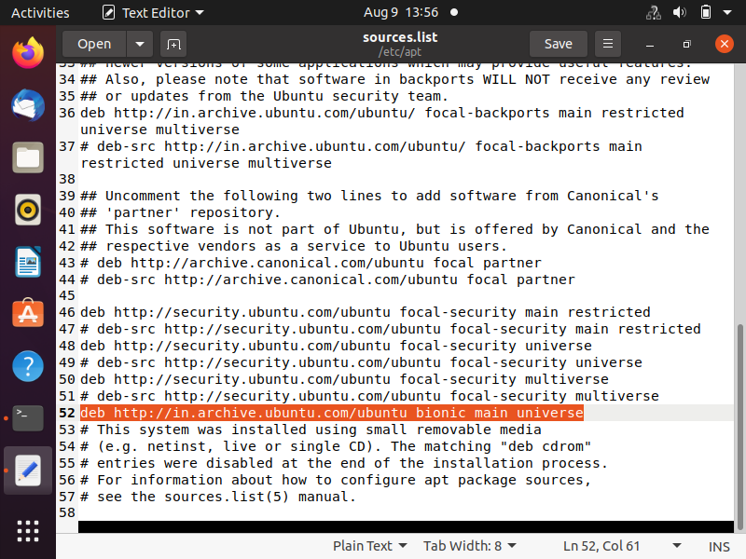
Steps for installation
EDUCATION
EMPLOYABILITY
ENTREPRENEURSHIP
www.task.telangana.gov.in

Slide 4
Steps for installation
EDUCATION
If you get any error use the below command
sudo apt-key adv --keyserver keyserver.ubuntu.com --recv-keys 3B4FE6ACC0B21F32
sudo apt update
EMPLOYABILITY
ENTREPRENEURSHIP
www.task.telangana.gov.in

Slide 5
Steps for installation
EDUCATION
3. Before installing the NS2, we have to install the basic required packages from
internet. In terminal type the following and click enter
EMPLOYABILITY
sudo apt-get install build-essential autoconf automake libxmu-dev
sudo apt install gcc-4.8 g++-4.8
ENTREPRENEURSHIP
www.task.telangana.gov.in

Slide 6
Steps for installation
4. To Extract nsallinone-2.35 to desktop, you can do it in two ways.
Right click over the above file and extract it to the Desktop.
(or)
Go to the location of the download folder and copy the file to the Desktop folder and open the terminal and give the command
EDUCATION
EMPLOYABILITY
cd Desktop
tar zxvf ns-allinone-2.35.tar.gz
ENTREPRENEURSHIP
www.task.telangana.gov.in

Slide 7
Steps for installation
EDUCATION
5. Go to Desktop/ns-allinone-2.35/ns-2.35/linkstate
select and open ls.h file
Edit the 137 line as
void eraseAll() { this->erase(baseMap::begin(),baseMap::end());}
save the file
EMPLOYABILITY
ENTREPRENEURSHIP
www.task.telangana.gov.in

Slide 8
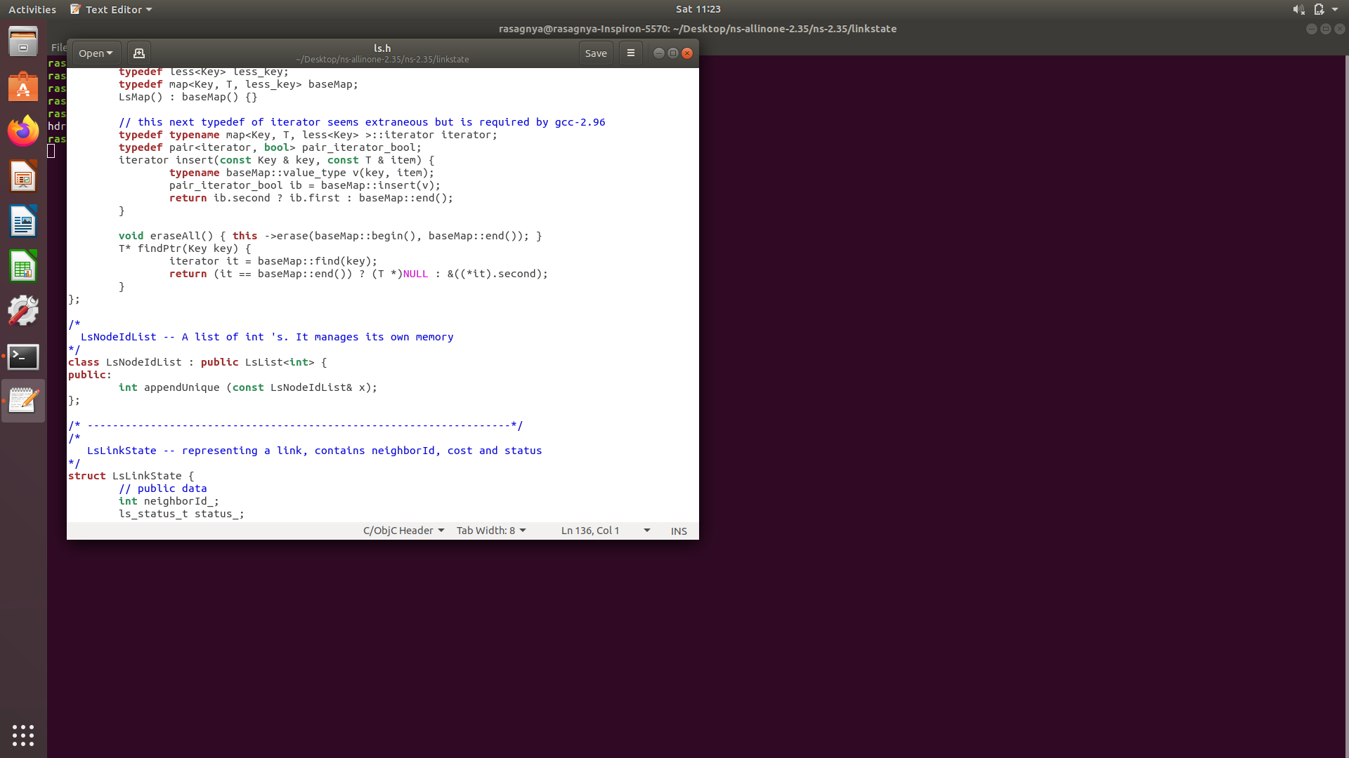
EDUCATION
EMPLOYABILITY
ENTREPRENEURSHIP
www.task.telangana.gov.in

Slide 9
Steps for installation
EDUCATION
6. Go to Desktop/ns-allinone-2.35/ns-2.35/Makefile.in
Edit line 36: CC = gcc-4.8
line 37: CPP = g++-4.8
Save the file
7. Go to Desktop/ns-allinone-2.35/nam-1.15/Makefile.in
Edit line 46: CC = gcc-4.8
line 47: CPP = g++-4.8
Save the file
EMPLOYABILITY
ENTREPRENEURSHIP
www.task.telangana.gov.in

Slide 10
Steps for installation
EDUCATION
8. Go to Desktop/ns-allinone-2.35/otcl-1.14/Makefile.in
Edit line 7: CC = gcc-4.8
Save the file
9. Go to Desktop/ns-allinone-2.35/xgraph-12.2/Makefile.in
Edit line 120: CC = gcc-4.8
line 123: CPP = g++-4.8
Save the file
EMPLOYABILITY
ENTREPRENEURSHIP
www.task.telangana.gov.in

Slide 11
Steps for installation
EDUCATION
10. Now install ns2,now go to terminal and type
ns installation takes place for 10-20 minutes
cd
cd Desktop
cd ns-allinone-2.35
type ./install
EMPLOYABILITY
ENTREPRENEURSHIP
www.task.telangana.gov.in

Slide 12
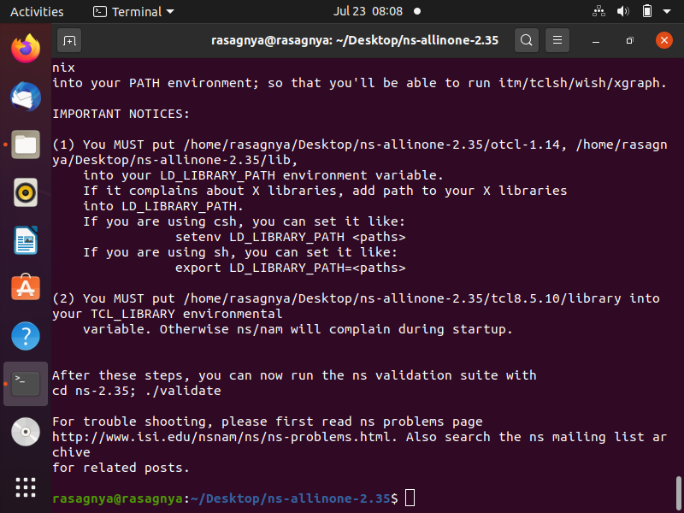
Steps for installation
EDUCATION
EMPLOYABILITY
ENTREPRENEURSHIP
www.task.telangana.gov.in

Slide 13
Steps for installation
EDUCATION
11. Now open terminal, type pwd and copy that what it comes in a separate place. It
comes as
/home/rasagnya/Desktop/ns-allinone-2.35/
12. Now type in the terminal, type cd to go to the home folder and then type
a file opens
now make some changes in it like, path changes
copy the path came when u type pwd in step11 in following places, that is we are replacing the path
save the file
EMPLOYABILITY
gedit ~/.bashrc
ENTREPRENEURSHIP
www.task.telangana.gov.in

Slide 14
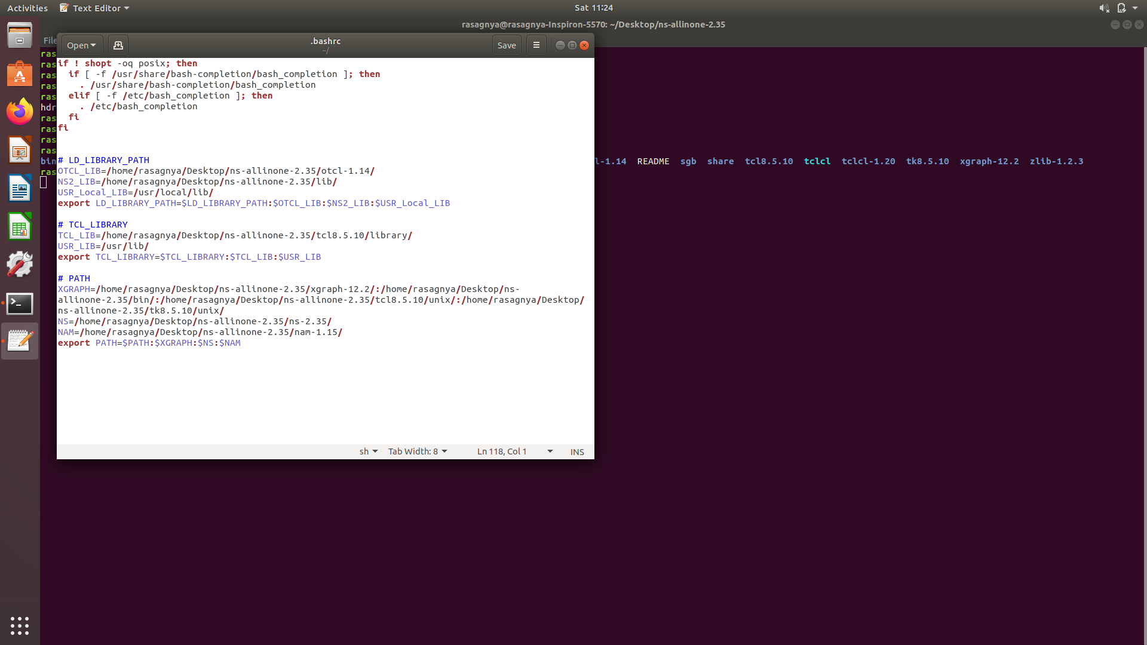
Steps for installation
EDUCATION
EMPLOYABILITY
ENTREPRENEURSHIP
www.task.telangana.gov.in

Slide 15
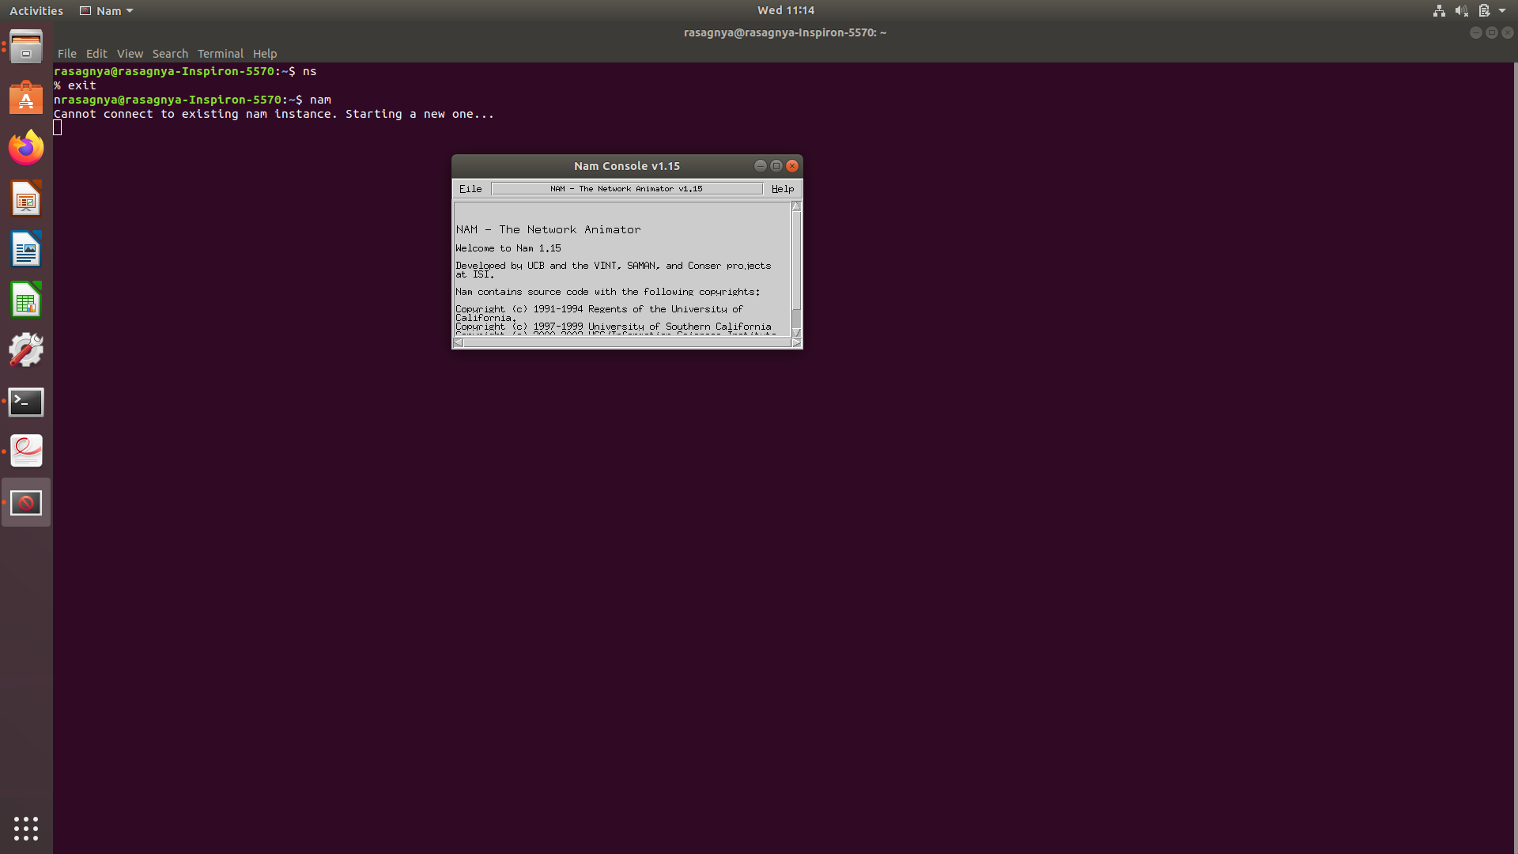
Steps for installation
EDUCATION
13. Now type in the terminal
source ~/.bashrc
cd press enter
ns press enter
%exit
nam press enter
EMPLOYABILITY
ENTREPRENEURSHIP
www.task.telangana.gov.in

Slide 16
Steps for installation
EDUCATION
14. If you get following error(segmentation fault error) for nam, open terminal and do following
15. After doing the above procedure if you get once again segmentation fault,
download the nam file from the given below link
https://drive.google.com/file/d/0B4nUSbTYSK4TclRYODFvbWgxeWM/view
cd Desktop/ns-allinone-2.35/nam-1.15/
sudo cp nam /usr/local/bin/
EMPLOYABILITY
ENTREPRENEURSHIP
www.task.telangana.gov.in

Slide 17
Steps for installation
16. First, remove the nam which was installed earlier using the following command
17. Install the new nam. So go to the folder where the file was downloaded and
type the following command
18. Now type nam in terminal, nam window will be displayed otherwise use the
following command
EDUCATION
sudo apt-get remove nam
EMPLOYABILITY
sudo dpkg --install nam_1.15-10_i386.deb
ENTREPRENEURSHIP
sudo cp nam /usr/local/bin/
www.task.telangana.gov.in

Slide 18
Steps for installation
EDUCATION
19. Download NSG2.1 software from following site
put it on the desktop, no need of extracting it
20. To run nsg we need java to be installed in our system, to install it run the following
commands,
open terminal and type cd press enter
sudo apt install default-jre
https://drive.google.com/file/d/0B6OGaRWIAsR0SHlLbkhLQ3pudVk/view?resourcekey=0-4wAdLpOJF-R56XtpYVr2tQ
EMPLOYABILITY
ENTREPRENEURSHIP
www.task.telangana.gov.in

Slide 19
Steps for installation
21. Gnuplot is used to plot the results, to install gnuplot open terminal and type
Command to plot the results using gnuplot, open terminal and type
( or )
EDUCATION
cd press enter
sudo apt install gnuplot
EMPLOYABILITY
gnuplot filename
gnuplot
plot “filename”
ENTREPRENEURSHIP
www.task.telangana.gov.in

