Slide 1

Compass
Private workflow coaching for GenAI adoption
AI Engineering Enablement Coach | Hackathon submission
Synthetic data only. Runs on a laptop. No API keys.
Notes:
Compass coaches how engineers use AI, privately, and gives managers only aggregated, suppressed insights. Everything in this deck runs on synthetic data.

Slide 2

AI adoption is up; delivery outcomes are not
-7.2%
19%
39%
estimated change in delivery stability for each 25% increase in AI adoption
longer task time for experienced open-source developers using AI tools
of developers report little or no trust in AI-generated code
DORA 2024
METR, July 2025 (16 developers, 246 tasks)
DORA 2024
Usage dashboards count seats and prompts. They can't tell an engineer what to change next, and they tempt managers to rank people.
Notes:
Sources: dora.dev and cloud.google.com DORA 2024 announcement; metr.org July 2025 study. Full list in docs/research/evidence.md.

Slide 3



Compass coaches how AI is used, not how much
Engineer (private)
Manager and leader
Workflow coach
Next best actions: observation, action, why, outcome to watch
Tailored to role, stack and project complexity
Dismiss and feedback stay private
Gaps shared by at least 5 engineers, with an enablement action
Suppression plus differencing protection
No path to any individual
Goal, facts, questions, tool, package, evidence, lesson
Feature or API, UAT defect, meaningful tests
Works with Copilot, Claude Code and Devin as they are
No scoring, ranking or labeling of people. Python standard library only. Works offline.

Slide 4
Architecture map
Engineer laptop, bound to 127.0.0.1
INPUTS
SERVICES (compass/)
VIEWS (web/)
OUTSIDE THE LAPTOP
Synthetic signals
(usage + PR/CI metadata)
Recommendation engine: rules + persona
Engineer view
(private)
Jira (optional)
read-only GET,
token never stored
Project folder
(read-only)
Aggregator: k = 5, no ids
Manager and leader
(aggregated)
Workflow coach: facts, 3 questions, tool policy
→ user copies the reviewed package
Story, defect
or Jira key
Enablement
(eval, audit)
← diffs and reports imported as evidence
Context budgeter + package: redaction, fencing
Copilot
Claude Code
Devin
signals.db
read-only
private.db
engineer only
Workflow coach
(7 steps)
Evidence + safe runner: no shell, approvals
Notes:
Two physically separate stores. The aggregator opens signals.db read-only and never touches private.db. The project folder is read-only; fixes are verified on temporary copies. Nothing leaves the laptop unless the user copies it, or enables Jira.

Slide 5



One journey: seven steps, at most three questions
1
2
3
4
5
6
7
Goal
Facts
Questions
Tool
Package
Evidence
Result
Story, defect or Jira key
Detected, inferred, confirmed or unknown, with file:line
Up to 3, each says why
Policy first, then fit; "no AI" allowed
Lean 4k, Balanced 8k, Deep 16k
Local checks, approved runs, imports
Verdict per criterion, next action, lesson
Feature or API
UAT defect
Meaningful tests
Shared security stage
Catches missing requirements against your API standard
No fix is accepted without a reproduction test
Proves tests fail when the behavior is broken
Secrets, risky patterns, ASVS chapter references
Planned, not shown as working: PR review, docs and onboarding, release and config.

Slide 6
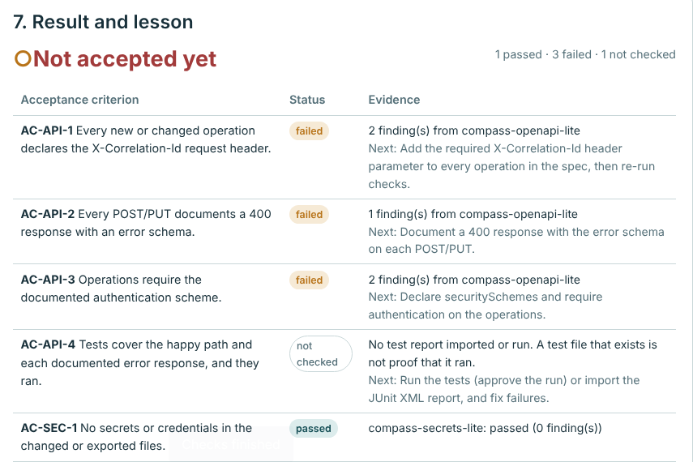
Demo 1: a missing API requirement, caught early
Story ORD-12: add an endpoint to cancel an order.
Compass finds the project's API standard and asks whether the operation needs X-Correlation-Id (standards/api-standard.md:10).
It also asks who may call it and which errors it returns.
The built-in OpenAPI check reports 1 passed, 3 failed, 1 not checked.
Not accepted yet
Agents fill missing requirements with guesses; those guesses are what fail review.
Notes:
Click the demo sample 'Catch a missing API requirement'. Show the source link on the correlation-id fact, then jump to the result: three failed criteria, each with a next action.

Slide 7
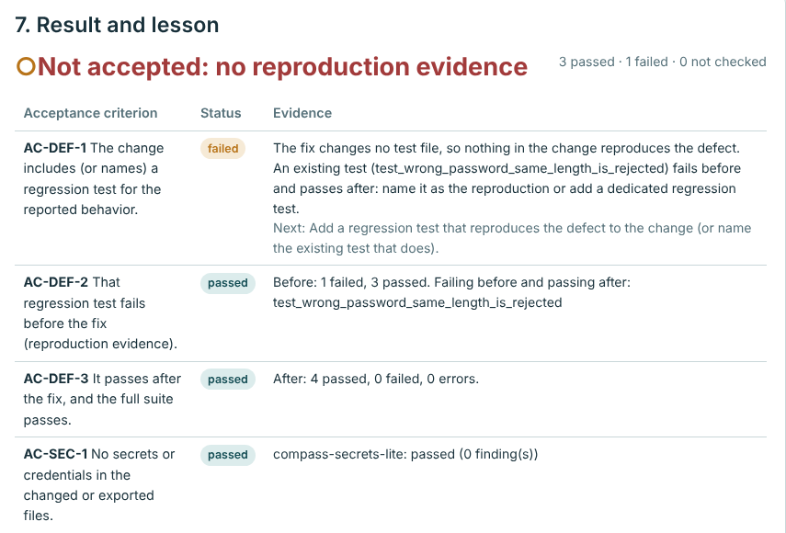
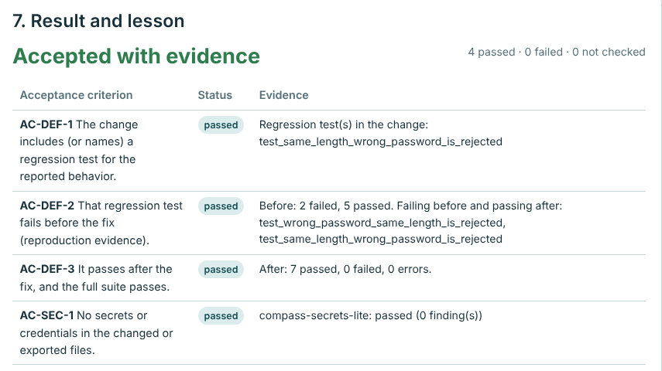
Demo 2: no reproduction, no acceptance
Fix without a test
Fix with a regression test
Both fixes make the suite pass. Only the second proves the defect was reproduced: its test fails before the fix and passes after, checked on temporary copies.
Notes:
LOGIN-7 defect. Import fixes/fix-no-repro.diff, verify: Not accepted, no reproduction evidence. Import fixes/fix-with-repro.diff: Accepted with evidence. The project folder is never modified.

Slide 8
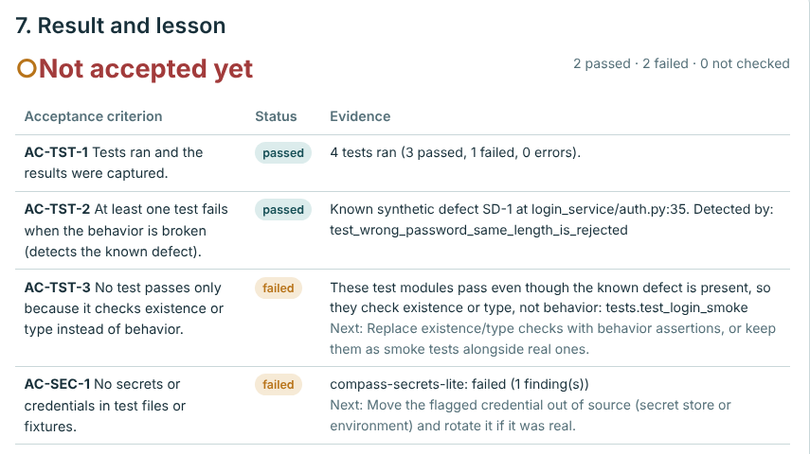
Demo 3: tests that actually detect a seeded defect
Synthetic defect SD-1 seeded at login_service/auth.py:35.
With approval, Compass runs the tests on a temporary copy: one test fails because of the defect.
Tests that pass on broken code (existence or type checks only) are flagged.
The built-in secrets check finds the synthetic credential in settings.ini.
Defect detected, suite flagged
A test that passes on broken code proves nothing.

Slide 9
Right-sized context, nothing silently dropped
~3.3%
Deep package vs pasting the whole 386-file repository: 15,145 vs 454,230 estimated tokens.
Lean ~4k
Balanced ~8k
Deep ~16k
Lean and Balanced report an overflow for that task instead of dropping a file the task names.
Estimates, not Copilot, Claude or Devin billing. On the tiny fixtures the package is slightly larger than the project (3,716 vs 2,977) because it adds goal, facts, questions and criteria.

Slide 10
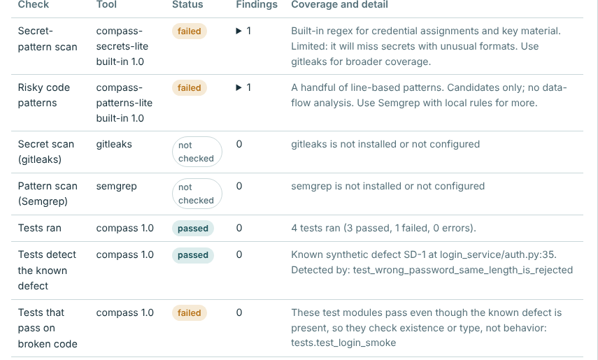
Honest evidence: a missing tool is never a pass
passed
The check ran and found nothing
failed
Finding with file:line and the next step
not checked
Tool missing or not approved
blocked
Report malformed or run refused
Real scanners verified through the approval flow
gitleaks 8.30.1, Semgrep 1.181.0 (metrics off, local rules), Spectral 6.17.0, plus JUnit and unittest reports.

Slide 11

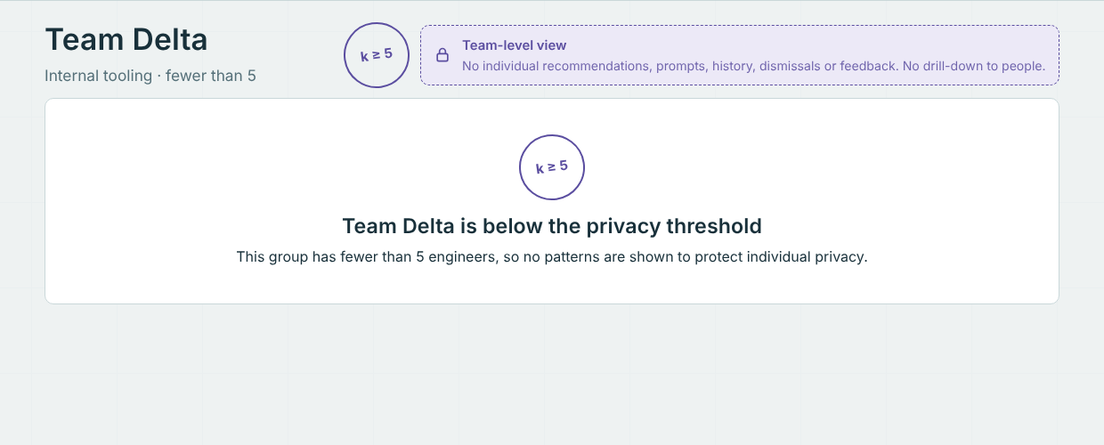



Privacy is designed in, not configured later
Two separate stores
signals.db for aggregation (read-only); private.db for the engineer
k = 5 suppression
Teams under 5 show nothing; differencing blocked in totals
No ranking, anywhere
A compliance check fails the build if scores or rankings appear
A manager of a team below the threshold sees no data at all.
Private by default
Dismiss, feedback and history: engineer-only, deletable
Data minimization
Metadata only: no code, prompt text or free text stored

Slide 12





Security guardrails for running on real projects
No shell, ever
Pinned, approved scanners
Named command templates, validated arguments, minimal environment, timeouts
Approved once and pinned by SHA-256; a changed binary is refused
Read-only project
Untrusted text stays data
Allowed folders only; no traversal, symlinks or credential files
Prompt-injection phrases flagged and fenced; secrets redacted on export
Localhost only
Jira read-only
127.0.0.1 with Host, Origin and JSON checks against other websites
One pinned https host; the token is never written to disk

Slide 13

Quality, measured and repeatable
74 / 74
25 / 25
16 / 16
37 / 37
automated tests pass
seeded scenarios pass (target 80%)
prompt-routing stories
personas get complete recommendations
Every scenario must be relevant, complete, explainable, actionable and persona-specific to pass.
The team wrote the scenarios, so 100% is a regression baseline, not held-out accuracy.
CI runs on Windows and Linux with Python 3.9 and 3.12. Reports: reports/eval-report.md, docs/measurements.md.

Slide 14
How Compass maps to the scoring guide
Area | Weight | What we show
Problem fit and innovation | 30% | All 14 acceptance criteria tested; coaches how AI is used, not how much; three live demos
Business impact | 25% | No new licenses or infrastructure; drops into any repo; pilot plan with success criteria
Tech excellence and AI | 20% | Context budgeter (~3.3% of a whole-repo paste); 25/25 eval; 74 tests; real scanner evidence
Demo and delivery | 15% | One-click start; 5-minute demo script; architecture, setup, user guide, security docs
NFRs and governance | 10% | Localhost, no shell, pinned tools, k = 5, audit of role, path and status only

Slide 15
Next: pilot, scale, and an independent check
ROADMAP
HAND-OFF FOR VERIFICATION
Now
Devin
MVP: private coaching, aggregated insights, workflow coach, agent kit
1
Independent Linux run; installs scanners from the approved artifact repository
Pilot, 4-6 weeks
GitHub Copilot
2-3 volunteer teams, authorized metadata only, SSO, k reviewed (consider 10)
2
Windows run-through, sample-data mapping, deck and submission text
Scale
Claude Code
VS Code extension shell, more workflows, central agent-kit repository
3
Code and security review, final pre-submission check
Notes:
Hand-off instructions live in docs/handoff/. None of the assistants needs MCP servers or API keys.

Slide 16
Coach the workflow, not the person
Double-click Start-Coach.bat, or run python -m compass
github.com/Kalyanraja/compass-ai-coach
Synthetic data only. MIT licensed.

