Slide 1

Easy to remember
UG student Kamile Kavaliauskaite

Slide 2

https://www.pexels.com/photo/codes-on-screen-9951077/

Slide 3

https://www.pexels.com/photo/scattered-letter-tiles-on-textured-surface-31818759/

Slide 4
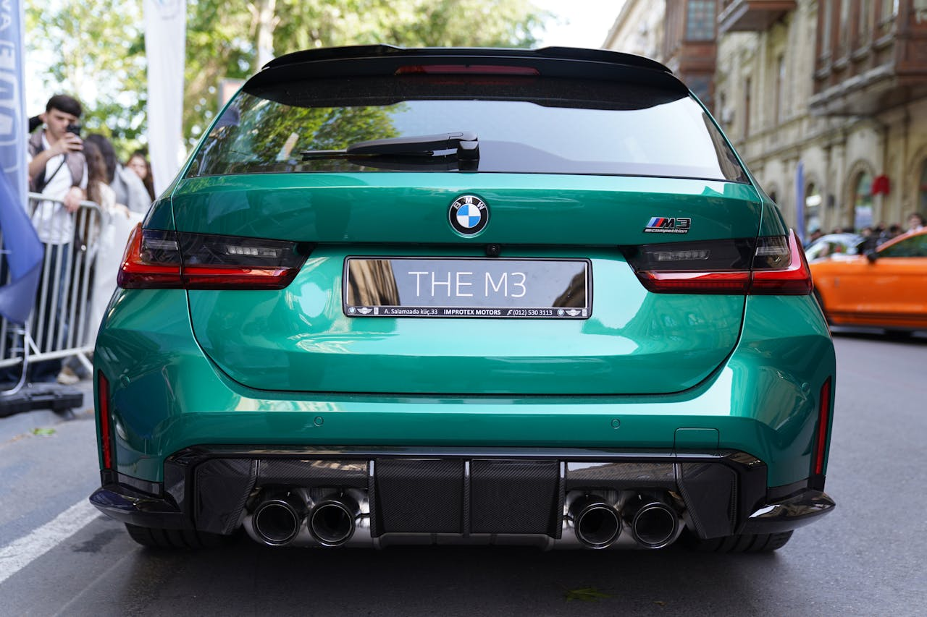
https://www.pexels.com/photo/green-bmw-m3-on-display-in-baku-street-32943798/

Slide 5

Preparation
Project infrastructure – GitHub, Notion, OneDrive.
Cognitive studies research on memorability
Algorithmic research
System architecture research on modularity
Functional and non-functional requirements
Defined rules

Slide 6
System design
Rules for numerical patterns
Methods
Multi-agent modular system
Incremental learning with temporal difference
Similarity and distance metrics
Weighted memorability score
Symmetry
Single-digit repetition
Numerical pattern repetition
Periodicity
Simple keyboard patterns
Unique number count
Chunking

Slide 7
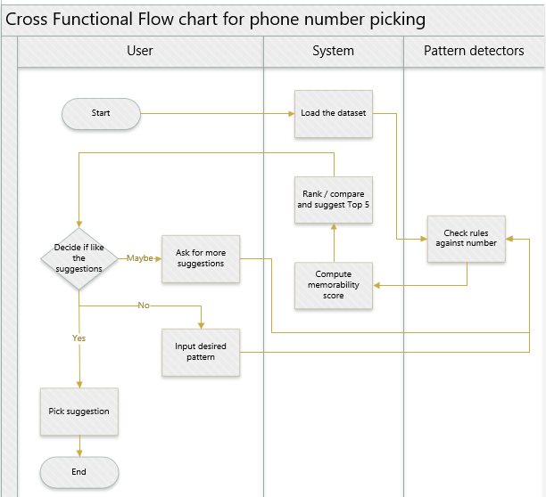
Workflow

Slide 8
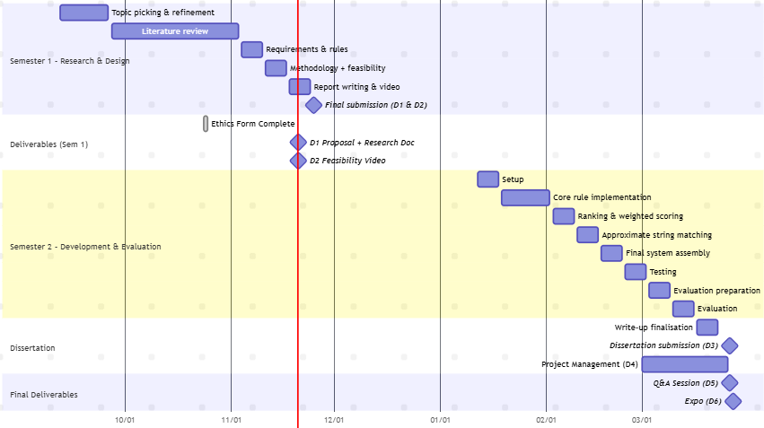

Slide 9
Risks and mitigations
Risks
Mitigations
Limited user feedback
Project development time constraint
Incorrect learning rate or discount factor may cause inadequate weight adjustments
Users input does not match any rules
Use fast adapting TD learning
Prioritising functionalities and use of modular design
Adjust the learning rate or discount factor if needed.
Make use of distance metrics as another way to detect similarity

Slide 10
Feasibility
Lightweight model free design
Modular design
Python implementation
Synthetic datasets

