Slide 1

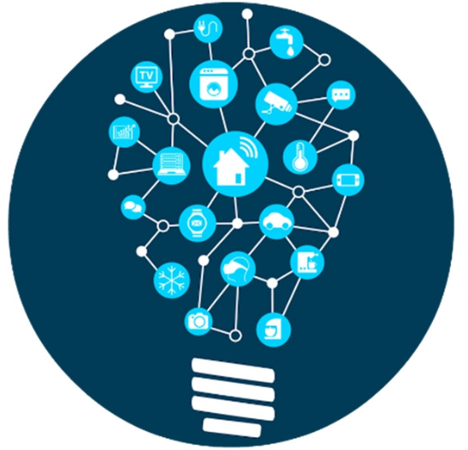

Istio
Developing Microservice on

Slide 2
Content
Microservice
Docker
Kubernetes
Traffic Management
Auth Policy
Notes:
Build the project, and create a docker image around the project

Slide 3
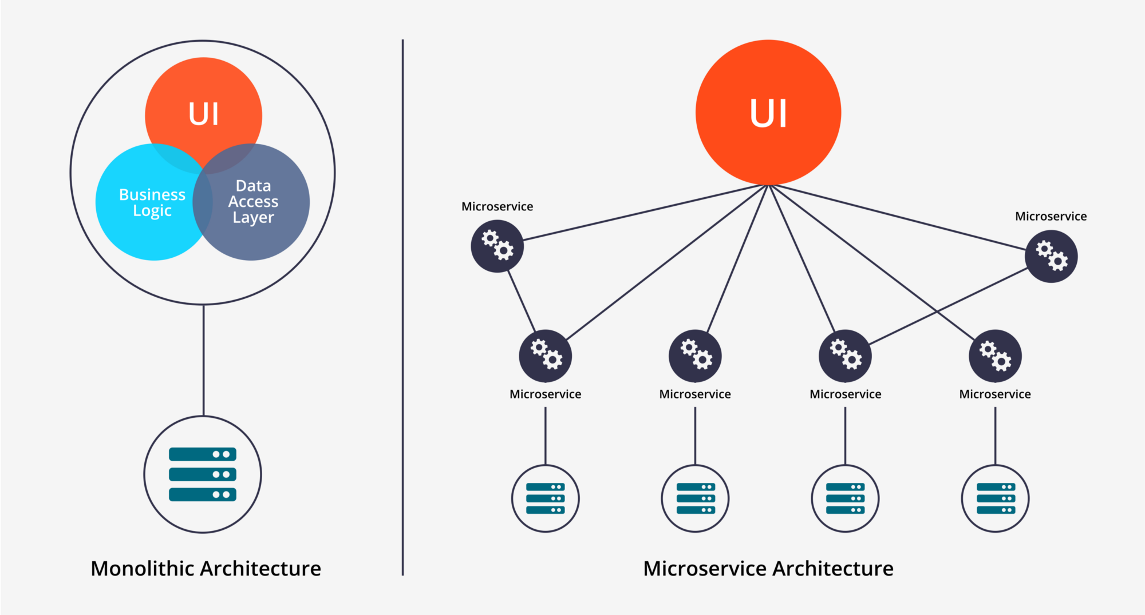
Notes:
In a traditional sense, we have a singular application that process the business logic, read and write data, and display information all by itself.
Gradually, people feel that it has become more and more inconvinent to test and develop new functions as the app grows, scale and expand. So Microservice Architecture is invented to take care of such concern by serperating each logical group into a Microservice.

Slide 4
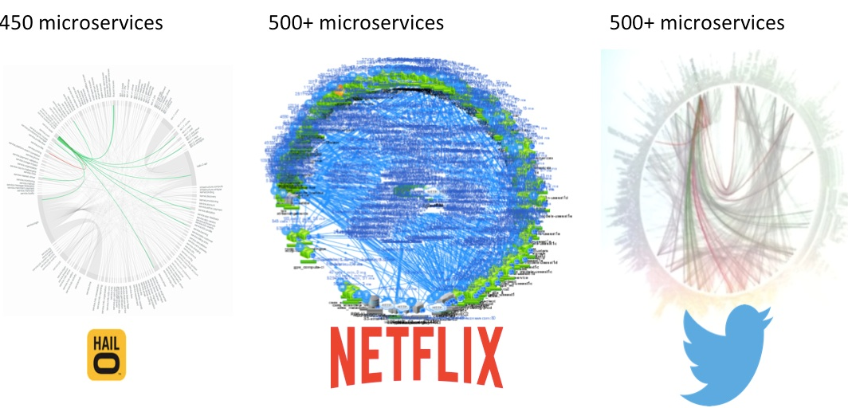
Notes:
A number of companies have, in fact, adopted Microservice development approach. Netflix’ former Chief Engineer told us a story that
Back in the days when they were still doing the DVD renting business, during the holidy season, they would literally go look for gigantic machines to physically and vertically scale their program.
Then they switched to the Microservice approach, an that’s when they started building this galaxy of services of muitlpe gateways.
Twitter, if you look at the graph, has mostly 2 gateways, and Hail mostly 1 gate way doing one directional calls.
Source:
Netflix: https://www.slideshare.net/BruceWong3/the-case-for-chaos
Twitter: https://twitter.com/adrianco/status/441883572618948608
Hail-o: https://https://sudo.hailoapp.com/services/2015/03/09/journey-into-a-Microservice-world-part-3/

Slide 5
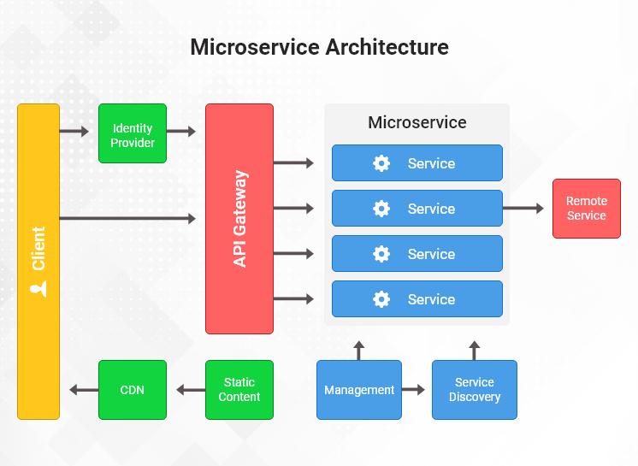

Slide 6
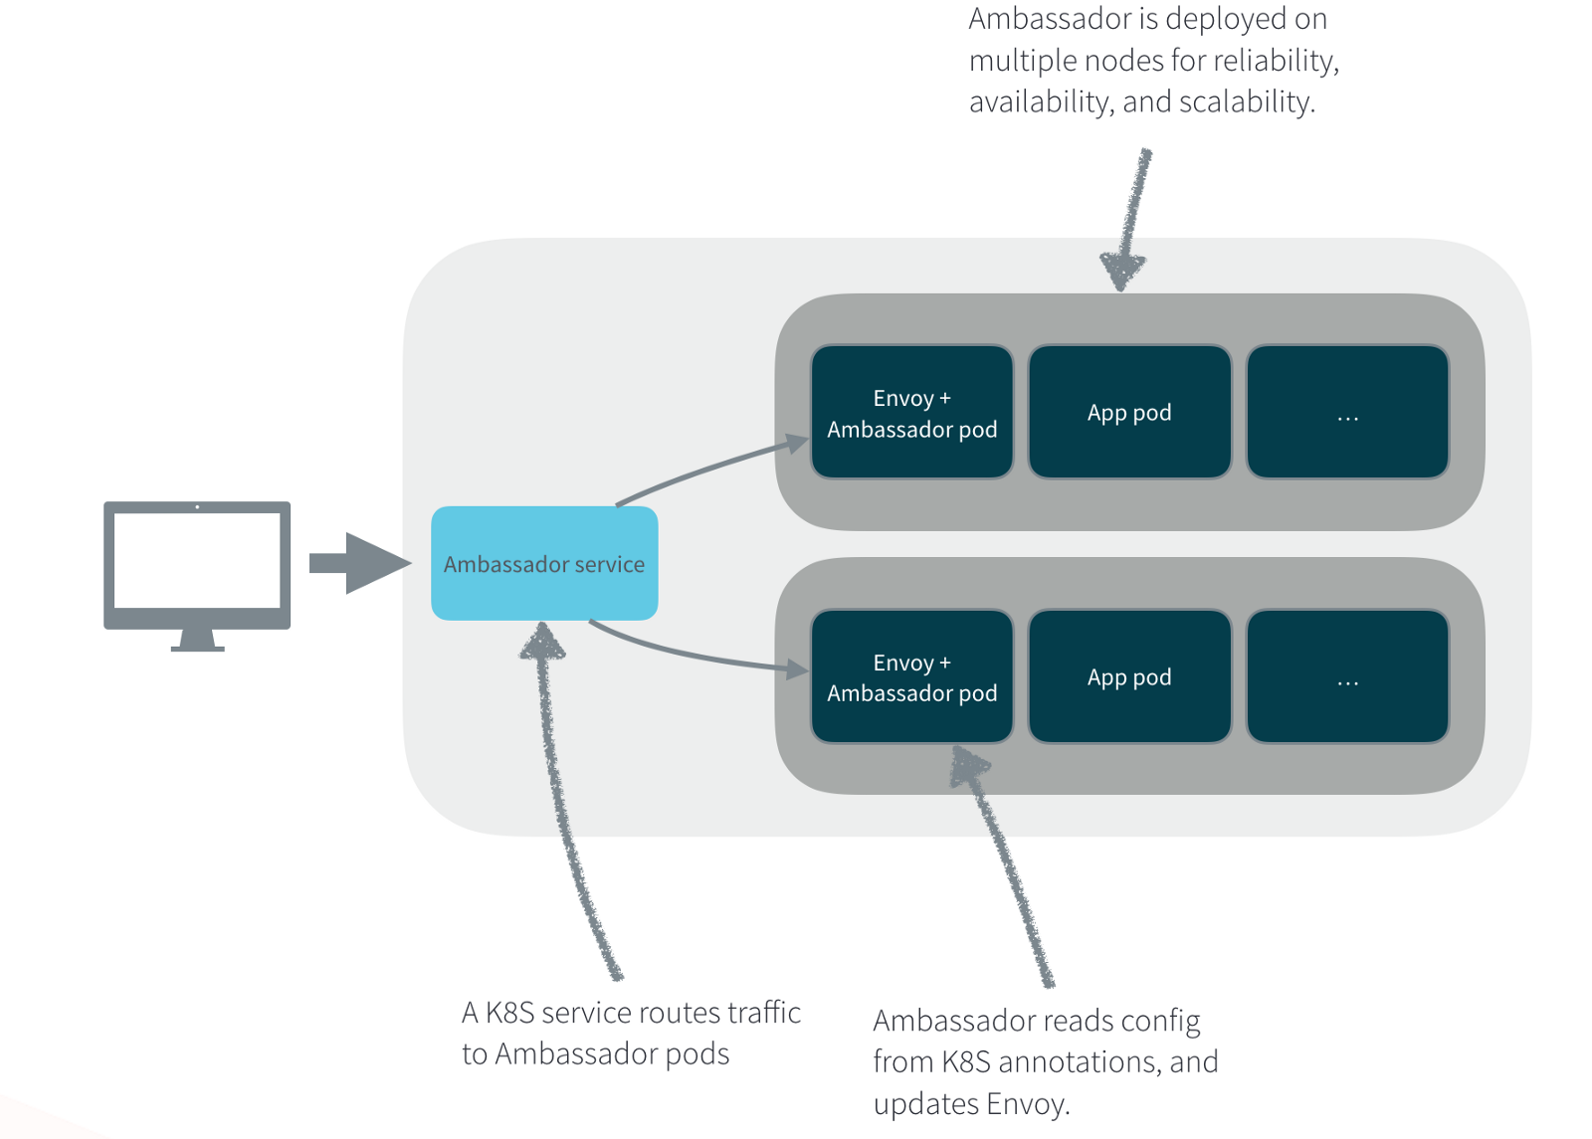
Service Registry, Management, Discovery
Gateways(Zuul, Ambassador, Istio):

Slide 7
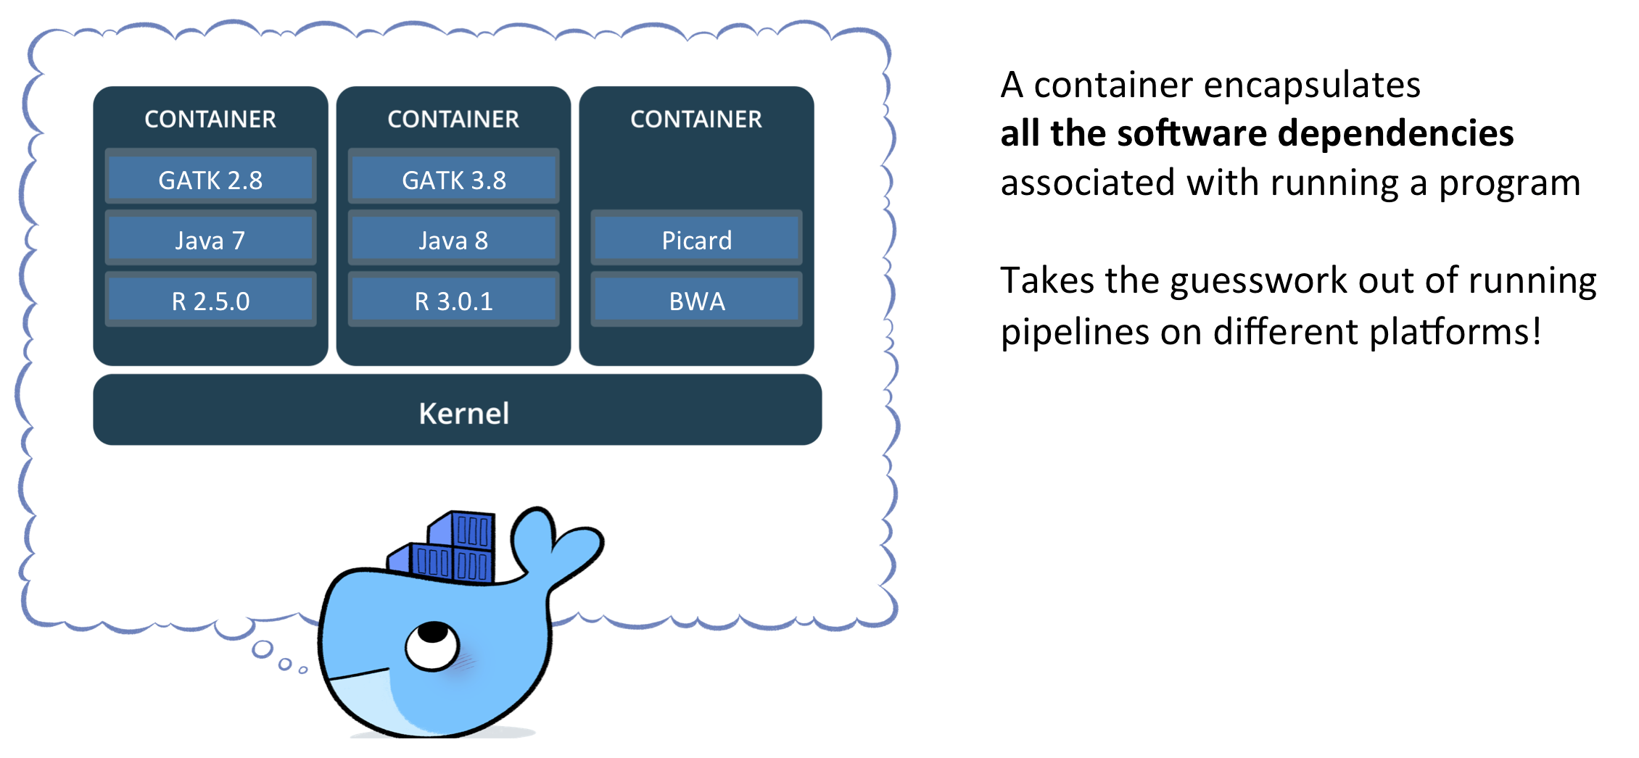
II. Docker What is Docker?
Notes:
Now, I want to talk a little bit about Docker, a tool we used in developing microservices application.
When developing application, we always want it to be able to build once and run anywhere. Docker enable use to do just that.
Docker builds images of your application, and enable you to deploy them in containerized environment, where all the software dependencies associated with running a program is included.

Slide 8
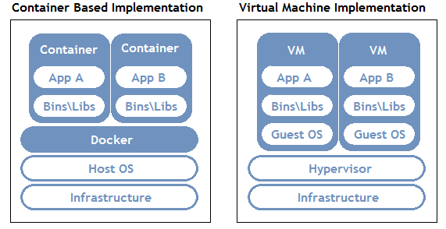
II. Docker Container vs Virtual Machine
Notes:
A common comparison is drawn between Docker and VM. Unlike VM, Docker moves the abstraction of resources from the hardware level to OS level. Thhe bottom-line is each container runs without the overhead cost of an virtualized OS.

Slide 9
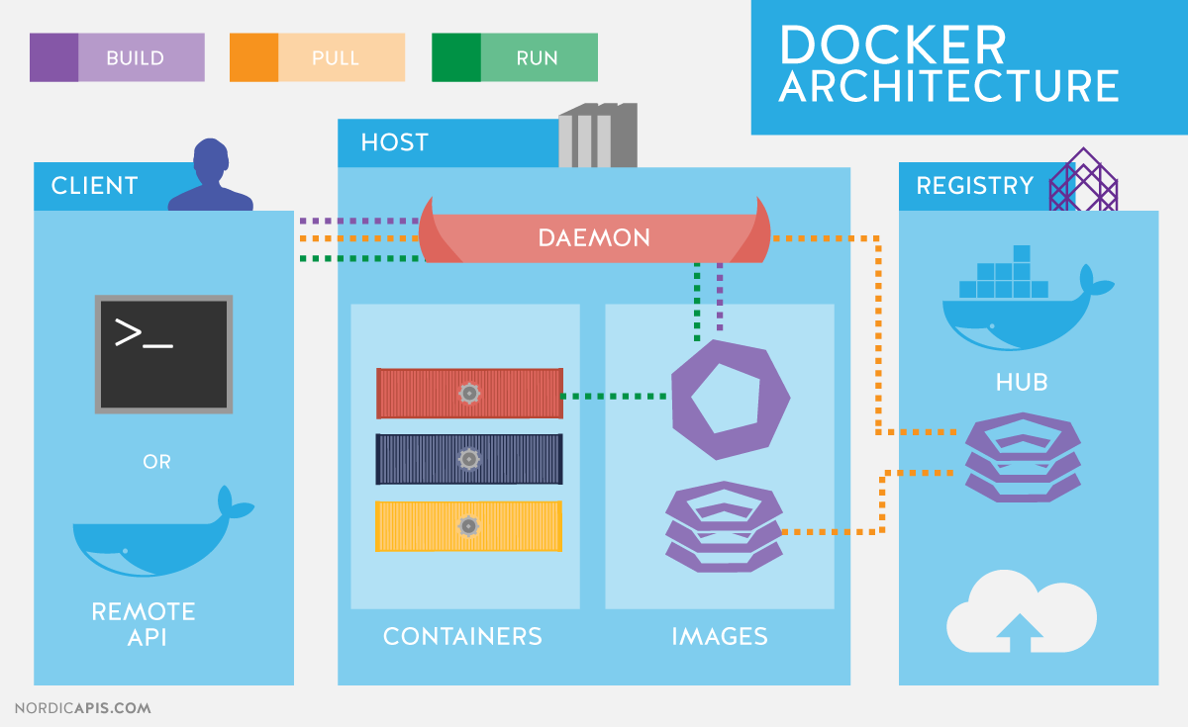
Notes:
Docker daemon: The daemon is responsible for all container related actions and receives commands via the CLI or the REST API.
Docker Client: A Docker client is how users interact with Docker. The Docker client can reside on the same host as the daemon or a remote host.
Docker Objects: Objects are used to assemble an application. Apart from networks, volumes, services, and other objects the two main requisite objects are:
Images: The read-only template used to build containers. Images are used to store and ship applications.
Containers: Containers are encapsulated environments in which applications are run. A container is defined by the image and configuration options. At a lower level, you have containerd, which is a core container runtime that initiates, and supervises container performance.
Docker Registries: Registries are locations from where we store and download (or “pull”) images.

Slide 10
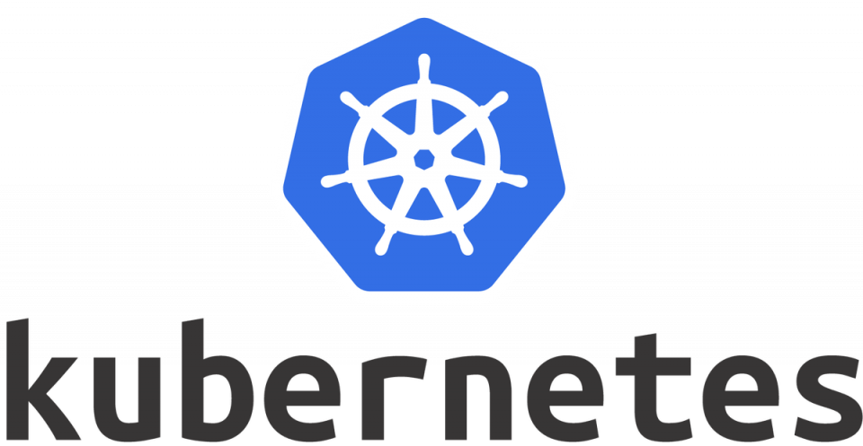
Notes:
Kubernetes, on the other hand is a container orchestration platform. Such distinction should be noted apart from docker. The

Slide 11
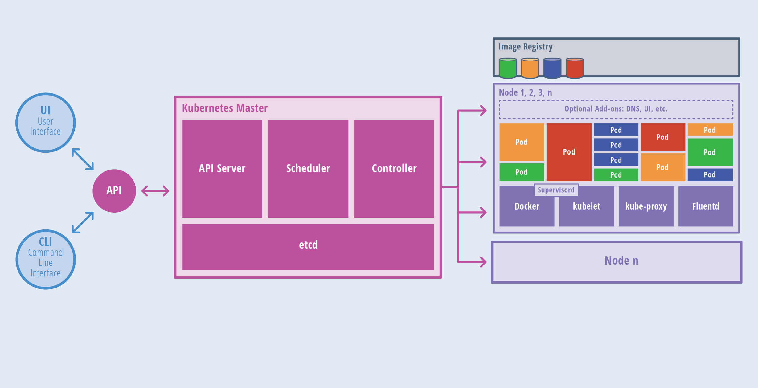
Kubernetes Architecture
Notes:
Kubernetes has a master-workers flow. A single master node control the flow to worker nodes. Kubectl command is utilized to communicate with kubernetes
Applications run in pods. If one pods goes down, kubernetes would attempt to bring it back up by default. However, liveness probe, and readiness probe can be done to determine whether an application require restart and a container is ready to accept traffic respectively.
$Kubectl logs podname
$kubectl exec –it podname --/bin/sh
$rollback deployment
Note: repopulate
Reference: https://godaddy.github.io/2018/05/02/kubernetes-introduction-for-developers/

Slide 12
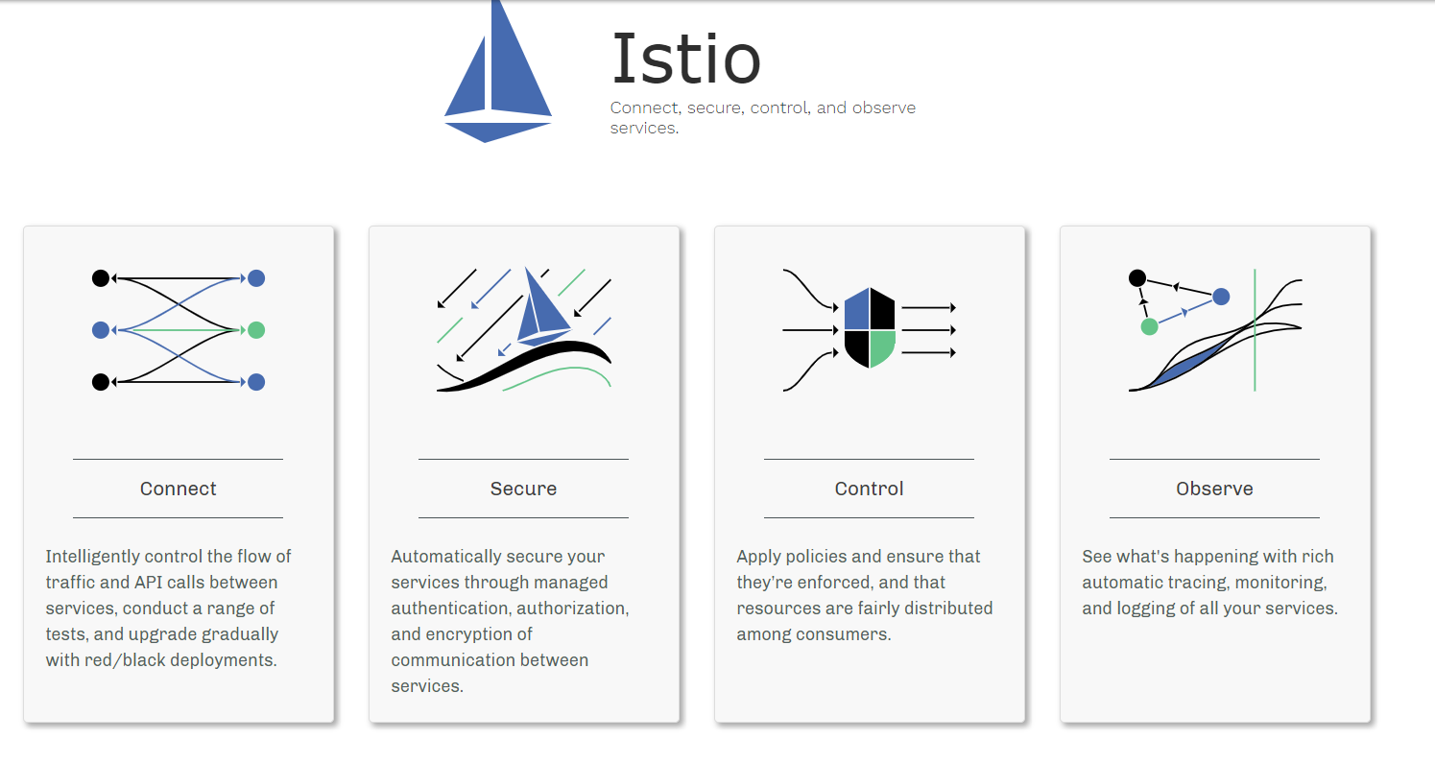
Notes:
Traffic management
Control the API calls between the services
Simplifies configuration for circuit breaker, timeouts and retries, making more reliable calls
Security
Istio manages authentication, authorization, and encryption of service communications
Service communications are secured by default
Observability
Robust tracing, monitoring, and logging

Slide 13
Service Mesh
Service discovery, load balancing, failure recovery , metrics and monitoring
Istio provides control over the service mesh
Deploy service with load balancing, service to service authentication, monitoring WITHOUT changing the service codes

Slide 14
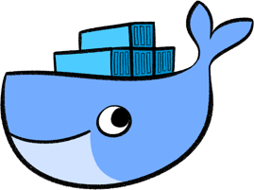
I. Prepare Image 1. Image Creation
Build the java project into jar
Configure DockerFile to compose an image
Build a Docker image Around
$docker build –t <image_name:version>

Slide 15
I. Prepare Image 2a. Deploy Image to Kubernetes
Create deployment and pod:
$kubectl run <deployment_name> --image=<iamge_name:version> --port=<port>
Expose deployment as a service:
$kubectl expose <deployment_name> --type=“type”
Type: cluster ip, Nodeport, LoadBalancer
Notes:
Option one will create pods along with the deployment

Slide 16
I. Prepare Image 2b. Deployment.yaml
In project root directory create deployment.yaml’
Specify ‘kind’ (deployment, service, destination, gateway)
At service section specified exposed deployment
spec.selector.app=<deployment label>
Notes:
Option one will create pods along with the deployment

Slide 17
II. Install Istio 1. Install Istio
Run a local instance of kubernetes, (eg. Minikube) Then download Istio
At istio root directory, set istioctl to path, and read istio CRD by
$kubectl apply –f install/kubernetes/helm/istio/templates/crds.yml
Install Istio:
$kubectl apply –f install/kubernetes/istio-demo.yml
Notes:
Option one will create pods along with the deployment

Slide 18
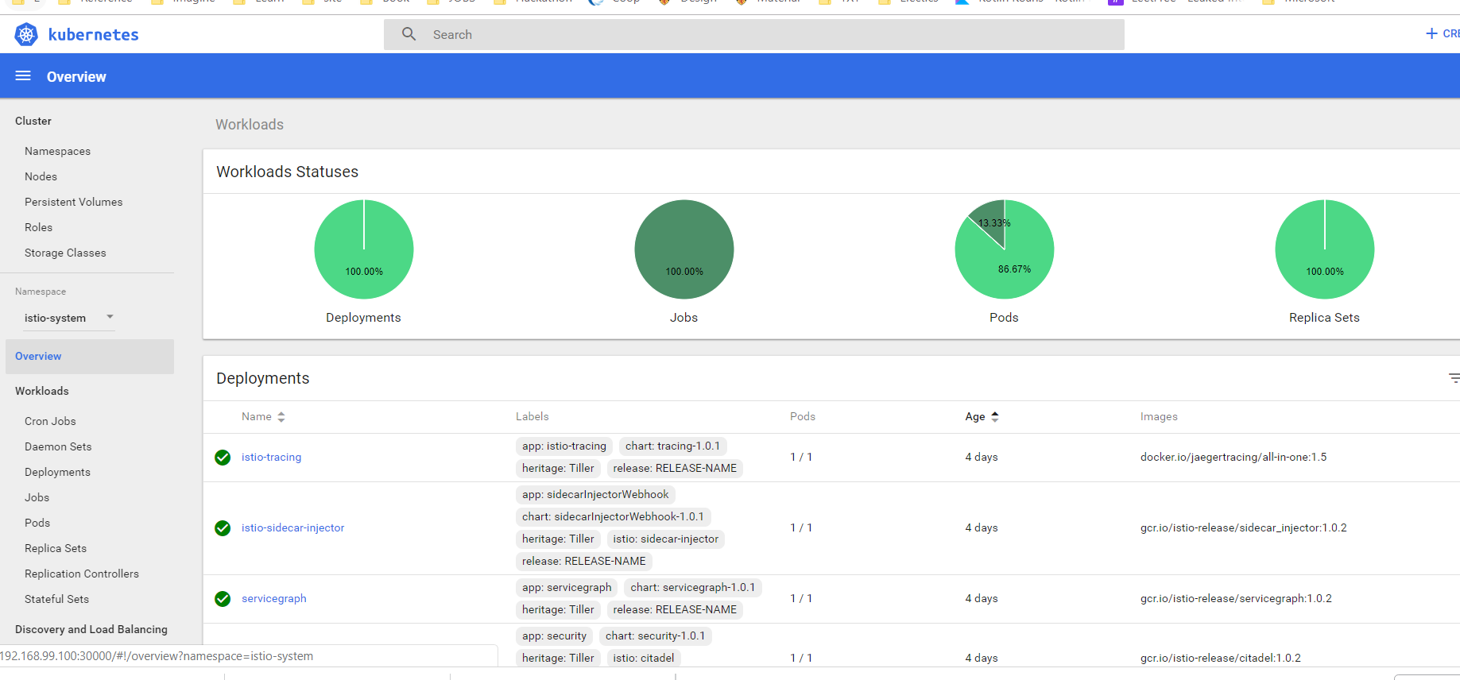
II. Install Istio 2. Check installation
Minikube dashboard
Notes:
Option one will create pods along with the deployment

Slide 19
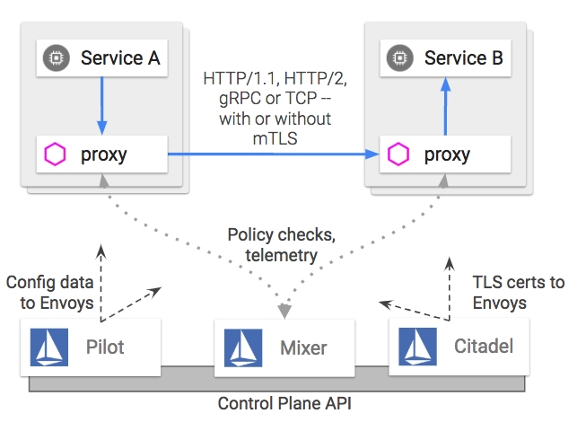
Istio API Features
Envoy(Proxy)
Pilot
Citadel
Mixer
Notes:
Pilot: Service Discovery, includes routing, circuit breaker,
Citadel: authentication service, could upgrade unencrypted traffic and control service access
Galley: API configuration for Istio.

Slide 20
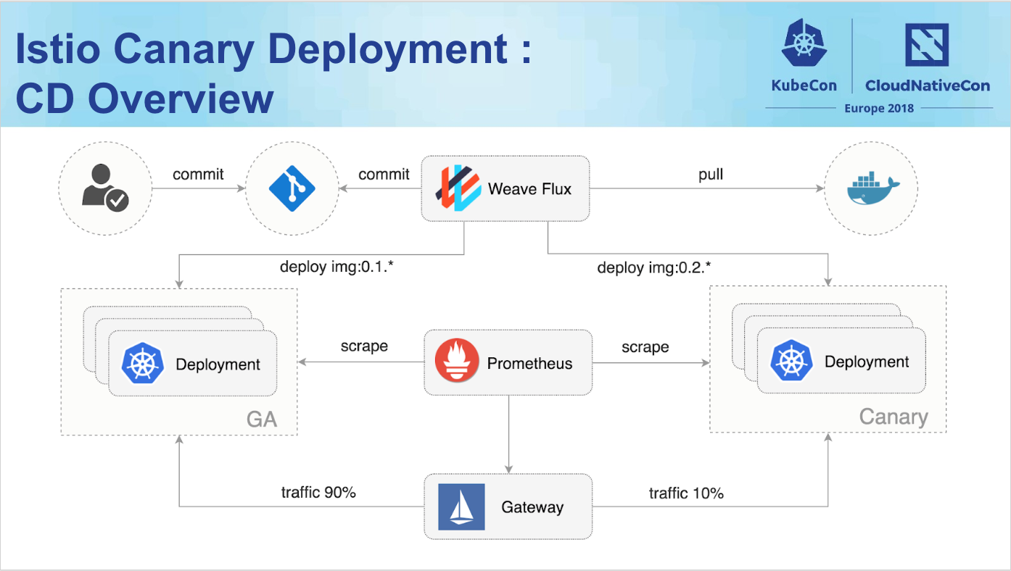
Notes:
https://www.weave.works/blog/gitops-workflows-for-istio-canary-deployments

Slide 22
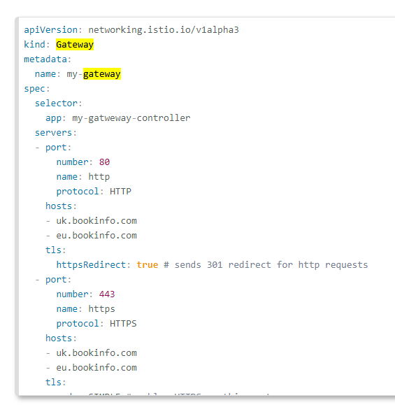
III. Traffic Management 1. Gateway
handles incoming/outgoing http/tcp connections (north south)
Describe load balancer at mesh edge
Virtual Service can then be bound to a gateway to control the forwarding of traffic arriving at a particular host or gateway port
Notes:
Option one will create pods along with the deployment

Slide 23
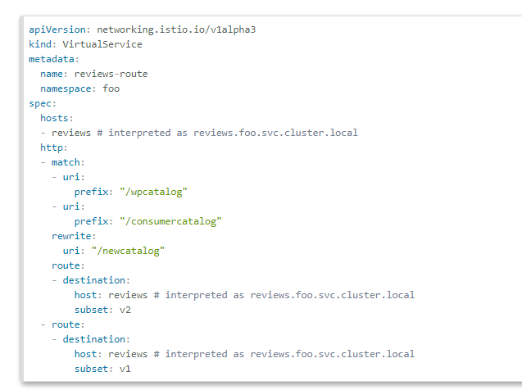
III. Traffic Management 2. Virtual Service
Specify gateway connected to the virtual service
Add Uri routing
Add route destionation
Refers to the destination rule to find subset (version)
Notes:
Option one will create pods along with the deployment

Slide 24
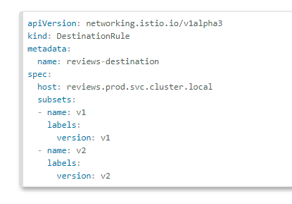
III. Traffic Management 3. Destination Rules
Declare subsets for deployment with labels
Refence to virtual service
Notes:
Option one will create pods along with the deployment

Slide 25
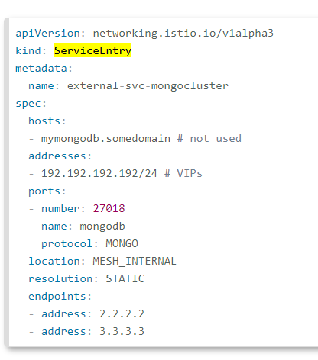
III. Traffic Management 4. Service Entry
Configure an external svc.
databse
other external apps
Notes:
Option one will create pods along with the deployment

Slide 26
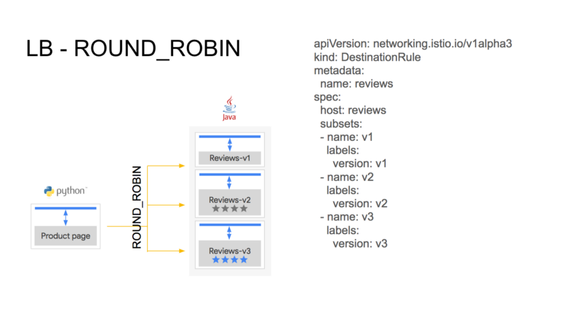

Slide 27
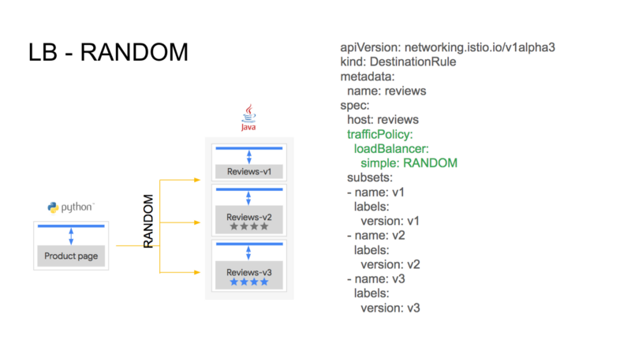

Slide 28
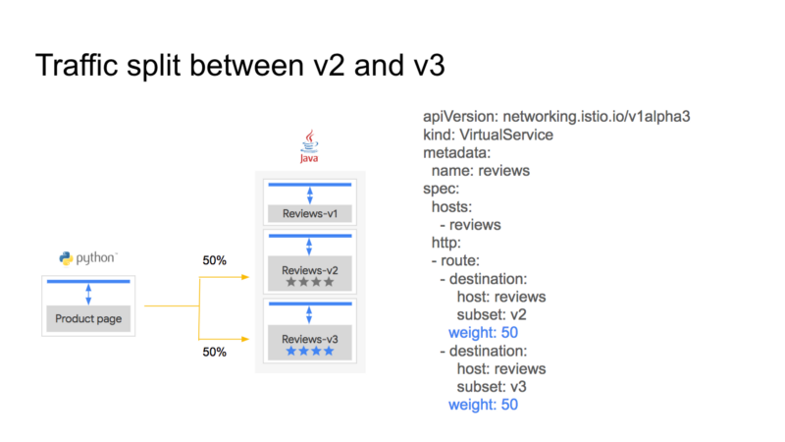

Slide 29
