Slide 1
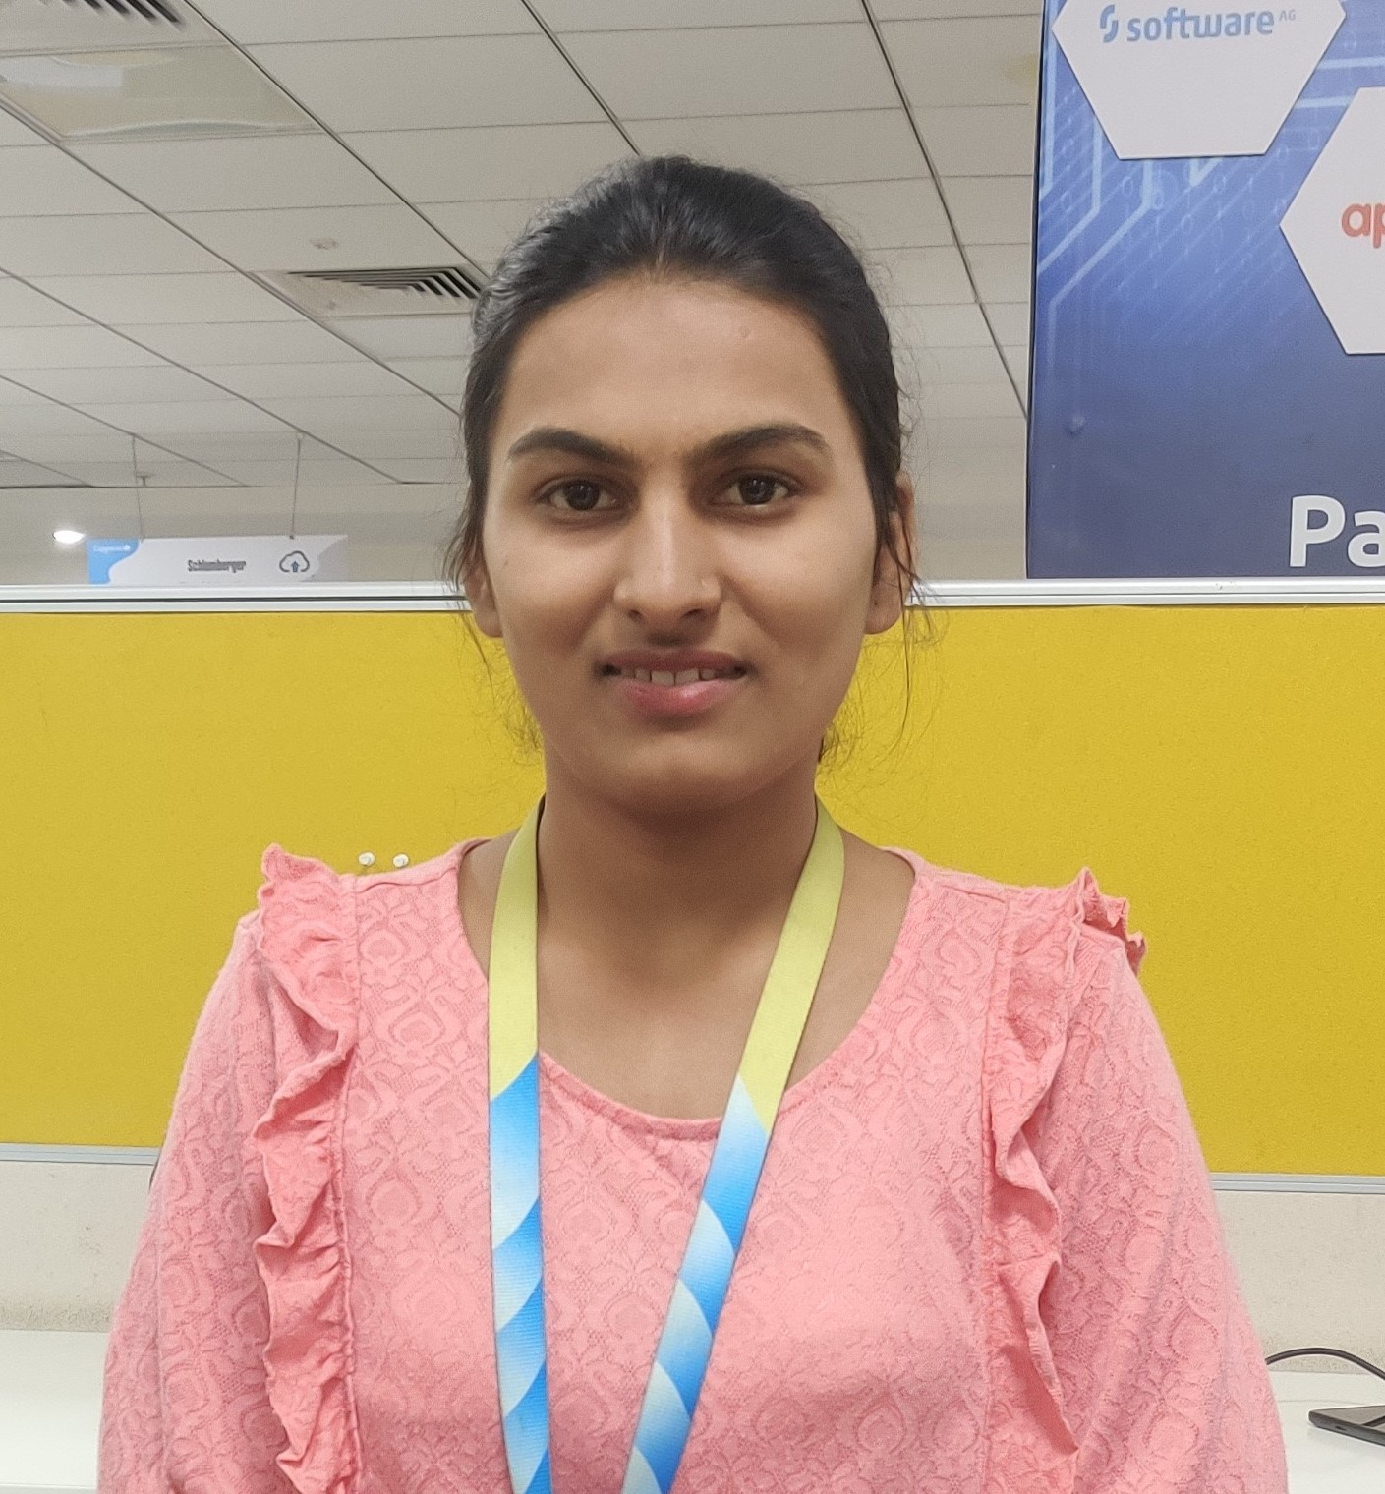

Kamaksha S Auti
Bachelor of Engineering,
Information Technology:2018-22
Analyst/Software Engineer
Mumbai
C# | Basics, OOPS, Exception Handling ,Arrays, Interfaces, Delegates, Collection and Generics.
.NET Framework | ADO.NET, .NET 6 WEB API, Entity Framework , ASP .NET with MVC5.
Database | SQL
Tools | GIT, Swagger, Visual Studio, Visual Studio Code, SSMS, CLI.
UI Technology | HTML5 ,CSS & Angular
Add On Skills | Communication Skills, Team Management
Kamaksha.auti@capgemini.com
7263887497
A4
Full Stack developer with Angular and .NET.
Practical understanding of C# and SQL concepts using Visual Studio and SQL Server
Hands on experience in developing applications using ADO.NET, RDbms, Entity Framework, ASP .Net core with Web Api, and in creating services with .Net Framework.
Proficient in creating Single page WebApplication in Angular .Hands on experience in developing web pages using HTML5, CSS3, object oriented, TypeScript .
Good Understanding of Oop concepts (Abstraction, Encapsulation, Polymorphism, Inheritance).
Having good knowledge of Git and GitHub
Developed a WEB APPLICATION as part of case study using .NET WEBAPI , & ANGULAR.
RollOff System for Employees.
Develop a project which helps to Roll off the employee. This project should act as a communication among Accounts team, PSP and admin. This web application automates and minimize the time off roll off process via email. Roll off must be shared within 30 days of notice period along with the complete details. In this application we can ensures that if employee are on probation and there is performance issue the respective Roll Off will not be considered.
Checkout my github account GithubLink here.

