Slide 1
Determining Seasonality: A Comparison of Diagnostics from X-12-ARIMA
Demetra Lytras
Roxanne Feldpausch
William Bell

Slide 2
Disclaimer
This report is released to inform interested parties of ongoing research and to encourage discussion of work in progress. Any views expressed on statistical, methodological, technical, or operational issues are those of the authors and not necessarily those of the U.S. Census Bureau.

Slide 3
Purpose
To evaluate the properties of diagnostics available in X-12-ARIMA for detecting seasonality (to determine if a series is a candidate for seasonal adjustment)

Slide 4
Overview
Definition of diagnostics
Nonseasonal series
Fixed seasonal effects models
Airline models
Conclusions

Slide 5
Tests for Seasonality
D8 F test for stable seasonality
M7
Spectrum of the differenced transformed original series
χ² test for fixed seasonal effects
  Extension to F_{mb} test (not in X-12-ARIMA)

Slide 6
Notation
Assume monthly data, changes for quarterly data are clear

Slide 7
D8 F Test Assuming Stable Seasonality
H₀: m₁=m₂=…=m₁₂
H₁: m_{p} ≠ m_{q} for at least one pair (p,q)
where
m₁,…,m₁₂ are the monthly means of the seasonal-irregular (SI) component (the detrended series)
Notes:
One-way ANOVA

Slide 8
D8 F Assumptions
The SI ratios are independently distributed as N(m_{i},σ²)
Problems: Estimated SI ratios are actually dependent and heteroscedastic (higher variance near the ends)
Traditionally attempted solution: use 7 as critical value

Slide 9
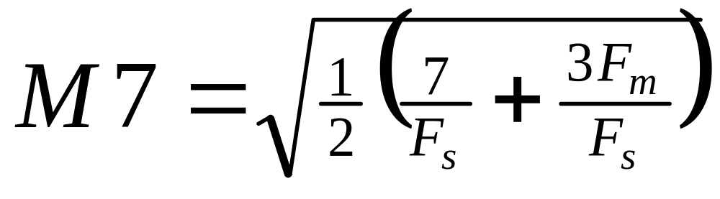
M7
where
F_{s} = D8 F statistic for stable seasonality
F_{m} = D8 F statistic for moving seasonality
Note: M7 < 1, series is seasonal

Slide 10
Spectrum of the Differenced Transformed Original Series
To determine seasonality, look for peaks at seasonal frequencies 1/12, 2/12, 3/12, and 4/12
A peak of six or more “stars” is considered seasonal where one star is 1/52nd of the spectral range in decibels
Used default start, estimated spectrum based on last 8 years of data
Notes:
One star corresponds with 1/52nd of the range between the maximum and minimum spectral values

Slide 11
χ² Test for Fixed Seasonal Effects
Fit a regARIMA model with
  Fixed seasonal effects
  Nonseasonal ARIMA model
Use results of the χ² test for fixed seasonal effect regression coefficients

Slide 12
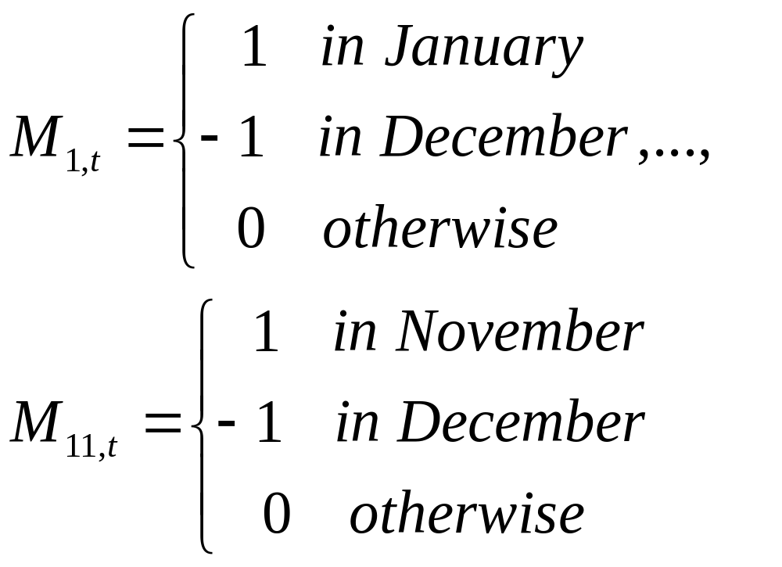
Fixed Seasonal Effects Regressors

Slide 13
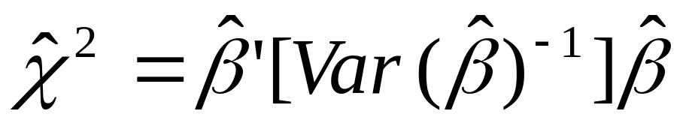

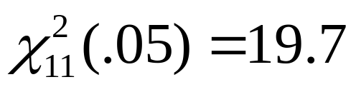
χ² Test for Fixed Seasonal Effects
where is the vector of fixed seasonal effect regression parameters
Compare to

Slide 14
χ² Test for Fixed Seasonal Effects Assumptions
χ² distribution (under H₀) holds exactly only if the ARMA parameters and the innovation variance σ² are known
Problem: Need to estimate the parameters
Attempted solution: use model-based F test to correct for the estimation of σ²
  Still need to estimate ARMA parameters

Slide 15
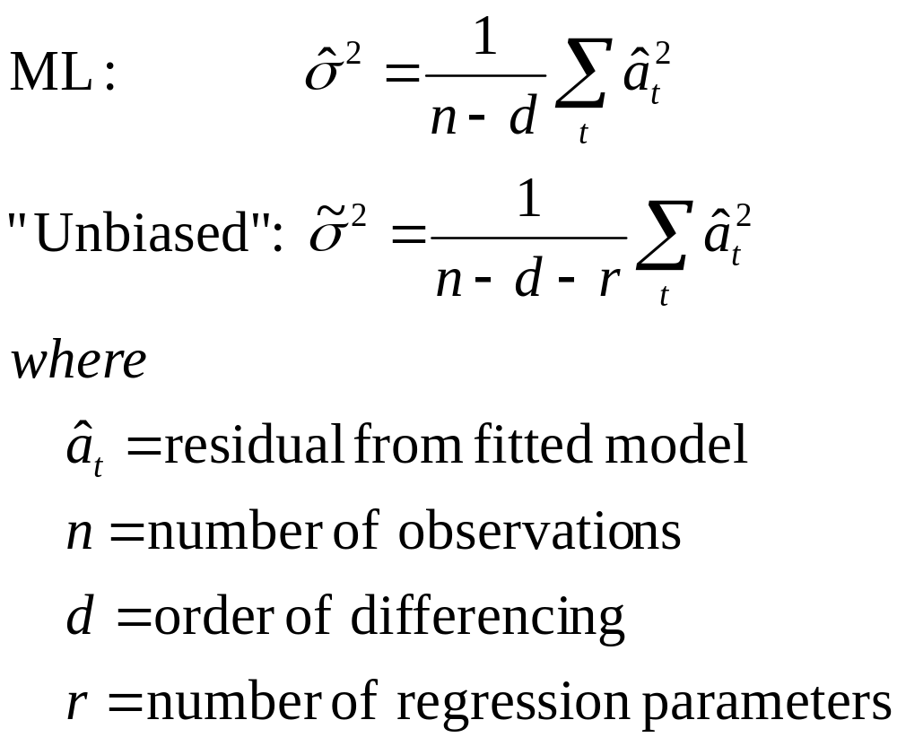
Estimates of σ²
Notes:
The chi-squared test uses the ML of sigma^2 and the model-based F-test uses the unbiased estimate and also allows for its degrees of freedom (by referencing it to the F-distribution).

Slide 16
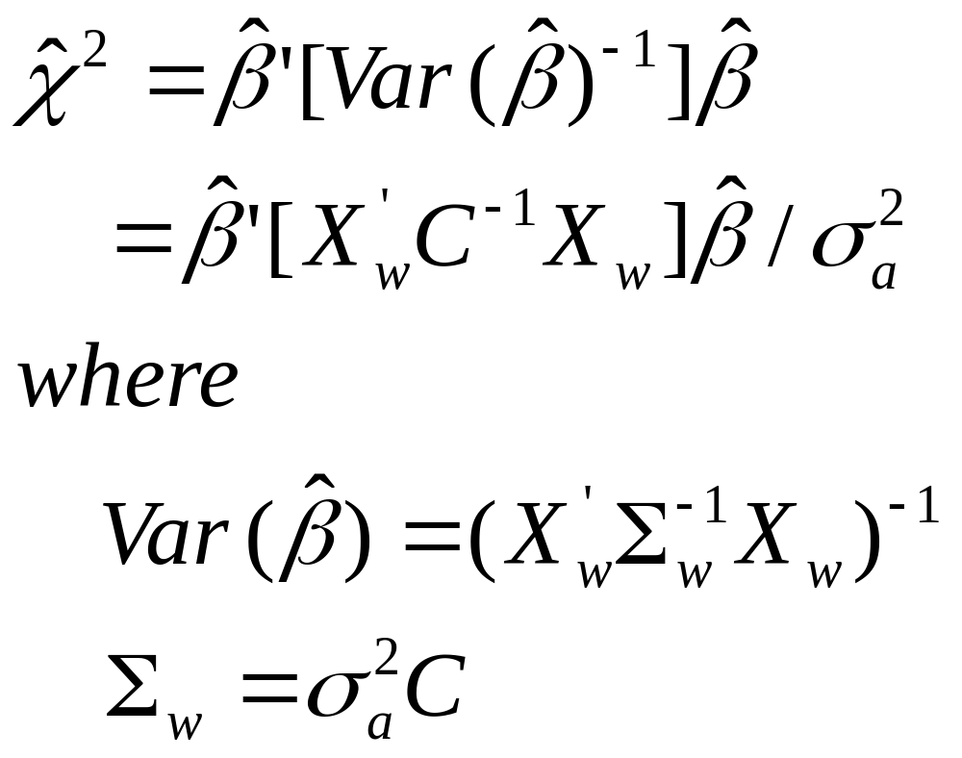

Slide 17
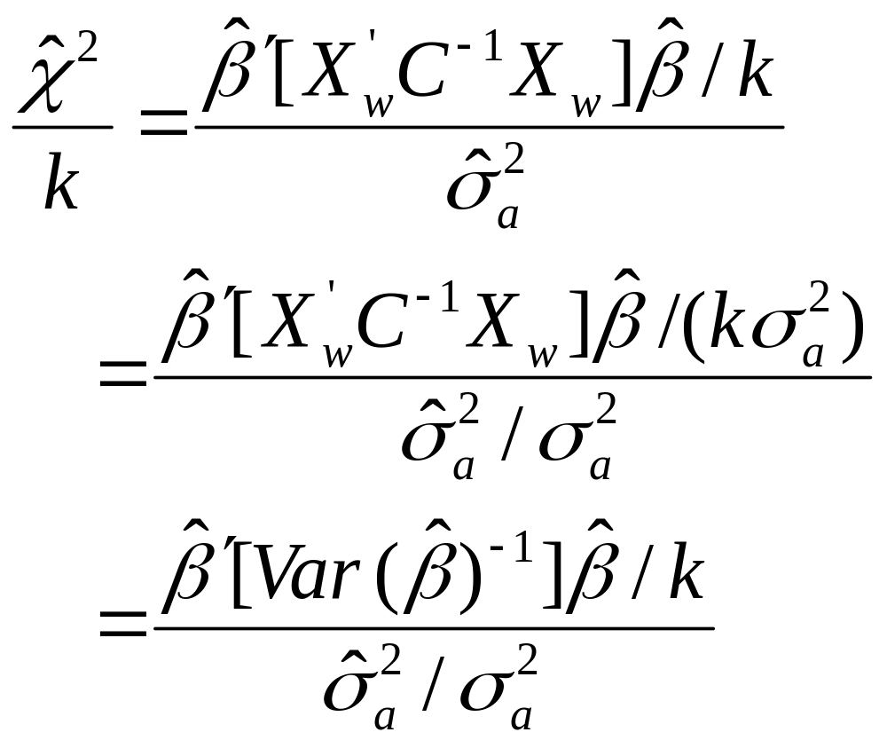

Slide 18
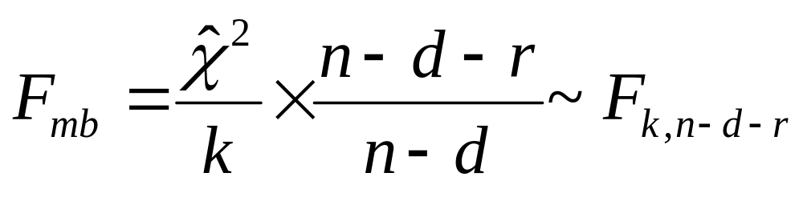

Extension to Model-based F test for Fixed Seasonal Effects
where
is the chi-squared statistic from X-12-ARIMA
k is the number of fixed seasonal effects regressors (k=11 for monthly data)
r is the total number of regression variables
Notes:
N-d-k/n-d is the degrees of freedom adjustment
We compared our results to the F-distribution 5% critical value with degrees of freedom shown in the slide.
In our case, for 20 years of data F=1.8 and for 10 years of data F=1.9

Slide 19
Methods
Simulate nonseasonal series to determine significance levels of the diagnostics
Simulate seasonal series to determine the power of the diagnostics

Slide 20
Methods - Nonseasonal Series
Simulated 10,000 monthly series with a length of 20 years for each of the following models
ARIMA (0 1 0)
ARIMA (0 1 1), with θ = 0.3, 0.5, and 0.8
ARIMA (1 1 0), with φ = 0.3, 0.5, and 0.8
Notes:
Simulated non-seasonal series to check the significance level of the diagnostics

Slide 21
X-12-ARIMA Settings
Model: Correct ARIMA model (estimated parameters) + seasonal regressors
Forecasts: 2 years
Adjustment Type: additive

Slide 22
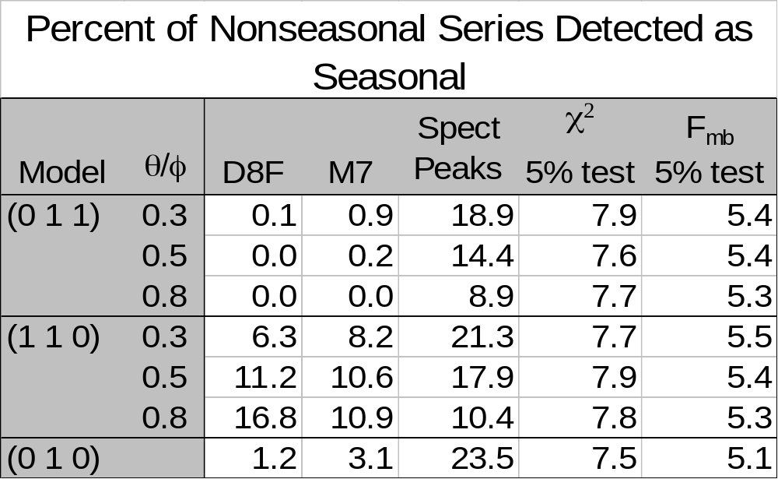
Notes:
Significance level table: M7, D8 F and spectrum peaks vary depending on the model. All three diagnostics found (011) series to be seasonal less often than (110) series. The significance levels also vary based on the parameters

Slide 23
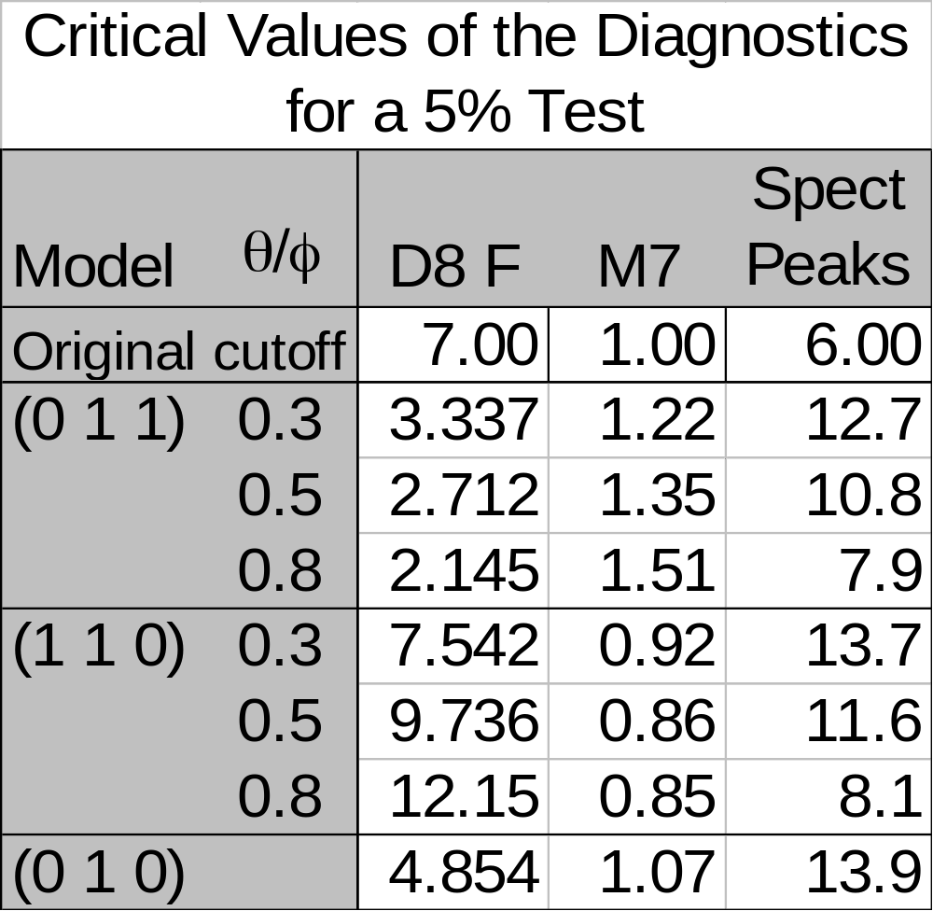
Notes:
Since the significance levels varied so much based on the model, we calculated the size-adjusted critical values. The critical values in the table are the values such that 5% of the nonseasonal series would be identified as seasonal.

Slide 24
Methods – Seasonal Series
Simulated series with
  Fixed seasonal effects
  Airline series
Applied seasonality diagnostics
  D8 F, M7, Spectrum – used size adjusted critical value
  F_{mb}

Slide 25
Fixed Seasonal Effect Series
Added fixed seasonal effects based on two real series to the nonseasonal simulated series

Slide 26
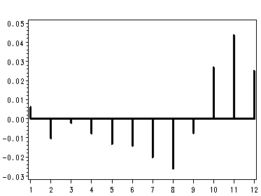
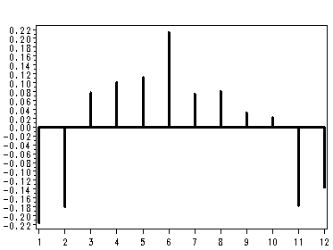
Seasonal Factors

Slide 27
Fixed Seasonal Effects
Simulated 1,000 series from each of the following 36 models
  Two sets of base seasonal factors
  Rescaling of base seasonal factors: small, medium, and large (compared to the irregular)
  Six (0 1 1) and (1 1 0) nonseasonal models

Slide 28
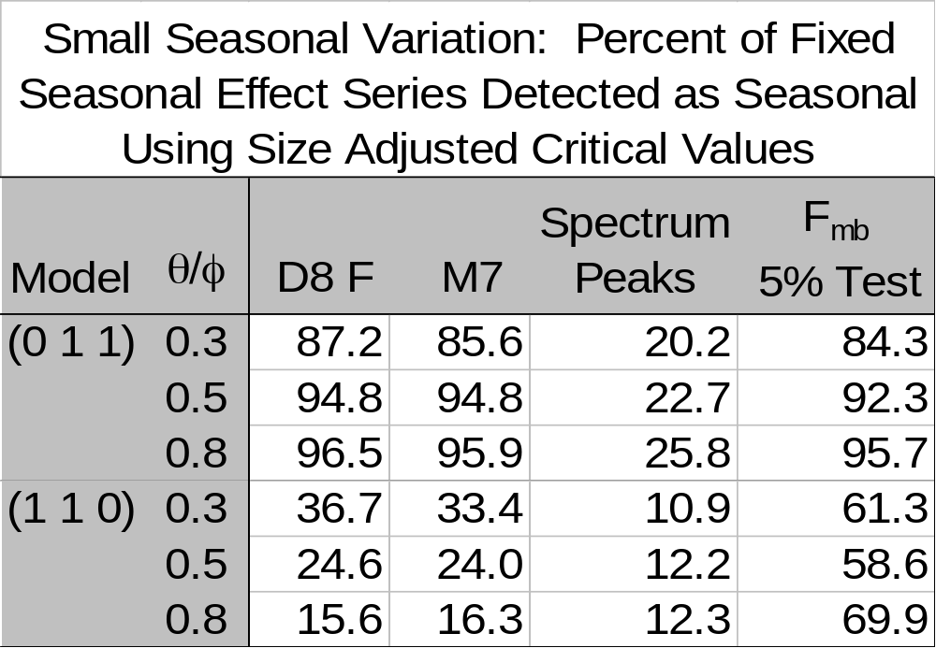
Notes:
This table shows some of the more interesting results for the fixed effects models. For these series the seasonal component was relatively small compared with the innovation variance. All of the test do better with the (011) models than with the (110) models. For the (011) models, M7, the D8 F and the F test of the seasonal regressors have similar power. While the peaks in the spectrum has a lower power. For the (110) models, the F test of the seasonal regressors has higher power than M7, the D8 F and the spectrum peaks.

Slide 29
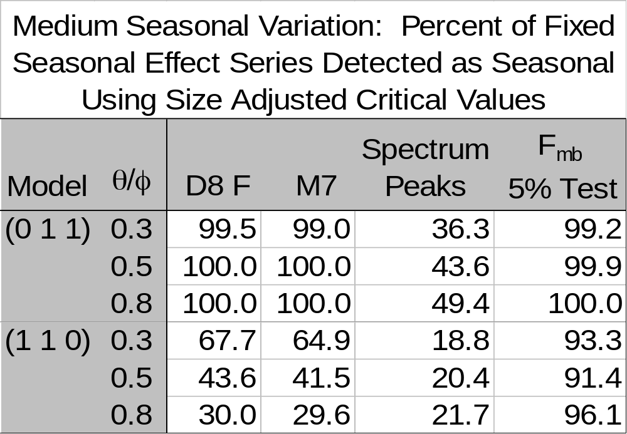
Notes:
For series with moderate sized seasonal factors compared with the innovation variance, we see the same pattern as we saw in the previous slide. However the powers are all larger, which we would expect, since the seasonal component is larger in comparison with the innovation variance than for the series we looked at in the previous slide. If we increase the size of the relative size of the seasonal component even more, M7, the D8 F, the chi-squared and associated F test of seasonal regresssors identify nearly all of the series as seasonal.

Slide 30
Methods – Airline Series
Simulated 1,000 series from each of the following 48 models
  Seasonal Θ = 0.6 and 0.9
  Nonseasonal θ = 0.3 and 0.8
  Length of 10 and 20 years
  Starting values:
    Zeros
    One of two sets of values based on real series
  Innovation variance: 1 and a smaller number
Notes:
Innovation variance for the series based with starting values from real series is the estimated innovation variance of the real series.

Slide 31
Results – Airline Series
F_{mb} test found 99 - 100% of the series seasonal
M7, D8 F and spectrum peaks found 89.2-100% of the series seasonal

Slide 32
Conclusions - D8 F, M7 and Spectrum Peaks
Significance levels vary greatly depending on the model
Power is equal or lower than that of the F_{mb} test for fixed seasonal effects
Notes:
First bullet: Cutoff values should be modified based on the model and the model parameters to provide consistent. Problems-true model and model parameters are not known and difficult to implement.

Slide 33
Conclusions – χ² and F_{mb} Tests for Fixed Seasonal Effects
The χ² test was slightly oversized
This is corrected by F_{mb}, whose significance levels are consistently close to the stated level of the test
F_{mb} has higher power than the M7, D8 F and spectrum peaks for most models

Slide 34
Contact Information
Demetra.P.Lytras@census.gov
Roxanne.Feldpausch@census.gov
William.R.Bell@census.gov

