Slide 1
Bootstrap

Slide 2
Introduction
Bootstrap is a free front-end framework for faster and easier web development.
Bootstrap includes HTML and CSS based design templates for typography, forms, buttons, tables, navigation, modals, image carousels and many other.
Bootstrap also gives you the ability to easily create responsive designs.

Slide 3
History
Bootstrap was developed by Mark Otto and Jacob Thornton at Twitter, and released as an open source product in August 2011 on GitHub.

Slide 4
Advantages
Easy to use
Responsive features
Browser compatibility

Slide 5
Including bootstrap
There are two ways to start using Bootstrap on your own web site.
Download Bootstrap from getbootstrap.com
Include Bootstrap from a CDN

Slide 6
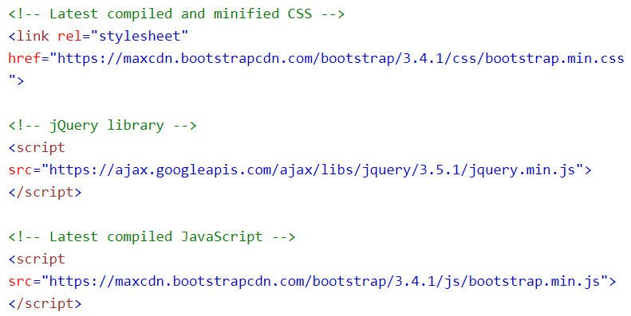
Bootstrap CDN

Slide 7
BS Containers
Bootstrap also requires a containing element to wrap site contents.
There are two container classes to choose from:
The .container class provides a responsive fixed width container
The .container-fluid class provides a full width container, spanning the entire width of the viewport

Slide 8
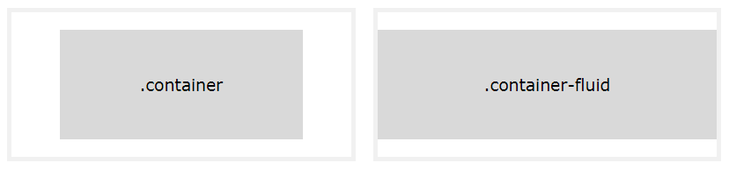

Slide 9
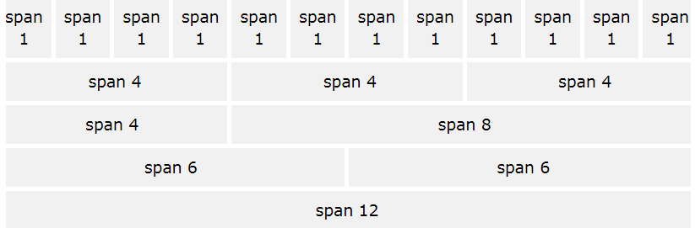
BS Grid System

Slide 10
Grid classes
xs (for phones - screens less than 768px wide)
sm (for tablets - screens equal to or greater than 768px wide)
md (for small laptops - screens equal to or greater than 992px wide)
lg (for laptops and desktops - screens equal to or greater than 1200px wide)

Slide 11
BS Typography
Bootstrap's global default font-size is 14px.
h1 Bootstrap heading (36px)
h2 Bootstrap heading (30px)
h3 Bootstrap heading (24px)
h4 Bootstrap heading (18px)
h5 Bootstrap heading (14px)
h6 Bootstrap heading (12px)

Slide 12
In Bootstrap the HTML <small> element is used to create a lighter, secondary text in any heading.
Mark example
Abbr example
Blockquote example
Blockquote reverse example
Pre example

Slide 13
BS Text and Background Colors
Textcolor example
Backcolor example

Slide 14
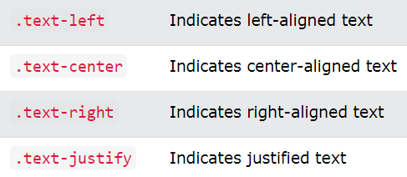
More typography classes

Slide 15
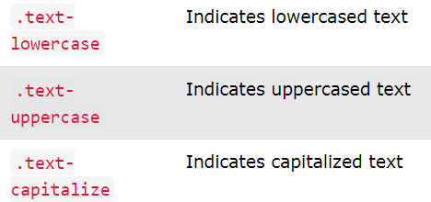

Slide 16
BS Tables
A basic Bootstrap table has a light padding and only horizontal dividers.
Table example
Striped example
Border example
Hover example
Tablecolor example

Slide 17
BS Images
Rounded corner example
Circle image example
Thumbnail image example
Responsive image example
Image gallery example

Slide 18
BS Jumbotron
A jumbotron indicates a big box for calling extra attention to some special content or information.
A jumbotron is displayed as a grey box with rounded corners. It also enlarges the font sizes of the text inside it.
Example

Slide 19
BS Alerts
Alerts help in displaying pre-defined alert messages.
Alerts are created with the .alert class, followed by one of the four contextual classes .alert-success, .alert-info, .alert-warning or .alert-danger.
Alert1 example
Alert as link-Alert2 example
Alert close-Alert 3 example

Slide 20
BS Buttons
Button1 example
Button size- button2 example
Block level button- button3.html
Active/disabled button- button4.html

Slide 21
BS Button Groups
Bootstrap allows you to group a series of buttons together (on a single line) in a button group.
Buttongroup1 example
Button group size- buttongroup2 example
Vertical button group- buttongroup3 example

Slide 22
BS Badges
Badges are numerical indicators of how many items are associated with a link.
Use the .badge class within <span> elements to create badges.
Badge example
Badges inside buttons- badge1 example

Slide 23
BS Labels
Labels are used to provide additional information about something.
Use the .label class, followed by one of the six contextual classes .label-default, .label-primary, .label-success, .label-info, .label-warning or .label-danger, within a <span> element to create a label.

Slide 24
BS List Groups
To create a basic list group, use an <ul> element with class .list-group, and <li> elements with class .list-group-item.
List example
List badge example
List-links example
Active/disabled example
Color-list example

Slide 25
BS Progress Bars
A progress bar can be used to show a user how far along he/she is in a process.
Progress bar example
Progress bar label example
Progress bar color example
Progress bar striped example
Progress bar animated example
Progress bar stacked example

Slide 26
BS Pagination
Pagination example
Pagination-active/disabled example
Pagination-size example

Slide 27
BS Panels
A panel is a bordered box with some padding around its content.
Panels are created with the .panel class, and content inside the panel has a .panel-body class.
Panel example
Panel header footer example
Panel group example
Panel color example

Slide 28
BS Dropdowns
A dropdown menu is a toggleable menu that allows the user to choose one value from a predefined list.
Dropdown example
Dropdown divider example
Dropdown header example
Dropdown active disabled example

Slide 29
BS Collapse
Collapsibles are useful when you want to hide and show large amount of content.
Collapse example

Slide 30
BS Media Objects
Bootstrap provides an easy way to align media objects (like images) to the left or to the right of some content.
This can be used to display blog comments, tweets and so on.
Media example
Media top bottom middle- media1 example
Nested media (media-nest example)

Slide 31
BS Carousel
The Carousel is a component for cycling through elements, like a slideshow.
Carousel example
Carousel caption example

Slide 32
BS Modal
The Modal is a dialog box/popup window that is displayed on top of the current page.
Modal example

Slide 33
BS Tooltip
The Tooltip is small pop-up box that appears when the user moves the mouse pointer over an element.
Tooltips must be initialized with jQuery: select the specified element and call the tooltip() method.
Tooltip example
Tooltip position example

Slide 34
BS Popover
The Popover is similar to tooltips; it is a pop-up box that appears when the user clicks on an element.
Popovers must be initialized with jQuery: select the specified element and call the popover() method.
Popover example
Popover position example

Slide 35
BS Navbar
A navigation bar is a navigation header that is placed at the top of the page.
Navbar example- nav1
Inverted navbar example- nav2
Right aligned navbar example- nav3
Navbar Button example- nav4

Slide 36
CTD…
Navbar form example- nav5
Navbar text example- nav6
Fixed navigation bar example- nav7
Collapsing navbar example- nav8

Slide 37
BS Scrollspy
The Scrollspy is used to automatically update links in a navigation list based on scroll position.
Scrollspy example - scroll

Slide 38
BS Inputs
BS supports all HTML input types.
BS input examples
Text field and password
Textarea
Checkbox (inline)
Radio button (inline)
Select List

Slide 39
BS Forms
Bootstrap provides three types of form layouts:
Vertical form (Default)
Horizontal form
Inline form

Slide 40
THANK YOU!!

