Slide 1
CT111
Introduction to communication Systems
End Semester Project
Professor : Yash Vasavada

Slide 2
Group ID
Lab Group 1
Project Group 2
Team ID
Date
202001011-202001020
16-07-2021

Slide 3

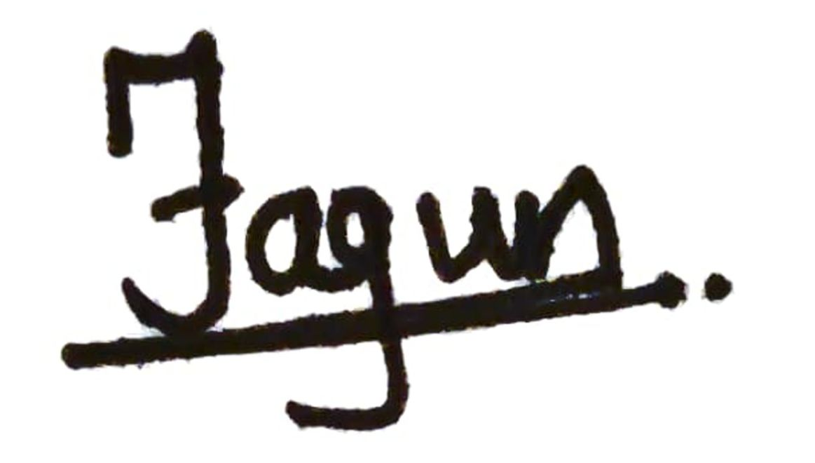

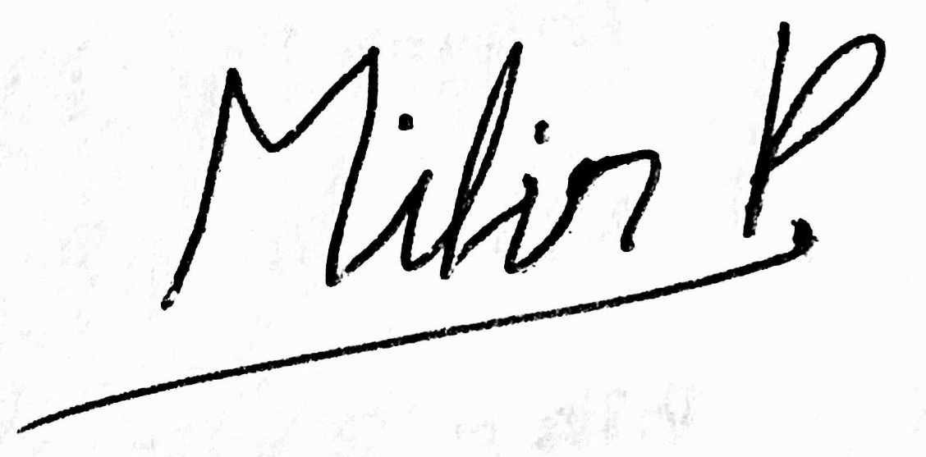


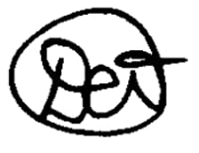
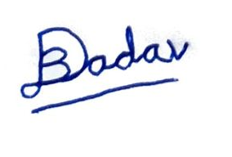
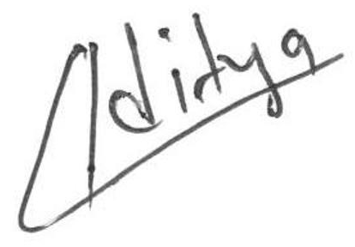
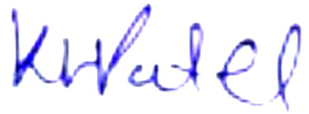
Honor Code
We declare that,
The work we are presenting is our own work, we have not copied work from any source
The concepts, understanding, and insights we will be describing are our own
Whatever we have relied on an existing work that is not our own, we have provided a proper reference citation
We make this pledge truthfully. we know that violation of this solemn pledge can carry grave consequences
Signatures

Slide 4
Contribution
Topics | Student Names | Student ID | Specific Contribution of the students
Channel Implementation (BSC & BEC) | Prakarsh Mathur Fagun Vora Ruchi Detroja | 202001012 202001013 202001019 | Created codes for noise generation of each channel.
Tanner Graph Implementation for message passing. | Vansh Parikh Dev Patel Mihirkumar Patel Kamal Patel | 202001011 202001014 202001017 202001018 | Logic was discussed and implemented in C++ by Kamal, Mihir and Dev. Vansh implemented same logic in python with minor changes.

Slide 5
Contribution
BSC Hard Channel BEC Hard Channel BSC Soft Channel | Vansh Parikh Dev Patel Mihirkumar Patel Kamal Patel | 202001011 202001014 202001017 202001018 | C++ implementation of the logic was done by Kamal , Dev and Mihir. Python implementation was done by Vansh.
BEC Soft | Vansh Parikh Kamal Patel Ruchi Detroja | 202001012 202001018 202001019 | C++ implementation of the logic was done by Kamal and Ruchi. Python implementation was done by Vansh.
Monte-Carlo Simulation: Probability of Successful Decoding (checking the probability for a range of probabilities) | Vansh Parikh Dev Patel Mihirkumar Patel Kamal Patel | 202001011 202001014 202001017 202001018 | C++ implementation of the logic was done by Kamal , Dev and Mihir. Python implementation was done by Vansh.

Slide 6
Contribution
Monte-Carlo Simulation: Algorithm Convergence | Vansh Parikh | 202001011 | Implemented the code and plotted the graph in python.
Graph and Comments | Om Vaghani Aditya Patel | 202001015 202001020 | Om plotted the graph in c++ but later on we used matlab graphs Aditya did commenting in the codes
Presentation | Whole Group |  | Design Part was done by Dev Jadav and Fagun vora. Content Writing was done by whole group.

Slide 7
Hard BEC
Hard BSC
Topics
Soft BEC
Soft BSC

Slide 8
1
BSC Hard :
Works till 0.1 - 0.15 and 0.08 - 0.13 bit Error Probability for H1 and H2 resp.
2
BEC Hard :
Works till 0.6 -0.7 and 0.5-0.6 bit Error Probability for H1 and H2 resp.
Accomplishments
3
BSC Soft :
Works till 0.15-0.2 and 0.12-0.17 bit Error Probability for H1 and H2 resp.
4
BEC Soft :
5
Works till 0.6 -0.7 and 0.5-0.6 bit Error Probability for H1 and H2 resp.

Slide 9
Problems and solutions
∞
Likelihood ratio going to infinity due to data type limitations
Gave a particular high value to it
Time complexity using Linked List
Used Array
Less decoding is occurring due to addition of feedback
We removed feedback.

Slide 10
Monte-Carlo Simulations
For BSC channel, when the noise value is equal to 1, we flipped the bit.
For each simulation, we generated a new binary noise string of length equal to the original codeword i.e. all zero-codeword
First, we made the decoders for all the four schemes. We took an all zero-codeword
For BEC channel, when the noise value is equal to 1, we erased the bit.
For each simulation, we give the noisy codeword to our decoder and check the result with the all zero-codeword

Slide 11
Improving Time and Space Complexity
We implemented Hard decision decoder for BSC channel using Linked List Data structure
After implementing our code (using Arrays), we still had time problems for Big H-matrices
To overcome this problem, we used a temp variable for storing messages at each CN and this helped us in reducing the number of loops we used previously over all the CNs.
Advantage
Works For different Degree of check nodes or variable nodes
Disadvantage Traversing Linked list is a time taking process

Slide 12
Hard BEC
Decoder

Slide 13
Algorithm for Decoding
Hard BEC:
In the first iteration, we will load the variable nodes in the array respectively. I.e there is no bit error we will send 0 else we will send -1.
Then we will iterate through check nodes, if there is any erasure in variable nodes connected to that check nodes, then
If there is one erasure then it is solvable. So,
The value of that erased node will be XOR of all other variable nodes’ values.
If there is more than one erasure then it is not solvable.
Then we will return the relative value to the variable node.
If there is no erasure in all variable nodes or if there is no change in e^{th} codeword and e^{th+1} codeword then we will break the loop.
Then we will check if transmitted and received codeword are same or not. If both are not same then we will consider that the codeword is not decoded and error count increases.

Slide 14
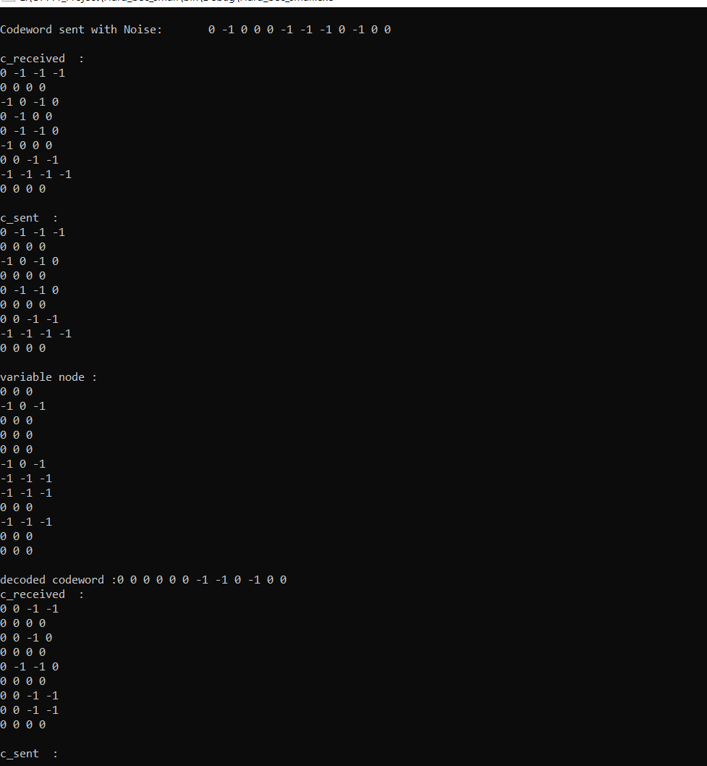
Snippet representing a short implementation of above discussed Hard BEC algorithm
Output shows Algorithm:
Noise added Received message
c_received contains values at CN’s received from connected VN’s
c_sent is updated value after SPC decoding
variable node contains values at each VNs received from connected CNs
Decoded message is Majority voting at each VN

Slide 15
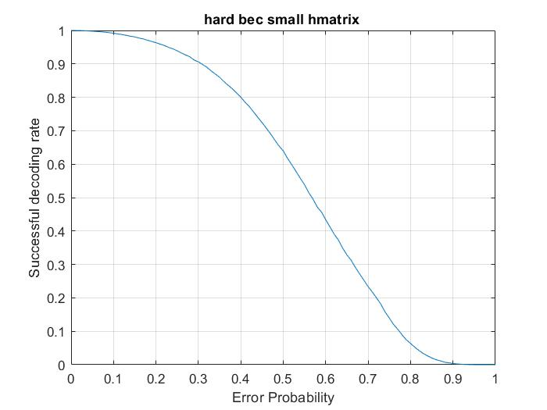
For small H matrix (9,12)
This graph shows Success Rate Vs Error Probability(p) for 10⁵ Monte-Carlo Simulations.
For Bit erasing probability / BEC(p) greater than 0.8 or 0.9 shows that it is hard / almost impossible to recover the original bit message.
The probability of success is monotonically decreasing because as probability of erasing bits increases, it is hard for decoder to decode the codeword.

Slide 16
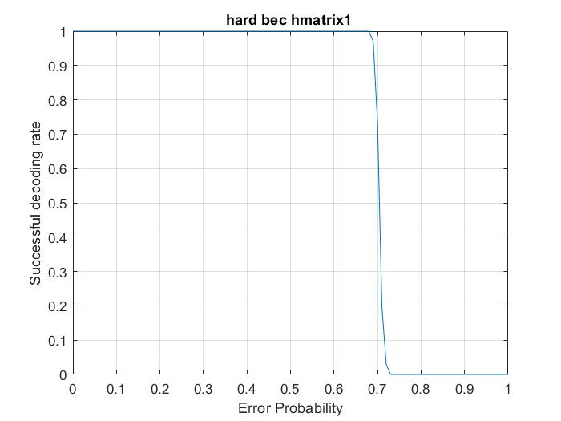
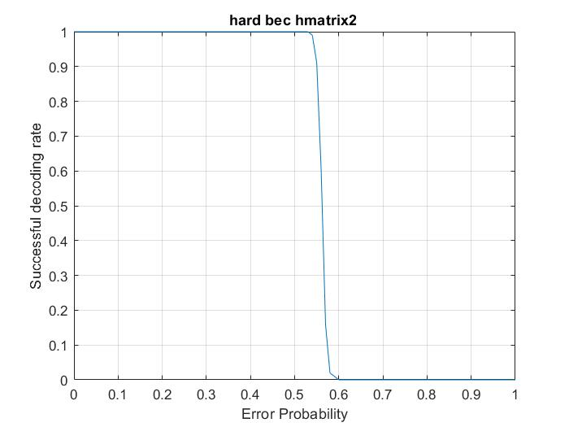
H matrix 1
H matrix 2
When the error probability is low the success rate is high for big H-matrix
When the error probability is high the success rate is high for small H-matrix.

Slide 17
Soft BEC
Decoder

Slide 18
Algorithm for Decoding
Soft BEC:
In the first iteration, we will load the variable nodes in the array respectively. I.e there is no bit error we will send 0 else we will send 0.5.
We have made spc function that will take the probability of variable nodes and return likelihood ratio(odds in favor of variable node=1) for all check nodes.
Then we will multiply all the likelihood ratios of check nodes for that variable node.
If for all the variable nodes likelihood ratio is other than 1 then we will consider that the codeword is successfully decoded.

Slide 19
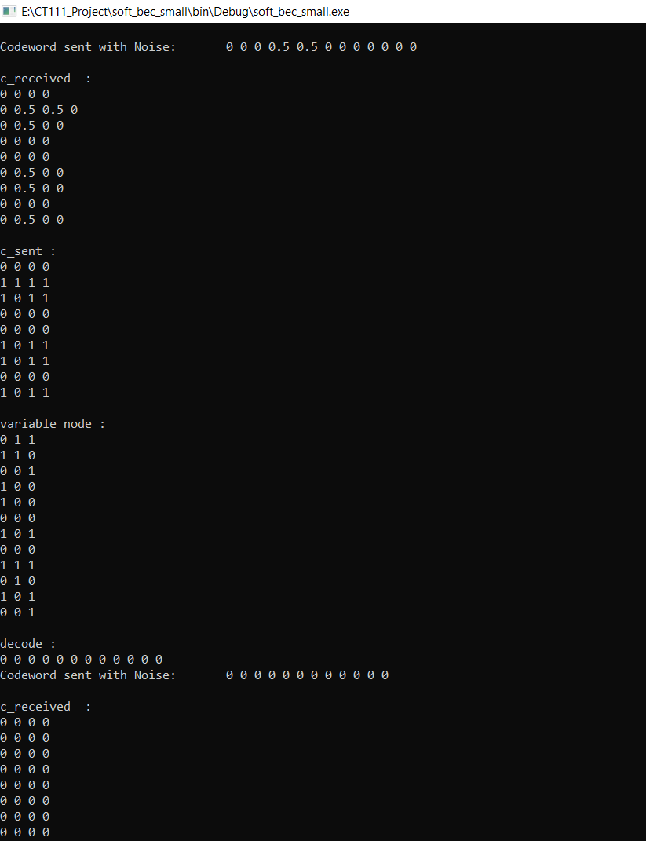
Snippet representing a short implementation of above discussed Soft BEC algorithm
Output shows Algorithm:
Noise added Received message/ probabilities
c_received contains values at CN’s received from connected VN’s
c_sent are updated values after SPC decoding
variable node contains values at each VNs received from connected CNs
Decoded message is after Majority voting at each VN

Slide 20
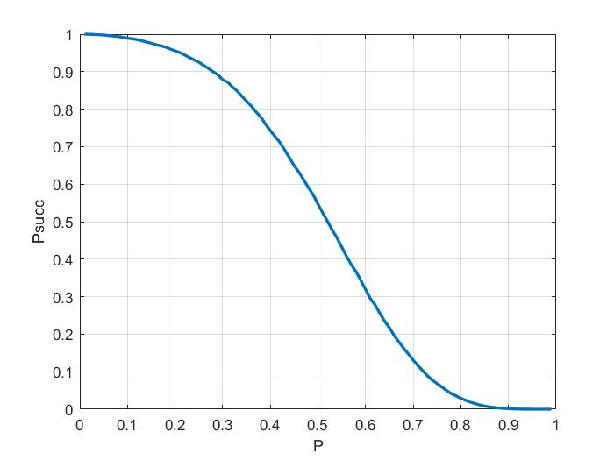
For small H matrix (9,12)
This graph shows Success Rate Vs Error Probability(p) for 10⁴ Monte-Carlo Simulations.
For Bit erasing probability / BEC(p) greater than 0.8 or 0.9 shows that it is hard / almost impossible to recover the original bit message.
The probability of success is monotonically decreasing because as probability of erasing bits increases, it is hard for decoder to decode the codeword.

Slide 21
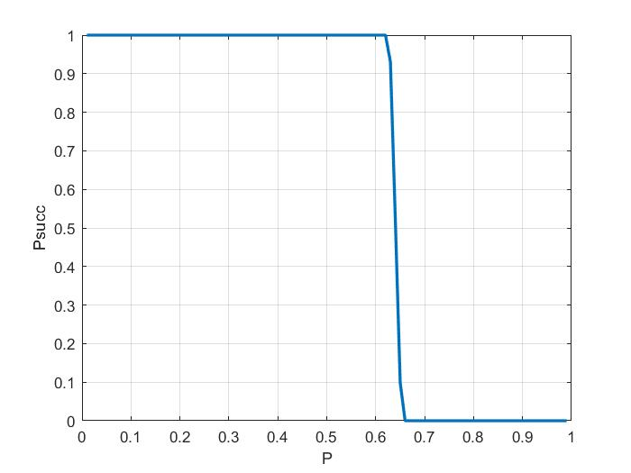
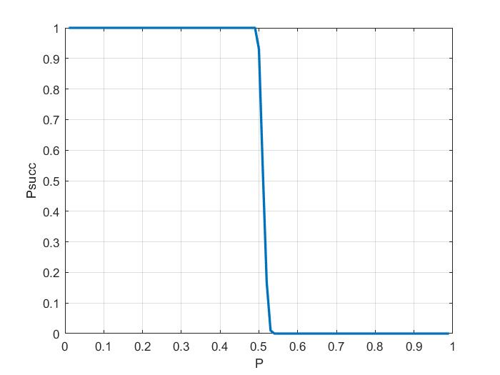
H matrix 1
H matrix 2
For BEC channel we know whatever bit we will have is either confirmed or eraser.
So for Big H-Matrices A very higher rate of success is noticeable.

Slide 22
Hard BSC
Decoder

Slide 23
Algorithm for decoding
Hard BSC:
In the 0th iteration, we will load the VNs in the array with the values of the corresponding received bits.
Then we will iterate through the CNs, update all the VNs connected to it with SPC decoding of remaining bits of that check node .
Then we will return the decoded values to all the respective variable nodes.
If there is no update in e^{th} codeword and e^{th+1} codeword, then we will break the loop. Otherwise in next iteration we will again load the check nodes with updated values of variable nodes .
After breaking of loop, we will check if the transmitted and received codeword are same or not, If both are same, then we will consider that the codeword is correctly decoded and the success count increases .

Slide 24
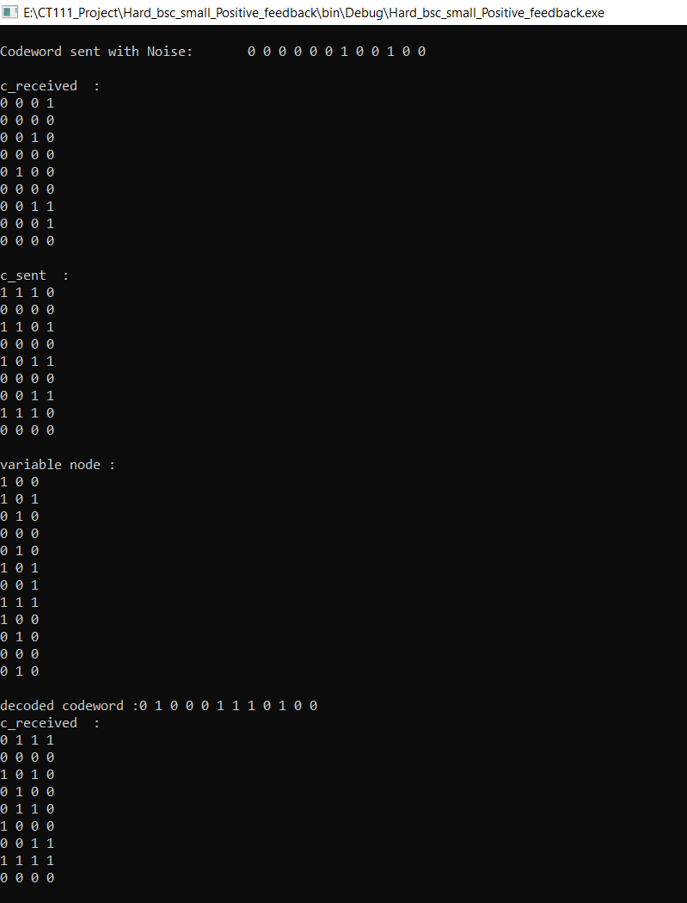
Snippet representing a short implementation of above discussed Hard BSC algorithm
Output shows Algorithm:
Noise added Received message
c_received contains values at CN’s received from connected VN’s
c_sent are updated values after SPC decoding
variable node contains values at each VNs received from connected CNs
Decoded message is after Majority voting at each VN

Slide 25
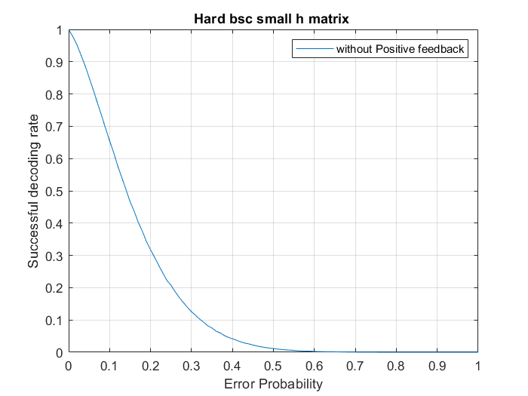
For small H matrix (9,12)
This graph shows Success Rate Vs Error Probability(p) for 1 lakh Monte-Carlo Simulations
Bit flipping probability / BSC(p) greater than 0.5 or 0.6 shows that it is hard / almost impossible to recover the original bit message
In the next slide, we will see that why we have not considered the value of node itself (Why we have not considered positive feedback)

Slide 26
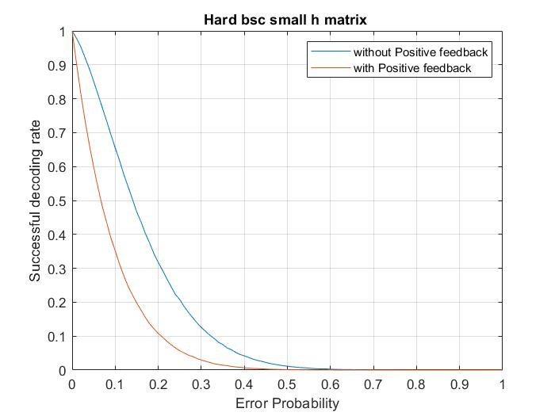
Positive feedback is like asking the bit about its own value, which is not desirable when we do SPC decoding, as the message generated at SPC / CN node for a particular VN depends only on the values received from other members of the SPC
Conclusion : In both VN → CN and CN → VN message passing, the message sent to a node will never depend on the message received from that node.
Here the graph clearly describes how the performance of the decoder gets better when we remove the positive feedback from the decoder.

Slide 27
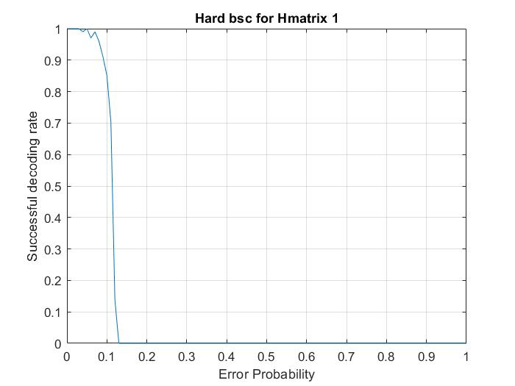
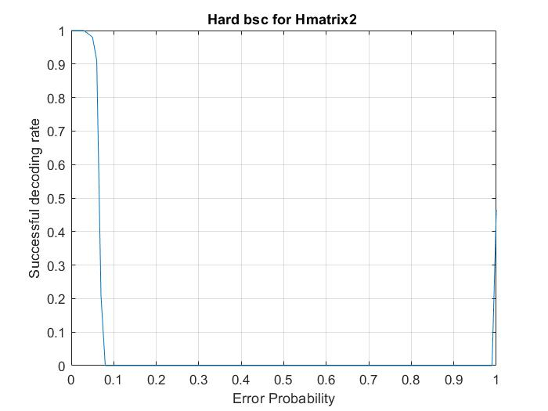
Hmatrix 1 (3972, 5056)
Hmatrix 2 (3000, 5000)
Here, we notice a quick downfall in the success rate of the decoder at earlier/lesser error probability (p~0.13), as compared to the BEC decoder which decodes at erasure probabilities as high as 0.6.
Here, for one more time, we notice an increment in success rate for Higher error probability(p) for an odd degree of Check node i.e. 5, in the above H matrix.

Slide 28
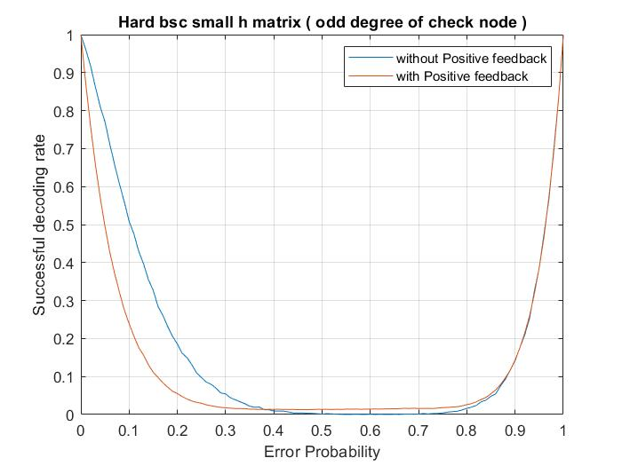
We can observe the increment in success rate again at higher error probability which makes the shape of graph parabolic.
Reason : As we have odd degree of check node, at every CN while SPC decoding we have remaining even number of nodes for generating the message, so when the error probability(p) is large(>0.8) i.e. when majority of the bits are flipped, the SPC/even parity check will satisfy for majority of CNs.
Again, we can see result of deoder with positive feedback is still less as compared to without positive feedback.

Slide 29
Soft BSC
Decoder

Slide 30
Algorithm for Decoding
Soft BSC:
In the 0th iteration, we will load the VNs in the array with the probability values of the corresponding received bits.
Then we will iterate through the CNs, update all the VNs connected to it with SPC decoding of likelihoods of the remaining bits connected to that check node.
Then we will return the decoded likelihood to all the respective variable nodes.
We will perform a majority vote decoding at each VN based on the likelihoods received from each CN connected to it & its value we received over the BSC(p) channel and thereby updating the values at each VN with the bit decision obtained by majority voting.
If there is no update in e^{th} codeword and e^{th+1} codeword, then we will break the loop. Otherwise in next iteration we will again load the check nodes with updated values of variable nodes.
After breaking of loop, we will check if the transmitted and received codeword are same or not, If both are same, then we will consider that the codeword is correctly decoded and the success count increases.

Slide 31
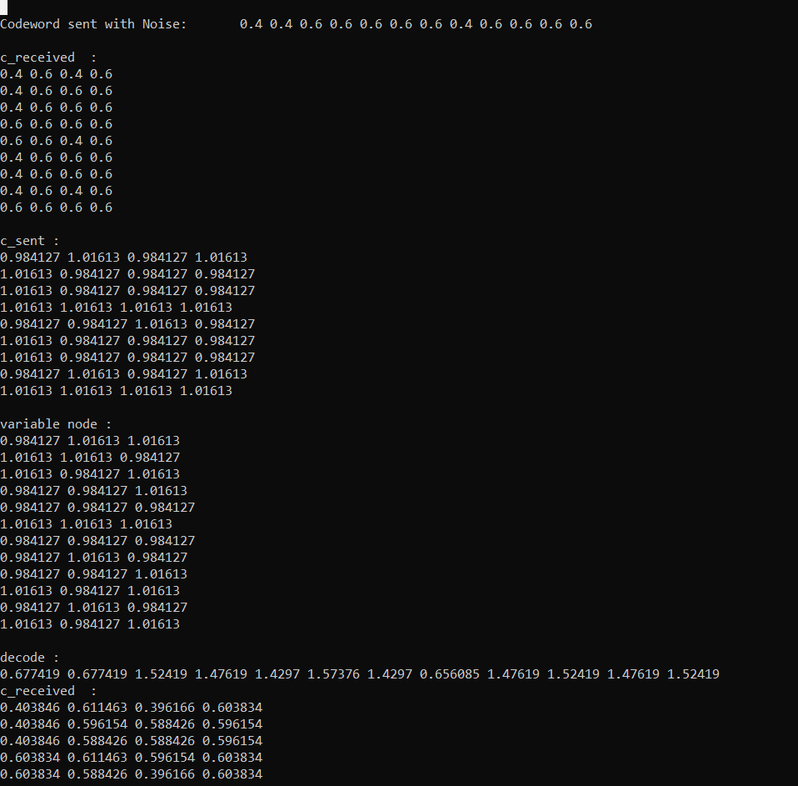
Snippet representing a short implementation of above discussed Soft BSC algorithm
Output shows Algorithm:
Noise added Received message/ probabilities
c_received contains probabilities at CN’s received from connected VN’s
c_sent are updated likelihoods after SPC decoding
variable node contains likelihoods at each VNs received from connected CNs
Decoded message is after likelihood analysis at each VN

Slide 32
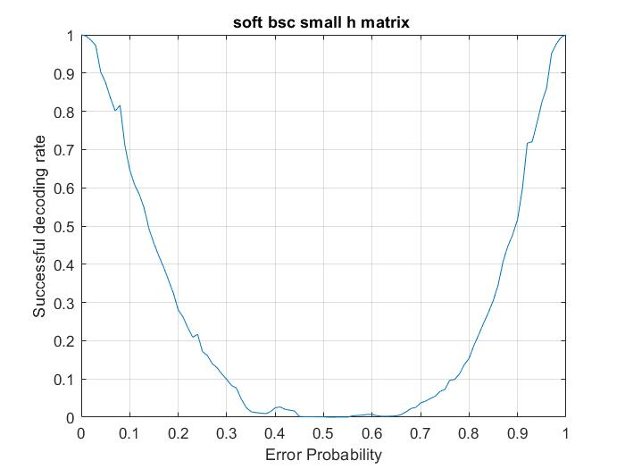
For small H matrix (9,12)
Soft decision decoding is not blind So our decoder also knows bit flip probability(p of BSC) which allows the decoder to determine how many bits are flipped in the received message
For any message that has higher error probability(>0.7), decoder can consider that message as highly flipped message at the time of decoding
So overall considering ideal condition, message with bit flip probability 0.3 and 0.7 are treated same

Slide 33
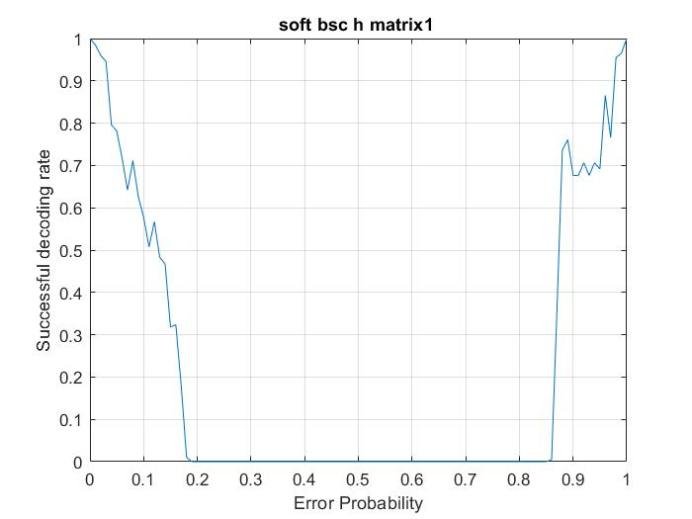
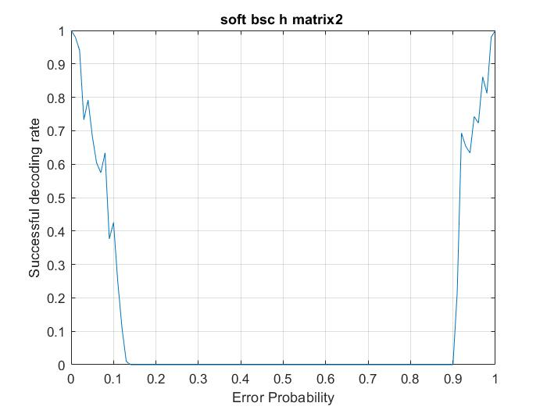
H matrix 1
H matrix 2
Again Success rate falls at very low Pe But the thing is we got quite better rate than Hard.

Slide 34
Algorithm
Convergence

Slide 35
Convergence graph for BEC
Convergence graph is the graph between probability of error and the number of iterations .
As iterations increases, number of erasure decreases which is obvious. So, graph will be asymptotic to to 0.
But when probability of erasure is greater than 0.6 then
graph will not be asymptotic to 0 but it is asymptotic to some constant value.

Slide 36
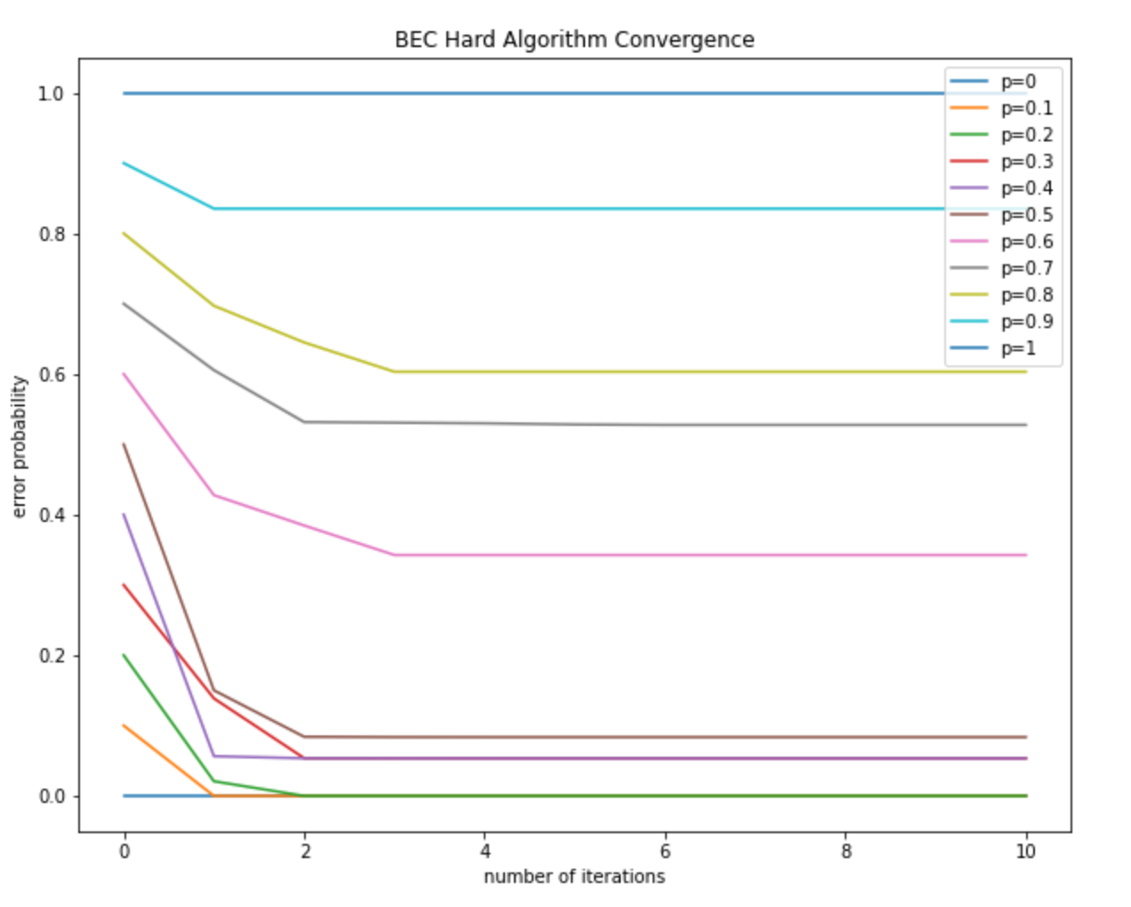
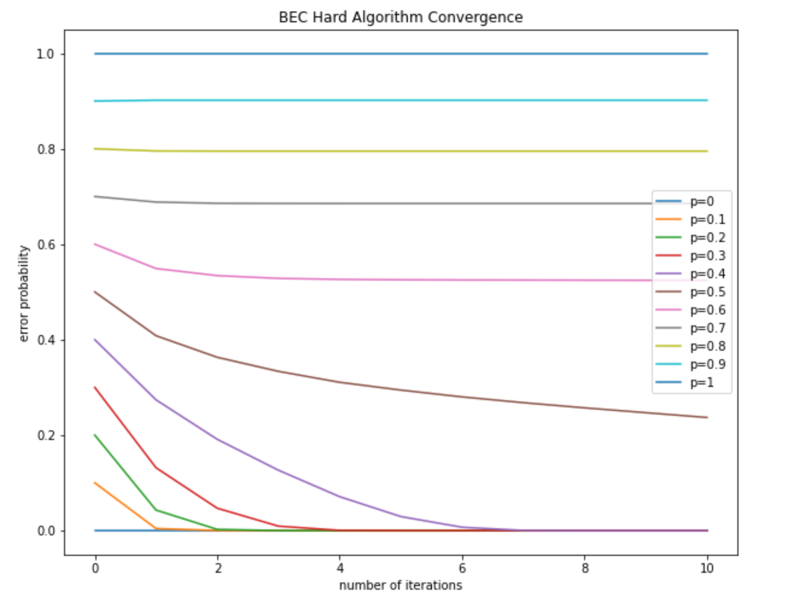
Convergence graph for BEC Hard
(9,12)
dc= 4 , dv = 3
(3000,5000)
dc =5 , dv =3

Slide 37
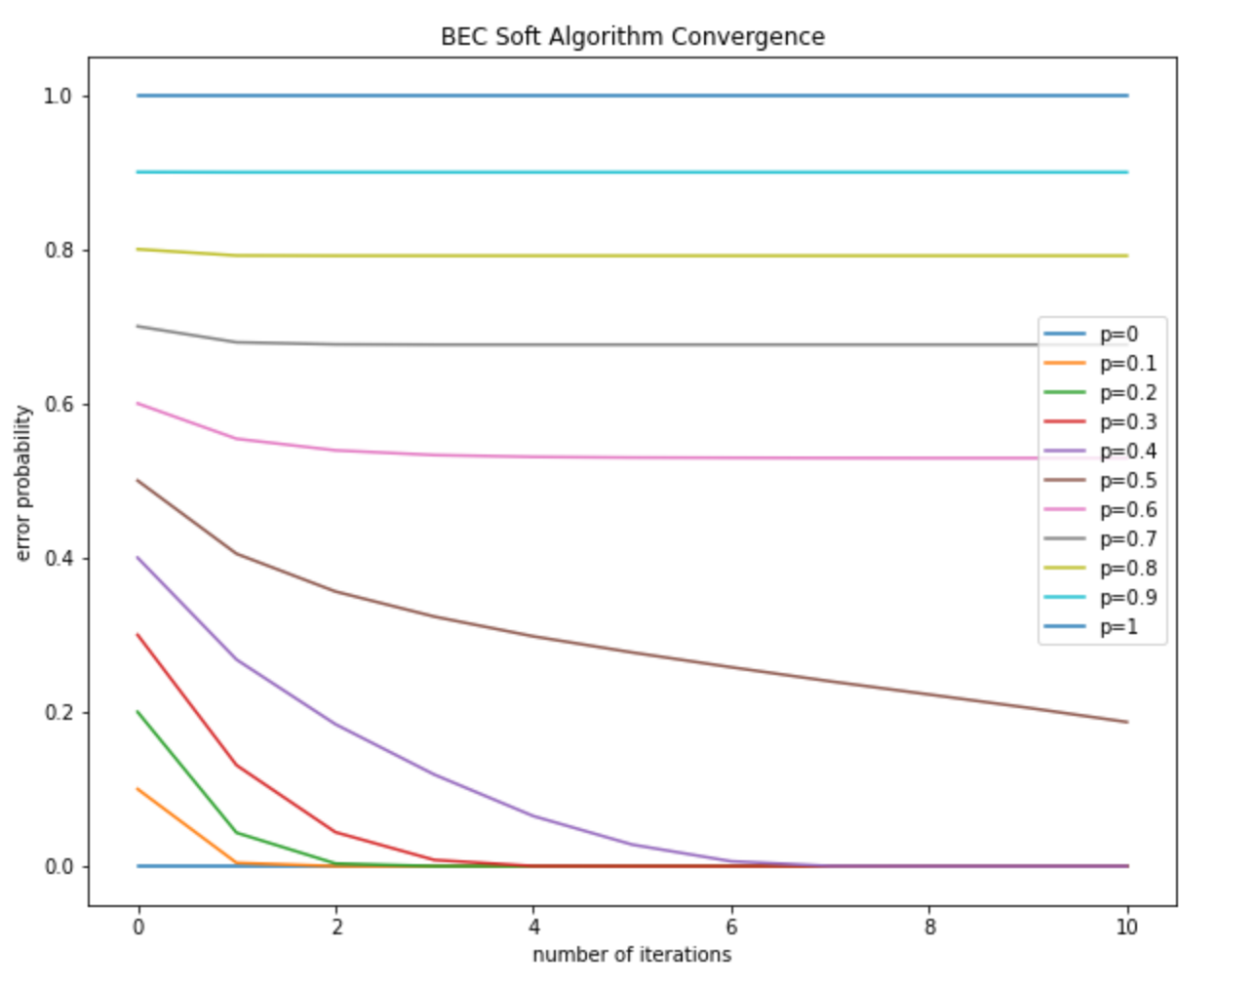
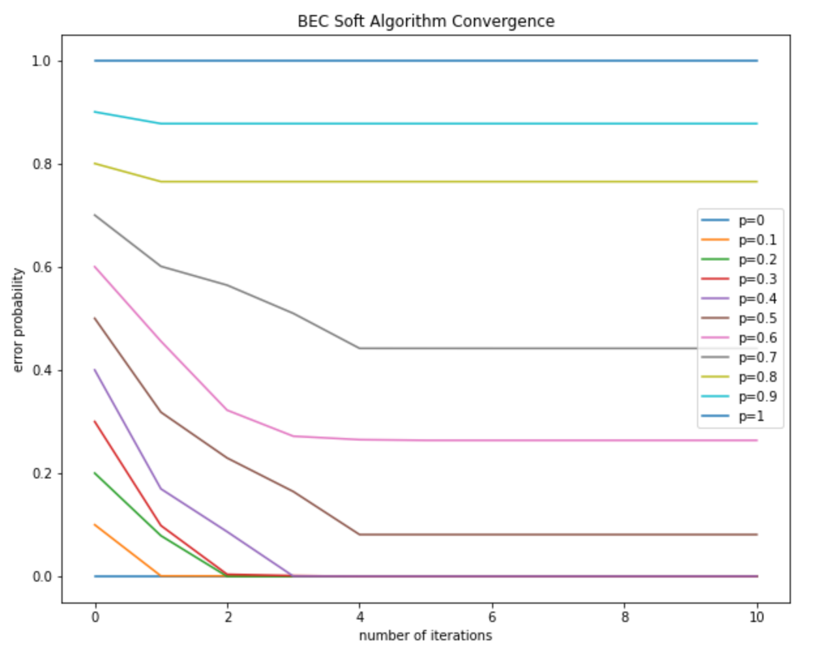
Convergence graph for BEC Soft
(9,12)
dc= 4 , dv = 3
(3000,5000)
dc =5 , dv =3

Slide 38
Convergence graph for BSC
In the BSC channel,as iterations increases, number of flipped bits decreases.
After some iterations, the graph will be asymptomatic to any constant line.
In BSC,for any value of bit flipping probability the graph will not approaches to 0 but it will approach any constant value.

Slide 39
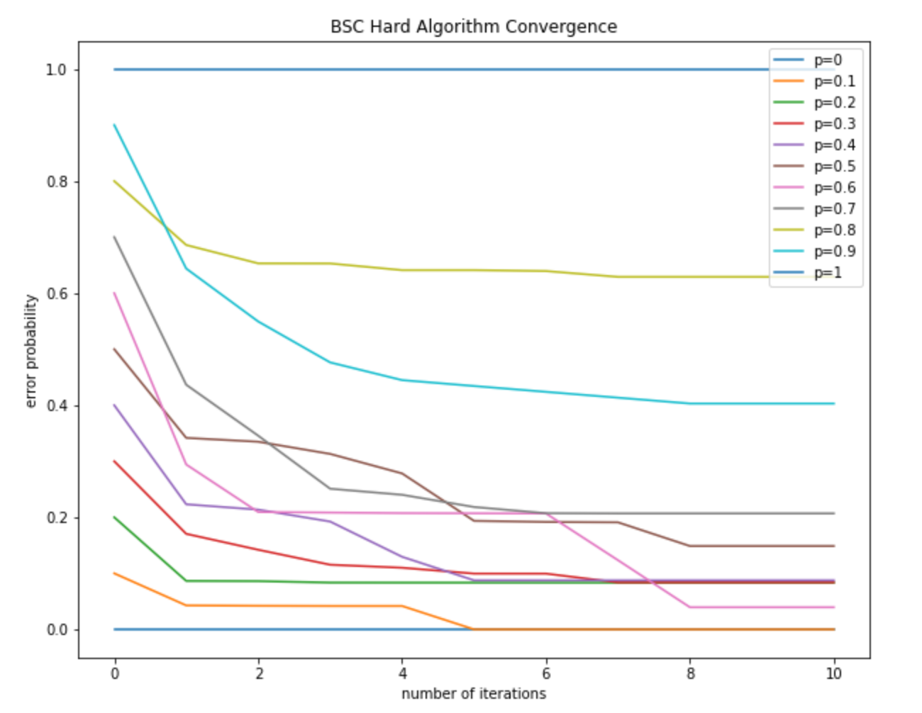
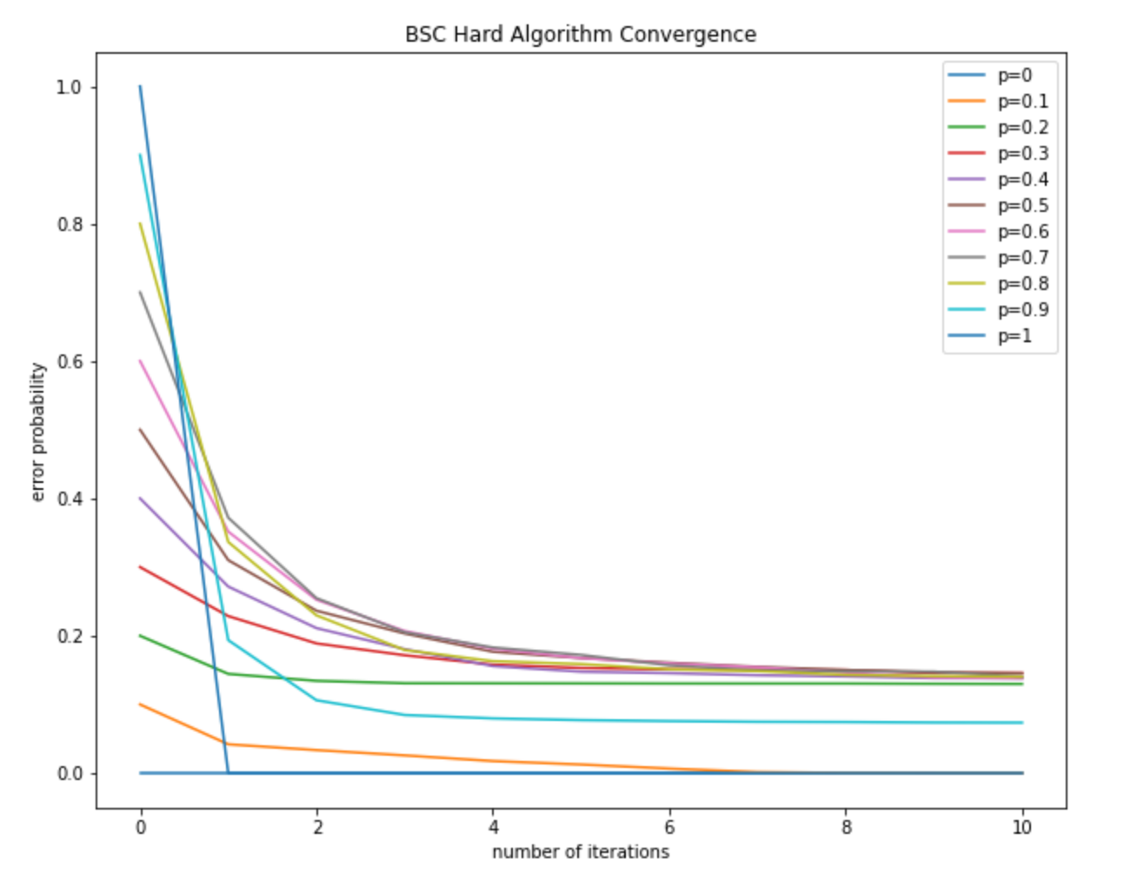
Convergence graph for BSC Hard
(9,12)
dc= 4 , dv = 3
(3000,5000)
dc =5 , dv =3

Slide 40
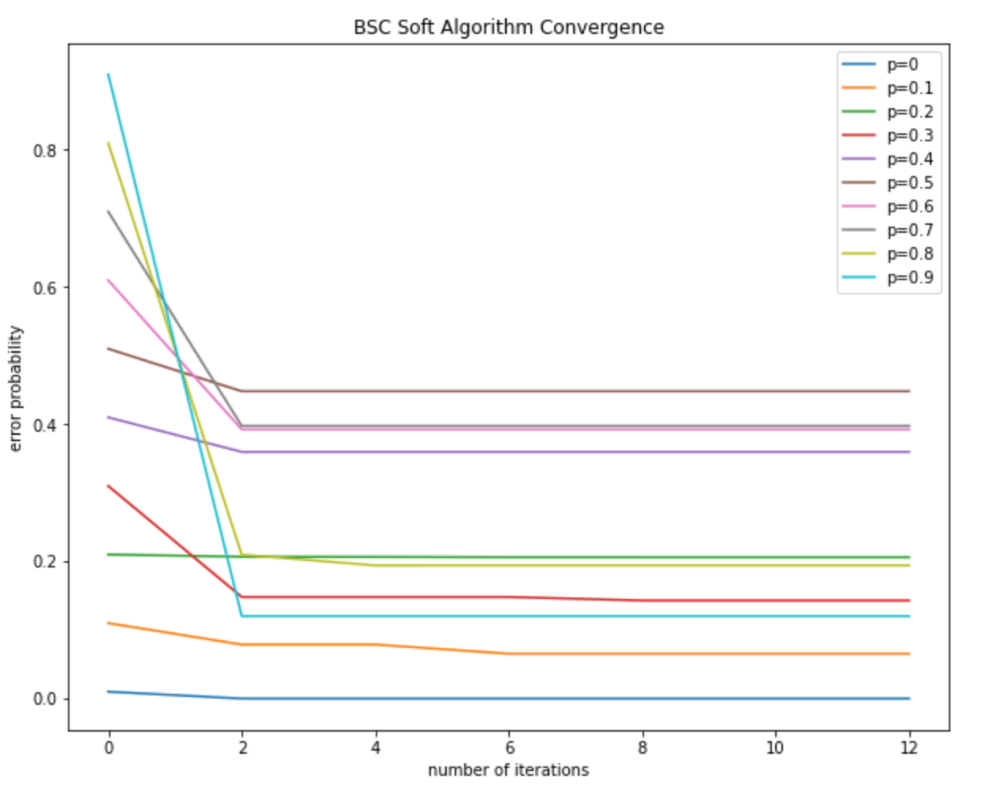
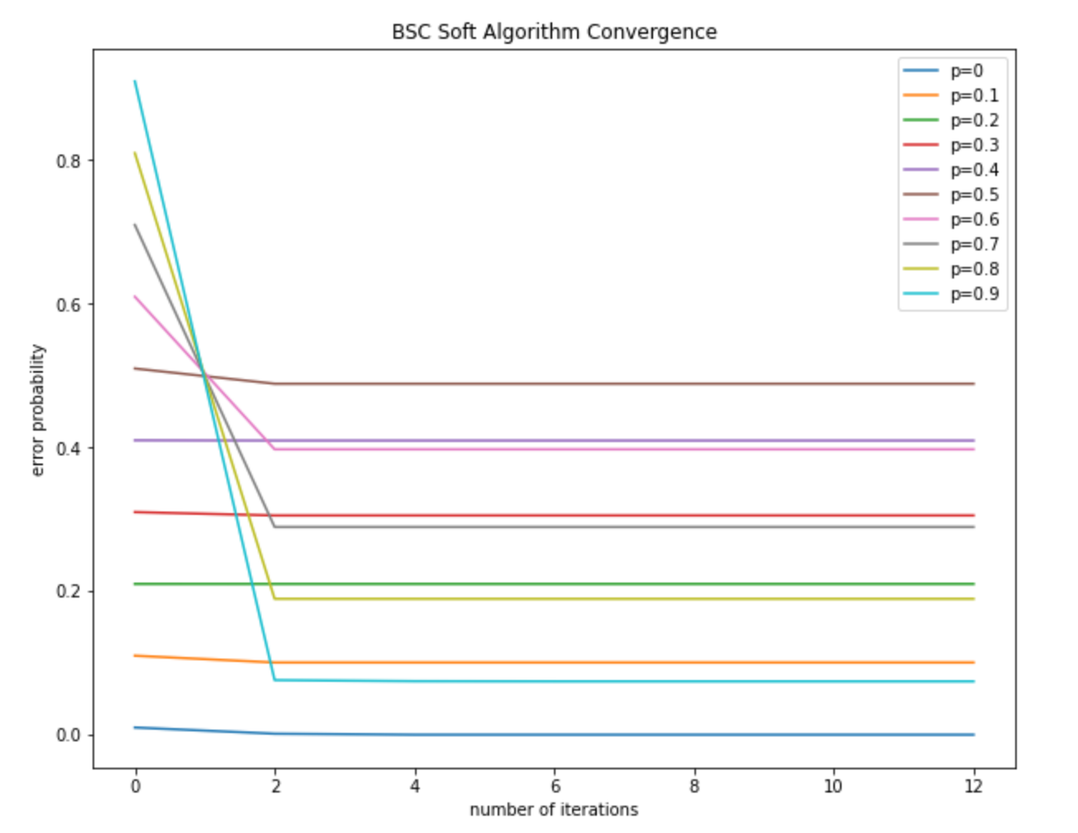
Convergence graph for BSC Soft
(9,12)
dc= 4 , dv = 3
(3000,5000)
dc =5 , dv =3

Slide 41
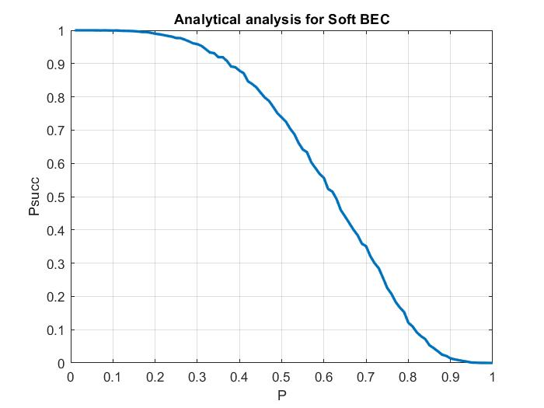
Comparison between Monte-Carlo and Analytical analysis for Soft BEC
Monte-Carlo
Analytical analysis
We have done analytical process by density evaluation method , which confirms our implemented / practical results.

Slide 42
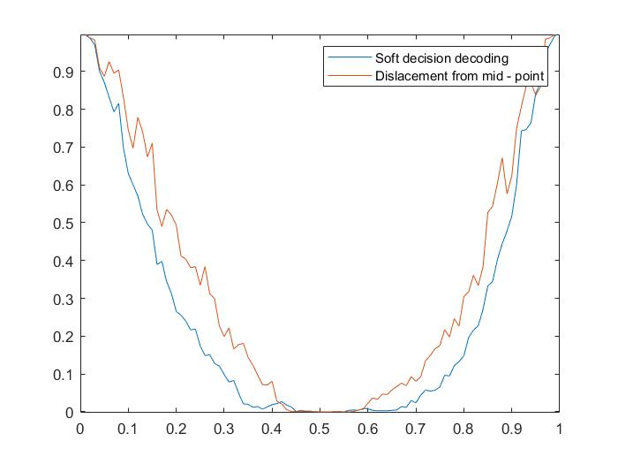
Displacement method (Advancement over previous methods)
How to make more advantage of received reliability at receiver ??????
eg. bit 1 =0 bit 2 =1
0--|----|--------------1
--0.1__0.2--------------
=> impact of 0.1 > 0.2 and towards 0
0--------------|-----|--1
--------------0.7___0.9--
=> impact of 0.9 >0.7 and towards 1
So the method is
step-1 --> |D|= distance from mid point
observation : D greater more than impact or reliability more
step-2 --> D = Displacement or Sign of distance
observation : sign gives us idea of bit's impact is towards which given bit
Receiver makes more advantage of received reliability probability than soft
in this ...

Slide 43
Summary
Overall, the project is acceptably hard but by helping each other out and solving each other’s difficulties, we completed the project.

Slide 44
References
‘LDPC codes-a brief tutorial’ -paper by Bernhard M.J. Leiner
Slides by Prof. Yash Vasavada

Slide 45
Thank You
By Group 1 Team 2
Thanks to our TAs, Aarushi Dhami & Abhishek Pandya
Mention : Prof. Yash Vasavada

