Slide 1
Hybrid Cloud Architecture for IT Apps
Parthiban Srinivasan
Technical Architect
6 March 2023
Notes:
Click to add notes

Slide 2
Agenda
Current IT landscape
What is a Hybrid cloud
VMC & Millennium Falcon
Rearchitecting for the Hybrid cloud
Design Considerations

Slide 3
Current IT landscape

Slide 4
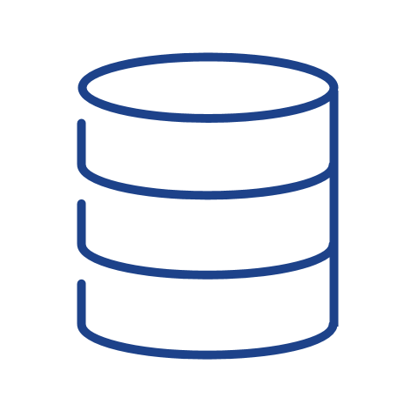
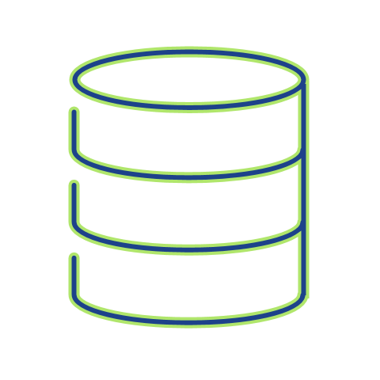
IT Landscape
Active
CDN
Standby
GSLB
PRIMARY DC
SECONDARY DC
NGINX
Apache [Layer 1]
NGINX
Apache [Layer 1]
DMZ
DMZ
TKG
TAS
TKG
TAS
Replication

Slide 5
Hybrid cloud
What & Why?

Slide 6
Hybrid Cloud refers to a cloud computing model that uses a combination of at least one private cloud and at least one public cloud, which works together to provide a flexible mix of cloud computing services.
vmware.com
Notes:
Hybrid clouds use public and private clouds as a single combined entity where data and application workloads can move seamlessly between platforms and share data between application workloads

Slide 7
Why Hybrid cloud?
Workload Migration
Migrate workload quickly using familiar tools and process
Modern Applications
deploy microservices and container-based applications
Enhanced Scalability
Leverage the instant agility and scale of public cloud providers
Increase Flexibility
speeds up IT response to changing needs
Security and Compliance
consistent adoption of policies, wherever workloads are deployed and managed.

Slide 8
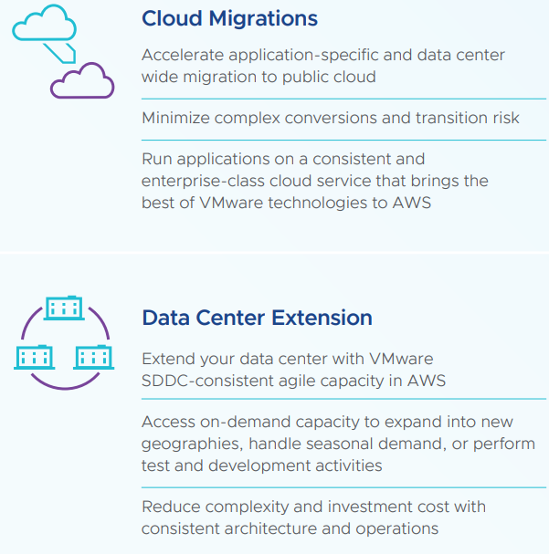
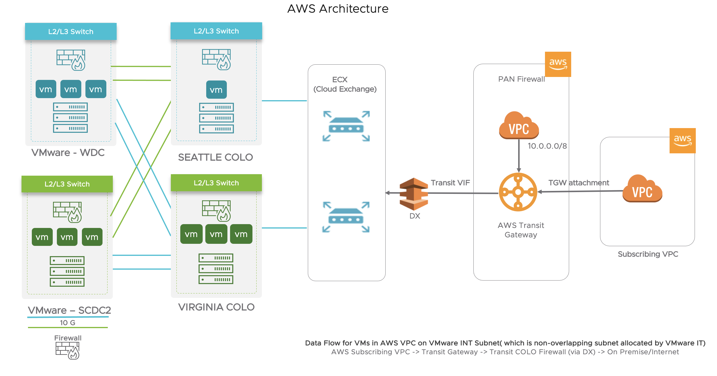
Hybrid cloud – VMWare IT
VMC on AWS
Millennium Falcon on AWS
Notes:
https://confluence.eng.vmware.com/pages/viewpage.action?pageId=959619502&src=contextnavpagetreemode

Slide 9
Rearchitecting for the hybrid cloud

Slide 10
Current application architecture
Active
CDN
Standby
GSLB
PRIMARY DC
SECONDARY DC
NGINX
Apache [Layer 1]
NGINX
Apache [Layer 1]
DMZ
DMZ
TKG
TAS
TKG
TAS
Replication

Slide 11
Challenges In current Architecture
Primary DC dependencies
Cross DC communication
Data collision

Slide 12
Design considerations
Data replication between regions must be fast and reliable.
You need a global network infrastructure to connect your different regions.
Services should not have local state — they must be stateless, and state should be shared between regions.
Synchronous cross-regional calls should be avoided when possible. Applications should use regional resources.
DNS routing should be used to permit for different scenarios.
Data replication via Tungsten or CDC
All 3 DC’s interconnected via global N/W
Microservices Arch for applications
Use regional resources
Using GTM for routing traffic – Primary – secondary - tertiary

Slide 13
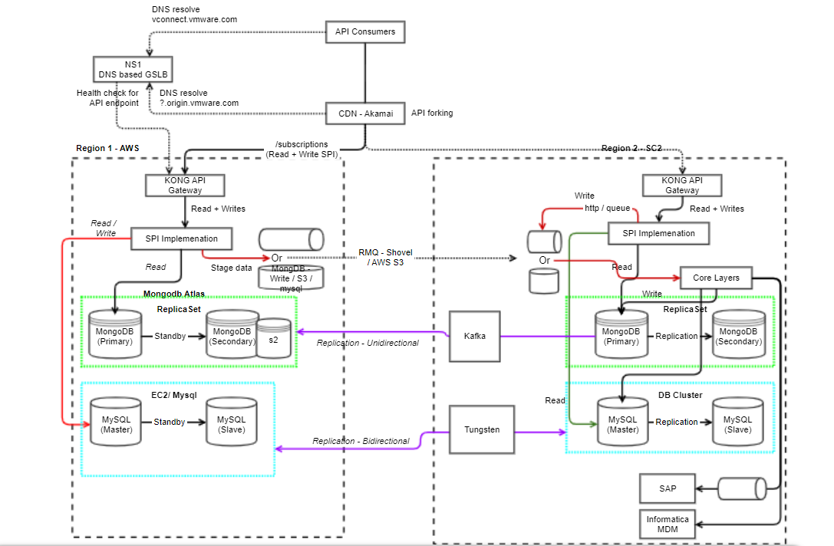
Data replication : Reference architecture – SAAS IT

Slide 14
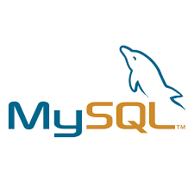
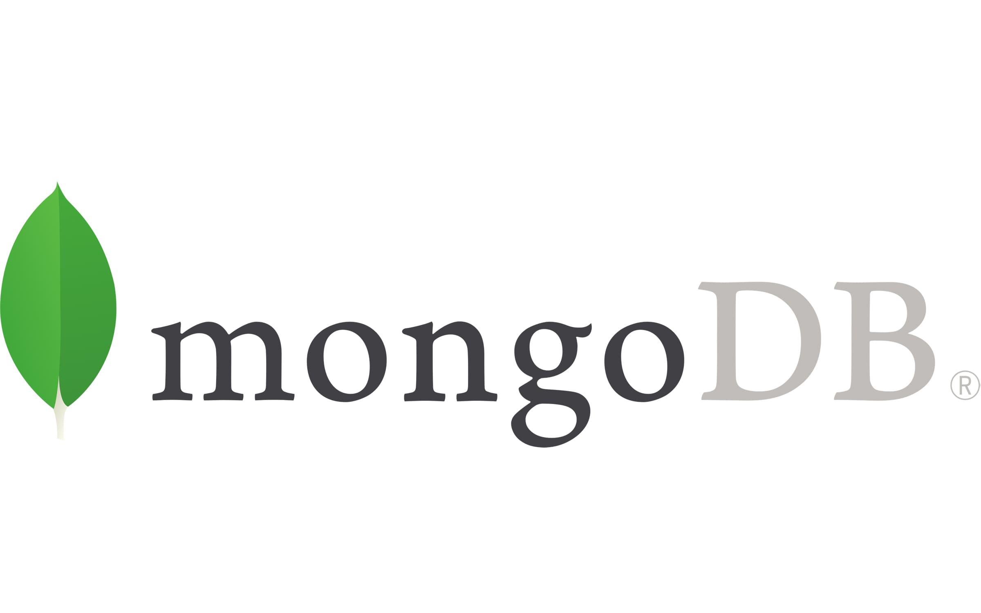
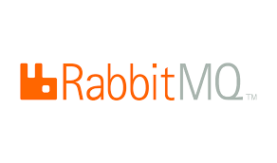
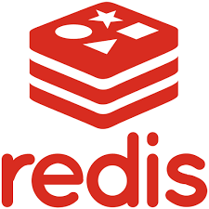

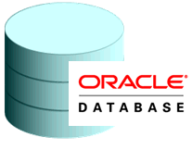

Reference architecture – SAAS IT
Tertiary - Datacenter
Primary - Datacenter
Secondary - Datacenter
NGINX
Apache [Layer 1]
NGINX
Apache [Layer 1]
NGINX
Apache [Layer 1]
DMZ
DMZ
DMZ
TKG
TKG
TAS
TKG
TAS
Shoveling
Shoveling
Tungsten
Tungsten
Change Data capture
Extended Cluster

Slide 15
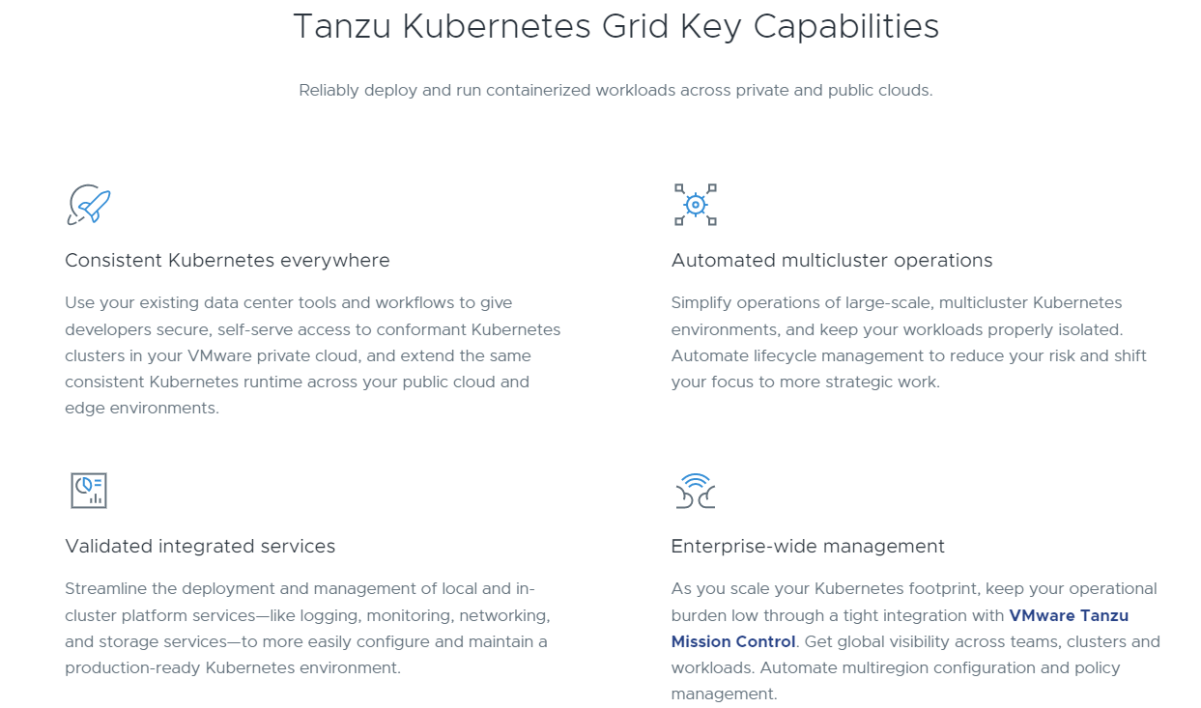
Why TKG?

Slide 16
Design considerations
Use KONG as external gateway.
CDN for WAF rules and rate limiting
Use CDN as an effective cache.
Spring cloud gateway for internal gateway
SCG with retries and circuit breaker
SCG for inter DC communication
Use Vault as cred store for all purposes
Config maps – only for string properties
Refresh scope and refresh to be built in app
Vault – use app role IDs
Use DC specific services like DB, Queue, Vault
Eventual consistency approach
ERP reads and writes are heavy – use cache
ERP writes can happen only in primary DC
Listeners can be focused on primary DC
Container scaling – Beware of DB connections exhaustion
Containers requests and limits – Noisy neighbors
Pay attention to what apps are hosted on public cloud.
When not in use, shut down the services to preserve cost
Design apps to prevent data collision
Avoid cross DC communication
Use S3 for storing non financial / non PII data
Size the pods based on valid tests
Have monitoring enabled for different DCs
Not all apps need to be micro service and not every app has 4 9’s requirement
Set timezone for your containers

