Slide 1

SEM EVAL TASK 9
TEAM KKR
KAMAL
KUSHI REDDY KANKAR
ROHAM MUKKA

Slide 2
Task Overview
Goal:
Binary classification of social media posts:
  1 → Polarized (hostile, divisive, ideological, extreme)
  0 → Not Polarized (neutral, factual, general statements)
Evaluation Metric:
  Macro F1-score (treats both classes equally)
  Average Accuracy
Dataset:
  Multilingual (22 languages total)
  I primarily worked with Amharic, Arabic, Bengali, German, English, Hausa, Hindi, Italian, Burmese

Slide 3
Baseline 1: Multilingual BERT
Model Overview
mBERT (Multilingual BERT) is a transformer-based model trained on Wikipedia across 104 languages.
It represents text using subword tokenization and performs well on multilingual classification tasks.
Implementation
Used the official baseline code provided by the task organizers.
Experimented with two variants:
  bert-base-multilingual-cased
  bert-base-multilingual-uncased
Why This Matters
  Cased mBERT keeps word capitalization — useful in languages like English, German, Arabic.
  Uncased mBERT removes case distinctions — helpful for languages where case is not meaningful, and reduces vocabulary sparsity.

Slide 4
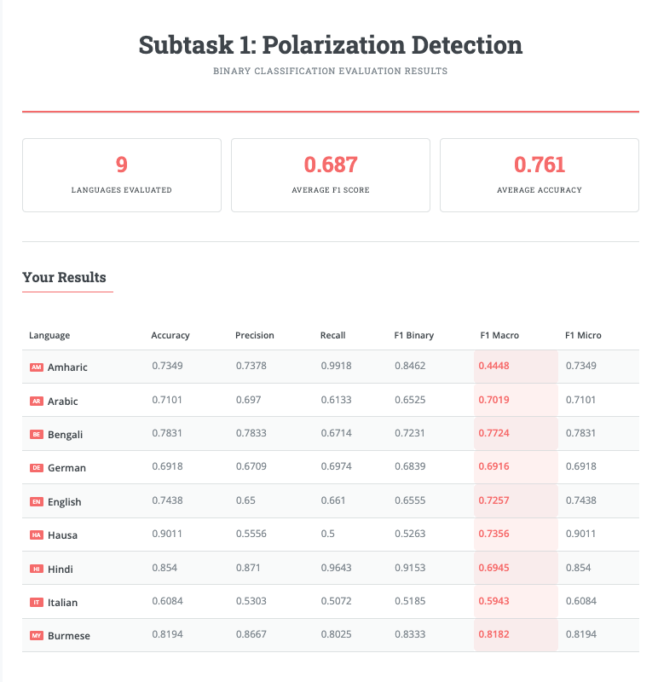
Results: cased

Slide 5
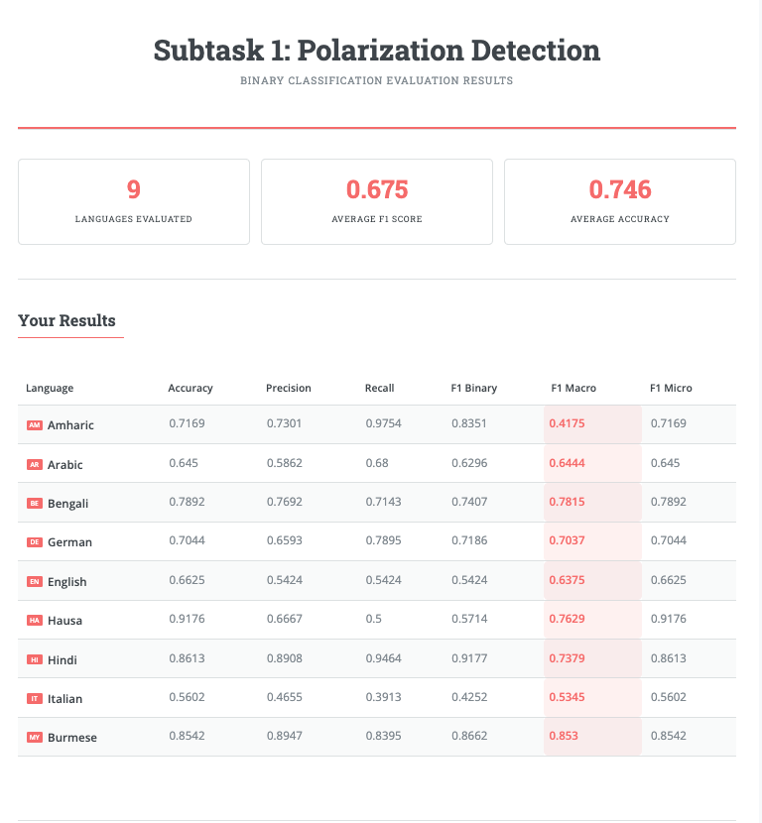
Results: uncased

Slide 6
Baseline 1: Multilingual BERT
Observations
  mBERT performance is highly language-dependent.
  Some languages (e.g., Hausa, Burmese, Bengali) score high, while others (e.g., Amharic, Italian, Arabic) drop significantly.
  Cased vs.uncased did not demonstrate a clear universal advantage.
  Cased performed slightly better for languages with capitalization rules (EN, DE, AR).
  Uncased performed better for languages where case is irrelevant or inconsistent.

Slide 7
Baseline 1: Multilingual BERT
Conclusion
  This observations indicates the task is not strongly case-sensitive overall.
  The limited improvements between cased and uncased indicate low improvement scope using traditional encoder-based models.
  This motivated testing alternative modeling approaches that can better interpret tone, intent, and political framing.
  Since mBERT was already the organizer-provided baseline and finetuned fully, switching to different model families (LLMs) became a logical next step.

Slide 8
Baseline 2: Zero-Shot LLM Model
Model Overview
GPT-4o-mini is a modern instruction-following LLM capable of zero-shot classification without any fine-tuning.
It can interpret political or social context better than classic encoders like BERT.
Implementation
  Designed a structured classification prompt instructing the LLM to output only 0/1.
  Evaluated only on English due to cost and latency constraints.
  Processed the entire dev set, producing a submission-ready file.
Why This Matters
  Zero-shot LLMs require no training, making them ideal when compute is limited.
  They understand nuanced political cues, idioms, sarcasm, and implicit hostility better than mBERT.

Slide 9
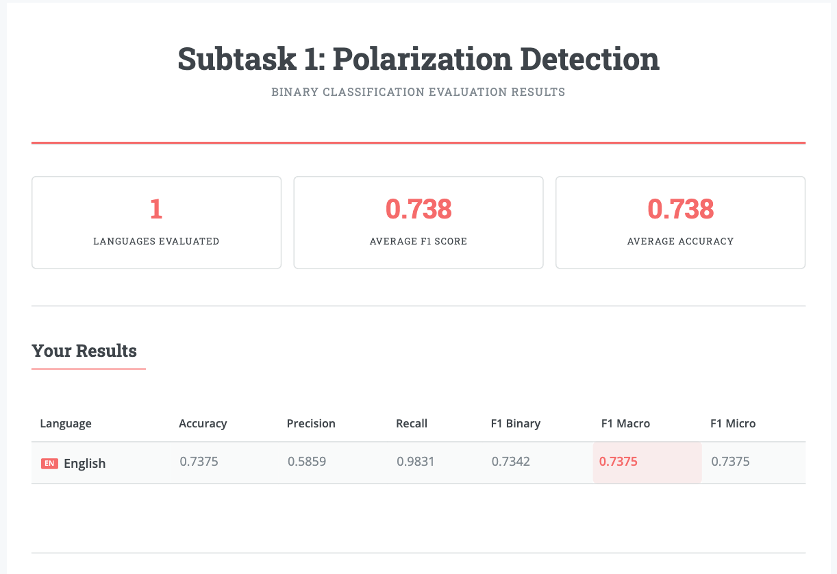
Results

Slide 10
Baseline 2: Zero-Shot LLM Model
Observations
  Zero-shot LLM performs surprisingly close to mBERT without training, achieving ~0.74 F1 on English.
  The model produced extremely high recall but lower precision.
  It successfully catches most polarized texts but misclassifies neutral political statements as polarized.This means the model is sensitive but not well-calibrated.
  However, the model understands complex phrasing, sarcasm, and implied hostility better than BERT.

Slide 11
Baseline 2: Zero-Shot LLM Model
Conclusion
  Zero-shot performance indicates there is room for improvement using prompting alone—without any additional training.
  This naturally leads to few-shot prompting as the next step to reduce misclassifications and align with annotation guidelines.

Slide 12
Improvement: Few-Shot LLM
Model Overview
Few-shot prompting demonstrates patterns of polarized vs. non-polarized text directly inside the prompt. The LLM learns the task boundaries from examples.
Implementation
  Added 3–5 carefully curated labeled examples directly into the prompt.
  Each example followed the exact format of the dataset:
    short social media post
    binary label (0/1)
  Ran the improved prompt across the full dev set and saved predictions in Codabench-compatible format.
Why This Matters
  Few-shot prompting guides the model toward the same labeling style as the annotators.
  Reduces ambiguity around some topics like:
    political disagreement vs. polarization
    factual statements vs. attacks

Slide 13
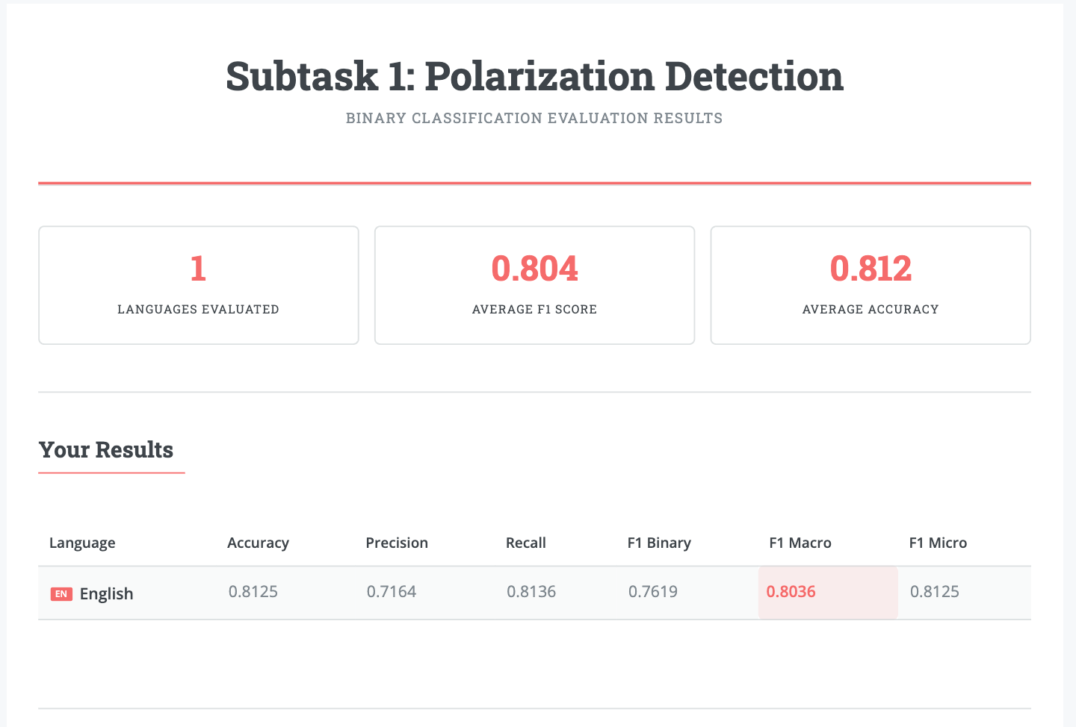
Results

Slide 14
Improvement: Few-Shot LLM
Observations
  Few-shot prompting significantly improves precision, bringing overall Macro-F1 to ~0.80, the highest among all models tested.
  Providing examples directly teaches the model the competition’s labeling style.
  Model shows better balance between recall and precision.
  Few-shot prompting leverages LLM strengths without heavy compute, making it more efficient than large-scale multilingual fine-tuning.

Slide 15
Improvement: Few-Shot LLM
Conclusion
  This confirms that LLMs benefit more from prompt engineering than from fine-tuning for this task.
  The task requires contextual understanding (sarcasm, hostility, group framing), which LLMs learn from examples better than mBERT learns from fine-tuning.
  This also validates the decision to move beyond mBERT baseline due to limited performance ceiling.

Slide 16
mT5 — Seq2Seq Reformulation
  Unlike BERT models (encoder-only), mT5 is encoder–decoder
  Reformulated the task as a text-to-text problem
    Input: text
    Output: "0" or "1"
  Works well for multilingual tasks because T5 uses unified vocabulary (SentencePiece)
  Trained on all languages jointly using the same pipeline as the baseline.
Notes:
mT5 works differently from BERT because it uses an encoder–decoder architecture.
BERT only encodes the text, but mT5 both encodes the input and decodes a new output, which makes it suitable for generation-style tasks.
Instead of treating polarization detection as a normal classification task, we reframed it as a text-to-text problem:
Input: the social media post
Output: a generated label → "0" (not polarized) or "1" (polarized)
This fits naturally with T5, because T5 is designed to generate text.
mT5 also handles multilingual text better because it uses SentencePiece, a unified subword vocabulary that works across many languages and scripts. This helps when the dataset includes languages like Amharic, Hindi, Chinese, etc.
Finally, the model was trained on all languages together, allowing high-resource languages to help low-resource ones. This shared learning improves generalization across the multilingual dataset while keeping the training pipeline similar to the baseline.
Low-resource languages
These languages have very little training data or the data is noisy, inconsistent, or full of dialect variations.

Slide 17
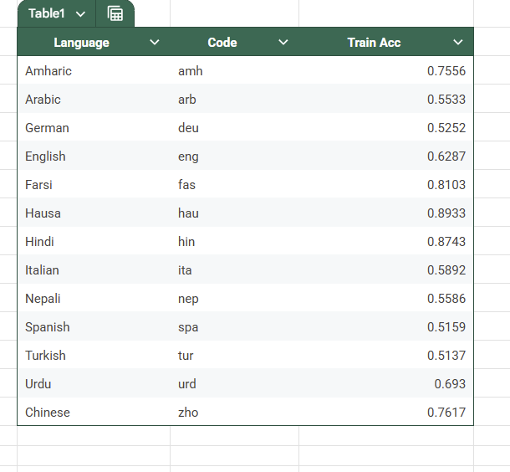
Training
Notes:
This table shows how well the mT5 model learned each language during training.
Languages with more training data and clearer writing patterns achieve higher accuracy — such as:
Hausa (0.8933)
Hindi (0.8743)
Farsi (0.8103)
Chinese (0.7617)
These are considered high-resource languages, so the model can understand their structure better.
Languages with less data, more noise, or strong dialect variations show lower accuracy — such as:
Arabic (0.5533)
German (0.5252)
Spanish (0.5159)
Turkish (0.5137)
These are low-resource languages, making it harder for the model to learn consistent patterns for polarization detection.
Overall, the training accuracy reflects how much the model was able to learn from the available examples in each language, and it highlights the difference between high-resource and low-resource languages in the dataset.

Slide 18


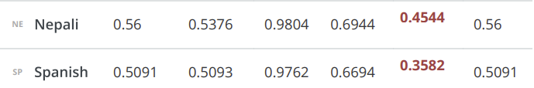
Development Set Results
Notes:
These results show how well the mT5 model performs on unseen data from the development set.
Performance varies by language:
Strong Performance (High F1 Scores)
Languages like Persian (0.8072), Hindi (0.8207), and Chinese (0.8077) show high F1 values.
This means the model generalizes well and correctly identifies both polarized and non-polarized posts.
These are typically high-resource languages with cleaner, more consistent training data.
Moderate Performance
Nepali has a moderate score (0.4544).
The model identifies many polarized posts (high recall) but makes more mistakes on neutral ones (lower precision).
This suggests the dev data is more diverse or contains informal writing styles.
Low Performance
Spanish shows a lower F1 score (0.3582).
This is because the model has very high recall but low precision, meaning it predicts “polarized” too often.
This usually happens in languages with less training data or more noisy text on social media.
Overall Insight
High-resource languages → strong generalization
Low-resource/noisy languages → weaker performance
Some languages need threshold tuning or additional language-specific adjustments to improve accuracy

Slide 19
Observation
  The mT5 model works well because it is an encoder–decoder system that treats the task as text-to-text. This helps it understand meaning, tone, and multilingual text better than encoder-only models like mBERT.
  Training accuracy is high for languages with more data and clearer patterns (Hausa, Hindi, Farsi, Chinese). Lower accuracy in languages like Arabic, German, Spanish, and Turkish suggests less data or more noisy/varied writing styles.
  Development set results follow a similar trend: languages such as Hindi, Farsi, and Chinese generalize well, while Nepali and Spanish show bigger drops due to more difficult real-world examples. Spanish especially has high recall but low precision, meaning the model overpredicts polarization.
  Overall, the model performs strongly on high-resource languages and struggles more with low-resource or highly variable languages.
Notes:
Even though every language had equal training rows, mT5 does not learn them equally.
High-resource languages already have strong pretrained representations, cleaner scripts, and better vocabulary coverage. Low-resource languages still struggle because of limited pretraining data, noisy text, and complex linguistic structures.

Slide 20
Baseline 3: Multilingual BERT + LoRA
LoRA = Low-Rank Adaptation
A method to fine-tune large models efficiently by training only a tiny fraction of their parameters.
Why LoRA?
  Large models (like BERT) have millions of parameters
  Training all parameters is slow and requires big GPUs
  LoRA trains only small additional matrices, not the whole model
The Core Idea:
Instead of updating the full weight matrix W, LoRA adds:
W' = W + B * A
Where:
  A = down-projection (reduces dimension)
  B = up-projection (restores dimension)
  A and B have very small rank (e.g., r = 8)

Slide 21
Benefits:
  Fast training
  Low memory usage
  Can train many versions (per language)
  No need to retrain the whole BERT model
  Trained a Multilingual Baseline LoRA Model
  One LoRA adapter on top of multilingual BERT
  Learns polarization detection across all 22 languages
  Fast and efficient fine-tuning
  Trained 22 Per-Language LoRA Models
  Each language (e.g., English, Arabic, Hindi, Chinese…) gets its own LoRA adapter
  Makes the model more specialized for that language
  Much smaller than training 22 full models

Slide 22
Built MixLoRA — Our Advanced Model
A mixture-of-experts model where:
  Each “expert” is a small LoRA transform
  A router chooses which experts to use based on the language
  Helps low-resource languages borrow patterns from similar languages
for example:
  Hindi might share an expert with Urdu
  Spanish might share an expert with Italian
  Cambodian might combine multiple experts
So, instead of giving each language its own model, MixLoRA creates shared experts that languages can mix, improving generalization.

Slide 23
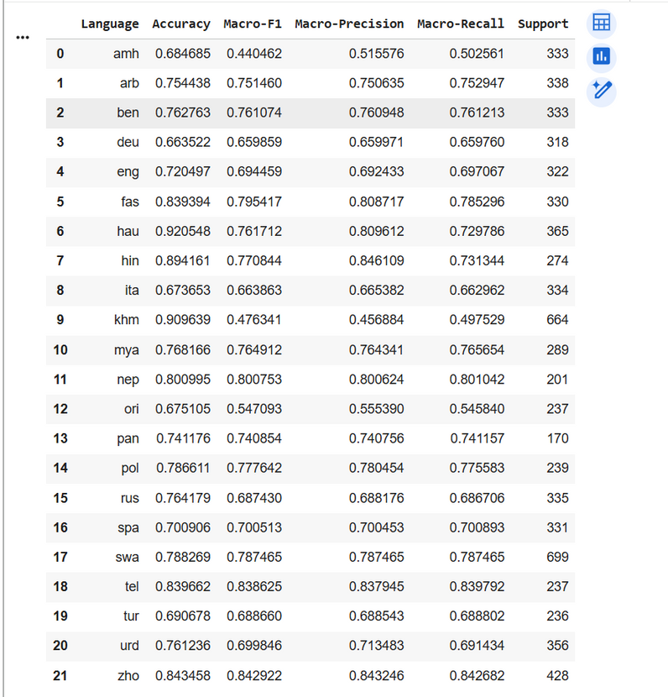
Evaluation
Multilingual LoRA

Slide 24
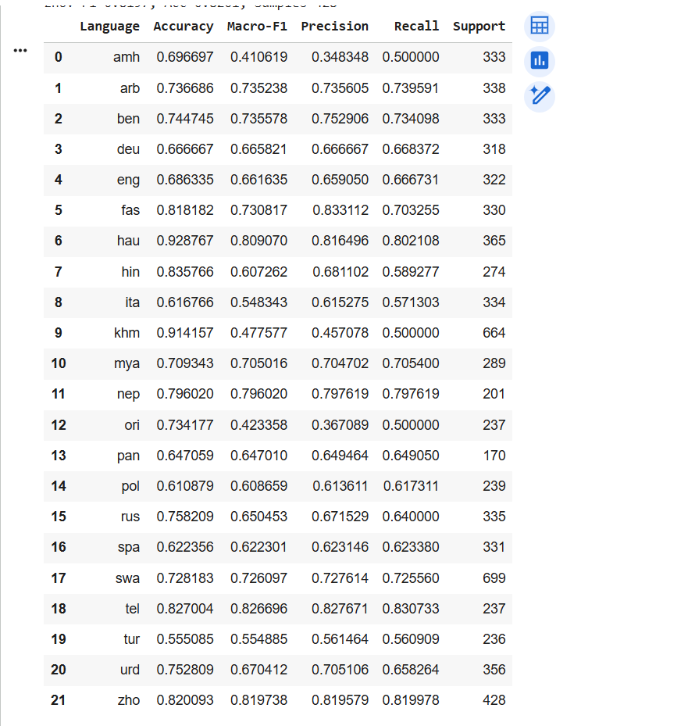
Per-language LoRA

Slide 25
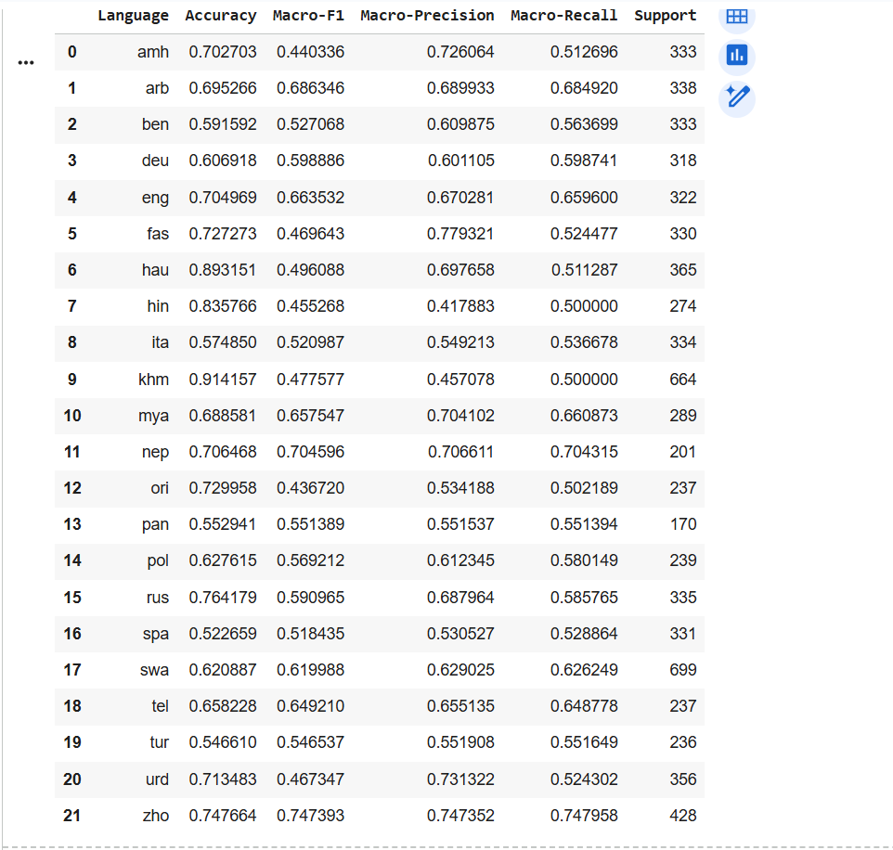
MixLoRA

Slide 26
Conclusion
Multilingual LoRA
  Best overall accuracy
  Highest performance in 16 / 22 languages
  Shared multilingual knowledge boosts generalization
  Best choice for a single global model
Per-Language LoRA
Wins in only a few languages:
  Hausa
  Oriya
  Slight improvement in German
Works well only when the language has enough training data

Slide 27
MixLoRA
  Improves some low-resource languages, e.g., Amharic
  Ties in Khmer and Russian
  Underperforms when:
  Router selects wrong experts
  Experts are not sufficiently specialized
  Better for languages needing shared but flexible representation
Although i experimented with per-language and MixLoRA models, my results show that the Multilingual LoRA model provides the best overall performance across all 22 languages, making it the strongest and most reliable choice for SemEval Task 9.

Slide 28
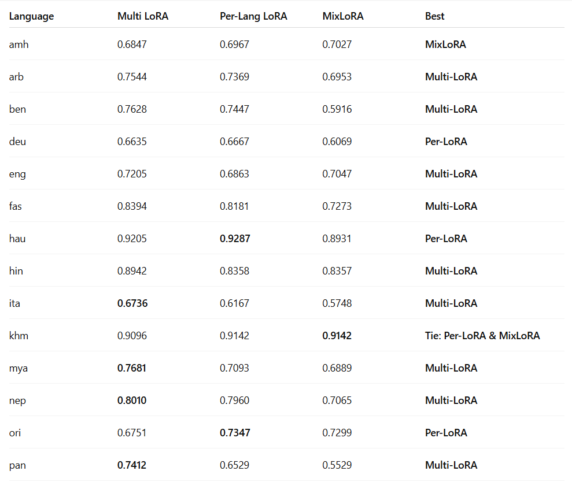

Slide 29
Conclusion
Multilingual LoRA delivered the strongest overall results across most of the 22 languages, making it the most reliable single model. Per-Language LoRA helped a few specific languages but was inconsistent where data was limited. MixLoRA showed potential for some low-resource languages but was unstable due to routing issues. mT5 performed well on high-resource languages but showed variable generalization. Overall, Multilingual LoRA remains the best-performing and most stable approach among the remaining models.

Slide 30
Future work
  Tune decision thresholds per language to fix over-prediction issues (especially in Spanish and Nepali) and improve Macro-F1 without retraining.
  Add language-specific fine-tuning for low-resource languages to reduce noise and improve precision.
  Experiment with mT5 + LoRA to make training faster and more efficient while keeping strong multilingual performance.
  Increase training data or use data augmentation (back-translation, paraphrasing) to support low-resource languages.
  Analyze model errors to understand patterns in false positives and false negatives, especially in noisy social-media text.
  Try larger T5 variants (mT5-base or mT5-large) if compute allows, to test improvements in long-range contextual understanding.

