Slide 1

ERD Concepts

Slide 2
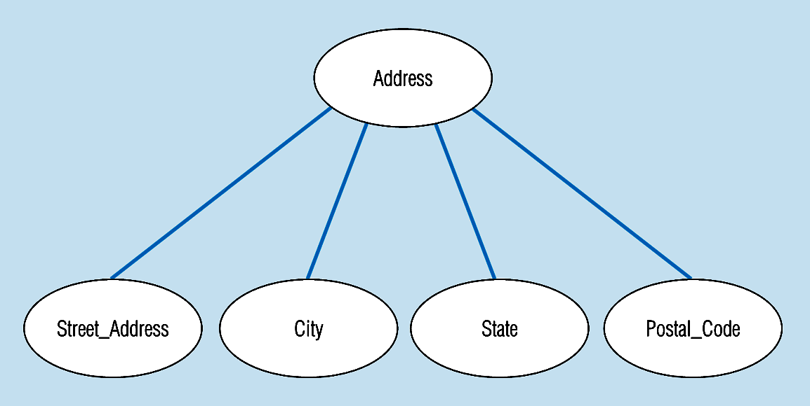
Figure 3-7 -- A composite attribute
An attribute broken into component parts
© Prentice Hall, 2002
Notes:
12

Slide 3

Figure 3-9a – Simple key attribute
The key is underlined
© Prentice Hall, 2002
Notes:
14

Slide 4
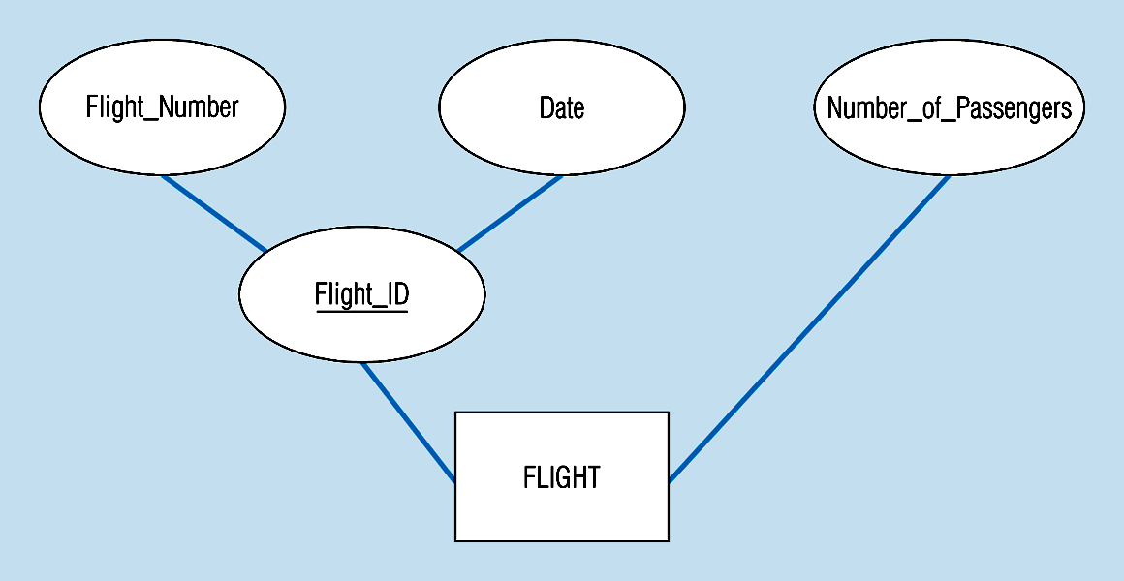
Figure 3-9b -- Composite key attribute
The key is composed
of two subparts
© Prentice Hall, 2002
Notes:
15

Slide 5
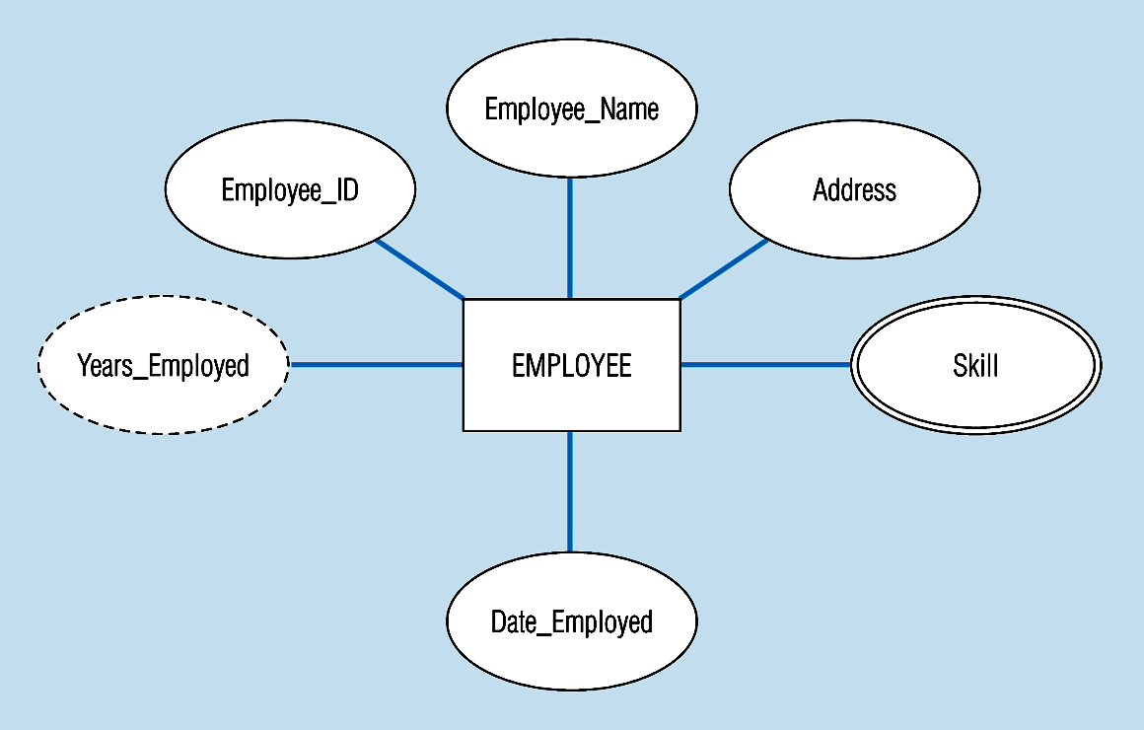
Figure 3-8 -- Entity with a multivalued attribute (Skill) and derived attribute (Years_Employed)
What’s wrong with this?
Multivalued:
an employee can have
more than one skill
Derived
from date employed and current date
© Prentice Hall, 2002
Notes:
13

Slide 6
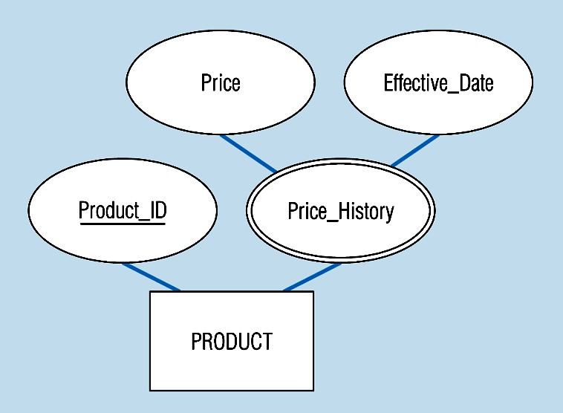
Figure 3-19 – an attribute that is both multivalued and composite
This is an example of time-stamping
© Prentice Hall, 2002
Notes:
37

Slide 7

Relationship Types vs. Relationship Instances
  The relationship type is modeled as the diamond and lines between entity types…the instance is between specific entity instances
Relationships can have attributes
  These describe features pertaining to the association between the entities in the relationship
Two entities can have more than one type of relationship between them (multiple relationships)
Associative Entity = combination of relationship and entity
  More on this later
© Prentice Hall, 2002

Slide 8

One – to – One
  Each entity in the relationship will have exactly one related entity
One – to – Many
  An entity on one side of the relationship can have many related entities, but an entity on the other side will have a maximum of one related entity
Many – to – Many
  Entities on both sides of the relationship can have many related entities on the other side
© Prentice Hall, 2002

Slide 9
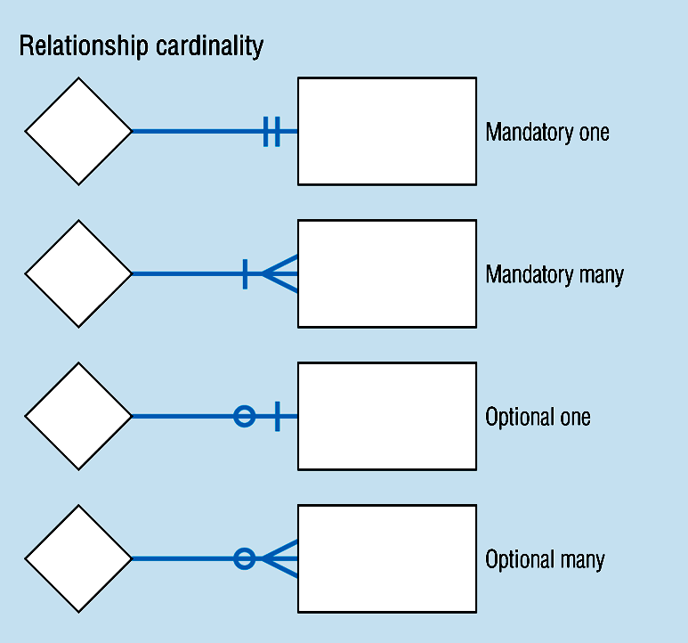
Cardinality – figure 3-2
© Prentice Hall, 2002
Notes:
8

Slide 10
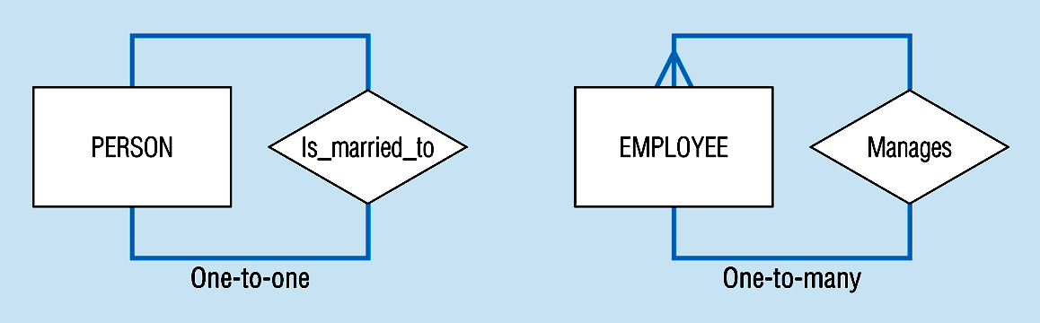
Unary relationships -- figure 3-12a
© Prentice Hall, 2002
Notes:
22

Slide 11
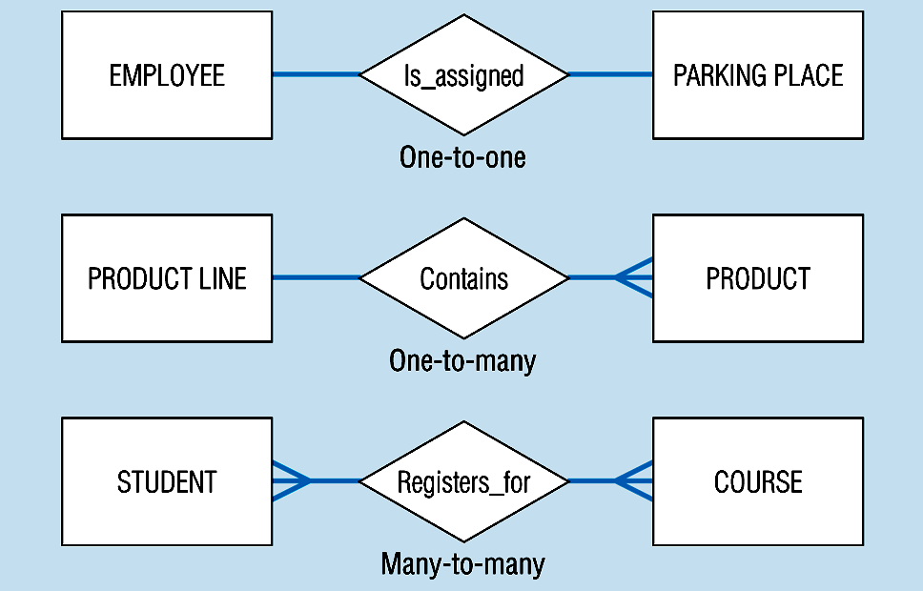
Binary relationships – figure 3-12b
© Prentice Hall, 2002
Notes:
23

Slide 12
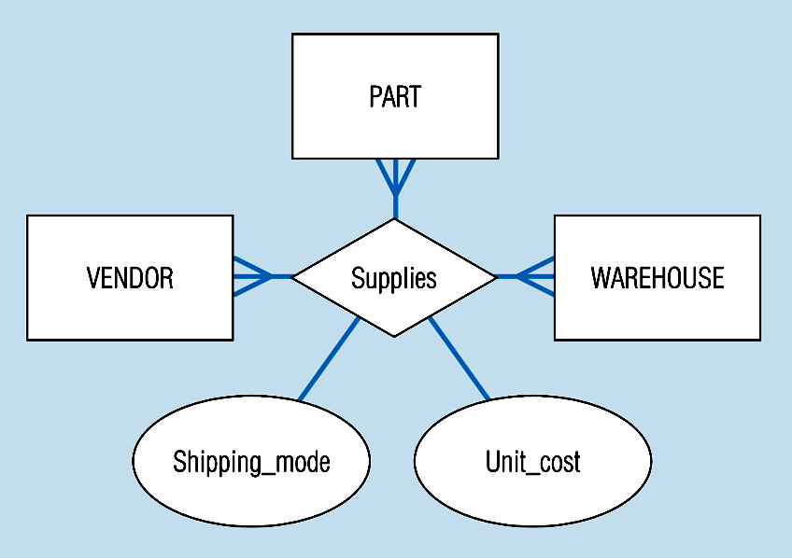
Ternary relationships –figure 3-12c
Note: a relationship can have attributes of its own
© Prentice Hall, 2002
Notes:
24

Slide 13

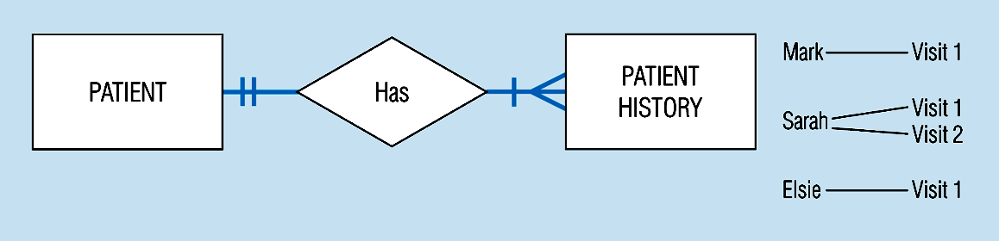
Basic relationship with only maximum cardinalities showing –
figure 3-16a
Mandatory minimum cardinalities – figure 3-17a
© Prentice Hall, 2002
Notes:
1

Slide 14
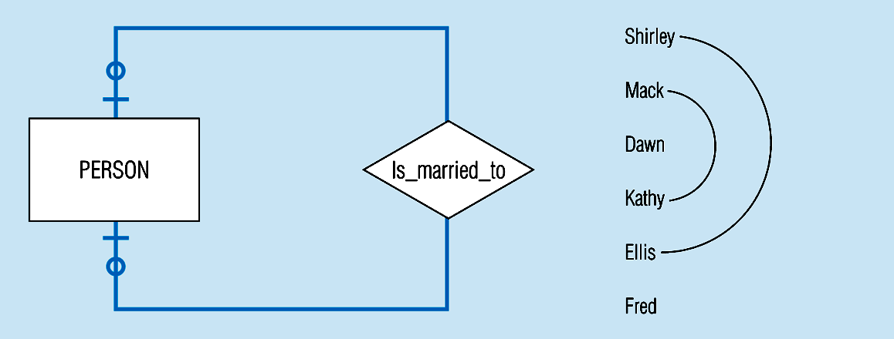
Figure 3-17c
Optional cardinalities with unary degree, one-to-one relationship
© Prentice Hall, 2002
Notes:
34

Slide 15
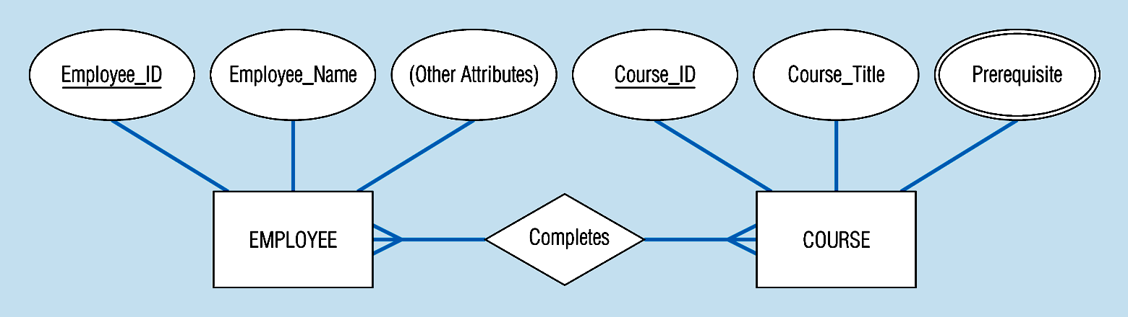
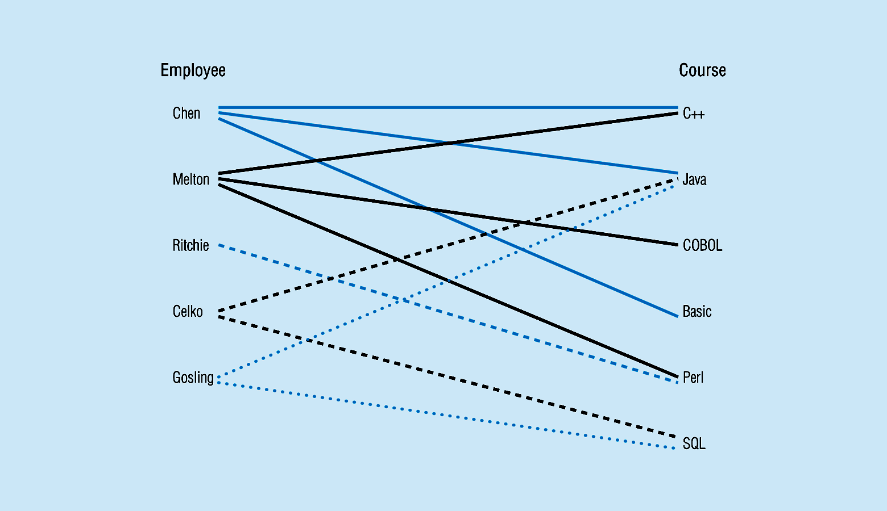
Figure 3-10a Relationship type
3-10b Entity and Relationship instances
© Prentice Hall, 2002
Notes:
17

Slide 16
Figure 3-12c -- A ternary relationship with attributes
© Prentice Hall, 2002
Notes:
24

Slide 17
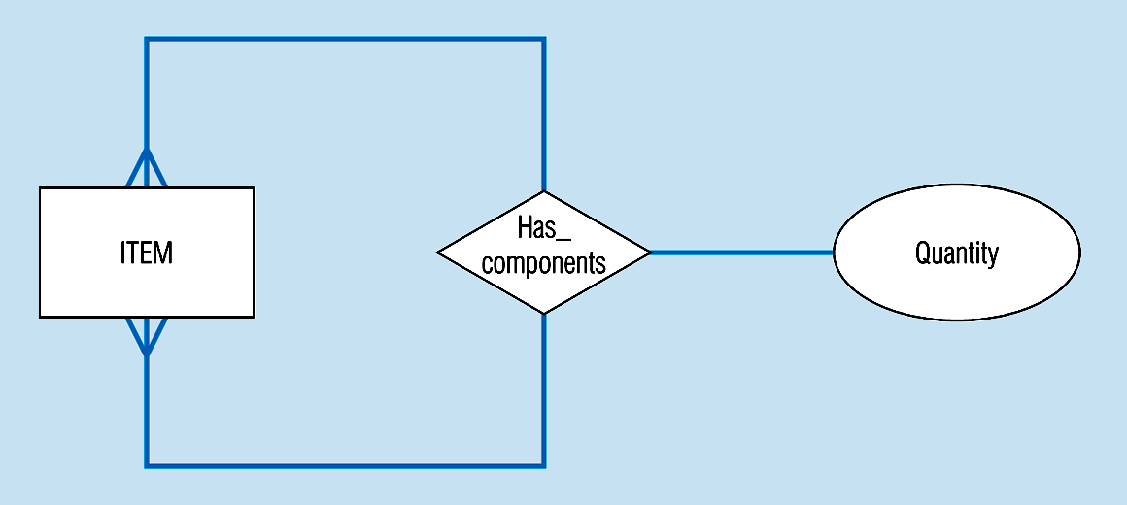
Figure 3-13a A unary relationship with an attribute. This has a many-to-many relationship
Representing a bill-of -materials structure
© Prentice Hall, 2002
Notes:
25

Slide 18
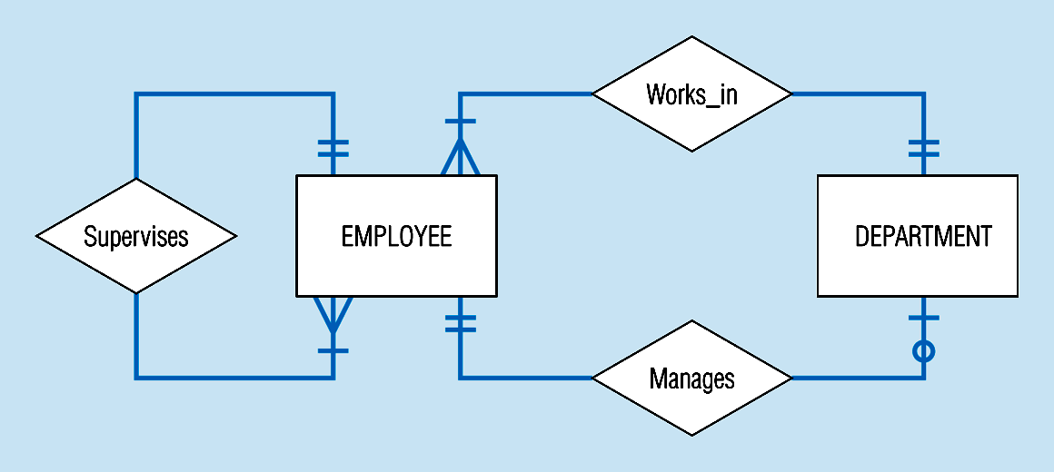
Examples of multiple relationships – entities can be related to one another in more than one way
Figure 3-21a Employees and departments
© Prentice Hall, 2002
Notes:
40

Slide 19
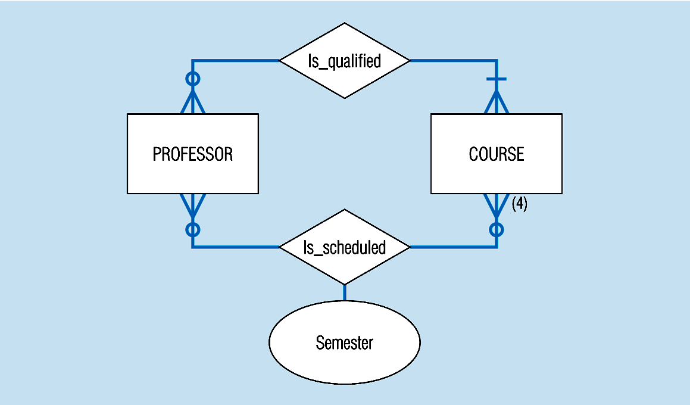
Figure 3-21b -- Professors and courses (fixed upon constraint)
Here,max cardinality constraint is 4
© Prentice Hall, 2002
Notes:
41

Slide 20
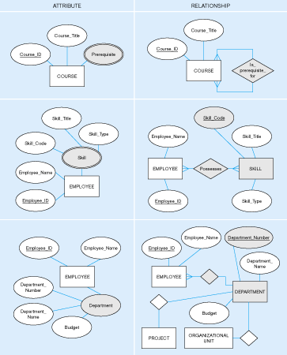
Figure 3-15: Multivalued attribute vs. relationship. Alternative approaches
© Prentice Hall, 2002

Slide 21

Strong entities
  exist independently of other types of entities
  has its own unique identifier
  represented with single-line rectangle
Weak entity
  dependent on a strong entity…cannot exist on its own
  Does not have a unique identifier
  represented with double-line rectangle
Identifying relationship
  links strong entities to weak entities
  represented with double line diamond
© Prentice Hall, 2002

Slide 22
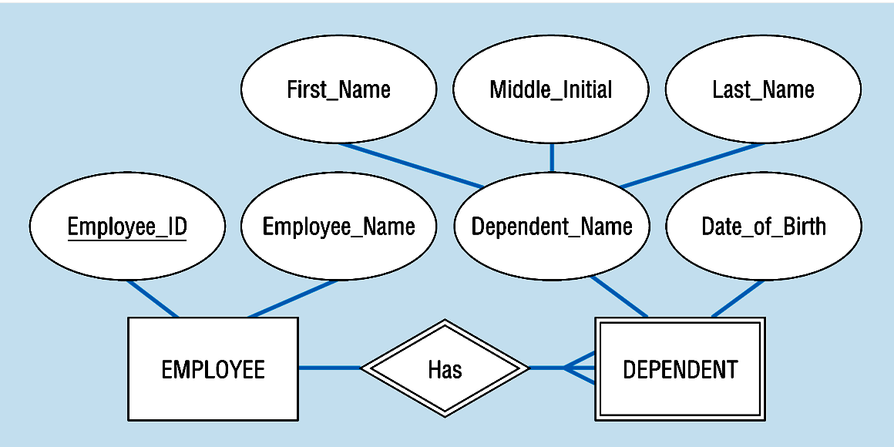
Figure 3-5: Strong and weak entities
Strong entity
Identifying relationship
Weak entity
© Prentice Hall, 2002

Slide 23

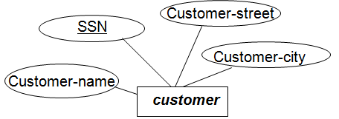
Superkey: is a set of attributes whose value can uniquely identify an entity in the entity set.
A super key contains one or more attributes.
The value of attributes “SSN” and “Name”, such as 558-36-1234 and Susan, can uniquely identify that particular customer in customer entity set

Slide 24
Other super keys for the entity set customer:
Superkey: (SSN)
Superkey: (SSN, Street)
Superkey: (SSN, City)
Superkey: (SSN, Name, Street)
Superkey: (SSN, Name, City)
Superkey: (SSN, Street, City)
Superkey: (SSN, Name, Street, City)

Slide 25

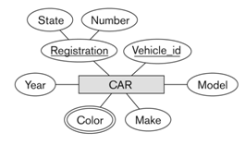
Super Key | Candidate Key | Primary Key
Broadest Unique Identifier | Is a Subset of Super Key | Is a subset of Candidate Key
ERD Concepts

Slide 26
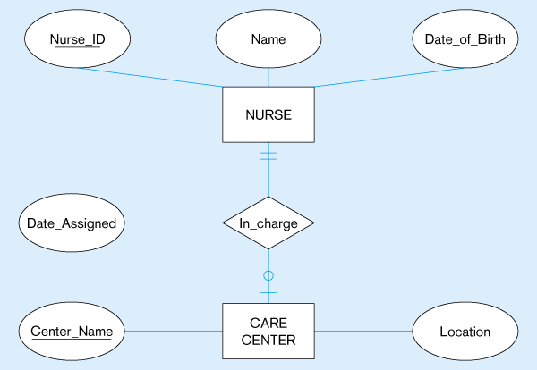
Figure 5-14: Mapping a binary 1:1 relationship
(a) Binary 1:1 relationship
© Prentice Hall, 2002

Slide 27
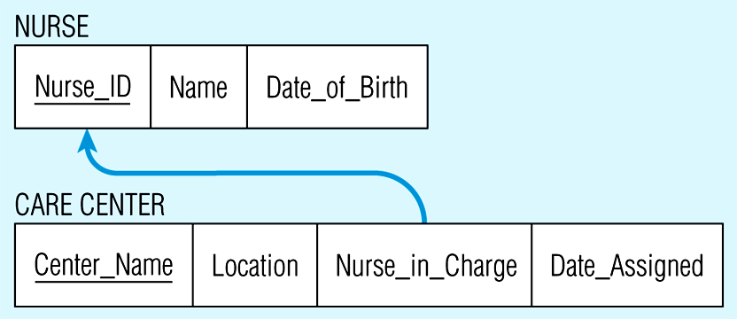
Figure 5-14(b) Resulting relations
© Prentice Hall, 2002

Slide 28
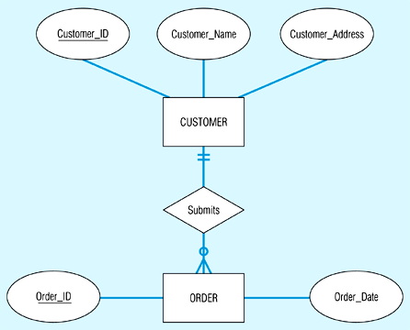
Figure 5-12: Example of mapping a 1:M relationship
(a) Relationship between customers and orders
Note the mandatory one
© Prentice Hall, 2002

Slide 29
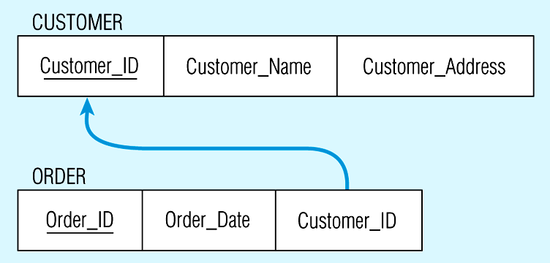
Figure 5-12(b) Mapping the relationship
Again, no null value in the foreign key…this is because of the mandatory minimum cardinality
Foreign key
© Prentice Hall, 2002

Slide 30

Mapping Associative Entities
  Identifier Not Assigned
    Default primary key for the association relation is composed of the primary keys of the two entities (as in M:N relationship)
  Identifier Assigned
    It is natural and familiar to end-users
    Default identifier may not be unique
© Prentice Hall, 2002

Slide 31
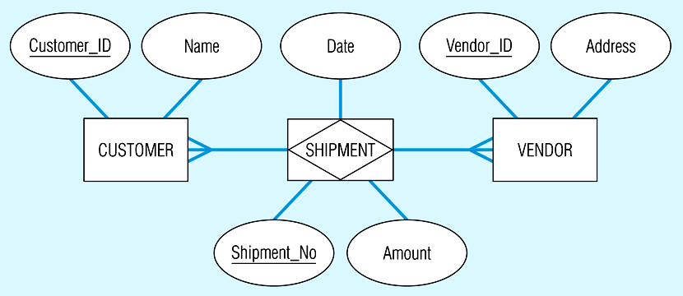
Figure 5-15: Mapping an associative entity
(a) Associative entity
© Prentice Hall, 2002

Slide 32
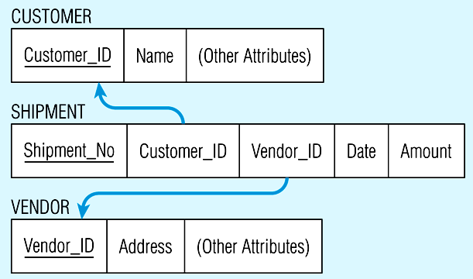
Figure 5-15(b) Three resulting relations
© Prentice Hall, 2002

