Slide 1
Category review: Chips
June 2020
Retail Analytics
Brand note: If client logo is not required, use alternate title page layout right click slide thumbnail > Layout > Title

Slide 2
Notes:
To view Privacy video explaining how important data privacy is to Quantium, please click here: https://www.youtube.com/watch?v=Zq1QDAkoRzU
or here Q:\Company Reference\Brand & Design\Brand videos\Q Privacy.mp4
At Quantium, we believe that data is the behavioural footprint of humanity and that it has to be treated with the utmost care and responsibility.
Histories, attitudes, indeed lives are stored within it in ways that aren’t always apparent – and that’s what makes its potential so powerful.
To work with it responsibly, sensitively, we set ourselves the highest data privacy protection and governance standards.
We have spent 17 years perfecting privacy-by-design and secure-by-design principles. Central to this is not holding any personally identifiable information about people –
we neither receive it, and put the necessary protections in place to be unable to decipher it.
Every aspect of handling data is safeguarded: from its de-identification, to its encryption – data security is paramount and of the highest grade.
We pride ourselves on gaining the trust of iconic organisations around the world through years of securely working with their data,
and in turn the trust that builds with their stakeholders.

Slide 3
Executive summary
01
Analysis of Chips Sales based on Different Metrices or KPI
Total Sales Trend over the Year
Customer Types and Their Chips Purchase
Life Stages and Premium Customer proportions
Top 5 Chips Brand
02
Trial Store Performance
Overall the Trial Store overperformed the Control Stores during Trial Period
Sales during Trial Period for each Trial and Control Stores
Trial VS Control Stores Sales during Trial Period

Slide 4
01
Analysis of Chips Sales based on Different Metrices or KPI

Slide 5
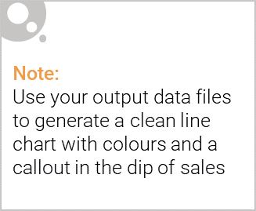
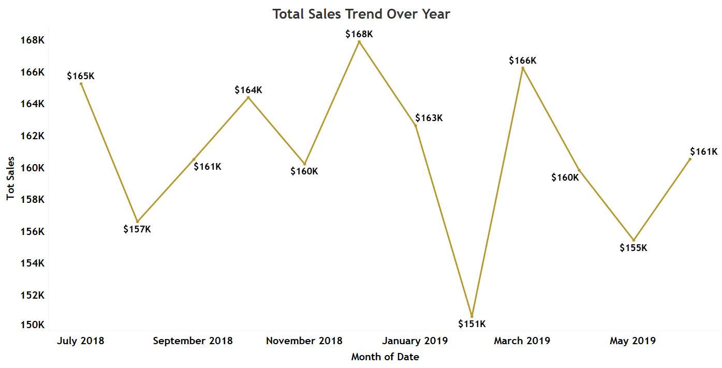
Total Sales Trend over the Year
Sales Total increased from $165K in July 2018 to $168K in December 2018 then it gradually decrease to $151K in Feb 2019 and once again rises up to $161K in July 2019.

Slide 6

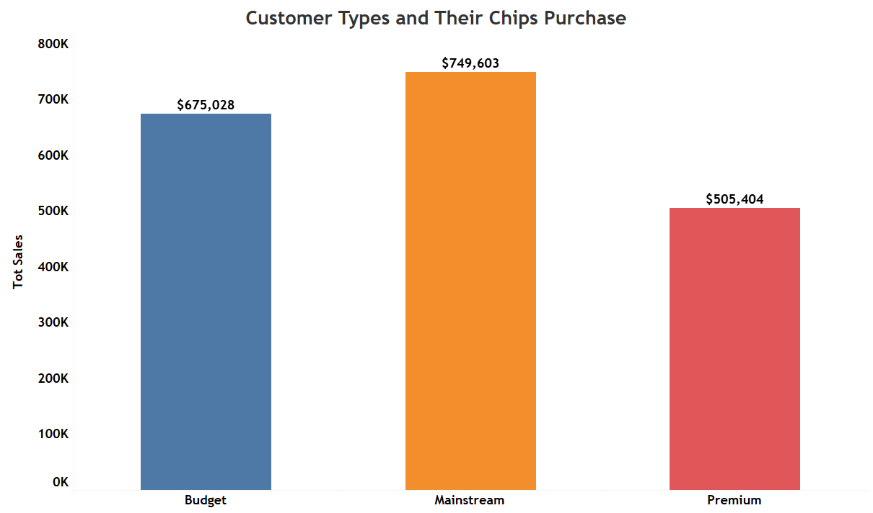
Customer Types and Their Chips Purchase
The graph below shows how much amount each customer type spends on purchasing the Chips.

Slide 7
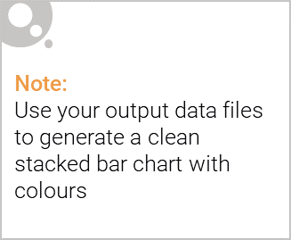
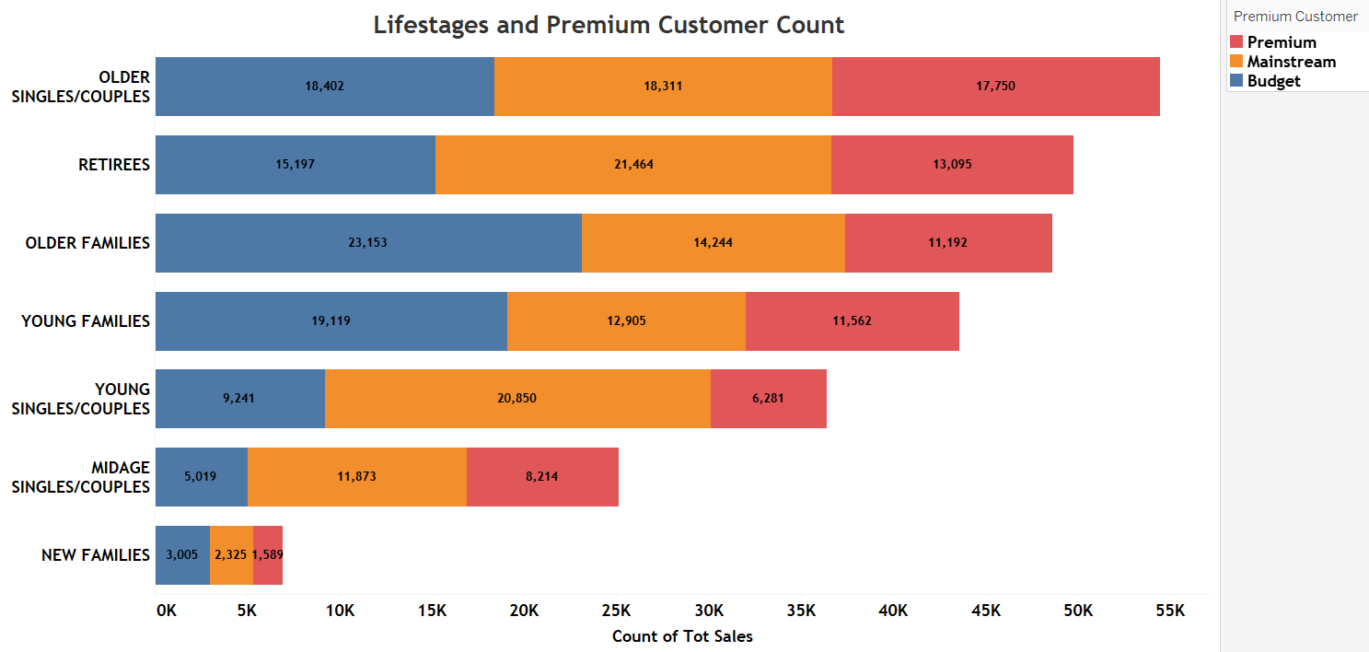
Editable (delete this)
Life Stages and Premium Customer proportions
The graph shows that Older People accounts more in purchasing Chips while the New Families tends to account few in purchasing chips.

Slide 8
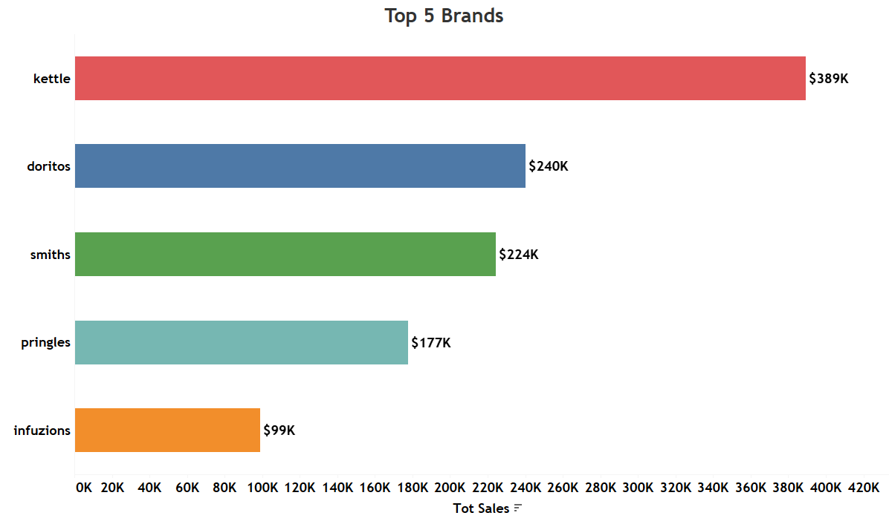
Editable (delete this)
Top 5 Chips Brand
The graph shows Top 5 Brands which sales the chips most with kettle in a lead with $389K sales followed by Doritos, smiths, pringles and infuzions.

Slide 9
02
Trial store performance

Slide 10
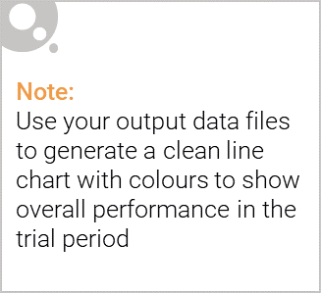
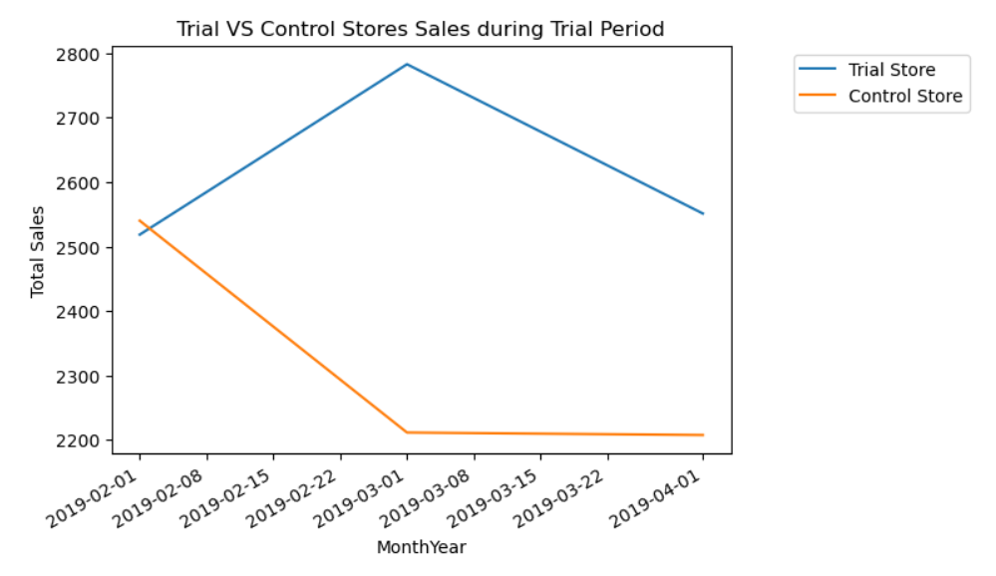
Control Store vs Trial Stores
The data shows that the Trial Stores have increased Sales from February 2019 to March 2019 and then ends with slight decline in April 2019.
The Control Stores sales declined from February 2019 to March 2019 and then ends without any changes in April 2019

Slide 11
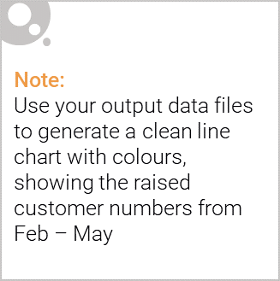
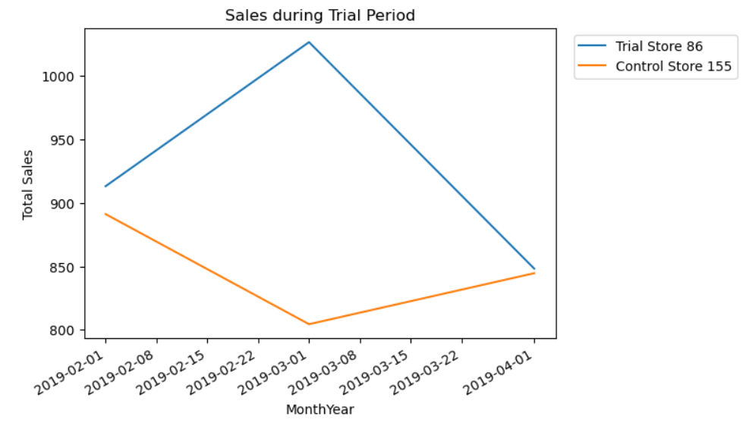
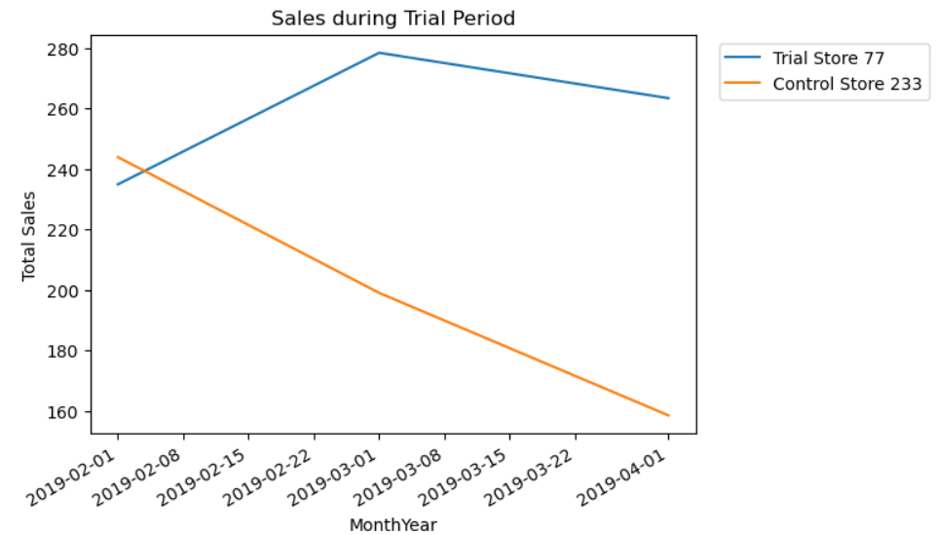
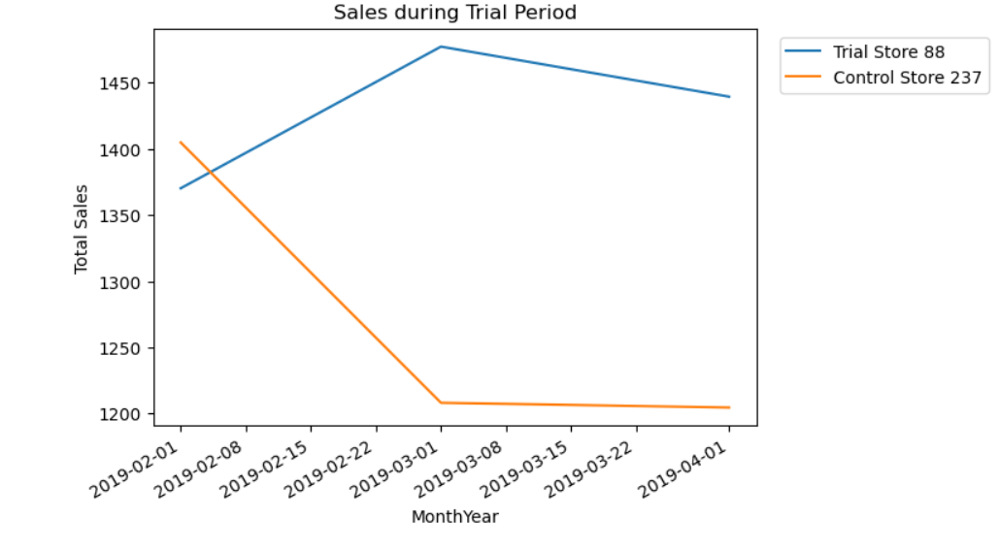
Sales during Trial Period

Slide 12
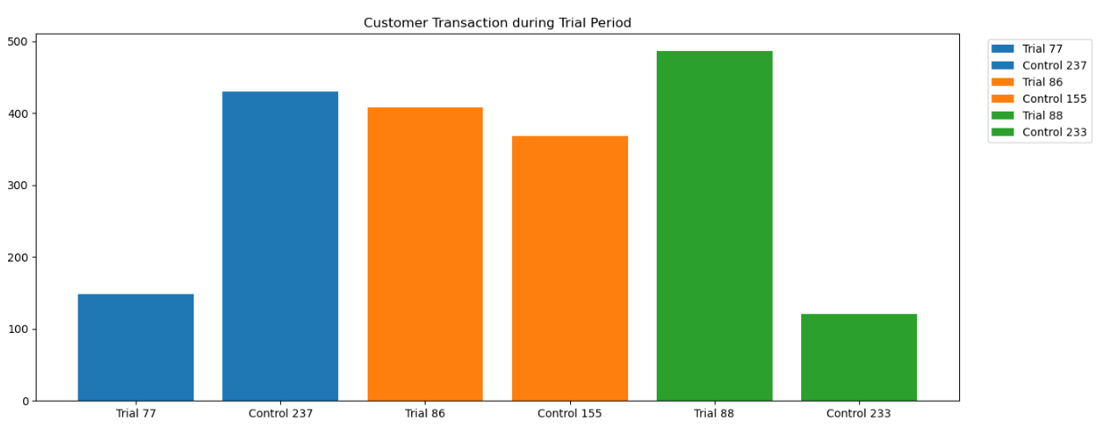
Total Customer Chips Transactions during Trial Period
The Graph shows that the Trial 86 and Trial 88 stores are outperforming their Control Stores while Trial 77 Stores underperform as compared to its Control Store.

