Slide 1




Strategic Database Modernization
Standardizing on Aurora PostgreSQL Multi-Region for Global Resilience and Operational Excellence
Architectural Consolidation
Operational Resilience
Business Agility
Executive Presentation | Q1 2026

Slide 2














Standardization Application on Aurora PostgreSQL Multi-region
Modern database applications across the mykiteapp on Aurora PostgreSQL Multi-region
Target State
Current State
Common App Stack
Web App
Mobile App
ERP System
Analytics
Web
Mobile
API
Analytics
Aurora PG
Aurora MySQL
RDS SQL Server
MODERNIZATION
RDS Oracle
On-Prem Oracle
On-Prem Server
Aurora PostgreSQL
Multi-Region Cluster
Strategic Enablement
Strategic Consolidation
Operational Excellence
"Standardizing our foundation to accelerate innovation and ensure global resilience."
Unified database architecture driving cost and architectural efficiency.
Standardized patterns and automated maintenance for global resilience.
Talent Optimization
Agile Support
Closing the skill gap through a focused, high-performance technology stack.
Streamlined cross-app support model to accelerate time-to-market.
Notes:
We're transforming our fragmented database landscape into a unified, resilient architecture. This move from disparate systems to Aurora PostgreSQL Multi-region isn't just a technical upgrade; it's a strategic imperative. We're consolidating our architecture, which drives significant cost efficiencies and improves our operational excellence globally. This standardization also optimizes our talent, closing skill gaps and enabling a more agile support model across applications. Ultimately, we're building a stronger foundation to accelerate innovation and ensure global resilience. Now, let's look at how we'll evolve our multi-region architecture.

Slide 3







Modernization Stages
Evolution of Multi-Region Database Architecture
Target: End of Q1
Target: End of Q2
Target: End of Q4 2027
1
2
3
Active-Pilot Light
Active-Warm Standby
Active-Active
Existing Database Platform
Existing Database Platform
Aurora PostgreSQL
Region A (Primary)
Region A (Primary)
Region A
ACTIVE
ACTIVE
ACTIVE
Async Backup
Continuous Replication
Global Replication
Region B (Secondary)
Region B (Secondary)
Region B
PILOT LIGHT
WARM STANDBY
ACTIVE
Legacy Platform
Legacy Platform
Aurora PostgreSQL
Notes:
Our modernization journey involves a clear evolution of our multi-region database architecture. We'll move from an Active-Pilot Light setup, which provides basic disaster recovery, to an Active-Warm Standby. This second stage offers continuous replication, significantly improving our recovery time objectives. The ultimate goal is an Active-Active configuration with Aurora PostgreSQL, ensuring maximum availability and performance across regions. This phased approach allows us to manage risk and build capabilities incrementally. This progression is key to achieving the strategic enablement we just discussed.

Slide 4




Migration Journey Pillars
Strategic Approach to reach our Target state
Workstream 1
Workstream 2
Workstream 3
Architectural Framework & Governance
Vendor-Agnostic Abstraction
Continuous Modernization & Optimization
Eliminate vendor-specific database features and replace them with database-neutral alternatives to enhance portability and flexibility.
Establish a robust migration framework and standardized solutions to ensure consistency and repeatability across all migration phases.
Achieve full standardization by redesigning or replacing inefficient legacy processes with modern, optimized cloud-native workflows.
•
Proprietary Feature Decommissioning
•
Reference Architectures
• VPD (Virtual Private Database)
•
OLTP Performance Tuning & Right-sizing
• Advanced Queues
•
Cloud-Native Design Patterns
•
Schema Decoupling & Logic Offloading
•
Polyglot Persistence & Data Offloading
•
Common repeatable and reusable Solutions
• Stored Procedures
•
Standardize app specific solutions
•
Automated Migration Tooling
• Triggers & Business Logic
•
Data Lifecycle Management (DLM)
•
Observability & Operational Resilience
How can we accomplish this:
•
DB team needs to upskill across all Database concepts
•
App teams must prioritize reducing DB code dependency and support all initiatives
•
Central Teams must enable the solutions to support DR, HA and DB Migrations
Notes:
Our migration journey is built on three core strategic pillars. First, we'll build a robust framework and establish clear standards to guide our efforts. This ensures consistency and efficiency across all migrations. Second, we're actively working to remove vendor lock-in, giving us greater flexibility and control over our technology stack. Finally, we'll standardize and redesign our systems, optimizing them for the new Aurora PostgreSQL environment. These pillars are critical to a successful and sustainable transformation. Now, let's examine the specific paths our applications will take on this journey.

Slide 5











Application Migration Paths
Availability & Data Protection Evolution (RTO/RPO)
APP 1
Oracle RDS (Single)
Active-Pilot Light
Active-Active (EC2)
Aurora PostgreSQL
RTO:
4-24h
RPO:
1h+
RTO:
<1h
RPO:
<15m
RTO:
<5m
RPO:
<1m
RTO:
<1m
RPO:
Zero
APP 2
Active-Pilot Light
Active-Warm Standby
Aurora PostgreSQL
RTO:
<1h
RPO:
<15m
RTO:
<15m
RPO:
<5m
RTO:
<1m
RPO:
Zero
APP 3
Oracle RDS (Single)
Active-Pilot Light
Active-Active (EC2)
Aurora PostgreSQL
RTO:
4-24h
RPO:
1h+
RTO:
<1h
RPO:
<15m
RTO:
<5m
RPO:
<1m
RTO:
<1m
RPO:
Zero
APP 4
Active-Pilot Light
Active-Warm Standby
Aurora PostgreSQL
RTO:
<1h
RPO:
<15m
RTO:
<15m
RPO:
<5m
RTO:
<1m
RPO:
Zero
Notes:
Here, we see the detailed roadmap for our application migration paths to the target state. Each application will follow a tailored journey, moving through various stages of modernization. For example, some applications will transition from single-region Oracle RDS directly to an Active-Active Aurora PostgreSQL setup. Others will move through intermediate steps like Active-Pilot Light or Active-Warm Standby. This granular approach ensures we manage complexity and risk effectively, guiding each application to its optimal, multi-region Aurora PostgreSQL state. This roadmap is our blueprint for achieving the operational excellence and strategic consolidation we've outlined.

Slide 6
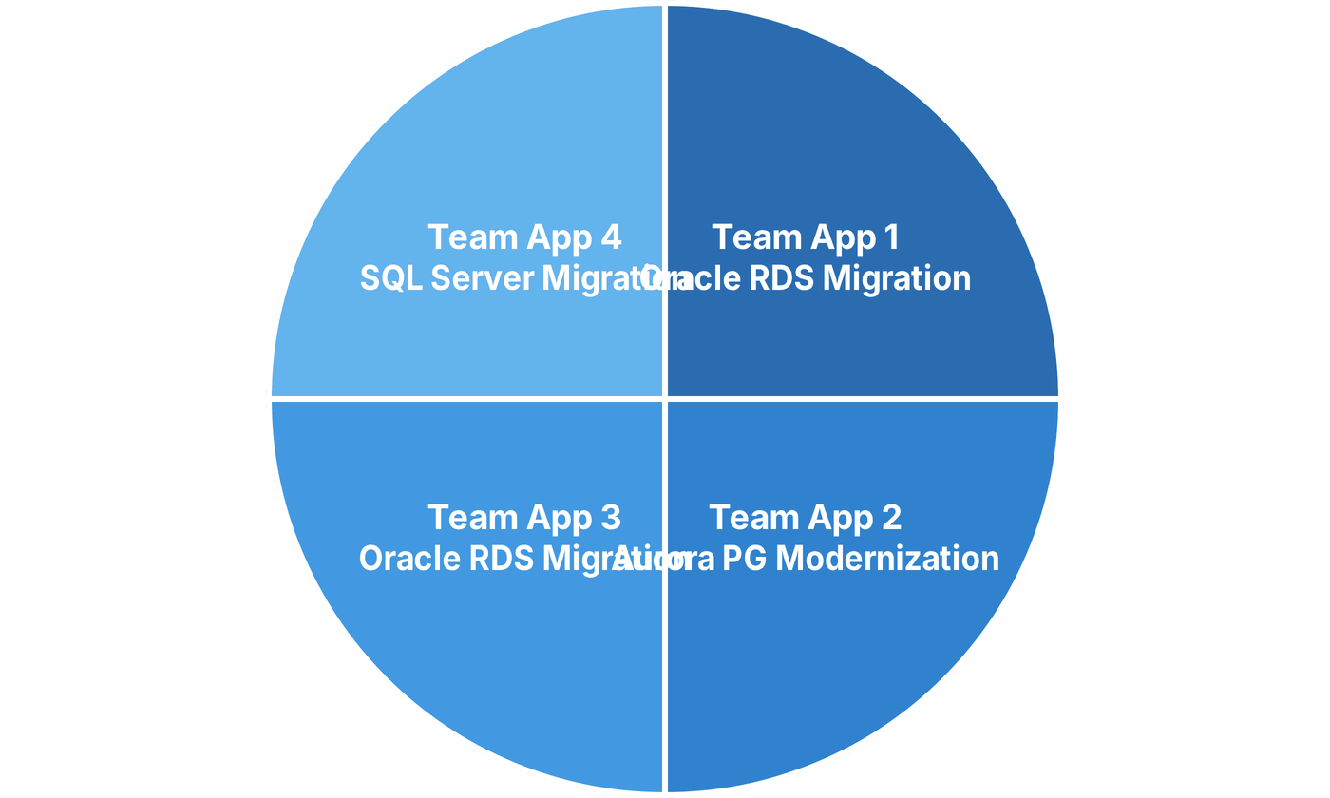
Strategic Resource Allocation: Application-Centric Teams
Balanced distribution of specialized talent across modernization streams
* Equal resource weighting ensures parallel execution and consistent delivery across all four application modernization paths.

Slide 7
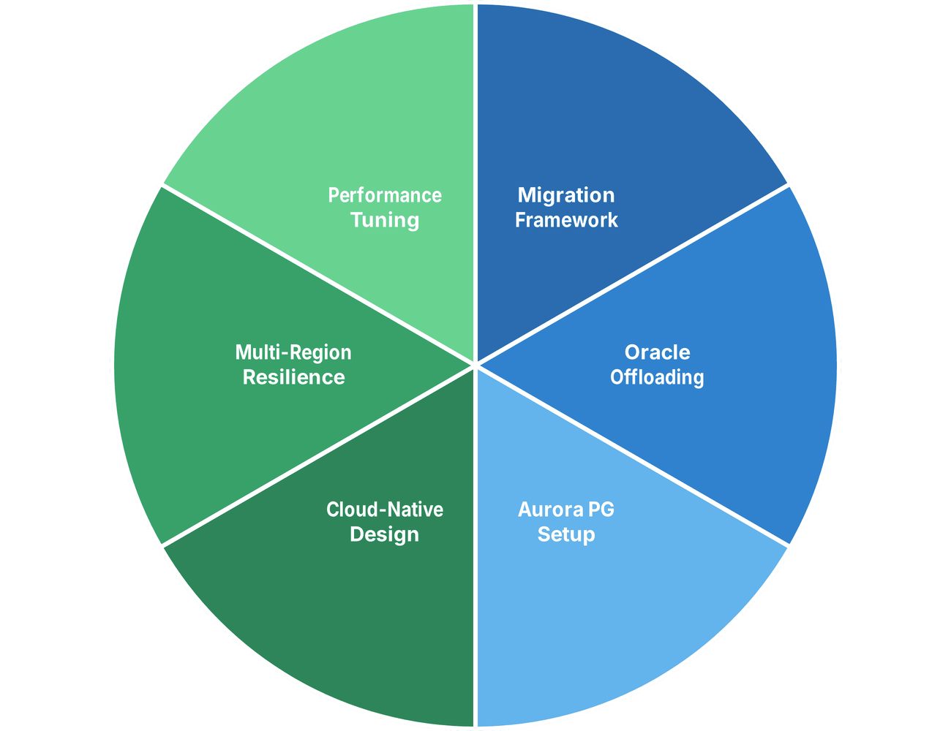


Unified Leadership & Ownership Matrix
Integrated accountability model for core modernization workstreams
Team 1 Lead
Team 2 Lead
Engineering & Migration
Modernization & Resilience
* A unified leadership structure ensures seamless coordination between migration engineering and cloud-native architectural standards.

Slide 8





Strategic Enablement & Management Support
Critical success factors for a seamless modernization journey
Central Team Collaboration
Application Team Alignment
Resource Skill Enhancement
Prioritize platform & security support for modernization initiatives.
Secure commitment to prioritize modernization over feature backlogs.
Invest in comprehensive upskilling for Aurora PostgreSQL.
Streamline infrastructure provisioning for multi-region setups.
Enforce adoption of standardized database-neutral patterns.
Bridge the gap in multi-region architectural expertise.
Enable cross-functional architectural reviews.
Align release cycles with migration milestones.
Foster a culture of continuous learning and best practices.
"Unified management support is the catalyst for transforming our database landscape into a resilient, global-scale asset."

