Slide 1




Project Overview
Failed Banking Transaction Analysis on GCP using Dataproc, Cloud SQL, and BigQuery.

Slide 2
Setting up MySQL instance
Create
Create MySQL instance
Add
Add user and password
Create
Create database: new_database
Create
Create table: failed_transactions

Slide 3


For Creating a Dataproc Cluster
Open Cloud Shell or Console:
gcloud dataproc clusters create training-cluster --region=us-central1 --zone=us-central1-a --single-node --master-machine-type=n1-standard-2 --image-version=2.0-debian10 --enable-component-gateway --optional-components=jupyter

Slide 4
Connect Dataproc to MySQL
Copy VM instance external IP address
Select your SQL instance
In connections add your external IP address in the add network

Slide 5
INGESTING THE DATA INTO THE GCS BUCKET
Create a bucket in the google cloud storage:
gsutil mb gs://kamalkumar-bucket/
Upload the CSV files to the bucket:
gsutil cp "E:/revature/p1bankproject/new_dataset/*.csv" gs://kamalkumar- bucket/transactions/
Upload Python scripts to the bucket:
gsutil cp "E:/revature/p1banking/cleancode.py" gs://kamalkumar- sbucket/scripts/
gsutil cp "E:/revature/p1banking/failedtrans.py" gs://kamalkumar- bucket/scripts/

Slide 6
Run pyspark job on dataproc cluster
Submitting a PySpark job for cleaning the dataset using a Python script
Command:
gcloud dataproc jobs submit pyspark gs://kamalkumar-bucket/scripts/cleancode.py --cluster=training-cluster --region=us-central1 --jars=gs://kamalkumar-bucket/jars/mysql-connector-j-8.0.33.jar --properties=spark.driver.memory=4g,spark.executor.memory=4g
Submitting a PySpark job for processing failed transactions using the failedtrans.py script.
Command:
gcloud dataproc jobs submit pyspark gs://kamalkumar-bucket/scripts/failedtrans.py --cluster=training-cluster --region=us-central1 --jars=gs://kamalkumar-bucket/jars/mysql-connector-j-8.0.33.jar -properties=spark.driver.memory=4g,spark.executor.memory=4g

Slide 7

Verify Data in Cloud SQL
Verify failed_transactions table and data insertion

Slide 8
Federated Connection: BigQuery to MySQL
Go to BigQuery
Click on CloudSQL (MySQL): BigQuery Federation
Click on add Data
Go to databases

Slide 9

Configure IAM Permissions
Copy service account from external connection
Add it to IAM with 'Cloud SQL Client' role

Slide 10
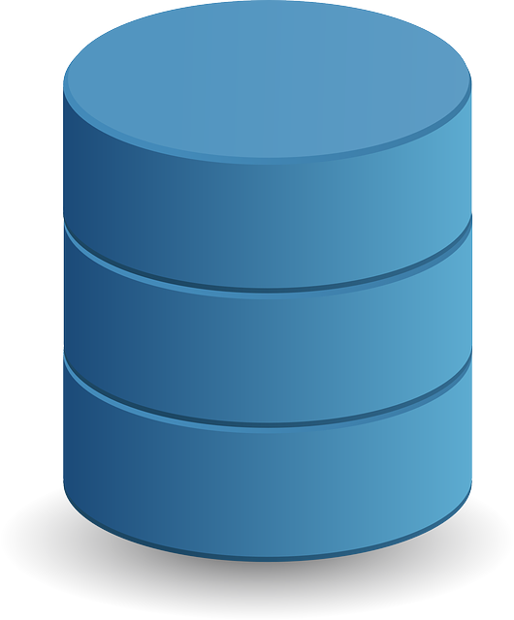


BigQuery Analysis and Visualization
Query federated tables
Export results to CSV ,json or bigquery tables etc
Visualize data using bigquery charts or looker studio
ThePhot
ThePhoto by PhotoAuthor is licensed under CCYYSA.

Slide 11
Conclusion:
Successfully integrated multiple GCP services for end-to-end data analysis
Automated the data pipeline from ingestion to visualization
Designed a scalable, secure, and efficient architecture
Delivered actionable insights to support informed decision-making

