Slide 1
IMDb Movie Dataset Project
-presented by
N. Kamal Kumar Nahak

Slide 2
Abstract
This project focuses on analyzing a large dataset of Indian and Hollywood movies using Python and MySQL. The dataset includes movie details like title, release year, genre, rating, and language. We clean, store, and analyze this data through a series of Python-based processes. The objective is to generate meaningful insights using SQL queries and Python visualizations. An interactive console also allows users to ask natural language-like queries to explore the data.

Slide 3
Technologies Used
Core language for scripting and data handling.
Pandas: For data cleaning and manipulation.
MySQL: For structured data storage and SQL-based querying.
Regex: To interpret user inputs in the interactive console.
MySQL Connector: Python package to interact with MySQL.

Slide 4
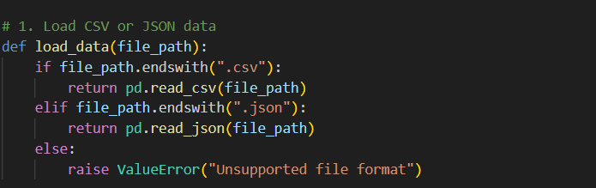
Loading the Dataset
Title: Step 1 – Load IMDb Data
Content: Load the dataset using Pandas from a .csv or .json file. This helps bring external movie data into memory for processing.

Slide 5
Cleaning the Data
Title: Step 2 – Clean and Sanitize Data
Content: 1.Remove duplicates. 2.Handle missing values. 3.Format titles and genres. 4.Standardize language info. 5.This ensures high-quality, usable data.

Slide 6
Uploading to MySQL
Title: Step 3 – Store Data in MySQL
Connect to the MySQL database using mysql.connector.
Drop the old movies table if it exists.
Create a new table with proper structure (including language column).
Insert cleaned data row-by-row into the database..

Slide 7
Analyzing Data with SQL
Title: Step 4 – Analyze Data Using SQL Queries
Run various SQL queries like:
Top-rated movies
Most common genres
Movies grouped by year or language
Save query results into CSVs for reporting.
Goal: Transform raw data into meaningful insights.

Slide 8
Interactive Console
Title: Step 5 – Interactive Console for Search
What Happens:
Allows user to type natural queries like:
"hindi movies"
"movies from 2015"
"movies with rating 8"
Uses regex to interpret query intent.
Generates and executes matching SQL queries.
Displays results in the terminal.

Slide 9
Smart Query Interpretation
Title: How the Console Understands Queries
What Happens:
Pattern matching using re.match() to recognize:
Year-based searches
Genre-based searches
Rating-based filters
Dynamically forms SQL queries behind the scenes.
Example: User types: “action movies from 2012” System runs:
SELECT * FROM movies WHERE genre LIKE '%action%' AND year = 2012;

Slide 10
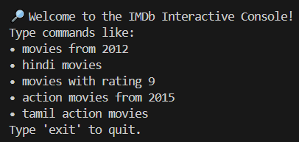
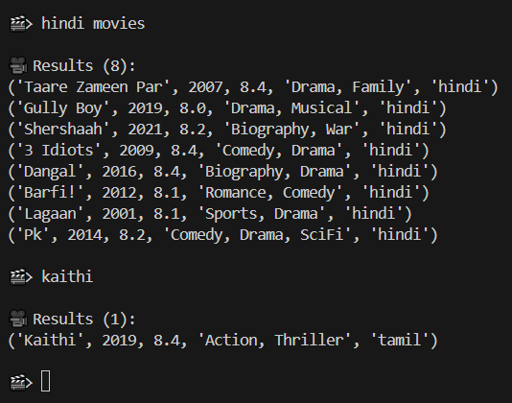
output

Slide 11
Conclusion
Title: Final Thoughts
Content:
This project showcases how data pipelines can turn raw data into actionable insights using Python and SQL. From cleaning to analysis to interactive exploration, this end-to-end workflow demonstrates real-world data analyst skills.

