Slide 1

SMART INDIA HACKATHON 2026
CareerCase
A career decision
should show its work.
Turn aptitude, aspirations, abilities and experience into an explainable career pathway.
SIH260480
SMART EDUCATION
SOFTWARE
Problem Statement
AI-Enhanced Career Guidance System for Personalized Career Pathways
TEAM ETERNALS
TEAM ID — NOT ALLOTTED
Notes:
[Sources]
Official SIH 2026 Problem Statement: SIH260480 — AI-Enhanced Career Guidance System for Personalized Career Pathways.
SIH2026 IDEA Presentation Format (slides 1–6).

Slide 2
02 / PROPOSED SOLUTION
One profile becomes a career decision you can defend.
Generic guidance overlooks the whole person. CareerCase turns four signals into a living, explainable case file.
1
Discover
2
Build
3
Match
4
Explain
5
Advance
Aptitude, interests
& values
Skills, experience
& aspirations
13 diversified
career options
Why this fits —
and what changes it
Close gaps; track
progression
THE CAREERCASE LOOP
WHOLE-PERSON PROFILE
AI, NOT A BLACK BOX
MULTIPLE, ACTIONABLE ROUTES
Interests, aptitude, skills, experience and constraints in one case file.
AI extracts and explains evidence; the core career score remains deterministic.
Focused, lower-risk and credential-led paths—not a single opaque answer.
DISCOVER → BUILD → MATCH → EXPLAIN → ADVANCE
SMART INDIA HACKATHON 2026 / ETERNALS / 02
CAREERCASE
Notes:
[Sources]
The Problem Statement.md — scope requirements: aptitude, aspirations, abilities/experience, progression and skill gaps.
PROJECT_BRIEF.md — CareerCase user journey and deterministic/AI boundary.
Designing a Six-Slide Smart India Hackathon Presentation… — consistent journey vocabulary.

Slide 3
03 / TECHNICAL APPROACH
The same journey runs through one traceable system.
Every recommendation has a visible input, a reproducible decision layer and a route the learner can act on.
U1 / CAPTURE
U2 / STRUCTURE
U3 / MATCH
U4 / PLAN
U5 / REFRESH
Assessments
Aspirations
Skills + experience
Career Passport
Evidence provenance
Consent + constraints
11-factor deterministic engine
13 diversified recommendations
Confidence + counterfactual
Skill Gap Index
3 core routes per role
Learning actions
Completed actions
Momentum signal
Updated explanation
AI ASSIST LAYER
Resume / aspiration extraction
Skill discovery
Grounded counsellor + dossiers
Trajectory / interview practice
AI clarifies the case; it never assigns the final match score.
REACT + TYPESCRIPT • SUPABASE • CLOUDFLARE WORKER • VERSIONED KNOWLEDGE BASE
SMART INDIA HACKATHON 2026 / ETERNALS / 03
CAREERCASE
Notes:
[Sources]
PROJECT_BRIEF.md — architecture, 11-factor matching, AI boundary, technology stack and route engine.
CareerCase source audit — deterministic engine, evidence provenance and applied AI surfaces.

Slide 4

04 / FEASIBILITY & VIABILITY
Built for trust where choices matter.
A functional prototype for demo and controlled pilots — with risks surfaced, not hidden.
RISK
HOW WE REDUCE IT
BLACK-BOX ADVICE
Deterministic 11-factor matching; “Why this?” reveals inputs, weights and gaps.
IMPLEMENTED
ASSESSMENT BIAS
Exploratory screeners; preserved baseline; capped, disclosed AI evidence adjustment.
PROTOTYPE
STALE / LOCAL CONTEXT
Versioned NCO / NSQF-grounded knowledge base; source and freshness disclosures.
IMPLEMENTED
DATA + ACCESS
Consent, export/delete controls, local continuity and EN / HI / TE core guidance.
IMPLEMENTED
BOUNDARY FOR JUDGES
Not a validated psychometric or government-certified production system yet.
SMART INDIA HACKATHON 2026 / ETERNALS / 04
CAREERCASE
Notes:
[Sources]
PROJECT_BRIEF.md — product constraints and non-overclaim boundaries.
CareerCase source audit — consent, local continuity, multilingual scope, assessment and knowledge-base limitations.

Slide 5
05 / IMPACT & BENEFITS
Career clarity becomes measurable progression.
CareerCase makes the next move visible for learners—and measurable for the people supporting them.
BEFORE
WITH CAREERCASE
PILOT SCORECARD
Learners
Scattered advice
and unclear next steps
An explainable fit, a route
and a skill-gap action
1
Decision clarity
2
Routes started
Professionals
Transferable skills
stay invisible
Viable transition routes
with trade-offs
3
Skill evidence gained
4
Recommendation stability
Counsellors + institutions
Fragmented, one-size-
fits-all guidance
A structured case file
and follow-through signal
5
Pathway completion
Validation plan — outcomes are not claimed as achieved.
5 USER SEGMENTS • 3 CORE GUIDANCE LANGUAGES • 3 ROUTES PER OCCUPATION
SMART INDIA HACKATHON 2026 / ETERNALS / 05
CAREERCASE
Notes:
[Sources]
The Problem Statement.md — target range from students to mid-career professionals, scalability/adaptability and expected outcomes.
PROJECT_BRIEF.md — five learner segments, three core routes and multilingual core guidance.
Deep Research Report… — label pilot KPIs as validation plan, not achieved impact.

Slide 6
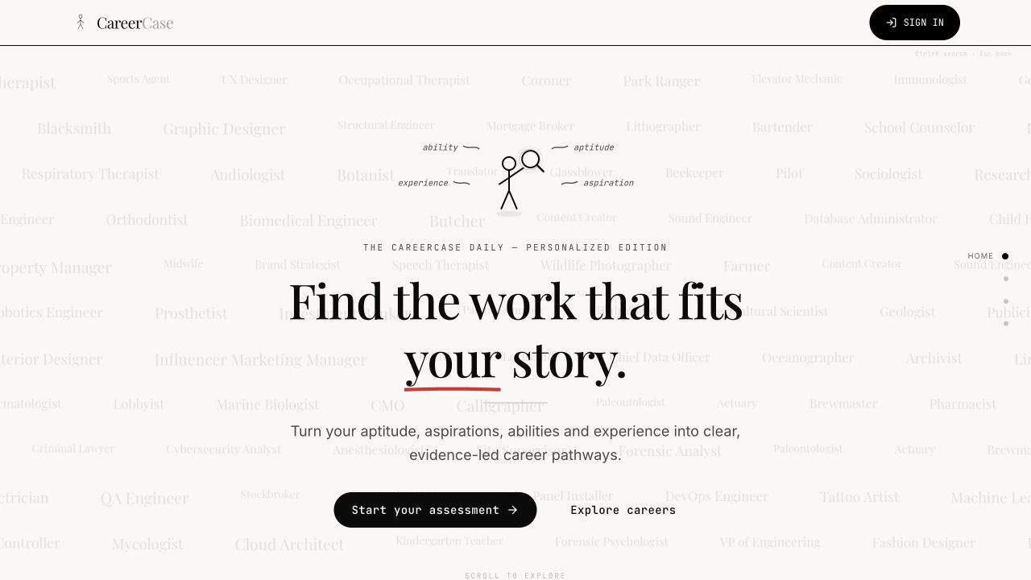
06 / RESEARCH & REFERENCES
Every recommendation carries its evidence forward.
Our proof is a case file: the problem is traceable, the decision is inspectable, and the demo follows the same path.
PROBLEM BASIS
CAREER KNOWLEDGE
MSDE / SIH 2026
SIH260480 problem statement
NCO-2015 roles
NQR / NSQF levels
PRODUCT PROOF
QUALITY + LIMITS
100 roles · 178 skills
105 qualifications · 300 transitions
Deterministic checks
Prototype; pilot next
LIVE PROTOTYPE / CAREERCASE
Demo sequence
The guidance must be personal.
The case must be credible.
Discover → Build → Match → Explain → Advance
Repository: github.com/KamalReddy2901/AI-Enhanced-Career-Guidance-System-for-Personalized-Career-Pathways
SMART INDIA HACKATHON 2026 / ETERNALS / 06
CAREERCASE
Notes:
[Sources]
Official SIH 2026 Problem Statement: SIH260480.
National Classification of Occupations (NCO-2015): https://www.ncs.gov.in/Documents/National%20Classification%20of%20Occupations%20_Vol%20I-%202015.pdf
National Qualifications Register: https://www.nqr.gov.in
CareerCase PROJECT_BRIEF.md and implementation audit — knowledge-base counts and prototype status.
Repository: https://github.com/KamalReddy2901/AI-Enhanced-Career-Guidance-System-for-Personalized-Career-Pathways

