Slide 1
Sales Performance Overview
Total Sales: $1,376,044.25
Average Sale: $30,578.76
Total Units Sold: 2433.75
Date Range: 2018-01-06 to 2019-12-21

Slide 2
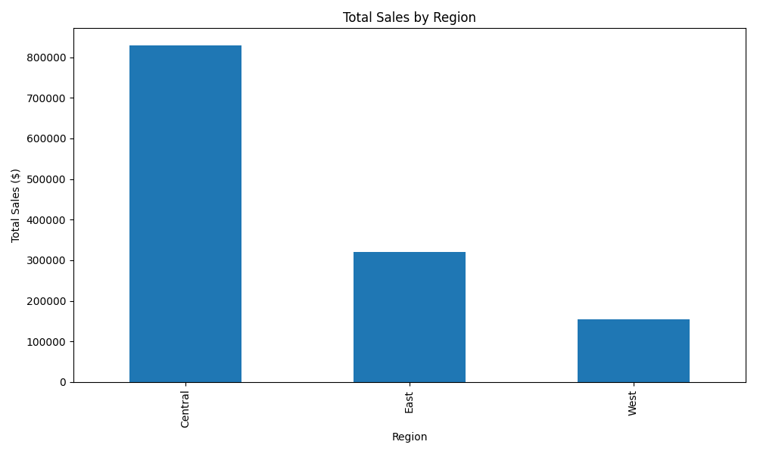
Sales by Region
Regional Sales Summary: Central: $829,769.50, East: $321,007.00, West: $154,899.00

Slide 3
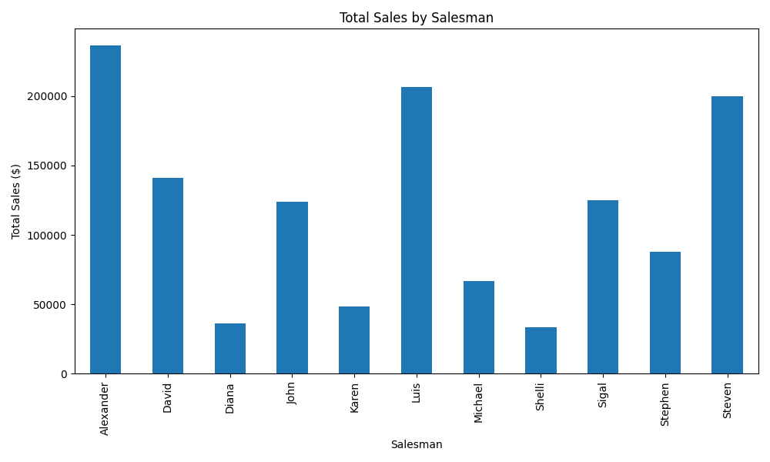
Sales by Salesman
Salesman Sales Summary: Alexander: $236,703.00, Luis: $206,373.00, Steven: $199,690.00, David: $140,955.00, Sigal: $125,037.50, John: $124,016.00, Stephen: $88,063.00, Michael: $66,836.00, Karen: $48,204.00, Diana: $36,100.00, Shelli: $33,698.00

