Slide 1
MyKaD Reader
Technical manual

Slide 2
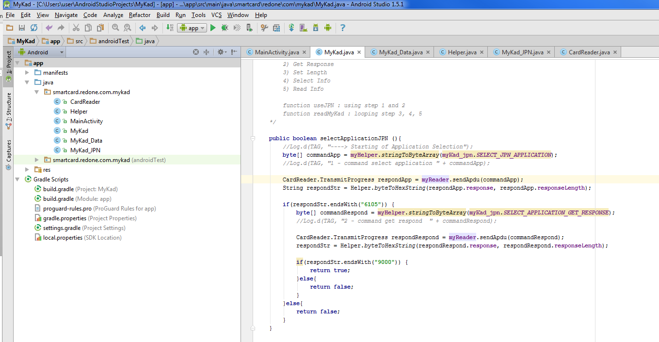
Native Android App (in Java)
Card Reader.java – interface class to connect to ACS library, which can be found at http://www.acs.com.hk/en/products/228/acr38u-pocketmate-ii/
Helper.java – helper class for conversion and sanitization
MainActivity.java – Android GUI .For Cordova plugin, this class is not needed.
MyKad.java - to read MyKad Data. Detail of how to read in comment in the class itself. Briefly, 5 stage of reading were used.
1) Select Application 2) Get Response 3) Set Length 4) Select Info 5) Read Info
MyKad_Data.java - GET, SET class
MyKad_JPN.java – location of the information on the card in form of offset and length

Slide 3
Reading MYKAD Process
How to use 5 stages to read MyKad,
https://forum.lowyat.net/index.php?s=684c18f20b1cb2afce4733afce81c5d0&showtopic=355950&st=20&p=11151482&#entry11151482
https://gist.github.com/amree/5251219
Name location is exceptional
static final String KPTName[] = { "C8", "00 00" };

Slide 4
Cordova Plugin Development
Cordova in Visual studio cannot debug java class (java plugin)
Try to use any Eclipse IDE , JBoss is recommended. For more info, please check, http://tools.jboss.org/documentation/videos/hybrid_angularjs_ionic.html
Main Activity Class from Native Android is not needed,

Slide 5
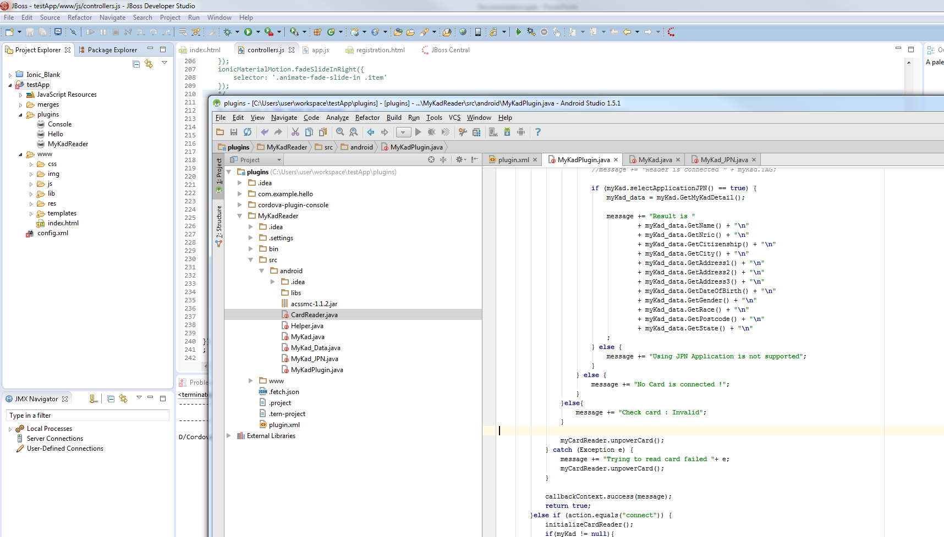
Cordova Plugin Development
Plug in follow a specific structure, please refer to the following tutorial,
http://www.mat-d.com/site/tutorial-creating-a-cordova-phonegap-plugin-for-android-app/
And sample Hello world plugin (very useful),
https://github.com/don/cordova-plugin-hello
After plugin was installed, it still can be edited. You can use Android Studio to edit it. JBosss will be rebuilt on each run.
Path of the package is also important
JBoss , plugin.XML cannot recognize the path(bug I suppose). Manually edit is required. i.e next slide…

Slide 6
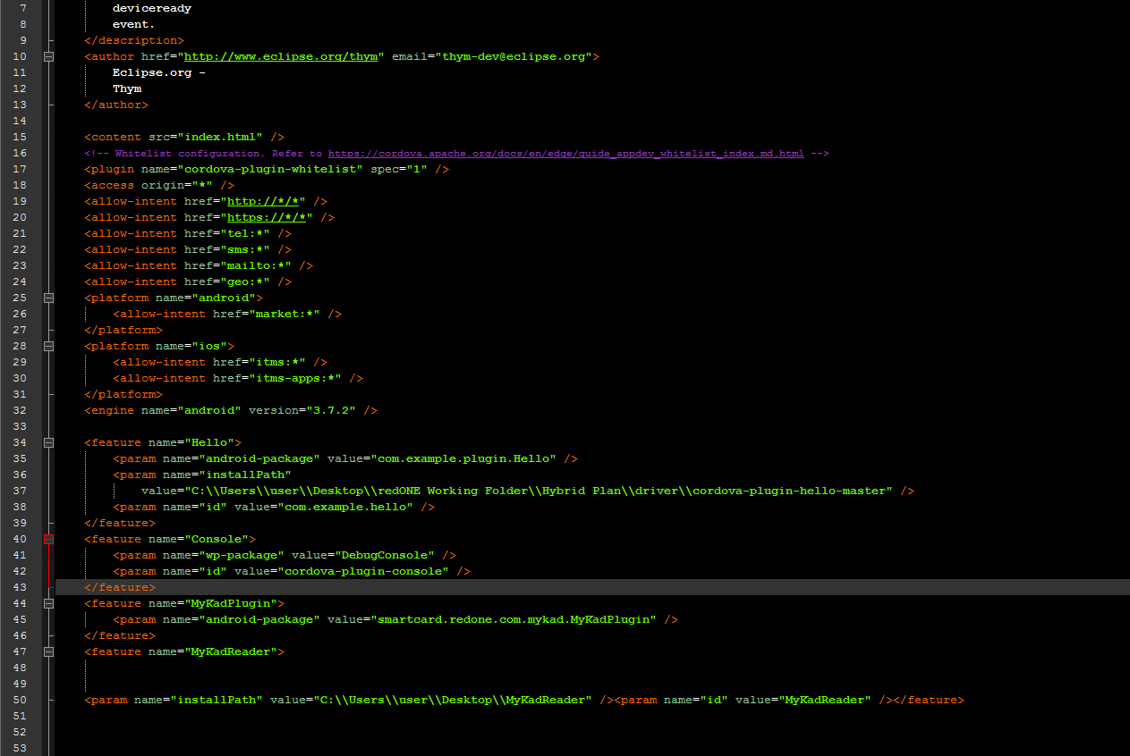
Path Error in JBOSS

Slide 7
Some Sample Cordova plugins
https://github.com/uxnow/cordova-plugin-lotuscard
https://github.com/stuart-xyz/acr35

