Slide 1
GLOBAL ELECTRONICS
...technologies...

Slide 2
DATASPARK – Illuminating Insights For Global Electronics

Slide 3
Content :
Customer Report Analysis
Sales Report Analysis
Store Report Analysis
Product Report Analysis
Exchange Rates Report Analysis
GLOBAL ELECTRONICS
...technologies...

Slide 4
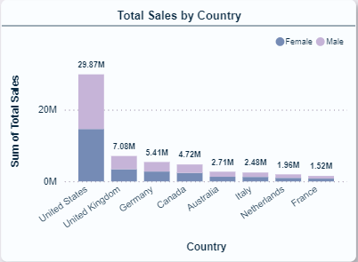
Customer Report Analysis
Insight Statement 1:
The chart titled "Total Sales by Country" shows that the United States has the highest total sales, significantly outperforming other countries with sales of nearly 30M. The sales are segmented by gender, indicating that both male and female contributions are substantial, but there may be a noticeable difference in proportions between the countries.
Problem Statement 1:
The significant gap in total sales between the United States and other countries highlights potential issues, such as insufficient store presence in other countries. The high number of stores in the U.S. likely contributes to its dominant sales performance. In contrast, the lower number of stores in countries like France, Italy, and the Netherlands might be limiting sales potential. Additionally, the differences in sales between male and female customers suggest varying consumer behavior that may need to be addressed to optimize sales.
Solution Statement 1:
The address the disparities in sales, it is essential to evaluate and potentially expand the store network in underperforming countries to better capture market opportunities. Additionally, conducting a detailed analysis of the factors driving success in the U.S. market could provide insights that can be applied to other regions. Customizing marketing strategies to target gender-specific preferences, along with exploring local market trends and consumer behavior, will help in designing effective campaigns and product offerings that resonate with customers in different countries, thereby improving overall sales performance.
GLOBAL ELECTRONICS
...technologies...

Slide 5
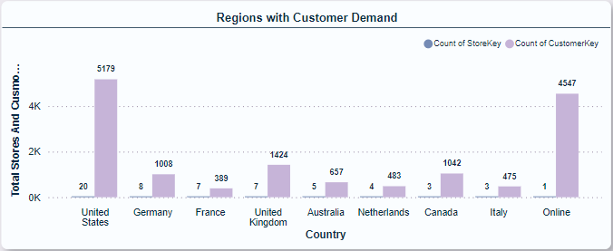
Customer Report Analysis
Insight Statement 2:
The United States has the highest customer demand, with 5179 customers, followed by Online with 4547 customers. While other countries have a significantly lower number of customers, there's still demand present, indicating potential for growth.
Problem Statement 2:
Although the United States and Online have a strong customer base, other regions are lagging behind, suggesting a potential missed opportunity for growth and expansion. This lack of customer demand in other regions could hinder overall business growth and market penetration.
Solution Statement 2:
Targeted Marketing: Implementing region-specific marketing campaigns to cater to the unique needs and preferences of customers in each country could boost customer demand.
Investment in Infrastructure: Improving logistics and distribution channels in less developed regions can streamline the delivery process and enhance customer satisfaction, ultimately boosting demand.
GLOBAL ELECTRONICS
...technologies...

Slide 6
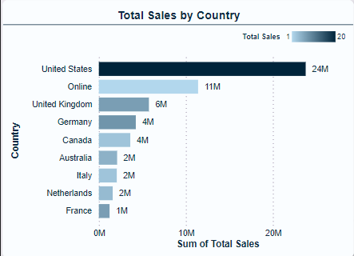
Sales Report Analysis
Insight Statement 1:
The United States and Online channels have the highest customer demand, indicating a significant potential for growth in these regions. However, other countries like Germany and the United Kingdom also have a considerable number of stores, suggesting an opportunity to further penetrate these markets.
Problem Statement 1:
While the United States and Online channels demonstrate high customer demand, other regions like Australia, Netherlands, and Italy exhibit significantly lower demand. This discrepancy presents a challenge in maximizing overall market reach and customer engagement across all regions.
Solution Statement 1:
Targeted marketing campaigns: Tailored promotions and marketing efforts specific to each region can help increase brand awareness and drive customer acquisition.
Strategic partnerships: Collaborating with local businesses and influencers can boost brand visibility and credibility within specific regions.
Localization strategies: Adapting products and services to cater to local preferences and cultural nuances can improve customer engagement and satisfaction.
GLOBAL ELECTRONICS
...technologies...

Slide 7
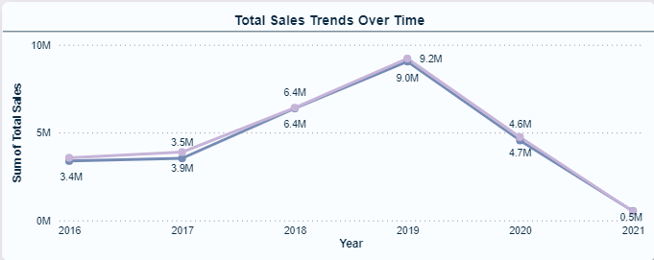
Sales Report Analysis
Insight Statement 2:
The company experienced a significant growth in sales between 2016 and 2019, reaching a peak of 9.2 million in 2019. However, sales dropped sharply in 2020 and continued to decline in 2021, reaching a low of 0.5 million. This suggests a potential shift in market conditions or internal challenges impacting the company's performance.
Problem Statement 2:
The company is facing a steep decline in sales, with 2021 sales reaching a mere 0.5 million, a dramatic drop from the peak of 9.2 million in 2019. Understanding the root causes of this downturn is crucial to effectively address the issue and restore sales growth.
Solution Statement 2:
Market research: Understanding changing market conditions and customer preferences to adapt products/services accordingly.
Internal assessment: Evaluating operational efficiency, marketing effectiveness, and sales processes to identify potential areas for improvement.
Customer engagement: Enhancing customer service, loyalty programs, and communication to retain existing customers and attract new ones.
GLOBAL ELECTRONICS
...technologies...

Slide 8
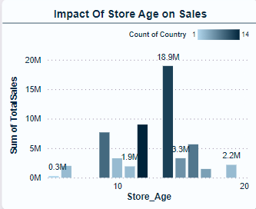
Stores Report Analysis
Insight Statement 1:
The total sales trend shows a steady increase from 2016 to 2019, peaking at 9.2M in 2019. However, sales experienced a significant drop in 2020 and 2021, reaching a low of 0.5M in 2021.
Problem Statement 1:
The business experienced a sharp decline in sales in 2020 and 2021, indicating a potential problem with the company's operations or market conditions. Understanding the root cause of this decline is crucial to implement effective solutions.
Solution Statement 1:
Market adjustments: Adapting to changing consumer needs by modifying product lines, pricing, or marketing strategies.
Operational improvements: Enhancing operational efficiency, optimizing product development, or improving customer service.
New market strategies: Exploring new market segments or expanding into untapped regions to diversify revenue sources.
By proactively addressing the root causes of the sales decline and implementing appropriate solutions, the business can aim to restore sales growth and ensure long-term sustainability.
GLOBAL ELECTRONICS
...technologies...

Slide 9
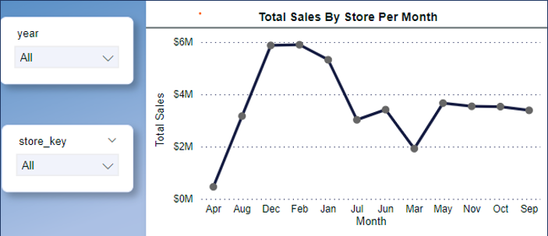
Stores Report Analysis
Insight Statement 2:
Sales peak sharply in December, reaching around $6M, followed by a gradual decline through February.
Problem Statement 2:
The consistent low sales during the middle of the year could indicate an off-peak season where customer demand is low. This fluctuation can create challenges in maintaining a stable cash flow and might impact profitability during off-peak months
Solution Statement 2:
Market research and adaptation: Adapting to changes in customer needs and preferences through product innovation, marketing campaigns, and sales strategies.
Cost optimization and efficiency: Streamlining operations and reducing expenses to enhance profitability in a potentially less favorable market.
Diversification of revenue streams: Exploring new product lines or markets to mitigate dependence on declining sectors.
Strategic partnerships: Collaborating with other companies to leverage their resources, expertise, or customer base.
GLOBAL ELECTRONICS
...technologies...

Slide 10
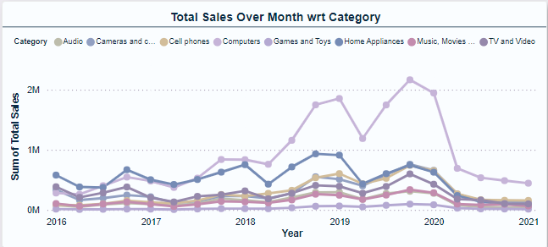
Product Report Analysis
Insight Statement 1:
The total sales trended upwards from 2016 to 2019, reaching a peak of 9.2M in 2019. However, sales declined drastically in 2020 and 2021, reaching a low of 0.5M in 2021. This suggests a significant shift in market conditions or company performance.
Problem Statement 1:
The company experienced a steep decline in sales starting in 2020, culminating in a dramatic drop to 0.5M in 2021. This raises concerns about the sustainability of the business and requires an urgent understanding of the root causes of this decline.
Solution Statement 1:
Product/service issues: Are there product quality issues, lack of innovation, or misalignment with customer needs?
Pricing: Are prices competitive or are there pricing strategies impacting sales?
Marketing and sales: Are marketing campaigns effective? Are sales strategies reaching the right target audience?
GLOBAL ELECTRONICS
...technologies...

Slide 11
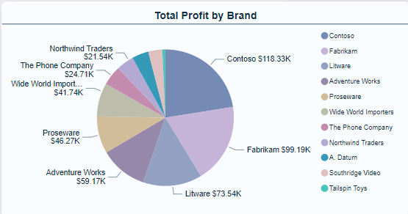
Product Report Analysis
Insight Statement 2:
Contoso is the most profitable brand followed by Fabrikam and Litware. Smaller brands like Northwind traders and Southridge video contribute much less to the overall profit
Problem Statement 2:
The Lower profitability of other brands like Northwind traders and Southridge video may indicate that these brands are struggling to compete or are not as effectively positioned in the market. This imbalance could pose a risk to overall business.
Solution Statement 2:
To tackle this issue, analyzing the strategies of top-performing brands like contoso and fabrikam and applying similar tactics to the weaker brands could help boost their profitability. Diversifying the brand portfolio by investing in underperforming brands can also reduce dependency on the top brands.
GLOBAL ELECTRONICS
...technologies...

Slide 12
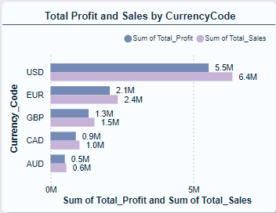
Exchange Rates Report Analysis
Insight Statement 1:
The United States has the highest customer demand with 5179 stores and customers, followed by online with 4547. Germany, the United Kingdom, and Canada are also showing promising customer demand with over 1000 stores. This data suggests potential for growth in these markets.
Problem Statement 1:
The company needs to strategically allocate resources to maximize growth and profitability. Currently, the United States and Online channels are dominating in terms of customer demand, however, other countries have potential but lower customer demand.
Solution Statement 1:
Focus on Expanding in High-Potential Markets: Invest resources in expanding to markets with promising customer demand, such as Germany, the United Kingdom, and Canada.
Target New Customer Segments: Explore opportunities to target new customer segments in both existing and new markets.
GLOBAL ELECTRONICS
...technologies...

Slide 13
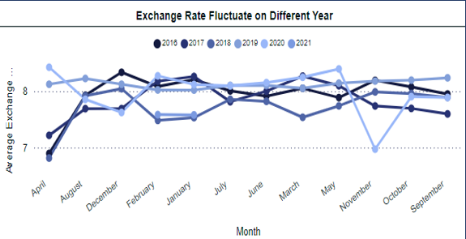
Exchange Rates Report Analysis
Insight Statement 2:
The average rates have experienced fluctuation over the years from 2016 – 2021. while some years, such as 2021, display more volatility, others like 2017 and 2020 remain relatively stable
Problem Statement 2:
The fluctuating exchange rates across different years present challenges for financial planning and budgeting. Sudden drop or spikes in exchanges rates could impact international transactions, pricing strategies, and overall profitability, making it difficult for businesses to maintain consistent financial performance
Solution Statement 2:
To tackle this issue, businesses should consider implementing hedging strategies to protect against adverse movements. Additionally, adjusting pricing strategies to account for potential exchange rate variations and closely monitoring economic indicators can help in making informed financial decisions
GLOBAL ELECTRONICS
...technologies...

