Slide 1



TYRE SALES AND INVENTORY WEBSITE
PROJECT MEMBERS
KAMALESH M - 23ITR076
KARTHIK R - 23ITR080
(19ITR014)
PROJECT GUIDE
Dr. J.PREMALATHA
Senior Professor/Department of IT
Kongu Engineering College

Slide 2
KEC-IT
COMPANY DETAILS
Company Name :
SNR TYRES
Owner :
N.Sathish Kumar
Address :
Prabu Complex,Salem Main Road,Iveli Village,Madathukulam,
SANKARI – 637 301. Salem (Dt).
Contact :
Phone no: +91 90255 55592
Email: snrsathish6688@gmail.com
2

Slide 3
KEC-IT
OBJECTIVE
To develop a secure and responsive tyre sales and inventory management website that allows users to browse tyre products, place orders, make online payments, manage inventory in real time, and access features based on their roles.
3

Slide 4
KEC-IT
PURPOSE OF THE PROJECT
Problem Statement
To develop a digital platform for customers to browse/purchase tyres online, relying on manual orders and in-person sales.
Solution
Develop a tyre sales and inventory website to:
Digitize tyre sales,order processing, and inventory tracking.
Enhance customer reach and provide 24/7 accessibility.
Enable secure online payments and efficient admin control.
4

Slide 5
KEC-IT
REQUIREMENTS OF THE PROJECT
HARDWARE REQUIREMENTS
Processor : Intel Pentium
Processor Speed : 250MHz to 667MHz
RAM : 8GB RAM
Hard Disk : 512GB
Keyboard : Standard 104 enhanced
Mouse : Local PS/2
SOFTWARE REQUIREMENTS
Platform : Visual Studio Code
Server-side Script : JavaScript
Cloud-based platform : MongoDB
Framework : React-Native
5

Slide 6
KEC-IT
Technology Stack
Frontend: React , JavaScript
Backend: MongoDB
Payment Gateway: Razorpay Payment Gateway API
Tools: Visual Studio Code, Git, Postman (for API testing)
6

Slide 7
KEC-IT
LIST OF MODULES
Admin
1.Admin Login
2.Order Management
3.Manage Stock quantity
4.View customer orders
User
User Authentication
Product Management
Order Management
7

Slide 8
KEC-IT
MODULE DESCRIPTION
USER MODULE
1. User Authentication • Provides secure login and registration for users. • Supports role identification for both customers and admins.
2. Product Management • Allows admin to add, edit, and delete tyres products. • Includes fields like category, description, price, and stock quantity.
3. Order Management • Enables customers to browse products and add items to the cart. • Allows order placement and real-time order tracking.
8

Slide 9
KEC-IT
MODULE DESCRIPTION
ADMIN MODULE
Admin Login Allows secure access for administrators to manage the system using authorized credentials.
Order Management Enables admins to view, process, update, and track customer orders efficiently.
Manage Stock Quantity Helps admins add, update, and monitor tyre stock levels in real time to avoid shortages.
View Customer Orders Provides detailed information about customer orders, including order status and payment details.
9

Slide 10
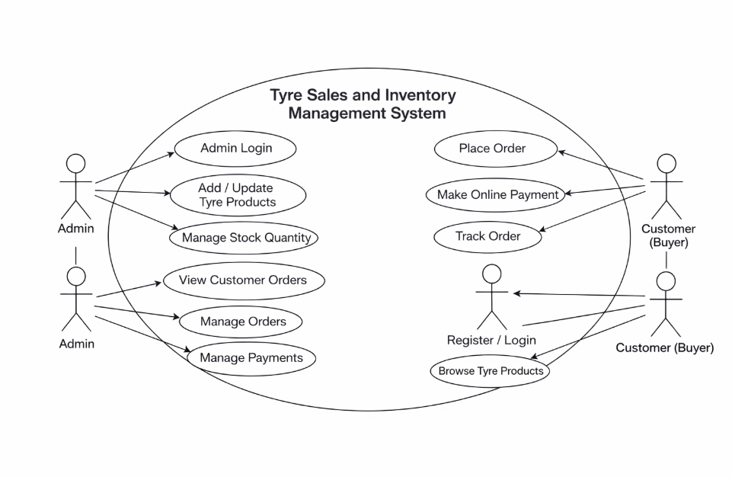
USECASE DIAGRAM

Slide 11
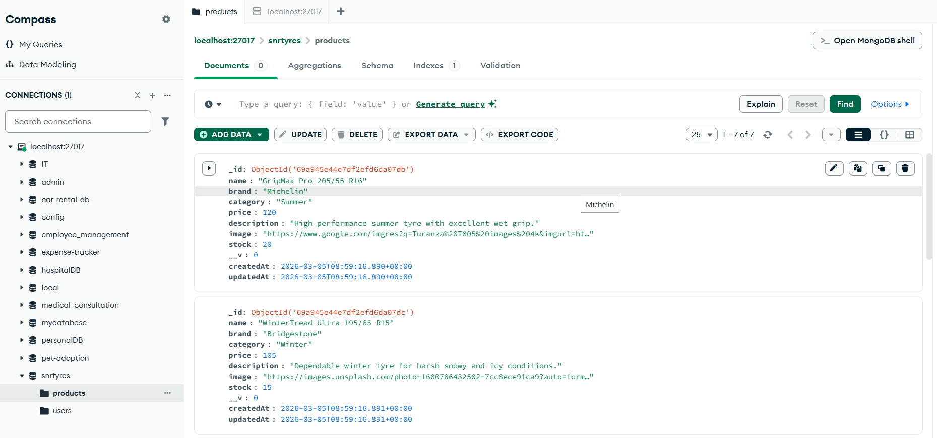
Database

Slide 12
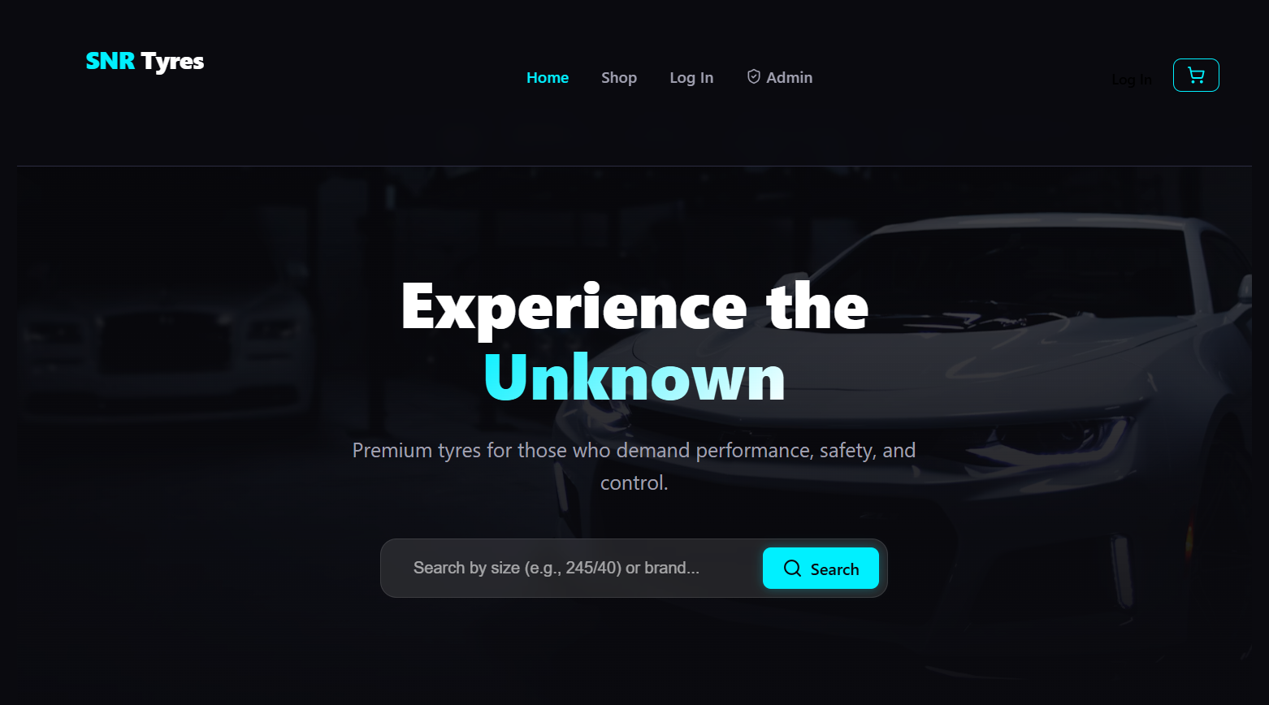
HOME PAGE

Slide 13
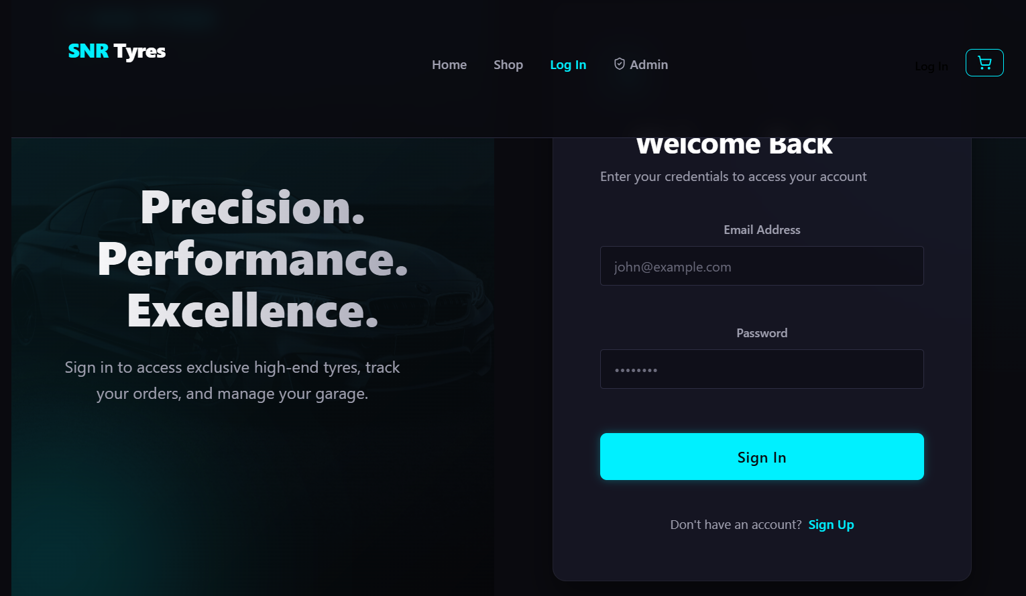
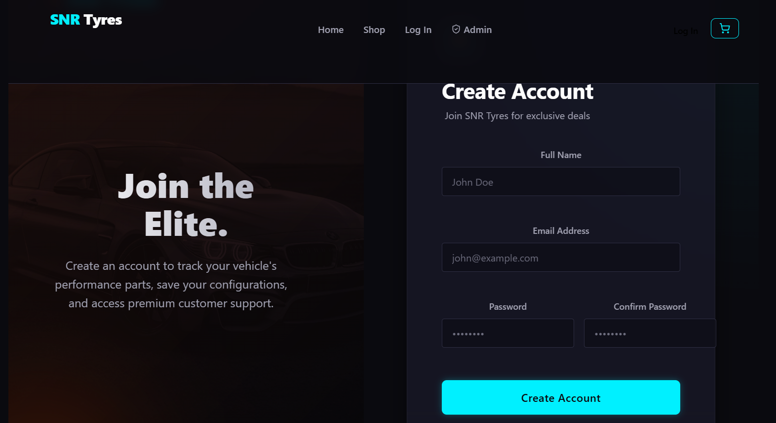
LOGIN PAGE & REGISTER PAGE

Slide 14
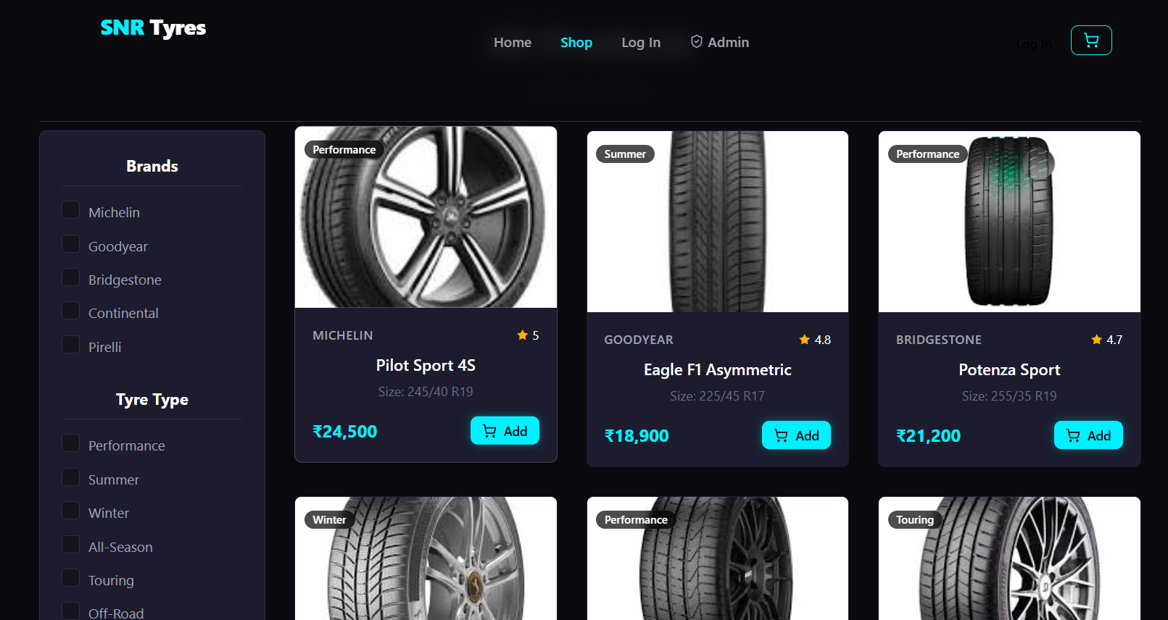
SHOP PAGE

Slide 15
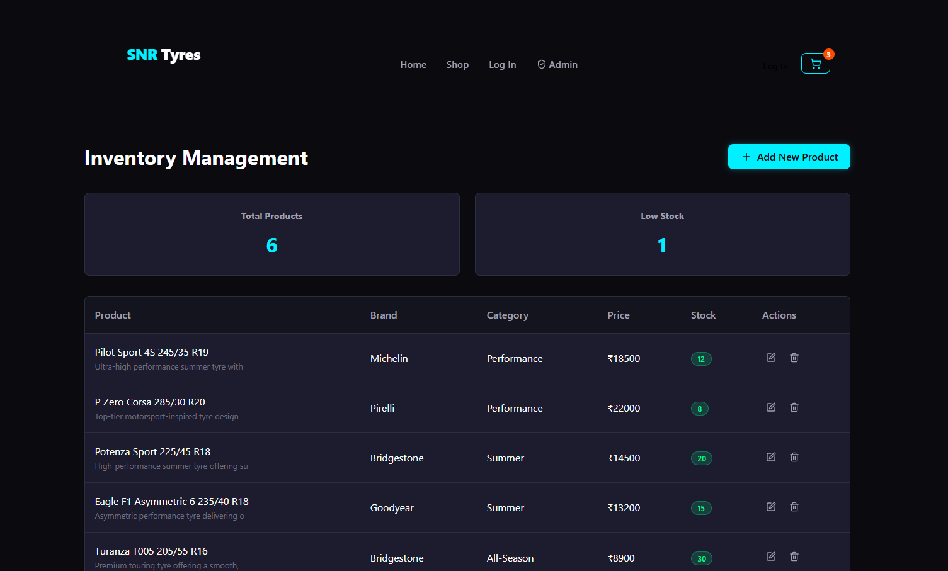
INVENTORY PAGE

Slide 16
REFERENCES
Online Resources:
https://www.jktyre.com/
https://react.dev/reference/react
https://nodejs.org/docs/latest/api/
https://www.mongodb.com/docs/

Slide 17
KEC-IT
THANK YOU
17

