Slide 1



Proforma Invoice Generator and Email Sending System
DONE BY:
Kavin Kharthik AP – 23ITR082
Pranesh Babu TJ -23ITR117
PROJECT MENTOR:
Ms.T.S.Vishnu Priya
Associate Professor/Department of IT
Kongu Engineering College
JAIHARI D (19ITR028)

Slide 2
Objectives
To develop a web-based application for Proforma Invoice generation
To automate invoice creation and generate invoices in PDF format
To implement client–server communication for secure data processing
To enable email sharing of generated invoices

Slide 3
COMPANY DETAILS
Company Name: SRI CHAKRI TRADERS
Company Address: 222, C1, P.K.M.R. Nagar,Dharapuram Road, Tirupur – 641 604
GST Number: 33DMSPD3047K1ZV
Email ID: srichakritraderstup@gmail.com
Contact Number: 8072202136
Contact Person: Mrs. T.J. Durga

Slide 4
Technology Stack
Frontend: React, TypeScript, Vite, CSS
Backend: Node.js, Express.js
Database: MongoDB
PDF Generation: pdf-lib
Email Service: Brevo (Sendinblue), Nodemailer
Deployment: Vercel (Frontend), Render (Backend)

Slide 5
Front-End Development
Admin Dashboard – Secure login, manage company logo, GST details, and tax settings.
User Dashboard – Enter receiver and order details using a structured form.
Dynamic Invoice Creation – Add/remove items, automatic calculation of amount, tax, and total.
PDF & Email Generation – Generate professional invoice PDF and send it to customer via email.

Slide 6
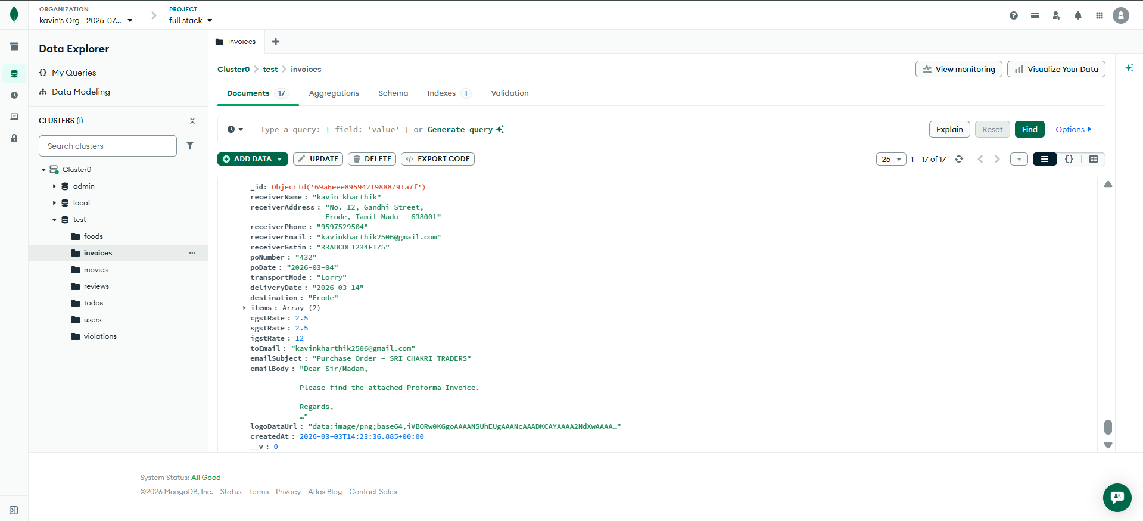
Core Tables in DBMS (MongoDB)

Slide 7
Cloud Deployment
Our frontend is deployed on Vercel to make the invoice system available online.
Our backend runs on Render to handle invoice processing and PDF generation.
We use MongoDB Atlas to store customer and invoice data securely.
We use Brevo to send invoice PDFs to customers by email.

Slide 8
API References
POST /api/generate-pdf
Generates a Proforma Invoice PDF
Includes company logo and UPI QR code
Can download PDF
POST /api/generate-and-email-pdf
Generates PDF and sends it via email
Sends email using Brevo (Sendinblue) transactional email API
Returns success/error message

Slide 9
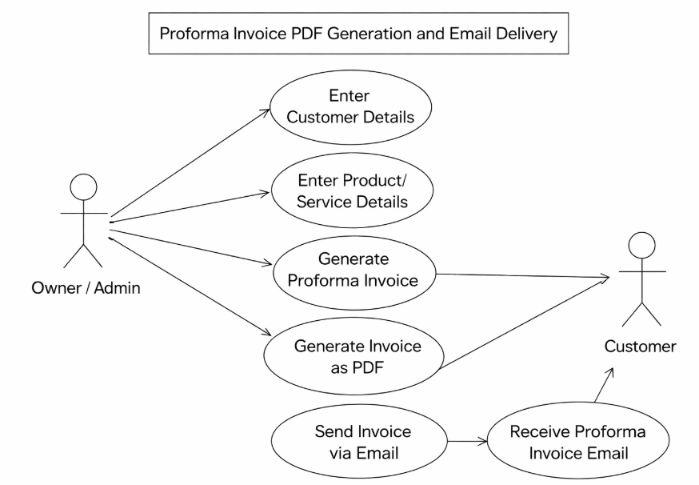
USECASE DIAGRAM

Slide 10
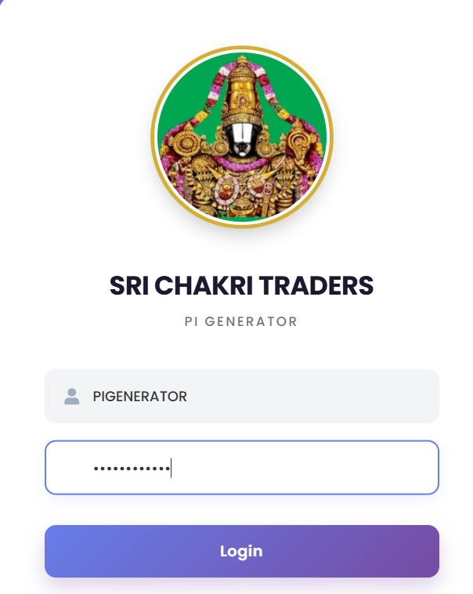
OUTPUT SCREENSHOTS
Login page

Slide 11
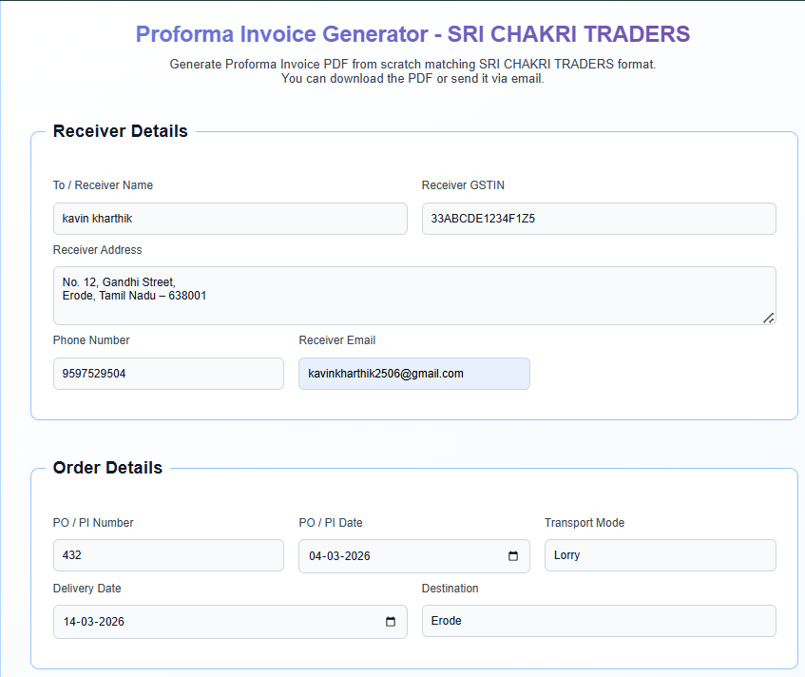
Proforma Invoice Generator

Slide 12
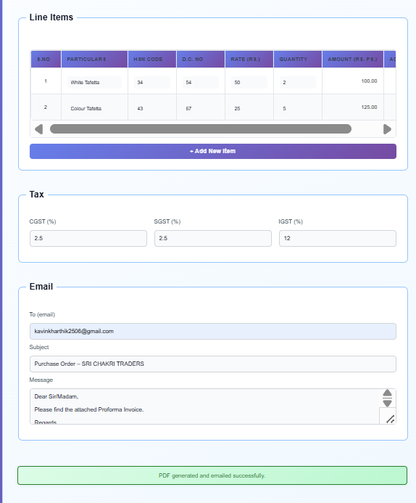

Slide 13
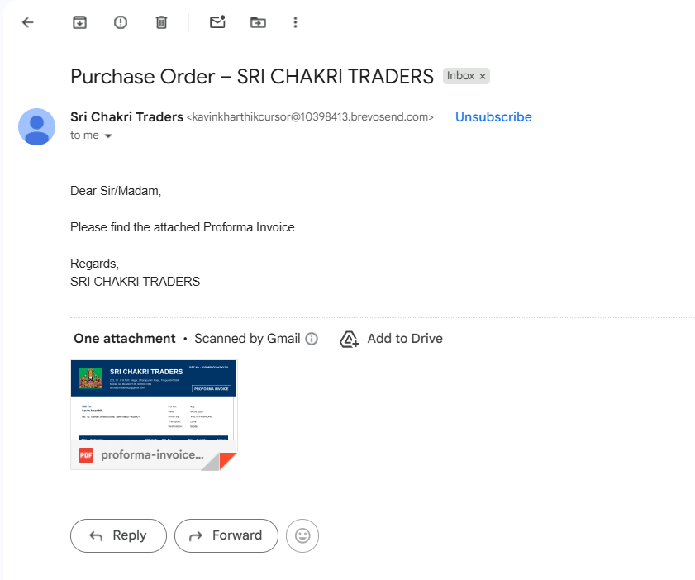
Receiver’s Email

Slide 14
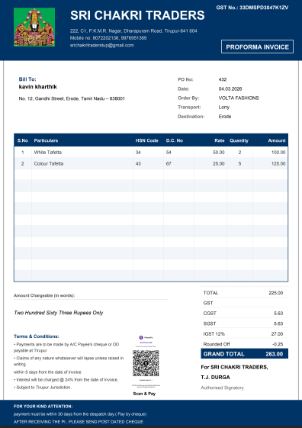
Receiver’s PDF

Slide 15
CONCLUSION
The system automates proforma invoice generation, reducing manual work and errors.
Invoices are sent directly to the receiver’s email, ensuring fast and reliable communication.
The payment feature improves the transaction process and enhances customer convenience.

Slide 16
REFERENCES
https://nodejs.org/docs/latest/api/
https://expressjs.com/
https://pdf-lib.js.org/
https://nodemailer.com/
https://www.mongodb.com/docs/
https://developers.brevo.com/docs/getting-started

Slide 17
Thank you!

