Slide 1
Academic Performance and Risk Analysis
Key Findings and Recommendations
Generated: 10 August 2026, 01:38 PM
Query: "Create a short management presentation showing the most important performance findings."

Slide 2
At-Risk Students Overview
Student Name | Department | Marks | Attendance (%) | CGPA | Status
Arun Kumar | Computer Science | 92.50 | 95.00 | 9.20 | Active
Priya Sharma | Mechanical Engineering | 88.00 | 91.00 | 8.80 | Active
Vikram Singh | Electrical Engineering | 45.00 | 65.00 | 5.40 | Probation
Neha Patel | Computer Science | 78.00 | 85.00 | 7.80 | Active
Suresh Kumar | Electrical Engineering | 40.00 | 60.00 | 4.90 | Probation

Slide 3
CGPA Performance Metrics
Average CGPA: 7.22
Highest CGPA: 9.20 (Arun)
Lowest CGPA: 4.90 (Suresh)
The average CGPA indicates a satisfactory overall performance, but there are significant individual variations.

Slide 4
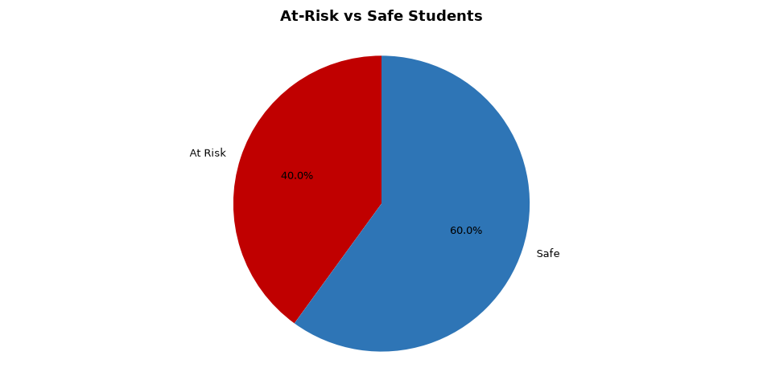
Risk Distribution

Slide 5
Departmental Performance and Intervention Needs
Electrical Engineering department requires immediate academic counseling intervention
Targeted intervention in the Electrical Engineering department could significantly improve overall academic performance and reduce the number of at-risk students.

Slide 6
Recommendations for Improvement
Enhance attendance monitoring
Provide targeted academic counseling
Regularly review student performance

Slide 7
Conclusion
Key performance findings
Recommendations for improvement
Implementing these recommendations can lead to improved academic performance and a reduction in the number of at-risk students.

