Slide 1
Mechanical Stimuli Based Touch and Tap Sensor to render resistive Output
Kamalesh Roy
kroy.nano21@gmail.com
roykamalesh.acdm@gmail.com

Slide 2
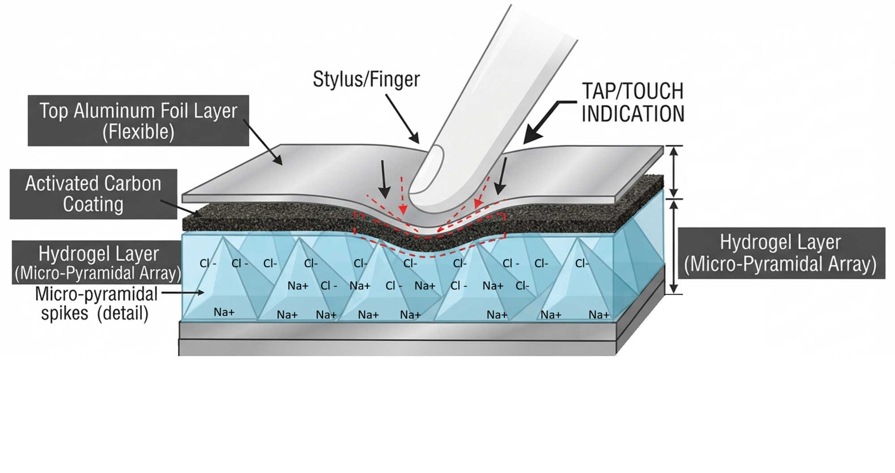
Pyramidal PVA Hydrogel Structures Soaked in NaCl Electrolyte
Converts touch into Resistance change

Slide 3
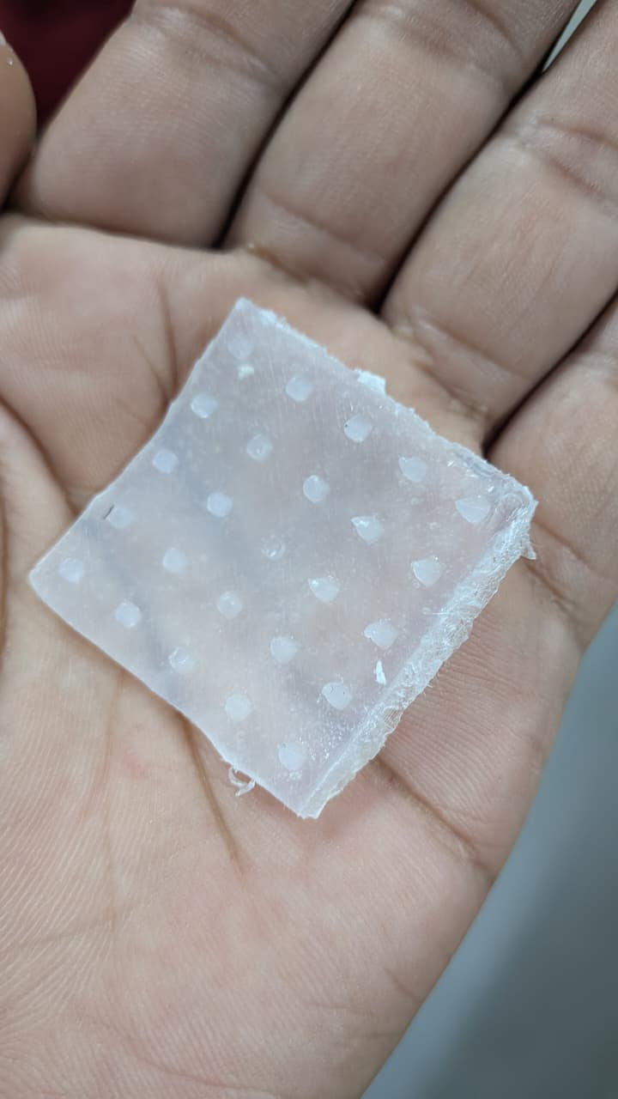
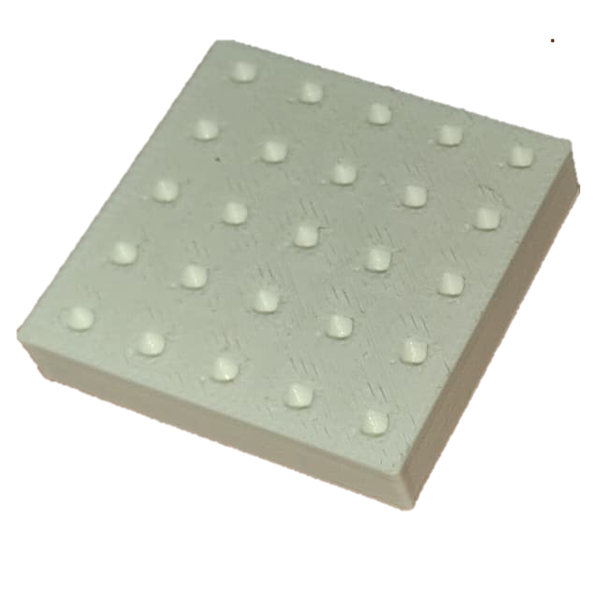
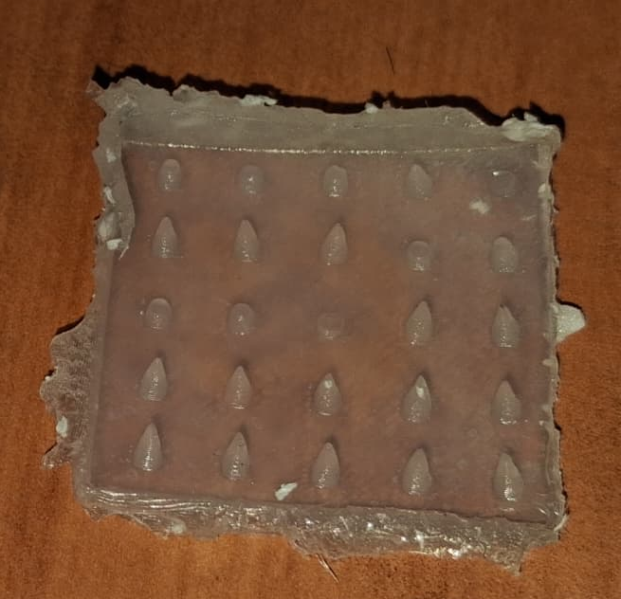
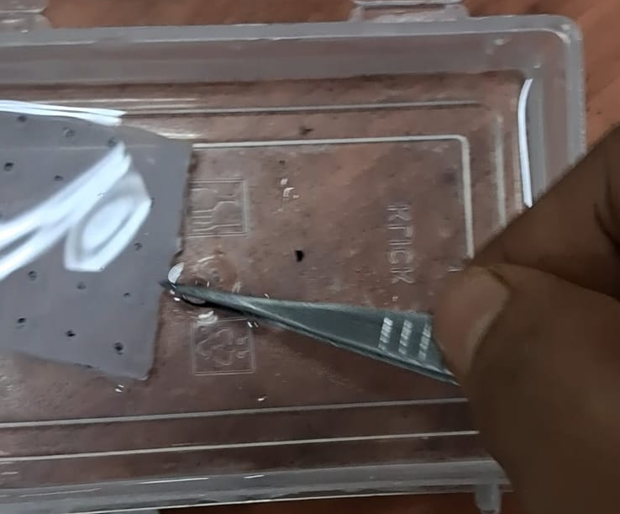
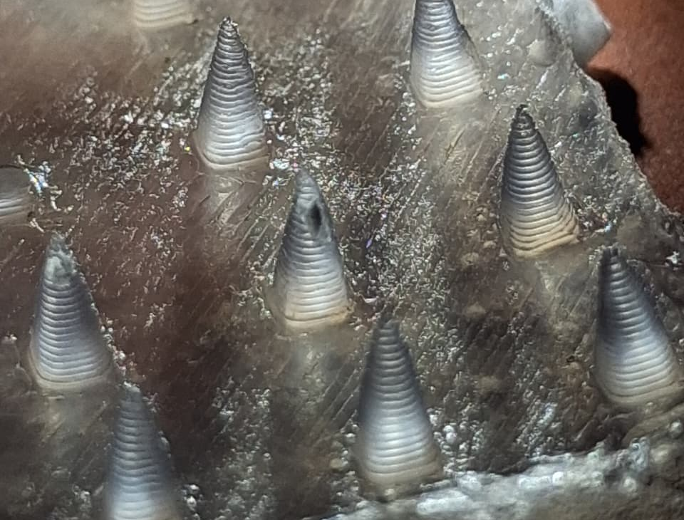
3D Printed PLA Template
PVA Hydrogel
Casting, 13% PVA
3 Cycles of Freezing & Thawing,
(20 hr at -20 degree C) and 4 hr at Room temperature.
Making The gel conductive with Electrolyte immersion

Slide 4
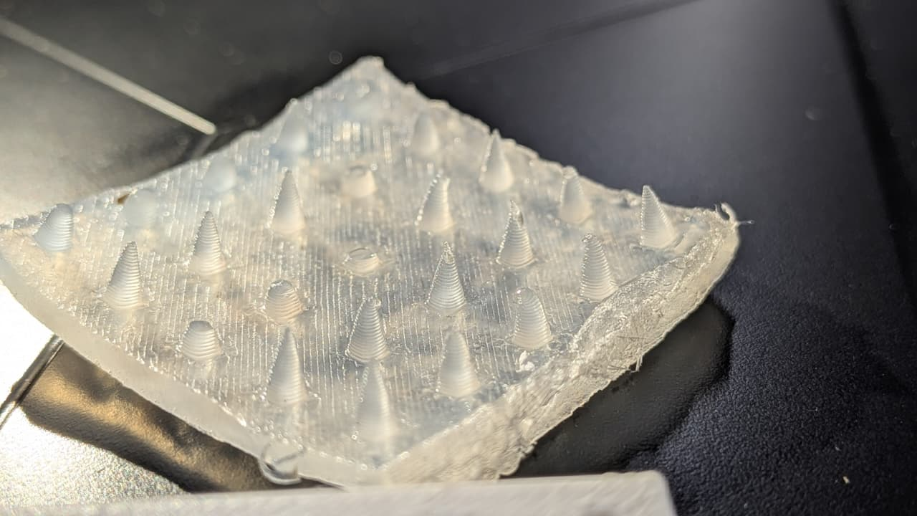
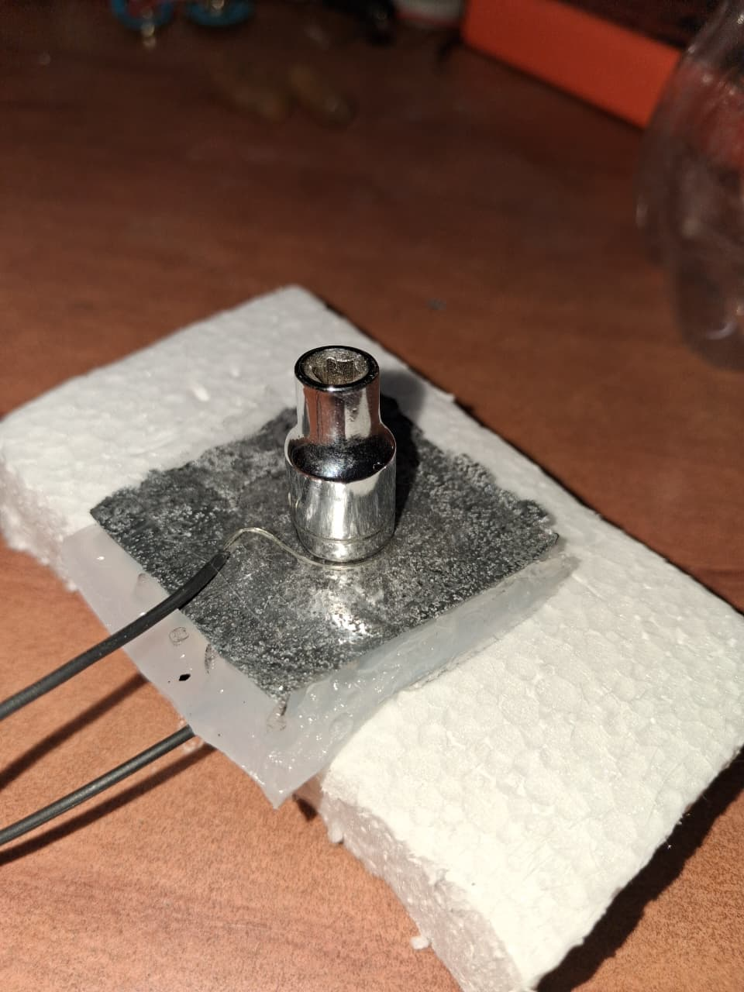
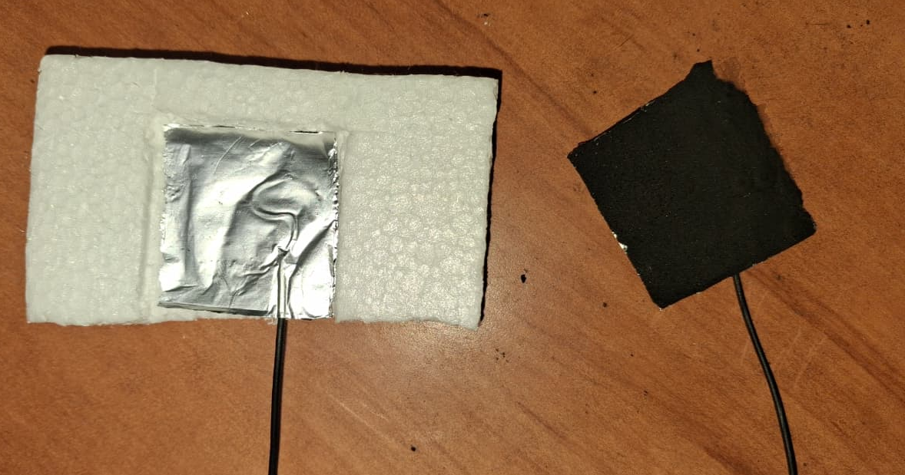
Hydrogel Layer with Pyramidal Needles after 3 cycles of Freezing & Thawing
Hydrogel Layer between two electrode with weight.
Bottom Electrode, Al Sheet
Top Electrode, Al Sheet Coated with Activated Carbon Paint

Slide 5
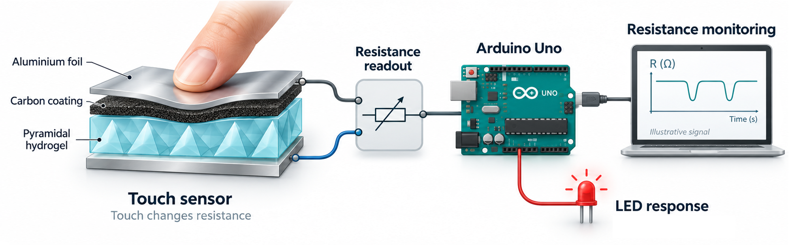
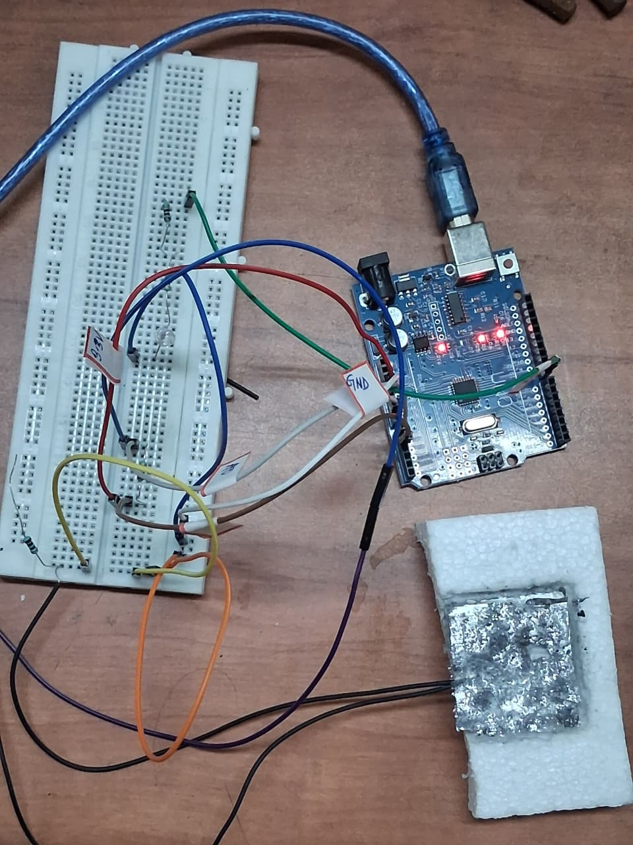
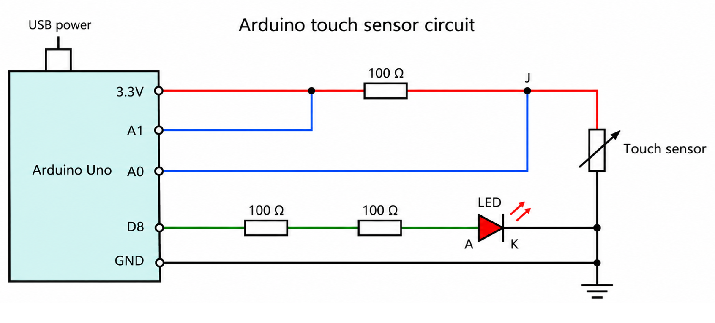
Arduino Uno
Touch Area
Fig. Circuit Design, Uno Integration

Slide 6
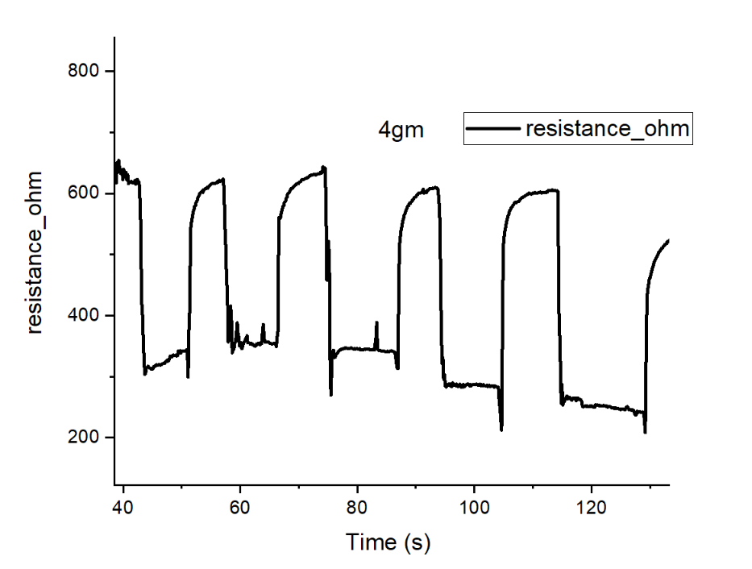
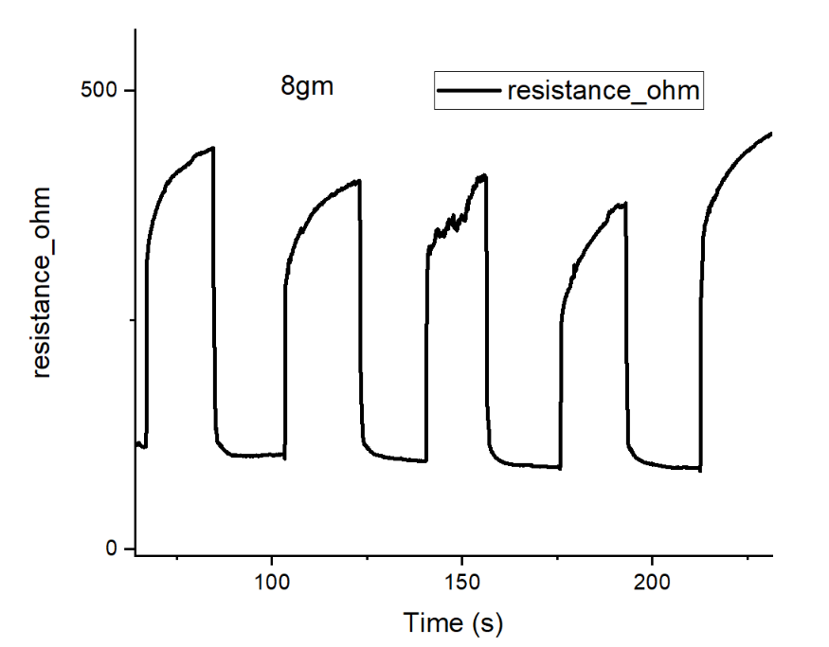
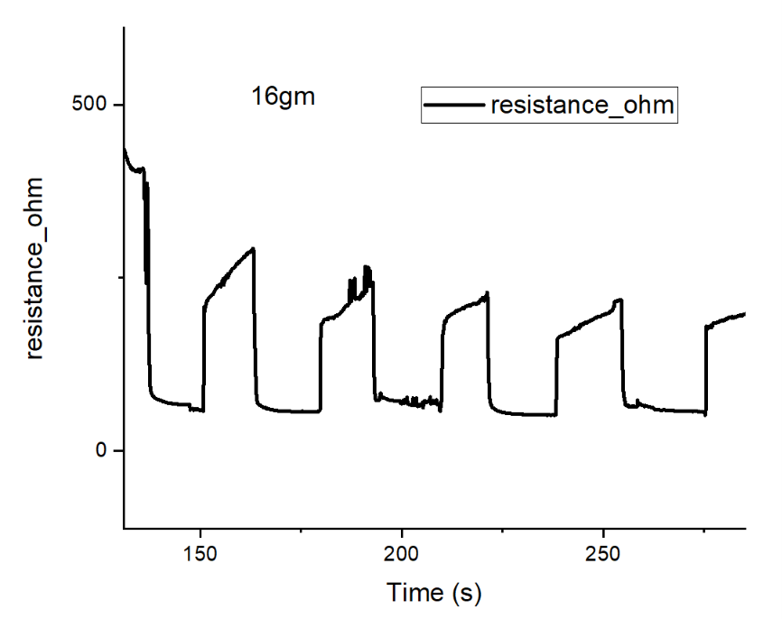
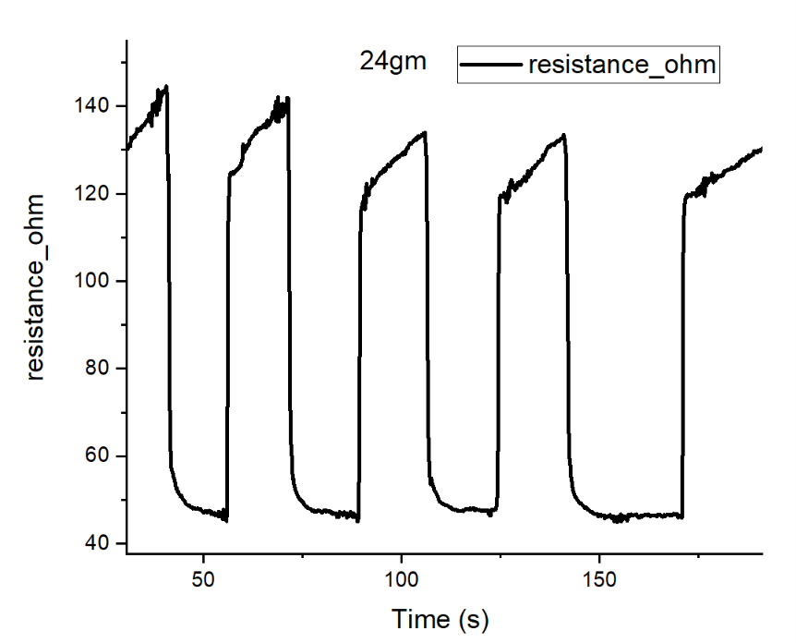
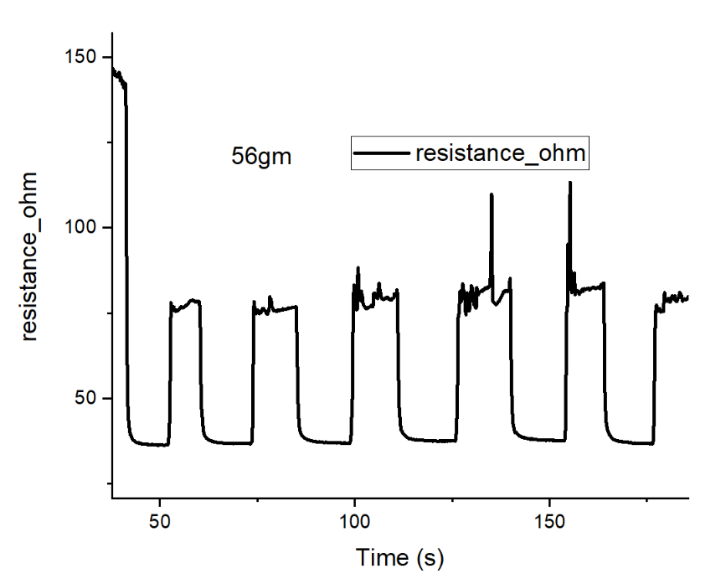
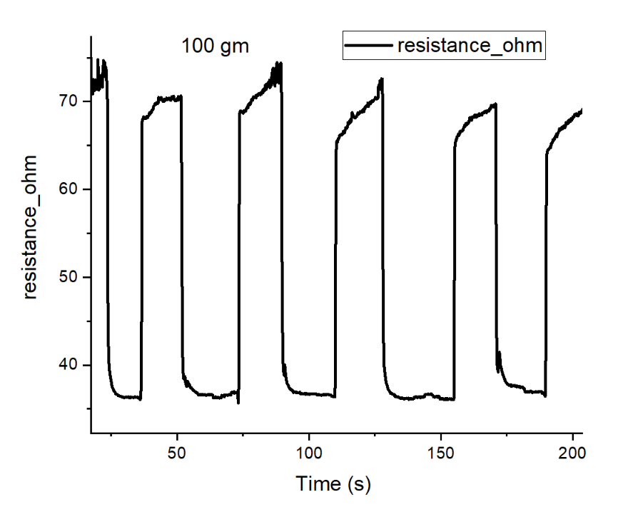
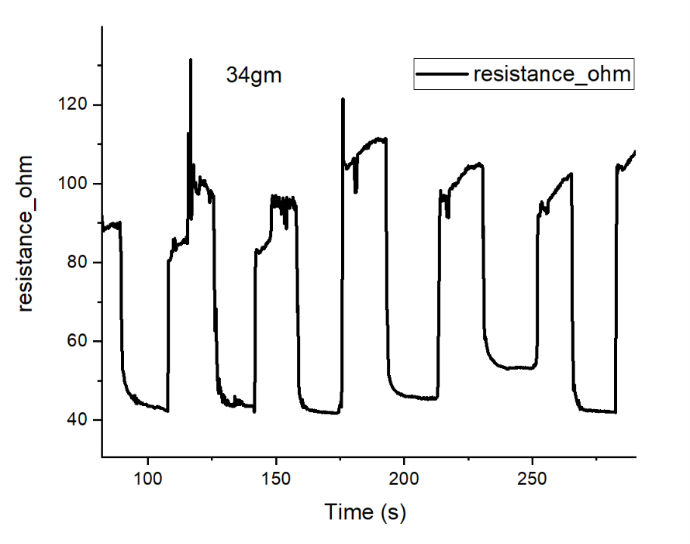
Fig. : Changes in resistance under various weight from 4gm to 100 gm. As the Pyramidal structures have some thawing problem hence the baseline is mostly varying. (Needs to be optimized after several rounds of freezing and thawing.)

Slide 7
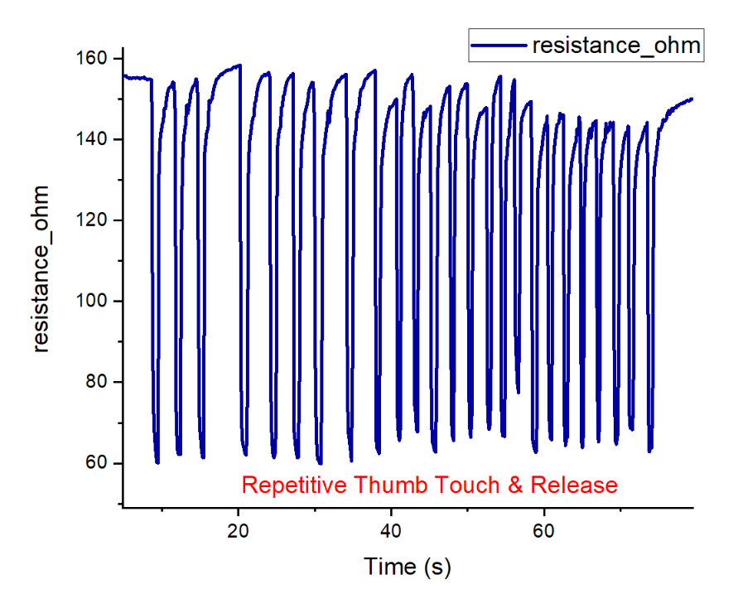
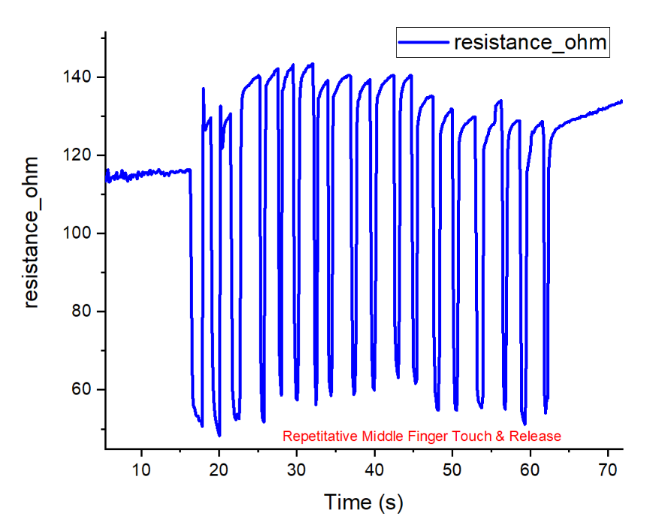
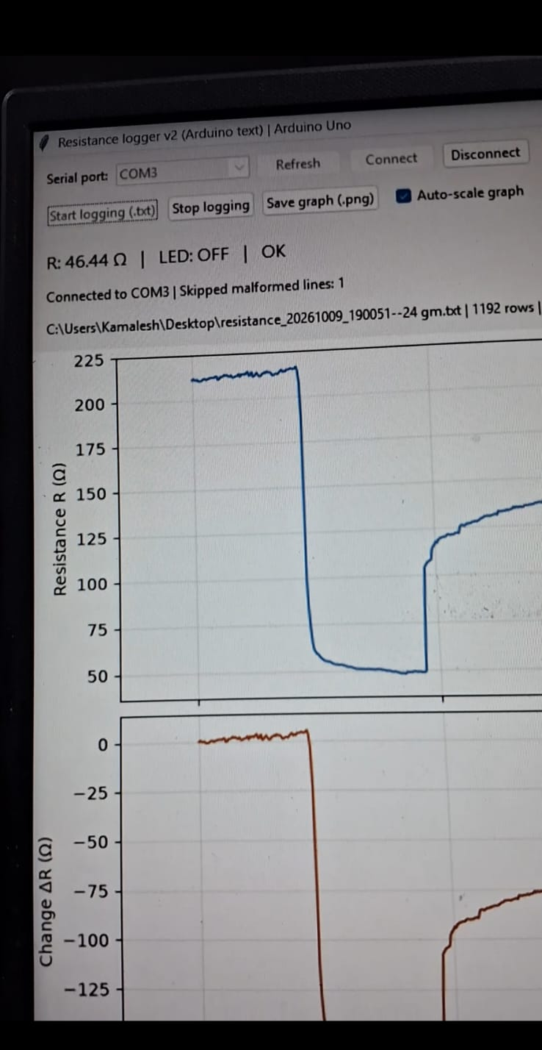
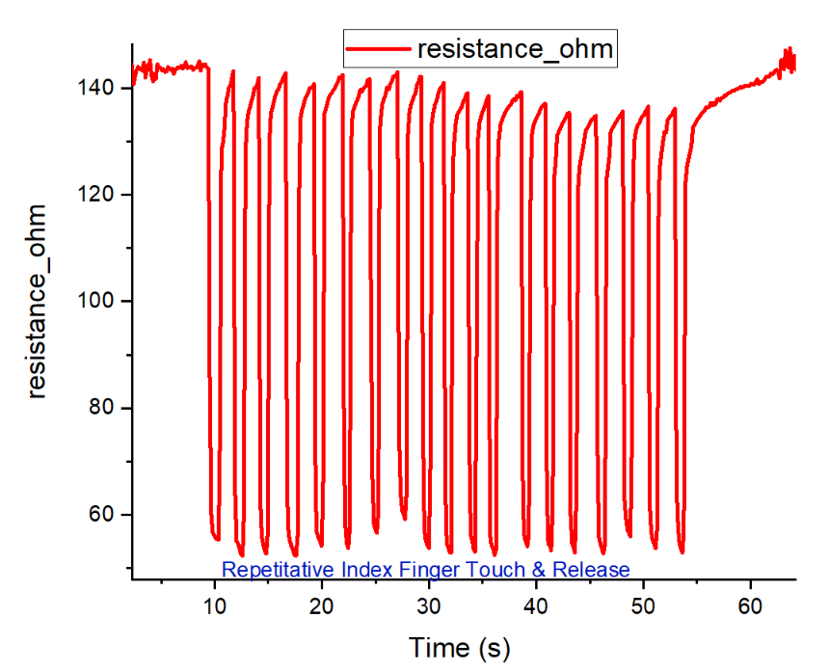
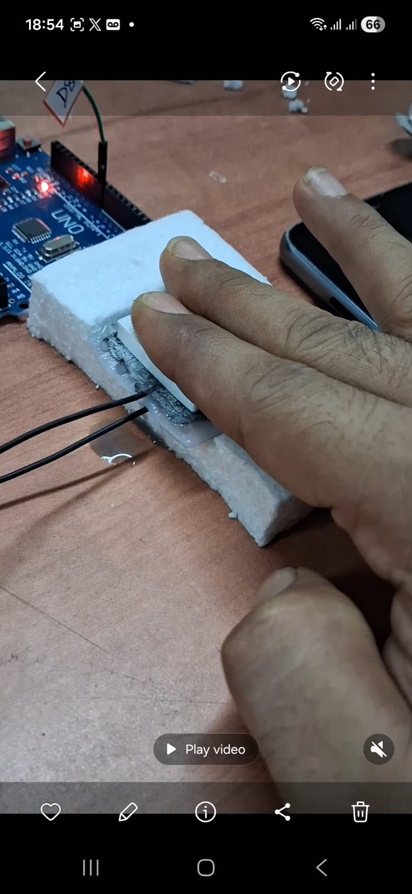
Fig. : changes in Resistance under various finger touch and release.

Slide 8
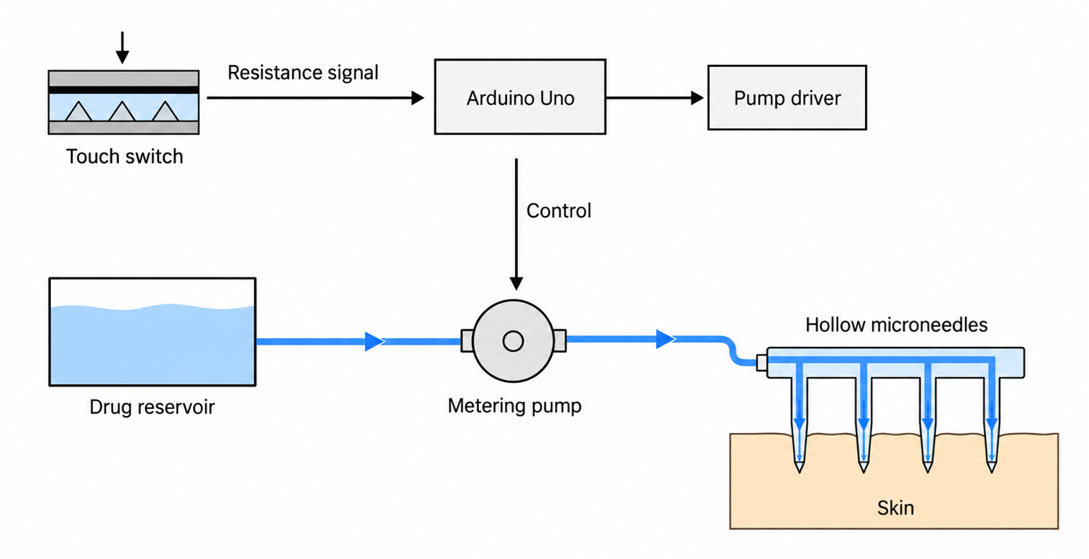
Potential Utility : Touch Controlled Precision Dosing of Drug

Slide 9
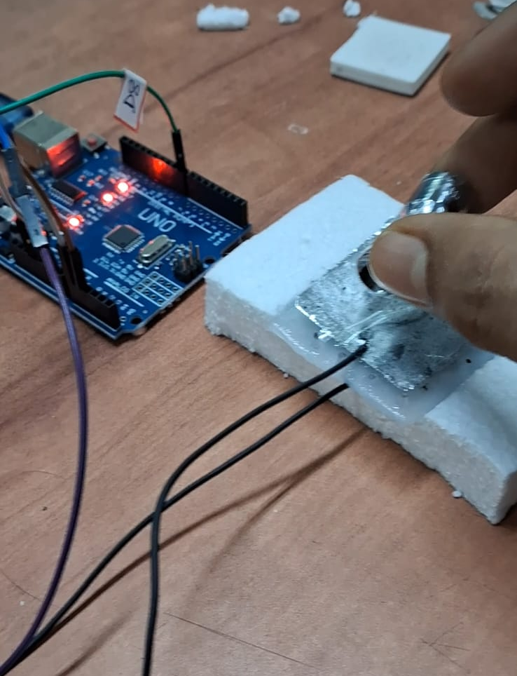
Various Images.

