Slide 1




Digital Portfolio
STUDENT NAME: KAMALESH M
REGISTER NO AND NMiD:astvu32332324u18020 DEPARTMENT:Bsc.computer science COLLEGE: Voorhees college

Slide 2


PROJECT TITLE
Personal Digital Portfolio Website Using front end web develop
■

Slide 3

AGENDA
1. Problem Statement
2. Project Overview
3. End Users
4. "ools and Technologies
5. Portfolio design and Layout
6. eatures and Functionality
7. Results and Screenshots
8. Conclusion
9. Github Link

Slide 4

PROBLEM STATEMENT
In today’s digital era, students and professionals need an effective way to showcase their skills, projects, and achievements beyond traditional paper resumes. A static resume often fails to highlight interactive elements such as project demonstrations, contact forms, and responsive design for mobile users. Therefore, there is a need for a digital portfolio website that provides an engaging, accessible, and professional platform where a student can present their personal information, technical skills, academic background, and project work in an organized manner. This portfolio will serve as a personal brand identity and a medium to connect with recruiters, teachers, or collaborators.

Slide 5


PROJECT OVERVIEW
The Digital Portfolio Website is a personal web-based application developed using HTML
CSS, and JavaScript. It is designed to provide an interactive platform for showcasing an individual’s academic details, technical skills, projects, and contact information in a professional manner.
The website consists of multiple sections such as About Me, Skills, Projects, and Contact Form, making it easy for visitors to navigate and learn more about the student. The use of CSS ensures an attractive and responsive layout, while JavaScript adds interactivity, such as form validation and dynamic features like downloading a resume.

Slide 6
WHO ARE THE END USERS?
• Students / The Portfolio Owner
• Recruiters / Employers
• Teachers / Academic Mentors
• General Visitors / Peers

Slide 7
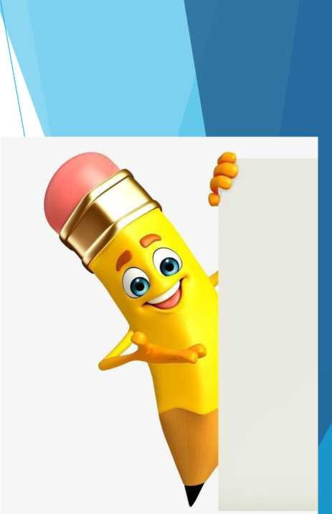

TOOLS AND TECHNIQUES
1. HTML (HyperText Markup Language) - for creating the structure of the website (sections like About, Skills, Projects, Contact).
2. CSS (Cascading Style Sheets) - for styling, layout design, colors, fonts,and making the site visually attractive and responsive.
3. JavaScript - for adding interactivity, such as form validation, Resume download button, and dynamic behavior.
4. Code Editor (VS Code / Sublime / Notepad++) - used to write and manage the code files.
NOTE: hosting platform by the github pages

Slide 8

POTFOLIO DESIGN AND LAYOUT
Header Section
• Contains the student’s name, a short tagline (e.g., “Web Development Learner”), and a Resume Downl
• Positioned at the top of the page with a highlighted background for visibility.
About Me Section
• Provides a brief introduction about the student.
• Includes details like academic background, interest in web development, and career goals.
Skills Section
• Displays a list of technical skills (HTML, CSS, JavaScript, etc.).
• Presented in a bullet-point or grid layout for easy readability.
Projects Section
• Highlights the student’s completed projects with titles and short descriptions.
• Each project is placed inside a card-style layout with proper spacing.
Contact Section
• Contains a contact form (name, email, message fields) for visitors or recruiters to connect.
• Includes a “Send” button with JavaScript handling the form submission.
Footer Section
• Displays copyright information.
• Can include social media or GitHub/LinkedIn links.

Slide 9


FEATURES AND FUNCTIONALIT
1. Personal Branding - Displays student’s name, introduction, and career interests.
2. About Me Section - Provides details about education, passion for web development, and goals.
3. Skills Showcase - Lists technical skills (HTML, CSS, JavaScript, etc.) in an organized way.
4. Projects Section - Highlights completed projects with descriptions.
5. Contact Form - Allows visitors or recruiters to send messages directly.
6. Resume Download Option - Provides a button to download the student’s resume.
7. Responsive Design - Works seamlessly on desktops, tablets, and smartphones.
8. Clean UI/UX - Simple, user-friendly, and professional interface.

Slide 10


RESULTS AND SCREENSHOTS
• Screenshorts of each section
• Before vs after (plain HTML--
--with css&js)

Slide 11
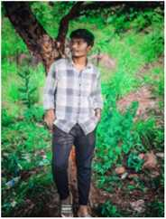
Hi, I'm KAMALESH M #
Web Developer | Designer | Learner Download Resume
About Me
I am a college student currently pursuing my degree in Computer Science with a strong interest in web development. I enjoy learning how websites are built and exploring technologies like HTML, CSS, and JavaScript to create interactive and user-friendly web pages. Along with my academic studies, I spend time working on small projects such as portfolios, to-do apps, and responsive designs to improve my skills. My goal is to become a skilled foil-stack developer and contribute to building modern, innovative web applications that solve real-world problems.
Skills
• HTML & CSS
• JavaScript
• React.js
• Python
Projects
Portfolio Website

Slide 12
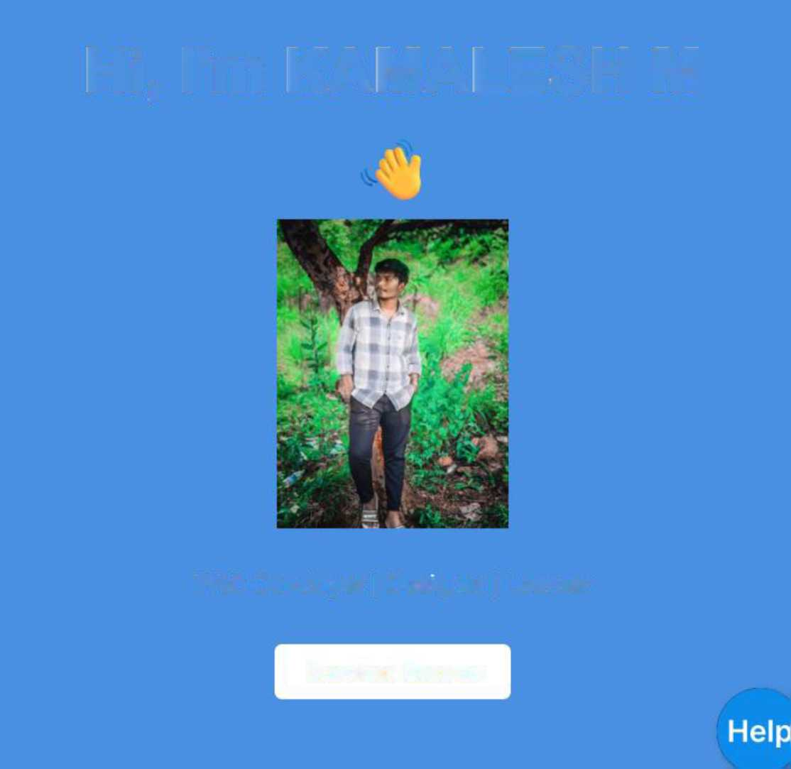
Hi, I'm KAMALESH M
£
Web Developer | Designer | Learner
Download Resume

Slide 13

About Me
I am a college student currently pursuing my degree in Computer Science with a strong interest in web development. I enjoy learning how websites are built and exploring technologies like HTML, CSS, and JavaScript to create interactive and user-friendly web pages. Along with my academic studies, I spend time working on small projects such as portfolios, to-do apps, and responsive designs to improve my skills. My goal is to become a skilled full-stack developer and contribute to building modern, innovative web applications that solve real-world problems.
Skills
• HTML & CSS
* JavaScript
• React.js
* Python

Slide 14
Projects
Portfolio Website
A personal portfolio site built using HTML, CSS, JS.
To-Do App
Task management app built with JavaScript.

Slide 15
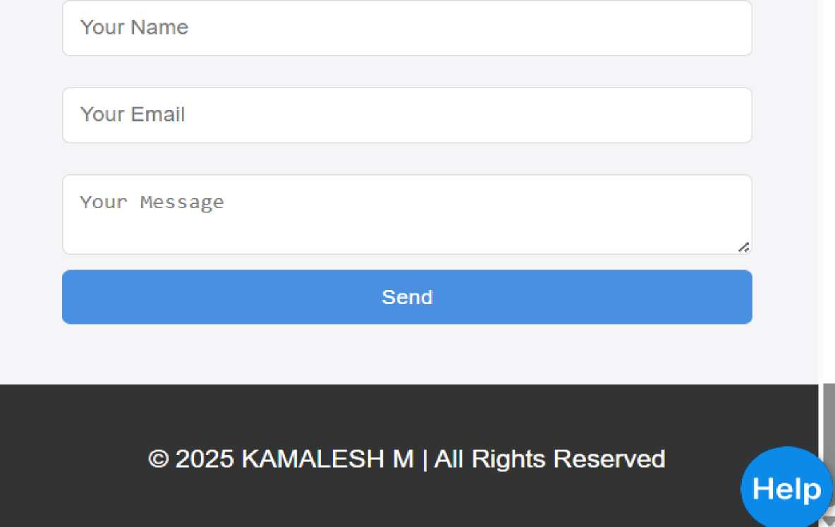
Contact Me

Slide 16

CONCLUSION
The Digital Portfolio Website successfully demonstrates the application of HTML, CSS, and JavaScript in building a responsive and interactive personal website.
It provides a structured platform for showcasing an individual’s academic background skills, projects, and contact details in a professional and visually appealing manner.
Through this project, the student has gained practical knowledge of front-end web development, responsive design principles, and basic interactivity using JavaScript. The website not only acts as a modern replacement for a traditional resume but also enhances the student’s online presence, making it easier for recruiters, mentors, and peers to evaluate their skills and connect with them.

