Slide 1
IBM University Engagement Project Submission
“Vyapar Mitra”
Agentic AI for Street Vendor Digitalization & Financial Inclusion
IBM watsonx.ai • IBM Granite AI • IBM Bob
Problem Statement #29 – Street Vendor Digitalization Agent

Slide 2

Project Domain & Title
DOMAIN
PROJECT TITLE
Financial Inclusion • Small Business Digitalization • Agentic AI
Vyapar Mitra – Street Vendor Digitalization & Micro-Credit Agent
CORE IDEA
A multilingual AI assistant that helps street vendors build a digital storefront, track micro-business finances, access government schemes, understand local market opportunities and generate digital payment / promotional assets.
Student Name | Recent Passport Photo | Email ID | Mobile number [WhatsApp]
Kamalesh M |  | Kamaleshmurugappan@gmail.com | 94874 64462

Slide 3
Problem Statement – Vyapar Mitra
The Challenge
Street vendors often operate with limited digital presence, informal bookkeeping and low access to structured financial services.
Important support such as UPI setup, government schemes, online commerce, market information and business promotion is fragmented.
Language and digital-literacy barriers make many existing tools difficult to use for everyday vendor operations.
The Objective
Provide one conversational AI agent that converts simple vendor requests into practical business actions.
Digitize payments, storefront presence, bookkeeping, scheme preparation, market insights and promotional content.
Improve financial visibility and digital readiness while keeping the experience multilingual and easy to use.

Slide 4
Proposed Solution – AI-Powered Vyapar Mitra
An agentic, modular business assistant for street vendors
Digital Onboarding
Digital Readiness Score
Micro-Accounting
Scores UPI, Maps, ONDC and government-scheme formalization, then recommends next actions.
Accepts natural-language sales/expense entries, calculates profit and exports reports.
Creates a business profile, pricing tips, UPI setup guidance and promotional assets.
Market Intelligence
Government Schemes
ONDC + Promotion
Uses knowledge/RAG data for mandi information, demand and hyperlocal selling advice.
Generates a PM SVANidhi application kit, document checklist and application steps.
Creates an ONDC-style catalogue, UPI QR and stall poster assets for digital commerce.

Slide 5
Technology Used
IBM Bob
IBM watsonx.ai
AI-assisted project development, coding and iterative implementation.
AI/model platform layer for enterprise-grade model access, deployment and governance.
IBM Granite AI Models
Agentic AI
Natural-language understanding, reasoning, response generation and personalization.
Intent routing and mode-based task execution across business functions.
RAG / Knowledge Base
FastAPI + Python
Retrieval layer for schemes, fintech guidance, platforms, mandi and supporting business knowledge.
Backend APIs, agent orchestration, ledger, catalogue, scheme and asset-generation services.
HTML / Tailwind / JS
Chart.js / Browser APIs
Responsive vendor dashboard with chat, reports, store, loan, ONDC, Maps and studio views.
Sales visualization, QR/promotion UI and interactive frontend behaviour.

Slide 6
Vyapar Mitra Agent Components & Functional Modules
Chat Input
Intent Router
Vendor query, preference or transaction text
Routes request to onboarding, score, ledger, market, loan, ONDC, Maps or poster mode
AI Agent / Granite
Interprets intent and generates the appropriate response
Micro Ledger
RAG Engine
Stores transactions and calculates sales, expenses, profit and margin
Retrieves relevant scheme, fintech, platform and market knowledge
Chat Output
Asset Generators
Returns actionable answer, checklist, report or generated business asset
UPI QR, stall poster and ONDC catalogue generation
Key design principle: one conversational entry point → specialized task execution → actionable output.

Slide 7
Vyapar Mitra Workflow
1. Vendor Input
2. Session & Profile
3. Intent Detection
4. Agentic Routing
5. Knowledge / Data
6. Granite / watsonx.ai
7. Action / Asset
8. Feedback Loop
Text / chat request
Load vendor context
Classify business task
Select specialized mode
RAG + ledger + profile
Reason + generate
Report, loan kit, catalogue, QR, poster
Update score/profile/ledger
Example: “I spent ₹300 on ice and sold fruits for ₹1,500” → intent = ledger → natural-language parsing → transaction logging → profit calculation → confirmation/report.

Slide 8
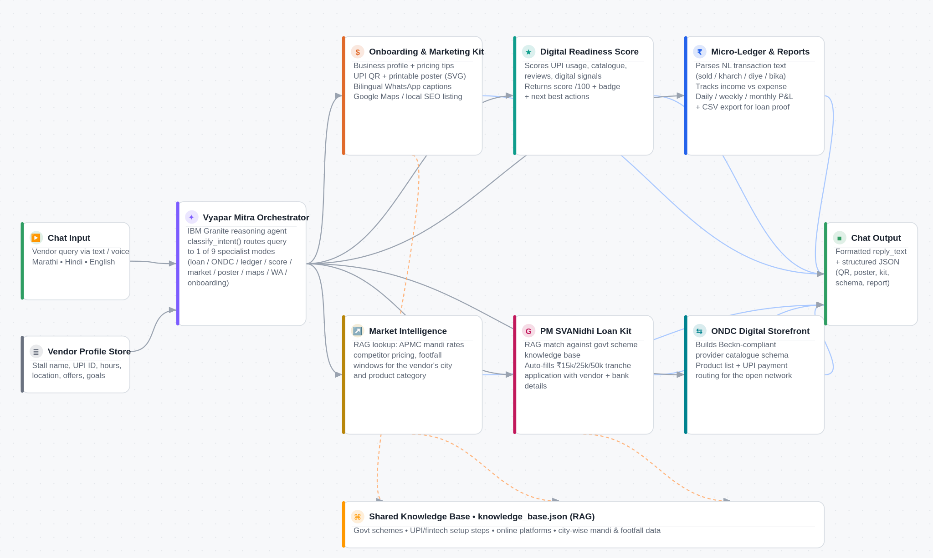

Slide 9
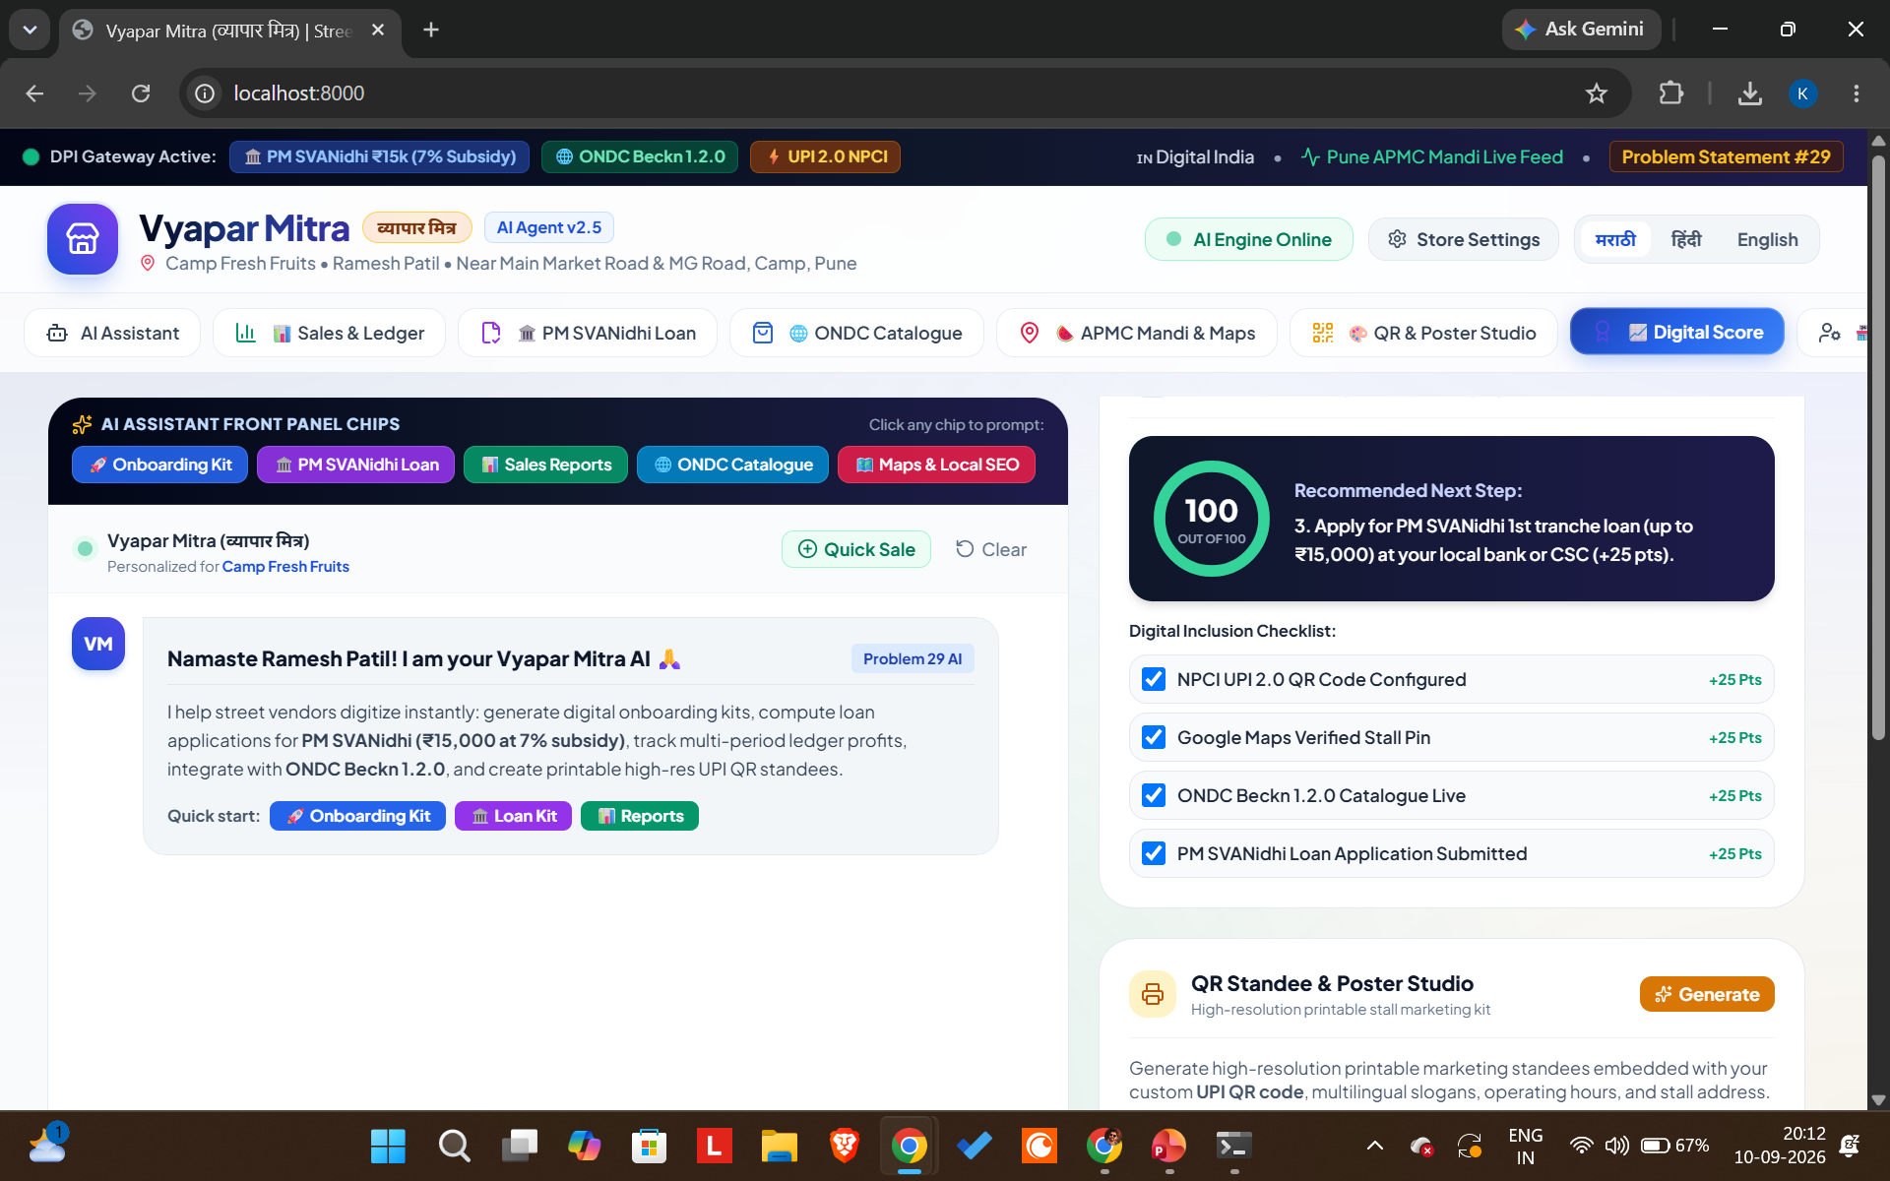

Slide 10
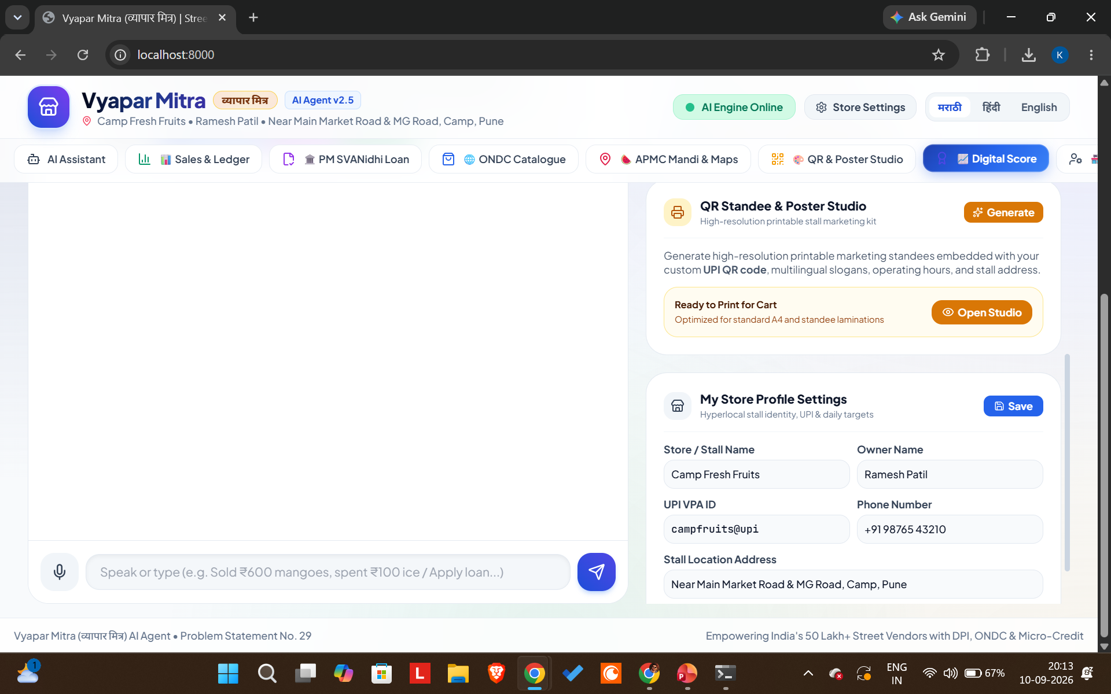

Slide 11
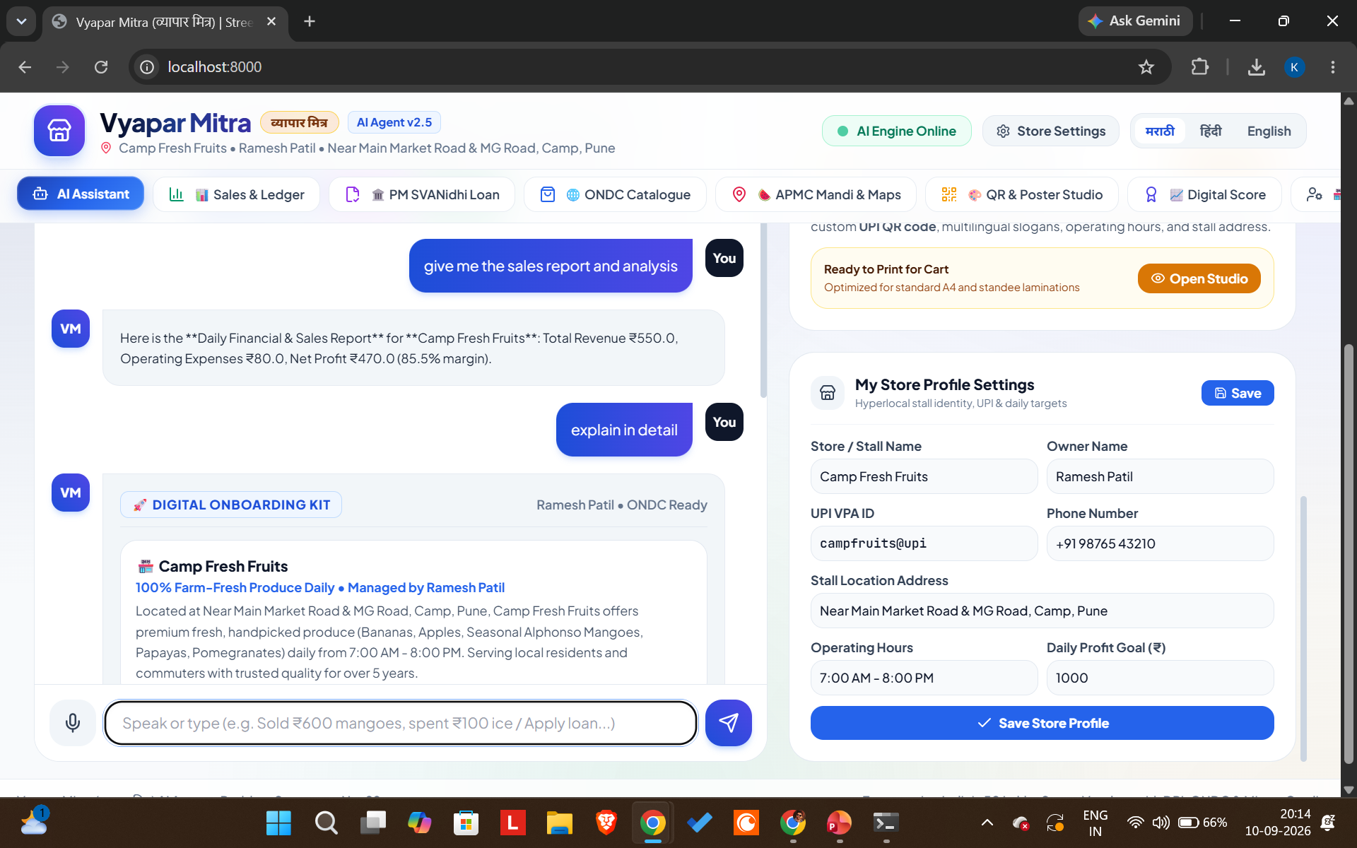

Slide 12
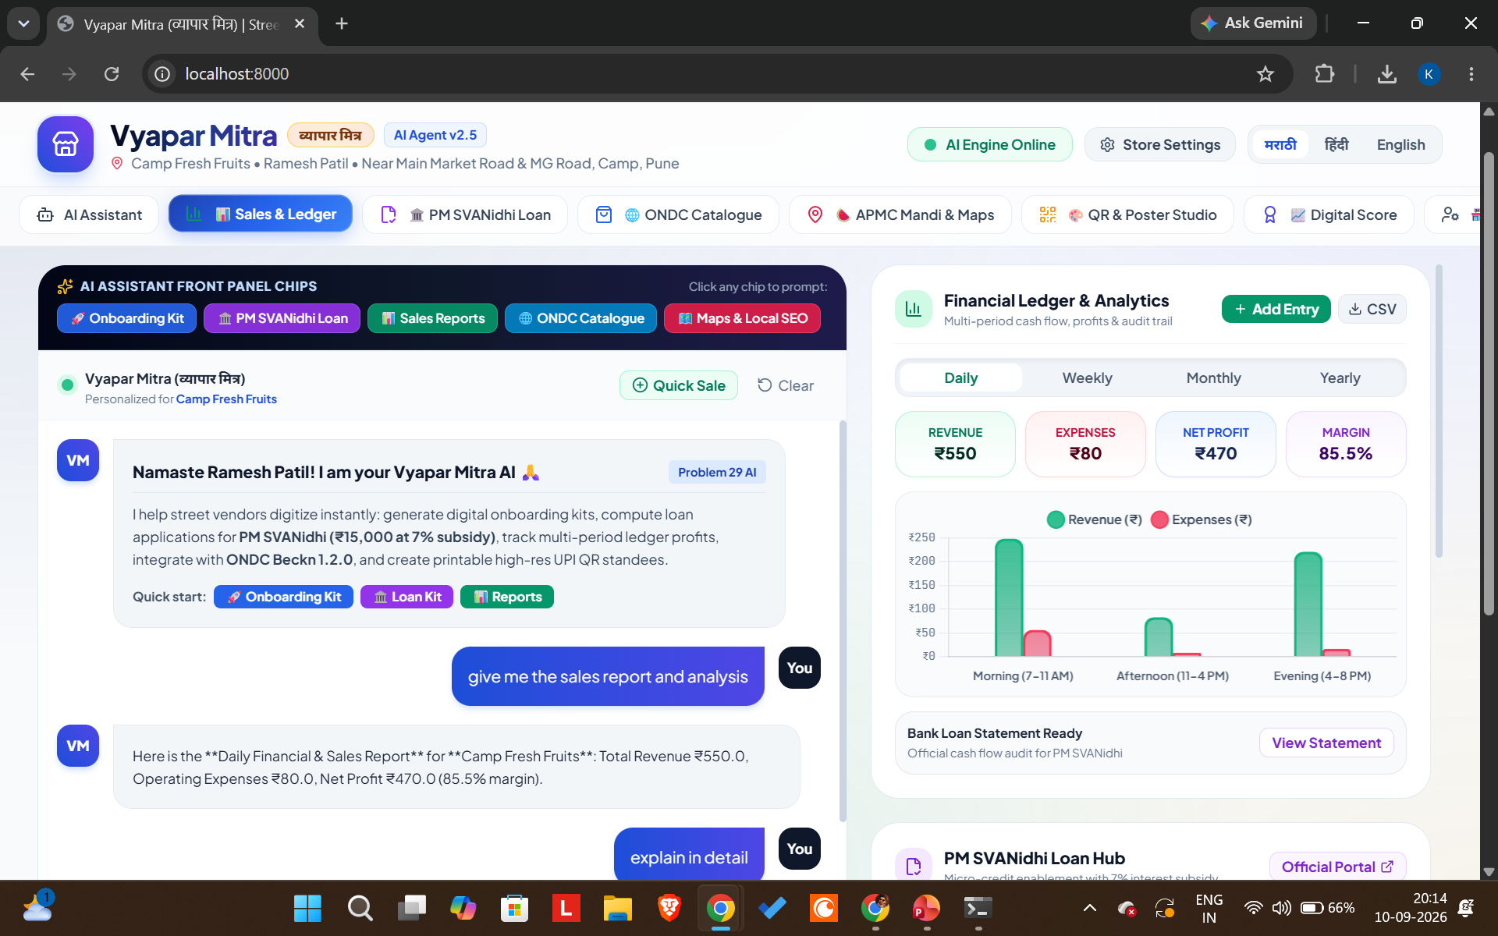

Slide 13
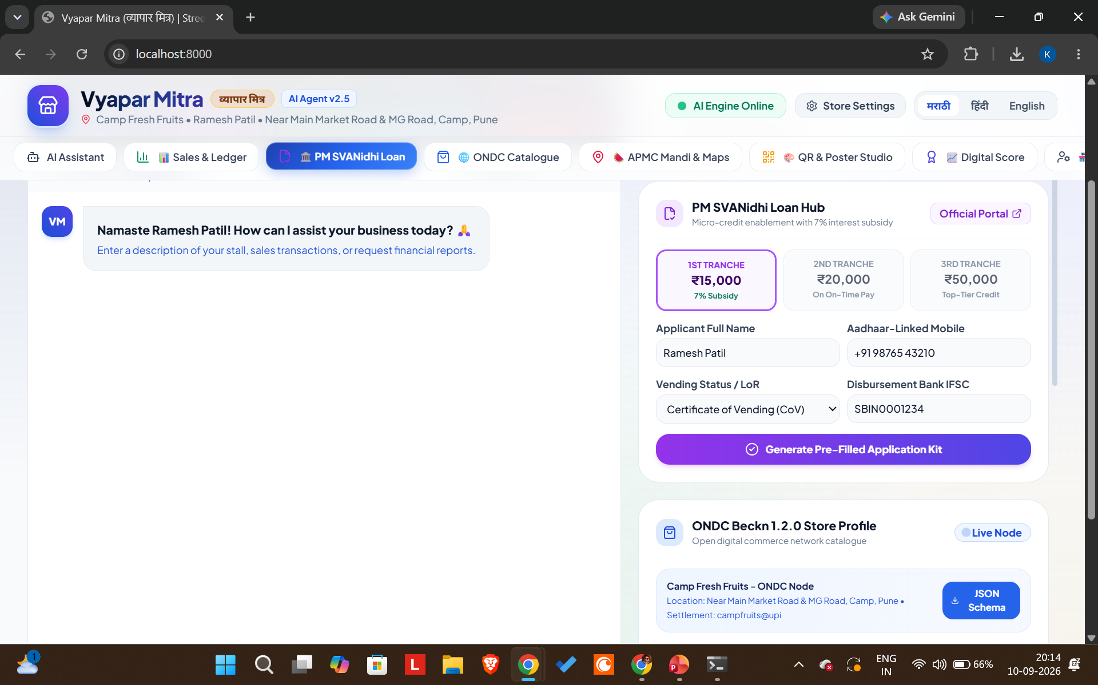

Slide 14
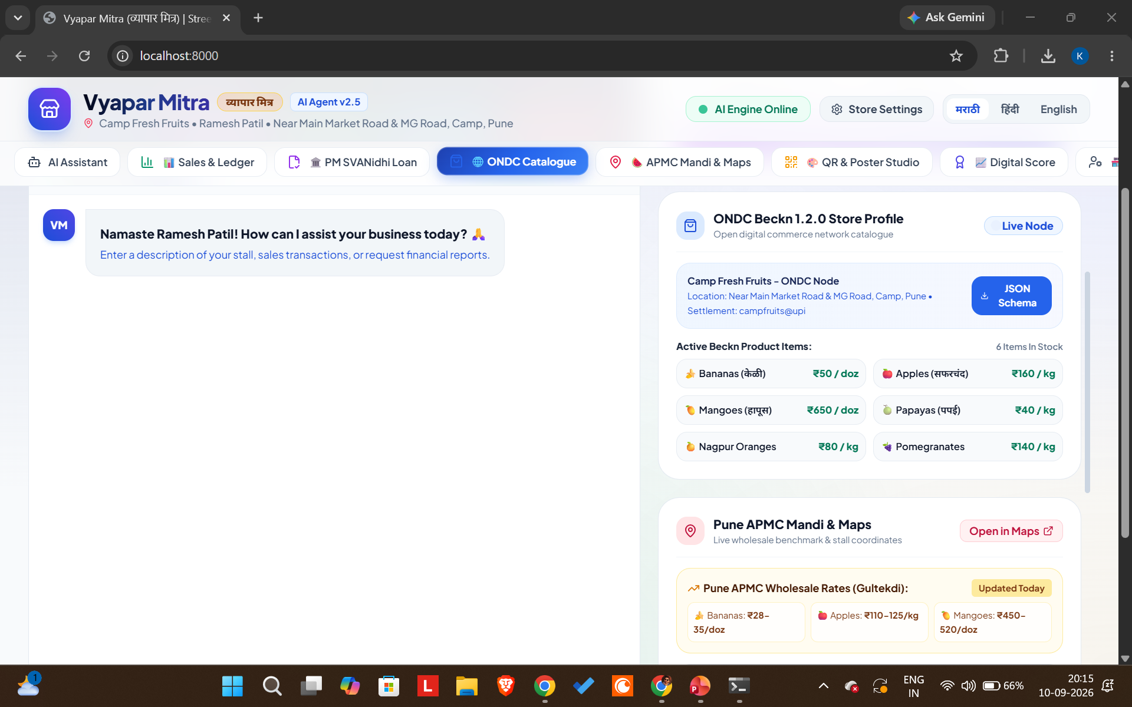

Slide 15
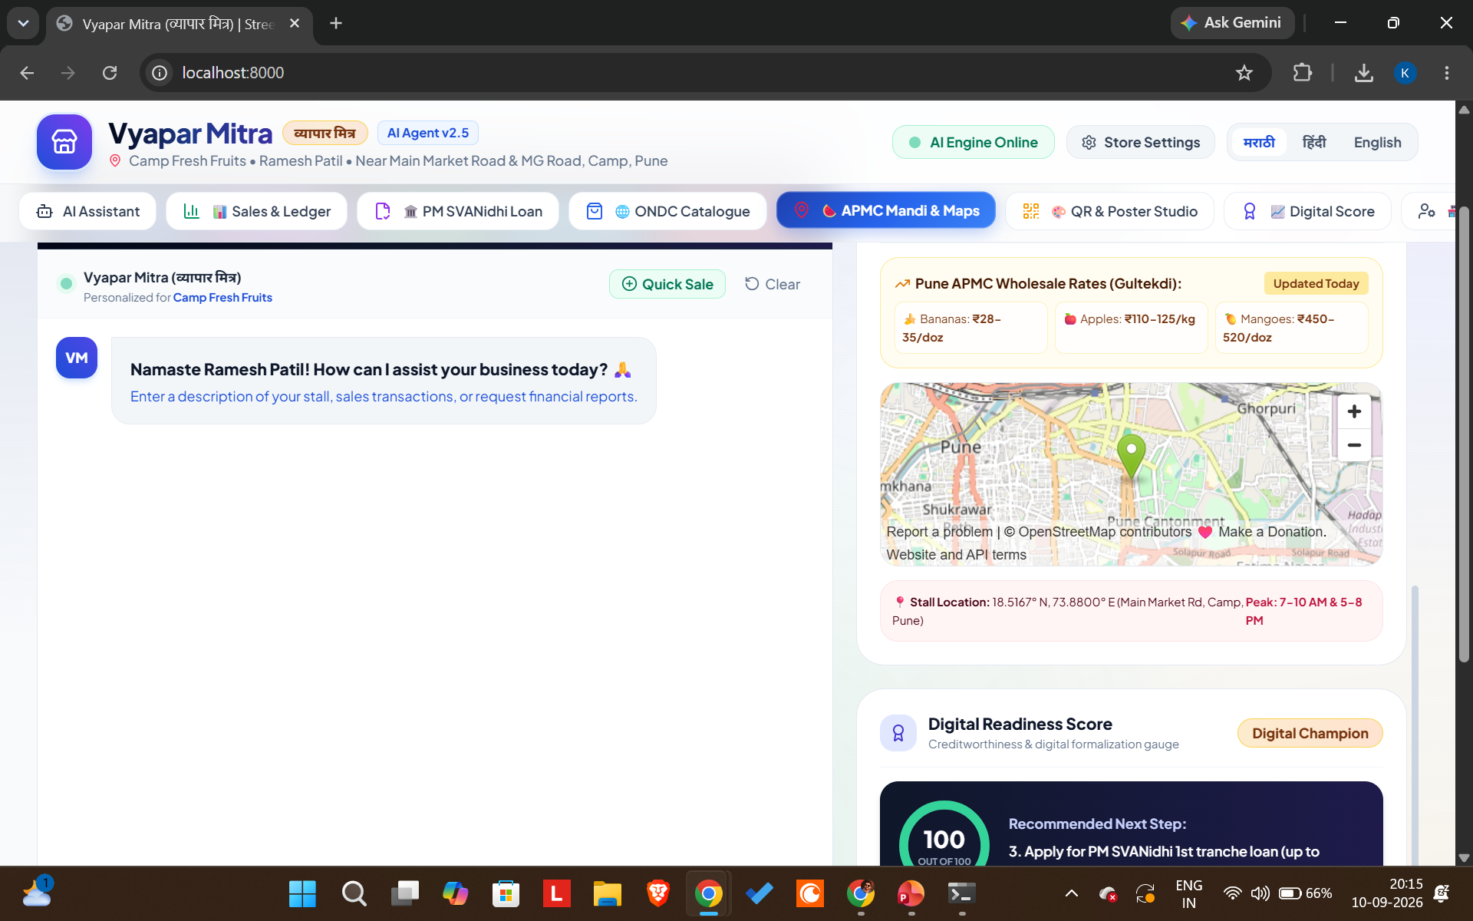

Slide 16
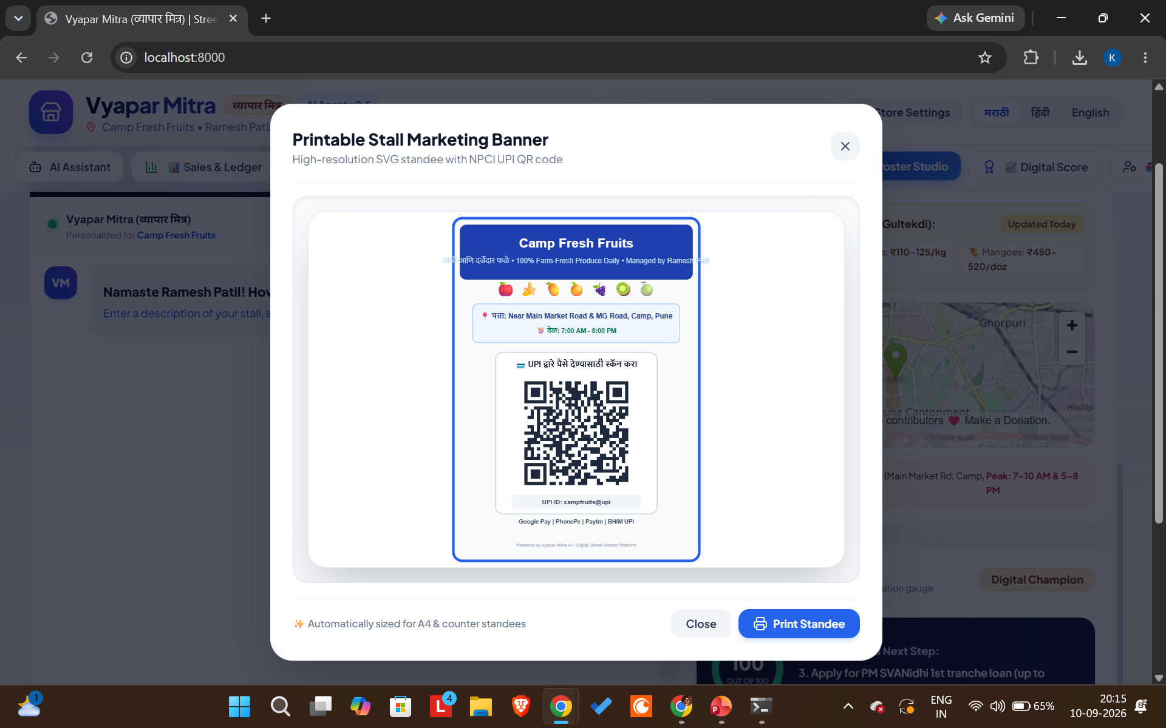

Slide 17
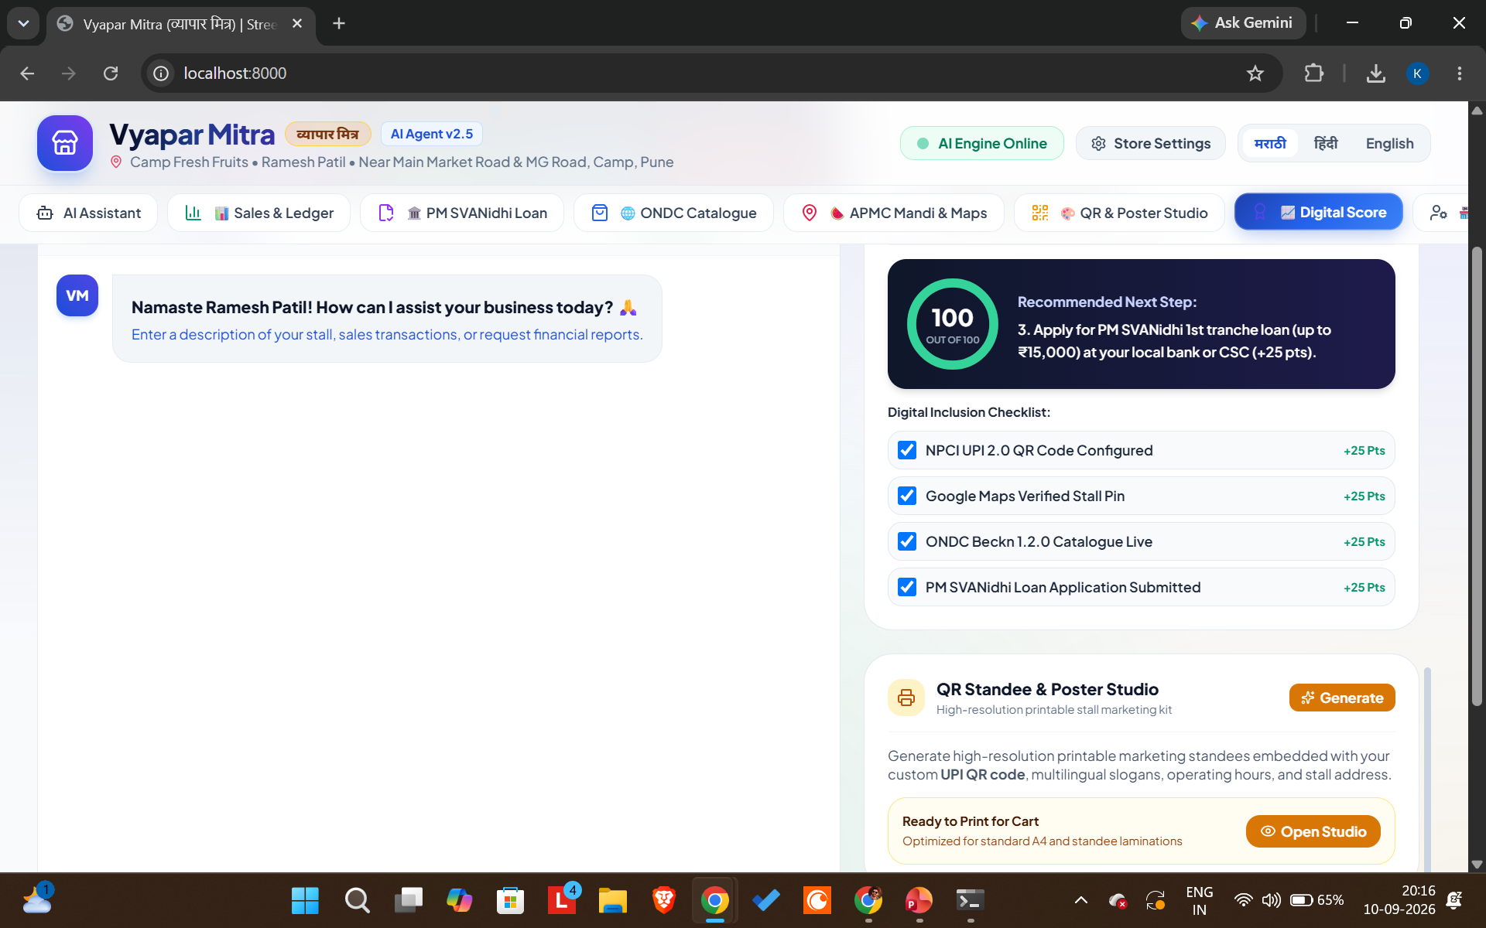

Slide 18
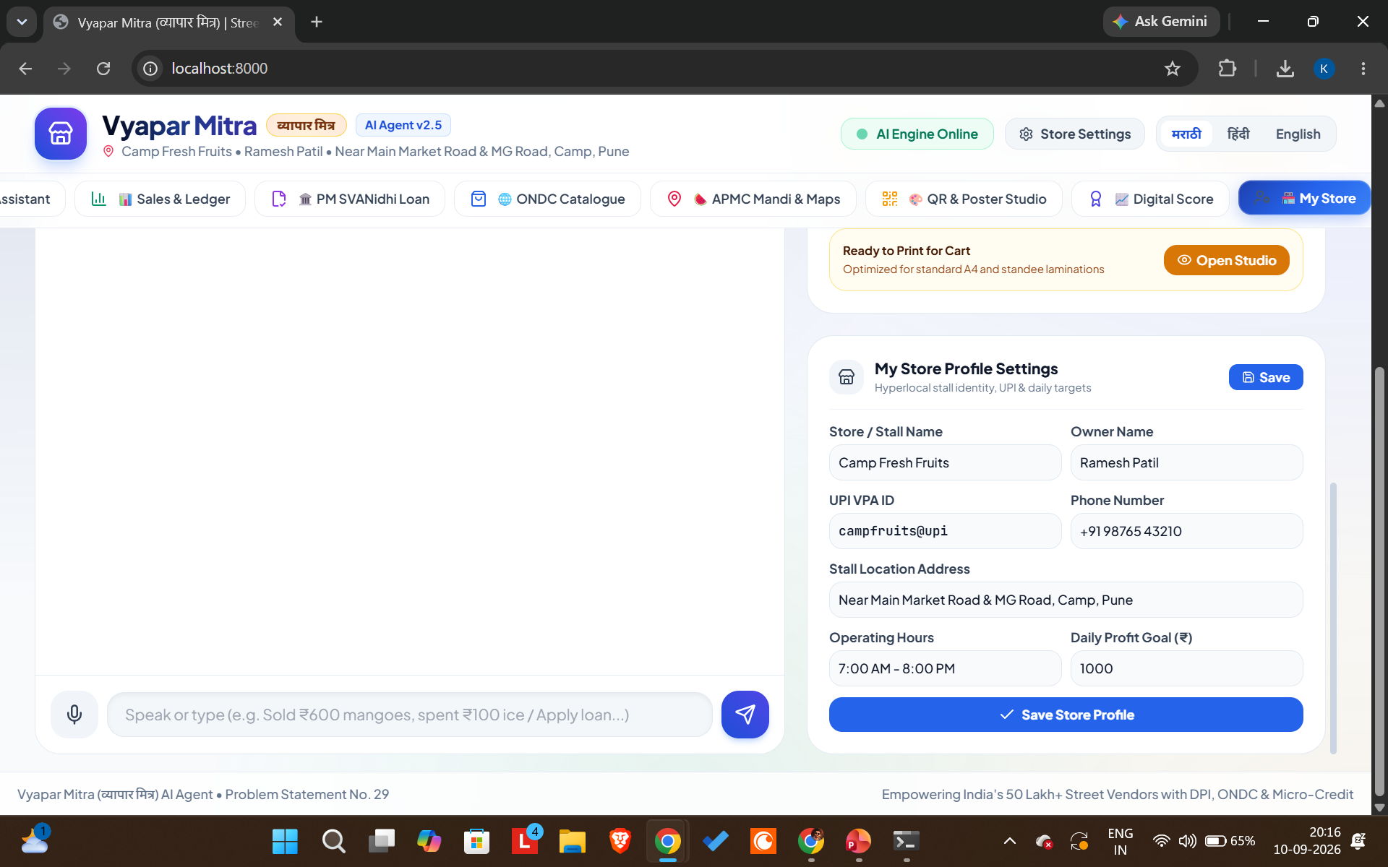

Slide 19
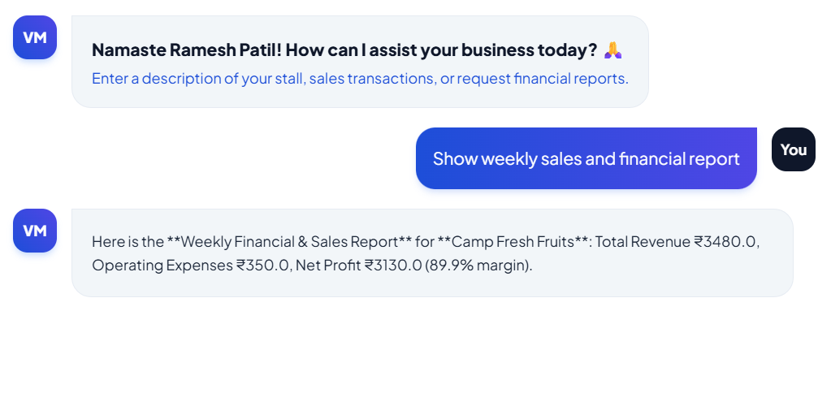

Slide 20
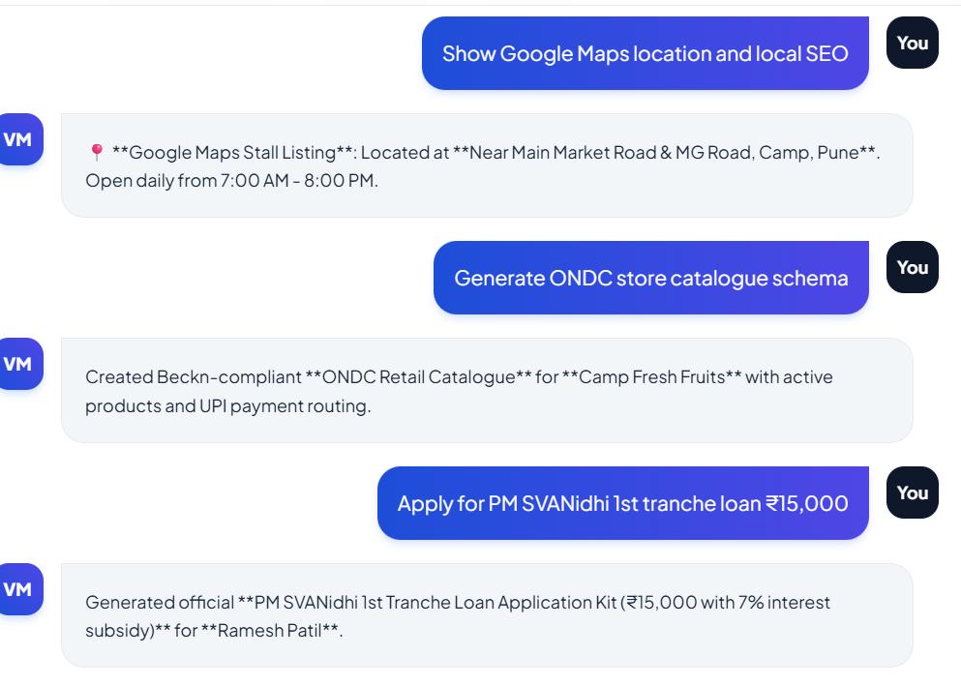

Slide 21
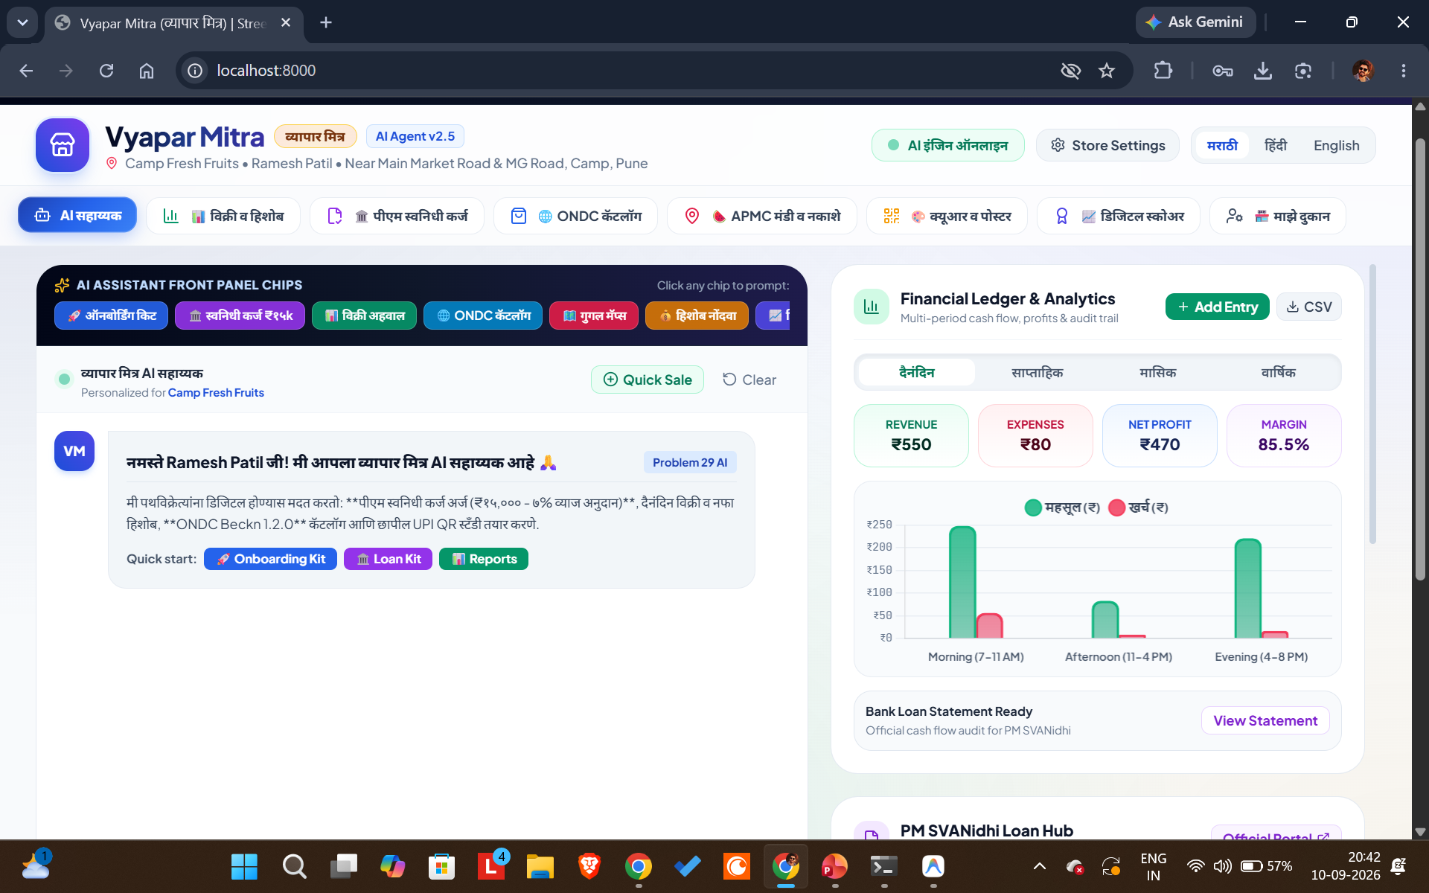

Slide 22


Slide 23
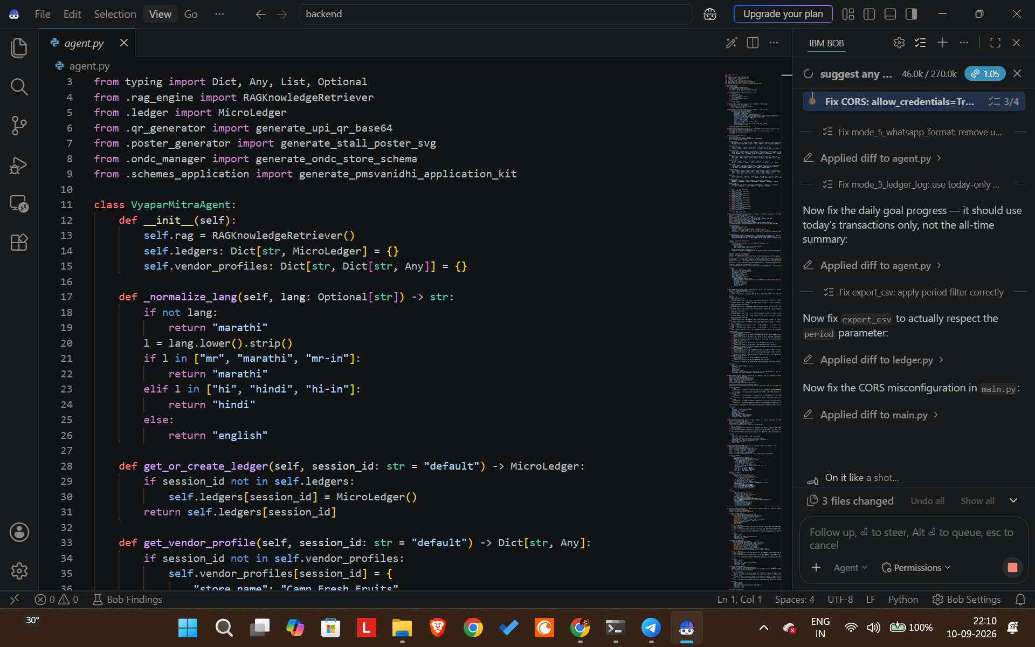

Slide 24
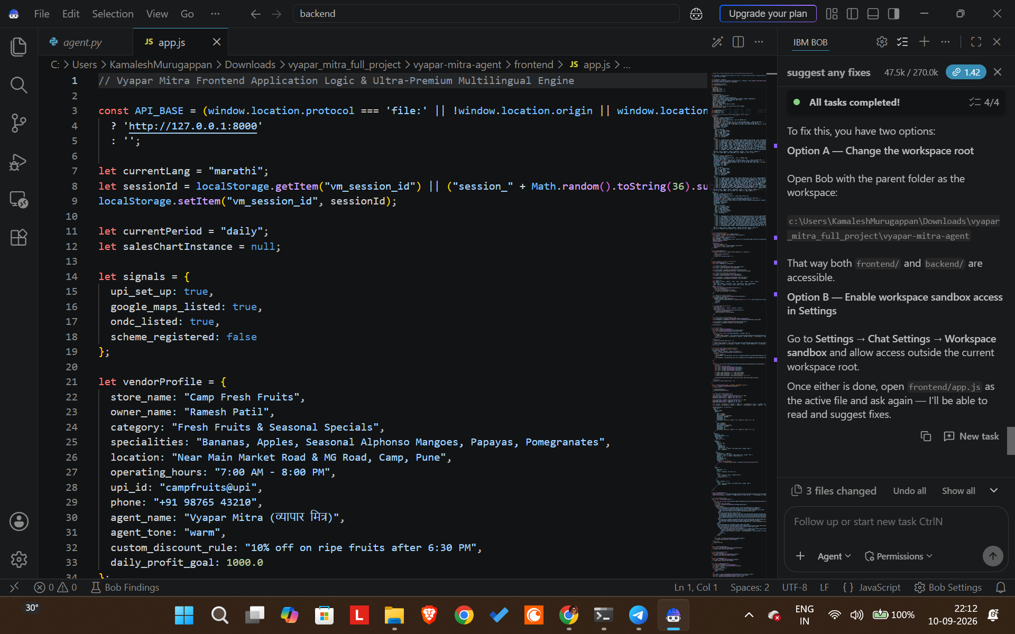

Slide 25
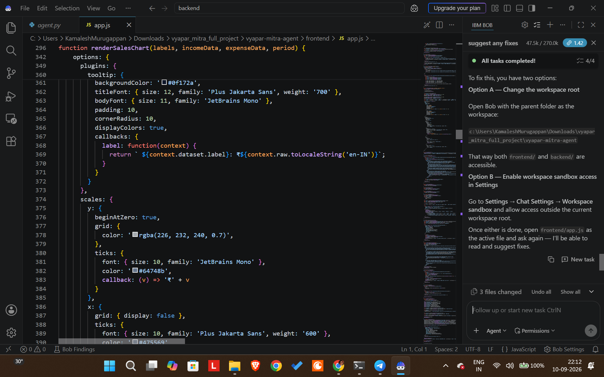

Slide 26
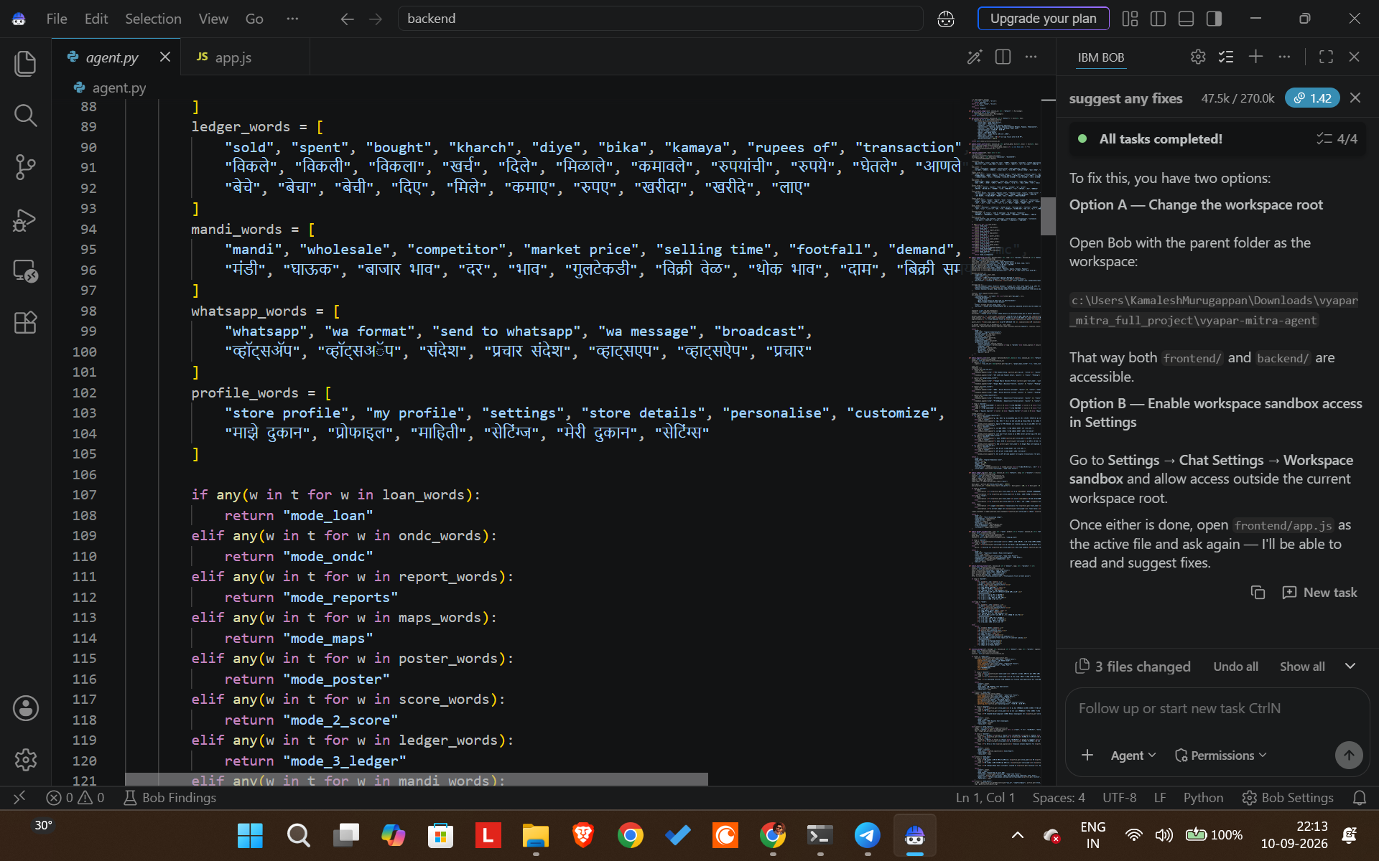

Slide 27
Architecture Blueprint
VENDOR / USER
WEB DASHBOARD
FASTAPI BACKEND
AGENT ORCHESTRATOR
Intent / Session
Context
IBM Granite AI
Models
IBM watsonx.ai
Model Platform
RAG Knowledge
Retriever
Digital Onboarding
Digital Score
Micro Ledger
Market Insights
PM SVANidhi
ONDC Catalogue
QR / Poster
Maps / Local SEO
Vendor Profile / Session
Micro Ledger / CSV
Knowledge Base / RAG Data
External outputs: PM SVANidhi portal • ONDC ecosystem • Google Maps • UPI payment apps

Slide 28
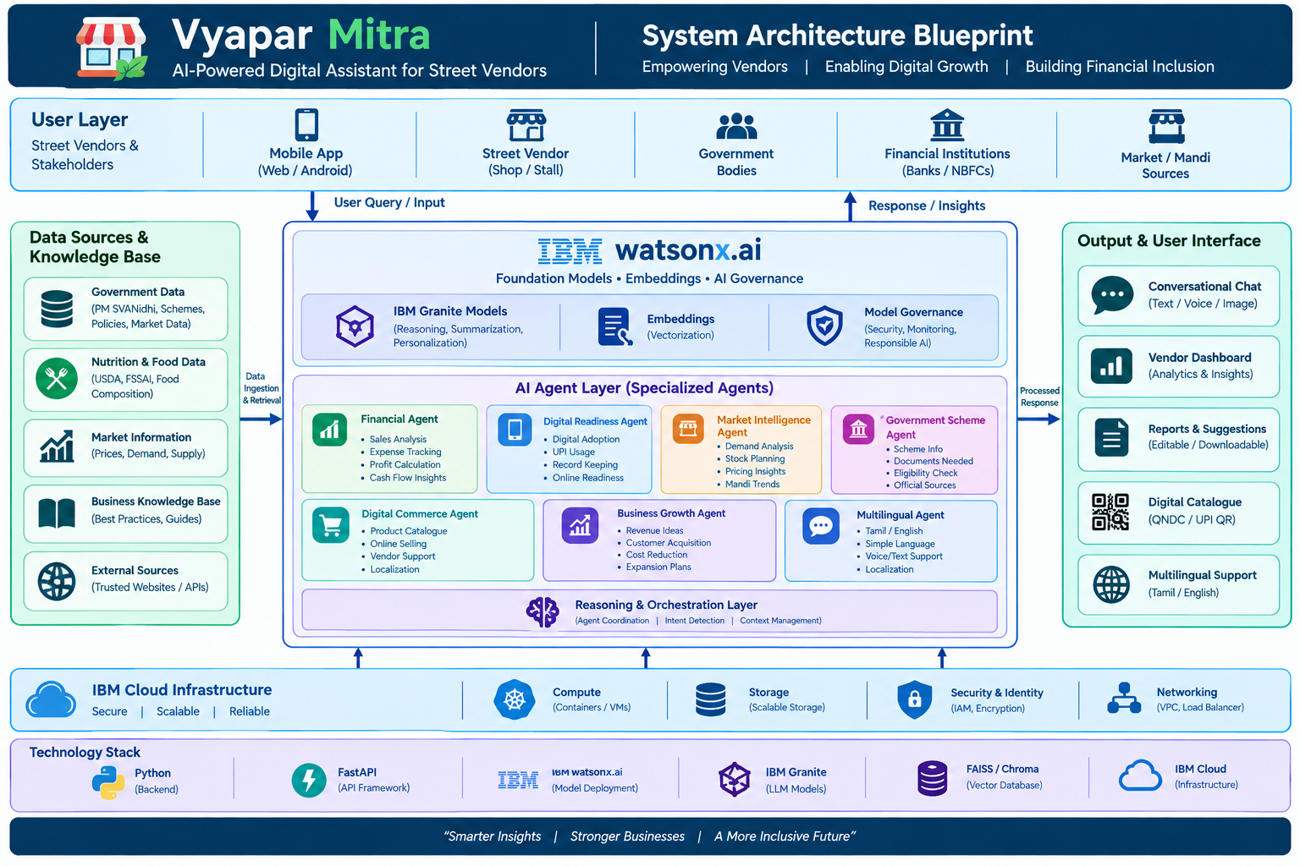

Slide 29
Role of Agentic AI in the Solution
AUTONOMOUS ROUTING
CONTEXT AWARENESS
TOOL-DRIVEN ACTION
The agent identifies the vendor’s intent and selects the correct business capability.
Vendor profile, language, goals and previous ledger state can shape the response.
Instead of only answering, the system can create reports, loan kits, catalogues, QR codes and posters.
Specialized task modes
Onboarding
Score
Ledger
Digital identity + UPI + promotion
Digital readiness + next actions
Sales/expense parsing + profit
Market
Schemes
Commerce
Mandi + hyperlocal demand
PM SVANidhi application kit
ONDC catalogue + storefront

Slide 30
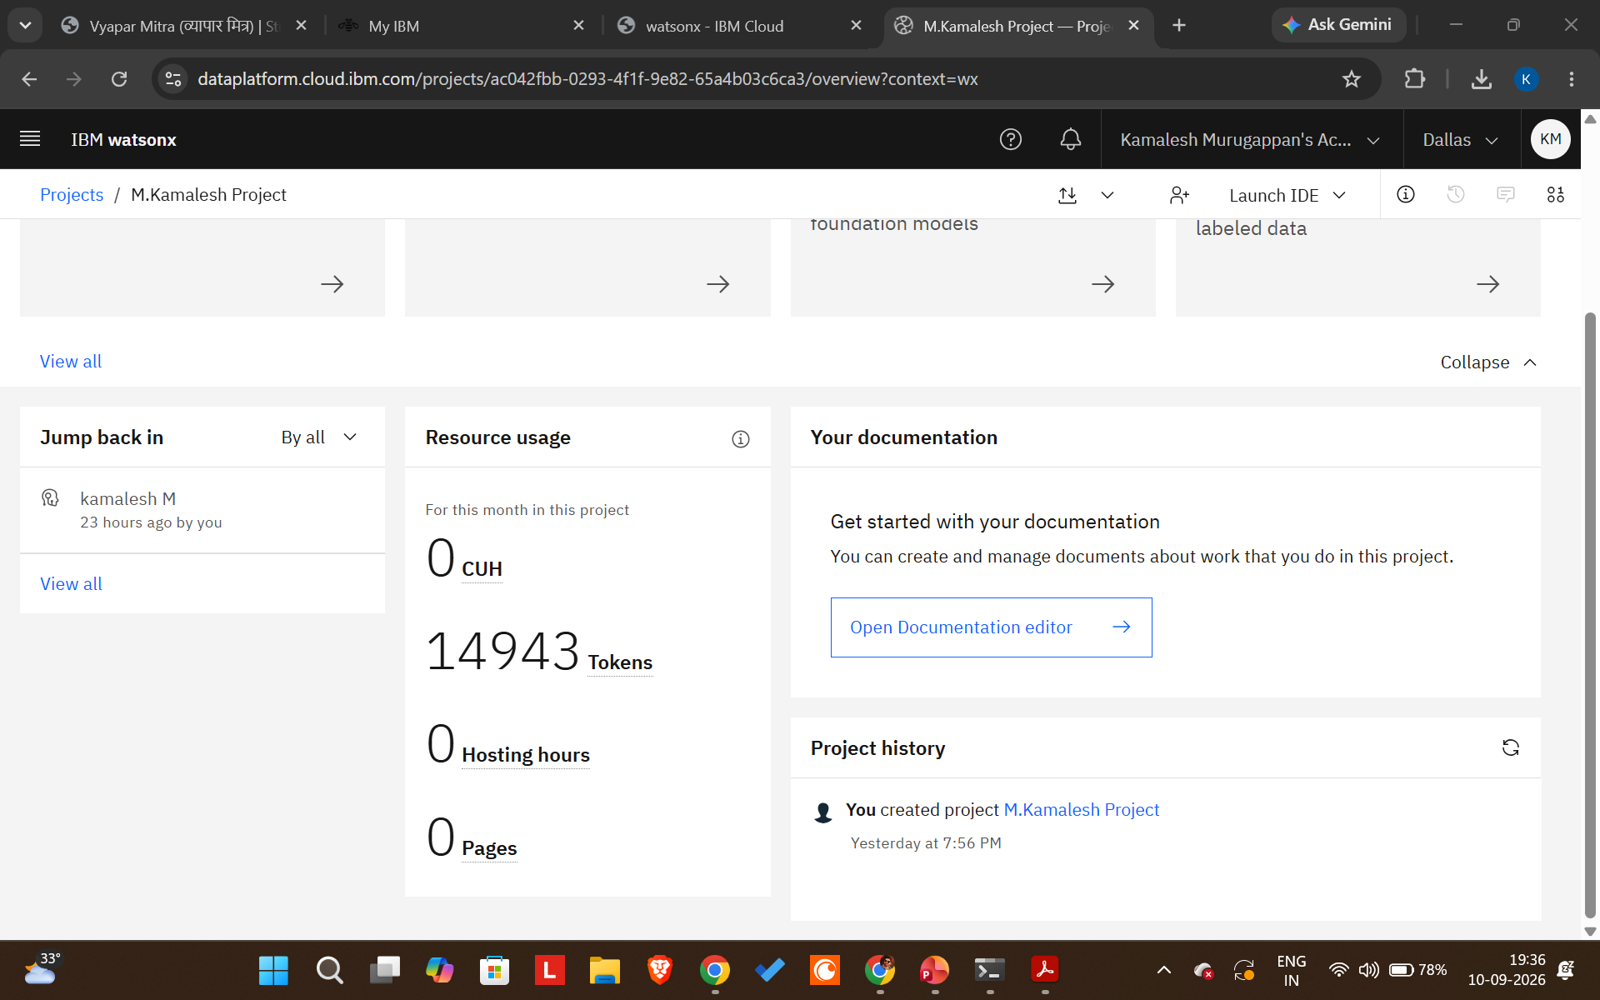
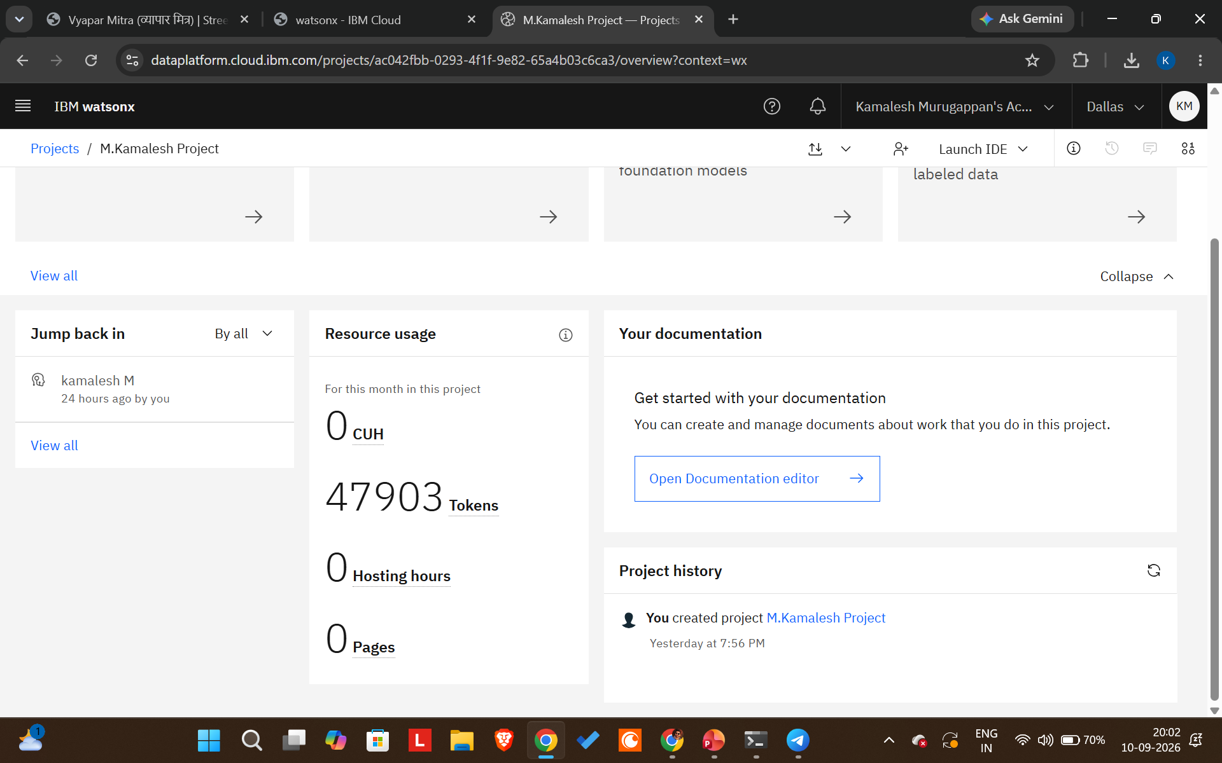
Model Interaction & Token Usage
The application is designed around concise task-oriented prompts so that vendor requests are converted into structured actions.
BEFORE PROMPT
CONTEXT
AFTER RESPONSE
32,960 tokens used
Short vendor request
Example: “Show my sales report”
Intent + vendor profile + relevant data / retrieved knowledge
Actionable result: report, recommendation, checklist or generated asset
Before prompt
After prompt

Slide 31
Novelty and Uniqueness
One-Stop Vendor Assistant
Action-Oriented Agent
Multiple daily business needs are accessed through one conversational interface.
Moves from Q&A to task completion and asset generation.
Financial Inclusion
Digital Commerce
Combines micro-accounting with government-scheme readiness.
ONDC catalogue + UPI + Maps + promotional assets improve discoverability.
Multilingual UX
Practical RAG
Frontend provides Marathi, Hindi and English language modes.
Knowledge retrieval supports scheme, fintech, platform and market guidance.
Result: a proactive digital business companion rather than a generic chatbot.

Slide 32
GitHub / Project Repository
PROJECT SOURCE
RECOMMENDED REPOSITORY CONTENT
The submitted project package contains the frontend, FastAPI backend, RAG engine, ledger, ONDC, scheme and asset-generation modules.
README.md • app.json • problem statement PDF • final PPT • project source code • tests
GitHub URL: _https://github.com/Kamalesh6328/vyapar-mitra-agent.git

Slide 33
Future Scope
Voice-first regional interaction
More Indian languages
Add speech input/output for vendors with limited typing ability.
Extend beyond Marathi/Hindi/English to additional regional languages.
Live market APIs
Digital credit profile
Connect verified live mandi/price sources for stronger real-time recommendations.
Use consistent ledger history and consented business data to support lender-ready records.
Deeper ONDC integration
Mobile / PWA deployment
Move from catalogue generation to production seller-network integration and order lifecycle.
Package the experience for low-bandwidth, mobile-first vendor usage.

Slide 34
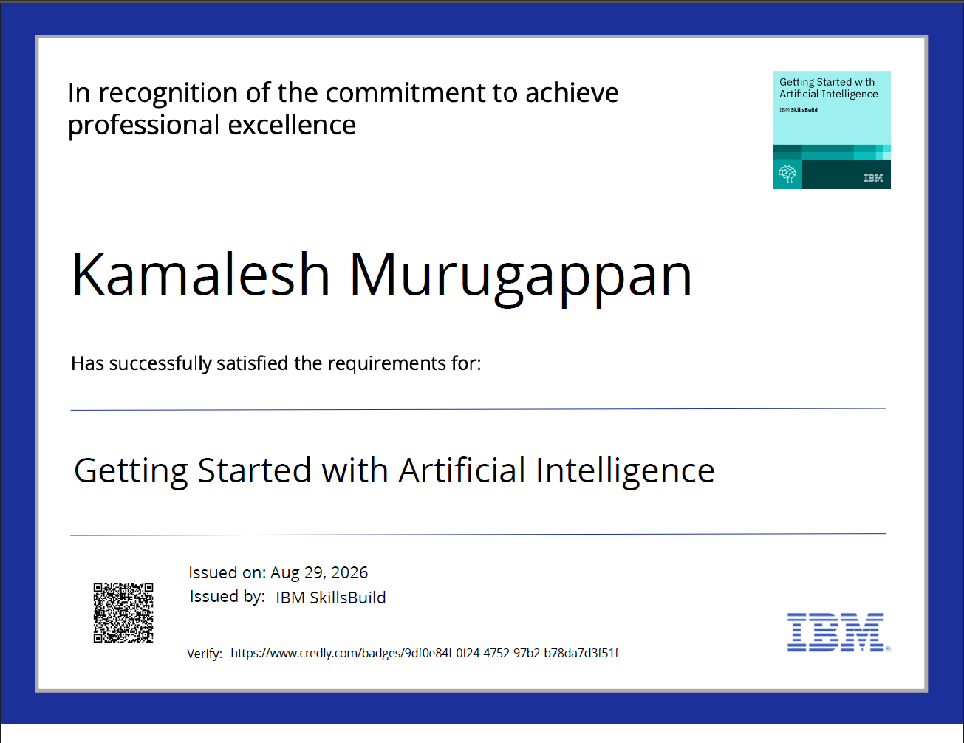
IBM Bob Certificate / Evidence

Slide 35
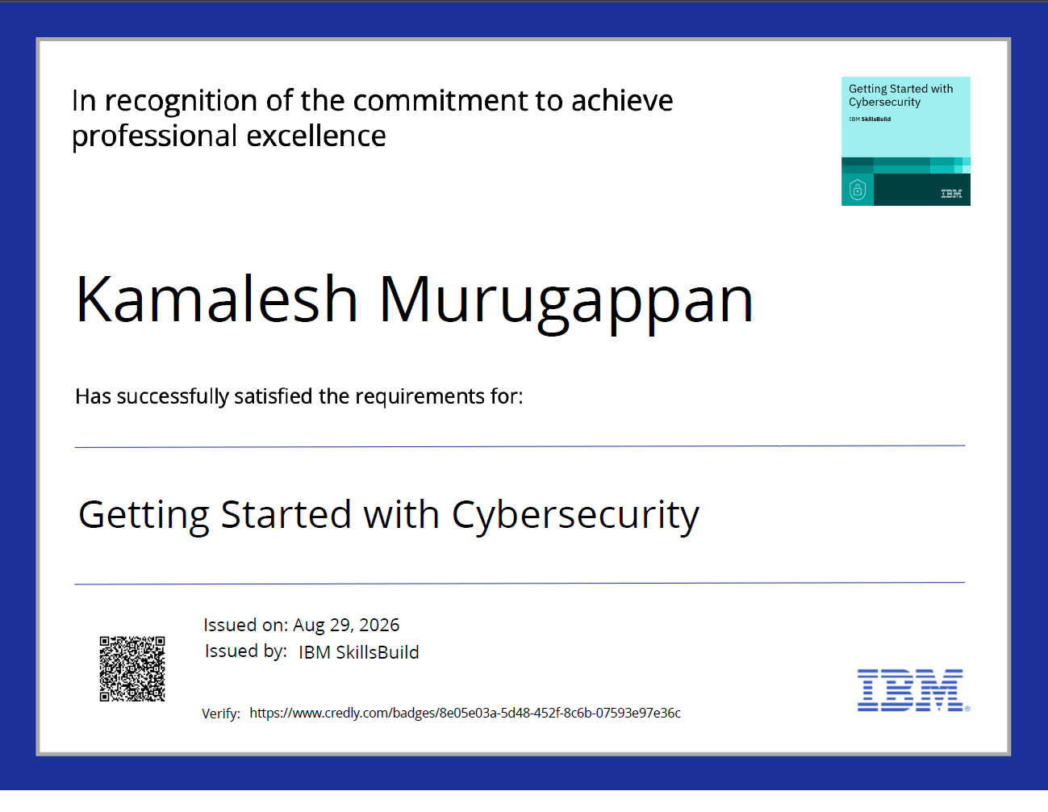
IBM Bob Certificate / Evidence

Slide 36
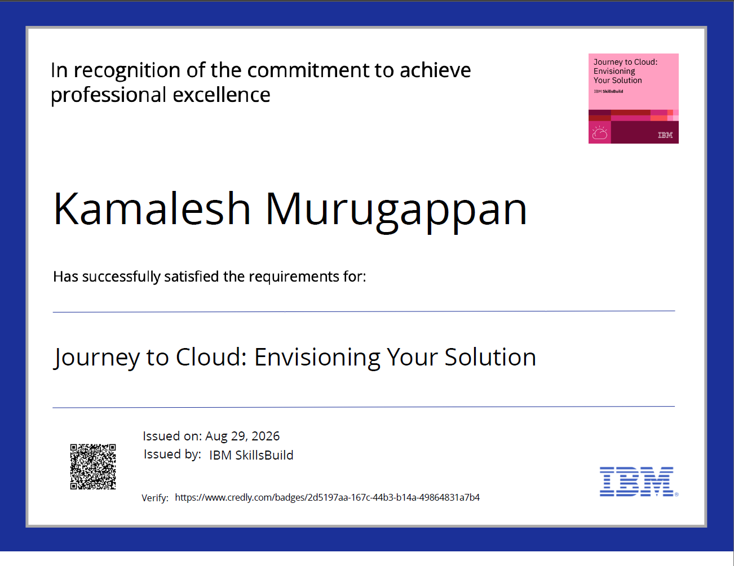
IBM Bob Certificate / Evidence

Slide 37
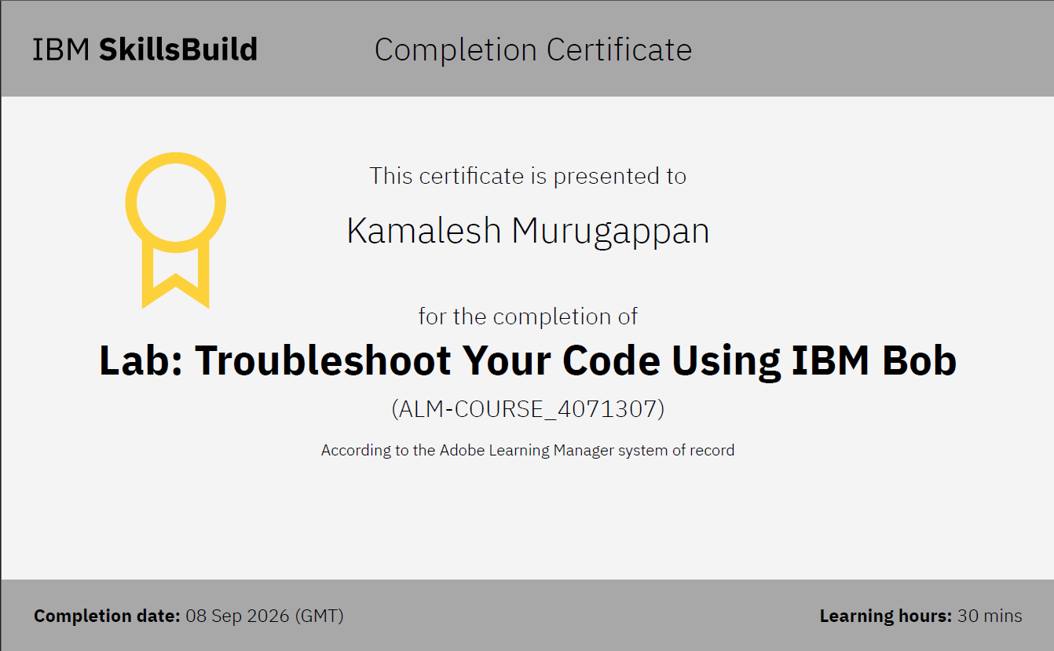
Certificates Earned:
Add your IBM BOB Certificate
​

Slide 38


