Slide 1
Singularity-Aware Physics-Informed
Neural Networks for Real-Time
Inverse Kinematics
Safe, Real-Time Motion Control for Robot Arms Using AI
BY Group 18:
Team Member 1 Roll No: __________
Team Member 2 Roll No: __________
Team Member 3 Roll No: __________
Team Member 4 Roll No: __________

Slide 2
Introduction
Robot arms are used in factories, hospitals, warehouses, and space missions.
To move the arm's hand to a target point, we must find the correct angle for every joint.
This calculation is called Inverse Kinematics (IK).
Modern arms have 7 joints — more than the minimum needed — which makes this calculation harder.
Target Point
(a location in space)
Joint Angles
(7 angles, one per joint)
Inverse Kinematics = solving this direction

Slide 3
Key Terms
1
Forward Kinematics
Know the joint angles → calculate where the hand ends up. (The easy direction.)
2
Inverse Kinematics
Know where we want the hand → find the joint angles. (The hard direction.)
3
Redundant Arm
An arm with extra joints — many different angle combinations reach the same point.
4
Singularity
A risky arm position where the controller can suddenly demand impossibly fast joint movement.

Slide 4
Motivation
Classical methods can freeze, or move dangerously fast, near singularities.
This risks damaging expensive robots or harming people working nearby.
Extra joints mean many solutions exist — plain AI models often blend them into nonsense.
A fast, self-checking AI solver could let robots react safely in real time.

Slide 5
Problem Statement
Robot arms can freeze or move dangerously fast when they reach certain risky joint positions, called singularities. Classical control methods struggle to handle these safely — especially in arms with extra joints, which have many possible solutions for reaching the same target point.
NEED
A fast, learning-based method is needed that can reach a target position while automatically staying away from these risky positions — without needing a large labeled dataset to train on.

Slide 6
Literature Review
Author(s) | Title | Journal | Outcomes | Limitations
Aydogmus & Boztas (2024) [1] | Singularity-free IK for humanoid arm via Bayesian-optimized DNN | Measurement, vol. 229 | High accuracy (MAE 0.02); 25ms predictions | Needs ~10B training samples; no explicit singularity-avoidance loss
Deng et al. (2024) [2] | Physics-informed ML model for inverse dynamics in robotic manipulators | Applied Soft Computing, vol. 163 | Physics-informed network improves torque prediction on a 7-DOF arm | Solves inverse dynamics (torque), not kinematics; no singularity handling
Calzada-Garcia et al. (2025) [3] | Review: IK, control & planning for manipulators via DNNs | Algorithms, vol. 18 | Surveys 5 years of DNN-based IK methods | Review only — no new singularity-safe solver proposed
Shi et al. (2021) [4] | Kinematics and singularity analysis of a 7-DOF redundant manipulator | Sensors, vol. 21 | Closed-form singularity conditions for a 7-DOF arm | Purely analytical; no learning-based real-time solver
Hong, Li & Huang (2024) [5] | RL-enhanced pseudo-inverse for self-collision avoidance of redundant robots | Frontiers in Neurorobotics, vol. 18 | 99.72% success avoiding self-collision on a 7-DOF Franka Panda | Targets self-collision, not singularity / manipulability safety

Slide 7
Gaps in Literature
Most learning-based IK methods have no explicit rule to avoid singularities.
Physics-informed learning has been used for torque prediction, not singularity-safe kinematics.
Classical singularity analysis is accurate but not learning-based or adaptive.
No reviewed work combines all three — training, joint limits, and singularity safety — in one model.

Slide 8
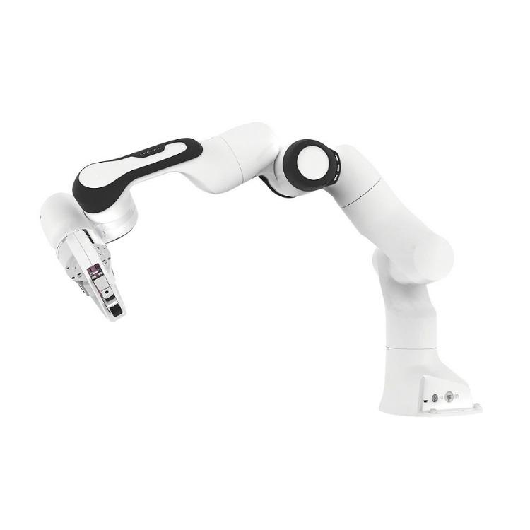
Objectives
1
Build the Simulated Arm
Create a computer model of a 7-joint robot arm that can be learned from.
2
Design the AI Model
Build a neural network that predicts safe joint movements.
3
Teach Three Safety Rules
Reach the target, respect joint limits, and avoid risky positions.
4
Compare With Tradition
Benchmark the AI model against a classical numerical solver.
5
Test and Fix
Find and fix real problems uncovered during training.

Slide 9
Our Approach
Target
Point
AI Model
(uses current pose)
Predicted
Joint Angles
Safety
Check
Safe Arm
Movement
The AI looks at where the arm is right now, then predicts a small, safe movement toward the target — instead of guessing a brand-new pose from scratch.

Slide 10
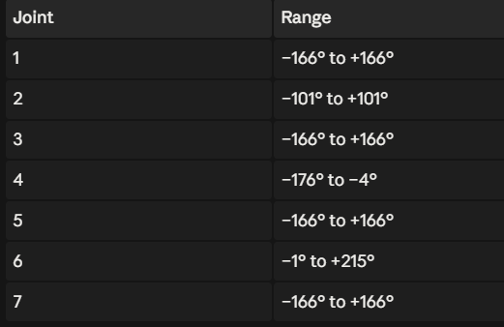
How We Keep It Safe
1
Reach the Target
The predicted hand position should end up close to the goal point.
2
Respect Joint Limits
No joint should twist past its safe mechanical range.
3
Avoid Risky Positions
The AI is discouraged from moving into “locked”, high-risk configurations.

Slide 11
What We Built So Far
A simulated 7-joint robot arm (Franka Panda) that a computer can move and measure
A traditional (classical) solver, used as a fair comparison baseline
The AI model itself — the physics-informed neural network
A training system that generates its own practice examples — no manual dataset needed
A testing and comparison system to measure accuracy and safety

Slide 12
Testing & Debugging
We didn’t just build it — we tested it and found real problems.
1
Problem 1
A math error in how arm sensitivity was calculated — caught by cross-checking against an independent method, then fixed.
2
Problem 2
Some training examples asked the AI to do something physically impossible for it — found by analyzing results, then fixed.
3
Problem 3
The “avoid risky positions” rule was barely active because its safety threshold was set too strictly — found and fixed.

Slide 13
Preliminary Results: Training Progress
Error dropped steadily and kept improving as training continued (10,000 steps shown).

Slide 14
Preliminary Results: AI vs Traditional Method
Our model is already safer near risky positions — accuracy is still catching up with more training.

Slide 15
Current Limitations & Next Steps
Accuracy still trails the traditional method — needs more training and a bigger network.
Not yet connected to a 3D physics simulator for visual demonstration.
Next: longer training runs, a bigger network, and simulator integration for a live demo.

Slide 16
References
[1] O. Aydogmus and G. Boztas, “Implementation of singularity-free inverse kinematics for humanoid robotic arm using Bayesian optimized deep neural network,” Measurement, vol. 229, p. 114471, 2024.
[2] W. Deng, F. Ardiani, K. T. P. Nguyen, M. Benoussaad, and K. Medjaher, “Physics informed machine learning model for inverse dynamics in robotic manipulators,” Applied Soft Computing, vol. 163, p. 111877, 2024.
[3] A. Calzada-Garcia, J. G. Victores, F. J. Naranjo-Campos, and C. Balaguer, “A review on inverse kinematics, control and planning for robotic manipulators with and without obstacles via deep neural networks,” Algorithms, vol. 18, no. 1, p. 23, 2025.
[4] X. Shi, Y. Guo, X. Chen, Z. Chen, and Z. Yang, “Kinematics and singularity analysis of a 7-DOF redundant manipulator,” Sensors, vol. 21, no. 21, 2021.
[5] T. Hong, W. Li, and K. Huang, “A reinforcement learning enhanced pseudo-inverse approach to self-collision avoidance of redundant robots,” Frontiers in Neurorobotics, vol. 18, 2024.
[6] Y. Nakamura and H. Hanafusa, “Inverse kinematic solutions with singularity robustness for robot manipulator control,” Journal of Dynamic Systems, Measurement, and Control, vol. 108, no. 3, pp. 163–171, 1986.

Slide 17
Thank You

