Slide 1


PANIMALAR ENGINEERING COLLEGE
DEPARTMENT OF COMPUTER SCIENCE AND ENGINEERING
CS8811 PROJECT WORK
REVIEW NO:02
Project title : FORWARD OBSTACLE COLISSION AVOIDANCE SYSTEM BASED ON FM RADIO WAVES(FOCA)
Guide Name: Mr . A . KARTHIKEYEAN
Team Members with Register number : KAMALESHWARAN B(211418104107)
KARAN SANJEEV(211418104110)
BATCH NO: E16

Slide 2
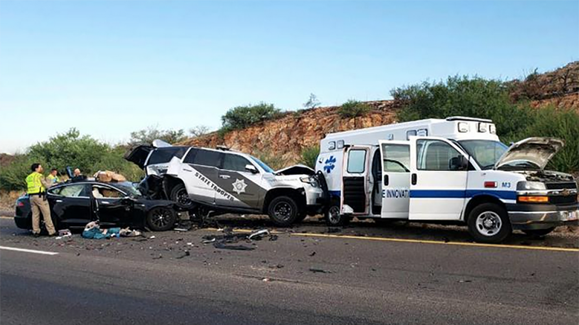
ABSTRACT
Obstacle collision is one of the most concerning aspects of safety in vehicles.
FOCA provides warning signals in an appropriate time to prevent accidents.
FOCA works by using a vehicle that has involved in an accident and using the airbag sensors of the vehicle to send an emergency beacon of FM wave which in-turn alerts the oncoming and incoming traffic which is received by their antennas and alerts the drivers of those vehicles through their vehicles multimedia system.

Slide 3
LITERATURE SURVEY
ADAS were first being used in the 1950s with the adoption of the anti-lock braking system. Early ADAS include electronic stability control, anti-lock brakes, blind spot information systems, lane departure warning, adaptive cruise control, and traction control.
A collision avoidance system (CAS), also known as a pre-crash system, forward collision warning system, or collision mitigation system, is an advanced driver-assistance system designed to prevent or reduce the severity of a collision.
In April 2019, IIHS/HLDI considered real-world benefits of crash avoidance technologies, based on rates of police-reported crashes and insurance claims.

Slide 4
PROBLEM STATEMENT
HOW TO AVOID A VEHICLE FROM CRASHING ONTO A BROKEN DOWN OR ACCIDENTAL VEHICLE THAT’S STRANDED ON A BUSY HIGHWAY IN TOUGH ROAD CONDITIONS(FOG,MIST,RAIN,LOW VISIBILITY DUST STORMS, CURVED ROADS) WITHOUT USING ANY KIND OF SPECIAL SENSORS(SUCH AS RADAR,LIDAR,GSM,CAMERA INPUTS,ETC) TO ALERT THE DRIVER AND WHAT WOULD BE THE MOST COST EFFECTIVE WAY IN DOING SO.

Slide 5
PROPOSED SYSTEM
The FOCA app uses the information from the ECU of the vehicle that has crashed and ensures the airbags deployed. In the case of deployment, the background running app will transmit a FM modulated digital signal to the transmitter
FOCA receives the emergency signal in the receiver end , as FOCA is a background software that constantly monitors this and a trigger event occurs as and displays an alert message to the driver using an alert command

Slide 6
ADVANTAGES OF PROPOSED SYSTEM
This will benefit large base of people as cars under the price range of 30 lakh rupees have no ADAS OR RADAR based system .
Cost effectiveness
The range of 500-600 meters is much effective since a modern car only requires 60 or so meters to come to complete halt
There is no requirement of any other special apparatus

Slide 7
EXISTING SYSTEM
Advanced driver-assistance systems (ADAS) are groups of electronic technologies that assist drivers in driving and parking functions. Through a safe human-machine interface, ADAS increase car and road safety. ADAS use automated technology, such as sensors and cameras, to detect nearby obstacles or driver errors, and respond accordingly.
A collision avoidance system (CAS), also known as a pre-crash system, forward collision warning system, or collision mitigation system, is an advanced driver assistance system designed to prevent or reduce the severity of a collision.
Various technologies and sensors that are used include radar (all-weather) and sometimes laser (LIDAR) and cameras (employing image recognition) to detect an imminent crash.

Slide 8
PROBLEMS IN EXISTING SYSTEM
HIGHLY EXPENSIVE
IS NOT PRESENT IN ANY CARS UNDER 30LAKHS-WHICH IMPLIES MASS MARKET IN-AVAILABILITY.
RADAR APPARATUS PRONE TO CRASH AREA. HENCE FREQUENT REPLACEMENT.
RANGE IS MUCH SHORTER IN FEW CHEAP SENSORS.

Slide 9
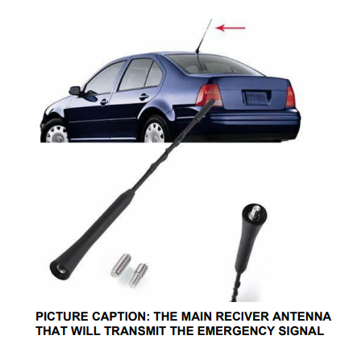
HARDWARE SPECS:
A shark fin antenna of a car
Infotainment system of a car
Airbag sensors of a car
FM frequency allotted by the government to permit transmission
Ecu unit of a car
Phone/tablet
Ram : 2GB (minimum)
Storage : 4GB (minimum)
FM transmitter and Receiver

Slide 10
SOFTWARE SPECS:
ANDROID STUDIO
JAVA PROGRAMMING
XML
ANDROID OS :8.0 AND ABOVE

Slide 11
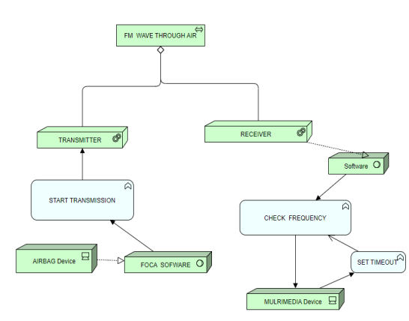
ARCHITECTURE DIAGRAM

Slide 12
MODULES 1) THE UNFORTUNATE ACCIDENT
First of all we don’t want a accident to occur ..
But , if a accident occurs FOCA helps in avoiding a trail accident.
As soon as a vehicle meet with an accident and due to that the airbags in the vehicle gets deployed.
In that case the FOCA senses the airbags deployed by the vehicle , and based on that senses that a emergency signal must be transmitted.

Slide 13
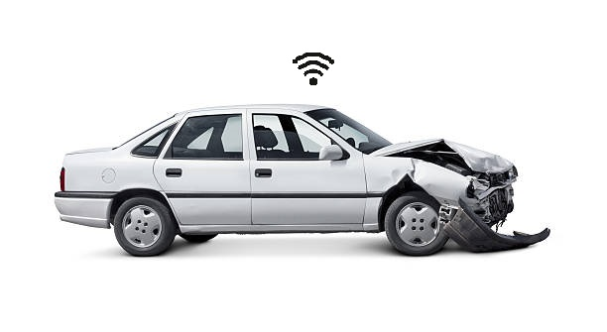
MODULES 2) THE ALERT SIGNAL
As the airbags gets deployed , the FOCA receives a binary digit of length ( two/four/six/eight) based on number of air bags in a vehicle.
Even if a single 1(true) occurs in that binary number, it means a air bag is open and the FOCA will transmit a emergency signal with the particular strength.
The FM signals have a range of 600-900 meters (based on environment) and thus the transmitted signal will be caught by the vehicle in the radius of this .

Slide 14

MODULES 3) THE RECEIVING END
The transmitted signal from the accident vehicle will be in a radius of 600- 900 meters.
Now any vehicle in this radius are capable of sensing this signal and here the FOCA does the job.
The FOCA app in the vehicles in this range gets the signal and checks for the frequency , if this passes the FOCA activates the alert message on the display of the vehicles.

Slide 15
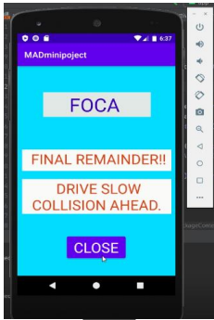
MODULES 4) THE ALERT MESSAGE
The FOCA software after it detects the signal it will display the warning message in the display screen of the car , warning the driver.
The alert keeps on till the car passes that region keeping a constant remainder to the driver.
Also , in case if the driver wants to stop the remainder and make himself take care of it , he can press the ok button followed by a close button in the final remainder App page

Slide 16
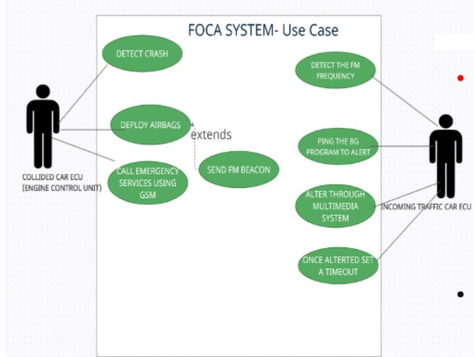
UML DIAGRAM : USECASE

Slide 17
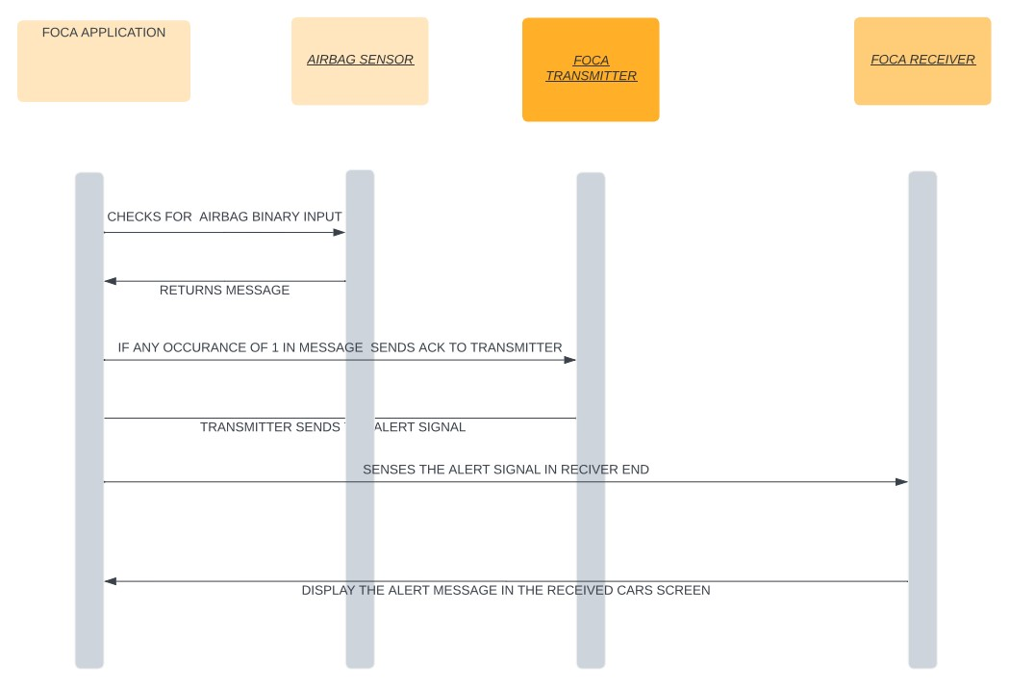
UML DIAGRAM : SEQUENCE

Slide 18
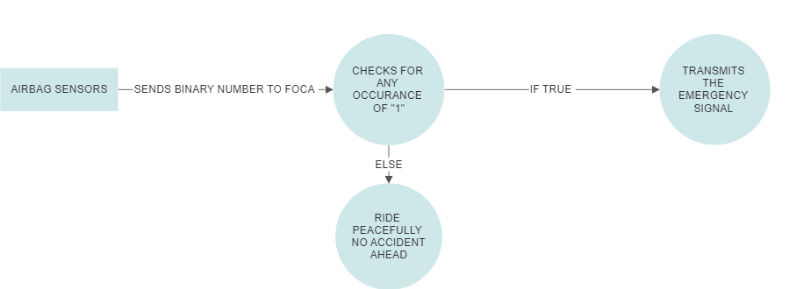
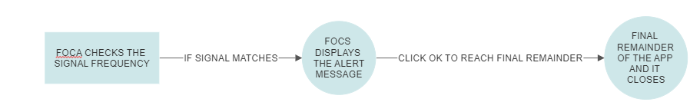
UML DIAGRAM : DATA FLOW DIAGRAM
TANSMITTER END:
RECEIVER END:

Slide 19
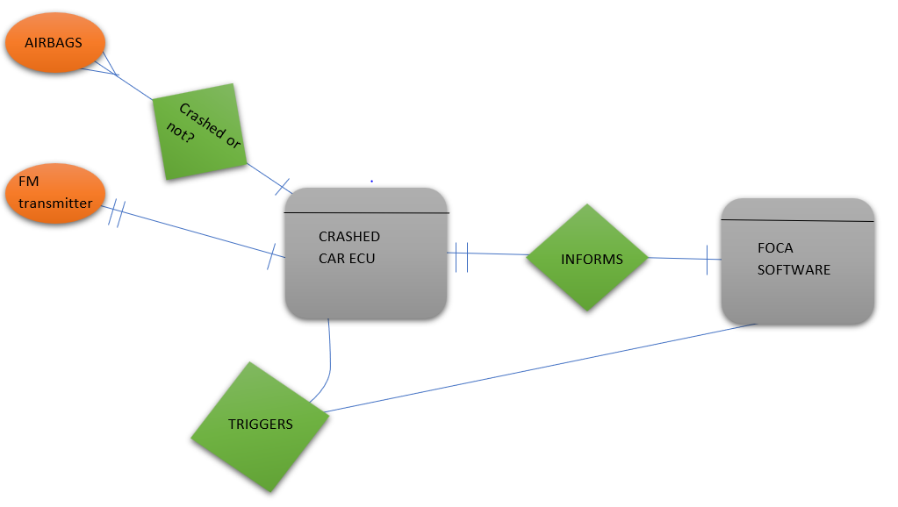
UML DIAGRAM : ER DIAGRAM
ER DIAGRAM FOR TRANSMIT FUNCTION

Slide 20
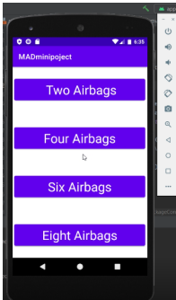

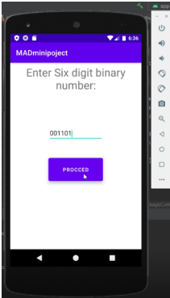
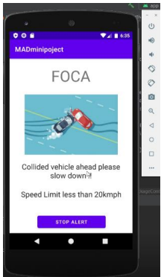
RESULT
FIG1: FIG2: FIG3: FIG4: FIG5:
FIG 1,2,3,4,5: RESULTS Sample shots of the app working under different input types

Slide 21
CONCLUSION
THIS SYSTEM IS A WORK IN PROGRESS AND IT REQUIRES FURTHER DEVELOPMENT TO BE IMPLEMENTED IN FULL SCALE, HENCE ONLY A PROTOTYPE OF THE PROPOSED IDEA IS PRESENTED HERE AND FURTHER RESEARCH AND ACCURATE TUNING WILL MAKE IT IMPLEMENTABLE ON LARGE SCALE CUSTOMER BASE
CURRENT LIMITATIONS TO BE OVERCOME FOR FULL SCALE IMPLEMENTATION:
Government allotment of a specific FM BAND for emergency services.
All car manufacturers ECU binding permission with the app.
Airbag sensors information provision.
All cars with FM antenna must be made mandatory

Slide 22
REFERENCES
FM Transmitter Circuit With 3km Range - EEE PROJECTS
[1] National Transportation Safety Board, Special Investigation Report - Highway Vehicle- and Infrastructure-based Technology for the Prevention of Rear-end Collisions. NTSB Number SIR01/01, May 200
Single Chip FM Radio Circuit with Diagram using TDA 7000 IC (circuitstoday.com)
https://www.earth.com/news/brain-learns-repeat-actions/
Wikipedia-airbags

