Slide 1
Analyzing S/F Ratio as an Additional Biomarker to characterize (a) RBC Transfusion Efficacy/responsiveness (b) Need for RBC Transfusion

Slide 2
Study on Red Cell Transfusion
Based on investigating median SpO2 (%), Hb, S/F under red cells transfusion
Transfusion time bar can be divided into two major categories: (i) BeforeT (24 hrs before T time), (ii) AfterT (𝜏 hrs after 4 hrs of T time), where 𝜏 = 3, 6, 9, 12, 24, and “T” is transfusion start time.
Considering 4 hrs duration of transfusion time, the regions are divided for vital signs data as: (a) BeforeT (T-24hr to T) , (b) AfterT1 (T+4hr to T+4+𝜏 hr), (c) AfterT2 (T+4+ 𝜏 hr to T+4+2𝜏 hr), (d) AfterT3 (T+4+2𝜏 hr to T+4+3𝜏 hr)
Sequence of
vital signs data
BeforeT (24 hrs)
4 hrs
AfterT1 (𝜏 hrs)
AfterT2 (𝜏 hrs)
AfterT3 (𝜏 hrs)
BeforeT measures: MedianSpO2,
MedianHb, MedianSF, MedianPF
AfterT measures: MedianSpO2,
MedianHb, MedianSF, MedianPF
T: Transfusion time
ΔSpO2 : Median SpO2 before and after transfusion time

Slide 3
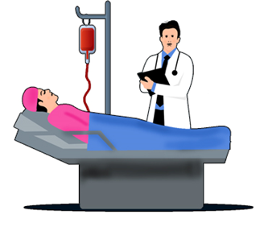

Study on Red Cell Transfusion
Analyzing SF ratio for assessing efficacy of red blood cells transfusion
Transfusion Bar:
Pre-transfusion region
Post-transfusion regions
Sequence of
vital signs data
Before T (24 hrs)
4 hrs
T1 (𝜏 hrs)
T2 (𝜏 hrs)
T3 (𝜏 hrs)
Measures: Median SF
Measures: Median SF T1, Median SF T2, Median SF T3
T: Transfusion start time
A statistical comparison on pre- and post- transfusion SF ratios
Transfusion response decision
Pre-transfusion region considered for the study
Post-transfusion region considered for the study

Slide 4
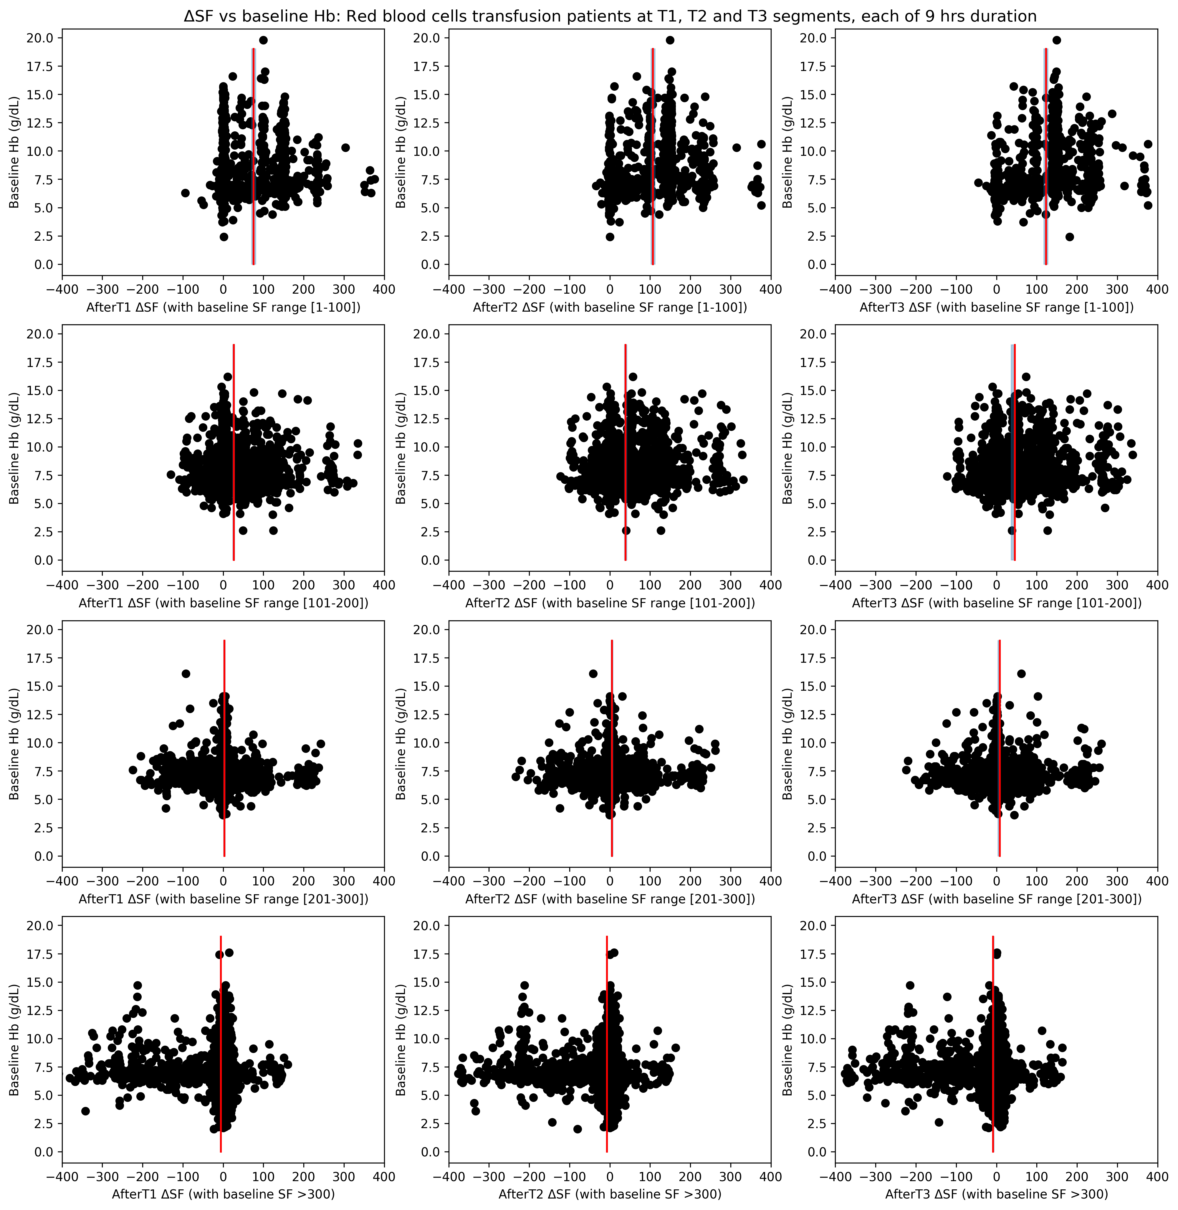

ΔSF vs Baseline Hb
2016-2020 Emory ICU patients, RBC transfused, no MTP, no overlapping segments included
Localized study on patients having different range of baseline SF ratios for 𝜏 = 9 hrs
1st Row: ΔSF vs baseline Hb for three post-transfusion regions with baseline SF range [1, 100]
2nd Row: ΔSF vs baseline Hb for three post-transfusion regions with baseline SF range [101, 200]
3rd Row: ΔSF vs baseline Hb for three post-transfusion regions with baseline SF range [201, 300]
4th Row: ΔSF vs baseline Hb for three post-transfusion regions with baseline SF >300
Observations:
SF always increases after transfusion for lower range of baseline SF [1-100]. This effect can be seen more as we move further after transfusion time.
For the lower baseline Hb, delta SF spread is more.
For the baseline SF >300, we do not see improvement in post-transfusion SF. They are having either zero or negative difference with the baseline. Mostly no difference is seen.

Slide 5
ΔSF vs Baseline Hb
2016-2020 Emory ICU patients, RBC transfused, no MTP, no overlapping segments included
Localized study on patients having different range of baseline SF ratios for 𝜏 = 9 hrs
1st Row: ΔSF vs baseline Hb for three post-transfusion regions with baseline SF range [1, 100]
2nd Row: ΔSF vs baseline Hb for three post-transfusion regions with baseline SF range [101, 200]
3rd Row: ΔSF vs baseline Hb for three post-transfusion regions with baseline SF range [201, 300]
4th Row: ΔSF vs baseline Hb for three post-transfusion regions with baseline SF >300
Observations:
SF always increases after transfusion for lower range of baseline SF [1-100]. This effect can be seen more as we move further after transfusion time.
For the lower baseline Hb, delta SF spread is more.
For the baseline SF >300, we do not see improvement in post-transfusion SF. They are having either zero or negative difference with the baseline. Mostly no difference is seen.

Slide 6
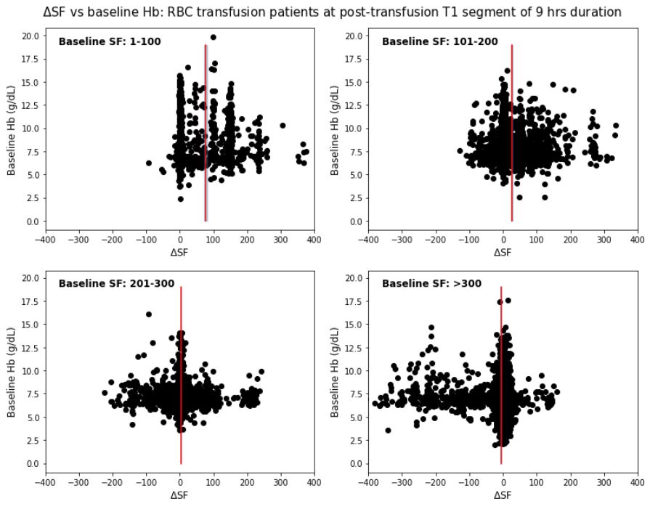
ΔSF vs Baseline Hb
2016-2020 Emory ICU patients, RBC transfused, no MTP, no overlapping segments included
Transfusions, n | 18716 | 1303 | 2851 | 3552 | 11010
Patient encounters, n | 13274 | 1258 | 2373 | 2763 | 8098
Unique patients, n | 11828 | 1250 | 2312 | 2672 | 7254

Slide 7
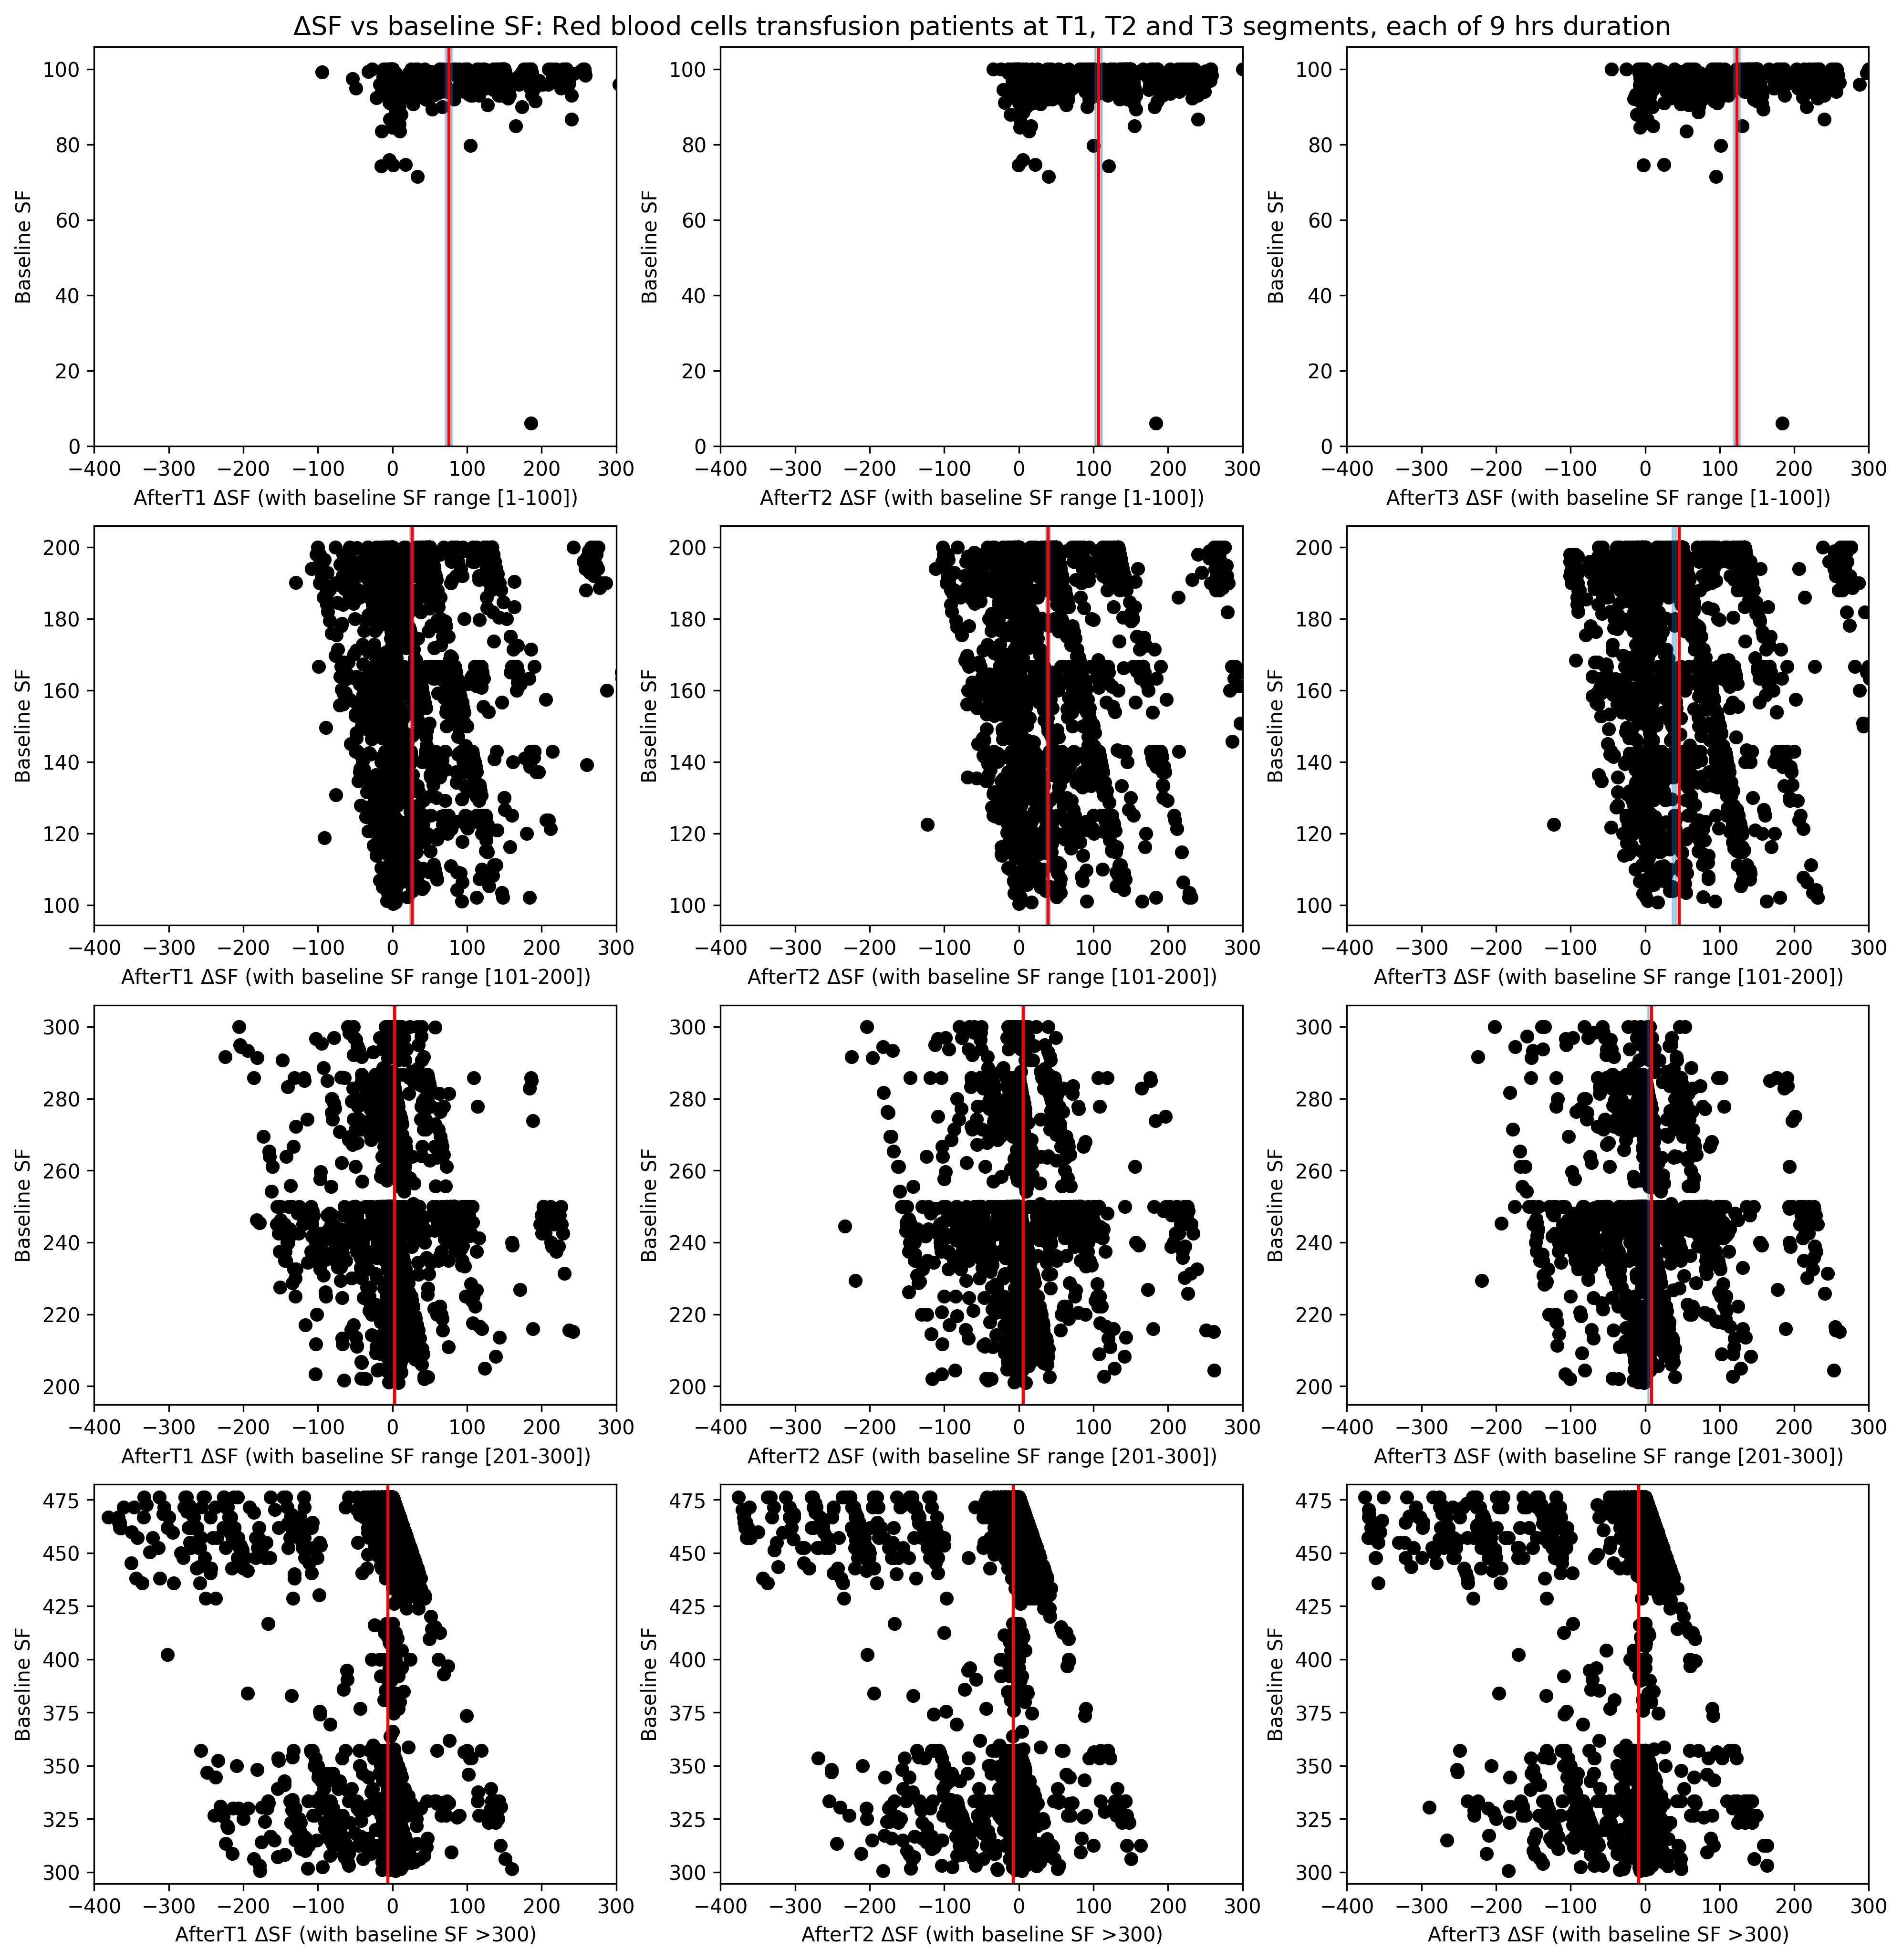
ΔSF vs Baseline SF
2016-2020 Emory ICU patients, RBC transfused, no MTP, no overlapping segments included

Slide 8
Validation on Grady Hospital
Transfusions, n | 6375 | 451 | 901 | 2852 | 2171
Patient encounters, n | 3757 | 434 | 711 | 1836 | 1621
Unique patients, n | 3552 | 433 | 703 | 1785 | 1553

Slide 9
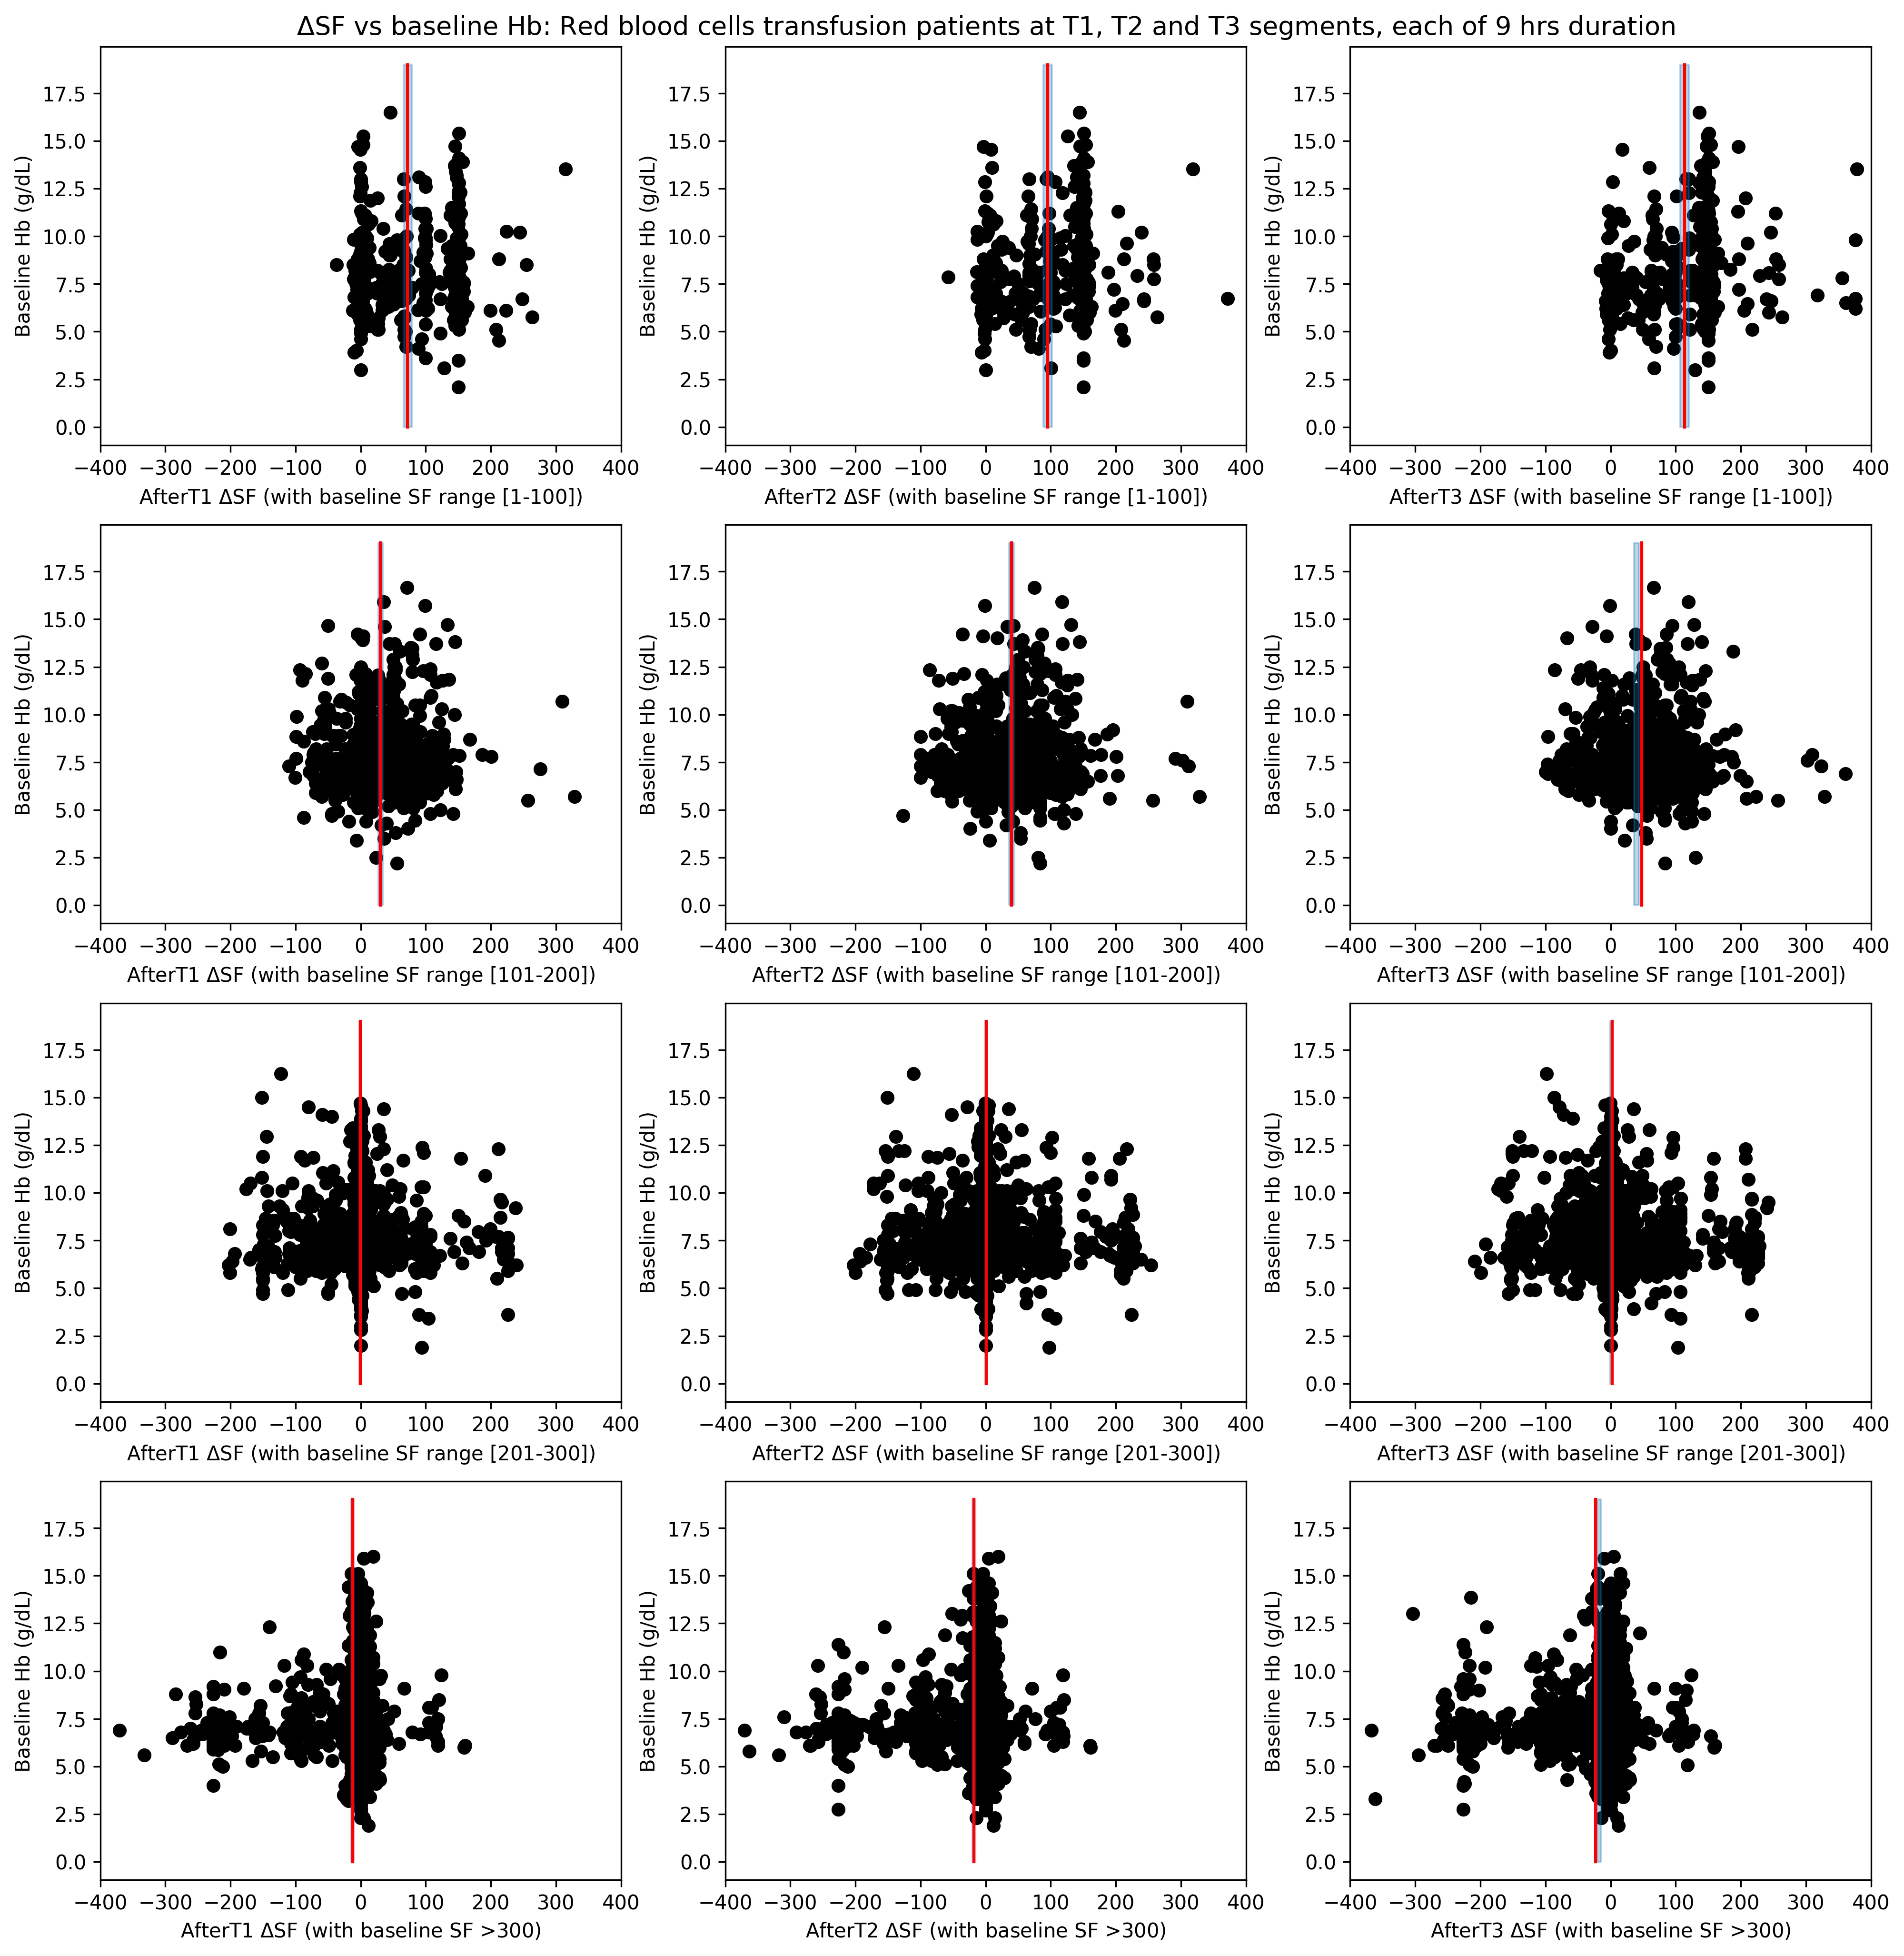
ΔSF vs Baseline Hb
2016-2020 Grady ICU patients, RBC transfused, no MTP, no overlapping segments included
Localized study on patients having different range of baseline SF ratios for 𝜏 = 9 hrs
1st Row: ΔSF vs baseline Hb for three post-transfusion regions with baseline SF range [1, 100]
2nd Row: ΔSF vs baseline Hb for three post-transfusion regions with baseline SF range [101, 200]
3rd Row: ΔSF vs baseline Hb for three post-transfusion regions with baseline SF range [201, 300]
4th Row: ΔSF vs baseline Hb for three post-transfusion regions with baseline SF >300
Observations:
SF always increases after transfusion for lower range of baseline SF [1-100]. This effect can be seen more as we move further after transfusion time.
For the lower baseline Hb, delta SF spread is more.
For the baseline SF >300, we do not see improvement in post-transfusion SF. They are having either zero or negative difference with the baseline. Mostly no difference is seen.

Slide 10
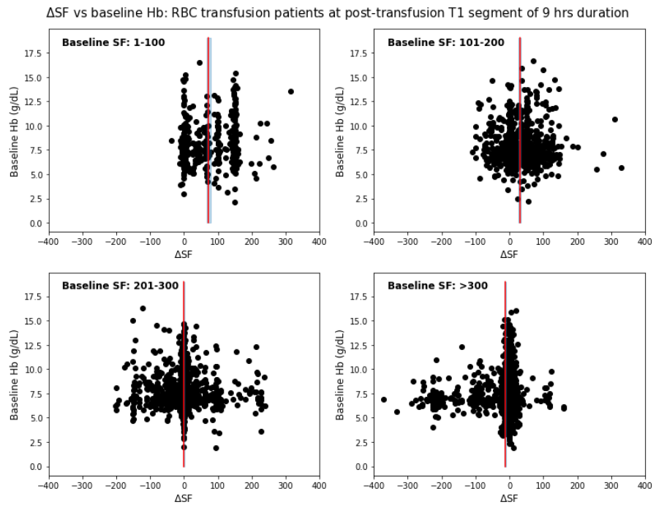
ΔSF vs Baseline Hb
2016-2020 Grady ICU patients, RBC transfused, no MTP, no overlapping segments included
Emory data
Grady data

Slide 11
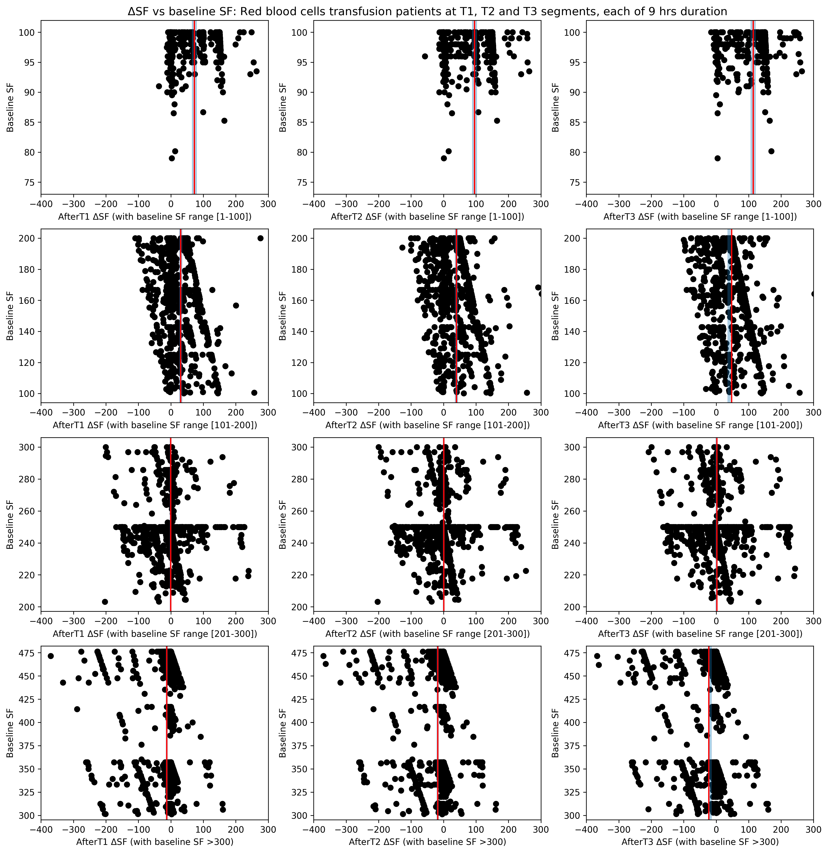
ΔSF vs Baseline SF
2016-2020 Grady ICU patients, RBC transfused, no MTP, no overlapping segments included

Slide 12
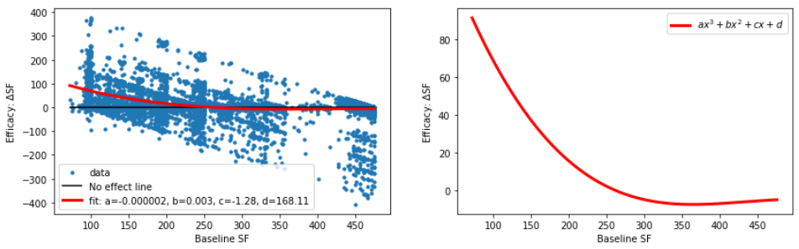
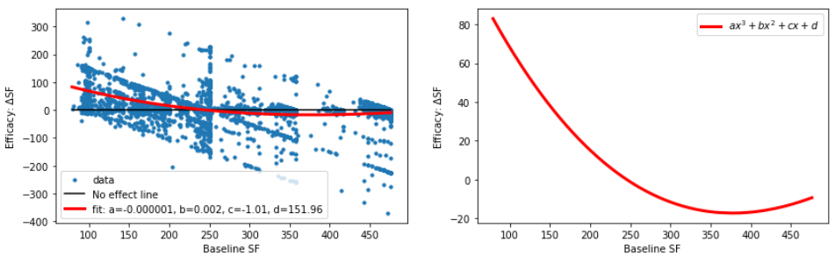
Transfusion efficacy TE: ΔSF BSF: Baseline SF ratio
ΔSF vs BSF: Modeling using Polynomial Curve Fitting
Emory data
R_squared = 0.19
Grady data
R_squared = 0.203

Slide 13
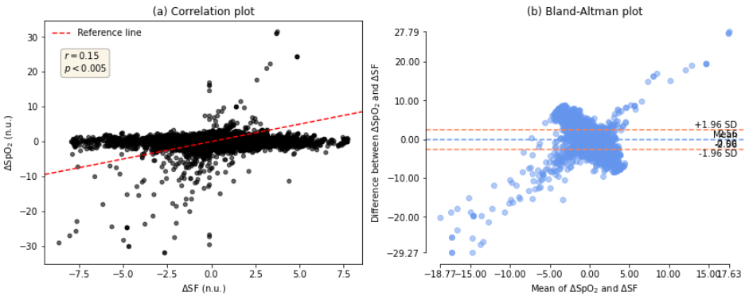
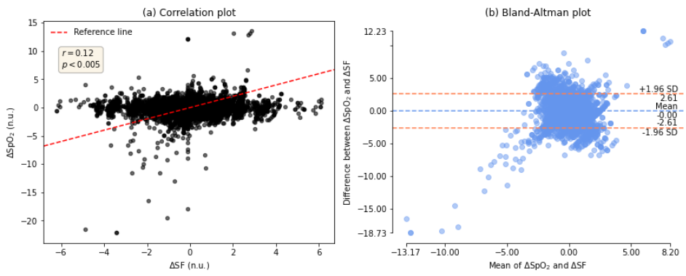
ΔSF vs ΔSpO2: Bland Altman Analysis
Emory data
Grady data

