Slide 1
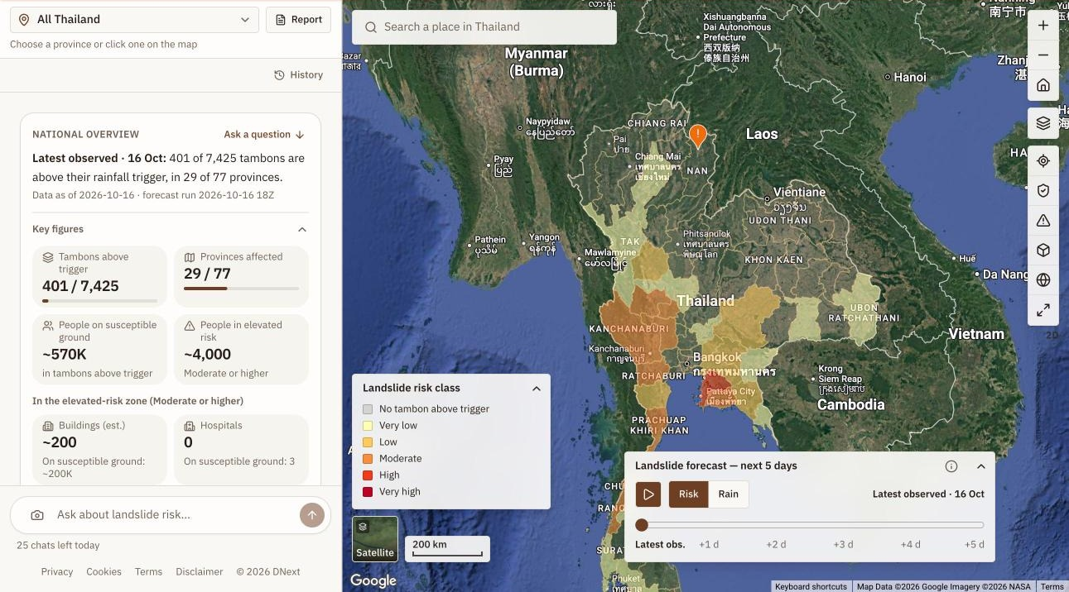
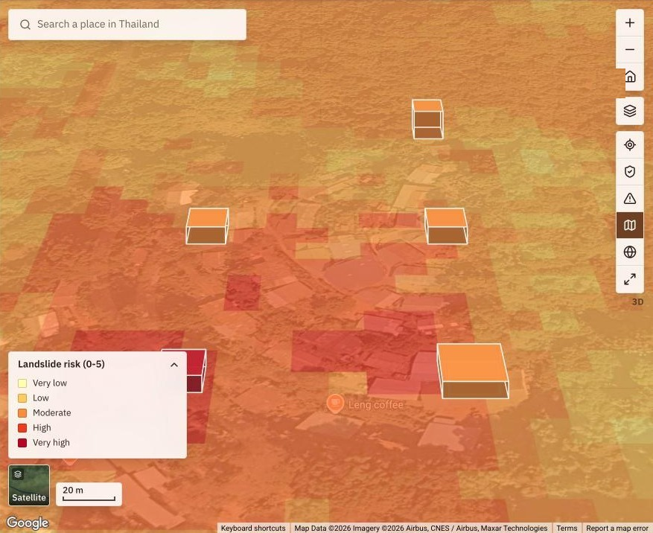
DNext · LandslideWatch TH
Landslide risk screening for Thailand, in plain language: where heavy rain is most likely to trigger landslides, and who and what sits in the way.
Theme: Sustainability & Social Impact
Category: Sustainability · Live: dnext-web-37ob55mcga-as.a.run.app
DNext (Disaster Next) Team
Kamal Hosen, Geospatial Application Developer
Hafsah Ilmy, Geospatial Data Scientist (Landslide Model Developer)
Notes:
Opening. DNext is a landslide risk screening tool for Thailand. Ask a what-if question in English or Thai and get a map, an estimate of what is exposed, and a five-day outlook. Built on Google Cloud: Gemini on Vertex AI through the Agent Development Kit, Earth Engine, Cloud Run, Firestore, BigQuery, Pub/Sub and Google Maps Platform.

Slide 2
Heavy rain triggers landslides, and planners lack a fast local view
Every rainy season, heavy rain sets off landslides on susceptible slopes across Thailand.
The data that answers "how bad could it get here?" sits in separate systems: rainfall, slope susceptibility, population, buildings, roads. Combining it takes a specialist and time.
People planning ahead need three answers quickly: which sub-districts are close to their rainfall trigger, who and what lies in the way, and where people can go.
7,425
tambons (sub-districts), each with its own rainfall thresholds
77
provinces covered, updated twice a day
30 days
of observed rain plus a 5-day forecast, compared with each tambon's own history
Notes:
The problem. Landslides in Thailand follow heavy rain. The inputs needed to judge the risk are spread across systems that need specialist skills. DNext brings them into one screen at tambon level and answers in plain language.

Slide 3



Who it helps, and how
Planners and local government
Responders, hospitals and schools
Communities
Compare 150 mm with 300 mm before the rain arrives.
See which sub-districts to check first.
Export an editable PDF report in English or Thai.
See buildings, main roads, hospitals and schools inside the Moderate-or-higher zone.
Follow a 5-day outlook and get an in-app alert when a watched province gets riskier.
Report a landslide or blocked road with a photo that AI checks before it is shown.
Find candidate safe places on low-risk ground and preview a route.
Notes:
Community benefit. Planners get a fast what-if view. Responders see what is exposed and are told when risk rises. Communities can report what they see and find candidate safe places. All of it is in English and Thai.

Slide 4
One screen for the whole country, today and for the next five days
Risk by province
Latest observed risk, coloured by class, with a play button for the next five days.
Key figures
401 of 7,425 tambons above their rainfall trigger in 29 of 77 provinces (16 Oct).
Reference layers
Susceptibility, vulnerability, exposure and population, each switchable.
Live screen, 16 October 2026: national overview with the 5-day forecast slider.
Notes:
The first screen shows the national picture. The slider steps through the next five days of forecast and the play button animates it.

Slide 5
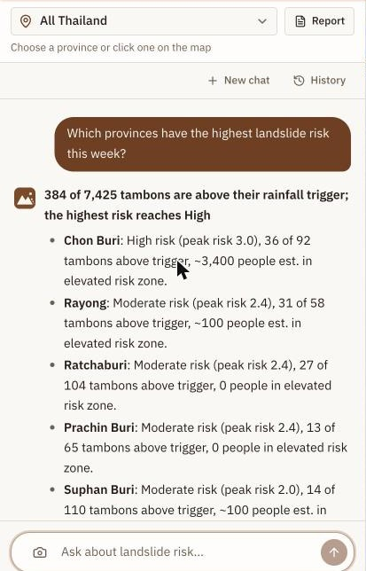
Ask in plain language, in English or Thai
What if 250 mm falls on Nan in 3 days?
Risk map, tambon table, people, buildings, roads, hospitals and schools.
Which provinces have the highest landslide risk this week?
A ranked list and table, with the data date and forecast run time.
How many schools and hospitals are at risk in Chon Buri?
Counts for the country, a province, a district or one tambon, plus named facilities.
And in Chiang Mai? / What about next week?
Follow-ups keep the place, the time horizon and the risk class.
Notes:
The assistant answers in the user's language. Ranking and how-many questions are answered from the daily data; follow-ups such as 'and in Chon Buri' or 'what about next week' keep the context.

Slide 6
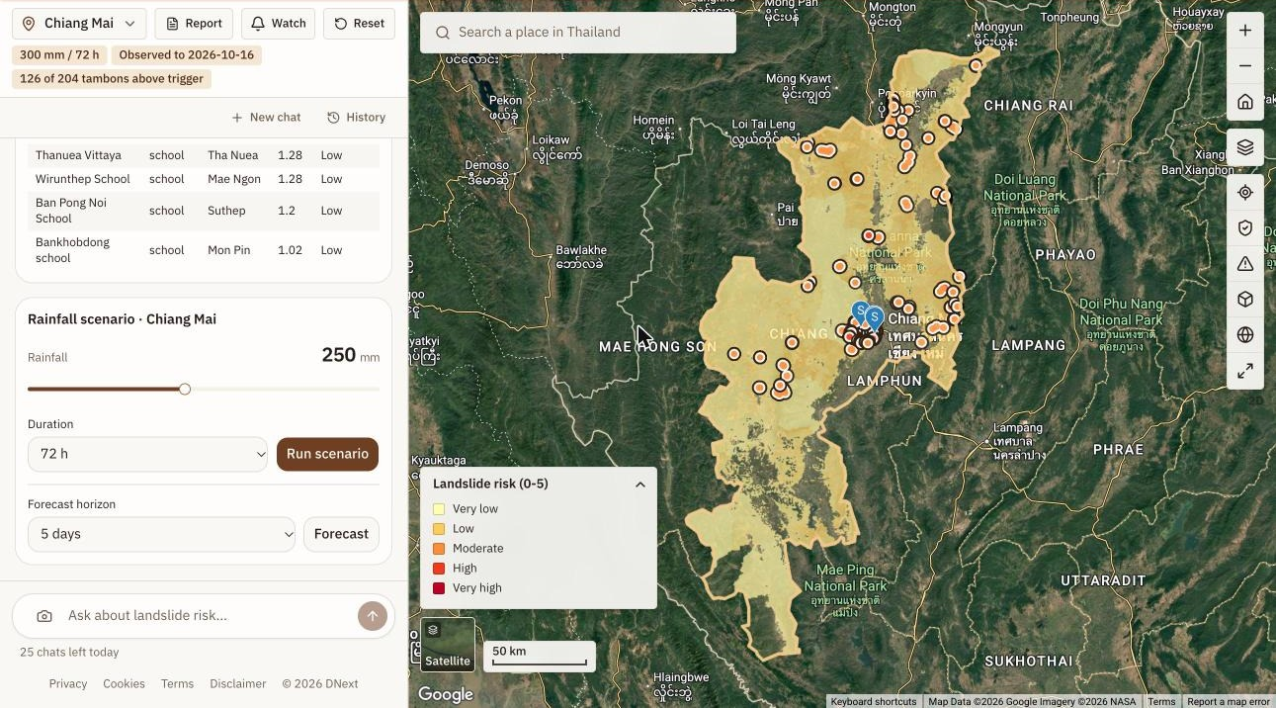
See what is exposed: buildings, roads, hospitals and schools
300 mm in 72 h, Chiang Mai: 3,424 buildings and 61.6 km of main road sit in the Moderate-or-higher zone. Each building is a point with a dark ring and white outline so thousands stay readable.
Street-level 3D: each affected footprint is raised by its estimated height. A "height exaggeration" control (x1 to x5) makes low rural buildings easier to see.
Notes:
Affected infrastructure is shown only for the Moderate-or-higher zone. Buildings come from Google Open Buildings, roads from OpenStreetMap. In 3D the heights are estimates, so the panel says so.

Slide 7
Every number is calculated, never written by the model
risk = trigger × susceptibility × vulnerability × exposure ÷ 125
Trigger
Susceptibility
Vulnerability
Exposure
A tambon's 30 days of rain (observed satellite rain plus the GFS forecast, or the what-if amount) against that tambon's own rainfall thresholds.
A landslide susceptibility map at 12 m, classed 1 to 5.
A national vulnerability index, classed 1 to 5.
A national exposure index, classed 1 to 5.
Data: JAXA GSMaP and NOAA GFS rainfall · ADPC susceptibility, vulnerability and exposure layers through Google Earth Engine · WorldPop 2020 · GHSL built-up area · Google Open Buildings · OpenStreetMap. A tambon counts as landslide-prone only with at least 1 km² and 2% susceptible ground, so flat cities show no false risk.
Notes:
The method is a screening calculation at tambon level. The classes are national and relative, not probabilities. The rain trigger uses each tambon's own history, which is what makes it local.

Slide 8




Gen AI at the core: an agent that calls tools and never invents figures
Question
Gemini agent
10 tools
Computed data
Answer
English or Thai
Vertex AI · Agent Development Kit
scenario, forecast, rankings, exposure, explain a point, briefing
daily files and Earth Engine
table, map, short text
The model chooses tools; the tools compute
Follow-ups keep the conversation
Every figure, name and class in an answer comes from a tool result. Ranking and "how many at risk" questions read the daily files directly, and a what-if is run only when the user gives a rainfall amount.
Place, time horizon and risk class carry over. A repeated place name such as "Bang Phra" gets one clarifying question instead of a guess.
Gemini also reads photos
Tested, not assumed
Community photos are checked for landslide, blocked road or slope damage, then compared with the area's data before anything is shown. The photo is never stored.
A 20-case evaluation set checks tool choices, plus 260+ automated tests. The closing caveat is fixed wording in English and Thai.
Notes:
This is where Gen AI does meaningful work: understanding the question in two languages, choosing the right tool, keeping the conversation, and explaining results. The numbers never come from the model. Gemini vision is used for community photo checks.

Slide 9
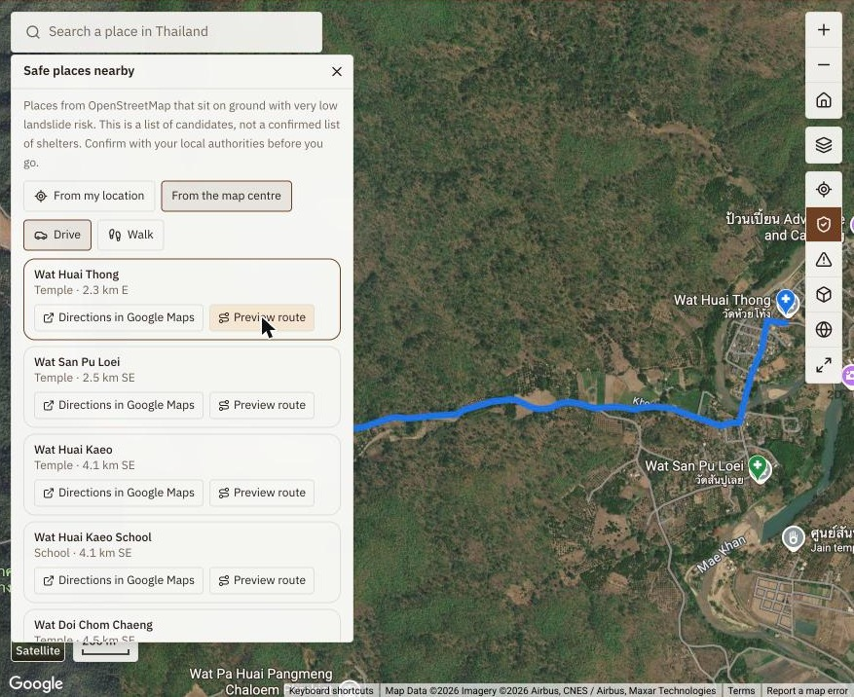


Communities can report, and find somewhere safer to go
Report what you see
A photo of a landslide, blocked road or slope damage. Gemini reads it and the data for the place is checked. Only reports where both agree are shown, for 48 hours (7 days for slope damage). Three flags hide a report.
Find candidate safe places
26,425 named places from OpenStreetMap (shelters, community buildings, schools, temples, hospitals) on ground that stays at very low risk.
Preview a route
Google Routes API, ranked by how little of each route follows risky main-road sections. Never a guarantee of safety.
Notes:
Community loop. Reports are labelled as checked by AI and not verified by authorities. Safe places are candidates from open data, not a confirmed shelter list.

Slide 10
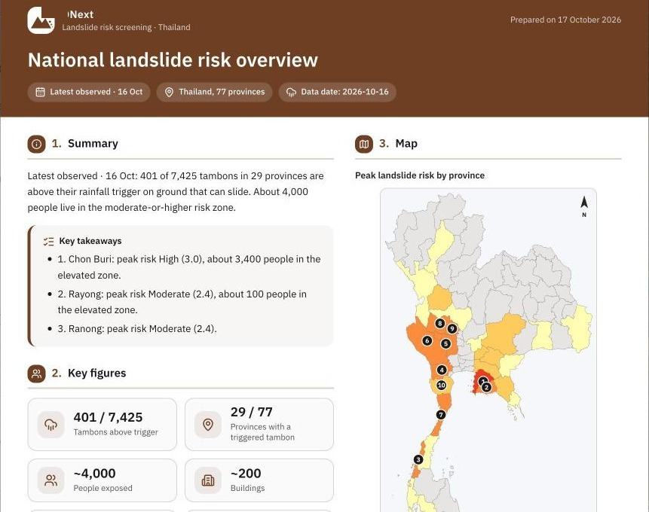



Reports to share, and alerts when risk rises
An editable report in one click
Maps, key figures, charts, priority areas and general safety guidance for the result on screen or the national overview. Click any text to edit, then save as PDF in English or Thai.
Watch a province
Signed-in users watch up to 10 provinces and get an alert in the app when the peak risk of one rises. Alerts are notices, not warnings.
History and a daily rhythm
A Cloud Run job runs at 06:30 and 18:30 Bangkok time, refreshes rainfall, appends the day to BigQuery (30-day trend) and announces new data through Pub/Sub.
The report editor: click any text to edit before exporting.
Notes:
The report editor is for sharing a result with colleagues. Alerts are generated by comparing each run of the daily job with the previous one.

Slide 11
Built on Google Cloud, serverless end to end
Gemini (Vertex AI)
Earth Engine
chat agent, photo check
layers, map tiles
Browser
Cloud Run: web
Cloud Run: API
English · Thai · phone to widescreen
Next.js · security headers
FastAPI · ADK agent · rate limits
Firestore
Cloud Storage
cache, chats, alerts, reports
precomputed data files
BigQuery
Pub/Sub
30-day history
new-data message
Cloud Scheduler
Cloud Run job
writes the daily files to Cloud Storage, history to BigQuery, and announces new data through Pub/Sub
06:30 and 18:30 Bangkok
rainfall per tambon, overview, history, alerts
Firebase Auth
Maps Platform
Google sign-in
Maps JS, Geocoding, Routes
Also: Secret Manager, Artifact Registry, Cloud Build and Cloud Logging for deployment and operations.
Notes:
Two Cloud Run services plus one Cloud Run job. The heavy work is precomputed twice a day, so a request needs milliseconds of arithmetic plus map tiles from Earth Engine.

Slide 12




Feasible today, and built to scale and to last
Fast by design
Elastic and shared
Heavy statistics are precomputed twice a day. The 5-day national overview answers in about 0.2 s; a scenario in roughly 1 to 8 s.
Cloud Run scales with traffic. Simultaneous requests share one computation, results are cached in Firestore and in memory, and stale data is served while it refreshes.
Cost-controlled
Secure by default
Per-account daily limits (30 chats, 200 runs, 40 route previews), a daily route cap, photos analysed once and never stored, records that expire on their own.
Google sign-in, per-caller rate limits, security headers, dependency audits in CI, no keys in the repository or the images.
Portable: replace the susceptibility, vulnerability and exposure layers and the same app covers another country or another rainfall-triggered hazard.
Notes:
Feasibility and scalability. Everything runs on managed Google Cloud services. Cost is bounded by per-account limits and by precomputing the expensive parts.

Slide 13
Honest about limits, clear about what comes next
What DNext is not
Next steps
A screening tool for planning, not a warning or an evacuation order.
Not calibrated for single slopes or villages; classes are relative, not probabilities.
What-if rain is assumed uniform across the area.
Buildings and people are rounded estimates; OpenStreetMap can be incomplete.
Safe places are candidates. Community reports are checked by AI, not verified.
Calibrate the thresholds against historical landslide records.
Pilot with provincial planning teams and collect their feedback.
Add flood and other rainfall-triggered hazards.
Extend to other ASEAN countries by swapping the national layers.
Short summaries for messaging apps, for places with weak connections.
DNext does not replace local knowledge. It helps people decide where to look first.
Notes:
We say plainly what the tool cannot do. The next steps are about validating it with real events and with the people who would use it.

Slide 14
Try it live
https://dnext-web-37ob55mcga-as.a.run.app
1
Open the page
2
Sign in with Google
3
Try a question
The national map and the 5-day forecast show without signing in. Press play.
Needed for chat, scenarios, routes and reports (per-account daily limits apply).
"What if 250 mm falls on Nan in 3 days?" · "Which provinces have the highest risk this week?" · "How many schools are at risk in Chon Buri?"
DNext (Disaster Next) Team
Kamal Hosen
Geospatial Application Developer
kamal.hosen@adpc.net
Hafsah Ilmy
Geospatial Data Scientist (Landslide Model Developer)
hafsah.ilmy@adpc.net
Theme: Sustainability & Social Impact · Category: Sustainability · Google Cloud: Gemini on Vertex AI, Agent Development Kit, Earth Engine, Cloud Run, Firestore, BigQuery, Pub/Sub, Cloud Storage, Firebase Authentication, Google Maps Platform
Notes:
Closing. The link works on any device. Sign-in is only needed for the parts that cost money to run.

