Slide 1
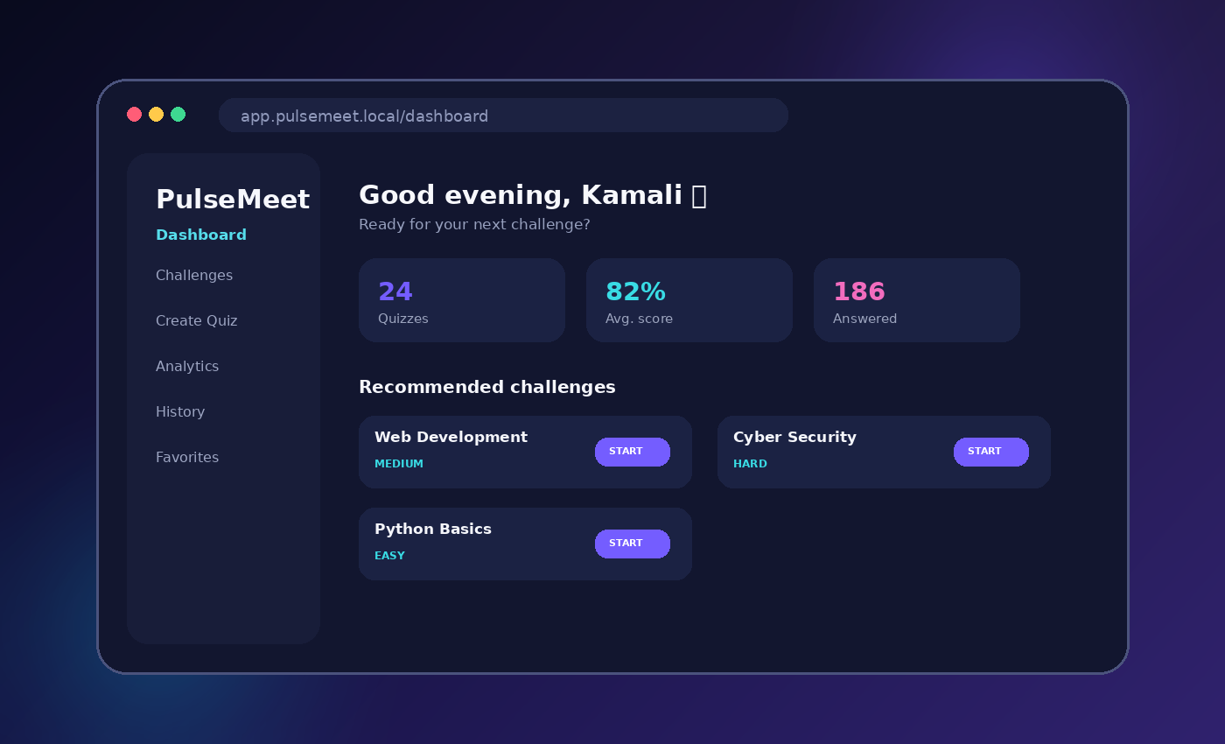
WEB PROGRAMMING | PROJECT PRESENTATION
PulseMeet
Interactive Live Polling
& Quiz Platform
KAMALI RJ
Roll No. 240701225
COMPUTER SCIENCE AND ENGINEERING
Web Programming • Semester V
CREATE • PLAY • TRACK
01

Slide 2
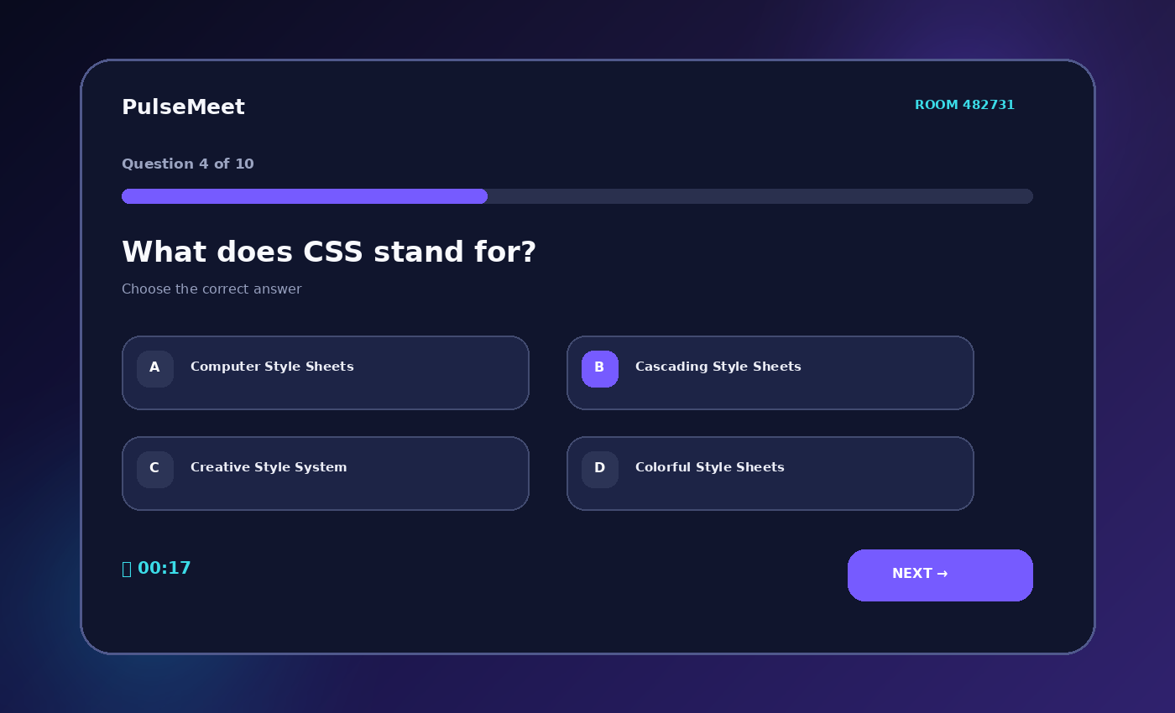
01 • INTRODUCTION
Project overview
A polished interactive platform that turns ordinary quizzes into engaging digital sessions.
THE IDEA
01
Create and discover interactive quizzes.
02
Answer questions with progress and a countdown timer.
03
Get instant score, feedback and achievement badges.
04
Review history and performance analytics.
Interactive quiz screen
PULSEMEET • WEB PROGRAMMING
KAMALI RJ • 240701225
02

Slide 3
02 • MOTIVATION
Problem statement & objectives
Designed to reduce manual effort while improving participation and feedback.
PROBLEM
OBJECTIVES
•
Manual scoring takes time.
✓
Build a responsive professional UI.
•
Feedback is often delayed.
✓
Create custom quizzes easily.
✓
Automate score and result calculation.
•
Managing multiple quiz topics is inconvenient.
✓
Add timer, room code and leaderboard.
•
Traditional quizzes may lack motivation.
✓
Track progress and achievements.
PULSEMEET • WEB PROGRAMMING
KAMALI RJ • 240701225
03

Slide 4
03 • TECHNOLOGY
Technology stack
The project uses a modern frontend stack suitable for a Web Programming project.
React
JavaScript
HTML5
Reusable components
Logic & state
Structure
CSS3
Vite
localStorage
Responsive design
Build & development
Browser persistence
PULSEMEET • WEB PROGRAMMING
KAMALI RJ • 240701225
04

Slide 5
04 • FEATURES
Core features
A complete workflow from challenge discovery to performance tracking.
Dashboard
Quiz Builder
1
2
Statistics, challenges and quick actions.
Create questions and publish quizzes.
Quiz Player
Room Code
3
4
Options, progress and countdown timer.
Join a live-style quiz session.
Leaderboard
Analytics
5
6
Compare participant scores.
History, accuracy, streaks and badges.
PULSEMEET • WEB PROGRAMMING
KAMALI RJ • 240701225
05

Slide 6
05 • UI / UX
Interface design
The interface uses visual hierarchy, card layouts and clear calls to action.
DESIGN HIGHLIGHTS
✓
Modern gradient accents
✓
Card-based challenge layout
✓
Responsive desktop/mobile UI
✓
Dark / light theme
✓
Clear action buttons
✓
Consistent icon language
PULSEMEET • WEB PROGRAMMING
KAMALI RJ • 240701225
06

Slide 7
06 • PROCESS
System workflow
The project follows a simple six-step interaction cycle.
01
CREATE
02
DISCOVER
03
JOIN
Build a challenge
Search & filter
Start / enter code
04
PLAY
05
RESULT
06
TRACK
Answer questions
Score & ranking
History & analytics
PULSEMEET • WEB PROGRAMMING
KAMALI RJ • 240701225
07

Slide 8
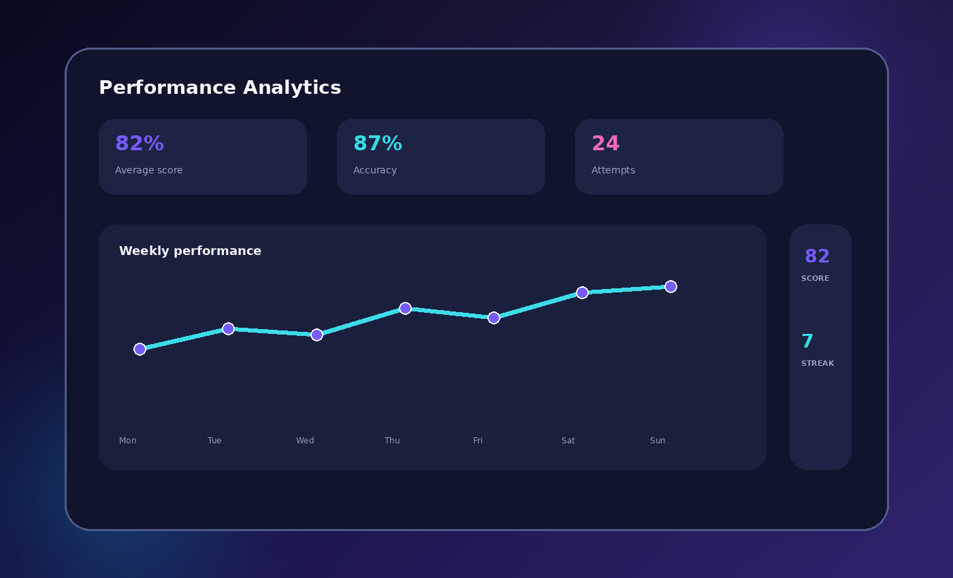
07 • TRACKING
Performance analytics
Users can understand progress through scores, accuracy, attempts and streaks.
TRACKABLE METRICS
82%
Average score
87%
Accuracy
24
Attempts
7
Day streak
PULSEMEET • WEB PROGRAMMING
KAMALI RJ • 240701225
08

Slide 9
08 • FUTURE
Future scope
The frontend prototype can be extended into a real-time multi-user platform.
Real-time rooms
Cloud database
WebSockets / Socket.IO
Supabase / Firebase / PostgreSQL
Teacher & admin
Advanced analytics
Roles, reports and approvals
Question-level insights
More interactions
Security
Polls, word clouds and Q&A
Authentication & authorization
PULSEMEET • WEB PROGRAMMING
KAMALI RJ • 240701225
09

Slide 10
09 • SUMMARY
Conclusion
PulseMeet brings interactive assessment, engagement and progress tracking into one polished web application.
KEY TAKEAWAY
PROJECT DETAILS
01
Demonstrates React, JavaScript, HTML and CSS in a practical project.
KAMALI RJ
Provides quiz creation, participation, scoring and analytics.
240701225
02
COMPUTER SCIENCE
AND ENGINEERING
03
Uses a responsive UI suitable for classroom and audience interaction.
04
Provides a clear foundation for future real-time and cloud integration.
THANK YOU
PULSEMEET • WEB PROGRAMMING
KAMALI RJ • 240701225
10

