Slide 1
Welcome to Azure DevOps
KAMAL BATHAM

Slide 2
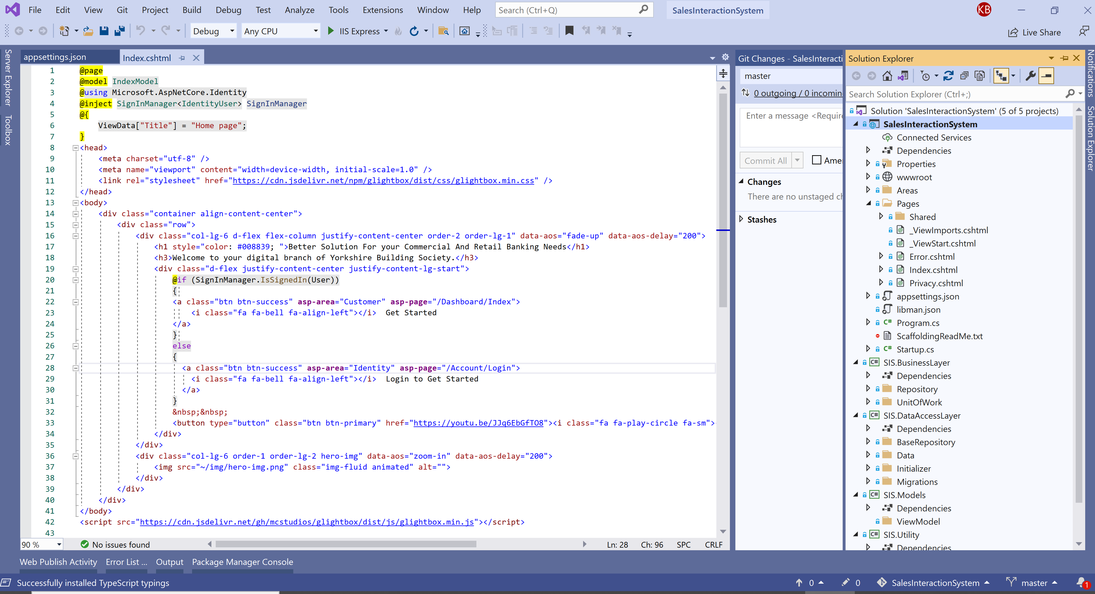
DevOps Infrastructure and Environment
How it configured in our On-premise machine:
1
Developed a .Net Core Razor Page Application – Developed a Web Application using .Net Core RazorPage for this demo, and to represent how azure devops works for CI/CD.
2
Local Source Control– Configured Git as local source control system
3
Centralized Source Control - Configured Azure Repository on H30007 as centralized source control system.
4
Azure DevOps Sever setup configured on H30007 and can be accessed by using - http://h30007:85/DefaultCollection
Entire Features – Including Board, Repository build pipeline, Test plans and Artifacts can be managed by using this ULR path.

Slide 3
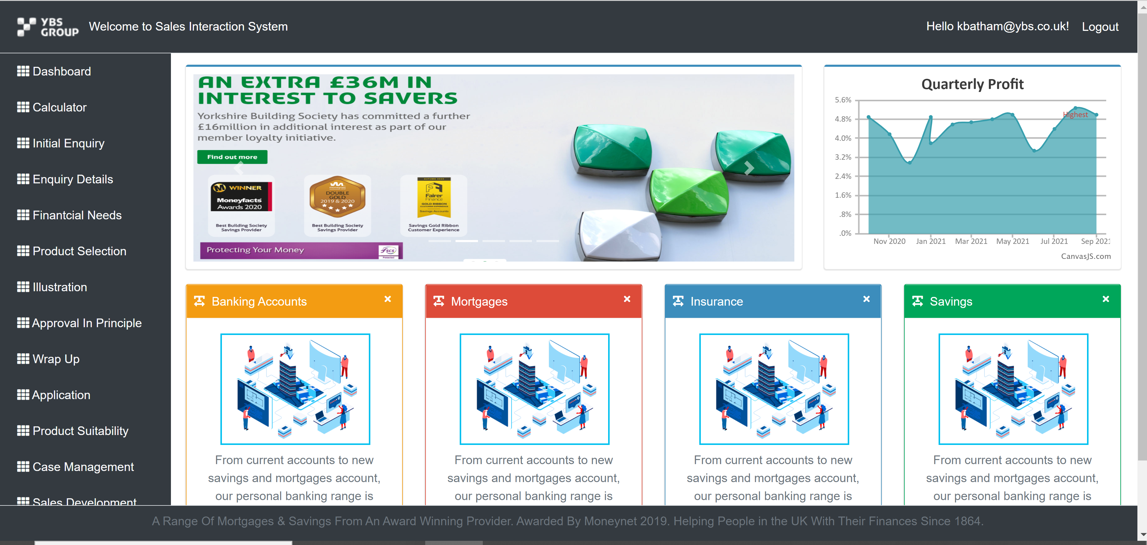
DevOps Infrastructure and Environment
How it configured in our On-premise machine:
1
Dev Stage– Set the H30007 as Dev environment and configured the Web Server (IIS) to deploy application using DevOps Pipeline. - http://h30007.ybs.com/
QA Stage– Configured H30022 As the QA environment. DevOps Pipeline automated the deployment to Prod environment. We can browse deployed application using below URL - http://h30022.ybs.com/
2
Pre-Production Stage– Configured H30006 As the QA environment. DevOps Pipeline automated the deployment to Prod environment. We can browse deployed application using below URL - http://h30006.ybs.com/
3
Production Stage– Configured H30006 As the Production environment as well. DevOps Pipeline automated the deployment to Prod environment. We can browse deployed application using below URL - http://h30006:85.ybs.com/
http://ybsxw505:84
4

Slide 4
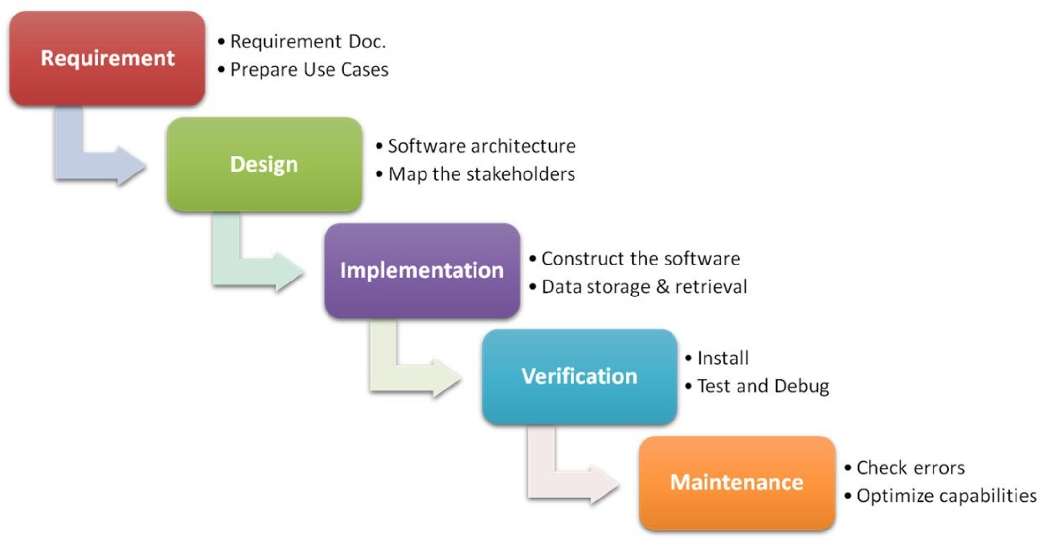
Waterfall Model

Slide 5
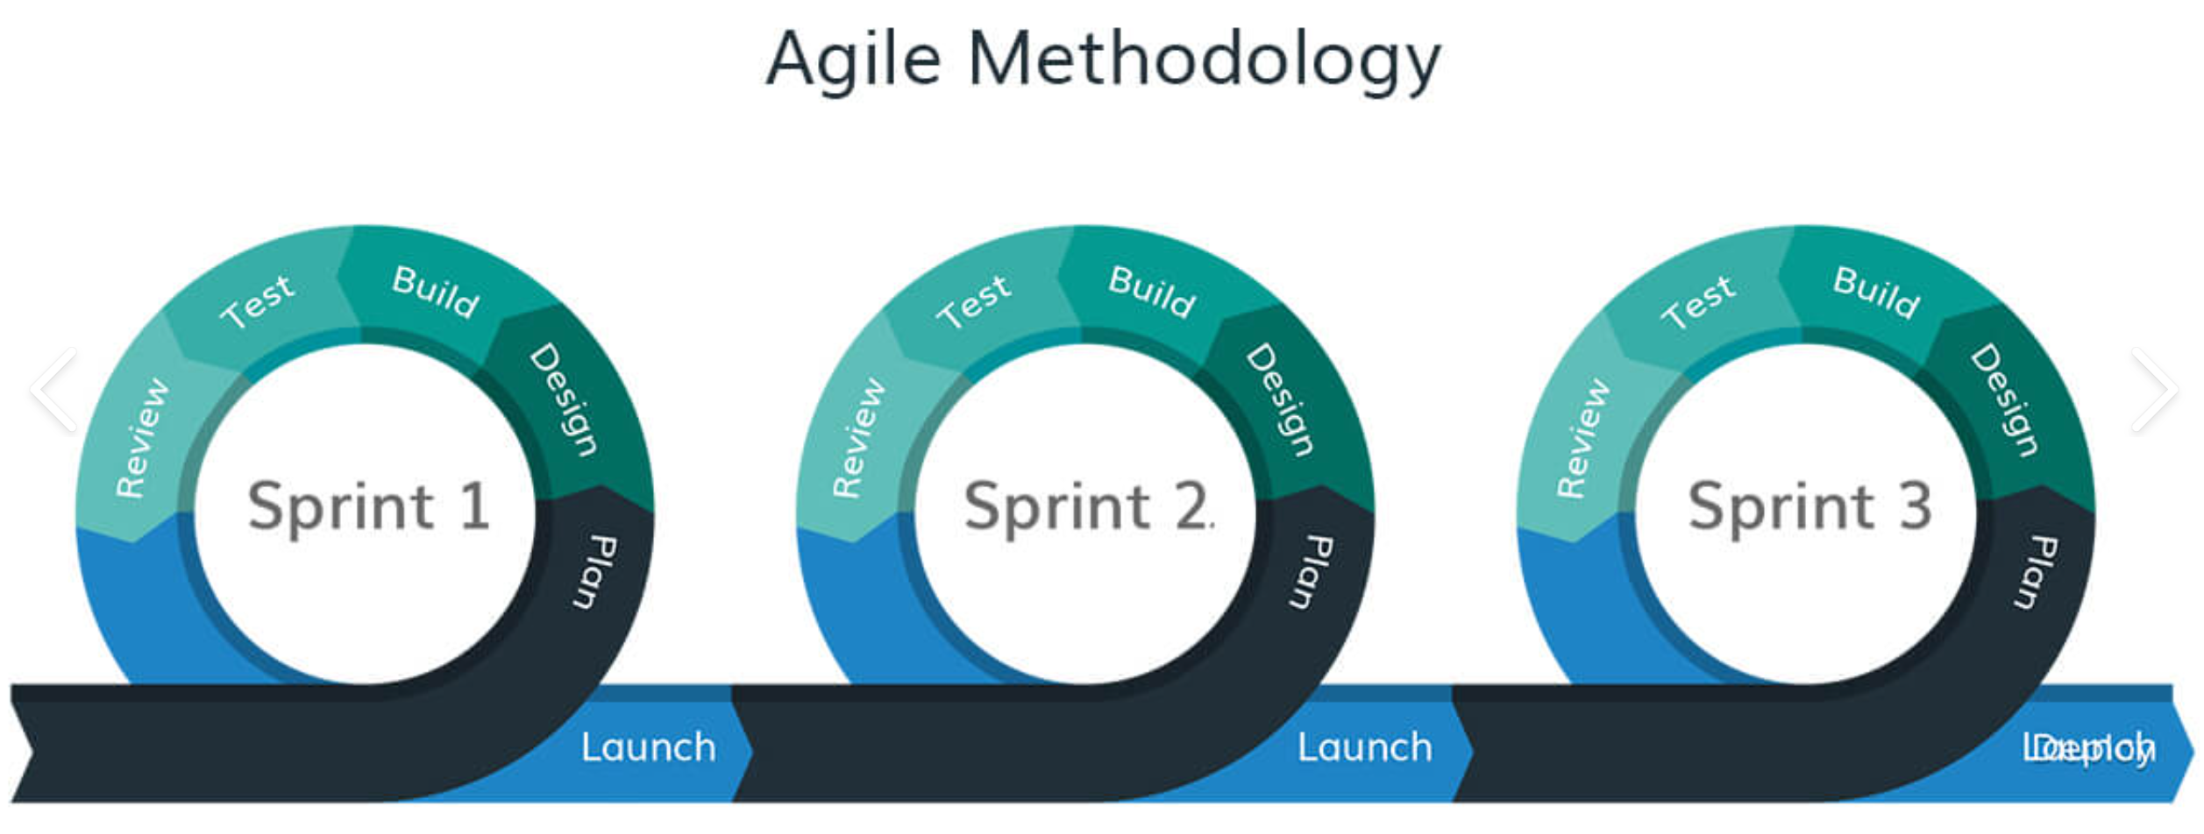
Agile Methodology

Slide 6
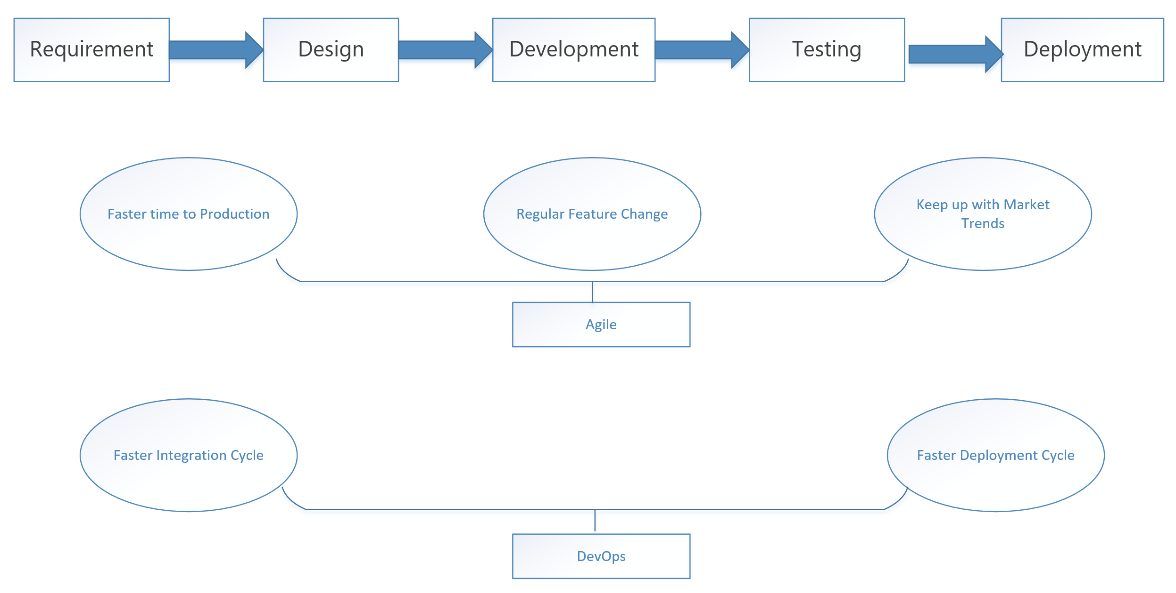
SDLC

Slide 7
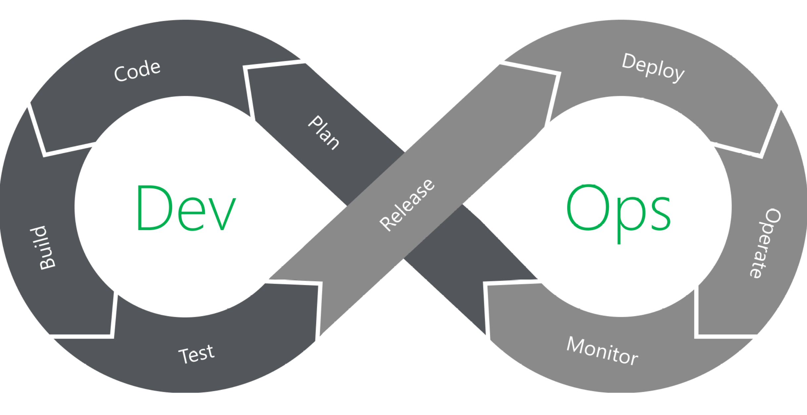
DevOps
DevOps - Both Development and Operation have agility feature.

Slide 8
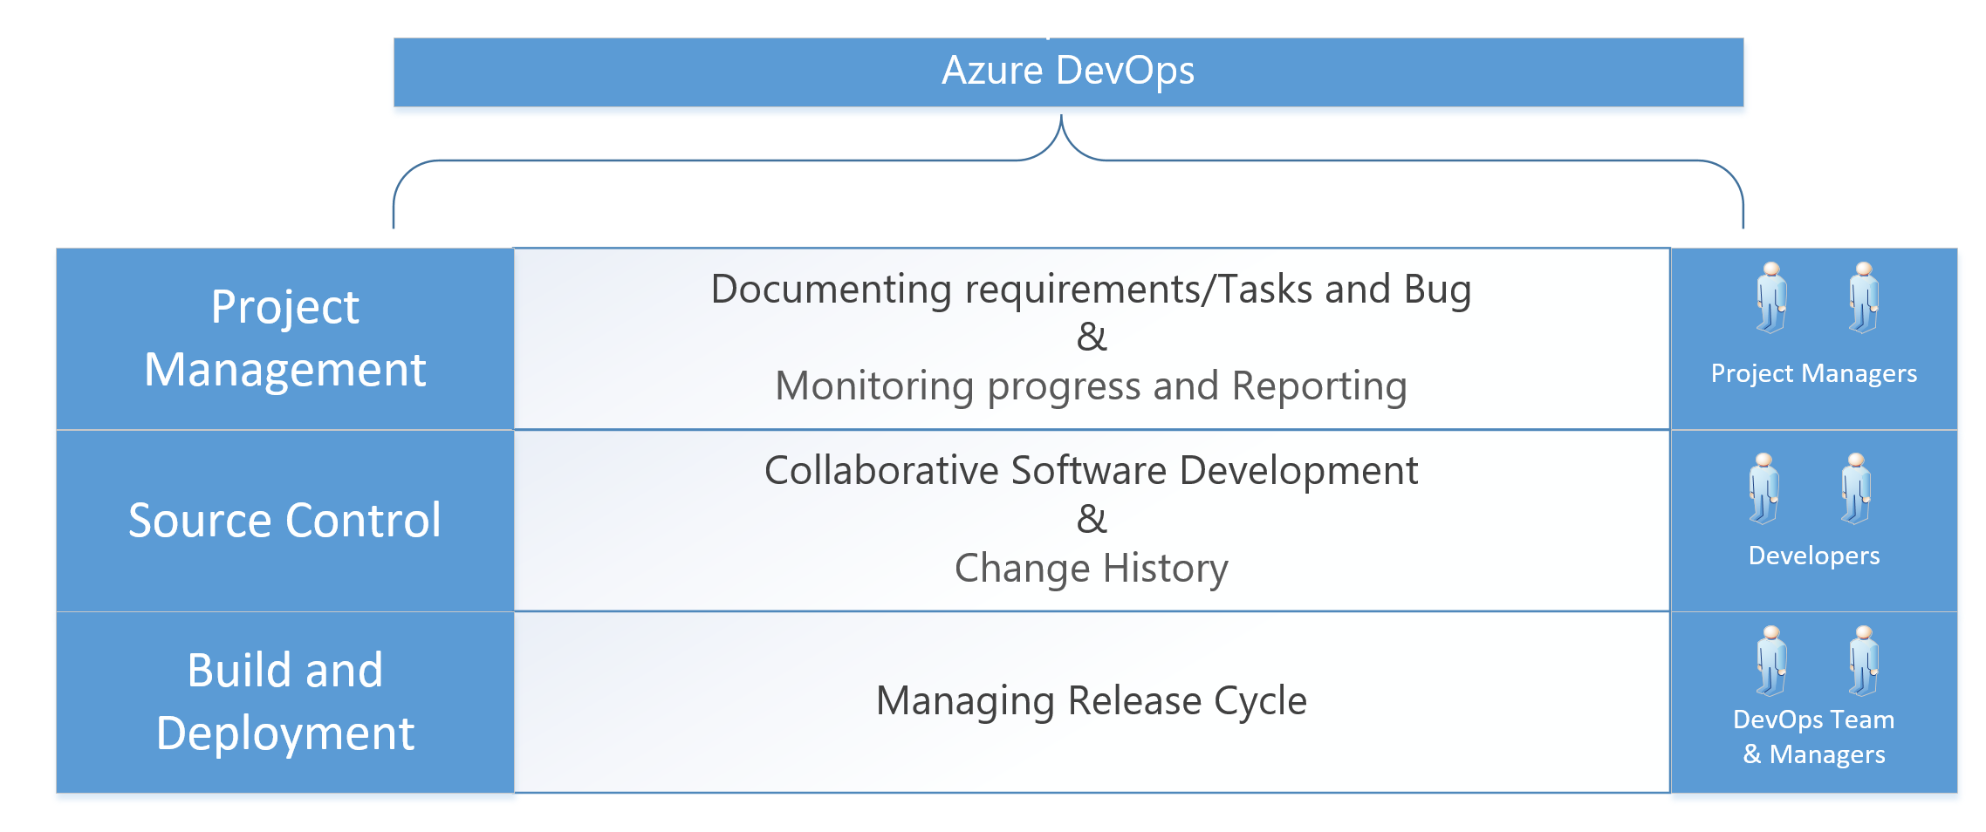
Why Azure DevOps

Slide 9
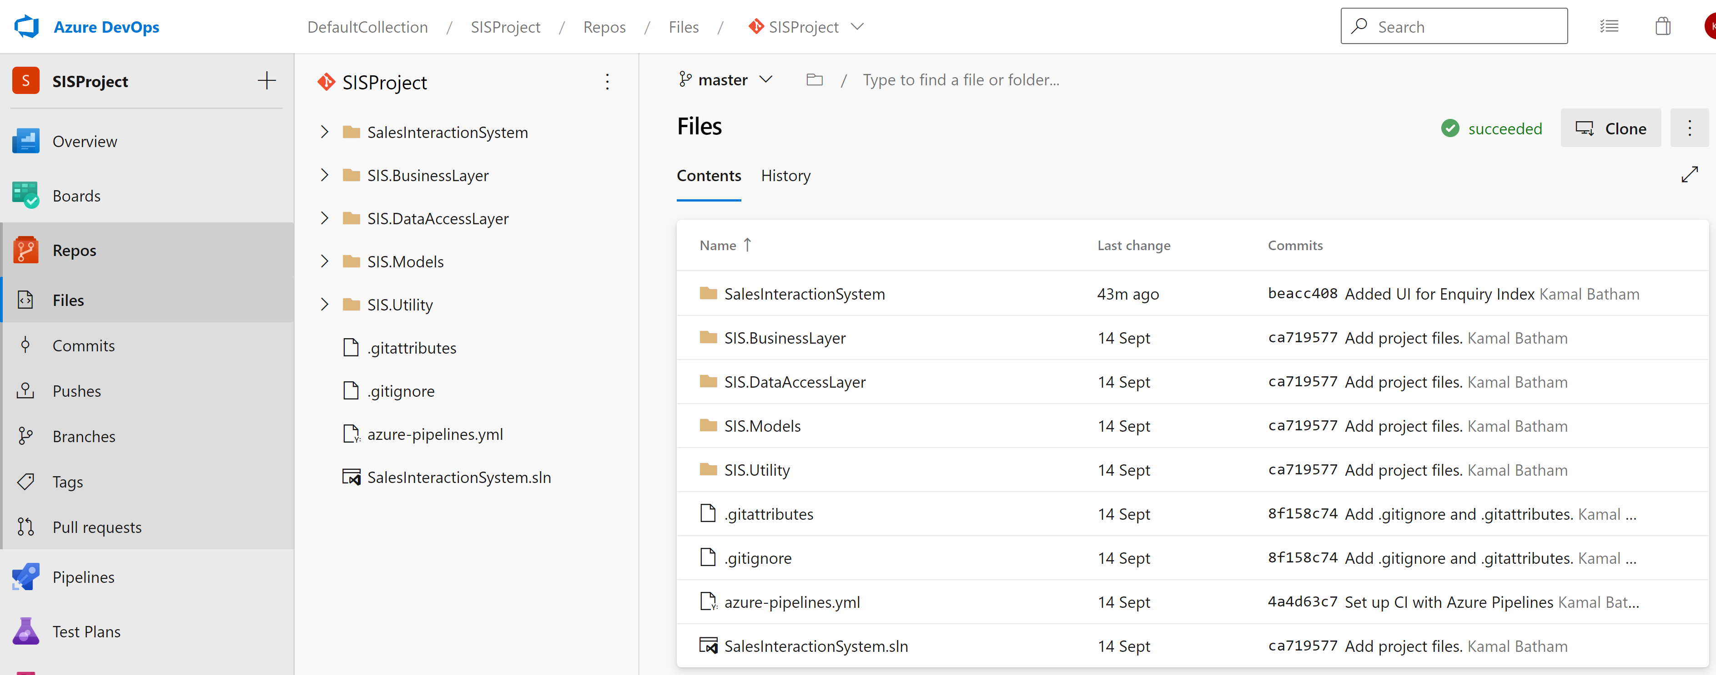
Azure DevOps Git Repository

Slide 10
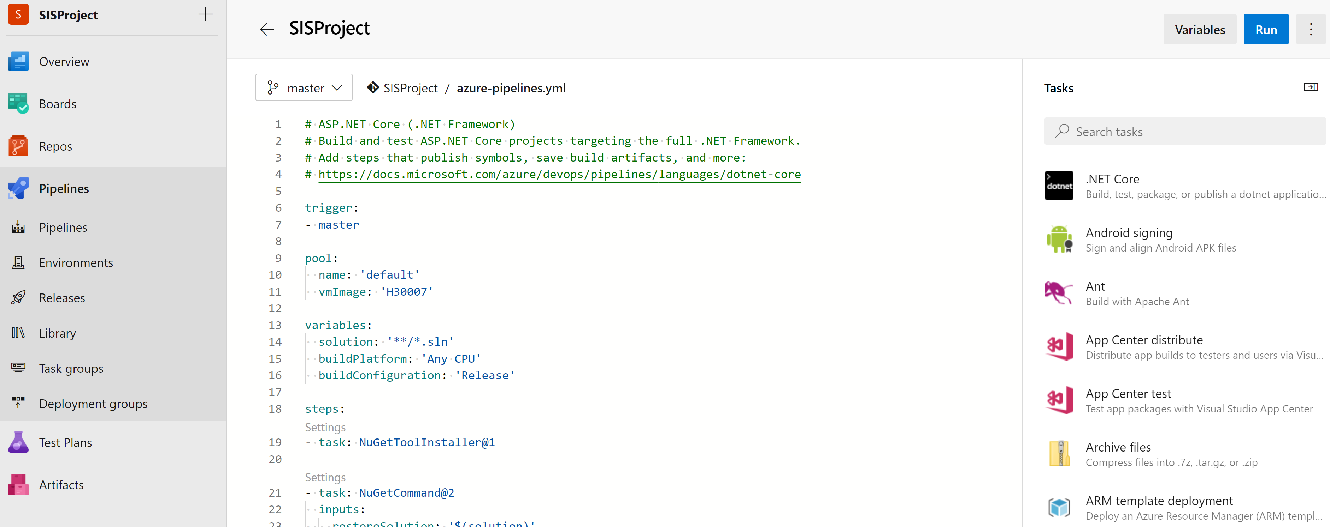
Build Pipeline

Slide 11
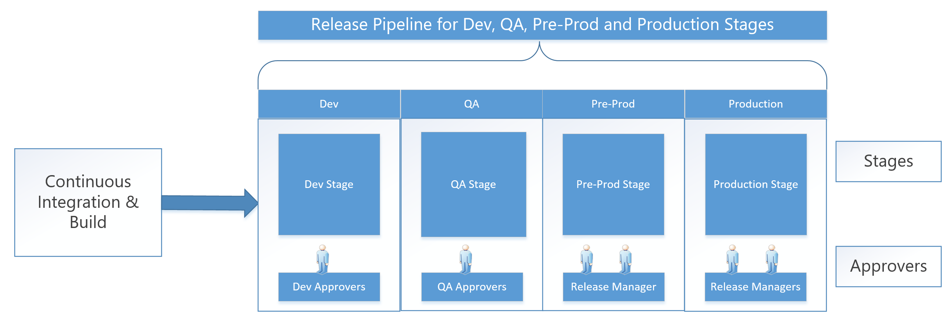
DevOps Release Pipeline

Slide 12
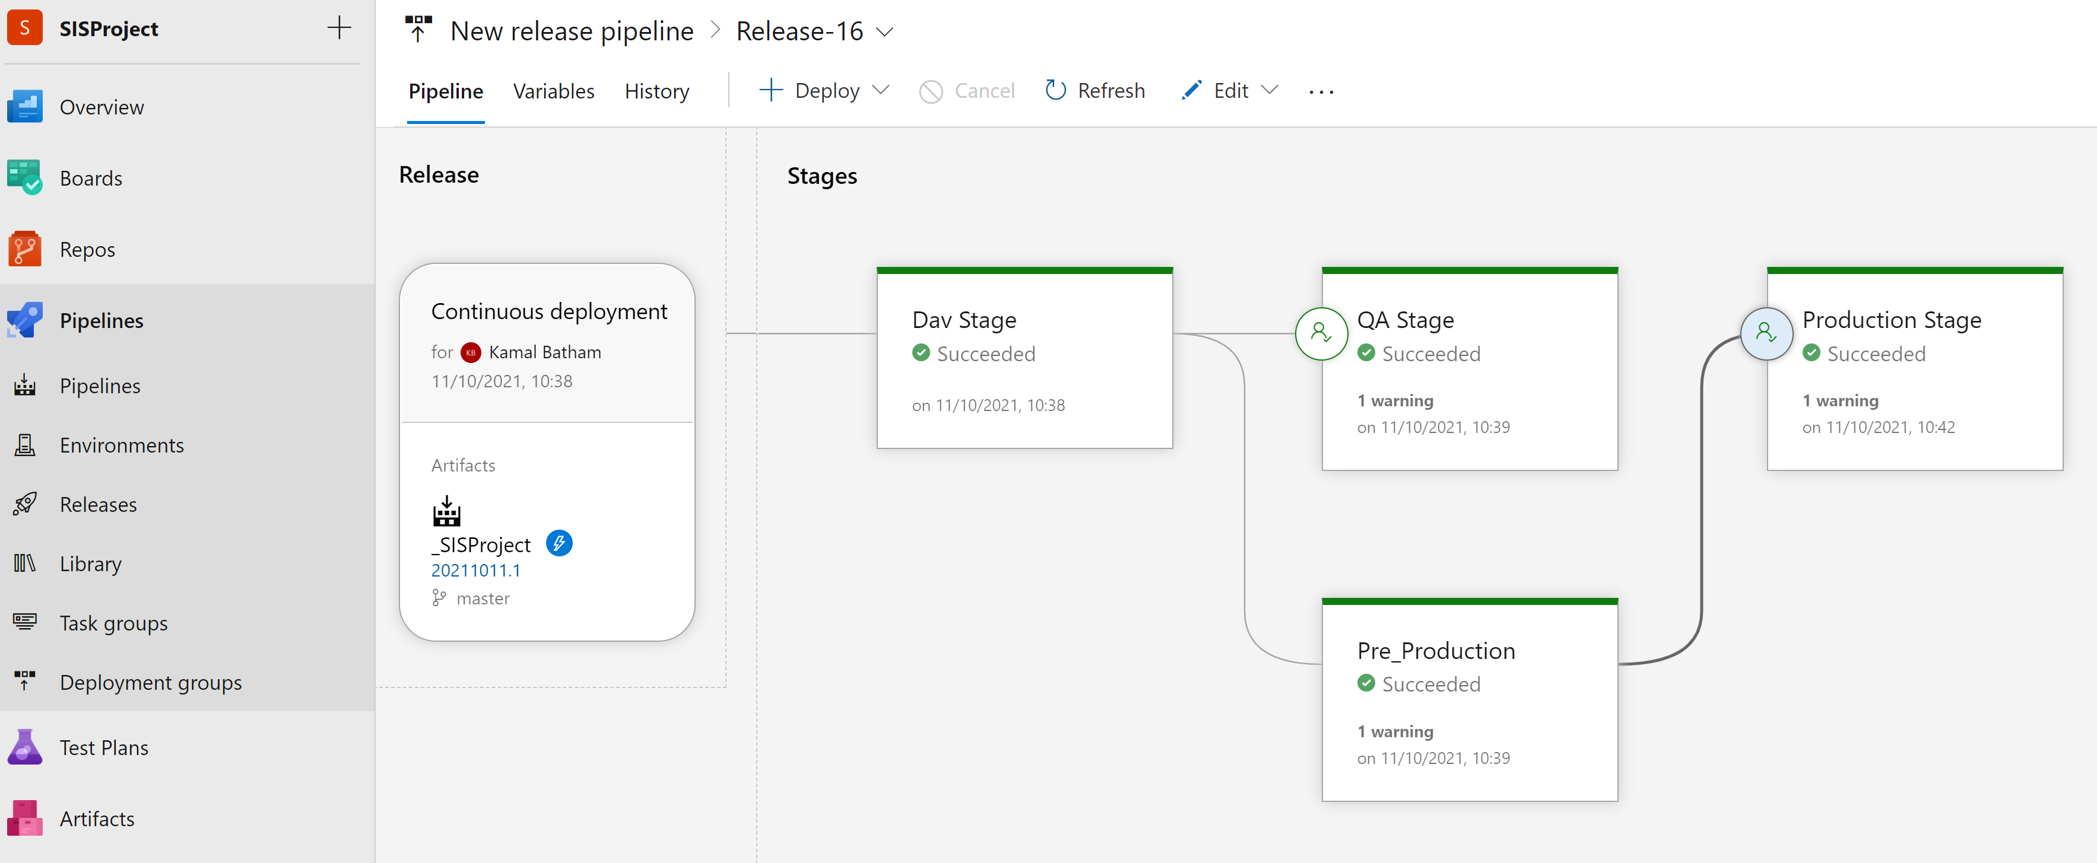
Release Pipeline

Slide 13
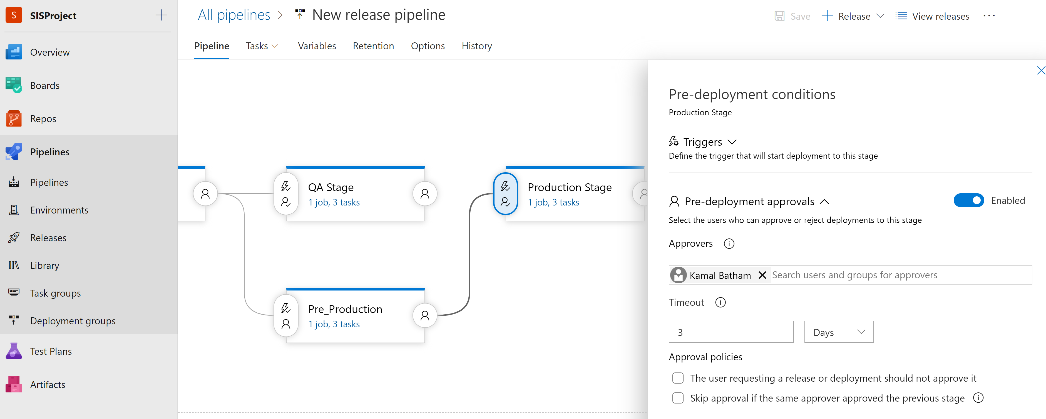
Deployment Approvals

Slide 14
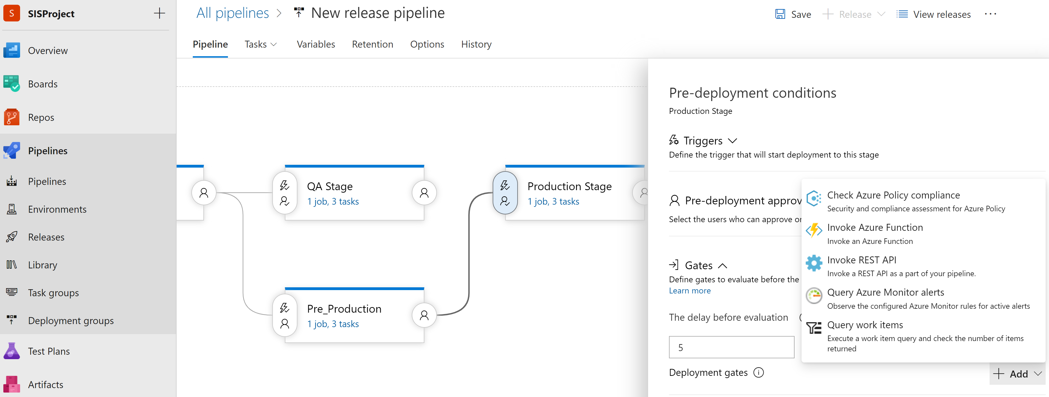
Gates

Slide 15
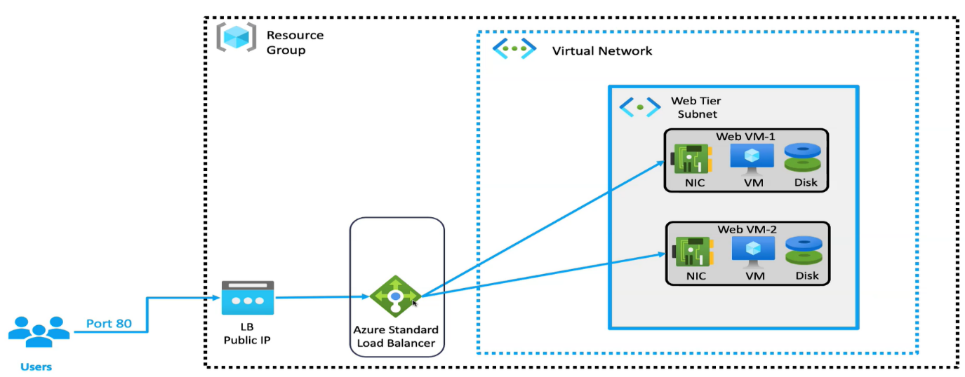
Infrastructure as Code - Terraform
Terraform is the infrastructure as code offering from hashicorp, that automate and manage your infrastructure, and the services that run on that infrastructure.
Tool used for building, changing and managing infrastructure in sage and repeatable way.
Human readable, reusable and used to automate cloud deployment
Support coding best practice, such as version control, testing and deployments.

Slide 16
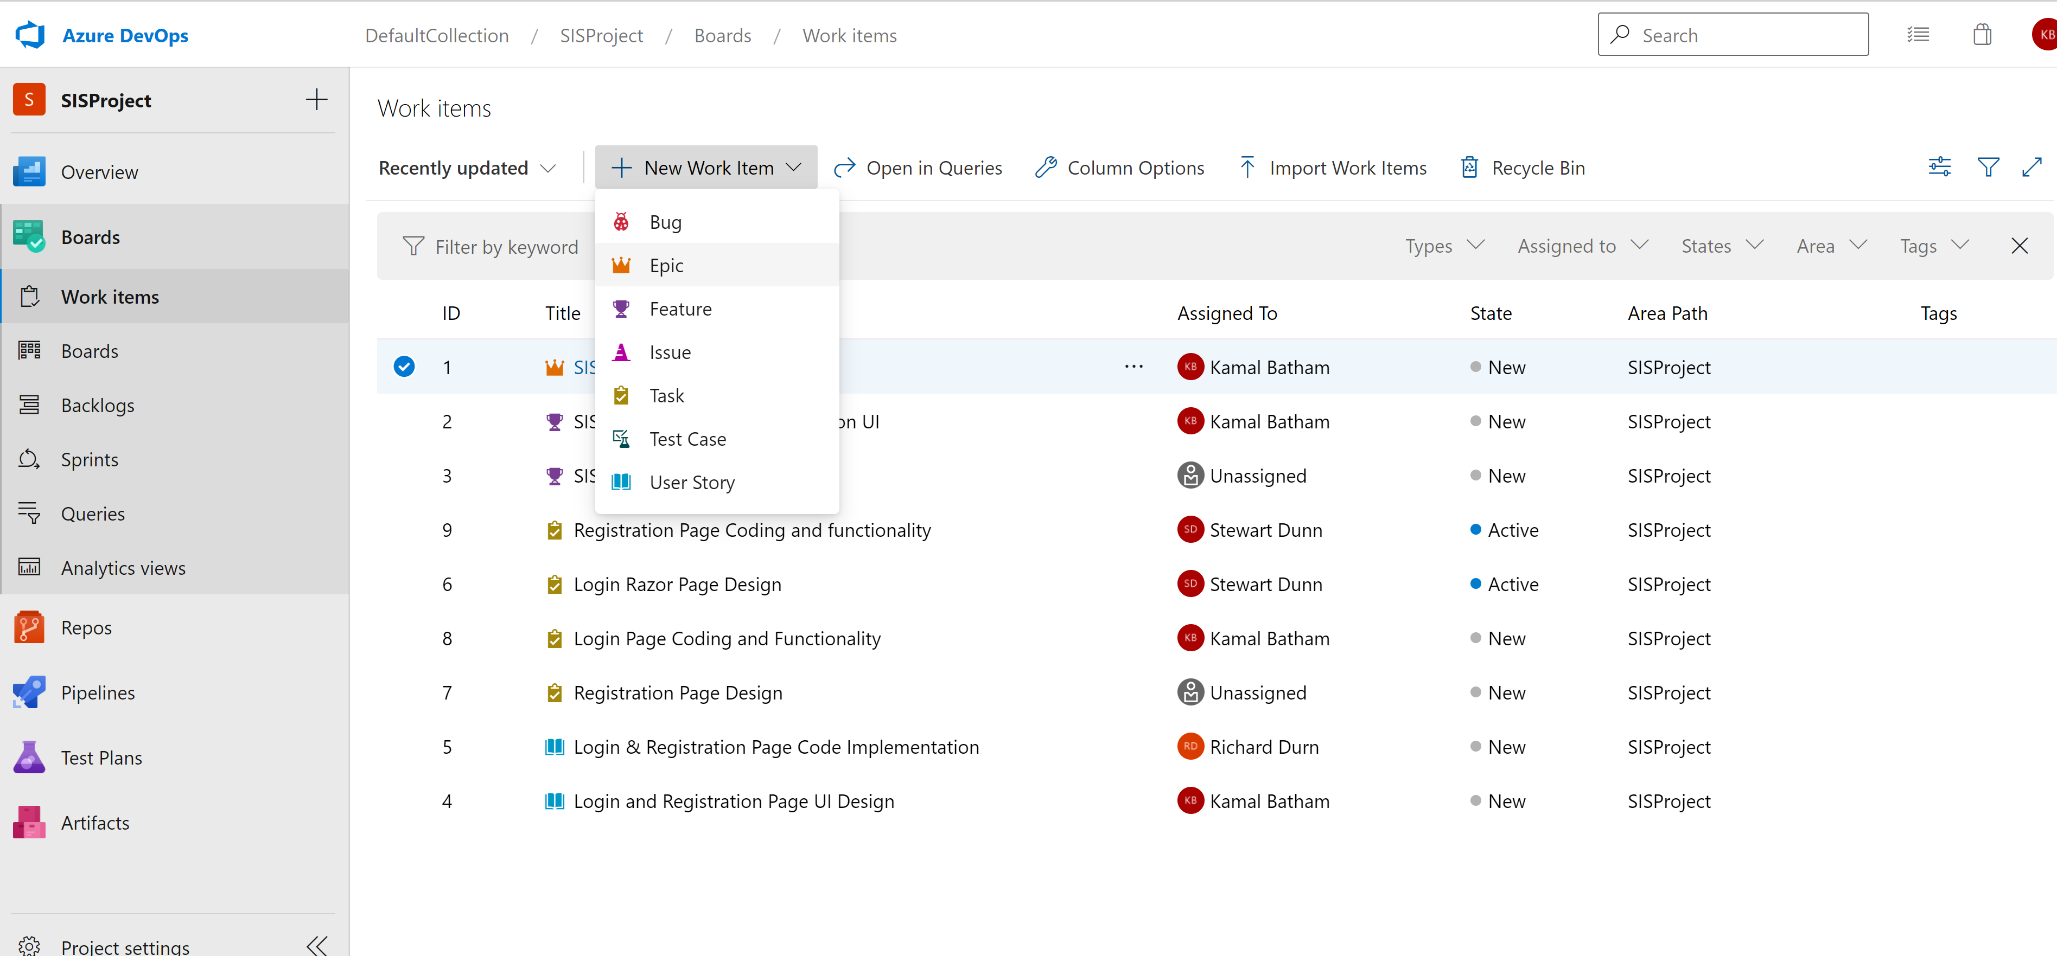
Azure DevOps Board

Slide 17
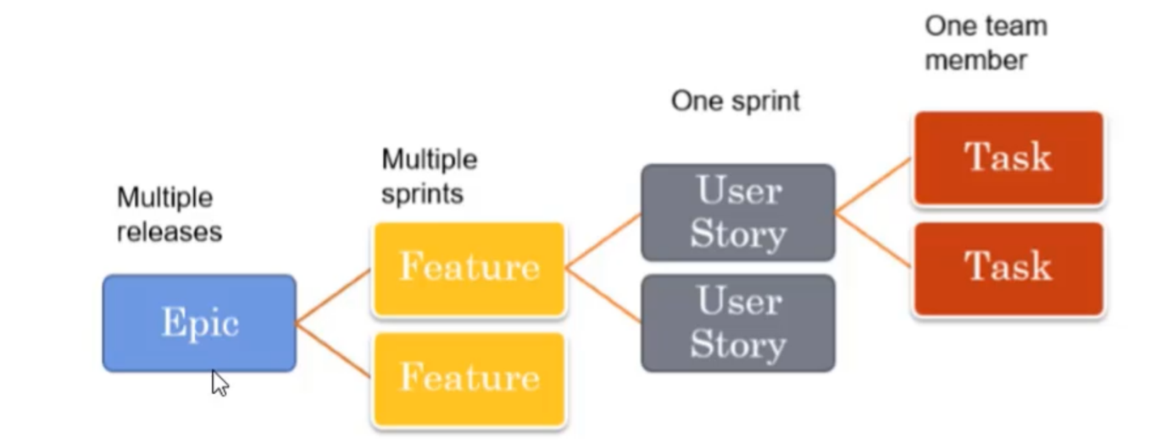
Azure DevOps Board

Slide 18
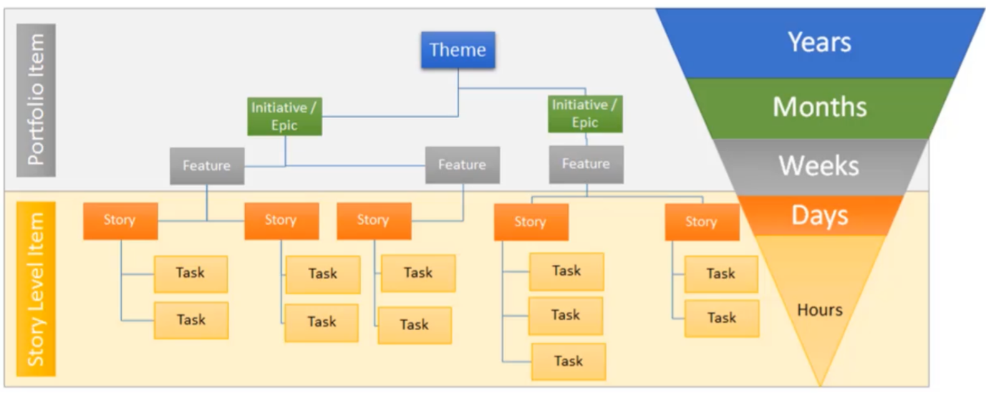
Board Features

Slide 19
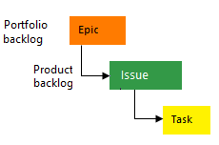
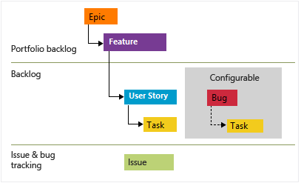
Process offered by DevOps
Basic : Choose Basic when team wants the simplest model that uses Issues, Tasks, and Epics to track work.
Agile: Choose Agile when team uses Agile planning methods, including Scrum, and tracks development and test activities separately. This process works great if you want to track user stories and (optionally) bugs on the Kanban board, or track bugs and tasks on the taskboard.

Slide 20
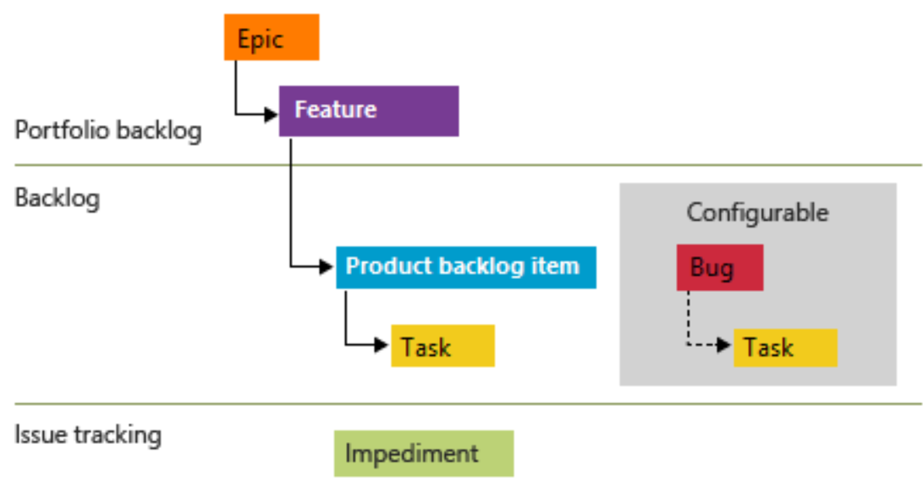
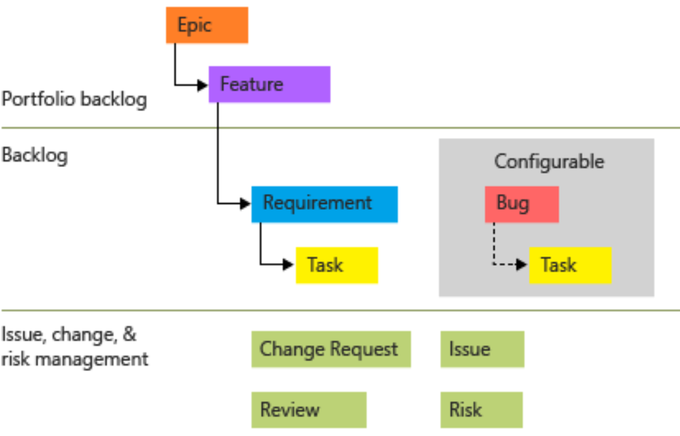
Process offered by DevOps
Scrum: Choose Scrum when your team practices Scrum. This process works great if you want to track product backlog items and bugs on the Kanban board, or break PBIs and bugs down into tasks on the taskboard.
CMMI: Choose CMMI when team follows more formal project methods that require a framework for process improvement and an auditable record of decisions. With this process, you can track requirements, change requests, risks, and reviews.

