Slide 1
Welcome to Azure DevOps
YBS –Retail Lending

Slide 2
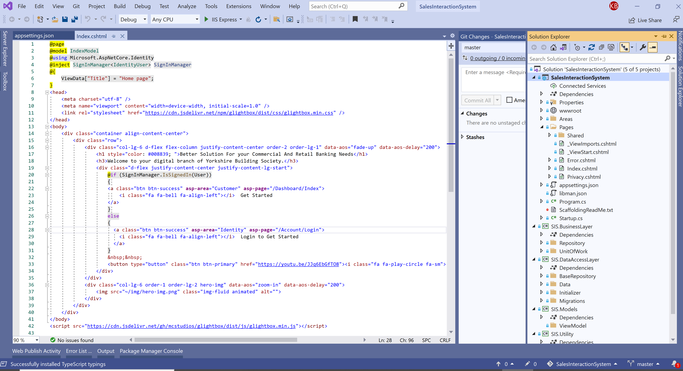
DevOps Infrastructure and Environment
How it configured in our On-premise machine:
1
Developed a .Net Core Razor Page Application – Developed a Web Application using .Net Core RazorPage for this demo, and to represent how azure devops works for CI/CD.
2
Local Source Control– Configured Git as local source control system
3
Centralized Source Control - Configured Azure Repository on H30007 as centralized source control system.
4
Azure DevOps Sever setup configured on H30007 and can be accessed by using - http://h30007:85/DefaultCollection
Entire Features – Including Board, Repository build pipeline, Test plans and Artifacts can be managed by using this ULR path.

Slide 3
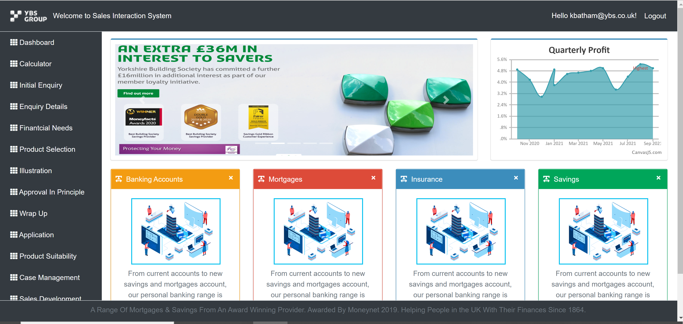
DevOps Infrastructure and Environment
How it configured in our On-premise machine:
1
Used H30007 (Windows 10) machine – Configured the Environment of Azure DevOps Server on H30007.
For Testing Purpose – Set the H30007 as QA environment and configured the Web Server (IIS) to deploy application using DevOps Pipeline. - http://h30007.ybs.com/
2
Set up H30022 – Configured H30022 As the production environment. DevOps Pipeline automated the deployment to Prod environment. We can browse deployed application using below URL - http://h30022:80/
Pre-production- http://h30006.ybs.com/
3

Slide 4
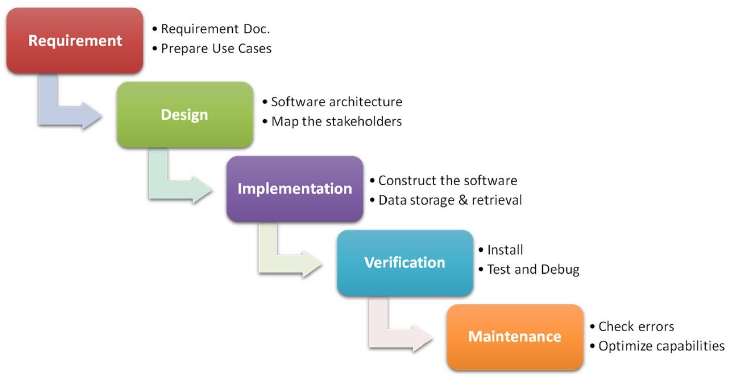
Waterfall Model

Slide 5
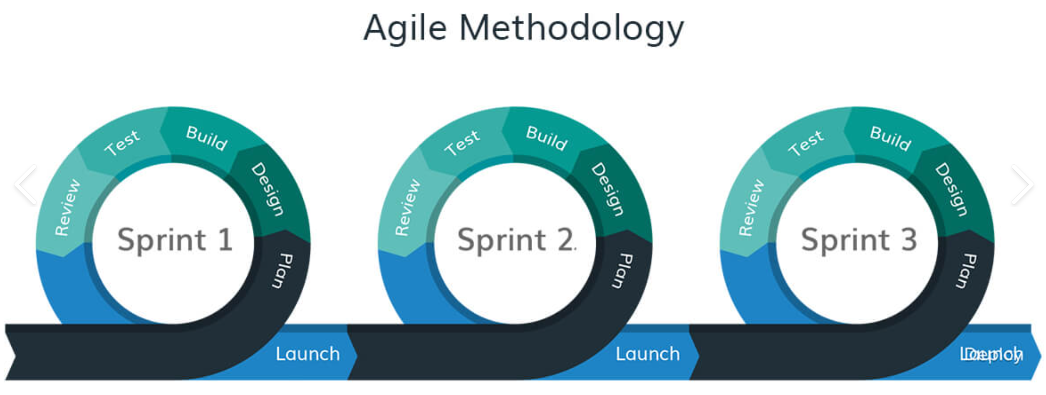
Agile Methodology

Slide 6
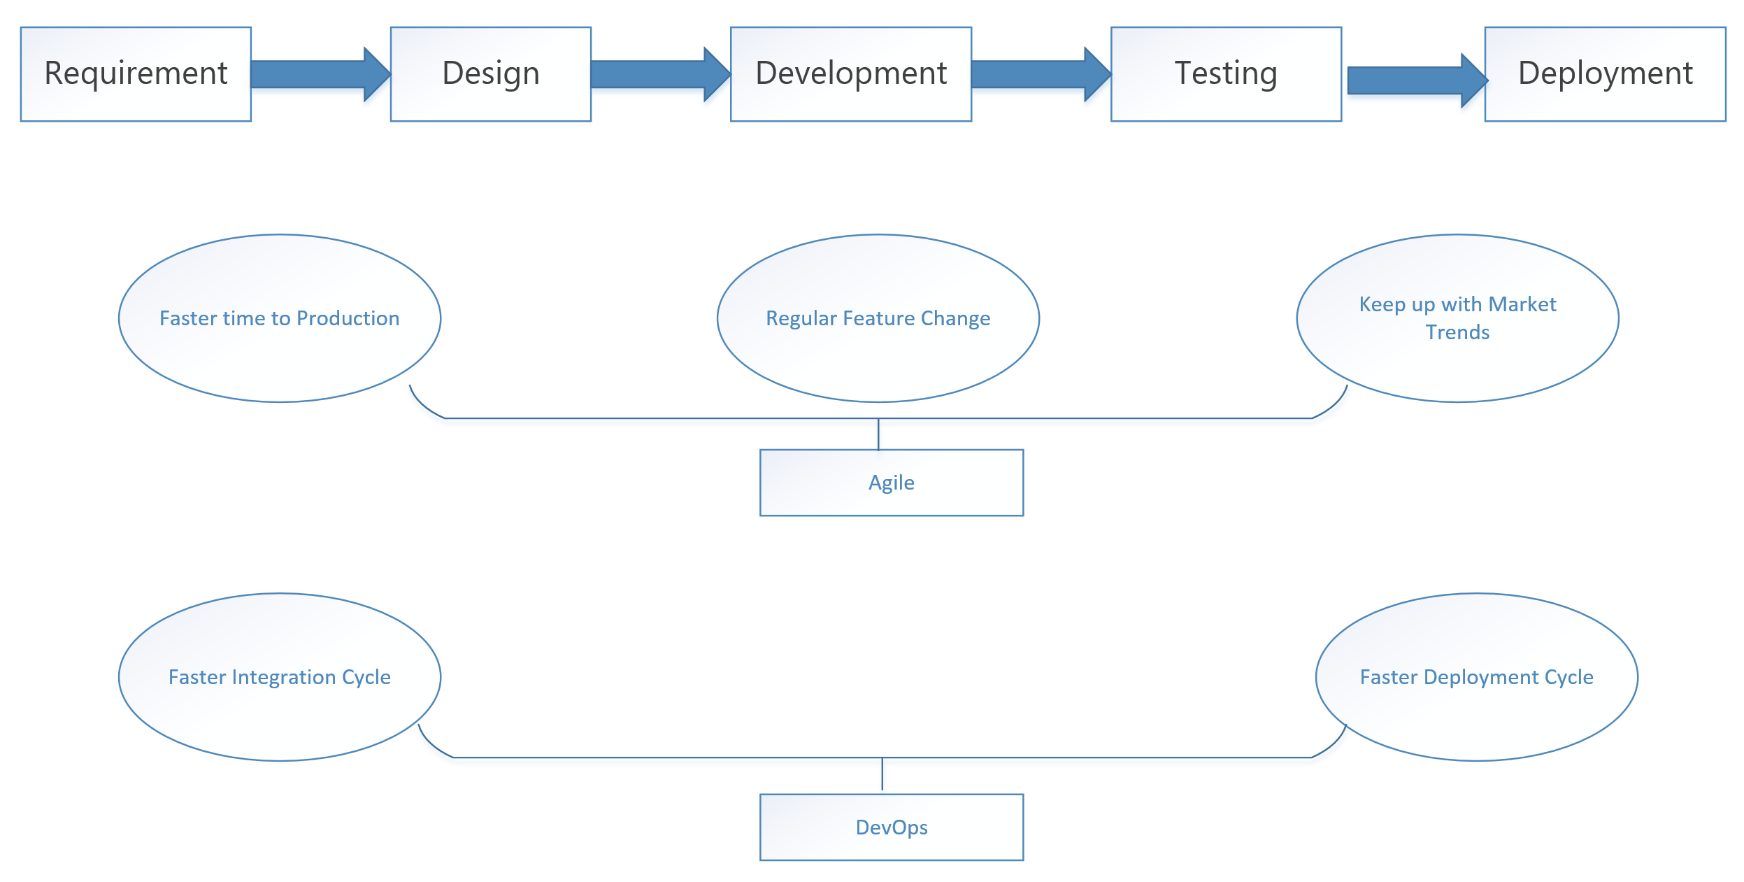
SDLC

Slide 7
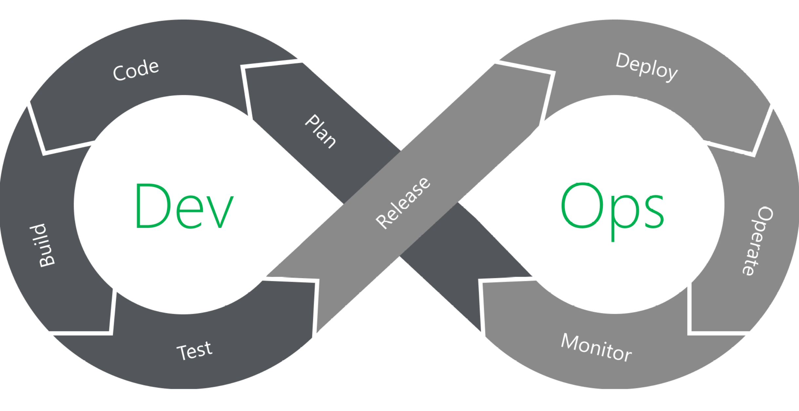
DevOps
DevOps - Both Development and Operation have agility feature.

Slide 8
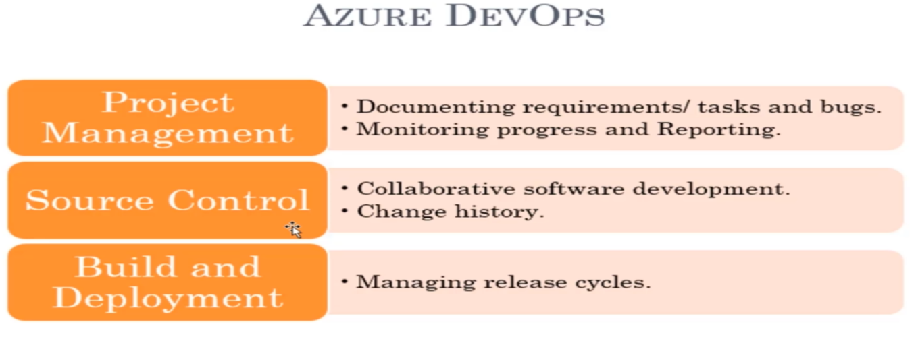
Why Azure DevOps

Slide 9
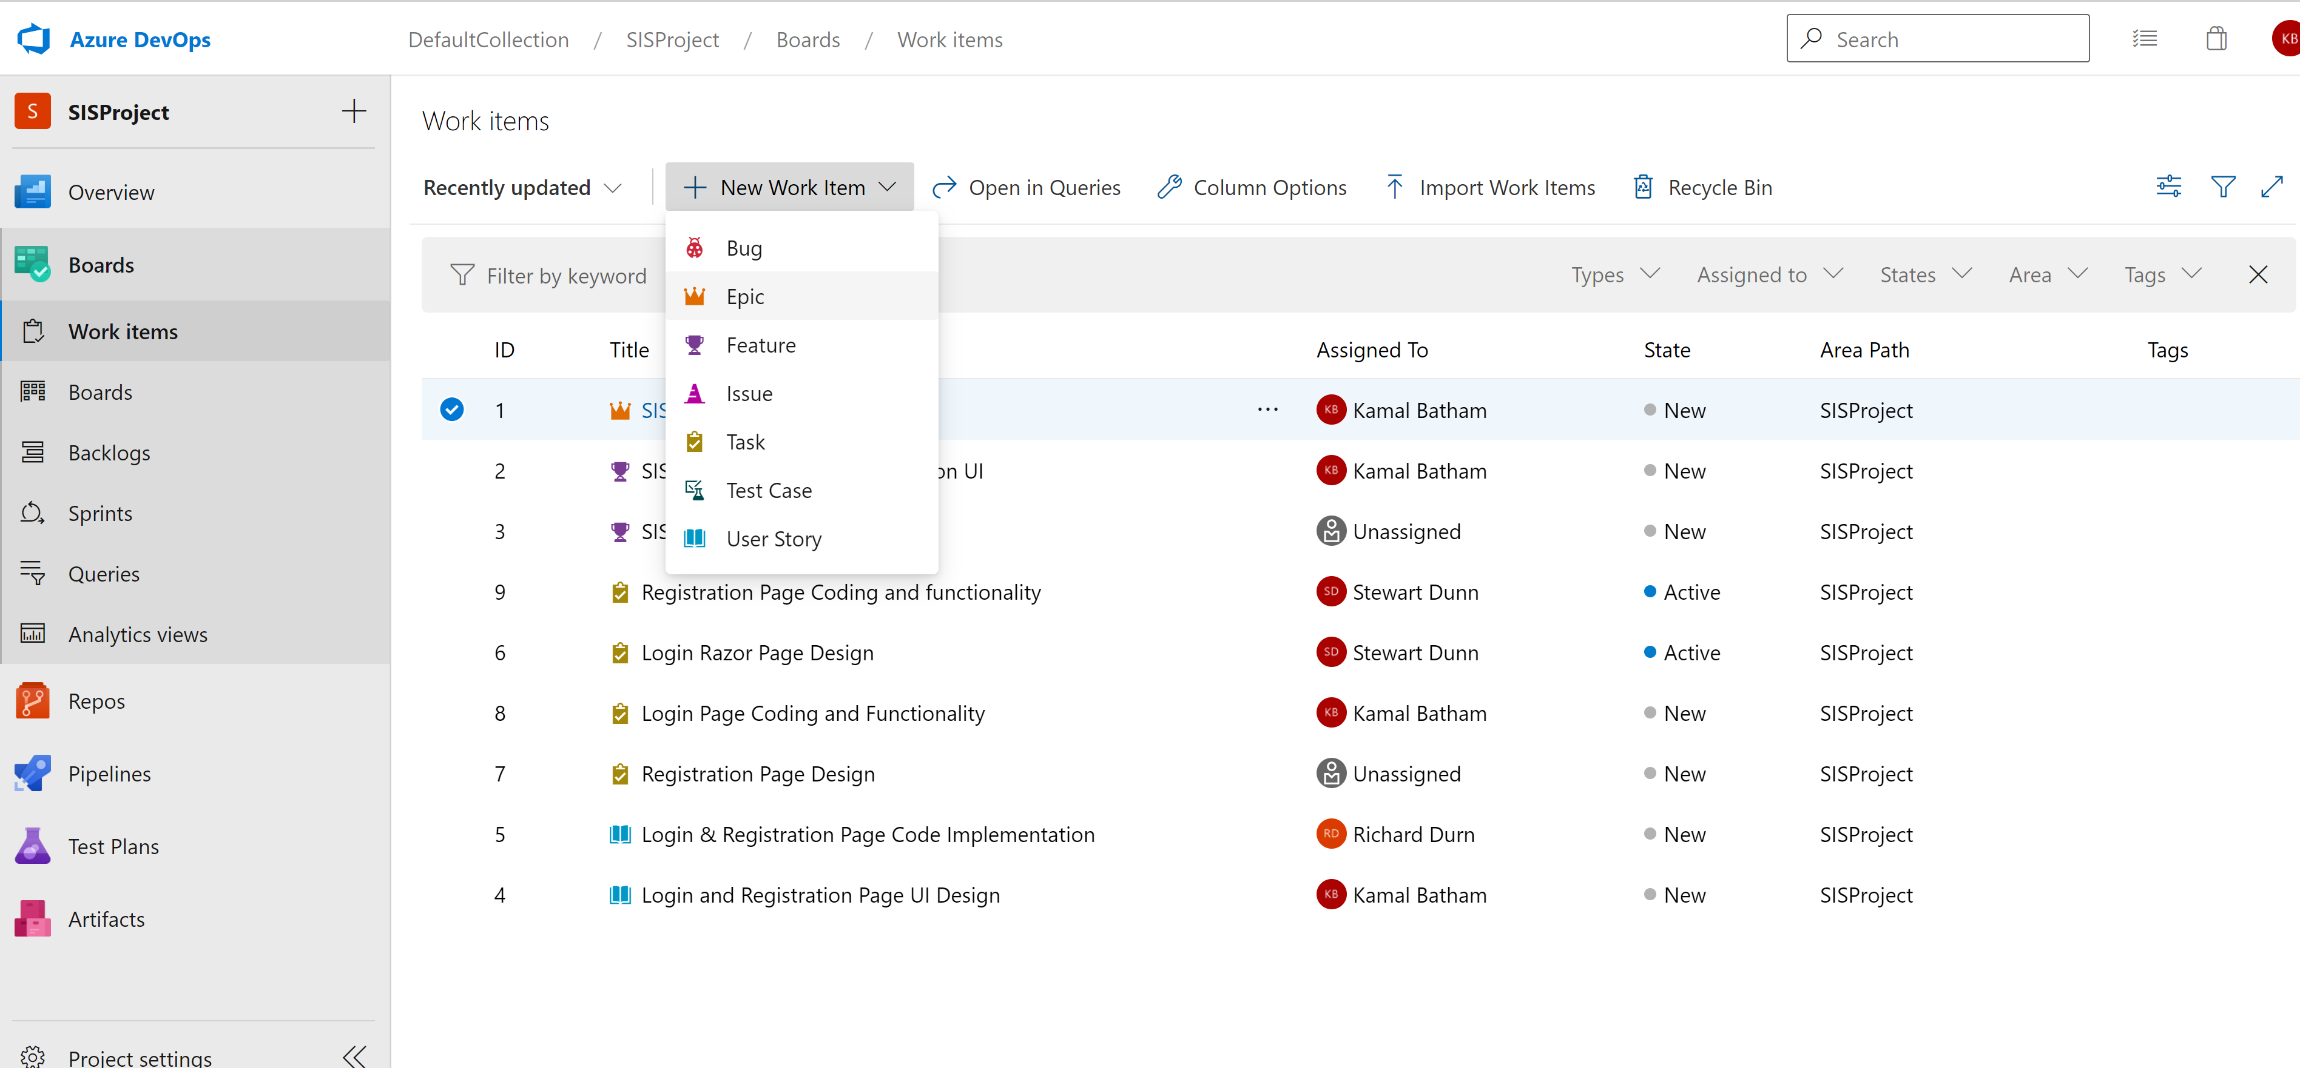
Azure DevOps Board

Slide 10
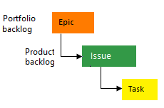
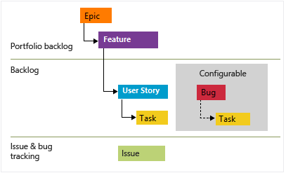
Process offered by DevOps
Basic : Choose Basic when team wants the simplest model that uses Issues, Tasks, and Epics to track work.
Agile: Choose Agile when team uses Agile planning methods, including Scrum, and tracks development and test activities separately. This process works great if you want to track user stories and (optionally) bugs on the Kanban board, or track bugs and tasks on the taskboard.

Slide 11
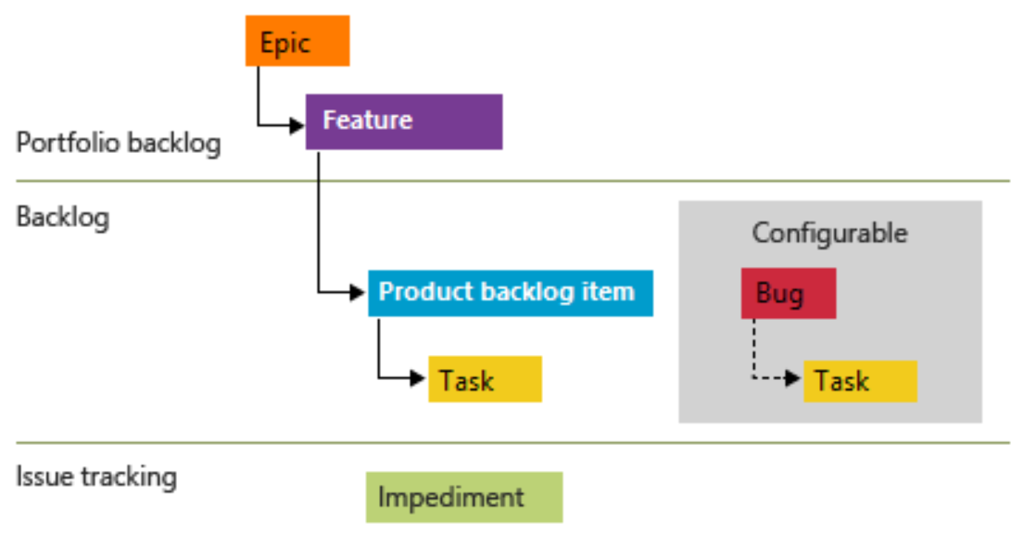
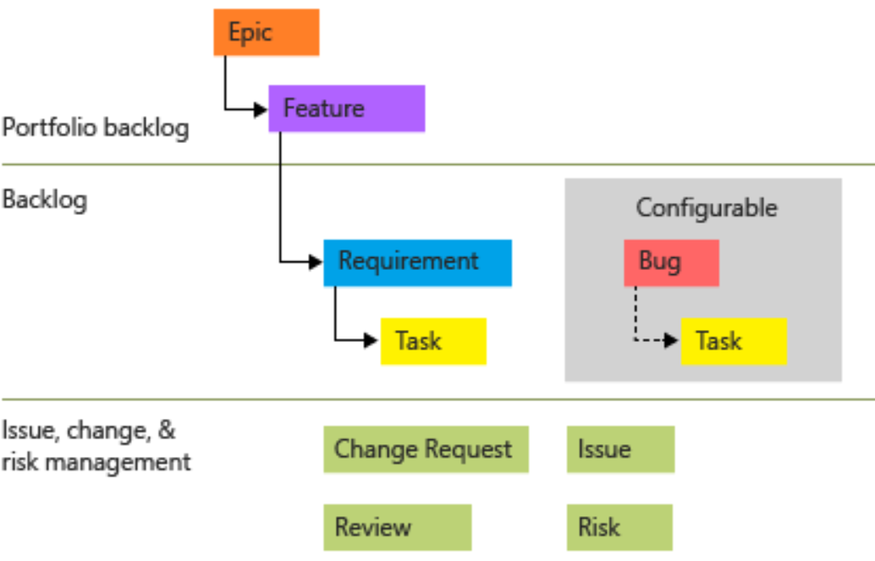
Process offered by DevOps
Scrum: Choose Scrum when your team practices Scrum. This process works great if you want to track product backlog items and bugs on the Kanban board, or break PBIs and bugs down into tasks on the taskboard.
CMMI: Choose CMMI when your team follows more formal project methods that require a framework for process improvement and an auditable record of decisions. With this process, you can track requirements, change requests, risks, and reviews.

Slide 12
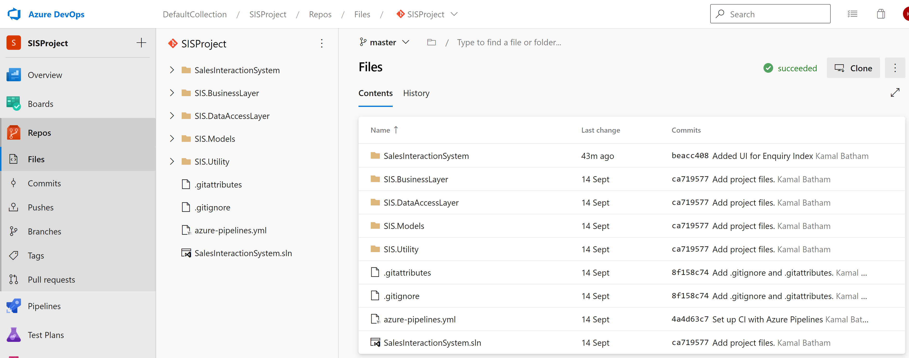
Azure DevOps Git Repository

Slide 13
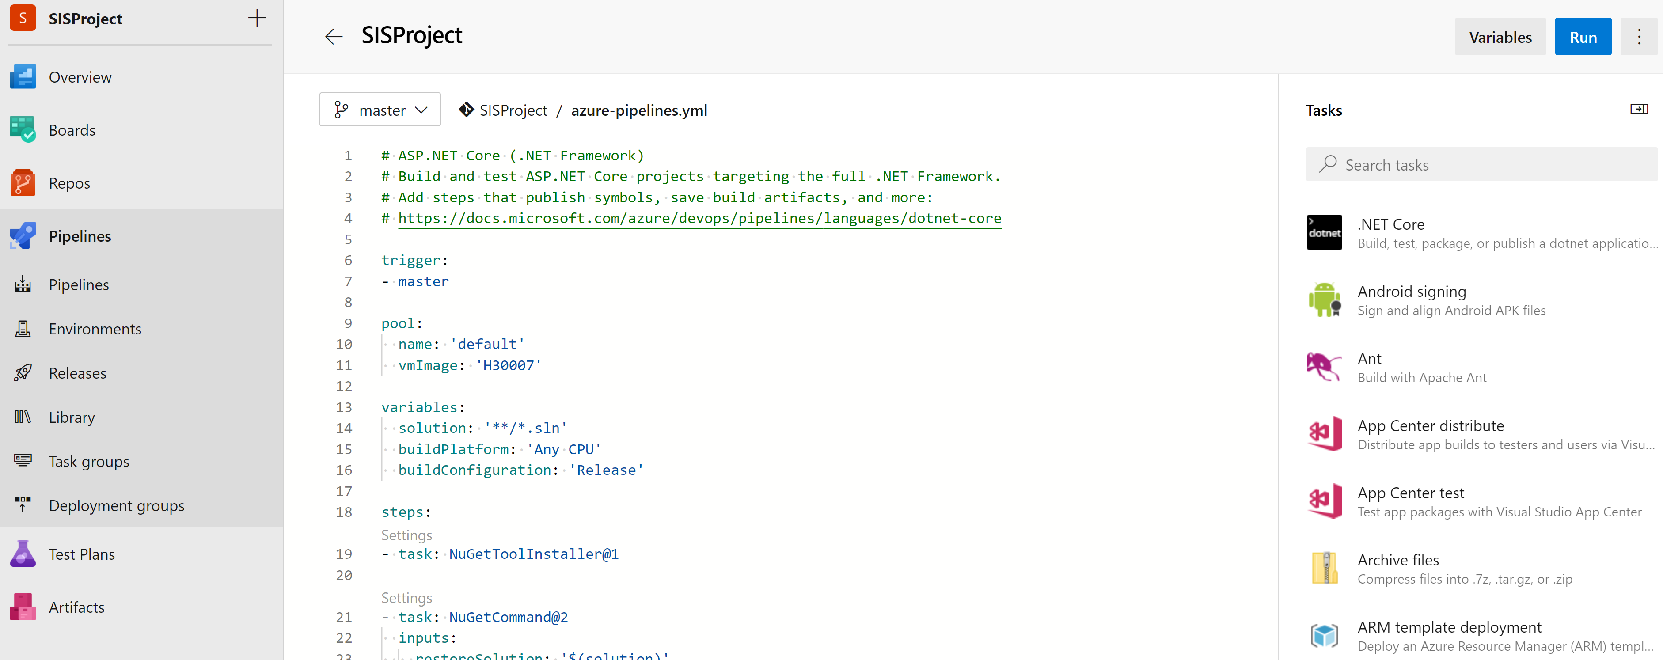
Build Pipeline

Slide 14
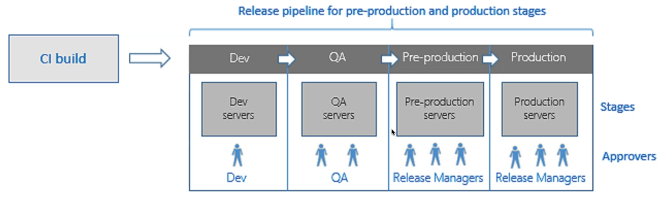
DevOps Release Pipeline

Slide 15
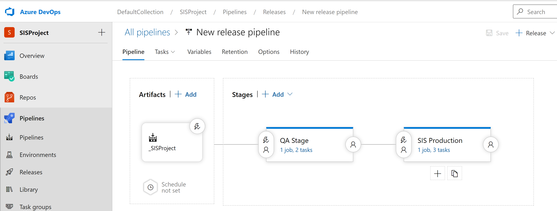
Release Pipeline

Slide 16
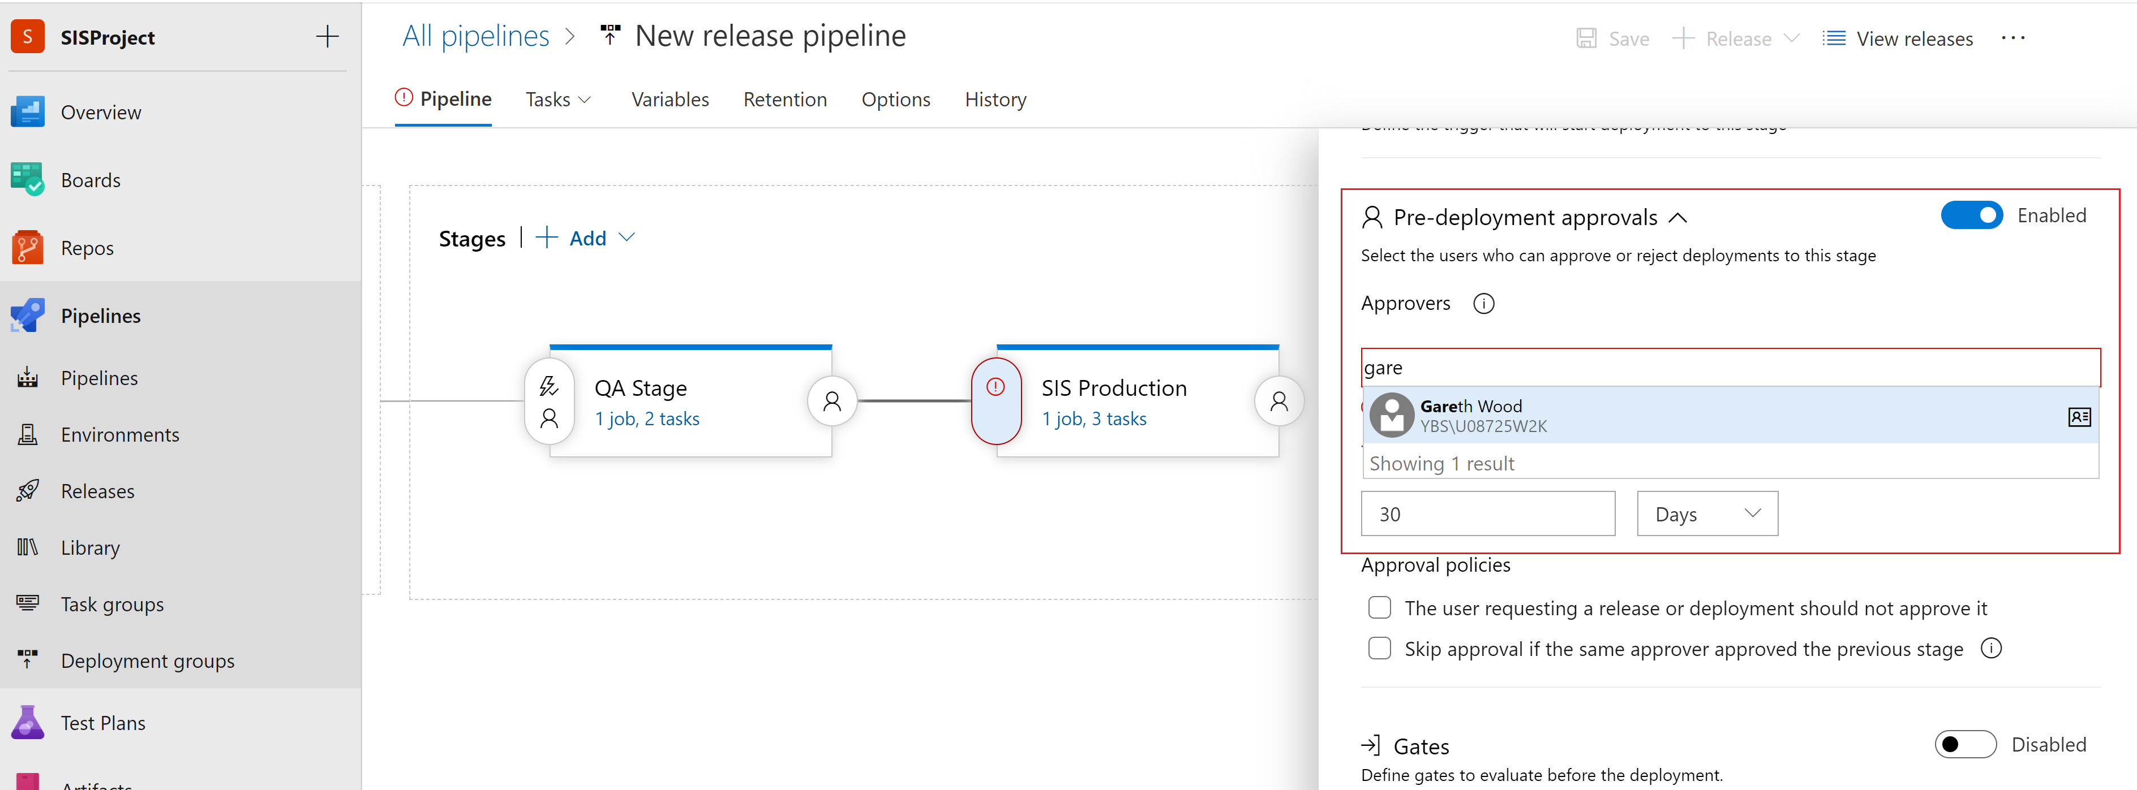
Deployment Approvals

Slide 17
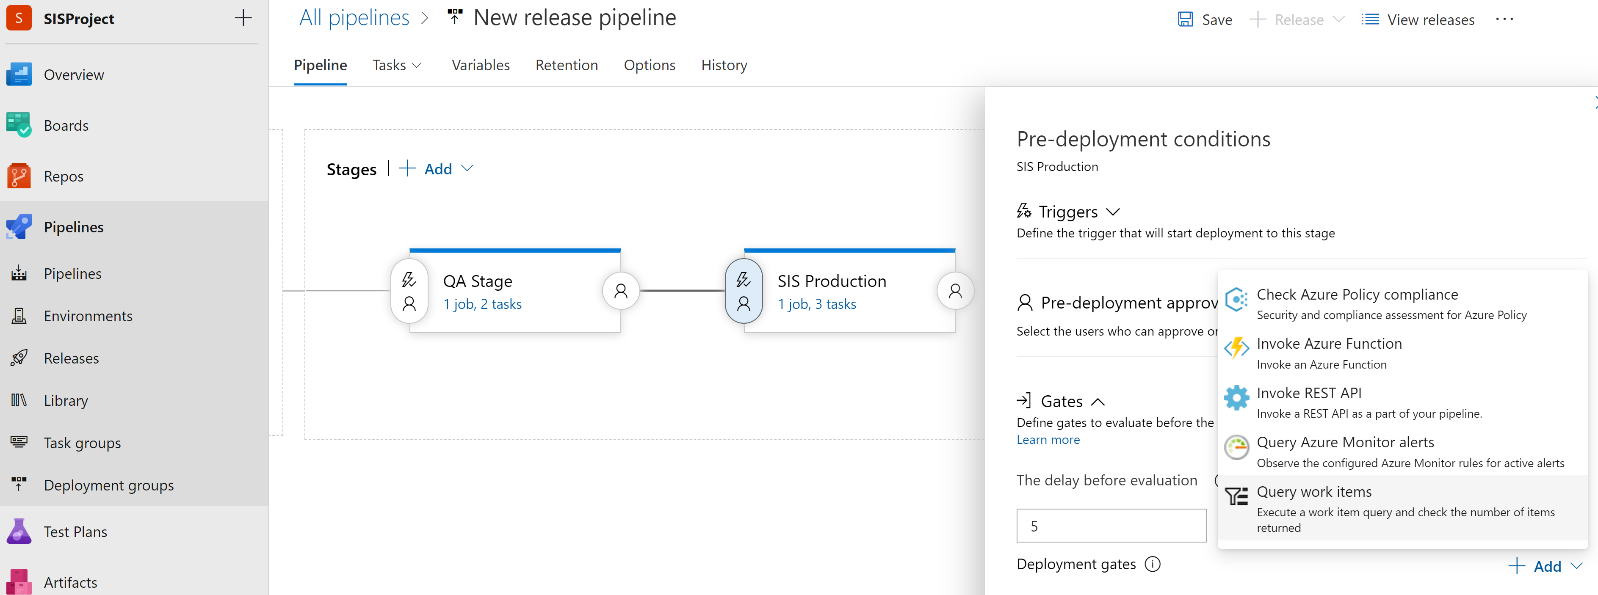
Gates

