Slide 1

Note: The data and information in this document is reflective of a hypothetical situation and client. This document is to be used for KPMG Virtual Internship purposes only.
Sprocket Central Pty Ltd
Data analytics approach
[Division Name] - [Engagement Manager], [Senior Consultant], [Junior Consultant – Kamal Jit Singh]

Slide 2
Note: The data and information in this document is reflective of a hypothetical situation and client. This document is to be used for KPMG Virtual Internship purposes only.
Agenda
Introduction
Data Exploration
Model Development
Interpretation

Slide 3
Note: The data and information in this document is reflective of a hypothetical situation and client. This document is to be used for KPMG Virtual Internship purposes only.
Introduction
Introduction:
I have made some research on Sprocket Central pvt Ltd. It is a Bike and bicycle company who sale both and sale it’s accessories also. We have good data we can analyse the data but before I will have to make it into a good format that can be useful for find the best insights
Datasets:
This company given me three datasets:
Transaction
CustomerAddress
CustomerDemographic
NewCustomer (it is the target dataset)
To analyse the trends and find to targeted the customers.
Steps gone through:
Data cleaning
Transformation and
Data Exploration – To explore and understand the data to find the insights
Our Aim:
Sprocket central pvt ltd has give me some data and we have to find insight and we have to find trends high value customer that can be target

Slide 4
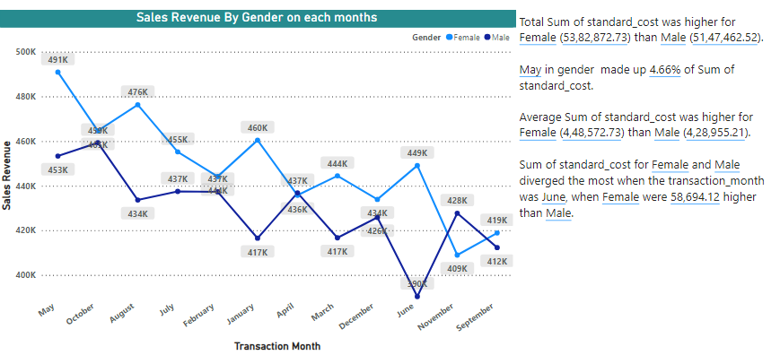
Note: The data and information in this document is reflective of a hypothetical situation and client. This document is to be used for KPMG Virtual Internship purposes only.
Data Exploration

Slide 5
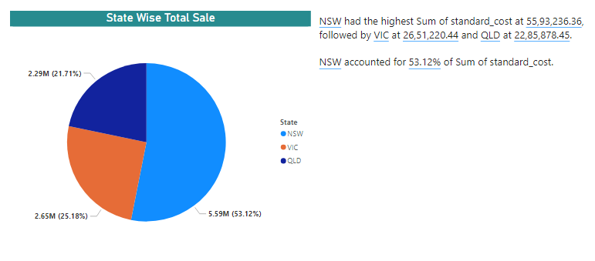
Note: The data and information in this document is reflective of a hypothetical situation and client. This document is to be used for KPMG Virtual Internship purposes only.
Data Exploration

Slide 6
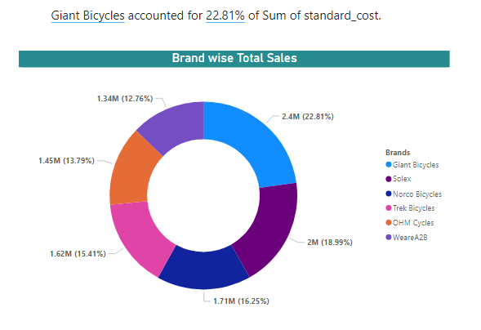
Note: The data and information in this document is reflective of a hypothetical situation and client. This document is to be used for KPMG Virtual Internship purposes only.
Data Exploration

Slide 7
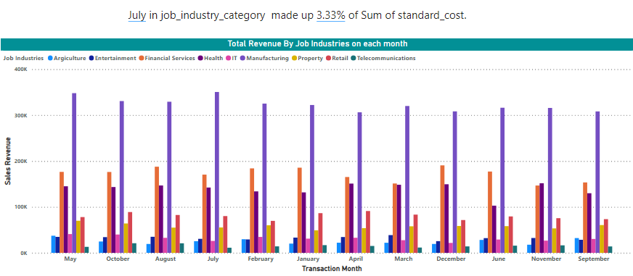
Note: The data and information in this document is reflective of a hypothetical situation and client. This document is to be used for KPMG Virtual Internship purposes only.
Data Exploration

Slide 8
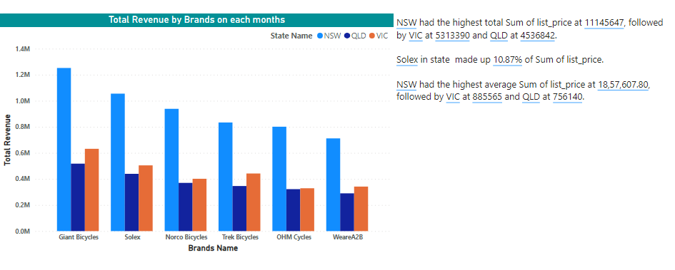
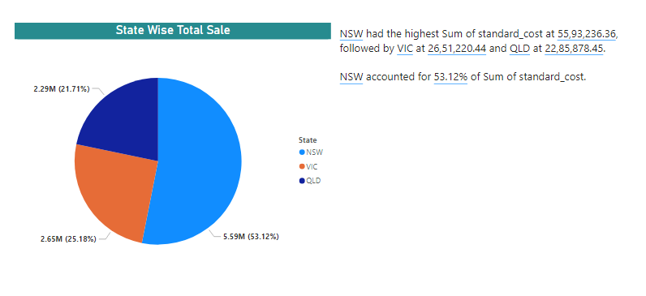
Note: The data and information in this document is reflective of a hypothetical situation and client. This document is to be used for KPMG Virtual Internship purposes only.
Data Exploration

Slide 9
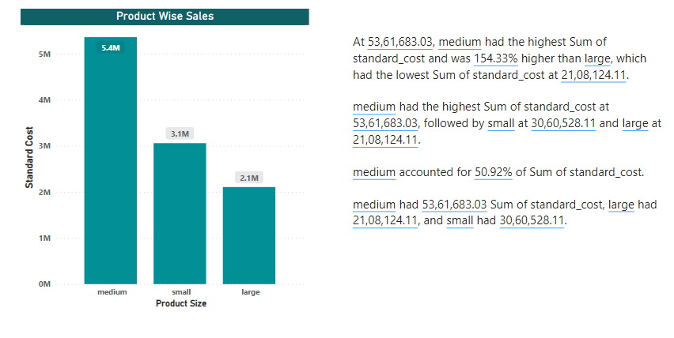
Note: The data and information in this document is reflective of a hypothetical situation and client. This document is to be used for KPMG Virtual Internship purposes only.
Data Exploration

Slide 10
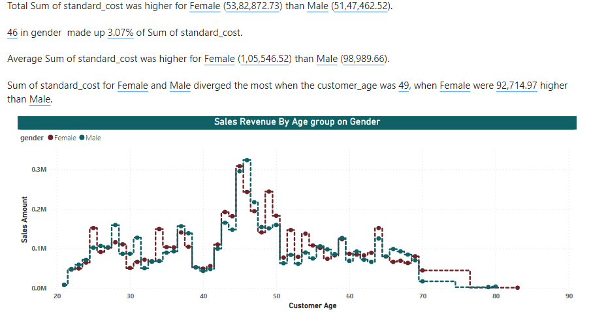
Note: The data and information in this document is reflective of a hypothetical situation and client. This document is to be used for KPMG Virtual Internship purposes only.
Data Exploration

Slide 11
Note: The data and information in this document is reflective of a hypothetical situation and client. This document is to be used for KPMG Virtual Internship purposes only.
Data Exploration

Slide 12
Note: The data and information in this document is reflective of a hypothetical situation and client. This document is to be used for KPMG Virtual Internship purposes only.
Model Development
Place headline insight or information here. This should be the most important point for this slide.
In Model development we use to do many things let suppose an organization want to run their business then we will understand and analyse how an organization want to collect, update and store the data. We have many tools for model developments. Model development are in six phases business understanding, data understanding, data preparation, modelling, evaluation and development.
Place any information about this point here.

Slide 13
Note: The data and information in this document is reflective of a hypothetical situation and client. This document is to be used for KPMG Virtual Internship purposes only.
Interpretation
Place headline insight or information here. This should be the most important point for this slide.
Place any information about this point here.
Here after all that above part we will have a good data we can prepare graphs and we can view and analyse for making the good decision for the business growth. This Interpretation part is very important for the decision making because we can get and find the best insights for the better decision.

Slide 14
Note: The data and information in this document is reflective of a hypothetical situation and client. This document is to be used for KPMG Virtual Internship purposes only.
Appendix

Slide 15
Note: The data and information in this document is reflective of a hypothetical situation and client. This document is to be used for KPMG Virtual Internship purposes only.
Appendix
This is an optional slide where you may place any supporting items.
Data analysis has many steps for the making the best decision.
First we get a row transactional data which will have many issues
like fault of data purity it may have many missing values, and useless
Features so the we select the important and useful features that will give
Best and useful result.
For the visualization part we can use any tools for data visualization like
Power Bi, Tablue etc.
Visualized data is very easy to understand and is very helpful for fast decision
Making.

