Slide 1
CLUSTERING

Slide 2
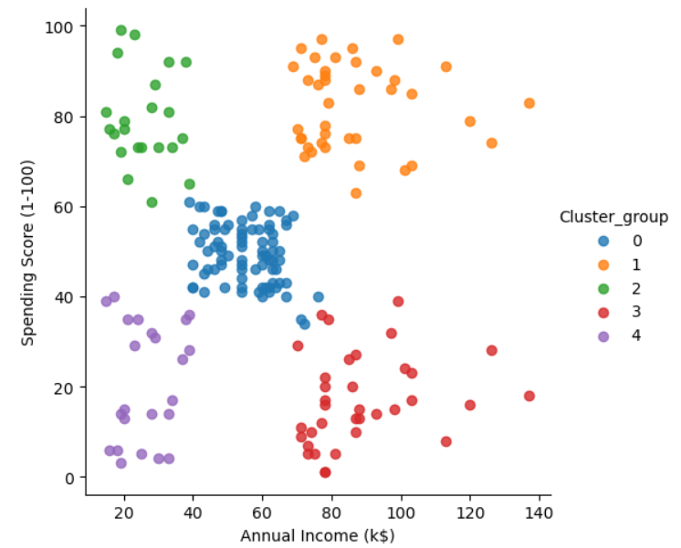
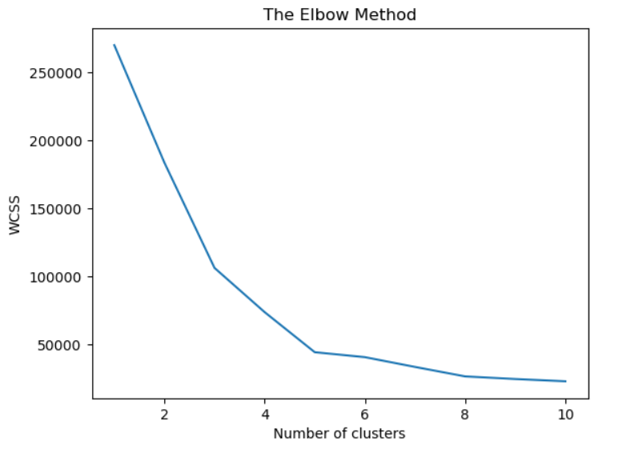
K Means
Centroids are assigned based on n_clusters defined
Elbow method to choose the right number of clusters.
The centroids are moved iteratively until the centroid best fits the cluster(closer data points)
Choose last point of n_cluster where the inertia dropped, Eg: 5
Inertia measures compactness of clusters.
Lower inertia → points are closer to their centroids → tighter, better‑defined clusters.
Higher inertia → points are spread out → clusters are less cohesive.

Slide 3
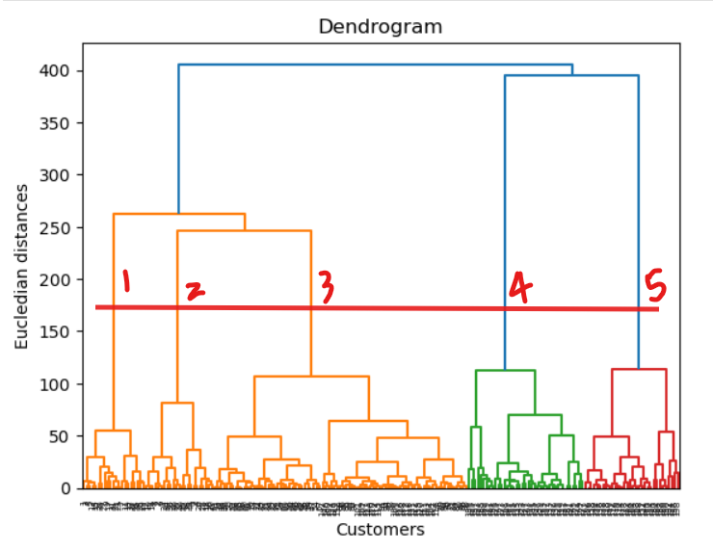
AGGLOMERATIVE
Start with singletons → Each data point is its own cluster.
Compute distances → Measure similarity between clusters (often Euclidean distance).
hierarchical clustering that builds clusters step by step by merging smaller groups into larger ones.
The dendrogram (tree diagram) shows this hierarchy and lets you “cut” at a chosen level to decide how many clusters you want.
Look for big jump in dendrogram, draw a horizontal cut line
Number of lines cut is n_clusters

Slide 4
Affinity Propagation
No need to specify n_clusters as like k-means, agglomerative
It automatically find the cluster centers (exemplars)
Similarity matrix → Compute pairwise similarities between all points
Message passing → Points exchange two types of messages:
Responsibility → How suitable a point is to be an exemplar for another point.
Availability → How appropriate it would be for a point to choose another as its exemplar.
Use Affinity Propagation when clusters are irregular, uneven
Think of irregular shapes like crescents, spirals, or uneven blobs:
K‑Means tends to “cut” them into round pieces.
Affinity Propagation can place exemplars along the curve, forming clusters that follow the irregular shape.

Slide 5
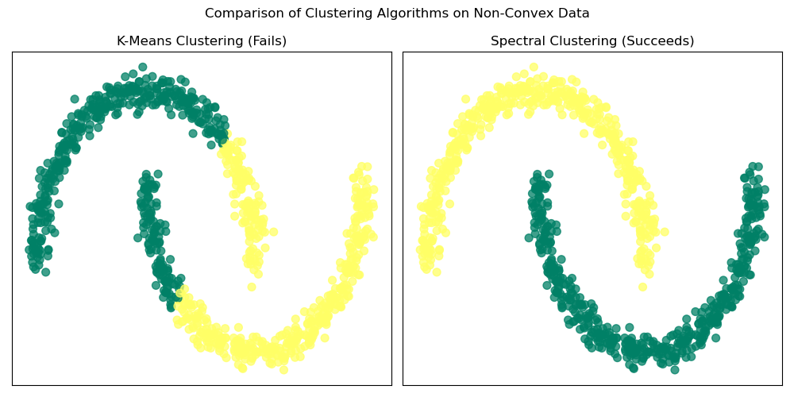
SPECTRAL CLUSTERING
Graph connectivity based clustering
Imagine data shaped like two moons or concentric circles. K‑Means fails because it assumes spherical clusters
Specific for irregular clusters
Strength → Excels at separating non-convex, irregular shapes (e.g., moons, rings) that K‑Means and Affinity Propagation may misclassify.
Graph-based → Builds a similarity graph and uses eigenvectors of the Laplacian to embed data.
Number of clusters must be specified (n_clusters) → Unlike Affinity Propagation, you decide how many groups.

Slide 6
DBSCAN (Density-Based Spatial Clustering of Applications with Noise)
A point is a core point if at least min_samples neighbors lie within a radius eps
eps → Radius of neighborhood around a point.
min_samples → Minimum number of points required to form a dense region.
Finds clusters of arbitrary shape (spirals, rings, irregular blobs).
Automatically detects outliers
automatically discovers clusters of arbitrary shape, and identifies noise/outliers — making it ideal for messy, irregular datasets./noise.

