Slide 1


STUDENT DROPOUT ANALYSIS Digital Marketing and Trend Analysis(CBCA311) Faculty Name: Dr. Arun Chaudhary By:- Kamal Verma(E22BCAU0116) , Kunj Garg(E22BCAU0106), MD Shumail Afjal (E22BCAU0104), Batch -04

Slide 2

Outline
Introduction
Objectives
Methodology
Graphs and Analysis
Outcome
Conclusion

Slide 3

Introduction
Education is vital for societal progress, yet student dropout poses a significant challenge. Understanding dropout factors is essential for effective interventions. This project analyzes dropout using data-driven methods, exploring demographics, academic performance, and socio-economic factors to uncover predictive patterns.

Slide 4

Objectives
Identify High-Risk Groups: Use machine learning to pinpoint demographic and socio-economic groups prone to dropout, aiding targeted interventions.
Factors Analysis: Assess how academic performance, socio-economic status, family background, and school environment impact dropout rates.
Predictive Modeling: Create models predicting individual dropout likelihood from historical data, enabling proactive interventions.
Intervention Strategies: Recommend evidence-based strategies and policies to reduce dropout rates and support at-risk students.

Slide 5

Methodology
Data Collection: Gather diverse datasets ethically, ensuring privacy.
Data Preprocessing: Cleanse and integrate data, handling missing values and outliers.
EDA: Analyze variables, identify patterns, and visualize relationships.
ML Modeling: Employ various algorithms to build predictive models, evaluating performance rigorously.
Interpretation and Reporting: Present findings, insights, and actionable recommendations clearly to stakeholders.

Slide 6
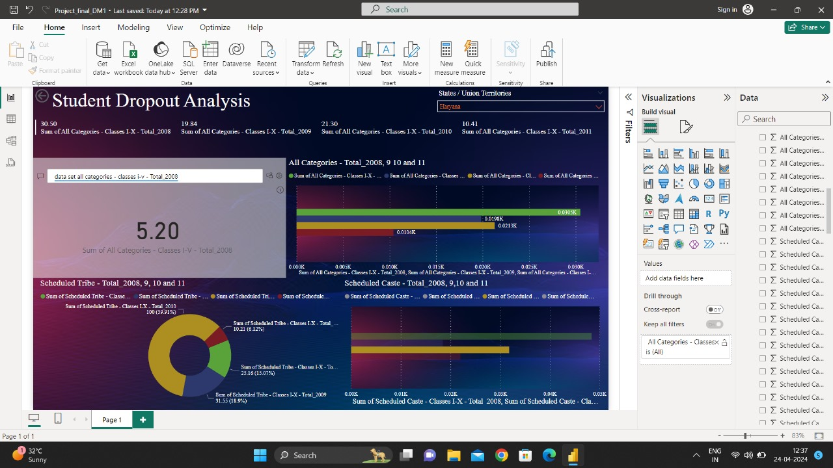

Slide 7
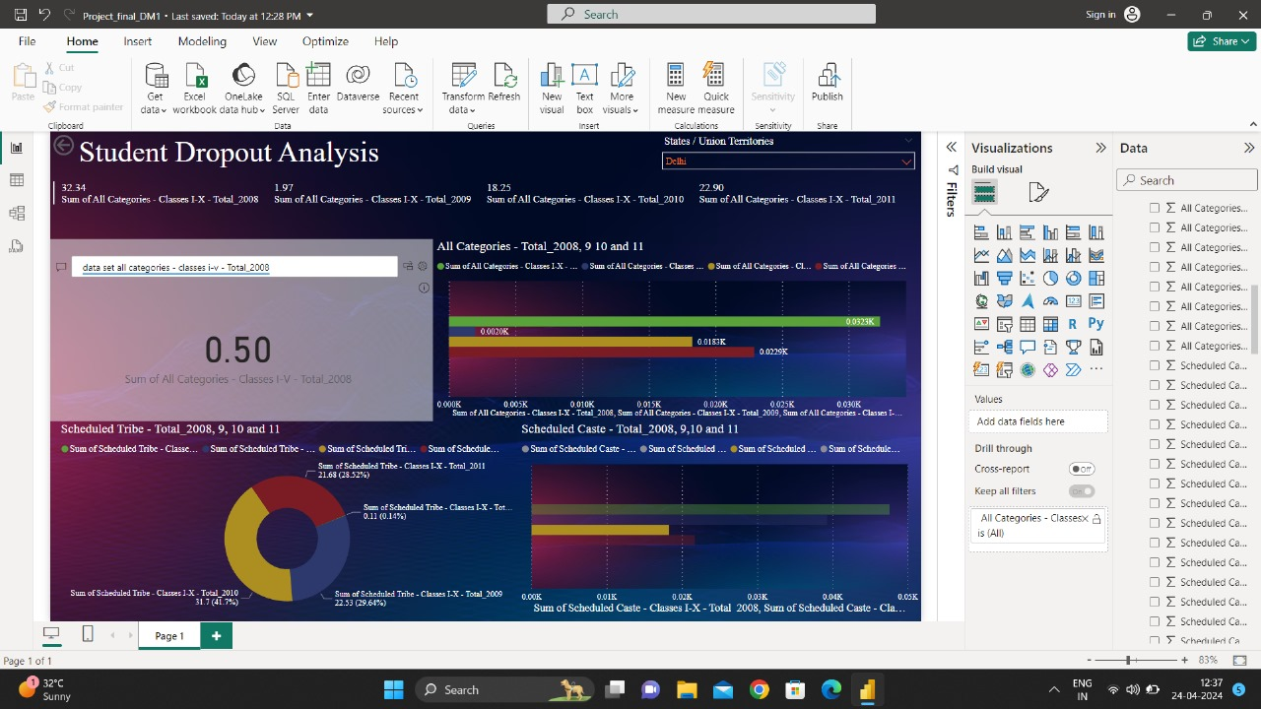

Slide 8
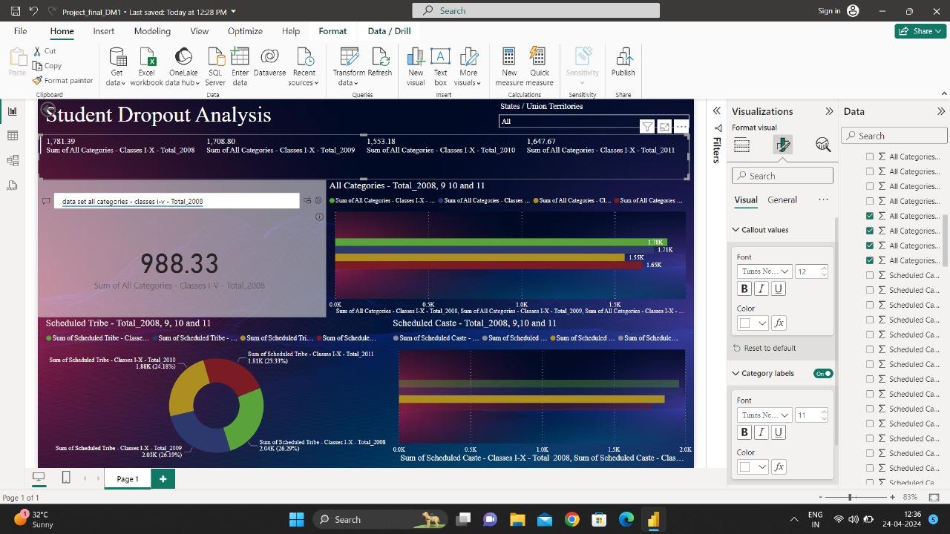

Slide 9
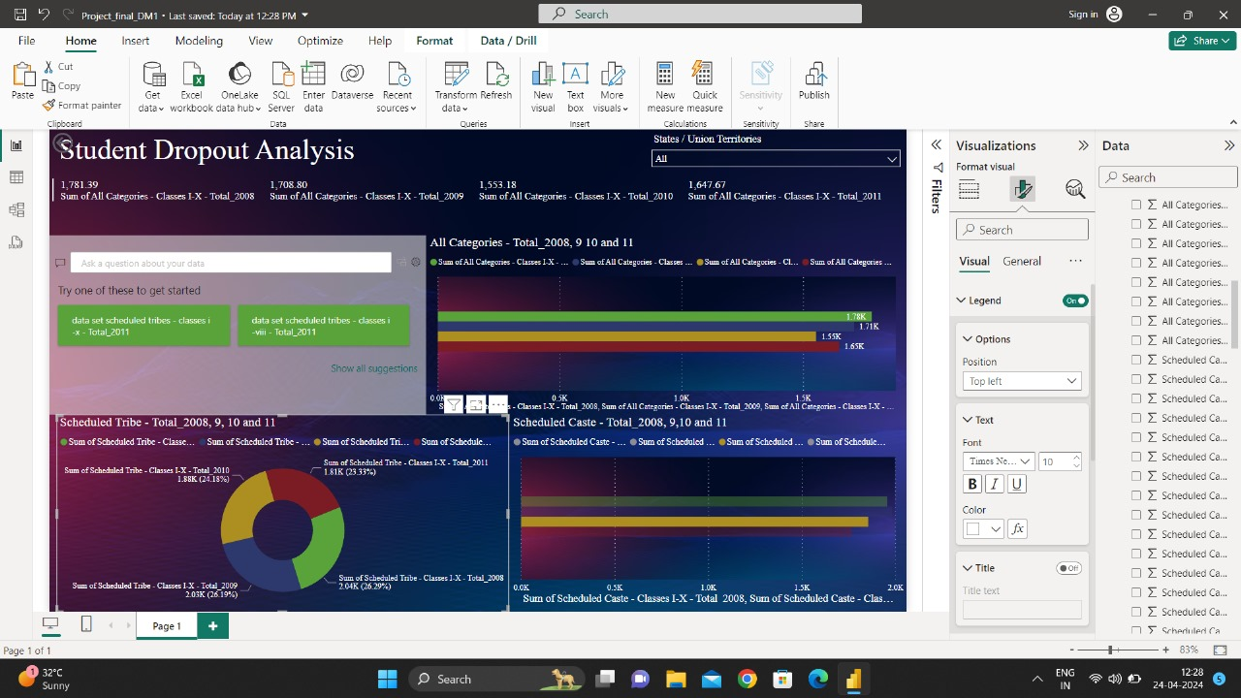

Slide 10
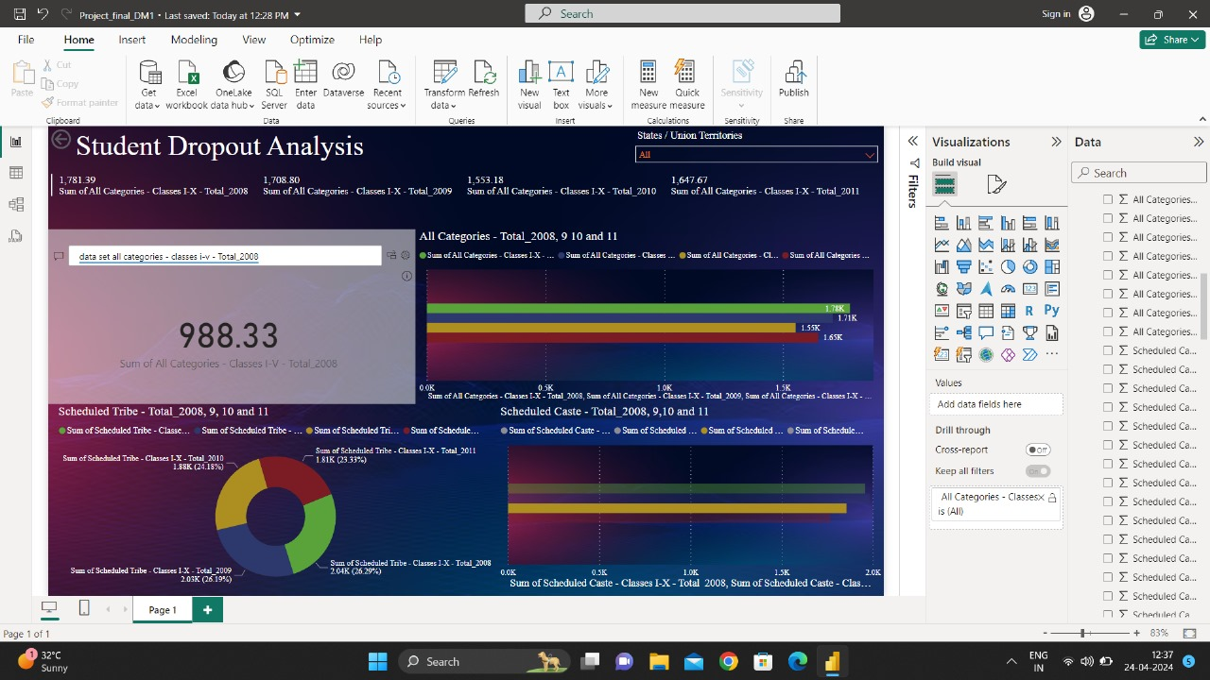

Slide 11

Expected Outcomes
Identification of key factors contributing to student dropout.
Development of predictive models for early identification of at-risk students.
Evidence-based recommendations for targeted intervention strategies.
Contribution to the broader discourse on education policy and reform.

Slide 12

Conclusiom
By employing advanced analytics techniques on comprehensive datasets, this project aims to shed light on the complex phenomenon of student dropout. Through actionable insights and evidence-based recommendations, we strive to empower educators, policymakers, and stakeholders to implement effective interventions and support mechanisms, ultimately fostering a more inclusive and equitable educational system.

Slide 13

Thank you

